Slide 1

Bureau use of SMS for operational scheduling
(and plans for evaluation of job scheduling options…)
Jim Fraser
Bureau National Operations Centre
14 Oct 2014

Slide 2
Role of Bureau National Operations Centre
BNOC serves as the real-time operational hub for Australia’s national weather service by:
providing numerical forecast guidance to the Regional Forecasting Centres and external clients
issuing a range of analysis and prediction products relating to weather, oceans and climate
supporting the operational communications and computing infrastructure
maintaining an archive of synoptic analyses and observations over the Southern Hemisphere
Various international roles: WMC, RSMC, RAFC, RTWP…

Slide 3
Structure of BNOC
Central Operations:
6-7 staff on duty at all times (24x7)
Senior Meteorologist (supervisor)
Aviation Meteorologists (2)
ITOps Computer Operator
ITOps Help Desk (IT and Comms)
Operational Support:
Operations Development (5)
NWP model implementation & support
Oceanographic Systems (6)
Ocean model implementation and support
National Weather Graphics (3)
National Tides Unit
Tsunami Systems (1)
Approximately 70 staff in total

Slide 4
Responsibilities
Operational Development Section
Support of the Operational NWP Suites:
Day-to-day support and maintenance of all the models which form the Operational NWP Suite.
Out of hours troubleshooting support for unusual problems
Implementation in the operational scheduler & running on operational machines of model upgrades / new systems developed by Bureau’s research centre (CAWCR)
Interfacing with downstream systems
Model forecast verification/assessment
IT Operations
Monitoring of operational systems
First-level support; escalation of problems to appropriate support staff

Slide 5
SMS job scheduling in BNOC
SMS = ECMWF “Supervisor Monitor Scheduler”
Powerful GUI environment for operational job scheduling and monitoring
Core component of BoM BNOC Operations for last two decades (first introduced into NMC in early 1990's)
Currently runs 17,200+ jobs per day in 55 separate suites
Allows for system inter-dependencies
Easy visual monitoring of system status
Gives interactive facilities for operational staff

Slide 6
Overview of SMS
Components:
SMS server –The scheduler, continuously running daemon process that submits tasks to remote machines upon trigger dependencies being satisfied
Child commands talk back to server to update status and attributes
cdp – Command line interface to SMS
XCDP – Graphical interface to SMS

Slide 7
SMS server functionality
Server (nmoc-sms) hosts the suites
Checkpoints (backup) suites tree periodically
Handles user and job requests (jobs submitted under userid "rto")
Logs activity

Slide 8
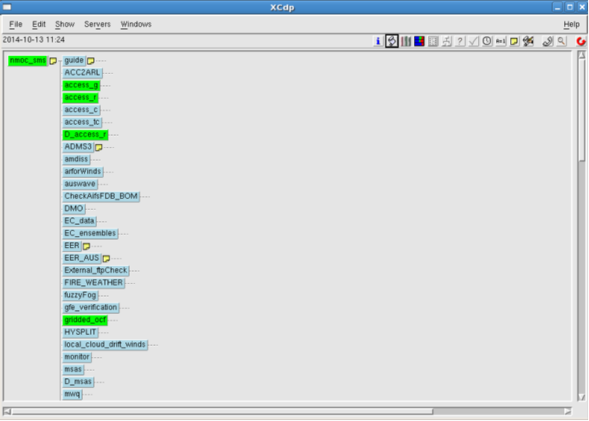
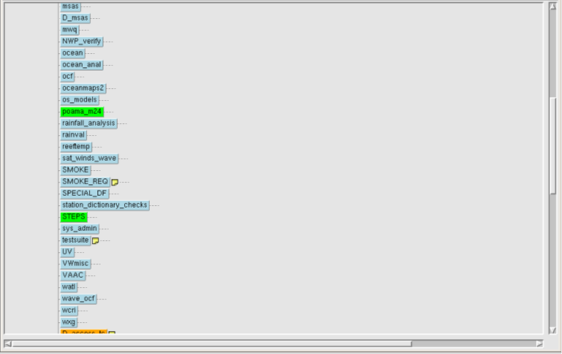
XCDP – graphical user interface
●Windowed GUI
●Allows direct interaction with SMS Servers
●Can access many SMS client commands
●Provides easy access to helpful information (script, manual, output, etc.)
●Contains alarm features, runs even when iconized
●User can mask information from being displayed
●User can search for task names, types, status etc

Slide 9
XCDP – graphical user interface

Slide 10
XCDP – graphical user interface

Slide 11
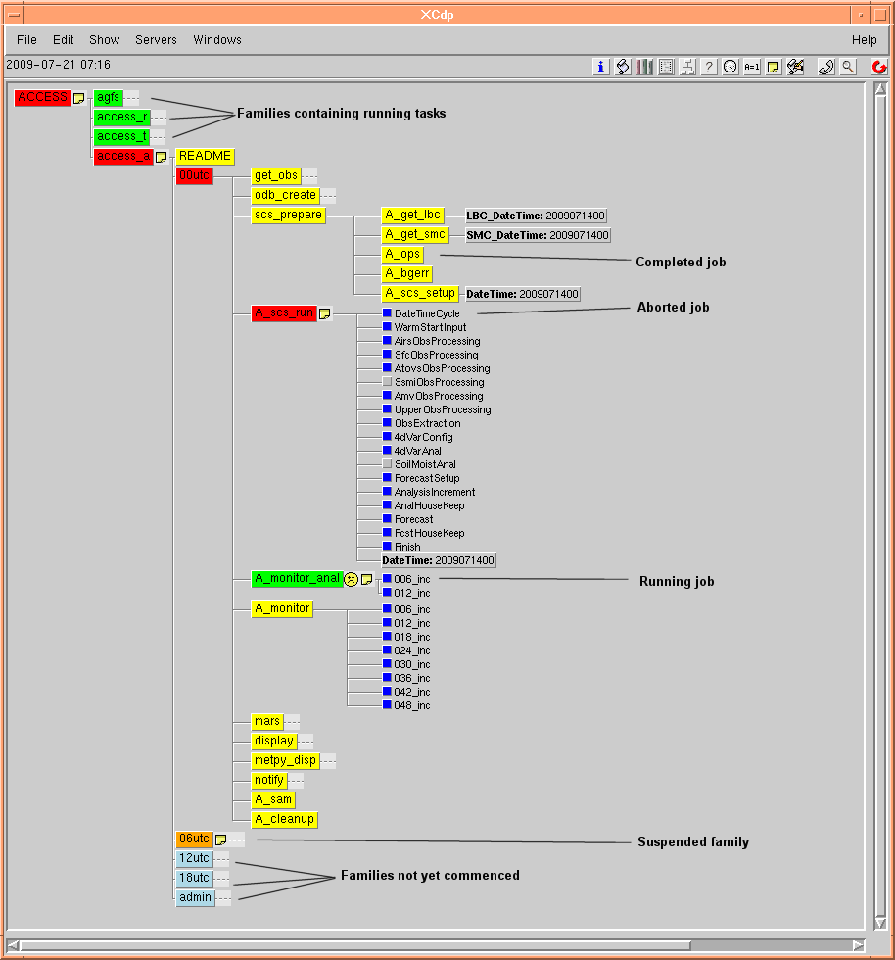
XCDP – graphical user interface

Slide 12
How it works
Define your suite (grouping of tasks) in a .def file
Structure, dependencies
Locations of scripts/outputs, etc
Add “hooks” to communicate to SMS server (using includes)
When ready, server submits the task (pre-processor adds SMS variables & expands include files)
Task tells server task has started - init client command
If an error is detected, task tells the server
Use error trapping to communicate errors,
Send abort client command
If task completes, tells the server
Send complete client command

Slide 13
SMS .def file example
Simple human readable
scripting language

Slide 14
Implementing ACCESS in SMS
SMS "scs_run.sms" task calls a "run-scs-suite" script which then initiiates the individual SCS tasks – a scheduler within a scheduler!
$RUN_SCRIPT/run-scs-suite $cold -d $SUITE_DIR -t $DATETIME
Hooks added inside SCS steps communicate back to SMS, signalling start, status, completion via function calls
SCS html output can only be viewed in web-browser (rather than XCDP)

Slide 15
Implementing ACCESS in SMS - II
Common scripts used wherever possible between all ACCESS suites to minimize maintenance
ACCESS suites comprised of 109 individual SMS scripts
Tools exist to automatically create multiple (3236) soft-links to these scripts giving tasks unique job names to make life easier for the operators
Scheduler syntax expands loops etc in .def file to submit a total of 11,420 individual ACCESS jobs per day

Slide 16
Task triggering in SMS
A variety of methods are used to control task initiation within SMS:
Simple dependencies on completion of prior jobs;
Time triggers (time of day; every x minutes; day of week etc);
Regular polling of files via SMS (e.g. EER suites);
Cross suite triggering by setting flags via cdp commands;
External daemons starting a task via cdp commands (e.g. VAWS);
Operator intervention (manually executing tasks)
Hindcast looping can be achieved by removing any time dependencies and specify start date and end date

Slide 17
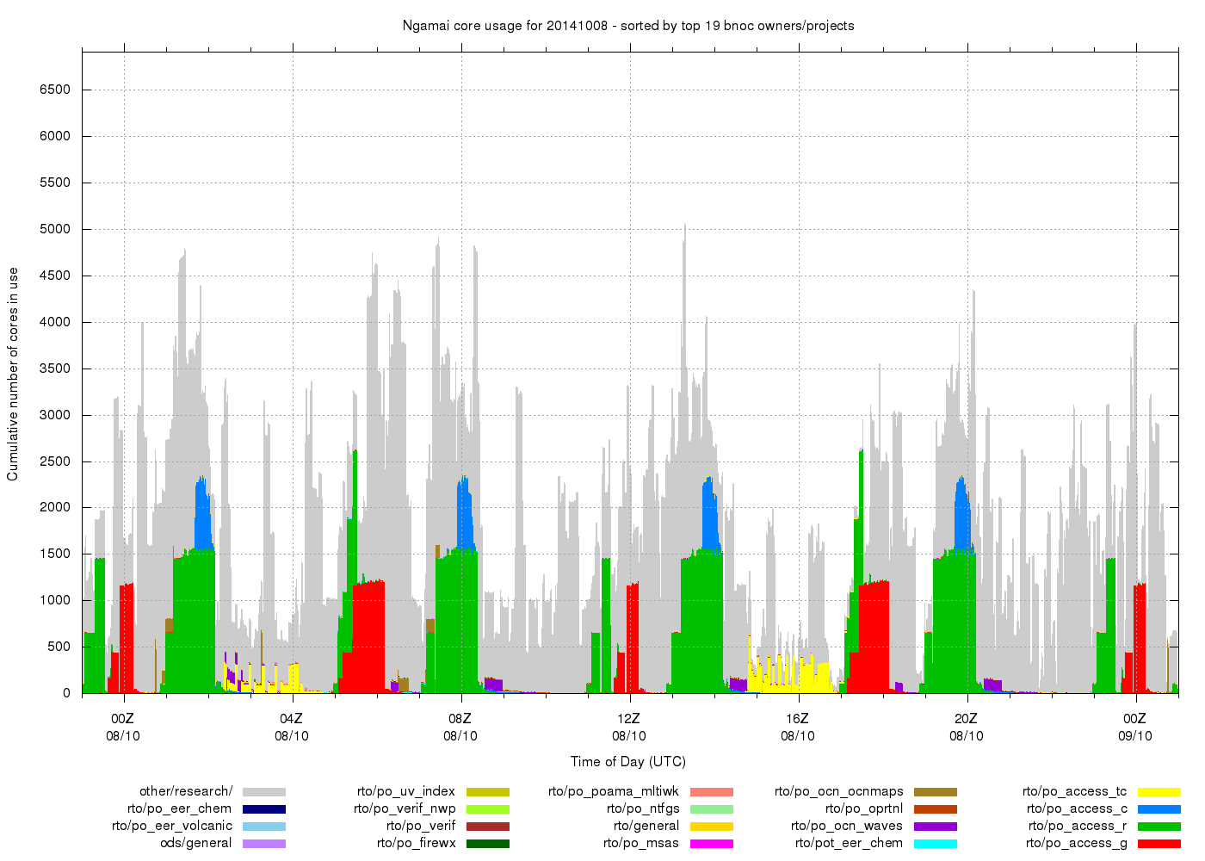
Operational job runtimes on Ngamai supercomputer

Slide 18
Things BNOC likes about SMS
One single GUI for operational system monitoring (can view multiple SMS instances in a single window)
Intuitive, relatively easy to use
Robust & stable (can run for months or years without crashing)
Lightweight, scalable (yet to hit any internal limits)
Can interactively replay/modify parts of a running suite
Can manually change SMS variables or perform one-off modified "edit" runs
Security – user lists control who can see what & do what

Slide 19
Some disadvantages of SMS
No longer "supported" by ECMWF (replaced by ecFlow recently)
32-bit code will eventually require replacement (10 years?)
Single-threaded – could hang if sshfs fails (workaround proposed)
00Z date cycling – can make inter-suite triggering delicate if 18Z model runs are delayed (alert emails now warn us if this happens)
Awkward to view previous days' output files (stored on disk but not viewable in GUI)
Rarely used by CAWCR developers → disjointed transition to operations
Can't handle multi-billion year astrophysical model runs!

Slide 20
Future options?
Could conceivably continue using SMS for many years…
Migrate to ecFlow (Python API, improved error handling, migration tools)
Hybrid approach – use Cylc for ACCESS VAR/UM + SMS for rest
Convert all operational SMS suites to Cylc? (Tools, resourcing?)

Slide 21
For more info on SMS in BNOC refer to
http://nmoc-svnop:8080/projects/sms/wiki/SMSlinuxsge
http://wiki.bom.gov.au/foswiki/NMOC/OperationsDevelopment/SmsBasics
Thank you…
Jim Fraser, BNOC
Ph: (03) 9669 4039
J.Fraser@bom.gov.au

