Slide 1
Migration of Met Office coupled model to Rose
Craig MacLachlan
ACCESS User Training Workshop – 14th October 2014

Slide 2

Who am I?
Craig MacLachlan
Lead developer for the Met Office seasonal forecast system, GloSea5
Lead a working group investigating issues for coupled/climate migration to Rose

Slide 3
(Talk) Timeline
Past
Present
Future
Seasonal suite migration
Revision controlled archiving
Metadata
Climate suites
Standard suites
Validation Macros
Smart Diff tool
External Repositories

Slide 4
Seasonal Migration (Dec 2012-Jan 2014)
The seasonal system was migrated to Rose with the operational suite (mainly NWP)
Seasonal migration wasn’t too difficult.
We already had good task encapsulation.
Strategy changed from being very flexible to more rigid. This made the suite simpler.
First coupled model version was available June 2013. Migration took a few months.

Slide 5
Seasonal Migration
- Highlights
Member step recovery
Transparency

Slide 6
Highlights from Rose migration: auto-recovery
Key Rose/cylc features:
Automatic retries (retry delay)
Optional configurations
New procedure:
If a particular 15 day section fails, then it is automatically repeated with a shorter time-step
This process can be repeated an arbitrary number of times for a give ensemble member (once in operations)

Slide 7
Highlights from Rose migration: auto-recovery
Results (Feb ’13 to June ‘13):
Very successful
Previous weekly failure rate was up to 15%
After migration, failure rate is:
  0.5% (5 ensemble members in 910)
  97 members out of 910 have been automatically recovered.
This has saved nearly 400,000 cpu hours
It also reduced the human interaction with the suite; making my job and operational systems teams jobs easier.

Slide 8
Highlights from Rose migration: reduced complexity
GloSea5 runs 8 seasonal ensemble members per day.
Each seasonal ensemble member consists of 14 X15 day submissions
To achieve this in the SCS system we had to have a WHILE loop over parallel model tasks. The SCS wasn’t really designed for this.
RESULT
GloSea is still configurable but more static when running.
Easier for operational support teams to understand what it going on
Task parallelism
Transfer of changes to operational team more transparent

Slide 9
Revision controlled archiving
Now that we have revision controlled suites, we have the opportunity to have version controlled data.
The suite revision number will be encoded in the pp header.
For most work, standard practice will be to overwrite existing data.
There will be an option to use revision numbers in archive paths.
Obviously this is site-specific. Rose doesn’t force a particular archiving setup/tool.

Slide 10
End of beginning

Slide 11
Metadata
Metadata is a key issue for climate model comparison projects.
Previous round required manual entry of metadata into a data base.
Rose suite metadata is defined on a project basis.
Some fields can be made mandatory.
Other data will be extracted from the suite.

Slide 12
Climate suites
The 360-day calendar has been the main barrier to a “standard” climate suite.
Climate suites are different from seasonal suites (daily operational cycling vs. model time cycling).

Slide 13
Beginning of end

Slide 14
Standard suites
Is there a better way to identify “standard” jobs than maintaining a wiki page, or relying on a point of contact?
Metadata is an obvious answer but there are issues.
  Metadata is (currently) persisted when suites are copied.

Slide 15
Validation Macros
Rose provides the ability to write validator macros. These warn if settings do not match a given specification.
They can also set variables to their correct values.
These could be used to validate scientific settings. For example: is this app GA6.0?

Slide 16
Smart Diff tool
One feature missing from Rose is a “smart” diff tool. The ini-style config files are very readible, but we need the namelist metadata too!
The UMUI included such a diff tool.
A simple tool to do this has been written, but needs work.

Slide 17
External Repositories
External repositories for the UM are currently being set up.
These are expected to be live in November 2014.
Rose suites will also be accessible through the external repositories
Suites can be made more portable but this requires work and maintenance.

Slide 18
Questions?

Slide 19
A brief GloSea orientation

Slide 20
A day in the life of GloSea5
2 x
Seasonal forecasts
~210 days
Sub-seasonal forecasts
~60 days
2 x
Seasonal hindcasts
~210 days
6 x

Slide 21

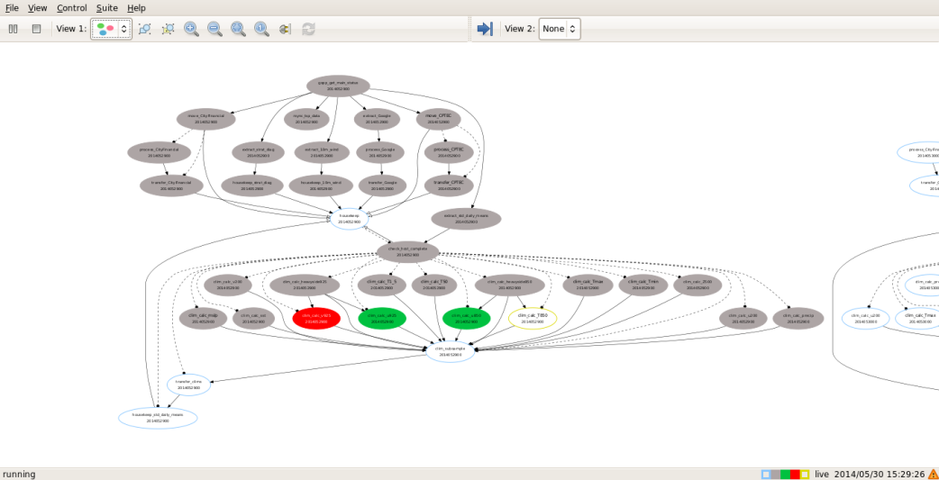
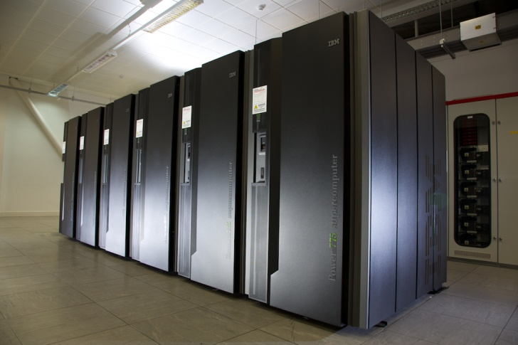

Tape storage
GloSea5
@HPC
GloSea
Post-processing
External FTP

Slide 22
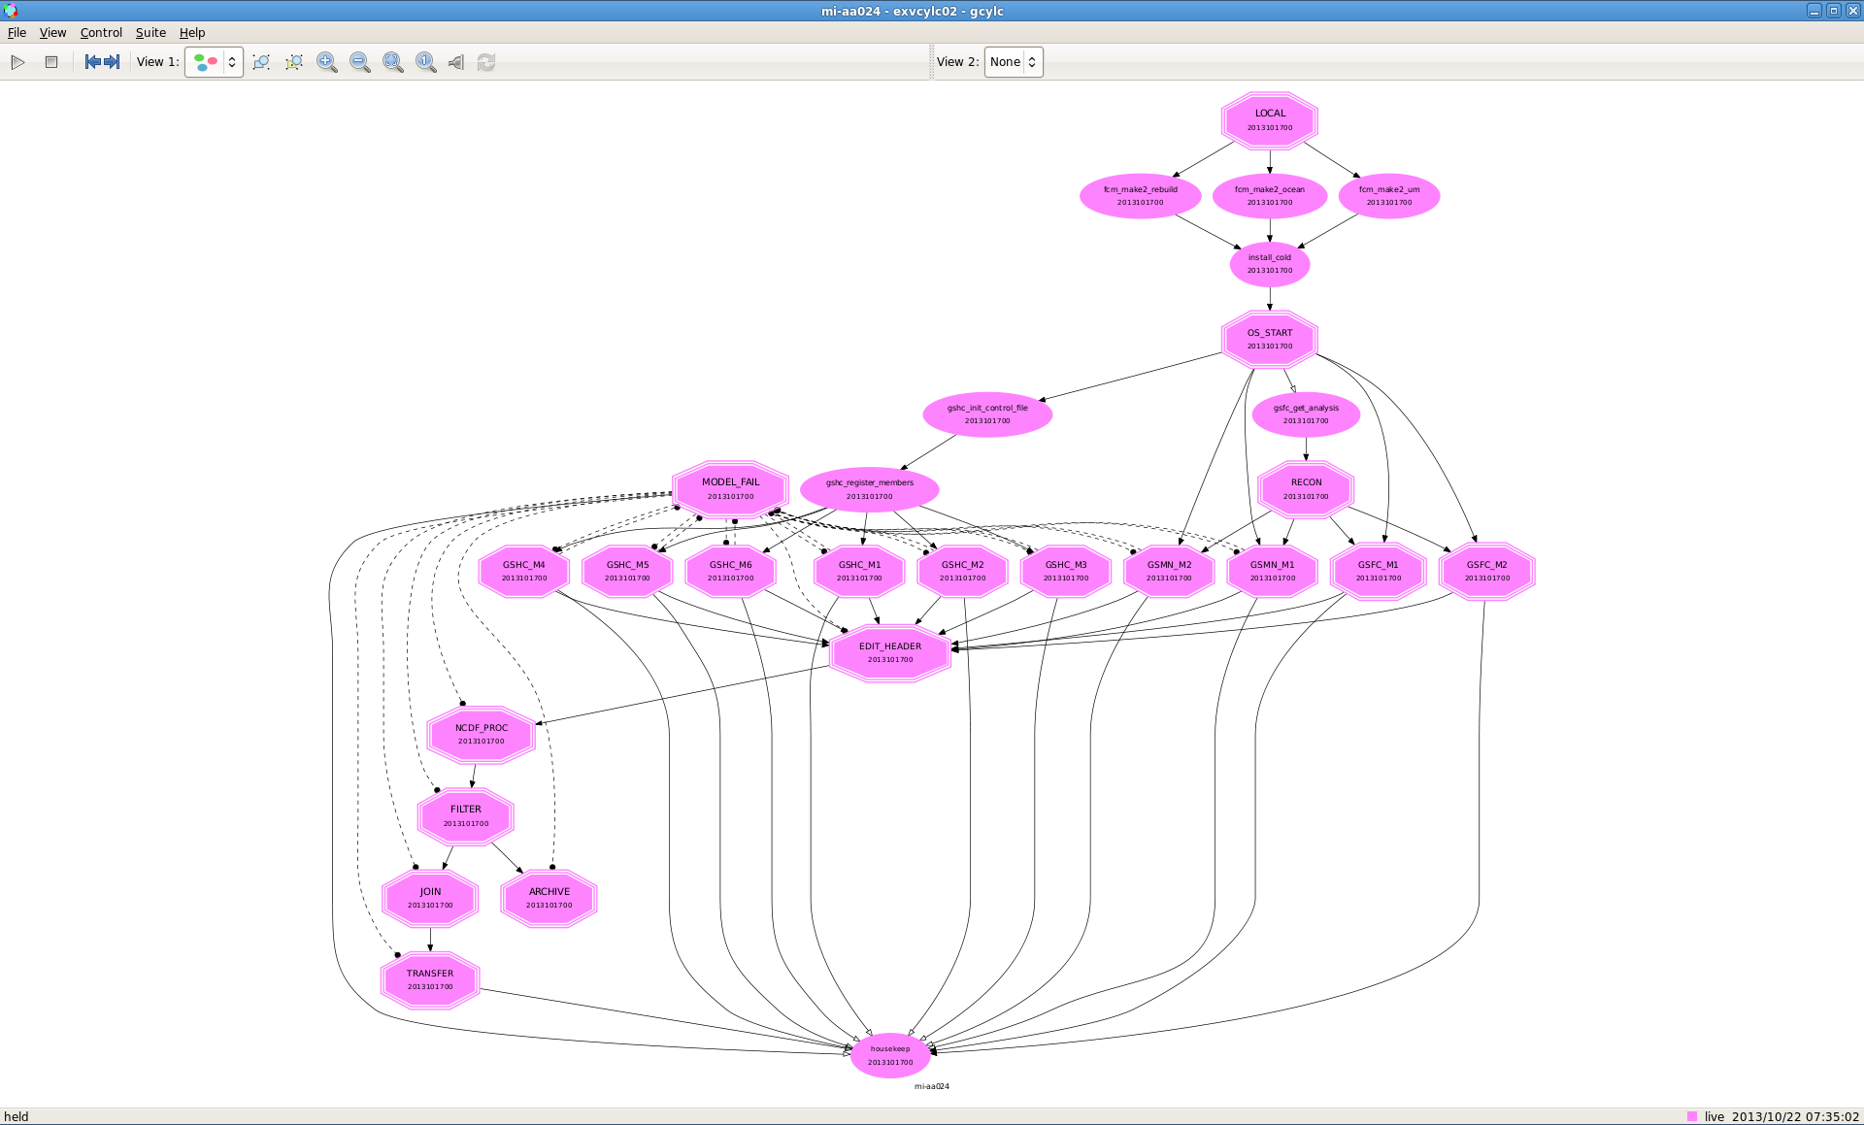

Slide 23
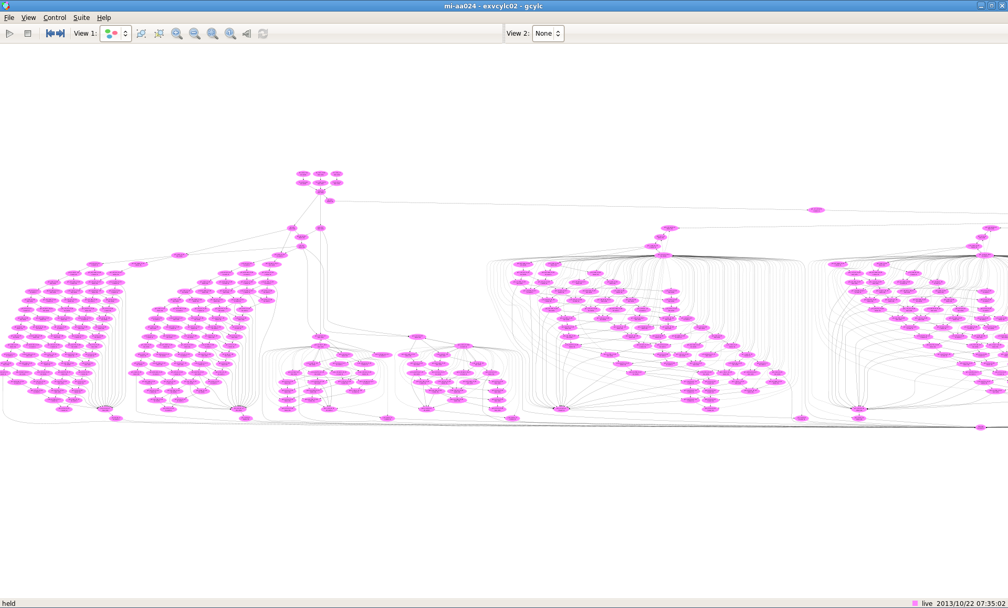

Slide 24
A simplified view
Model step 1
NetCDF Proc
Model step 2
Product proc
NetCDF Proc
Archive
Product proc
Archive

