Slide 1
ACCESS 1.0/1.3 Coupled Model in Rose
www.cawcr.gov.au
Ian Campbell, Peter Uhe
Martin Dix
26th March 2014

Slide 2
ACCESS 1.0 and 1.3
Atmosphere
HadGEM2 r1.1 or
HadGEM3 GA 1.0
Land Surface
MOSES or CABLE 1.8
Coupler
OASIS 3.2.5
Ocean
GFDL MOM4p1
Sea Ice
CICE 4.1
Notes:
Explain Met Office climate model development

Slide 3
The ACCESS Model CMIP5 configurations
ACCESS 1.0
Atmosphere: HadGEM2-A r1.1 configuration
MOSES land surface scheme
ACCESS1.3
Atmosphere: HadGEM3-A r1.1 configuration (GA 1.0)
CABLE 1.8 land surface
Almost no dust
PC2 cloud scheme
Bugfixes and tuning
Atmosphere resolution N96 1.875x1.25 degrees, 38L
Full GHG, aerosol, volcanic, solar forcings
Fixed vegetation
Notes:
Can also run atmosphere alone (AMIP) or AusCOM (ocean + sea-ice). UM vn7.3
Early testing also considered HadGEM2 + CABLE (1.1), and HadGEM3 + MOSES (1.2)
Local changes to atmosphere in HadGEM3. Except for change from RH based CAPE closure to vertical velocity based CAPE closure this is GA1.0. Thanks to Charline for providing the files to help sort this out.
Triple cloud scheme

Slide 4
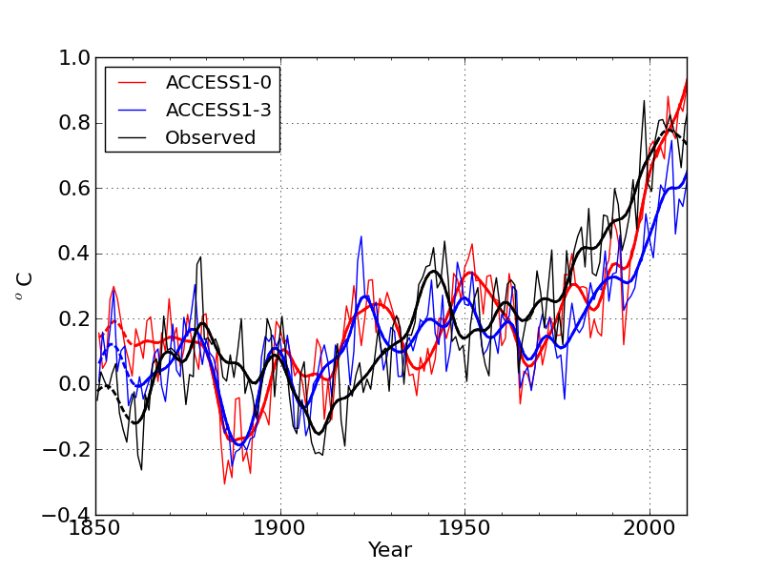
Global surface air temperature Anomalies relative to 1880-1920 average
The Centre for Australian Weather and Climate Research A partnership between CSIRO and the Bureau of Meteorology

Slide 5
ACCESS 1.4
Based on ACCESS 1.3
Includes some bug fixes
CABLE 2.0 with carbon cycle
Oasis MCT

Slide 6
ACCESS 2.0
Hoping to release an interim version towards end of year
Atmosphere - UM GA6.0 configuration (N96 L85)
Ocean – MOM6
Ice – CICE 5
Coupler: OASIS MCT

Slide 7
Weaknesses of current coupled model setup
Existing environment is a hurdle, particularly for new users
Coupled model much harder to use than atmospheric model
Coupled model scripts are a mixed combination of configuration and job control
Difficult to share jobs
Only ad hoc revision control
Can be difficult to continue runs after problems
We’ve seen many advantages with the job database and UI for the atmospheric model and would like to bring these to the coupled model

Slide 8
Advantages of Using Rose suites
Single Interface for editing various models MOM4, CICE and UM
Simple mechanism for sharing or copying suites between users
Automate additional steps (Eg post processing data into CMIP5 format)
Improve traceability of suite development

Slide 9
Example Suite au-aa025
Historical Run
Runs from 1951 until 2001
Incorporates Scripts from ACCESS 1.0 Coupled Model
Includes build steps for MOM4, UM 7.3 and CICE models

Slide 10
Checking out/Editing the Model
On accessdev
$ rosie checkout au-aa025
$ rose edit -C ~/roses/au-aa025
Allows users to edit
Top Level Variables
Environment variables
Namelists
Input data files
Configuration of the Post Processing of data

Slide 11
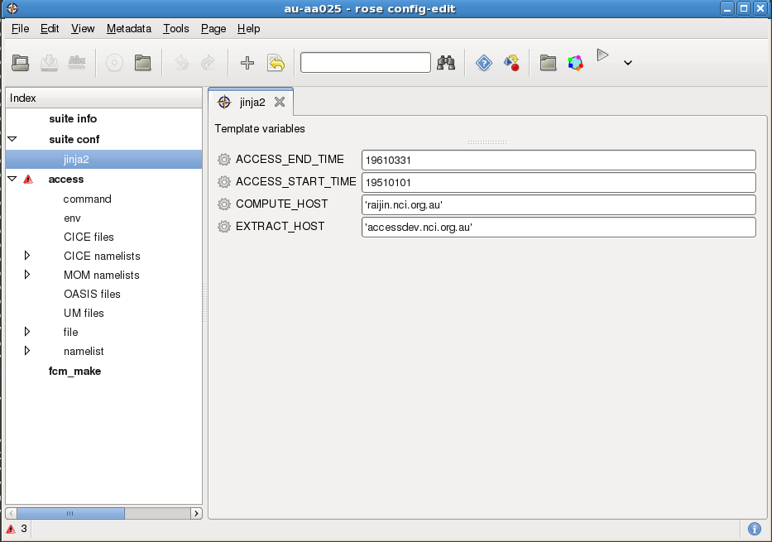
Top Level Items

Slide 12
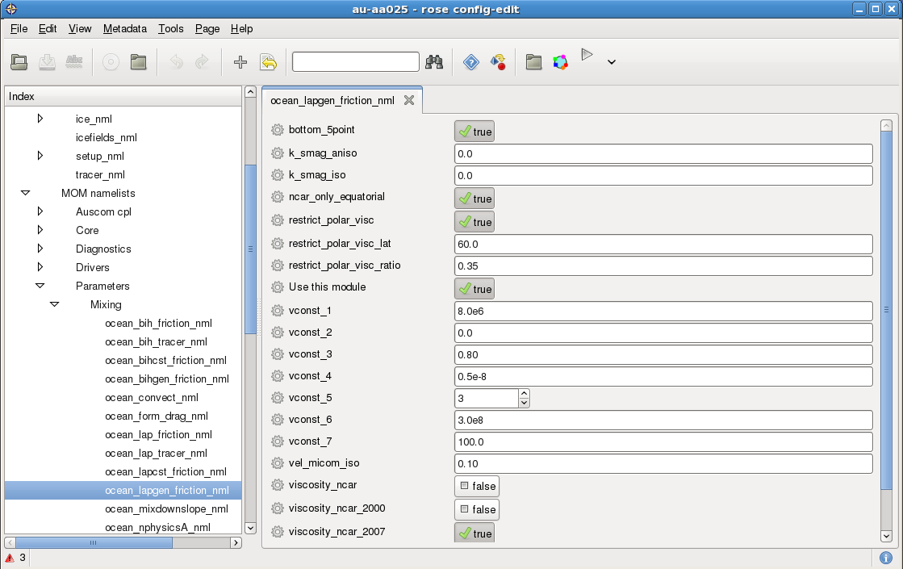
Editing the Model

Slide 13
Running the Model
To run the Model on Accessdev
$ rose suite-run –C ~/roses/au-aa025
Alternatively click on the play icon in the Rose edit interface
What it does?
Builds the various models
Runs the model from 1951 in 3 month chunks
Installs and runs the suite in $HOME/cylc-run
Work and Share directories under /short/$PROJECT/$USER/cylc-run

Slide 14
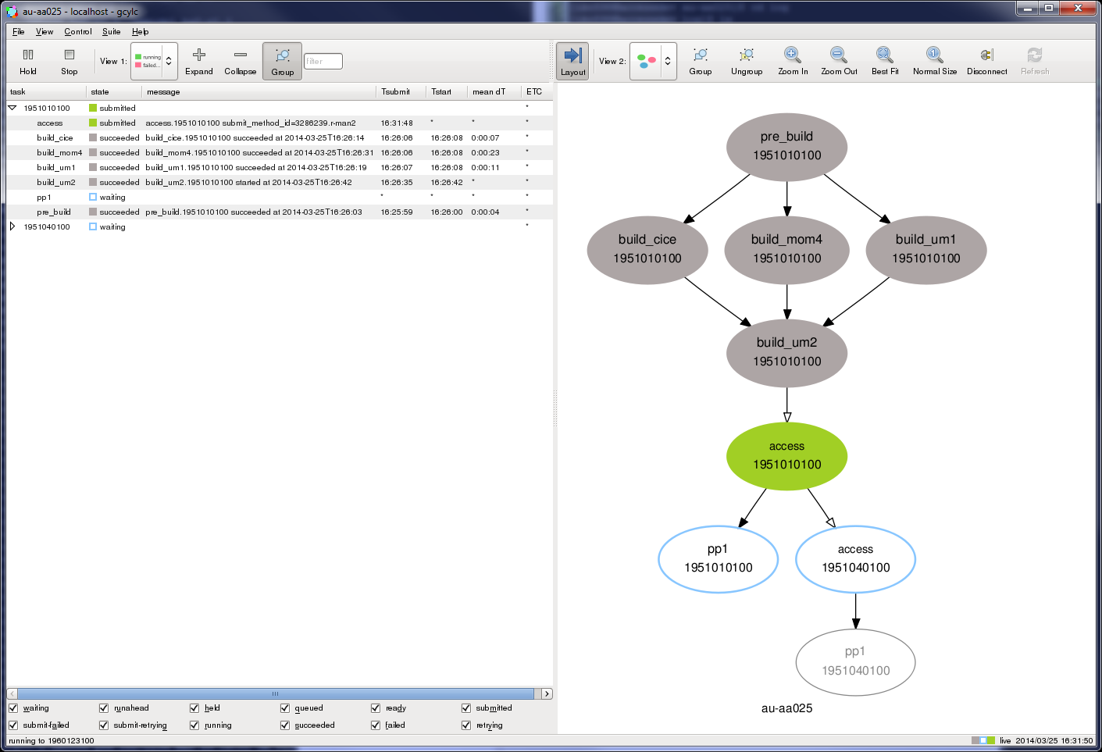
Cylc Window

Slide 15
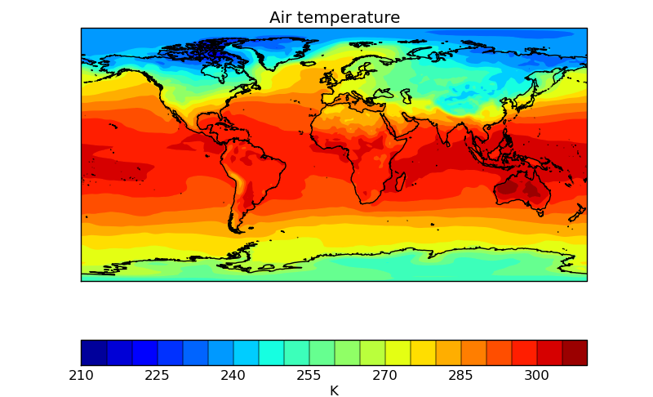
Viewing the Output
Data files on Raijin
/short/$PROJECT/$USER/cylc-run/au-aa025/share/data/history
Data post processed into CMIP5 format
/g/data1/$PROJECT/$USER/CMIP5/output/CSIRO-BOM/ACCESS1-0/au-aa025
Notes:
This is monthly mean surface air temperature for Jan 1960
import iris
import iris.quickplot as qplt
import matplotlib.pyplot as plt
import numpy as np
cubes = iris.load('au-aa025.pa-1960001001', 'air_temperature')
qplt.contourf(cubes[0],np.arange(210,315,5))
plt.gca().coastlines(resolution='50m')
# plt.show()
plt.savefig("/short/p66/mrd599/junk.png")

Slide 16
When things go wrong!!
Rose log files
Suite log files on Accessdev
$HOME/cylc-run/au-aa054/log/suite/log
$HOME/cylc-run/au-aa054/log/suite/out
$HOME/cylc-run/au-aa054/log/suite/err
Job log files on Raijin
$HOME/cylc-run/au-aa054/log/job/TASK.YYYYMMDD.N.err
$HOME/cylc-run/au-aa054/log/job/TASK.YYYMMDD.N.out
Log files can be also viewed via the web interface Rose Bush
https://accessdev.nci.org.au/rose-bush/

Slide 17
Future Development
Final release next month
Completed interface with the UMUI
Completion of MOM meta data
Further down the track
ACCESS 2.0
Completion of interface with UM with release of UM 9.1

Slide 18
Further Information
Wiki
https://trac.nci.org.au/trac/access/wiki/ACCESS1.0_rose
https://trac.nci.org.au/trac/access/wiki/RunningRoseAcessdev
Rose
http://metomi.github.io/rose/doc/rose.html
Cylc
http://cylc.github.io/cylc/

Slide 19

Thank you
The Centre for Australian Weather and Climate Research
A partnership between CSIRO and the Bureau of Meteorology
Ian Campbell
Phone: 03 9616 8412
Email: i.campbell@csiro.au
Web: www.cawcr.gov.au
Thank you
www.cawcr.gov.au

