Slide 1
Introduction to the Rose suite
The UM - as seen with Rose
21/03/2016 by João Teixeira & Wenming Lu

Slide 2
Contents
What we’ll cover …
Overview of Rose and Cylc
What’s Rose ?
What’s Cylc ?
Managing a Rose suite
Rose suite structure
Rose utilities
Checkout a suite – finding information
Rose suite metadata
Making changes to suite configuration
Q & A

Slide 3
Overview of Rose and Cylc
What are they?

Slide 4
What’s Rose?
What does Rose look like?
Rose is a group of utilities
provides a common way to
manage development
run software
Research
Operations
It can be used for (almost) anything
It is not specific to any type of:
Language
Application
etc...

Slide 5
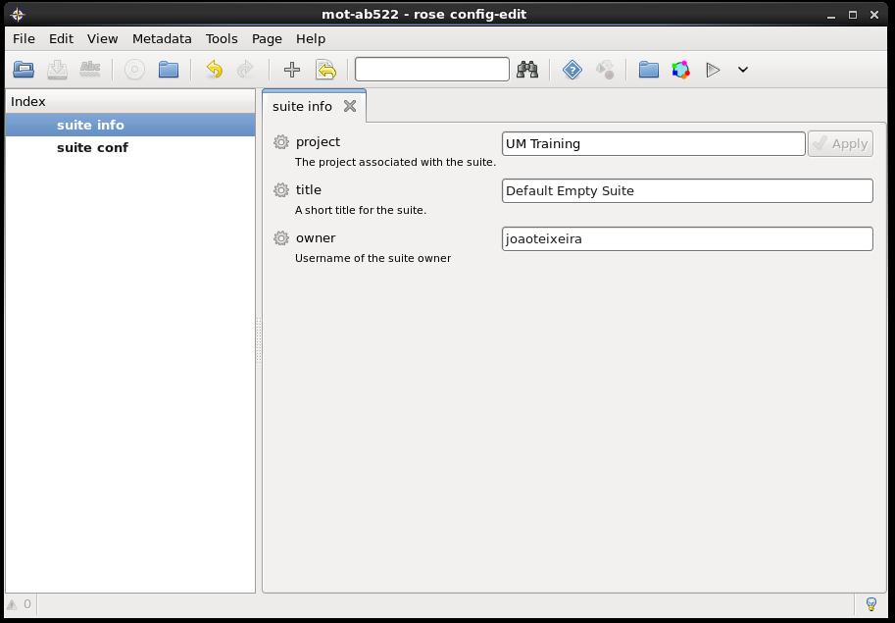
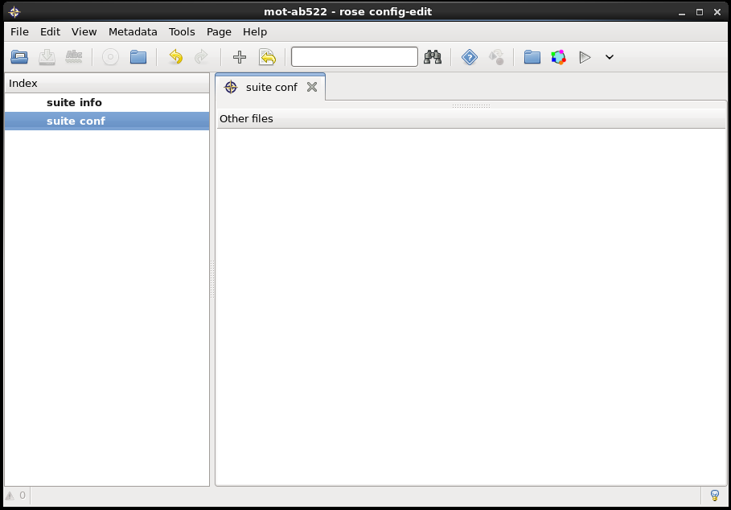
What’s Rose?
A very pretty GUI – why is it empty? (test-aa070)

Slide 6
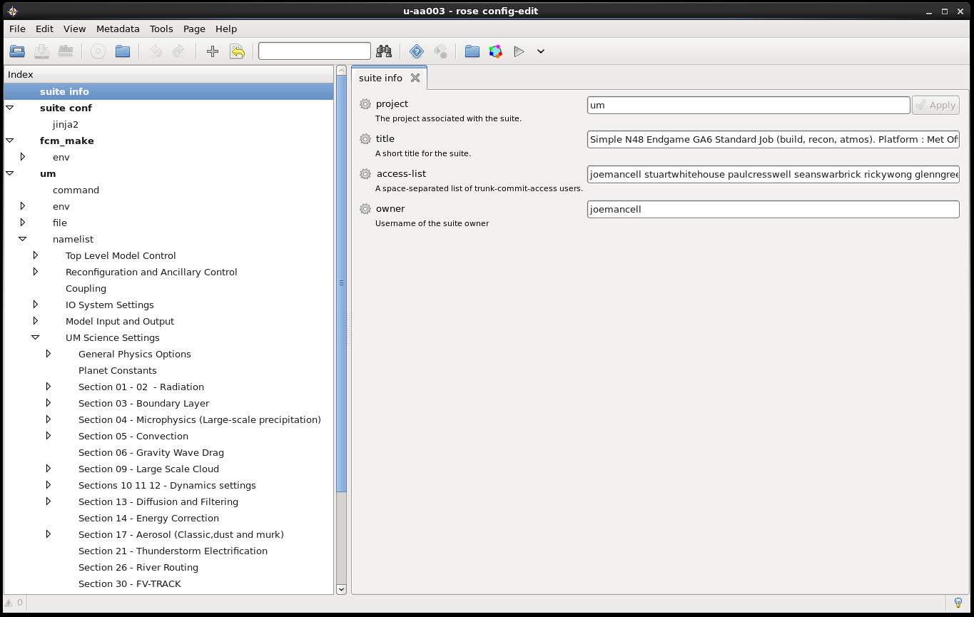
Rose as a UM GUI
Where is the UM in Rose? Suite u-aa003/test-aa071

Slide 7
What’s Cylc?
What does Cylc look like ?
workflow engine and meta-scheduler
specialises in continuous workflows of cycling tasks
It can be used for non-cycling tasks
Scheduler used by Rose to control tasks

Slide 8
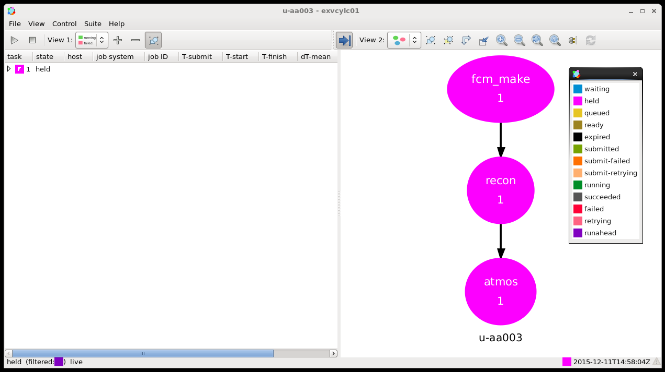
Cylc Graph
For an UM Atmosphere only system – it looks nice

Slide 9
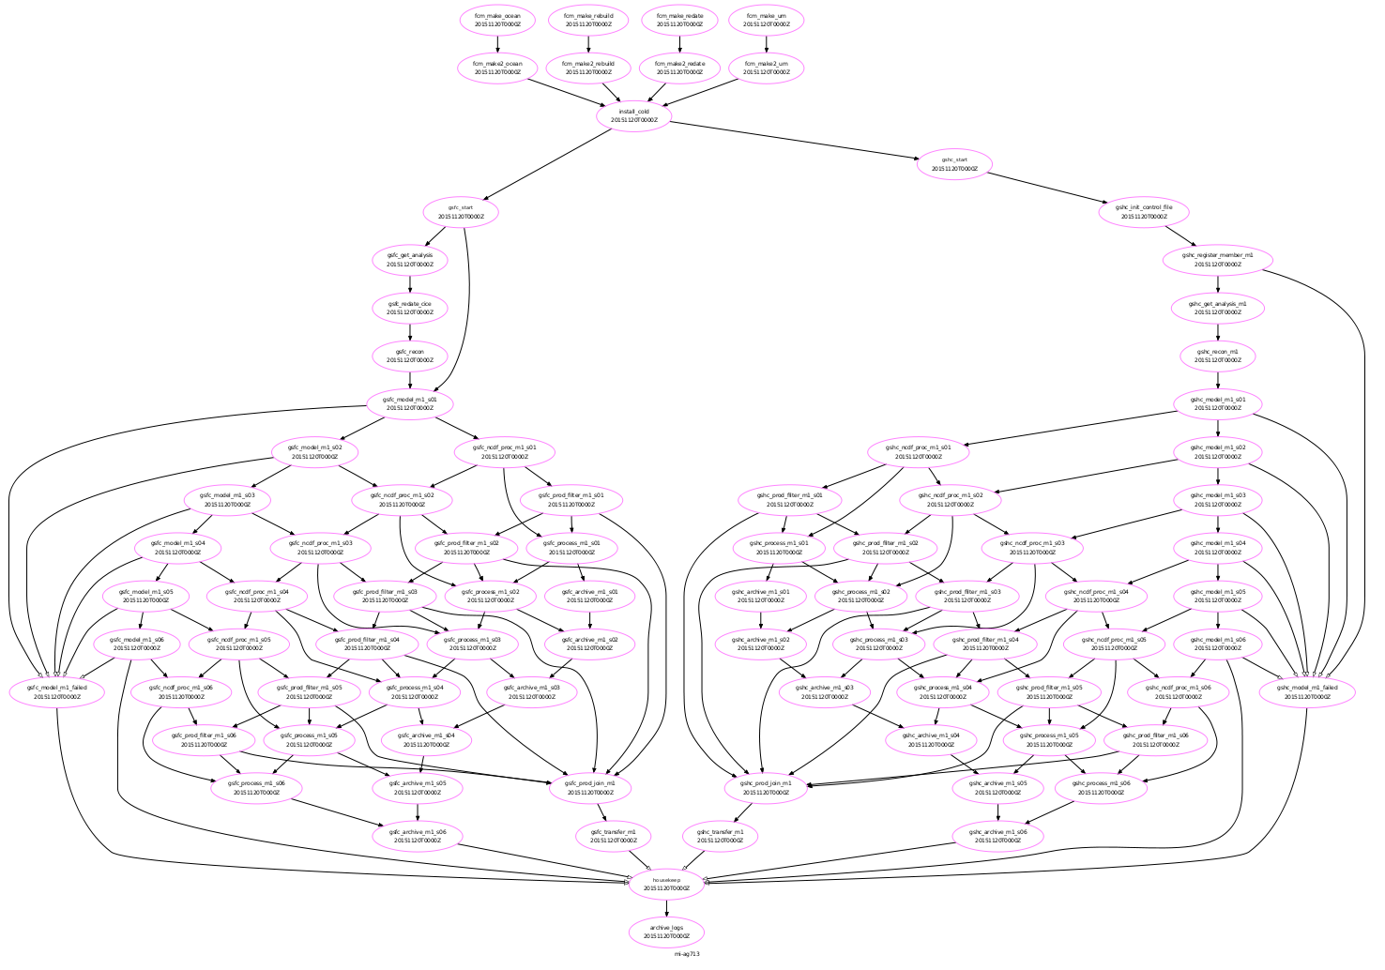
Cylc Graph
For a UM GloSea5 system – it looks like ...

Slide 10
Managing a Rose suite
Introduction to Rose utilities – creating, copying and changing a suite

Slide 11
Rose Suite
Contents of a Rose Suite -- UM
Rose suite contents - reside in a directory
xx-
aa000
Server ID
Suite ID
xx-aa000
|---- app/
| |---- fcm_make/
| | |---- file/
| | | |---- fcm-make.cfg
| | |
| | |---- rose-app.conf
| |
| |---- um/
| | |----- rose-app.conf
|
|---- meta/
| |---- rose-meta.conf
|
|---- rose-suite.conf
|---- rose-suite.info
|---- suite.rc
Applications configuration files and etc...
Namelist files
Configuration files for compiling
auxiliary data
etc
Metadata for the Rose GUI
Rose and Cylc configuration files
Notes:
In here I should explain the contents of each file:
* rose-suite.conf
* rose-suite.info
* suite.rc

Slide 12
Managing a Rose Suite
Rose Utilities -- Rosie
Rosie is a suite manager for Rose suites
create -- empty suites
copy
checkout
delete
lookup
go -- It also has a GUI
Wrapped around svn
manage code development and release
added functionalities to work with UM code
Rose manages the rose suite
Edit
Suite-run
Suite-gcontrol
Deals with the rose repository syntax and Rose id

Slide 13
Checking out a Rose Suite
Hands-on a UM Rose suite ...
Checkout an UM Rose suite
What info do you find for this suite?
Who owns it?
What kind of UM system/configuration is this?
Where do you expect it to run?
Will it compile the UM code?
What tasks will it run?
In what order?
Are there any dependencies for the tasks?
How can these settings be changed?
u-aa003/test-aa071 - standard simple UM suite
A simple example
u – lives in the unified repository MORS
aa003/test-aa071 is the suite ID
Can you do all this from a GUI or a command line?

Slide 14
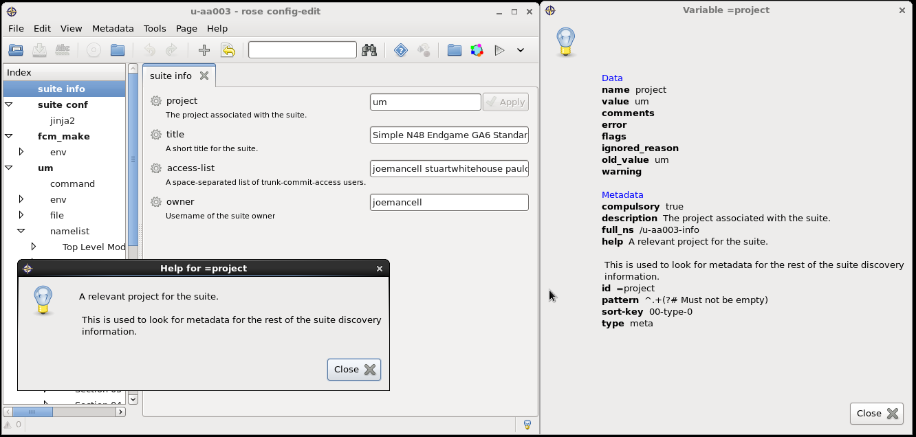
Metadata in a Rose Suite
Adding more power to a Rose suite
Metadata provides information about settings in Rose configurations
help
range
pattern
etc ...
Try setting a blank title in the Rose suite !!!
Notes:
Show the basics for the suite info and refer that will cover this with an UM example → Validators

Slide 15
Committing changes -- Rose
Commit changes – Looking to the repository on the web ...
One can make local changes to the suite
without commit to the repo.
Make a copy of u-aa003/test-aa071
This will give you a new suite ID
Make the desired changes
Save
Commit the changes to repo.
Check the differences from with the original
Not the suite owner
Where does your suite live?
Version control – Rosie / FCM

Slide 16
Checking Suite Outputs & Logs
Rose Bush: https://accessdev.nci.org.au/rose-bush/
At left, type your user ID to check all your suites
At right, type your user ID and suite ID to check a particular suite logs

Slide 17
Useful links
Online tutorials and documentations ...
Rose
https://github.com/metomi/rose
http://metomi.github.io/rose/doc/rose.html
Cylc
https://github.com/cylc/cylc
http://cylc.github.io/cylc
FCM
http://metomi.github.io/fcm/doc/user_guide
MOSRS
https://code.metoffice.gov.uk
roses-u https://code.metoffice.gov.uk/trac/roses-u

Slide 18

Questions … ?
Coffee ?
15’ break ?

