Slide 1
UM Science Configurations
Global Model Development & Science configuration
09/02/2016 by João Teixeira

Slide 2
Contents
What we will cover …
UM Global Model Development
GMED Process
GA / GO / GSI / GL / GC
GA7 Amip Suite
Comparison tasks
Activating / Deactivating tasks
Build and Run switches
Archiving

Slide 3
UM Global Model Development
UM Science Configurations

Slide 4
Science Configurations
Process design
Multi-year timescales
Annual release cycle
System dependent
Model Development
Research Cycle
Implementation Cycle
Operational
Implementation/Use
Progress updates/review
PEGs/informal meetings
Research projects
Diagnostic studies
Process Evaluation Groups
Routine verification
Monitoring/feedback
Model Evaluation/Verification

Slide 5




Global model development
What’s out there?
UM – Atmosphere Science configuration (GA)
NEMO – Ocean Science configuration (GO)
Global Coupled
(GC)
CICE – Sea Ice Science configuration (GSI)
JULES – Land Science configuration (GL)

Slide 6
GA7 Amip suite
What does it look like?

Slide 7
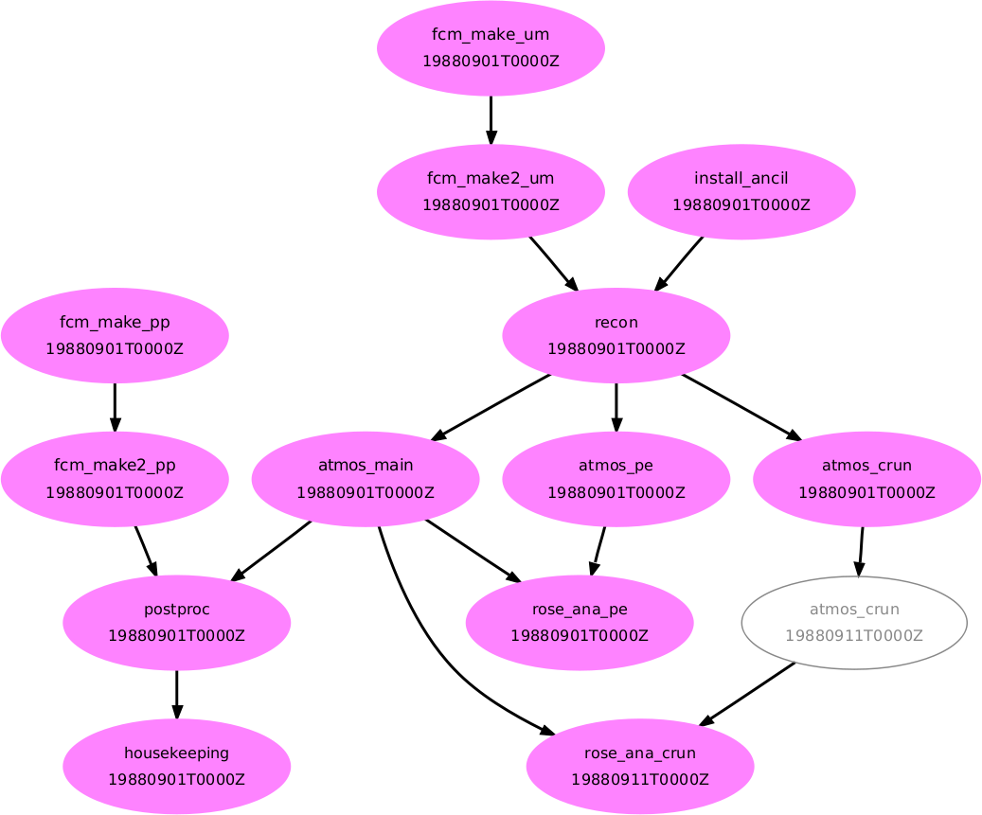
Standard AMIP GA7
Lots more apps and tasks...

Slide 8
Standard AMIP GA6
What are they?
Task | Description
fcm_make2_um | will continue the fcm make command at a remote HOST
install_ancil | Installs the ancil file
Fcm_make_pp | Build Archiving app
atmos_pe | Tests if a different processor decomposition affects the model results
atmos_crun | Tests if job resubmissions affects the model results
rose_ana_* | rose ana comparison task
postproc | Archiving and deletion of dumps and pp files
housekeeping | Tidy logs and old working directories

Slide 9

Comparison tasks
Why should we have them?
Resubmission tests - Tests if job resubmissions affects the model results
Processor decomposition test - Tests if a different processor decomposition affects the model results

Slide 10
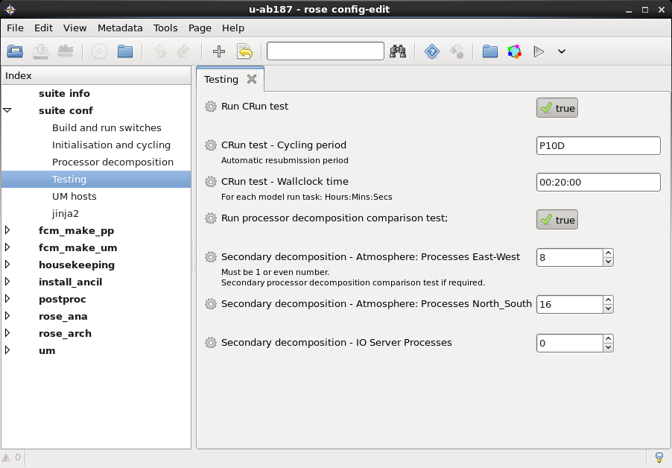
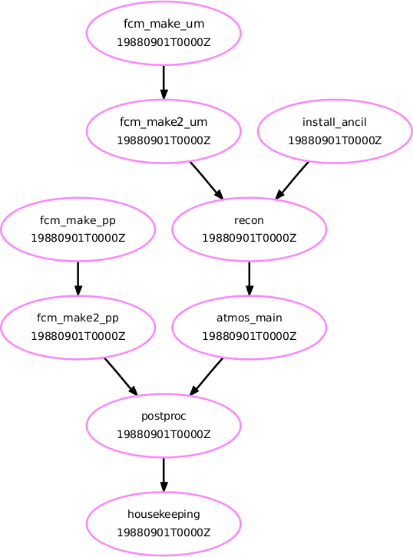
De/Activating Tasks
Crun tests...
We may not want to run these tests
False

Slide 11
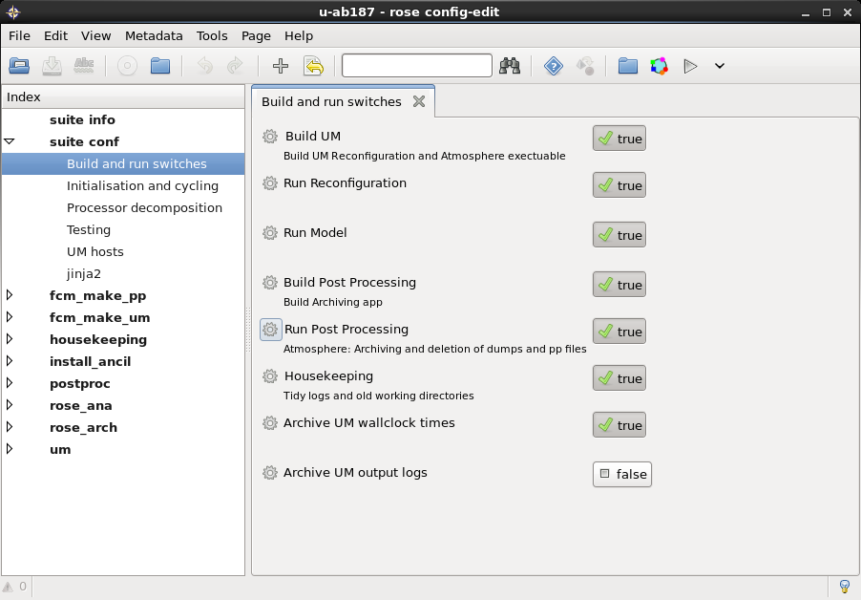
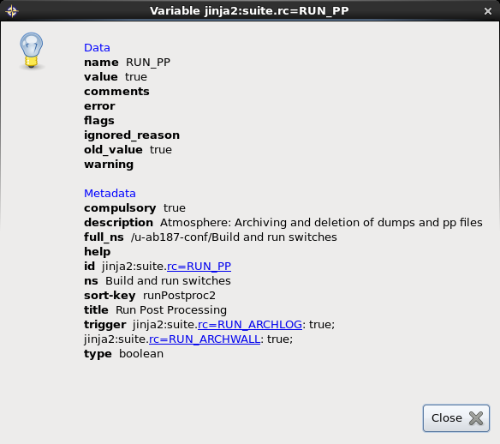
Build and Run Switches
What else comes with GA configurations?
Post Processing – Archiving, deletion of dumps and PP file conversion

Slide 12
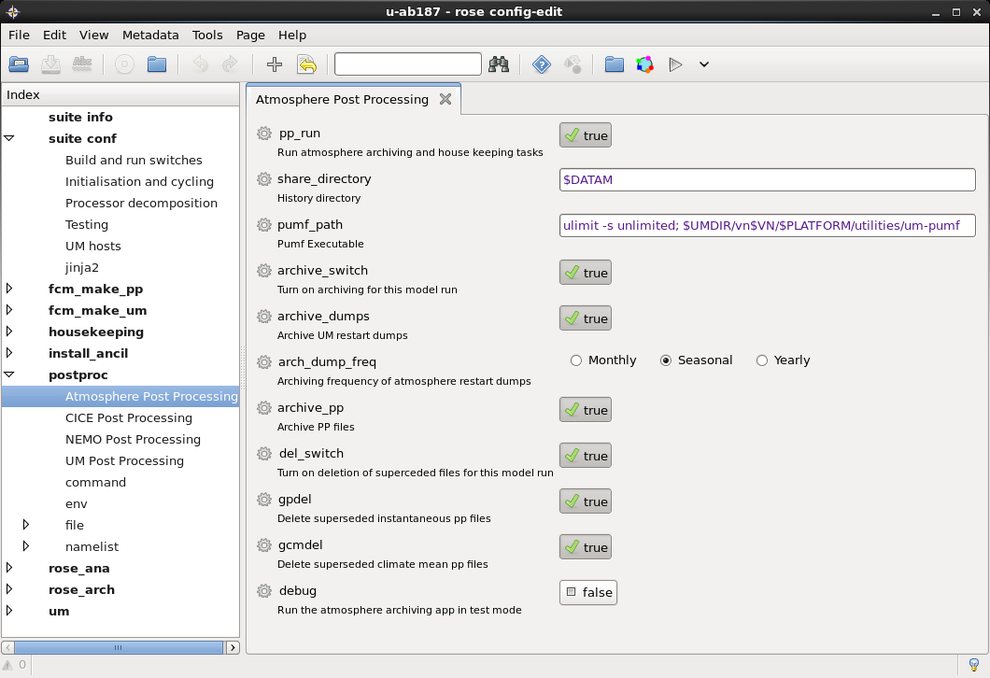
Post Processing App
Options and Switches...

Slide 13
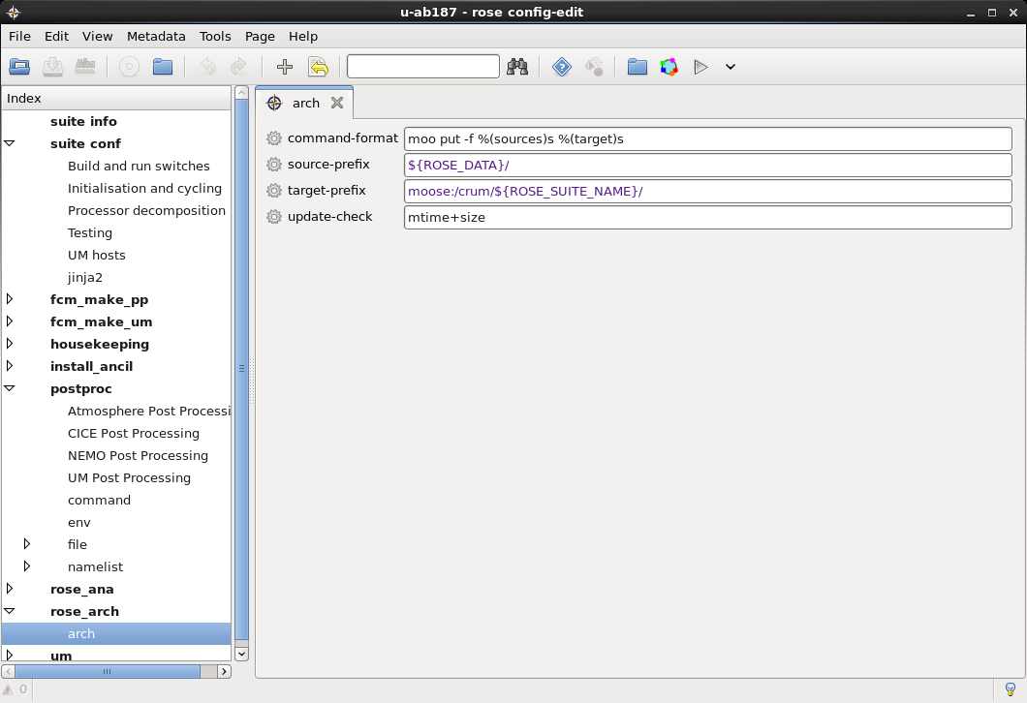
Rose Archiving
What commands will run, should one change it?

Slide 14
Useful links
Online documentations ...
UM Documentation
https://code.metoffice.gov.uk/doc/um/
http://collab.metoffice.gov.uk/twiki/bin/view/Support/UMarticles
http://collab.metoffice.gov.uk/twiki/bin/view/Support/UnifiedModel
Global Model Development
http://collab.metoffice.gov.uk/twiki/bin/view/Development/WebHome
https://code.metoffice.gov.uk/trac/gmed
https://code.metoffice.gov.uk/trac/GA/wiki/GADocumentation/GA7.0

Slide 15
Questions … ?

