Slide 1
Python data visualization
Using IRIS python module
14/02/2016 by João Teixeira
Notes:
Using this output we can deduce that:
The cube represents air potential temperature.
There are 4 data dimensions, and the data has a shape of (3, 7, 204, 187)
The 4 data dimensions are mapped to the time, model_level_number, grid_latitude, grid_longitude coordinates respectively
There are three 1d auxiliary coordinates and one 2d auxiliary (surface_altitude)
There is a single altitude derived coordinate, which spans 3 data dimensions
There are 7 distinct values in the “model_level_number” coordinate. Similar inferences can be made for the other dimension coordinates.
There are 7, not necessarily distinct, values in the level_height coordinate.
There is a single forecast_reference_time scalar coordinate representing the entire cube.
The cube has one further attribute relating to the phenomenon. In this case the originating file format, PP, encodes information in a STASH code which in some cases can be useful for identifying advanced experiment information relating to the phenomenon.

Slide 2
Contents
What we will cover …
Introduction to Iris
The Iris Python library
Iris Data Structures
Practical Exampled
Loading Iris cubes
Saving Iris cubes
Navigating a cube
Subsetting a cube
Ploting a cube
Interpolation and regriding
Merge and Concatenate
Cube statistics
Basic cube mathematics

Slide 3
Iris Python Library
An Introduction

Slide 4

Iris Python Library
What's Iris?
Python library for analysing and visualising meteorological data sets
Providing a powerful and easy to use, community-driven tool
With Iris you can:
Use a single API to work on your data, irrespective of its original format
Read and write (CF-)netCDF, GRIB 1&2, PP files and Field Files
Easily produce graphs and maps via integration with matplotlib and cartopy

Slide 5
Iris Data Structures
An Introduction

Slide 6
Iris data structures
What's Iris?
The top level object in Iris is called a cube
contains data and metadata about a phenomenon
A cube is an interpretation of the Climate & Forecast (CF) Metadata Convention
requires conforming datasets to contain sufficient metadata that they are self-describing, including physical units if appropriate, and that each value can be located in space (relative to earth-based coordinates) and time.
Coordinates exist on the cube to locate the data spatially/temporally
Notes:
Iris data structures¶
The top level object in Iris is called a cube. A cube contains data and metadata about a phenomenon.
In Iris, a cube is an interpretation of the Climate and Forecast (CF) Metadata Conventions whose purpose is to:
require conforming datasets to contain sufficient metadata that they are self-describing... including physical units if appropriate, and that each value can be located in space (relative to earth-based coordinates) and time.
Whilst the CF conventions are often mentioned alongside NetCDF, Iris implements several major format importers which can take files of specific formats and turn them into Iris cubes. Additionally, a framework is provided which allows users to extend Iris’ import capability to cater for specialist or unimplemented formats.
A single cube describes one and only one phenomenon, always has a name, a unit and an n-dimensional data array to represents the cube’s phenomenon. In order to locate the data spatially, temporally, or in any other higher-dimensional space, a collection of coordinates exist on the cube.

Slide 7
Iris data structures
Coordinates
Coordinate is a container to store metadata about some dimension
Each coordinate has a name and a unit
When a coordinate is added, the data dimensions that it represents are also added
Values may be discrete points or be bounded to represent interval extents
Coordinates have a dictionary of attributes which can hold extra metadata
More complex coordinates may contain a coordinate system in themselves

Slide 8
Iris data structures
Coordinates
There are two classes of coordinates:
DimCoord
Numeric
Monotonic
Representative of, at most, a single data dimension (1d)
AuxCoord
May be of any type, including strings
May represent multiple data dimensions (n-dimensional)

Slide 9
Iris data structures
Cube
A cube consists of:
A standard name and/or a long name and an appropriate unit
A data array whos values are representative of the phenomenon
A collection of coordinates and associated data dimensions on the cube’s data
A dictionary of attributes which can hold arbitrary extra metadata.
A list of cell methods to represent operations already applied to the data
(e.g. “mean over time”)
A list of coordinate “factories” used for deriving coordinates from the values of other coordinates in the cube

Slide 10
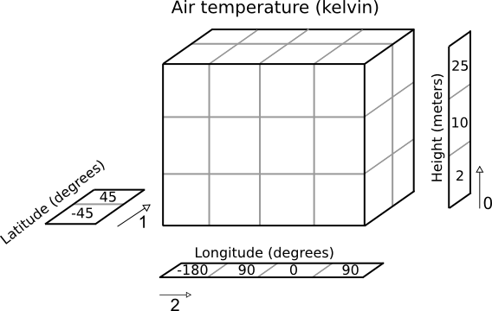
Iris data structures
Cube
A simple cube example
24 air temperature readings (in Kelvin)
4 different longitudes
2 different latitudes
3 different heights

Slide 11
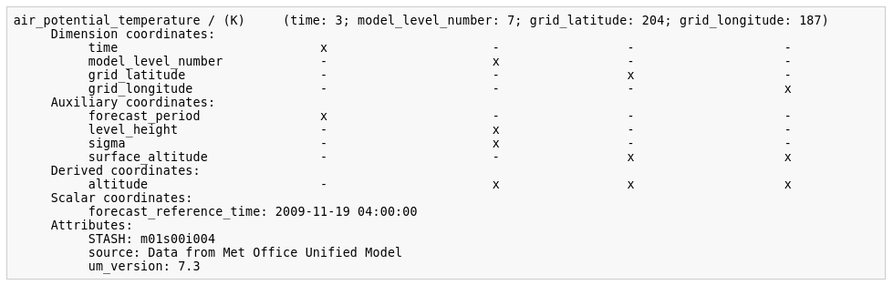
Iris data structures
Cube
Every Iris cube can be printed to screen
quickest way of inspecting the contents of a cube

Slide 12
Loading Iris cubes

Slide 13
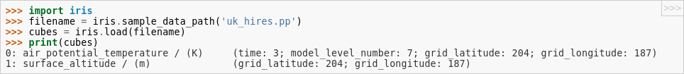
Loading Iris cubes
Getting the data into Python...
loading a file into a list of Iris cubes the iris.load() function is used:
Iris will return as few cubes as possible by collecting together multiple fields
To find out what has been loaded, the result can be printed:
Loading the filenoutputs 2 cubes. They are:
air_potential_temperature
surface_altitude
The result of iris.load() is always a list of cubes

Slide 14
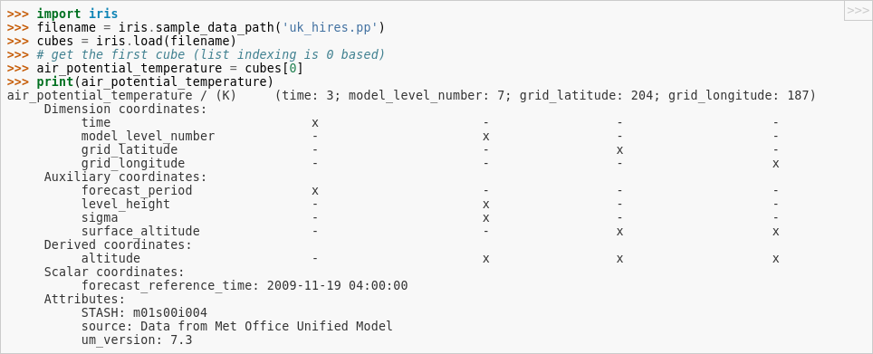
Loading Iris cubes
Getting the data into Python...
List indexing can be used to get the air_potential_temperature from the list

Slide 15
Loading Iris cubes
Getting the data into Python...
To load more than one file a list of filenames can be provided to iris.load()
It is also possible to load one or more files with wildcard substitution

Slide 16
Loading Iris cubes
Constrained loading...
It is possible to restrict/constrain the load to match specific Iris cube metadata
Specifying a name as a constraint argument to iris.load() will mean only cubes with a matching name will be returned

Slide 17
Loading Iris cubes
Constrained loading...
The iris.Constraint class can be used to restrict coordinate values on load
Constrain the load to match a specific model_level_number
Can be combined using & to represent a more restrictive constraint

Slide 18
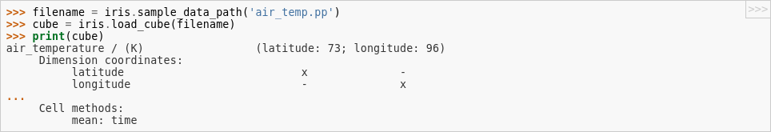
Loading Iris cubes
Strict loading...
similar to iris.load():
iris.load_cube()
iris.load_cubes()
Can only return one cube
Return a ordered list of cubes

Slide 19
Saving Iris cubes

Slide 20
Saving Iris cubes
Iris supports the saving of cubes and cube lists to:
CF netCDF (1.5)
GRIB (edition 2)
Met Office PP
iris.save() function saves one or more cubes to a file

Slide 21
Navigating a cube

Slide 22
Navigating a cube
Working with cubes...
Every cube has a standard name, long name and units
Each cube also has a numpy array which represents the phenomenon and can be accessed with Cube.data
Units can be converted with the convert.units() method

Slide 23
Navigating a cube
Accessing coordinates on the cube...
we can get an individual coordinate given its name with Cube.coord() method
Every coordinate has a Coord.standard_name, Coord.long_name, and Coord.units attribute
Additionally every coordinate can provide its points and bounds

Slide 24
Subsetting a Cube

Slide 25
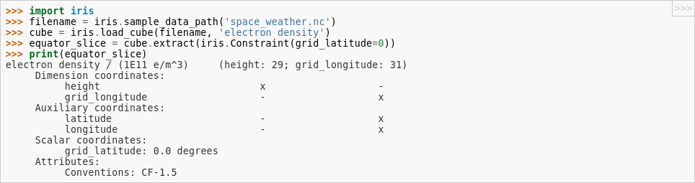
Subsetting a Cube
Cube extraction...
A subset of a cube can be “extracted” from a multi-dimensional cube

Slide 26
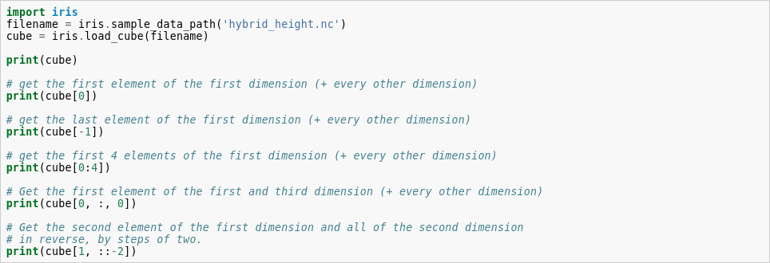
Subsetting a Cube
Cube indexing...
You can index a Cube the same way as a numeric multidimensional array

Slide 27
Plotting a Cube

Slide 28
Plotting a Cube
Iris cube plotting...
iris.quickplot and iris.plot extend the Matplotlib pyplot interface by implementing thin wrapper functions
As a rule of thumb, if you wish to:
do a visualisation with a cube, use iris.plot or iris.quickplot
show, save/manipulate any visualisation use matplotlib.pyplot
create a non cube visualisation, also use matplotlib.pyplot
iris.quickplot is the same as the iris.plot, but it adds title, x and y labels and a colorbar when appropriate

Slide 29
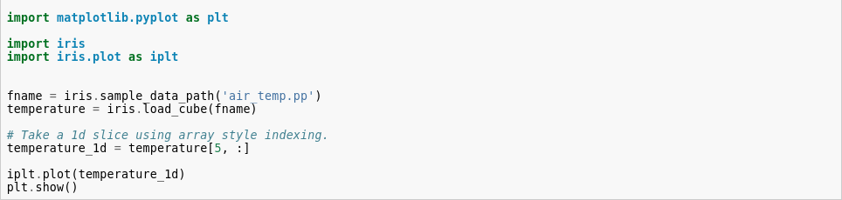
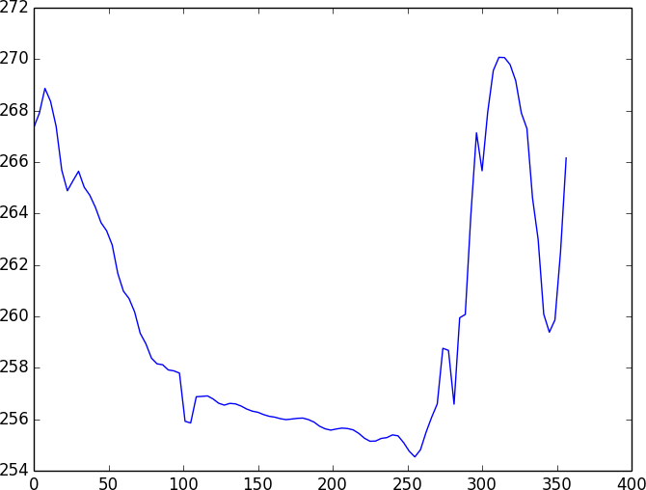
Subsetting a Cube
Plotting 1-dimensional cubes...

Slide 30
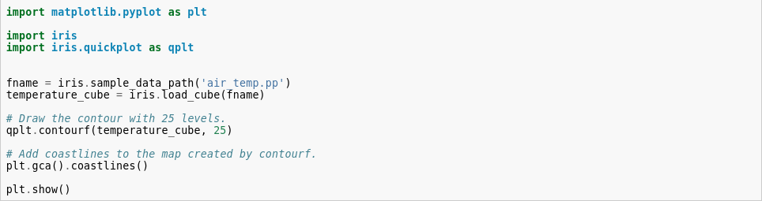
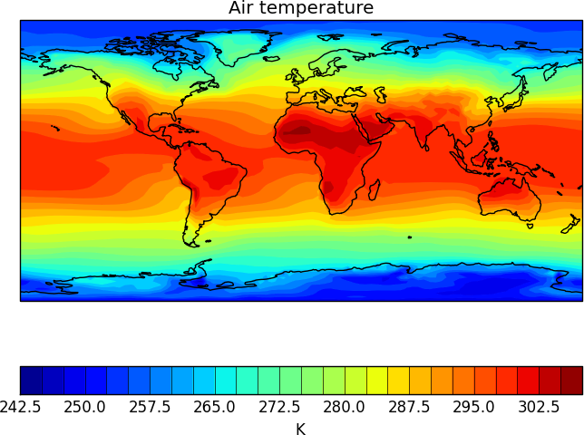
Subsetting a Cube
Plotting 2-dimensional cubes...

Slide 31
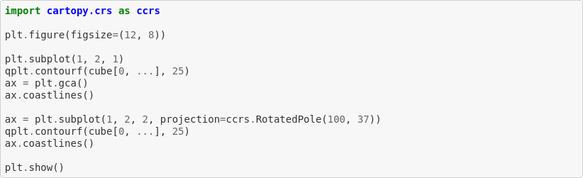
Subsetting a Cube
Plotting 2-dimensional cubes...
When the result of a plot operation is a map
Iris will automatically create an appropriate cartopy axes if one doesn't already exist
We can use matplotlib's gca() to get hold of the automatically created cartopy axes:

Slide 32
Cube interpolation and regridding

Slide 33
Cube interpolation and regridding
An overview...
Iris provides powerful cube-aware interpolation and regridding
Building upon existing interpolation schemes implemented by SciPy
In Iris we refer to the types of interpolation and regridding as schemes
Interpolation Schemes
linear interpolation iris.analysis.Linear
nearest-neighbour interpolation iris.analysis.Nearest
Regridding Schems
Linear regridding iris.analysis.Linear
nearest-neighbour regridding iris.analysis.Nearest
area-weighted regridding iris.analysis.AreaWeighted

Slide 34
Interpolation
The interpolate() method...
The interpolate() method expects two arguments:
The sample points to interpolate
The interpolation scheme to use
Sample points must be defined as an iterable of (coord, value(s)) pairs

Slide 35
Regridding
The cube.regrid() method...
The cube.regrid() method expects two arguments:
Another cube defining the target grid onto which the cube should be regridded
The regridding scheme to use

Slide 36
Merge and Concatenate

Slide 37
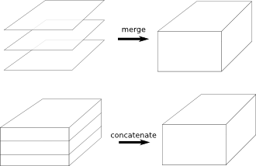
Merge and Concatenate
Putting cubes together...
merge and concatenate
Take multiple cubes as input and result in fewer cubes as output
There is one major difference between the merge and concatenate processes
merge process results in a single cube with new dimensions
concatenate process results in a cube with the same number of dimensions

Slide 38
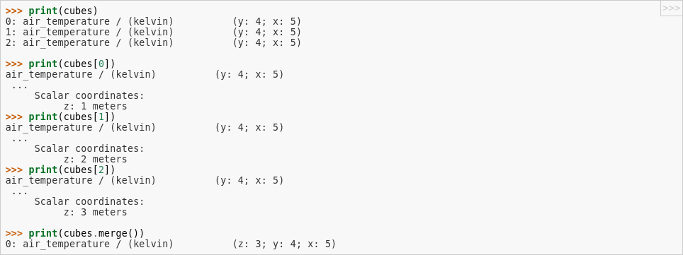
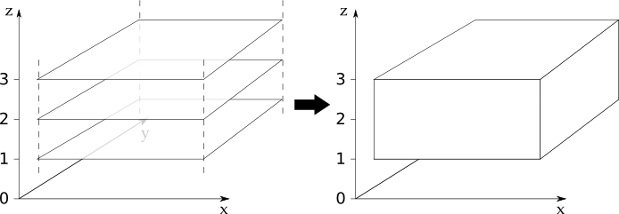
Merge and Concatenate
Merge example...

Slide 39
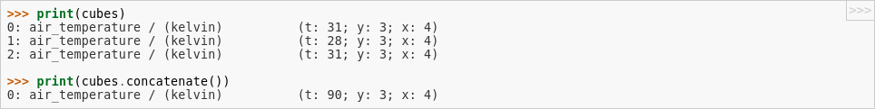
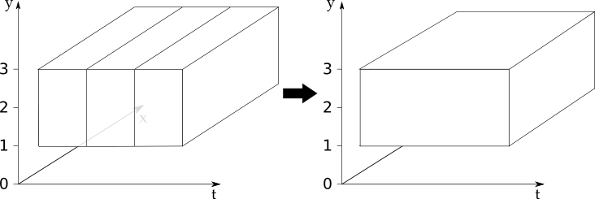
Merge and Concatenate
Concatenate example...

Slide 40
Cube statistics

Slide 41
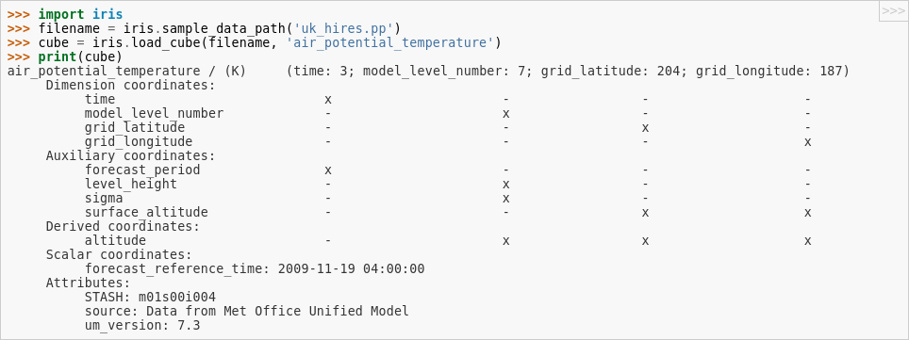
Cube Statistics
Collapsing entire data dimensions...
We can produce statistical functions of the data across a given dimension
Lets use a 4D cube as an example:

Slide 42
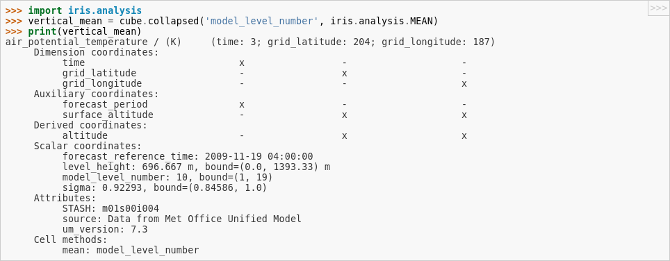
Cube Statistics
Collapsing entire data dimensions...
We can mean the vertical (z) dimension down to a single valued
Analysis operators such as MAX, MIN and STD_DEV can be used instead of MEAN
(see iris.analysis documentation for more...)

Slide 43
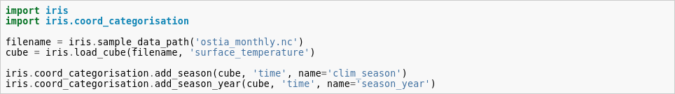
Cube Statistics
Collapsing entire data dimensions...
iris.coord_categorisation module can be used to make ‘categorical’ coordinates out of ordinary ones
e.g aggregate data over regular time intervals -- month or day of the week

Slide 44
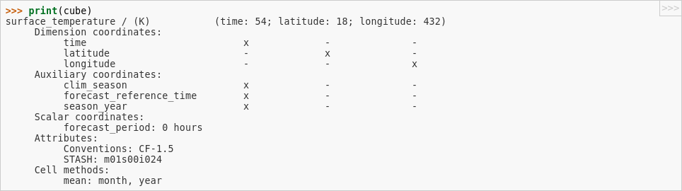
Cube Statistics
Collapsing entire data dimensions...

Slide 45
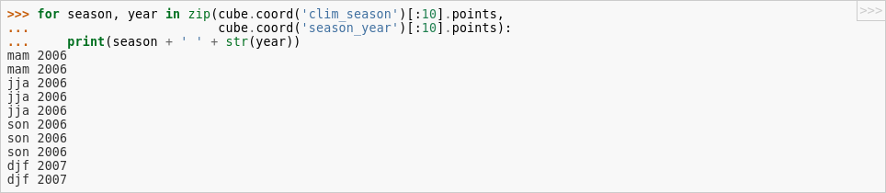
Cube Statistics
Collapsing entire data dimensions...
cube’s data has been reduced in the ‘time’ dimension by aggregation
This has collected together all datapoints with the same values of season and season-year

Slide 46
Basic cube mathematics

Slide 47
Cube Statistics
Collapsing entire data dimensions...
Attribute can then be manipulated directly
e.g by subtracting 273.15 to the temperature in K we get temperature in C
Problem: metadata may become inconsistent
In order to reduce the amount of metadata which becomes inconsistent, fundamental arithmetic operations such as addition, subtraction, division and multiplication can be applied directly to any cube

Slide 48
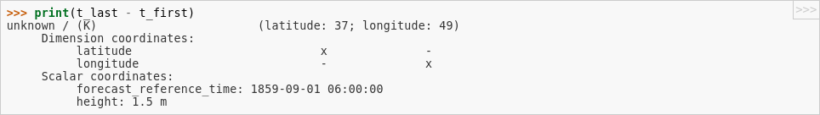
Cube Statistics
Collapsing entire data dimensions...
Example of the subtraction of two cubes
Notice that the coordinates “time” and “forecast_period” have been removed from the resultant cube; this is because these coordinates differed between the two input cubes

Slide 49
More Examples and Exercises
Extra examples and exercises
https://github.com/SciTools/courses/blob/master/course_content/notebooks/iris_intro.ipynb

Slide 50
Useful links
Online documentations ...
Iris Documentation
http://scitools.org.uk/iris/docs/
https://github.com/SciTools/courses

Slide 51

Questions … ?
Coffee ?
20’ break ?

