Slide 1
BoM ACCESS NWP data and tools on NCI
Tan Le
Earth Systems Modelling Program
Bureau of Meteorology
ACCESS User Training Course
Melbourne, 21-24 March 2016

Slide 2
Agenda
BoM ACCESS NWP data
Tools to access and manipulate ACCESS NWP data
Future BoM APS2+ ACCESS NWP data

Slide 3
BoM ACCESS NWP data
ACCESS-G (global), ACCESS-R (Australian region), ACCESS-TC (tropical cyclones), ACCESS-City (Australian States)
Data in GRIB1 format
Started from January 2014
/g/data/rr4/opendap/access-X/0001/yyyymmdd/hhmn/type
X = g, r, tc, ad, bn, dn, ph, sy, vt
type = 4v, an, fc
Require access to rr4 project

Slide 4
BoM ACCESS NWP data naming conventions
pb: sfc
pd: ml 4v an fc
an-3 0 1 2 3 4 5
Assim
pc: pressure levels
Forecast
3,5 4,6 …
pa: sfc pf: ml cloud
pe: ml pg: aviation
pj: hourly precip

Slide 5
ACCESS-G 4v
4v
pX00N : basetime-3 + (1+N)hr fc
X = b : sfc fields, d : ml fields
N = 0, 1
av_netswsfc 211.228 single W/m2 0
av_oswrad_flx 203.228 single W/m2 0
av_swirrtop 216.228 single W/m2 0
av_sfc_sw_dir 115.228 single W/m2 0
av_sfc_sw_dif 047.228 single - 0
av_swsfcdown 214.228 single W/m2 0
av_netlwsfc 212.228 single W/m2 0
av_olr 215.228 single W/m2 0
av_lwsfcdown 213.228 single W/m2 0
…

Slide 6
ACCESS-G an
pX002
X = b : sfc fields, c : pl fields, d : ml fields
zonal_wnd 131.128 multi m/s 0
merid_wnd 132.128 multi m/s 0
air_temp 130.128 multi K 0
spec_hum 133.228 multi kg/kg 0
vertical_wnd 134.228 multi m/s 0
geop_ht 156.128 multi m 0
dewpt 017.228 multi K 0
relhum 157.128 multi % 0
cld_water 246.128 multi kg/kg 0
cld_ice 247.128 multi kg/kg 0
CLWdensity 243.231 multi kg m-3 0

Slide 7
ACCESS-G fc
pXNNN
X = a,b : sfc fields, c : pl fields, d,e : ml fields
f : ml cloud fields, j : hourly precip data
NNN = fc in hours for a, c, e, f, j
(fc-2) for b, d
3 hourly forecast to 243 hours

Slide 8
ACCESS-R 4v/an
4v
pX00N : basetime-3 + (1+N)hr fc
X = b : sfc fields, d : ml fields, g : aviation
N = 0, 1
an
pX002

Slide 9
ACCESS-R fc
pXNNN
X = a,b : sfc fields, c : pl fields, d,e : ml fields
f : ml cloud fields, g: aviation
j : hourly precip data
NNN = (fc-2) in hours for a, b, d, e, f
fc for c, g, j
Hourly forecast to 75 hours

Slide 10
ACCESS-city
Same as access-r but without 4v fields
pb003 : 1hr fc
pb004 : 2hr fc
pa005 : 3hr fc
…
Hourly forecast to 36 hours

Slide 11
BoM ACCESS NWP data
https://accessdev.nci.org.au/trac/wiki/access/opdata_on_nci

Slide 12

ACCESS NWP tools
module use ~access/modules
module load mars
RETRIEVE,
CLASS = od,
STREAM = access-g, source
EXPVER = 1,
TYPE = an,
LEVTYPE = sfc, type
PARAM = msl,
DATE = 20150101/to/20150131, time
TIME = 1200,
TARGET = "/short/dp9/ttl548/msl_201601.grb"
https://accessdev.nci.org.au/trac/wiki/access/mars_on_nci

Slide 13
ACCESS NWP tools
module load cawcr-utils
g2nc input.grb output.nc : convert grib1 to nc
g2nc2 : convert grib2 to netcdf
gprofile : print content of grb1, one msg/line
grib_hdr : print 1st msg in full detail
module load grib-api/1.10.4
https://software.ecmwf.int/wiki/display/GRIB/Home

Slide 14
ACCESS NWP tools
module load nmoc-utils
access_regrid : horizontal/vertical interpolation
grib_subset : select subset of grib file

Slide 15
ACCESS NWP tools
module load cawcr-utils
um2grb : convert um pp to grb1
um2grb2 : convert um pp to grb2
umdump : print content of um pp – field files, obstore, varobs, cx (require module load ncl)

Slide 16
ACCESS NWP tools
xconv
um2netcdf.py
IRIS
CDAT
http://climate-cms.unsw.wikispaces.net/Analysing+UM+outputs

Slide 17
Future APS2+ NWP data
/g/data/lb4/APSN/ops/access-X/0001/yyyymmdd/hhmn/type/levtype
N = 2+
X = g, r, tc, ge, ad, bn, dn, ph, sy, vt
type = 4v, an, fc, cf, em, pf
levtype = sfc, pl, ml

Slide 18
Future APS2+ NWP data
Data in netcdf format, with opendap access
Individual field per file with all levels and fc time steps
Can select subset with opendap or MARS
Require access to lb4 project
Work in progress
http://dap.nci.org.au/thredds/catalog.html

Slide 19
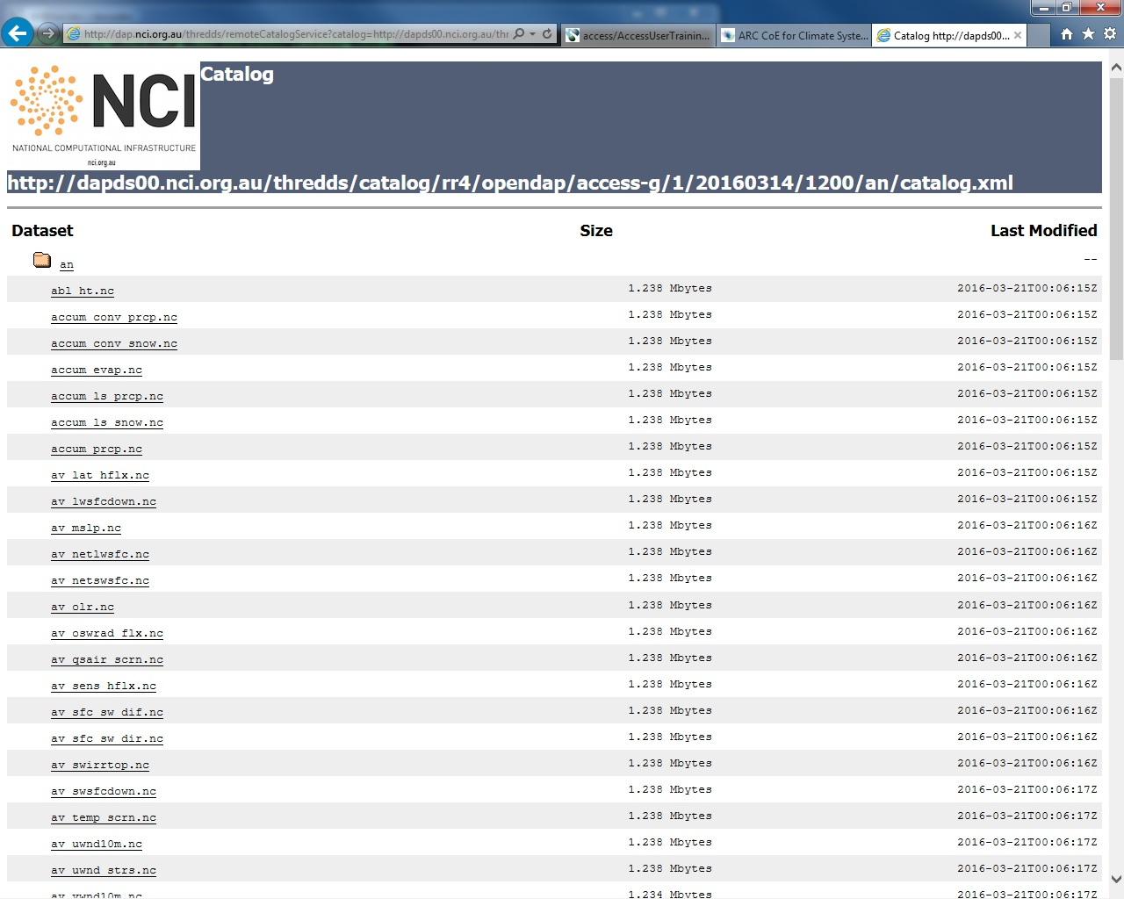

Slide 20
Questions?
ACCESS User Training Course
Melbourne, 21-24 March 2016

