Slide 1
Introduction to Nesting suite
16/03/2016 by João Teixeira (from Stu Webster presentation)

Slide 2
Contents
What we will cover …
Nesting Suite Introduction
Background
Recent Developments
2. Nesting Suite Tour

Slide 3
Nesting Suite Introduction

Slide 4
Background
How did the nested suite was born...
Increasing requirement to setup different domain configurations
– Stu Webster
Alpine drag convergence studies (2005) → Global → 12km → 4km → 1km
Environmental impact of an African mining (2008). → Global → 12km → 4km → 1km → 333m
Wind resource modelling around the UK (2011). Global → 12km → 4km → 1km → 333m → 100m
Handed suite over to be run by non-UM experts – setting up and running needed to be as easy as possible
Todd Lane and Stu Webster (2011) work on hi-res UM simulations of convective gravity waves (CGW) at BoM.
Suite Ported (UM vn7.7) to ACCESS system.
Took 2 months to modify the suite so that it worked for MO and ACCESS.
NIWA (c/o Hilary Oliver) got that suite up and running via emails alone

Slide 5
Background
How did the nested suite was born...
Increasing requirements to setup different domain configurations
– Stu Webster & Chris Short
Chris Short worked on a tropical cyclones project.
Automatically relocatable version of the (ENDGame) vn8.5 suite.
Convective-scale simulations for all TCs present in the global model run
(historical or real time).
Domains built “on the fly”.
Chris was also maintaining the operational Philippines model, which included porting it to ROSE.

Slide 6
Currently
Current developments...
The Nested Suite is in continuous development...
– Stu Webster & Chris Short & Hilary Oliver
More metadata available describing all the options
More user friendly
Hilary Oliver making it more portable different sites

Slide 7
Nested Suite Tour
Options – Setup – Metadata

Slide 8
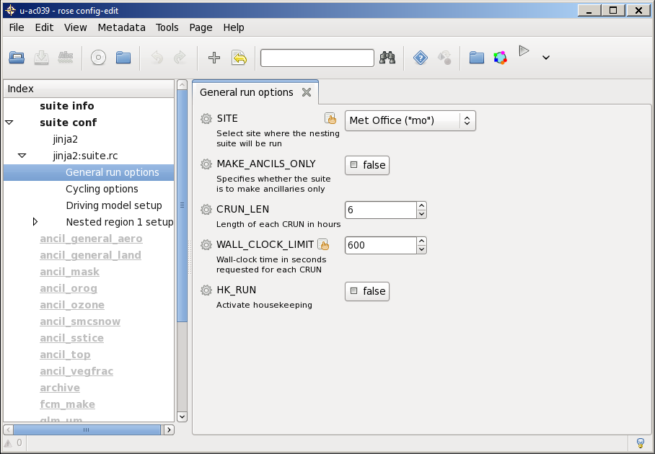
ROSE Suite General Options
Collaborator Site selection

Slide 9
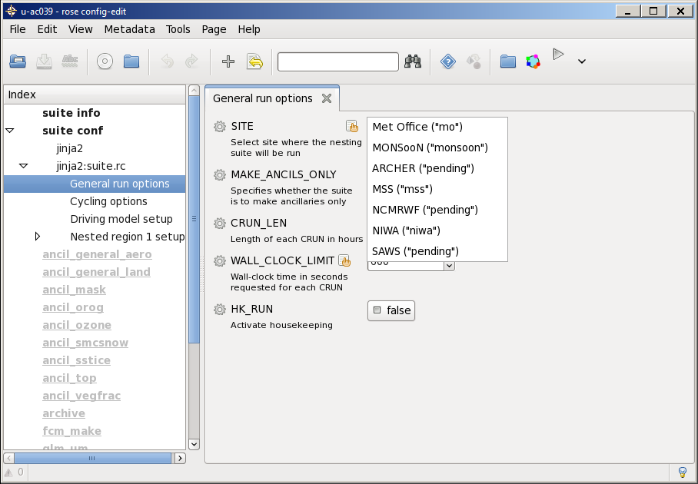
ROSE Suite General Options
Collaborator Site selection
Suite now available at 7 sites
Ported to nci by Scott Wales
User can copy a suite and choose their site from drop down menu

Slide 10
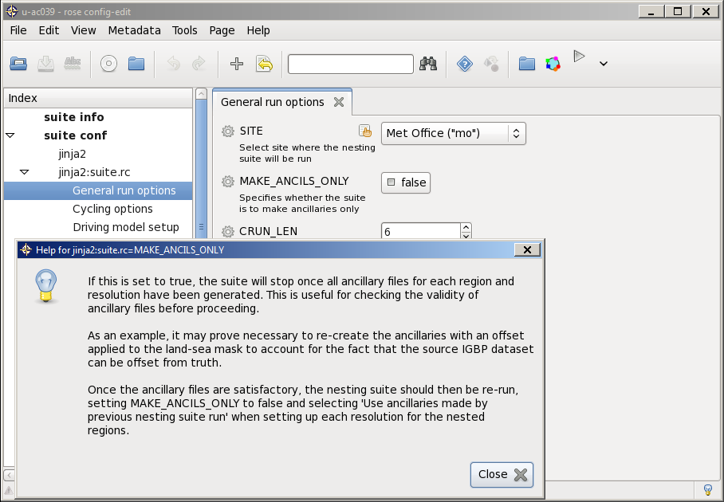
ROSE Suite General Options
GUI Help Example
metadata as been written for most options
You will find help by clicking the cog wheel

Slide 11
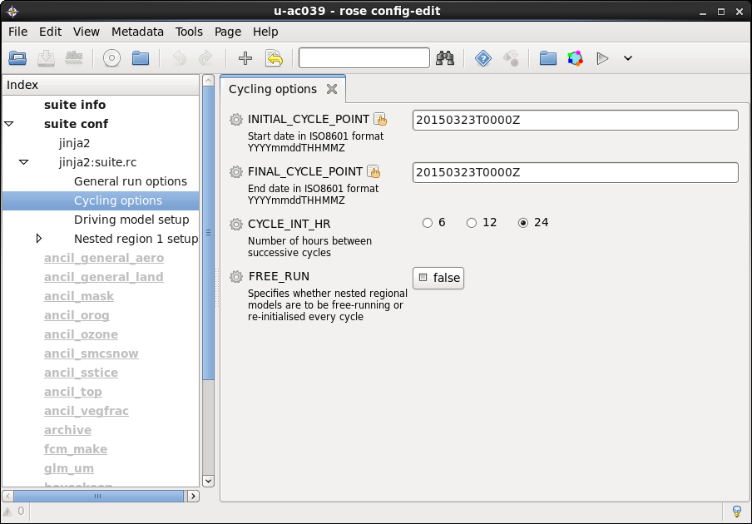
ROSE Cycling Options
Defining the initialisation time(s)
Cycling Options
Loop over analysis time (top 3 entries)
Free Run
Allows LAMS to be run for extendend periods with LBCs being provided by reinitialised driving model (to keep LBCs close to reality)

Slide 12
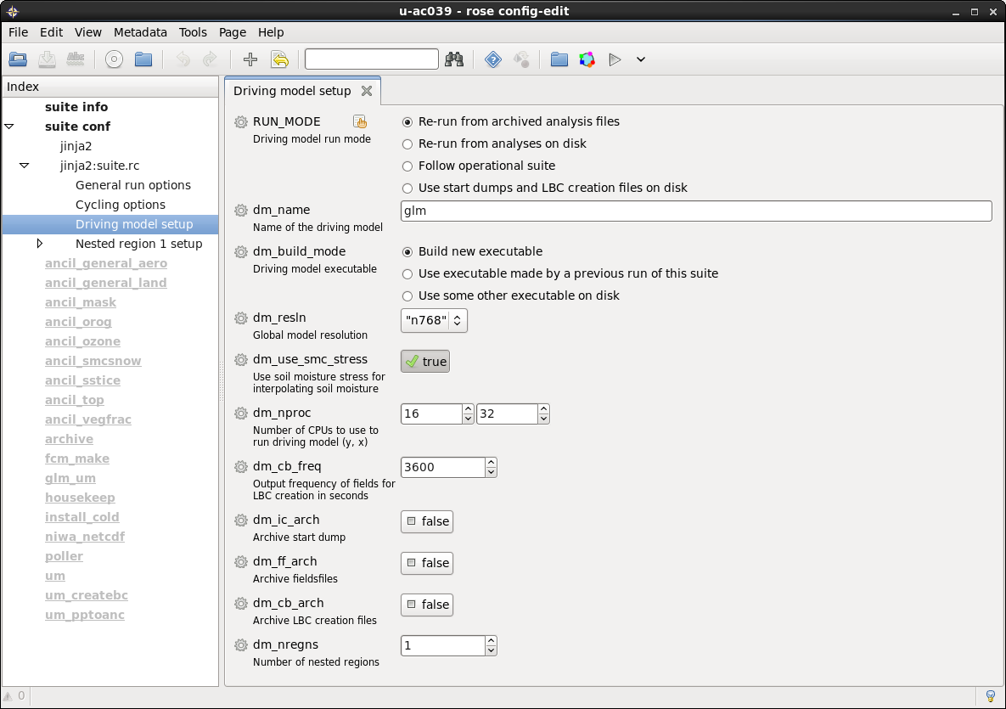
Driving model
Re-run from archived analysis files.
Driving Model Options
Some options are Met Office specific
Rerun from operational archive
Auto retrives operational analysis for current CYCLE

Slide 13
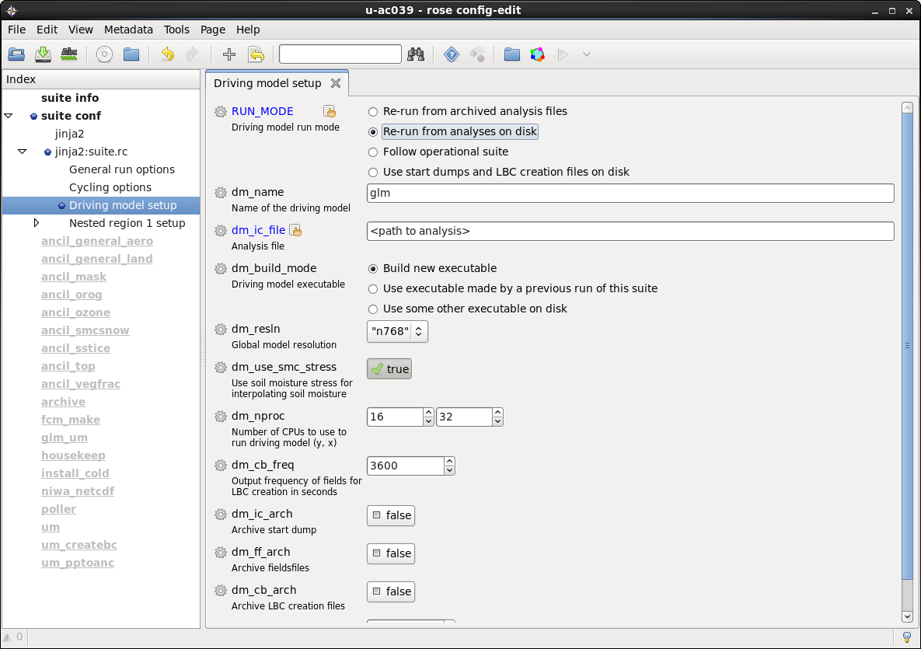
Driving model
Re-run from analyses on disk
Usual mode for any site
Specify full path to analysis
Can run from ECMWF grib data
Currently experimental
Different soil model in ECMWF model means that need to configure in a UM soil moisture analysis otherwise soils are too wet.

Slide 14
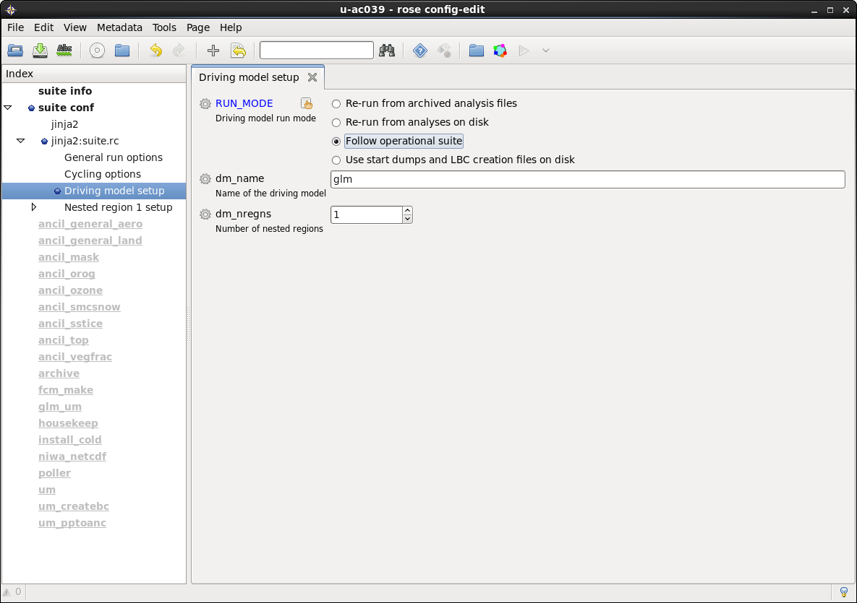
Driving model
Follow operational suite
Run as real time downscaler.
Only working for MO global currently.
will be easy to add operational UKV as an option
Other sites could easily point at:
their own global model output
or their MO global cut-out and frames.

Slide 15
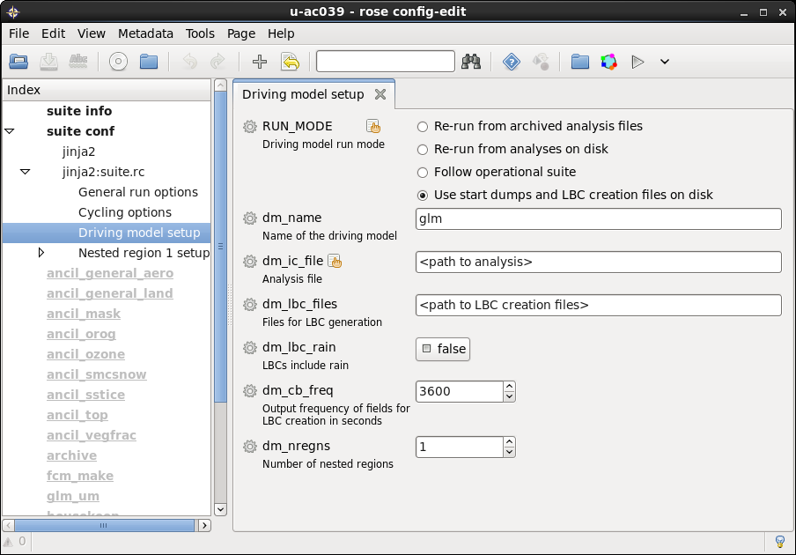
Driving model
Use start dumps and LBC creation files on disk.
Use files from a previous driving model run.
Could be a previous nesting suite global model or LAM run.
Could be files from any LAM model, which output appropriate files.
e.g. UKV

Slide 16
Driving model
Choosing the driving model configuration
glm to be replaced by options of ga6 and ga7.
Also could add in other pre-specified LAM domains here
i.e. this is how UKV case studies could be run in this suite

Slide 17
Driving model
Choosing the driving global model resolution
Drop down menu for resolutions from N768 down to N96.

Slide 18
Driving model
Getting the soil moisture reconfiguration right.
Switch to ensure soil moisture is reconfigured correctly for a given resolution. Needed because of issues with reconfiguration code.
Code issues have been fixed in UM vn10.4.
An example of why picking up the most recent version of the suite is always a good idea.

Slide 19
Driving model
Defining the number of nested regions
Default number of regions is 1.
User can increase this by running script “bin/setup_metadata X Y Z”
X is number of regions
Y is number of resolutions
Z is number of configurations
So its trivial to set up the suite for numerous sites

Slide 20
Driving model
Defining the number of nested regions
Default number of regions is 1.
Setting to zero is allowed, i.e. the suite then just runs the driving model.
Suite already used in this way for GA6 orographic drag horizontal resolution sensitivity study.
Would also do this when using the suite to run a pre-defined LAM.
e.g. UKV

Slide 21
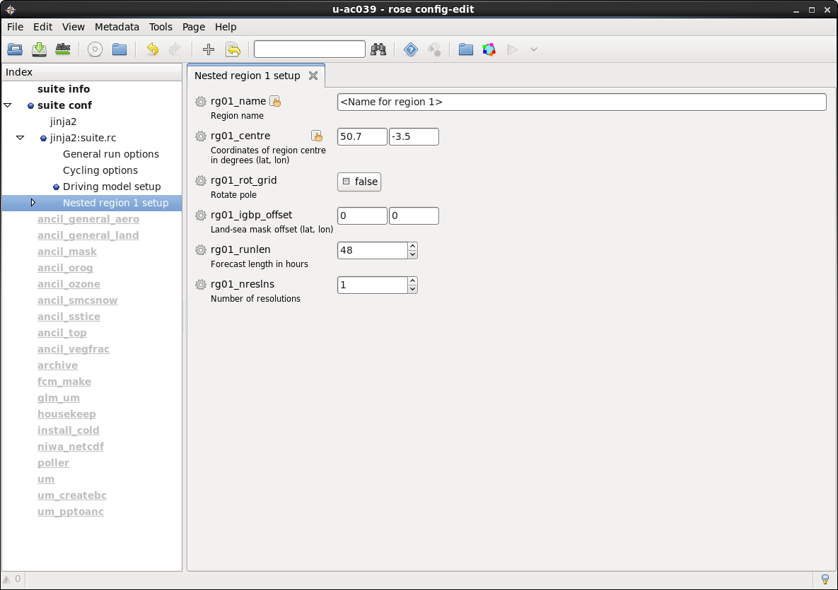
Defining the LAM region
Defining the domain(s) centre
Choose point to centre domain on
Choose whether to use true lat/lon grid or rotated pole grid.

Slide 22
Defining the LAM region
Coping (!) with the Central Ancillary Programme
Needed to counter issue with Central Ancillary Programme processing of IGBP dataset, which leads to 0-5km displacement of data relative to coastlines.
Use of CCI dataset will lead to retirement of this offset parameter.
Planned to bevailable on 1-2 year timescale

Slide 23
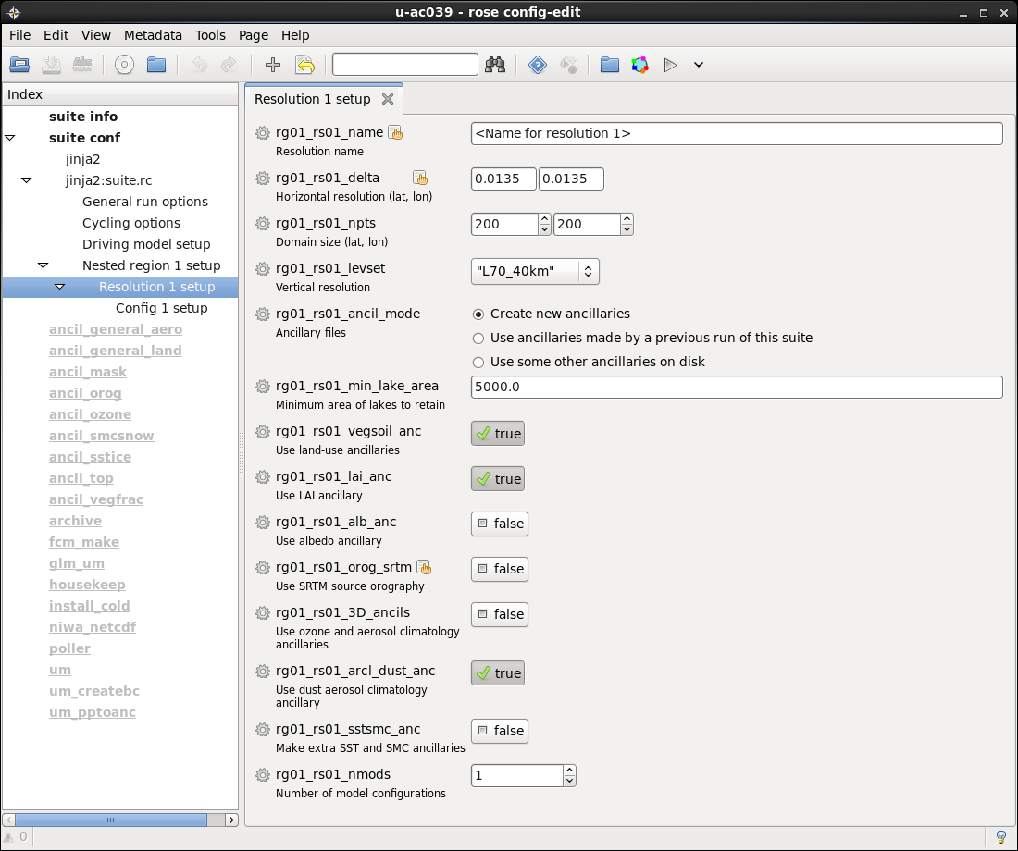
LAM resolution window
Specifying the resolution and mesh size
Specify mesh size and number of gridpoints
model is centred on point specified in previous window

Slide 24
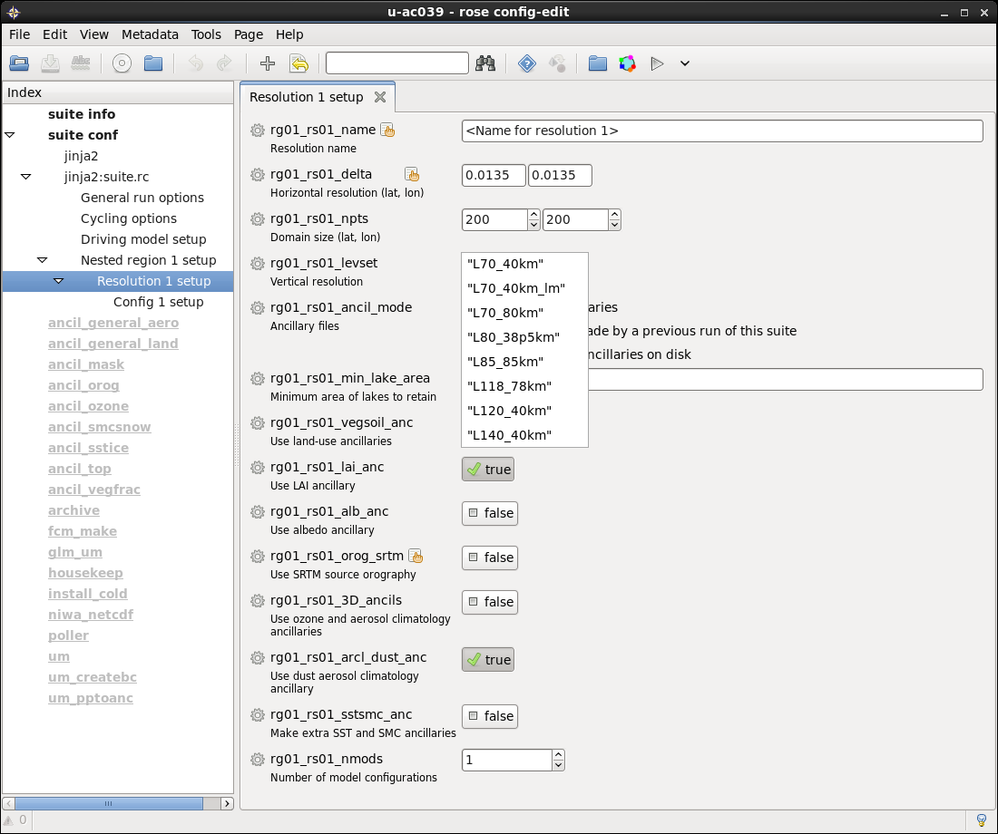
LAM resolution window
Choosing a vertical levels set
Choose levels set from drop down menu

Slide 25
LAM resolution window
Choosing a vertical levels set
Choose levels set from drop down menu
Critical relative humidity profile set as part of level choice
“How to” is available to change the RHcrit profile - this needs adding to the documentation.

Slide 26
LAM resolution window
Coping with both the CAP and the reconfiguration
Land sea mask (LSM) related variable.
Use to eliminate sea point “small” lakes by the CAP
otherwise require the reconfiguration to go in search of the nearest sea point to determine the lake surface temperature.
Search is usually time consuming and so reconfiguration can run out of wall clock time.
e.g. MO queue time limit is 3 hours.
5000 km² appears to work well most of the time.
Point treated as land point (inland water)
BUT domain edge is assumed by CAP to be land...

Slide 27
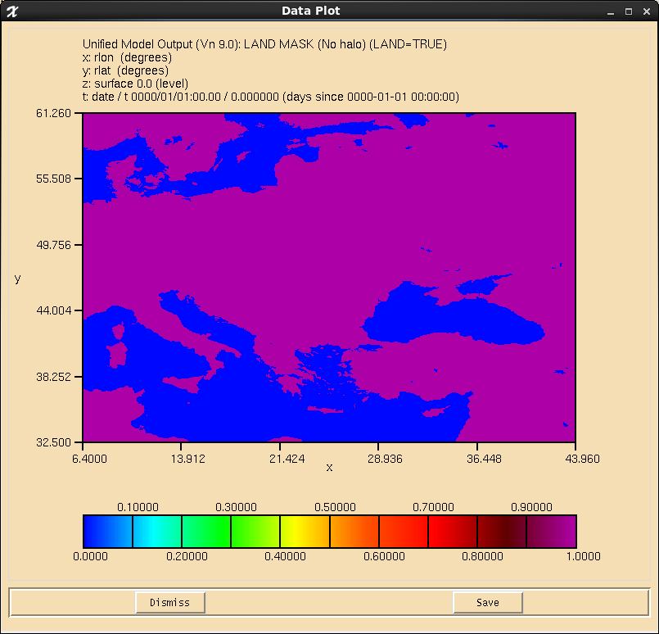
Impact of min lake area
100 km²

Slide 28

Impact of min lake area
1,000 km²

Slide 29

Impact of min lake area
5,000 km²

Slide 30
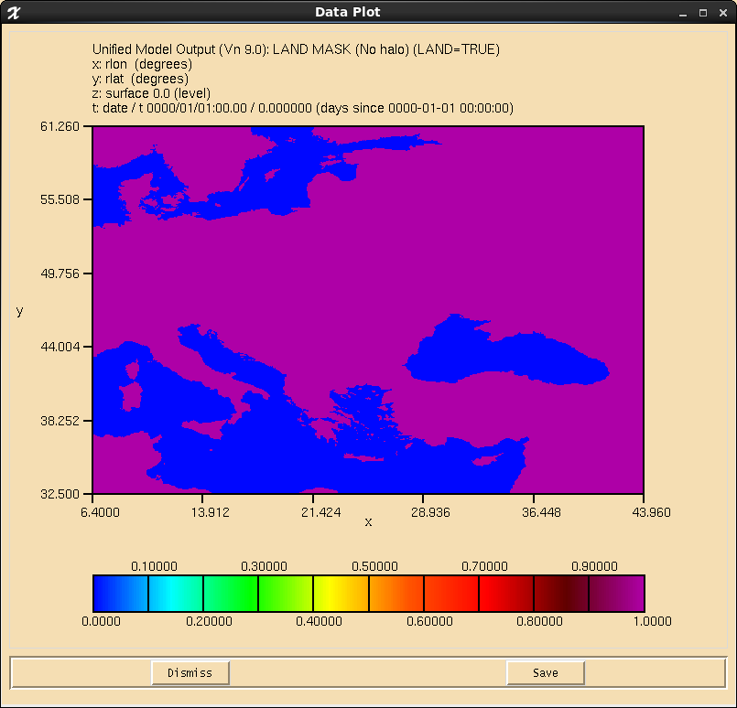
Impact of min lake area
50,000 km²

Slide 31
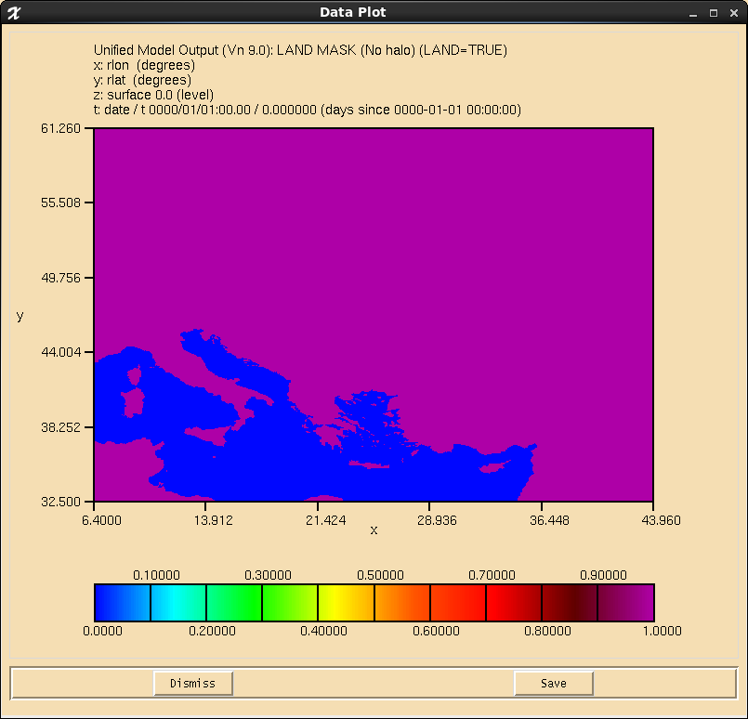
Impact of min lake area
500,000 km²

Slide 32
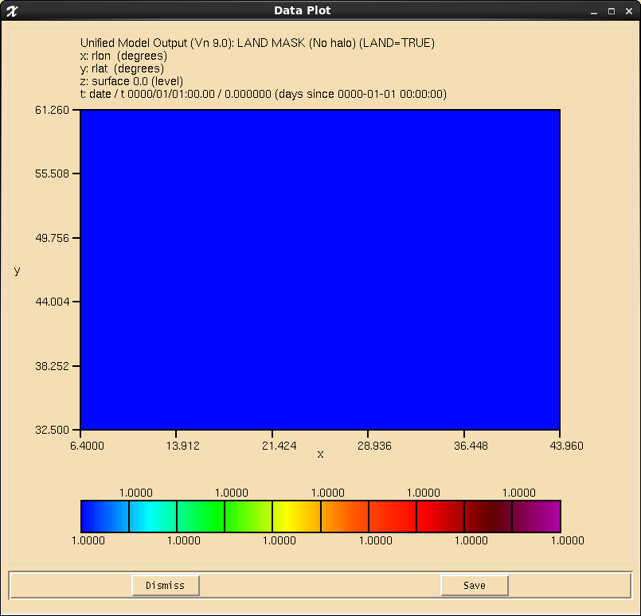

Impact of min lake area
5,000,000 km²
Domain is all “land”, with lakes being lake tiles.
Quirk/feature of the CAP means that true sea points are defined as bare soil points

Slide 33
LAM resolution window
Coping with both the CAP and the reconfiguration
IMPORTANTE
check your LSM, especially when on very small domains, e.g. When down at 100 m resolution.

Slide 34
LAM resolution window
Use 100 m resolution SRTM orography dataset
Uses 100 m SRTM dataset instead of 1km for orography
Uses IDL code – so IDL licence required
And also requires Met Office IDL libraries

Slide 35
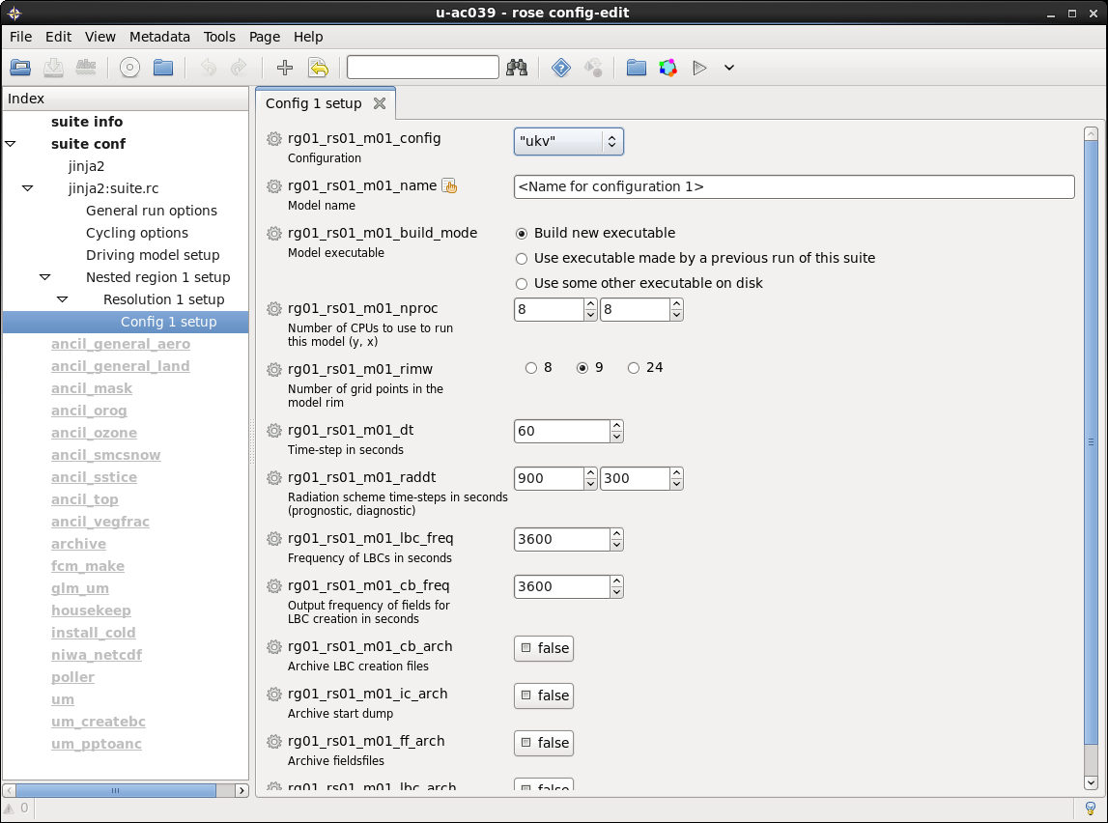
Defining the model configuration
Choosing the science configuration
Choose a Science Configuration from:
ukv – Suitable for mid-latitudes (default)
eur – Suitable for mid-latitudes
singv – Suitable for tropical regions
ga6 – Global model configuration

Slide 36
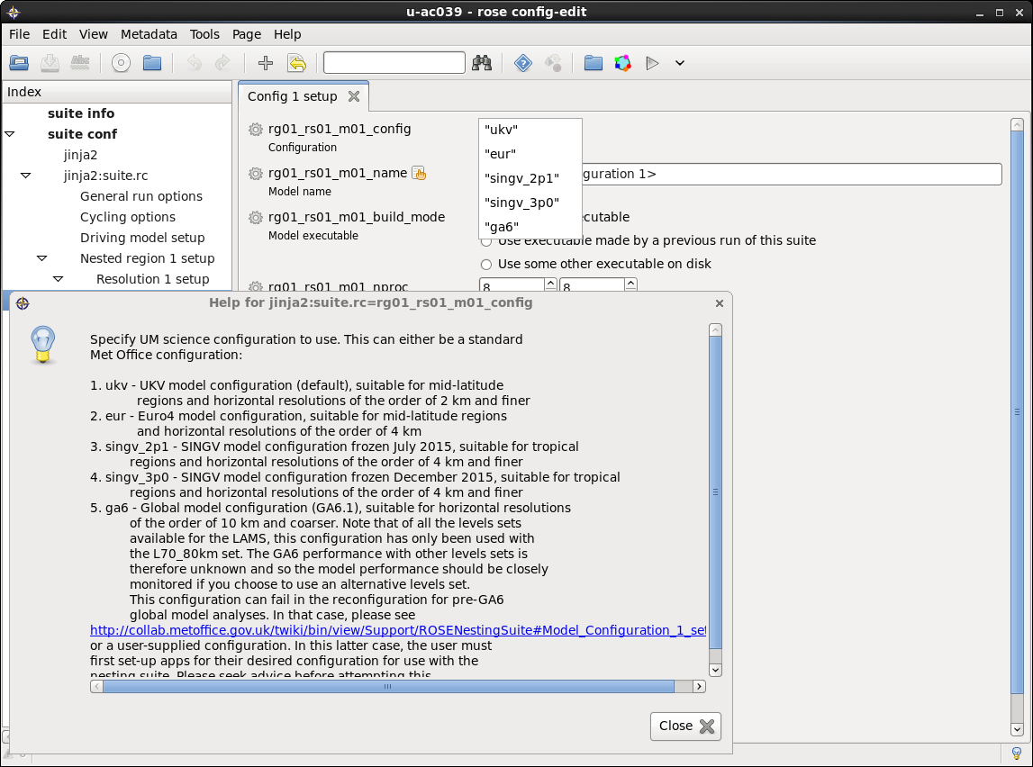
Defining the model configuration
Choosing the science configuration
Choose the configuration from the drop down menu
Click on the variable name to get the help panel to the left.

Slide 37
Defining the model configuration
Choosing the science configuration
Option available to run a global model science configuration LAM.
so suite is not restricted to the convective-scale.

Slide 38
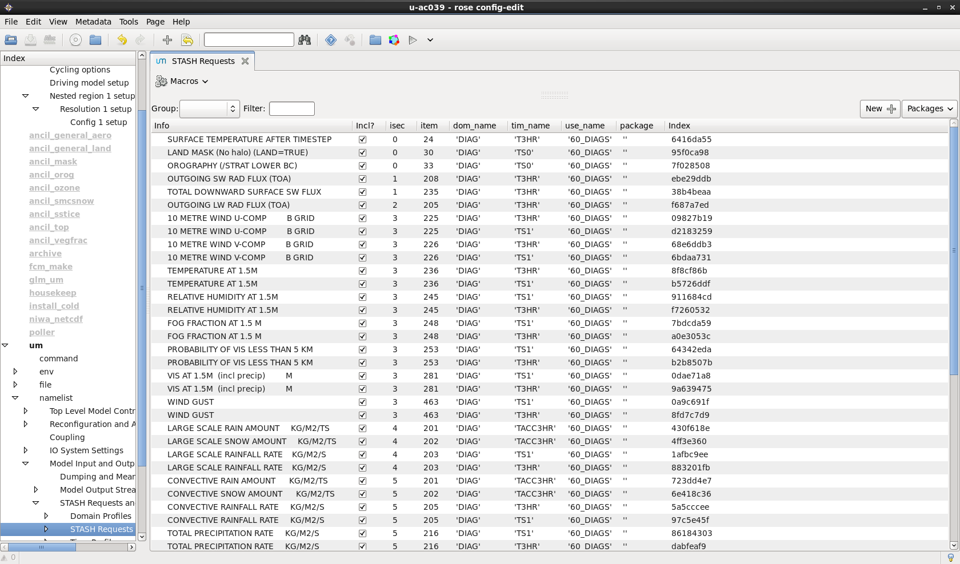
Updating LAM diagnostics
Click on um to load up the LAM namelists and then change diagnostics (STASH).
Same app is used for all LAMs.
Issue of sub-hourly diagnostics needing to be specified in timesteps.
means that get different output interval when run with multiple timesteps (e.g. for different resolutions).
finally resolved at UM vn10.4, since interval between diagnostics can now be requested in minutes + seconds!

Slide 39
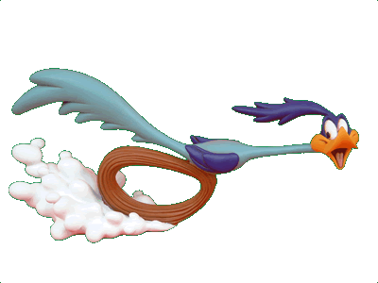
Running the Nested Suite
How do you run it?
All set – Just need to type rose suite-run

Slide 40
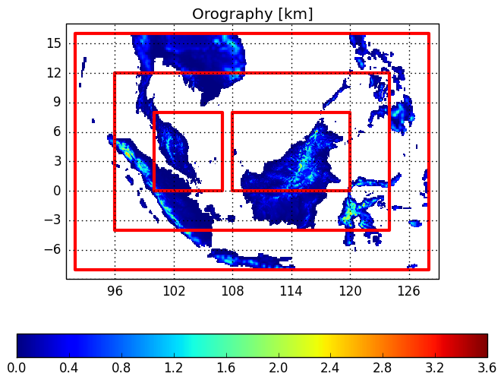
Example
Newton Funded Malaysia project
36 hour forecasts initialised every 6 hours through period 17/12/14 to 6/1/15
12 km
GL→ 12 → 4.4 →1.5
GL → 12 → 1.5
GL → 4.4 → 1.5
GL → 1.5
4.4 km
1.5 km
1.5 km
Off-centering option added to this suite to enable pair of 1.5 km models

Slide 41
Useful links
Online documentations ...
UM Nested Suite Documentation
http://collab.metoffice.gov.uk/twiki/bin/view/Support/ROSENestingSuite
http://collab.metoffice.gov.uk/twiki/bin/view/Support/ROSENestingSuiteLSMIssues
Latest Suite
https://code.metoffice.gov.uk/trac/roses-u/browser/a/a/7/5/3/trunk

Slide 42

Questions … ?
Coffee ?
20’ break ?

