Slide 1
Rose & Cylc
Rose suites
09/02/2016 by Joao Teixeira

Slide 2
Contents
What we’ll cover …
Overview of Rose and Cylc
What’s Rose ?
What’s Cylc ?
Hands on!!!
Metadata configuration
Introduction
Creating Metadata
Hands on!!!
Cylc in Rose
Introduction
Cylc controls
Hands on!!!
Q & A

Slide 3
Overview of Rose & Cylc
What is this?

Slide 4
What’s Rose?
What does Rose look like?
Rose is a group of utilities
provides a common way to
manage development
run software
Research
Production
It can be used for (almost) anything
It is not specific to any type of:
Language
Application
etc...
Uses human readable and writable file formats
Rosie – system for managing suites

Slide 5
What’s Cylc?
What does Cylc look like ?
workflow engine and meta-scheduler
specialises in continuous workflows of cycling tasks
It can be used for non-cycling tasks
Scheduler used by Rose to control tasks
Configured via a suite.rc file that lives in the top directory of a Rose suite
Clever algorithm for deciding when applications are ready to run

Slide 6
Rose Application
What is a Rose Application Configuration?
An app config:
Can define how to run a scientific model
Describes how to run a command
(executable or script to call, environment variables, input files)
Not tied to a version of the model or a GUI
Simple to process and run
Simple to:
edit
compare
review

Slide 7
Rose Application
What is a Rose Application Configuration?
xx-aa000
|---- app/
| |
| |---- um/
| | |----- rose-app.conf
| | |
| | |
| | |
| | |
| | |
| | |----- bin/
| | |----- meta/
| | |----- opt/
Configuring which:
Executable to run
Environment
Input files (e.g. Namelists)
May not be present

Slide 8
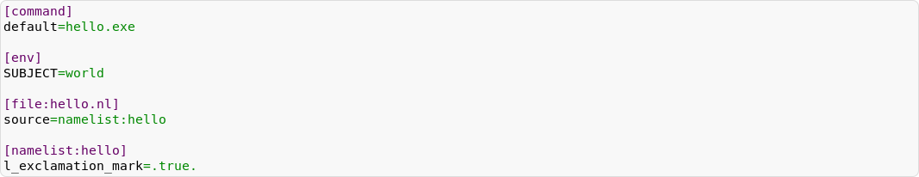
Rose Application
What is a Rose Application Configuration?
example of a rose-app.conf file:
When Rose runs the app, it creates a file hello.nl that looks like this:
and runs hello.exe with the environment variable SUBJECT set to world

Slide 9
Rose Application
App configs can have metadata
Metadata is:
a way of providing information about app config inputs
used to drive the rose edit GUI for editing app configs
(not part of the GUI itself)
a simple specification defined in a similar format to the app config.
Metadata sometimes lives in the meta/ directory of an app config, but more often in a shared central location

Slide 10

Rose
A Brief Tour
Lets get “hands on” with Rose
http://metomi.github.io/rose/doc/rose-rug-brief-tour.html
Notes:
Go trough the practical with them

Slide 11
Configuration Metadata
information about settings in Rose configurations

Slide 12
Rose Metadata
Introduction
Metadata is used to provide information :
Help document your inputs
Perform automatic checking
(including whether an input is needed)
Enhance the interface to your configurations
(e.g. the Rose config editor)

Slide 13
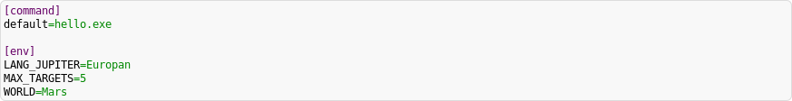
Rose Metadata
Creating metadata
Lets use the Rose example suite our hands on:
We are going to develop metadata for the app my_hello_mars
Change directory to the suite app/my_hello_mars/
The rose-app.conf file contains the following:
This configuration will run hello.exe with some environment variables set up: MAX_TARGETS, LANG_JUPITER, and WORLD

Slide 14
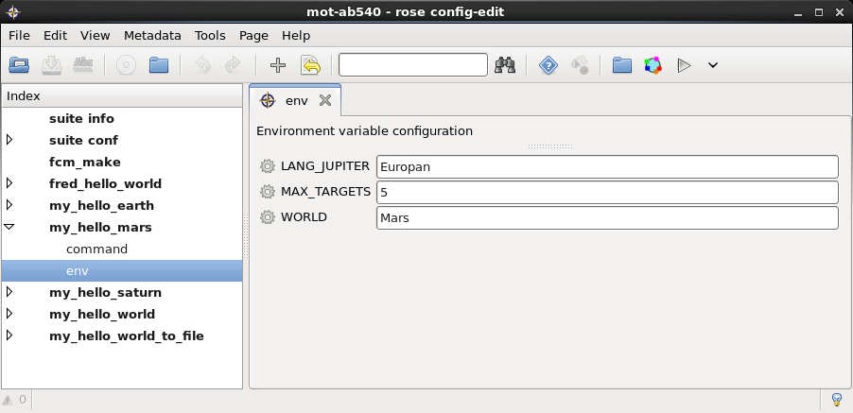
Rose Metadata
Creating metadata
Compare the text in the rose-app.conf with the one in the Rose GUI

Slide 15

Rose Metadata
Let’s create the metadata
... for a variable called MAX_TARGETS:
We can specify that it's an integer by giving it a type:
We could also improve the way it's displayed by giving it a title:
We can restrict the number using a range:

Slide 16
Rose Metadata
rose metadata-check
rose metadata-check checks the syntax errors in the metadata
Automatically run when the rose editor loads
Can be run from the command line in a metadata directory
Try setting an invalid entry in the metadata e.g.:
What happens in the GUI?

Slide 17
Rose Metadata
Reference to metadata location...
Metadata for rose-suite.conf and rose-app.conf settings
can be referenced by the meta flag
You can store metadata in other locations
--meta-path=PATH option
ROSE_META_PATH environment variable
meta-path setting in user configurations
Usually references centrally-stored metadata

Slide 18
Rose Metadata
Advanced Configuration Metadata
Metadata supports logical expression syntax, e.g:
Range
Trigger
Warn-if
Syntax is a subset of Python with extra metadata functionality
You can use standard Python operators
Notes:
The syntax is a subset of Python with some extra metadata functionality - you can use standard Python operators e.g.:(foo * bar + baz) / wibble >= wobble - flob ** quxor"spam" in foo and not bar or (baz and 5 < wibble <= wobble)Where you would normally use a variable name, use an id to refer to the value of a setting (e.g. namelist:run_snow=max_ok_ice_fraction) or use this as a shorthand for the id of this setting.The syntax also has array element support via bracketed indices (e.g. this(2) or namelist:run_snow=monthly_snowfall(12)).There are any and all functions (e.g. any(namelist:run_snow=monthly_snowfall > 10)).

Slide 19
Rose Metadata
Advanced Configuration Metadata
Other useful configuration options are available :
compulsory
Setting it to true means that the section should always be in the configuration
duplicate
Allow duplicated copies of the setting
sort-key
Used to order and group pages and variables in the config editor
value-titles
Allows you to set a title to display for each of the values
macro
Used to associate a setting with a set of custom macros

Slide 20
More about Metadata
Advanced exercises...
More examples of metadata:
http://metomi.github.io/rose/doc/rose-rug-metadata-tutorial.html
http://metomi.github.io/rose/doc/rose.html#advanced
UM Metadata (all version)
https://code.metoffice.gov.uk/svn/um/main/trunk/rose-meta/um-atmos/

Slide 21
Cylc in Rose
The scheduler

Slide 22

Cylc
Suite engine that drives task submission and monitoring
Originally developed by Hilary Oliver at NIWA
Developed to provide a fast, automated way of scheduling tasks so that a suite can catch up after outages
Currently
Acollaborative effort, involving the Met Office
Written in Python and uses PyGTK for its GUIs
It is open source and licensed under GPL v3
Lives on github
Notes:
The syntax is a subset of Python with some extra metadata functionality - you can use standard Python operators e.g.:(foo * bar + baz) / wibble >= wobble - flob ** quxor"spam" in foo and not bar or (baz and 5 < wibble <= wobble)Where you would normally use a variable name, use an id to refer to the value of a setting (e.g. namelist:run_snow=max_ok_ice_fraction) or use this as a shorthand for the id of this setting.The syntax also has array element support via bracketed indices (e.g. this(2) or namelist:run_snow=monthly_snowfall(12)).There are any and all functions (e.g. any(namelist:run_snow=monthly_snowfall > 10)).

Slide 23
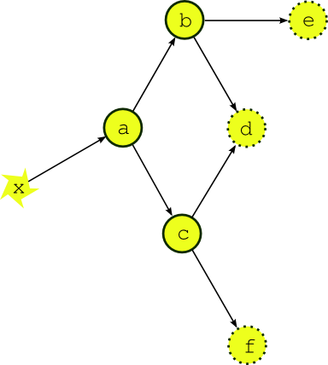
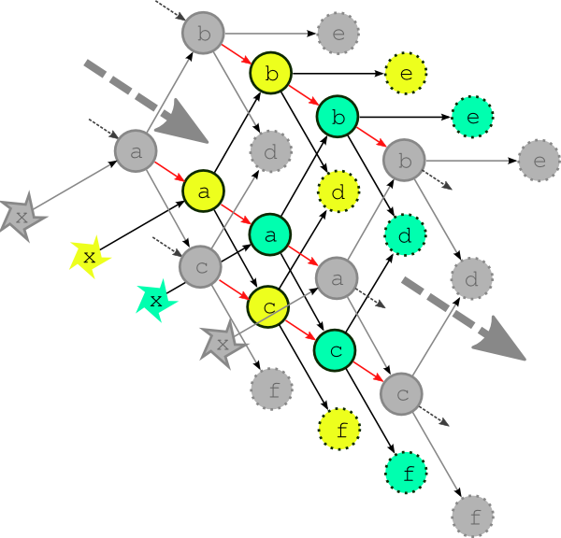
Cylc
Scheduling Algorithm
Scheduling - making sure tasks run in the correct order, at the correct time
Every task has input and output dependencies
Each task checks the others to see if its inputs are satisfied - if so, it runs

Slide 24
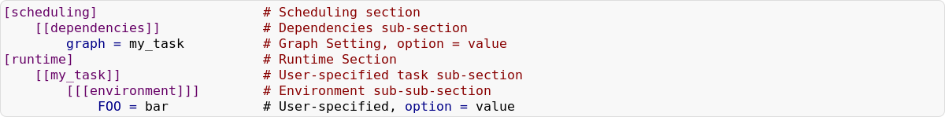
Cylc
The suite.rc File
Cylc has a single file to configure the suite, the suite.rc file
It configures:
Task dependencies, including times and dates
Task environment
Task scripting
Uses a nested INI-based configuration format that looks like this:

Slide 25
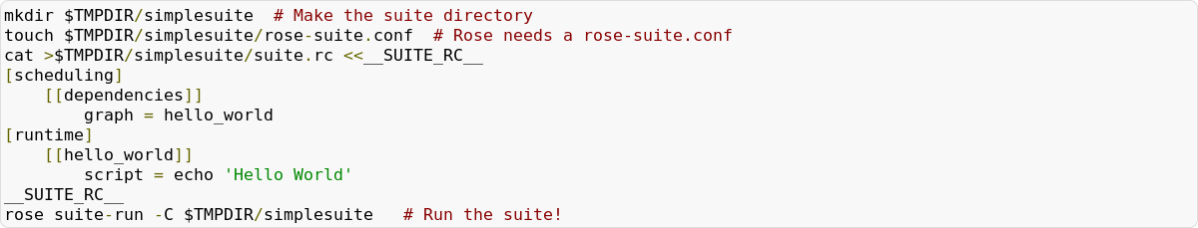

Cylc
Hands on...
Let’s create something simple...
The suite will run and then shutdown when all tasks are successful
in this case, the only task is hello_world
Output will be in our cylc-run directory
access it by running rose suite-log --name=simplesuite
Notes:
Tasks such as our hello_world task above are generic - they can be Rose applications, or commands or executables as above.

Slide 26
Cylc
Invoke a Rose application
What if we wanted to invoke a Rose application
make an app called hello_world
making an app/hello_world/ directory
creating a rose-app.conf file in there
Set the command in rose-app.conf file
We would then have to change the [runtime] section – pointing it to the rose task

Slide 27


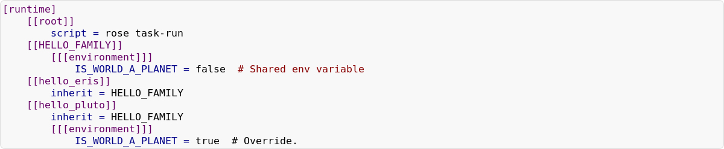
Cylc
Families
Families define shared configuration
Can be used to reduce duplication between tasks
Possible to override family settings
Multiple inheritance
Can be used to help write the dependencies
e.g. to set up a task so that it runs when all the tasks in a family succeed

Slide 28
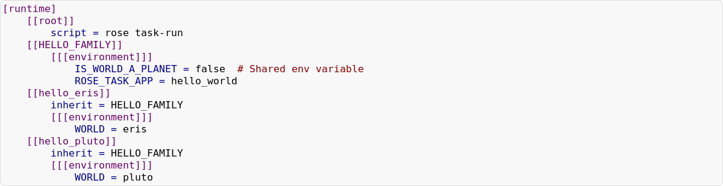
Cylc
Sharing Applications
If we don't really need two Rose apps (app/hello_eris/ and app/hello_pluto/)
We can create two tasks that share a single family
Reference to single application, app/hello_world/ using ROSE_TASK_APP
Notes:
In the last example, if we don't really need two Rose applications, (app/hello_eris/ and app/hello_pluto/) we can create two tasks that share a single application, with some override settings - in this example, a WORLD environment variable.We can reference our single application, app/hello_world/ by using ROSE_TASK_APP. rose task-run will read this environment variable value and use it to run the Rose app. We will put the override setting (WORLD) in the suite.rc file.

Slide 29
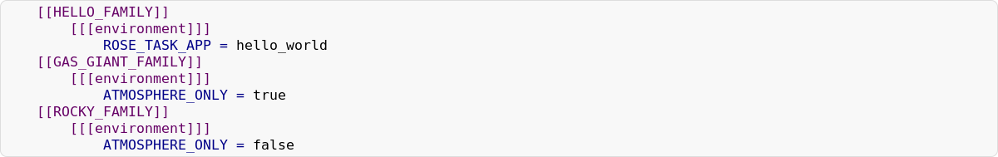
Cylc
Multiple Family Inheritance
cylc supports multiple inheritance
Tasks can combine the configuration from more than one family
can be inherit them like this:

Slide 30
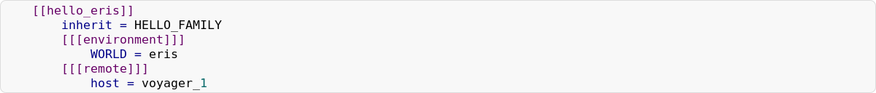
Cylc
Remote Hosts
The example tasks run on the localhost
tasks can be run on a remote host
(e.g. compute server or a cluster/ supercomputer)
We can set hello_eris to run on a given host by setting [[[remote]]] section settings:
The order in which they are combined is essentially last to first
e.g. HELLO_FAMILY will override any shared setting in GAS_GIANT_FAMILY
Notes:
So far, the example tasks run on the localhost - it is usually better to farm off tasks to a remote host like a compute server or a cluster/supercomputer.We could set hello_eris to run on a given host by setting [[[remote]]] section settings:
The order in which they are combined is essentially last to first - e.g. HELLO_FAMILY will override any shared setting in GAS_GIANT_FAMILY.

Slide 31
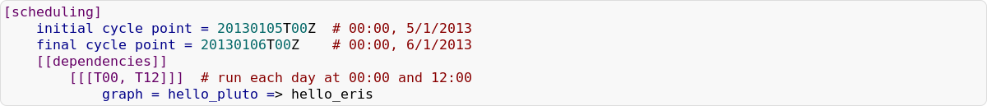
Cylc
Dependencies and scheduling
The [scheduling] part of the suite.rc
Let's say hello_pluto must run and succeed before hello_eris
We can put this in our suite.rc:
Cycling Dependencies
We can make this run as a cycling suite, repeating every 12 hours:

Slide 32
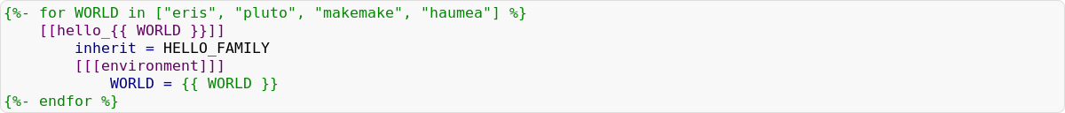
Jinja2
templating language
cylc uses a templating language called Jinja2
Can be used to:
collapse duplicated portions of configuration
Insert settings
Useful when you have a lot of repetition (e.g. in an ensemble context)
You can use if and for blocks, amongst other things:

Slide 33
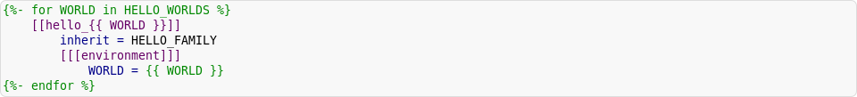
Rose – Cylc – Jinja2
centralise commonly-used settings
You can use Jinja2 to centralise commonly-used settings.
Rose supports storing these in the rose-suite.conf file - e.g.
Rose passes variables in this section into the Jinja2 template at runtime.
This means that we can have a suite.rc snippet that looks like this:
It's useful to keep commonly-changed variables in the rose-suite.conf file, so users don't have to modify the suite.rc itself.

Slide 34
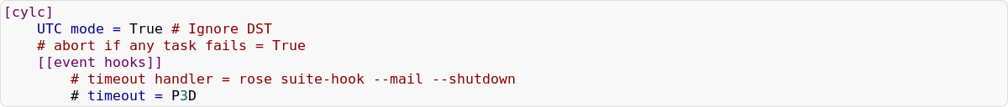
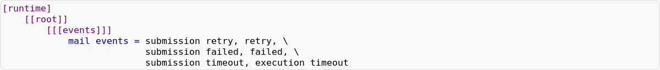
Cylc
Event Hooks and UTC mode
Suites can have event handlers to report events or shutdown on failure
It is recommend running all suites in UTC mode
If abort if any task fails = True is not commented, the suite will abort when a task fails
Suites can also be configured to email you on specific events
Notes:
When a task fails, the suite will continue to run as much as possible and wait for user input to fix the failure so it can continue
If abort if any task fails = True is not commented out, the suite will abort as soon as a task fails
The events should be adjusted if necessary - for example, increasing the timeout lengths or altering the events that require email notification.

Slide 35
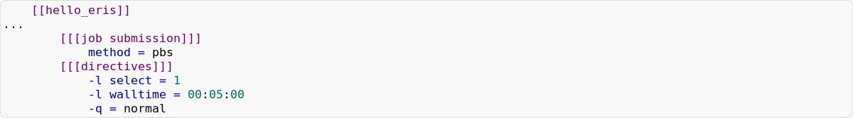
Cylc
Job Submission
Example of a job submission method, such as using PBS
The job submission method may need configuration via directives:
cylc supports the following job submission methods (and more):
at
background (default)
Loadleveler
pbs (Portable Batch System)
sge (Sun Oracle Grid Engine)
slurm (not the fictional soft drink)
lsf
...

Slide 36
Building a Suite
Practical
Let’s get “hands on” with Rose and Cylc
http://metomi.github.io/rose/doc/rose-rug-suite-writing-tutorial.html

Slide 37
Useful links
Online tutorials and documentations ...
Rose
https://github.com/metomi/rose
http://metomi.github.io/rose/doc/rose.html
Cylc
https://github.com/cylc/cylc
http://cylc.github.io/cylc
FCM
http://metomi.github.io/fcm/doc/user_guide
MOSRS
https://code.metoffice.gov.uk
roses-u https://code.metoffice.gov.uk/trac/roses-u

Slide 38
Questions … ?

