Slide 1
SMOCS Statistical Model Output Collection System
Purpose
Monitor model output
Is something outside normal parameters?
Compare model upgrades
What’s changed (in a statistical sense)
Scope
Every field on every (history) output file from every forecast
Mean, STD
Max, Min (with locations)
Percentiles (with optional bin-mean coordinates)
Get separate results for full domain, land, sea
Level by level and complete volume
Python scripts
Currently cdms based but plan to move to iris

Slide 2
SMOCS Statistical Model Output Collection System
Two phase approach
Collection
Each forecast summarised in a single json file
Stored in Year and month directories
Harvest
Collect and process json files to produce summaries and reports
Long term envelope for each field and statistic
Long term mean spin up
Comparison between models
Your application goes here
Output to web pages, spreadsheets, graphics etc
See: https://accessdev.nci.org.au/trac/wiki/access/SMOCS

Slide 3
SMOCS Statistical Model Output Collection System
ACCESS-R1 vs ACCESS-R2 candidate: single level global fields November 2015
Global surface
 | Mean |  |  | Std Dev |  |  | Max |  |  | Min
 | Diff Mean | mean(r) | mean(r2t6) | Diff Mean | mean(r) | mean(r2t6) | Diff Max | max(r) | max(r2t6) | Diff Min | min(r) | min(r2t6)
abl_ht_2d | 8.7407 | 698.5729 | 689.8322 | 20.8873 | 417.2351 | 396.3478 | 1048.537 | 15975.018 | 14926.481 | 0 | 22.2762 | 22.2762
accum_conv_prcp_2d | -0.0195 | 4.9902 | 5.0097 | 0.021 | 10.1283 | 10.1074 | 1224.7656 | 1905.2539 | 680.4883 | 0 | 0 | 0
accum_conv_prcp_rate_pa_2d | -0.0138 | 0.1243 | 0.1381 | -0.0087 | 0.4356 | 0.4443 | 18.7031 | 136.5625 | 117.8594 | 0 | 0 | 0
accum_conv_prcp_rate_pb_2d | -0.008 | 0.1298 | 0.1378 | 0.0338 | 0.4639 | 0.4301 | 48.832 | 128.2031 | 79.3711 | 0 | 0 | 0
accum_conv_snow_2d | -0.0645 | 0.0499 | 0.1143 | -0.3625 | 0.2293 | 0.5918 | -33.8945 | 29.8945 | 63.7891 | 0 | 0 | 0
accum_conv_snow_rate_pa_2d | -0.0019 | 0.0012 | 0.0031 | -0.0156 | 0.0138 | 0.0295 | 6.1953 | 14.6836 | 8.4883 | 0 | 0 | 0
accum_conv_snow_rate_pb_2d | -0.0017 | 0.0015 | 0.0032 | -0.0145 | 0.0156 | 0.0301 | 0.125 | 4.9297 | 4.8047 | 0 | 0 | 0
accum_evap_2d | 40774.3222 | -253.3602 | -41027.6824 | -14351.8472 | 92.0905 | 14443.9377 | 4.634 | 25.9465 | 21.3125 | 0 | -1000000 | -1000000
accum_evap_rate_pa_2d | 12.3211 | -889744.0681 | -889756.3892 | 15.2807 | 311417.2799 | 311401.9992 | 0.2251 | 1.1313 | 0.9062 | 0 | -1000000 | -1000000
accum_evap_rate_pb_2d | -294573.7192 | -887744.6427 | -593170.9235 | 103116.1235 | 310717.4658 | 207601.3423 | 0.3386 | 1.198 | 0.8594 | 0 | -1000000 | -1000000
accum_evap_sea_2d | 0 | 0 | 0 | 0 | 0 | 0 | 0 | 0.0003 | 0.0003 | 0 | -0.0001 | -0.0001
accum_evap_sea_rate_pa_2d | 0 | 0 | 0 | 0 | 0 | 0 | 0 | 0.0002 | 0.0002 | 0 | -0.0001 | -0.0001
accum_evap_sea_rate_pb_2d | 0 | 0 | 0 | 0 | 0 | 0 | 0 | 0.0001 | 0.0001 | 0 | -0.0001 | -0.0001
accum_ls_prcp_2d | 0.1125 | 1.2273 | 1.1149 | 0.4378 | 3.4413 | 3.0035 | 50.8594 | 343.3438 | 292.4844 | 0 | 0 | 0
accum_ls_prcp_rate_pa_2d | -0.0001 | 0.0304 | 0.0305 | 0.0142 | 0.2011 | 0.1869 | 63.9141 | 94.2344 | 30.3203 | 0 | 0 | 0
accum_ls_prcp_rate_pb_2d | 0.0002 | 0.0314 | 0.0311 | 0.0251 | 0.2099 | 0.1849 | 54.668 | 73.4727 | 18.8047 | 0 | 0 | 0
accum_ls_snow_2d | 0.0225 | 0.3677 | 0.3452 | 0.0761 | 1.422 | 1.3459 | 26.1016 | 77.2383 | 51.1367 | 0 | 0 | 0
accum_ls_snow_rate_pa_2d | -0.0003 | 0.009 | 0.0092 | -0.0007 | 0.0687 | 0.0693 | 5.0469 | 13.5 | 8.4531 | 0 | 0 | 0
accum_ls_snow_rate_pb_2d | 0.0001 | 0.0098 | 0.0098 | 0.0012 | 0.0707 | 0.0695 | 1.5625 | 8.8359 | 7.2734 | 0 | 0 | 0
accum_prcp_rate_pa_2d | 0.0509 | 6.6351 | 6.5842 | 0.2213 | 10.6743 | 10.453 | 1433.8959 | 2189.2461 | 755.3502 | 0 | 0 | 0
accum_prcp_rate_pa_rate_pa_2d | -0.0161 | 0.1649 | 0.181 | 0.0048 | 0.5071 | 0.5023 | 46.6435 | 165.3666 | 118.7231 | -0.0001 | -0.0001 | 0
accum_prcp_rate_pa_rate_pb_2d | -0.0094 | 0.1724 | 0.1819 | 0.0499 | 0.5394 | 0.4895 | 58.0039 | 141.9853 | 83.9815 | 0 | 0 | 0
air_temp_3d | 0.6479 | 250.4189 | 249.7709 | -0.7889 | 30.6133 | 31.4021 | 1.6094 | 319.3594 | 317.75 | 10.7969 | 154.4219 | 143.625
area_cld_frac_3d | -0.0018 | 0.0652 | 0.067 | -0.0001 | 0.1919 | 0.192 | 0 | 1 | 1 | 0 | 0 | 0
area_cld_frac_3d_prs | -0.0088 | 0.0803 | 0.0891 | -0.0127 | 0.1988 | 0.2114 | 0 | 1 | 1 | 0 | 0 | 0
av_lat_hflx_2d | 0.0342 | 92.4104 | 92.3762 | 0.889 | 69.3301 | 68.4412 | 23.7674 | 867.7674 | 844 | -16.0065 | -165.0065 | -149
av_lwsfcdown_2d | -0.0424 | 371.8885 | 371.9309 | -0.5948 | 62.8883 | 63.4831 | 0.9624 | 489.7905 | 488.8281 | 3.506 | 148.3185 | 144.8125
av_mslp_2d | 10.0789 | 100732.8919 | 100722.8131 | -12.3573 | 1261.6736 | 1274.0309 | -1.5 | 103493.5 | 103495 | -338.125 | 92309.875 | 92648
av_netlwsfc_2d | -0.0133 | -47.7211 | -47.7078 | 0.9477 | 31.1575 | 30.2097 | 0.7422 | 48.7422 | 48 | -9.4375 | -363.6406 | -354.2031
av_netswsfc_2d | -5.263 | 204.3915 | 209.6545 | 0.9719 | 165.2315 | 164.2596 | 35.4454 | 1139.3516 | 1103.9062 | 0 | 0 | 0
av_olr_2d | 0.3291 | 240.9474 | 240.6183 | 1.3457 | 42.8235 | 41.4778 | 8.1188 | 405.0094 | 396.8906 | -2.7003 | 68.8309 | 71.5312
av_oswrad_flx_2d | 6.7688 | 141.9308 | 135.1619 | 5.5675 | 118.3208 | 112.7533 | 25.8672 | 1074.8203 | 1048.9531 | 0 | -0.0156 | -0.0156
av_qsair_scrn_2d | 0 | 0.0119 | 0.0119 | 0 | 0.0063 | 0.0063 | 0.0059 | 0.0352 | 0.0293 | -0.0007 | 0 | 0.0007
av_sens_hflx_2d | 0.1346 | 13.7205 | 13.5859 | 0.6732 | 42.1413 | 41.4681 | -195.4377 | 1274.9373 | 1470.375 | -172.179 | -487.054 | -314.875
av_sfc_sw_dif_2d | -11.7512 | 85.5145 | 97.2657 | -3.7217 | 69.8345 | 73.5561 | 112.8047 | 794.5703 | 681.7656 | -0.0156 | -0.0156 | 0
av_sfc_sw_dir_2d | 6.2211 | 136.2071 | 129.986 | 11.4908 | 153.1232 | 141.6324 | 101.3516 | 1142.6328 | 1041.2812 | 0 | 0 | 0
av_swirrtop_2d | 0.8372 | 443.1471 | 442.31 | -0.9251 | 261.9803 | 262.9054 | -0.003 | 1398.3408 | 1398.3438 | 0 | 0 | 0
av_swsfcdown_2d | -5.3442 | 221.2782 | 226.6224 | 1.9771 | 177.2257 | 175.2486 | 50.9685 | 1208.531 | 1157.5625 | 0 | 0 | 0
av_temp_scrn_2d | -0.0103 | 292.0491 | 292.0593 | -0.0158 | 10.9751 | 10.9909 | 1.2656 | 321.0156 | 319.75 | 0.1406 | 256.1406 | 256
av_ttl_cld_2d | -0.0482 | 0.6503 | 0.6986 | 0.0196 | 0.3175 | 0.298 | 0 | 1 | 1 | 0 | 0 | 0
av_uwnd10m_2d | -0.0452 | 0.3064 | 0.3516 | -0.0201 | 6.1937 | 6.2138 | 2.0949 | 32.9699 | 30.875 | 1.4464 | -25.4286 | -26.875

Slide 4
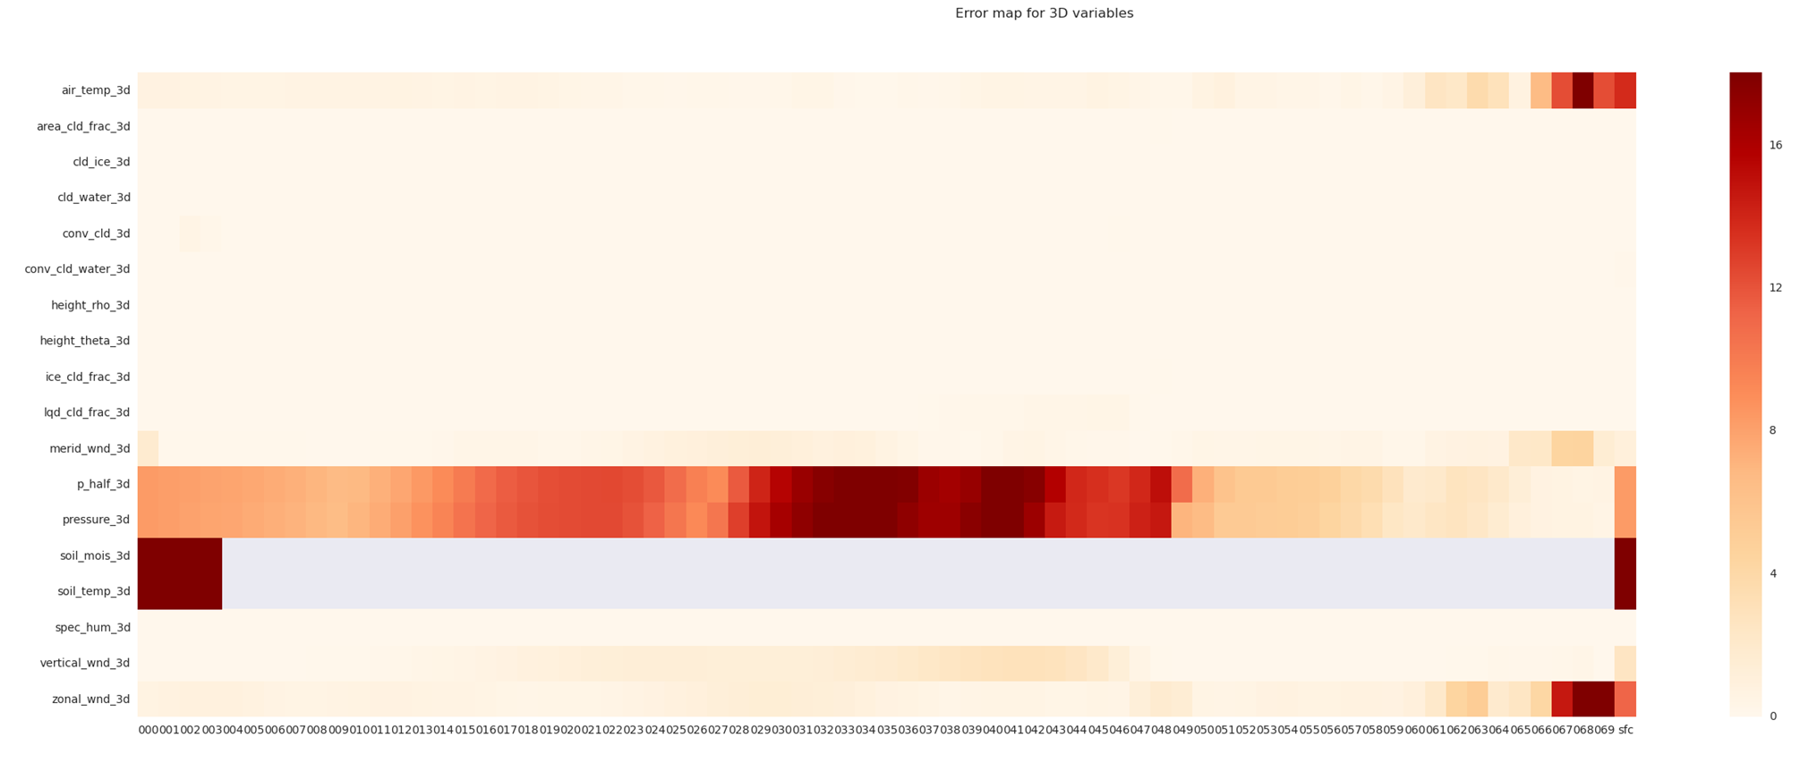
SMOCS Statistical Model Output Collection System
ACCESS-R1 vs ACCESS-R2 candidate: model level global fields November 2015 - Summary

Slide 5
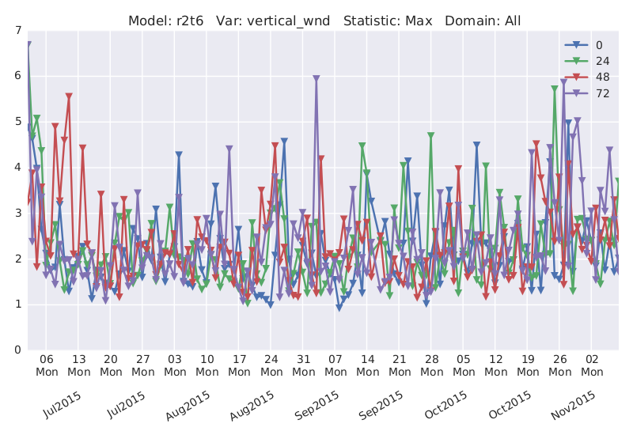
SMOCS Statistical Model Output Collection System
A healthy model?

Slide 6
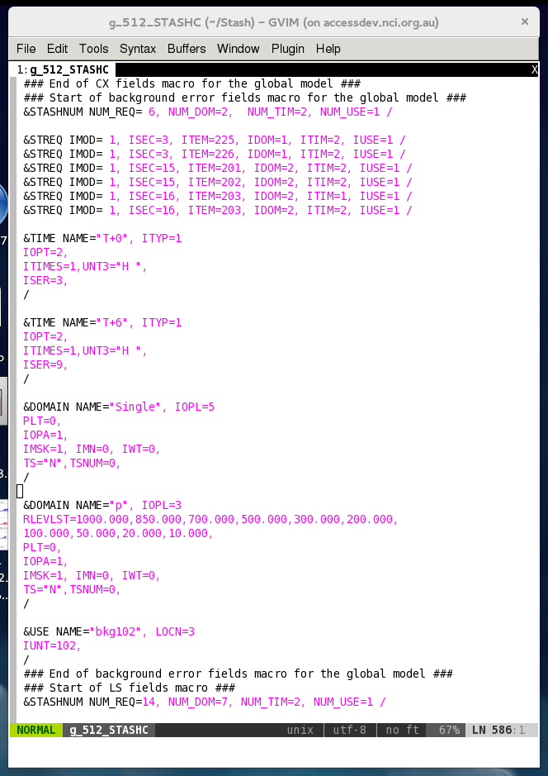
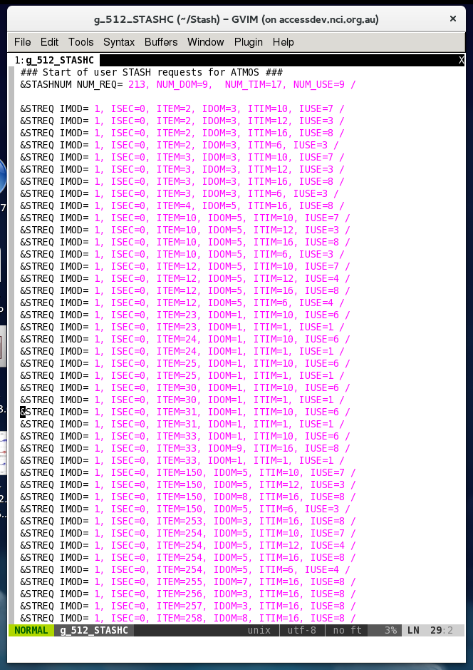
STASH utilities
How do you compare STASH settings?

Slide 7
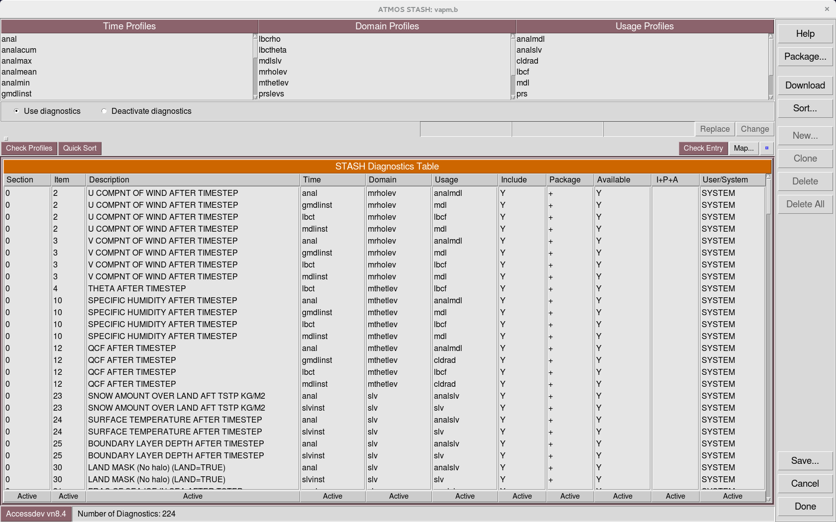
STASH utilities
The UMUI View

Slide 8
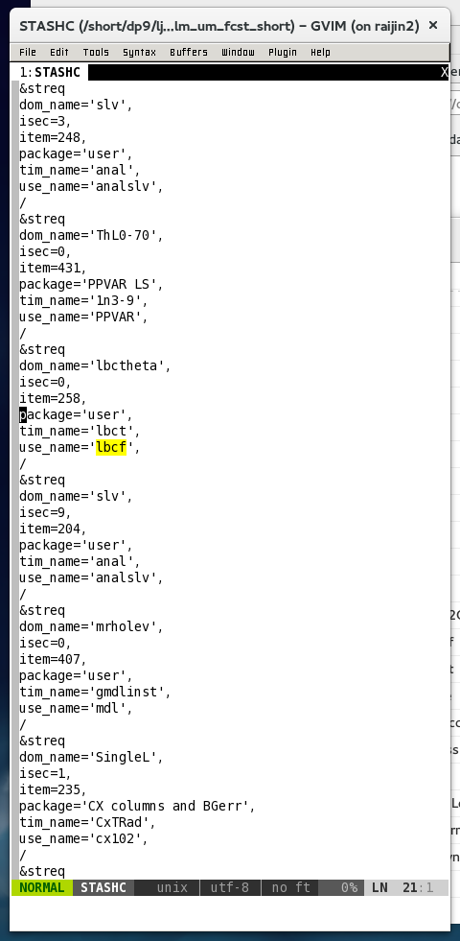
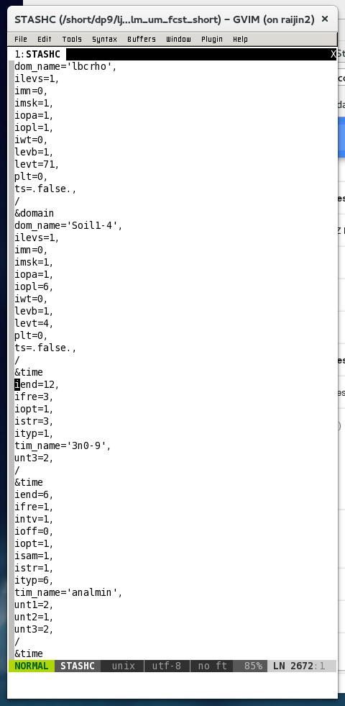
STASH utilities
The Rose View

Slide 9
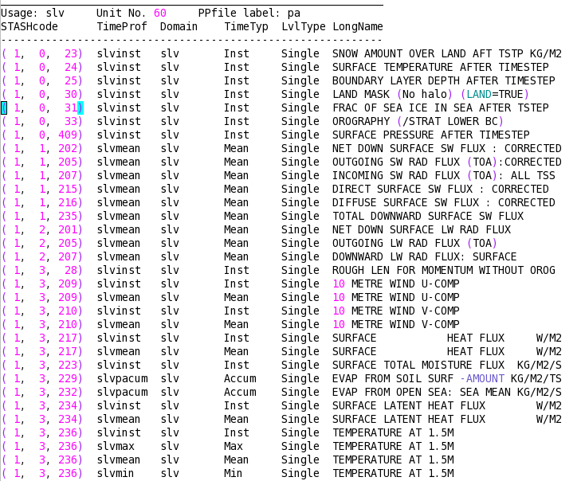
STASH utilities
A solution: pretty_stash.py

Slide 10
STASH utilities
pretty_stash combines STASHMaster and STASHC Info
Groups output fields by output file/stream
Names profiles and links them to the fields
Output piped to text files records standard STASH settings
pretty_rose reads rose-app.conf files for STASH
See: http://ngamai.bom.gov.au:8011/APS1/wiki/STASHspecifications

Slide 11
STASH utilities
Other STASH tasks/utilities/modules
Convert umui STASH to rose world
Convert STASHC/CONTCNTL information to rose namelist format
Extract specified STASH package from rose-app.conf file and save to file
Replace specified STASH package in rose-app.conf file
Python dictionaries to convert STASHid/cell_method to BoM standard variable names.
Used by SMOCS and pretty_stash etc
Encapsulate the STASHMaster and BoM variable information

