Slide 1
UM Partnership Convective Scale Modelling Workshop, Singapore, 22-25Feb 2016
Peter Steinle
(Alain Protat, Charmaine Franklin, Susan Rennie, Harald Richter, Peter May, Todd Lane)

Slide 2
Regional Model Evaluation & Development (RMED)
Aim to establish RMED/RA process (similar to GMED/GA)
Regional = Convective Scale
Mon & Tues: discuss science (developments & issues)
both individuals and centres
Wed: Summarize the major issues and what could be done
Microphysics, Turbulence/PBL, Evaluation/Verification, Data Assimilation, Surface Exchanges
Thu: Planning for the next year or two.
Fri: Partnership Board (Peter May)
http://collab.metoffice.gov.uk/twiki/bin/view/Support/ConvectiveScaleWorkshop2016#Presentations%20and%20Posters
S:/Head Office/CAWCR/PUBLIC_Bureau/ACCCESS_NWP/_Other_Workshops_Presentations_etc/Convective Scale Modelling Workshop Singapore Feb2106

Slide 3
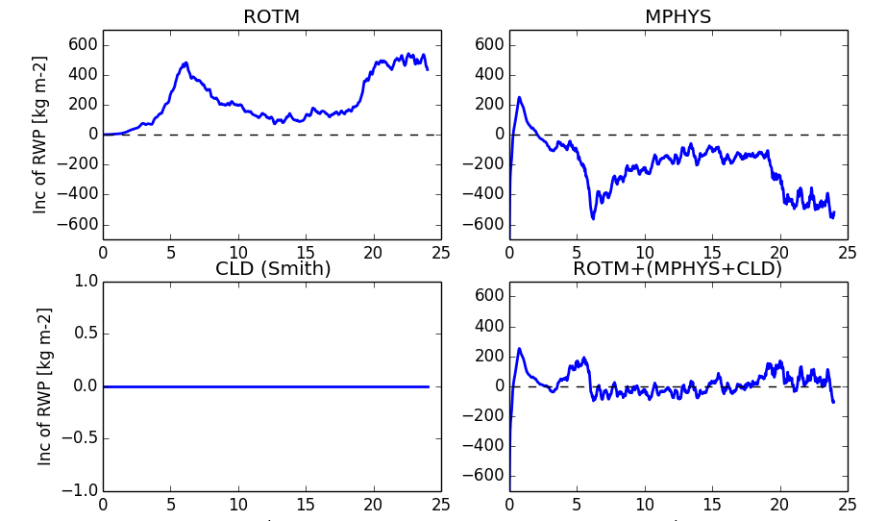
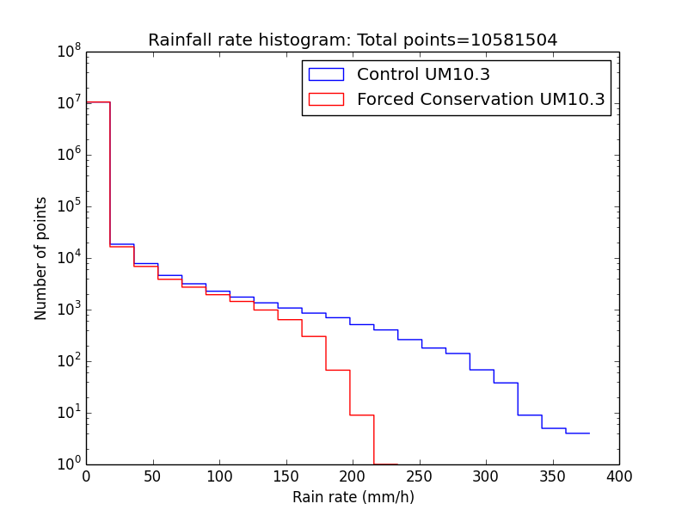
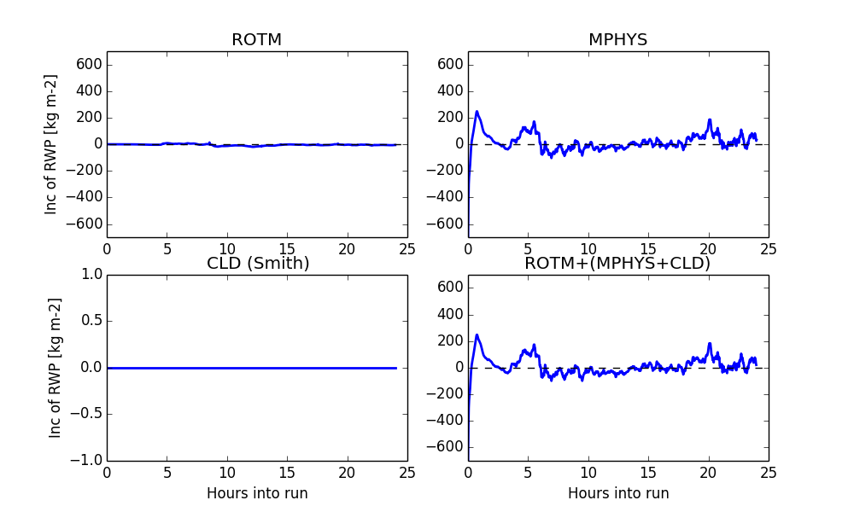
Science
Spurious large rain rates due to non-conserving Semi-Lagrangian advection
grid scale blobs of moisture conv.
See Excess Rain PEG (Jonathon Wilkinson)

Slide 4
Science - Convection
Still other major problems (Simon Vosper)
Lack of cumulus congestus : PBL mixing turbulence?
Convection still poorly resolved
Need handover from parametrized shallow to “resolved” deep conv.
Blended turbulence scheme (Adrian Lock et al.)
Pete Clark looking at other turbulence parametrization
→ Resolution does not cure everything
Lack of stratiform rain: Microphysics?
Cloud physics needs to be aware of grid scale (amount of sub-grid variability)

Slide 5
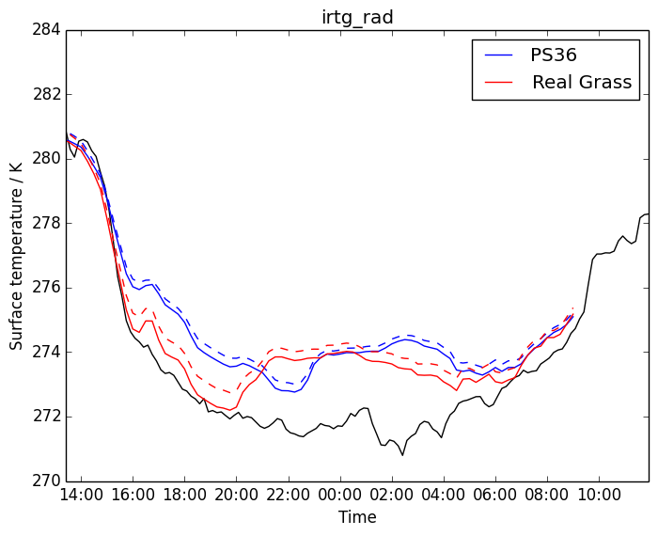
Science – Surface Exchanges
Value of conditional verification: clear days & nights
(Simon Vosper)
Night-time warm bias →
Excessive SBL mixing?
Day-time cold bias →
Surface fluxes/Bowen ratio wrong?
Boundary-layer depth/entrainment issues?
Night and day→
Too strong coupling between atmosphere and soil?
Improve representation of grass
Land surface characterization needs work!
USAF 557th Weather Wing

Slide 6
Infrastructure
Work progressing on improving ancillary data
Replacing CAP with ANTS
Need for easy exchange of
Suites – Hilary Oliver, Stu Webster
Initial conditions, LBCs – JASMIN?
Verifying data – JASMIN?
Partners to contribute
Verification/Evaluation (Chris Short & Rachel North)
Toolbox
Calculation and display
Use IRIS within Rose-stem workflow

Slide 7
Making a change
Test cases
Which ones and how many to be decided
Agree on core metrics that everyone will calculate
Can add others as you see fit
Timing to be decided
Maybe aim to have RA plans linked to UMUW ?
3 months for developments to be tested individually
3 months for package testing
3 months report and setting next round of issues
Strawman from Mike Bush et al.
Very much a starting point

Slide 8
Working Together
Current PEGs to Met Office focussed
Set up Working / Interest Groups
Tentative convenors appointed
Scope & Terms of Reference TBD
DA – Steinle
Verification – Mittermaier
Convection – Lean
Surface Exchanges - Lock

Slide 9
Summary
Some major progess
Still plenty to do
Lack of congestus, lack of stratiform rain
DA, Land Surface, Verifcation, Evaluation…
Experiences across the partnership
Improving communication
Common suite
Common testing environment
Common test cases
Partnership holds a lot of reference observations
Regular video conferences / ….

