Slide 1
UM Practical Exercises
How do you do it?
09/02/2016 by João Teixeira

Slide 2
Contents
What we will cover …
Practical Exercises
Changing run length
STASH Requests and Profiles
UM Code - Development

Slide 3
Changing run length
Long runs? Short runs? How to set it up…

Slide 4
Changing run length
Based on GA7 Amip (u-ab187/test-aa073)
Standard settings of an Amip run
Uses 360 days calendar
Starts 01/09/1988
Runs for 20 years and 6 months
Cycles each month
Time uses ISO8601 standard inherited from Rose & cylc
Description | ISO8601
Combined date and time | <date>T<time>
Durations | PnYnMnDTnHnMnS

Slide 5
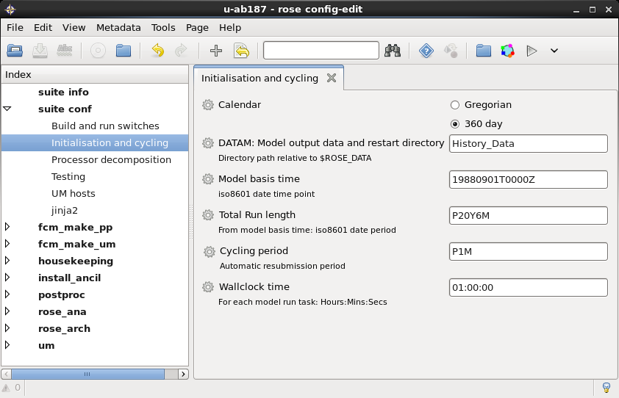
Changing run length
Initialisation and Cycling (u-ab187/test-aa073)
How would you setup the run to have a length of 1 month?

Slide 6
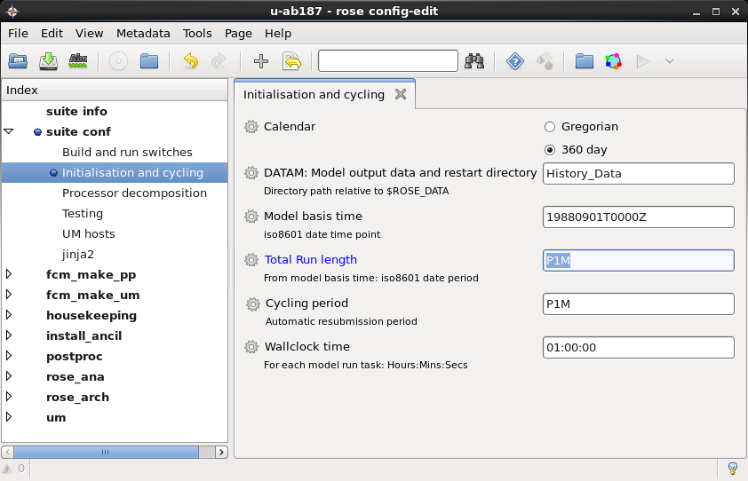
Changing run length
Solution!!!
Do you have a similar setting?
Can you tell which file and variable was changed in the rose suite?

Slide 7
STASH Requests and Profiles
Changing the model output…

Slide 8
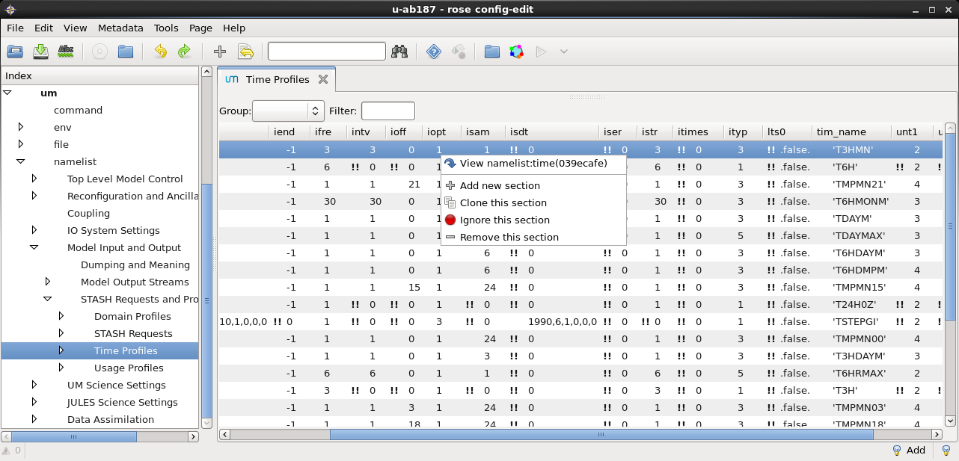
Time Profiles
Editing...
um → namelist → Model Input and Output → STASH Requests and Profiles → Time Profiles
“View namelist:time” to check a given time profile option
“Add new section” to create a new blank time profile (you will need to edit)
Notes:
Go to "um --> namelist --> Model Input and Output --> STASH Requests and Profiles --> Time Profiles". This window lists various time profiles (e.g. time averages) that the model is outputting data. The fourth column from the right (tim_name) is the best way to distinguish between them. For instance if you right click on TDAYM and click on "View namelist" it shows you information on how the model generates daily means.Back in the Time Profiles window right click on anywhere in the table and click on "Add new section". This should make a new time profile where we will set up a single timestep time profile. Right click on this new time profile "Probably index 25" and "View namelist". Give it a name (tim_name) (e.g. TSTEP). Change iend to -1 and ifre to 1.Go to "um --> namelist --> Model Input and Output --> STASH Requests and Profiles --> STASH Requests". This lists all the diagnostic output from the model. Click on the "New +" button in the top right corner.Select "5: Convection --> 251 DOWNDRAUGHT MASS FLUX (Pa/s)" and click on "Add +" in the top right. Close down the new STASH requests window to go back to the main Rose edit window.Right click on the new "DOWNDRAUGHT MASS FLUX" item in the table and click on "View namelist". We need to fill in information to tell it to output on all theta levels, output every timestep and go into the A stream. To do this fill in the following: dom_name = DALLTH package = UMUT diagnostics tim_name = TSTEP (or whatever you called your new timestep time profile in step 3) use_name = UPB

Slide 9
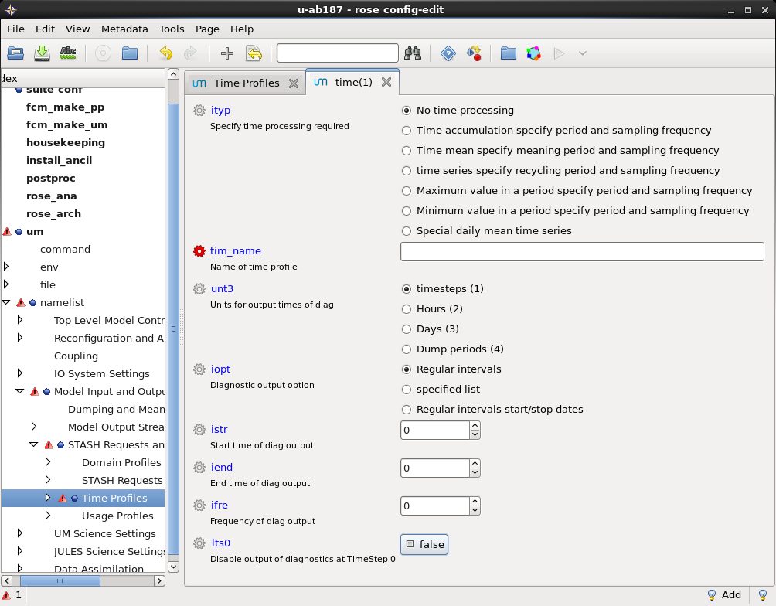
Time Profiles
Creating a new Time Profile...
Create a Time profile to output at the end of every timestep (pay attention to istr and iend)

Slide 10
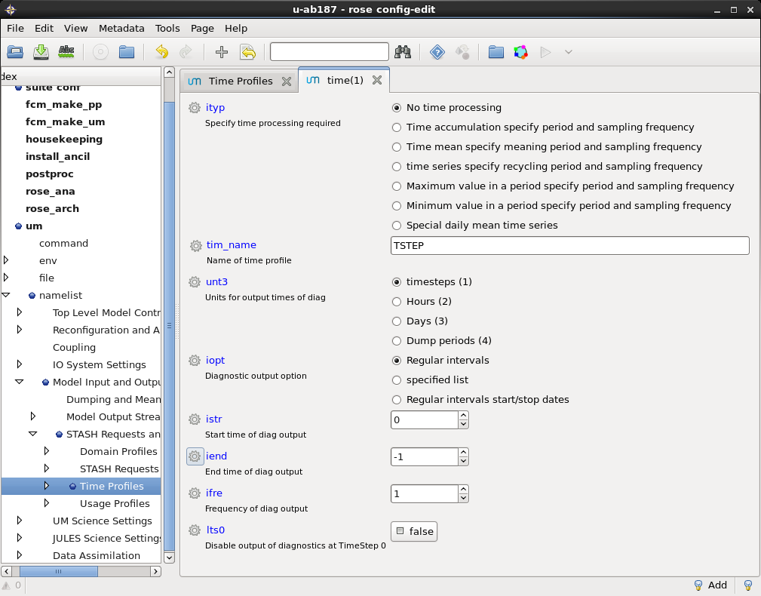
Time Profiles
Solution!!!
Do you have a similar setting?

Slide 11
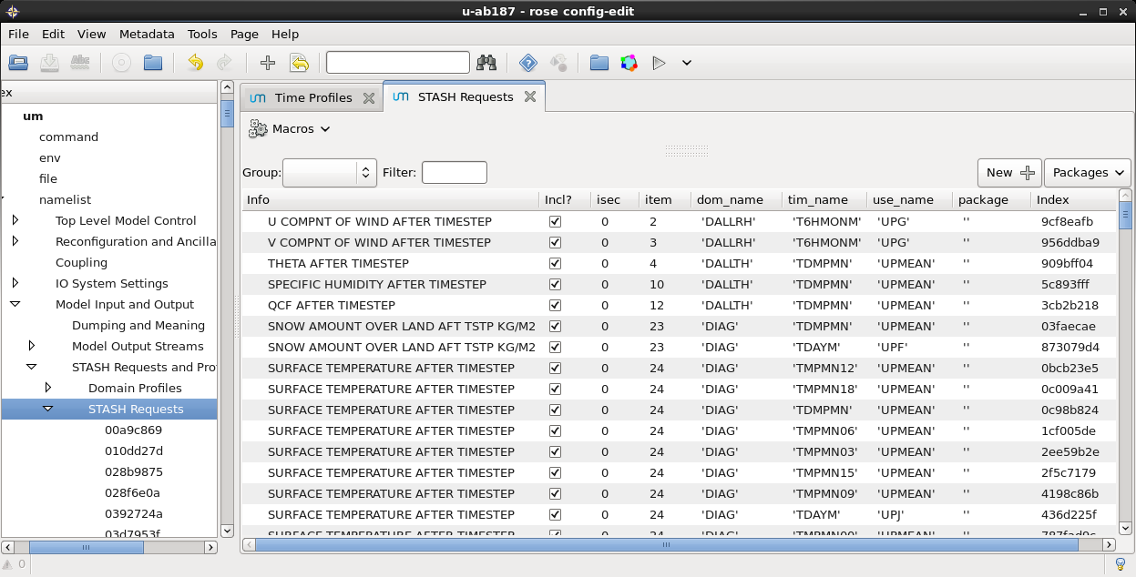
STASH Request
Adding an output variable
um → namelist → Model Input and Output → STASH Requests and Profiles → STASH Requests

Slide 12
STASH Request
Adding an output variable
By clicking in the “New“ button, one gets a list of available variables

Slide 13
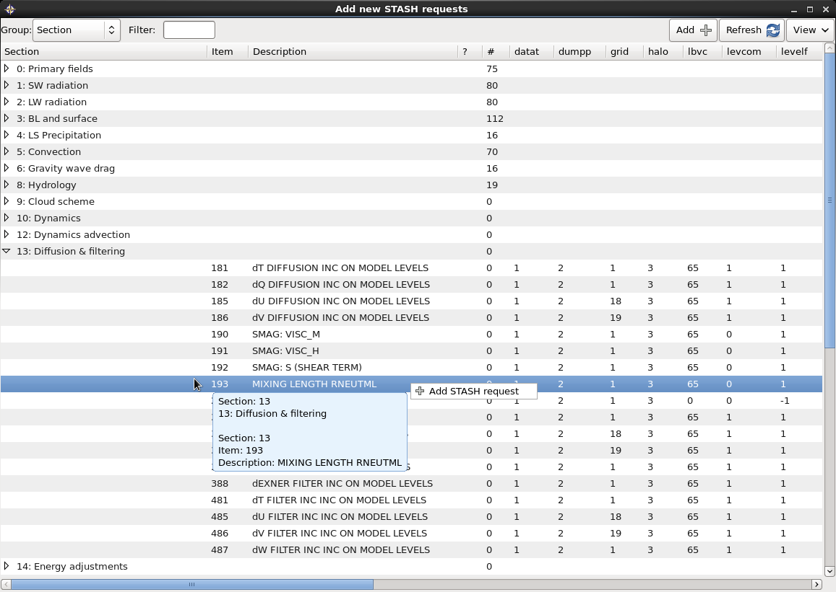
STASH Request
Adding an output variable
STASH organised in sections
Detailed description of variables
Grid info
Try adding STASH 251
What is it?

Slide 14
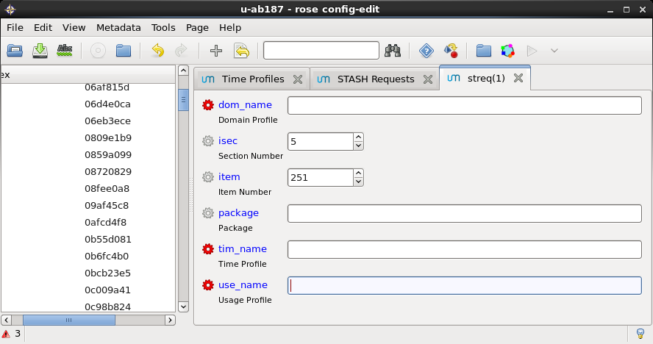
STASH Request
Adding an output variable
We need to add some information...
What if we want to output at
All theta levels
Output every timestep
Output stream A

Slide 15
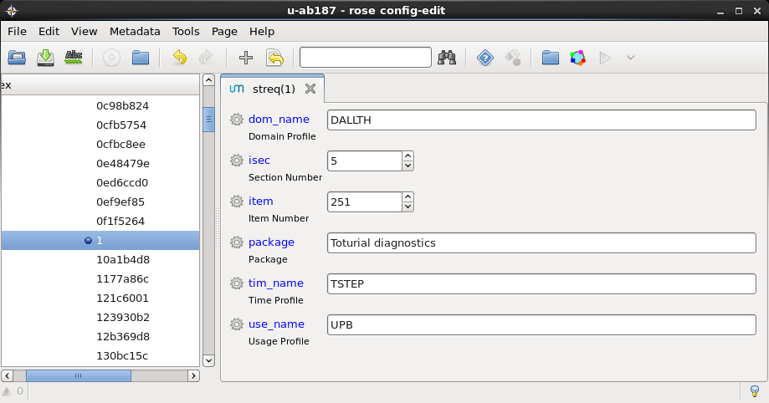
STASH Request
Solution!!!
Do you have a similar setting?
All theta levels
Output every timestep
Output stream A

Slide 16
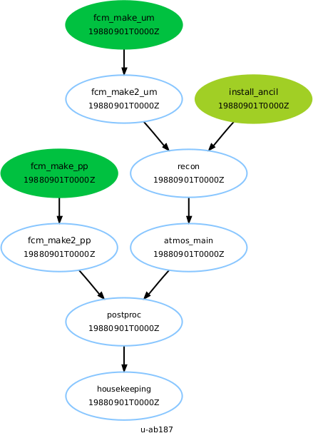
STASH Request
Running...
You can now run your suite...
Rose suite-run
Check if the output is what you would expect
In what stream can you find the requested filed?

Slide 17
UM Code - Development
Changing the um code… creating a branch

Slide 18
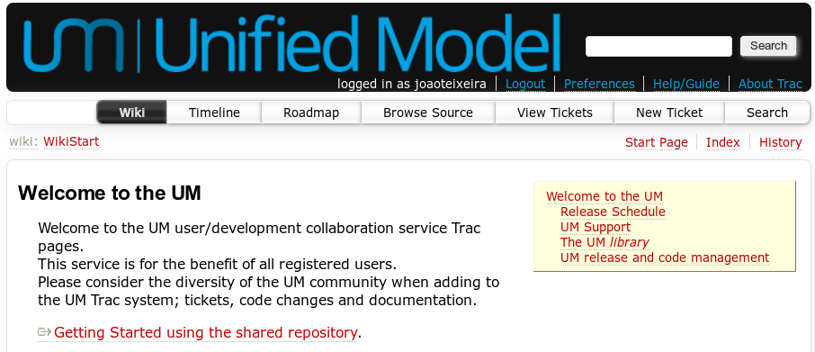
UM Code - Development
Creating a Ticket
First priority → Creating a ticket to describe purpose of branch

Slide 19
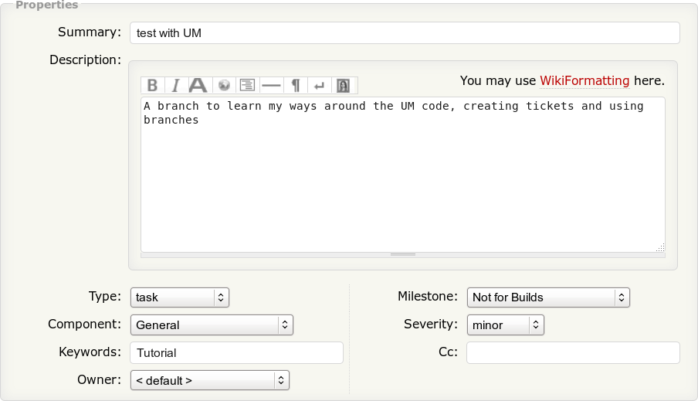
UM Code - Development
Creating a Ticket
Meaningful Summary
Detailed description
Type of code change
Model component it applies to
Keywords
Milestone – When to include it
You will be able to add comments describing you progress

Slide 20
UM Code - Development
Creating your branch
You can use FCM to create a branch with a copy of the trunk
fcm branch-create -k (ticket number) (branch name) fcm:um.x_tr@(version)
Checkout a local copy ☺
This opens a text editor where you should write a short description
fcm checkout fcm:um.x_br/dev/(user)/(version)_(branch name)

Slide 21

UM Code - Development
Changing the code
Lets make a change to the code...
Lets turn off downdraught in the deep part of the convection scheme
Edit the file
...br_name/src/atmosphere/convection/deep_conv-dpconv5a.F90
Set the if statment in line 3088 to be always false
3088 IF (.FALSE.) THEN
3090 b_dd(i) = .TRUE.
3091 ELSE
3092 b_nodd(i) = .TRUE.
...

Slide 22
UM Code - Development
Commit the code
You can now check your changes and commit
Check differences against original code to check that your have made the correct change
fcm diff –g
Commit this to the respository and type a line into the revision log
fcm commit

Slide 23
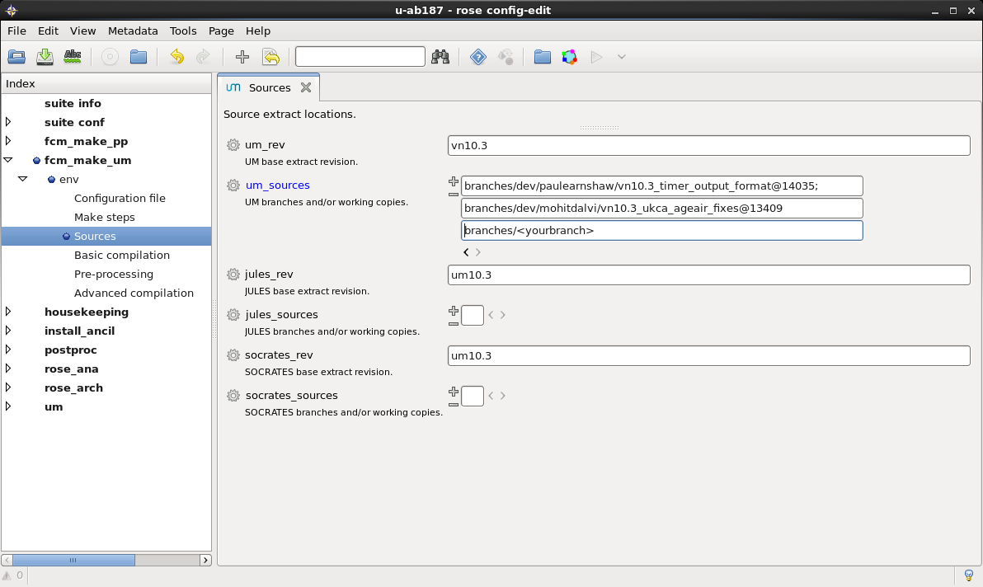
UM Code - Development
Adding the branch to your suite
Add your branch to the list of UM sources...
NOTE: Need to change the parameterization for convection to use the right option (5)

Slide 24
UM Code - Development
Running
You can now run your suite... Probably a good idea to do it from a copy
rose suite-run
Compare the output with the previous run
Is there any difference?
Is it what you would expect?

Slide 25
Useful links
Online tutorials and documentations ...
Rose
https://github.com/metomi/rose
http://metomi.github.io/rose/doc/rose.html
Cylc
https://github.com/cylc/cylc
http://cylc.github.io/cylc
FCM
http://metomi.github.io/fcm/doc/user_guide
MOSRS
https://code.metoffice.gov.uk
roses-u https://code.metoffice.gov.uk/trac/roses-u

Slide 26

Questions … ?
Coffee ?

