Slide 1
ACCESS Model Experiment Library: ACCESS City and ACCESS Domain-on-Demand
www.cawcr.gov.au
Wenming LU, Mike NAUGHTON
lwenming@bom.gov.au
mjn@bom.gov.au
MAR 26 2014

Slide 2
ACCESS City Forecast System Operational
ACCESS City Forecast system, ACCESS-C, is the highest resolution operational numerical weather prediction system in Weather Bureau.
Has spatial resolution of 4km and vertical resolution of 70 levels
Runs out to 36 hours and 4 times daily 00, 06, 12 and 18Z, nesting within ACCESS-Regional, i.e., the initial and boundary conditions are interpolated from the larger ACCESS-R analyses and forecasts

Slide 3
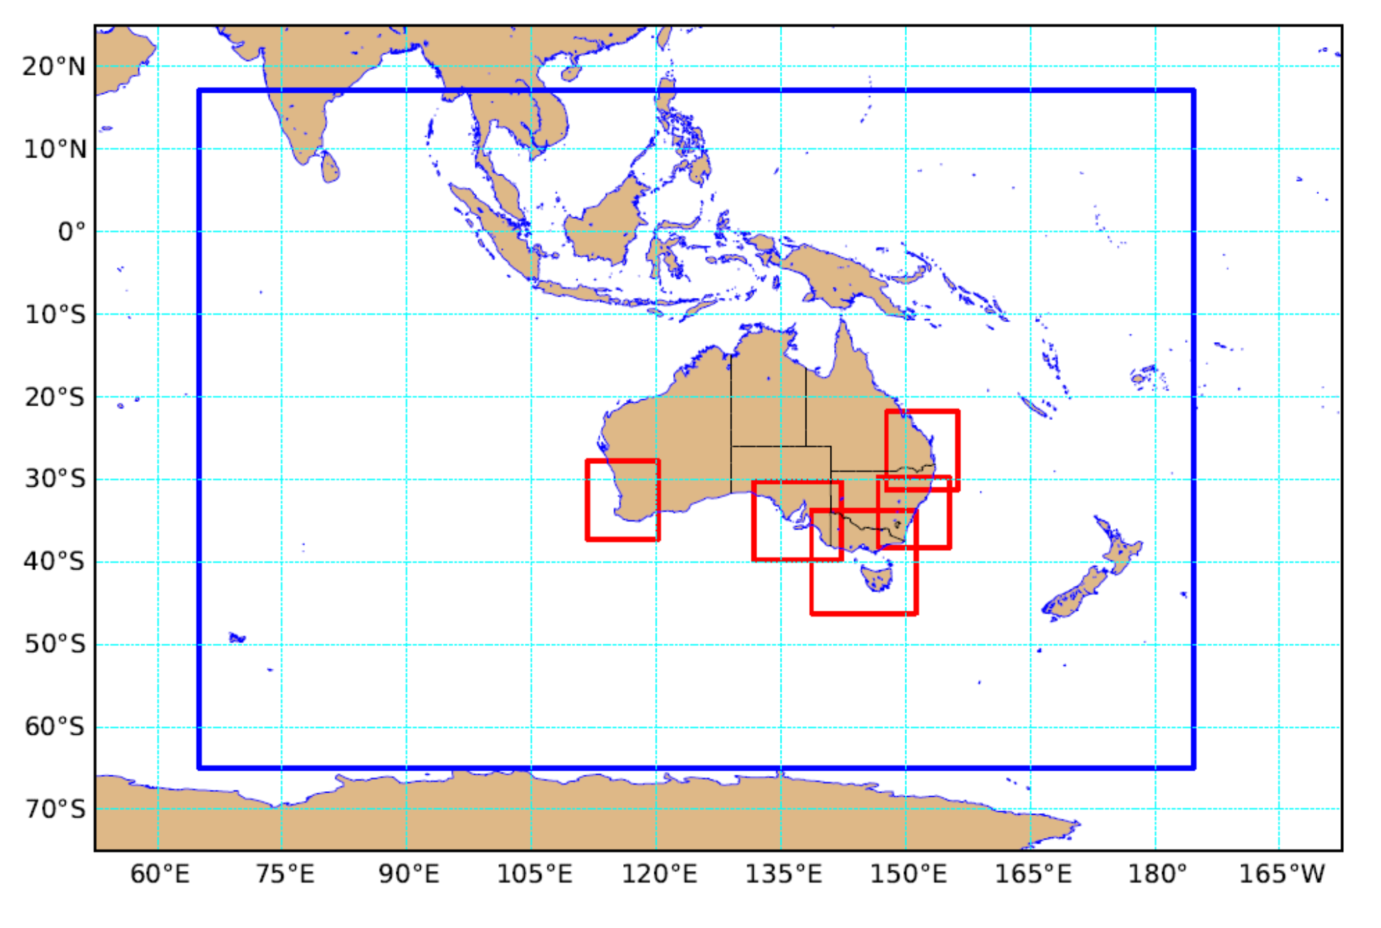

Slide 4
ACCESS C and ACCESS X Research System
The operational ACCESS-C aps1_access_c is UM vn7.6 system.
Research suite access_c_vn7.8_1.5km is UM vn7.8 with spatial resolution of 1.5km
ACCESS-X: domain-on-demand, user specified movable domain within ACCESS-R
extra task(s): create ancillaries on fly by user's specification
access_x_vn7.6_4km
access_x_vn7.8_1.5km

Slide 5
ACCESS C and ACCESS X How-to
The detailed instructions are located at
https://trac.nci.org.au/trac/access/wiki/AccessModelExperimentLibrary
Please go to section
NWP configurations (forecast-only)
ACCESS-C : Limited area

Slide 6
ACCESS C and ACCESS X Standard Experiments
Preparation: raijin and accessdev
Installation: system files, suite files and source codes
Running: accessdev (rose suite-run) and raijin qstat –u $USER
Checking forecast data and plot: pp files, netCDF data and plots
Configuring: running for different dates, nesting within other system
Checking resources: comparing with resources by standard domains

Slide 7

Thank you
The Centre for Australian Weather and Climate Research
A partnership between CSIRO and the Bureau of Meteorology
Mike NAUGHTON
Wenming LU
mjn@bom.gov.au
lwenming@bom.gov.au
Web: www.cawcr.gov.au
Thank you
www.cawcr.gov.au

