Slide 1
Enabling Collaborative Development
David Matthews, Keir Bovis, Glenn Greed
4 Dec 2014

Slide 2
Contents
Background + Technical: Dave
Plans & Working Practices: Keir
UM specifics: Glenn

Slide 3
Background
Current Subversion repositories & Trac environments only accessible on Met Office network.
Collaborators maintain “mirrors” of trunk & critical branches.
fcm patch hard to maintain & error prone.
High overhead in maintaining mirrors.
No shared UMUI / SCSUI / etc databases

Slide 4
Background
Impact
Collaborators do not contribute to pre-release testing.
Collaborative code development almost impossible.
Collaborators cannot see details of known issues or changes under development and cannot participate in code reviews.
etc.

Slide 5
Status @ May 2012
As agreed at UM User Workshop 2012
Major barrier to collaboration.
Essential we move towards shared repositories & issue trackers.
High priority work package defined
Implement shared Subversion repositories & Trac environments
Moving away from Subversion (to git) considered but too much work at this time
Mustn’t distract from Rose/Cylc work
Timescale: 12-18 months (!)

Slide 6
What is provided?
Subversion repositories
Trac environments
Static web pages (limited use)
E.g. UM & JULES documentation
Rosie (suite repository & database)

Slide 7
How?
Service hosted by Skyscape Cloud Services
UK government accredited
Using OpenAM + LDAP for account management & access control
Group access controls
Read-only access from Met Office IP address

Slide 8
Issues: Performance
svn log -v, OPS, 741516 lines of output
Met Office, using internal repos: 5s
Met Office, using shared repos: 51s
Australia (accessdev): 43s

Slide 9
Issues: Performance
svn ls -R, OPS, 14408 lines of output
Met Office, using internal repos: 3s
Met Office, using shared repos: 111s
Australia: 17 min!
This command is used by fcm extract
So is svn info –R which performs similarly

Slide 10
Issues: Performance
svn checkout, UM, 4143 lines of output
(122 MB working copy)
Met Office to local disk: 8s
Met Office to $HOME: 45s
Australia to local disk: 13s
Australia to $HOME: 70s

Slide 11
Issues: Performance
Lots more test results available
switch, update, copy (branch create), commit, diff, rm
Generally all perform well
Very large merges may be a little slow.

Slide 12
Issues: Performance
Summary
Worse than internal repositories (as expected) but generally OK
Better than expected from Australia, etc
svn 1.8 big help
Need to use mirrors for fcm extract
Network file system performance and size of working copies (number of files / volume) are more of a factor than the use of external repositories
Current OPS working copy contains ~14000 files

Slide 13
Issues: Security
Publicly available repository we need to manage the risks
Protected trunk (as already done with UM)
Branch commits will be restricted to owner by default
Strong passwords: another password to manage!
No plain text password storage: Keyrings
Fairly straightforward on desktop
More complicated when using a server
Authentication for svn read-> use mirror in batch
Eclipse
Protected trunk
Only branch owner can commit by default

Slide 14
Issues: Eclipse
Eclipse / Subclipse doesn’t currently work with GNOME keyring
It helpfully offers to disable GNOME keyring!
Implications
Can’t use Eclipse if you’re using shared repositories
If you do use Eclipse for other work make sure you select Cancel when it offers to disable the keyring
Fix should be in next releases of svn and SubClipse

Slide 15
Issues: Mirrors
We will provide internal mirrors of the repositories
Full mirrors - identical to master repository (not like the crude way collaborators currently mirror our trunk)
Updated every 5 minutes
Required for fcm extract
Provide read-only access in case service is down (e.g. Internet access problems)
Required for access from batch jobs (we don’t require authentication for read from our internal repositories)
Collaborators will need these also
Easy to set up and maintain

Slide 16
Benefits
System accessible whilst working away from the office
Enables effective collaboration!

Slide 17
Met Office Science Repository Service Infrastructure for an effective scientific collaboration
Keir Bovis
December 2014
Notes:
.

Slide 18
Contents
Governance of the Met Office Science Repository Service.
Requesting a user accounts, group access and passwords
Supporting the service
Current and future hosted projects on the service

Slide 19
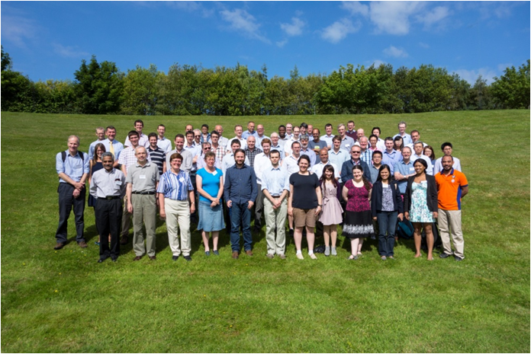
Governance of the service
I wonder if I can share my code with anyone here?
1. Review individual repository content
2. Review working practices associated with repository
3. Information Asset Owner approval to share
I’ll ask Science Partnerships.
Project content held on the service subject to initial and proposed annual review.
Notes:
An key aim of the technical infrastructure Programme is to provide an efficient, user-friendly and easy to use common research and development environment, that allows scientist from across the partnership and strategic to collaborate more effectively.
When scientists meet, for example at the UM User Workshop, it usually results in collaboration.
How do we decided what we can share?
What authorisation has to be given for sharing?
The governance process for migrating projects to the new service intends to clarify this.
It comprises three stages.

Slide 20
Review repository content
Project content reviewed under broad headings defined in a register of assets (an asset is a project):
Sensitivity
Is the asset protectively marked?
Risks
Associated with the sharing of the asset
Access
Who can access the asset and how?
Trust
Additional validation required to prove asset is correct, up-to-date and what it claims to be.
Personal data
Does the asset contain information that might fall under the data protection act.
Notes:
The first stage in the governance process...
Examples of these categories following that review for the initial tranche of repositories to be migrated:
Personal data
Recommended that amendment history removed from all files stored.
Sensitivity
Clarification about sharing of sensitive models (crisis area model) or operational model configurations.
Approach taken has been to liaise closely with Asset Owner and seeking business owner approval before proceeding
Risks
Consider the risks to the asset in sharing it. For example malicious intent, reputational damage, etc. These are captured and monitored in risk registers.
Access
Who is allowed access to the asset, are they licenced to use it. Responsibility of Science Partnerships to ensure user authentication at group level is correct and that users are appropriately licensed.
Trust
How confident are we that the information is correct? Is the documentation up-to-date? Can we validate that the integrity of the head of the trunk adequately?

Slide 21
Review repository working practices
Developer tests
Routine tests
Review process
System manager or owner
Protected branches & trunk
For operational systems working practices should address the following areas.
In practice, any research project should follow this best practice where possible.
Notes:
The second stage in the governance process....
Ensure that working practices associated with a project are in place and consider the following:
Protected branches & trunk
Commits to the trunk should be restricted to authorised 'trusted' users only where ever possible.
Review process
Working practices should include a code review activity that allows the integrity of code changes to be assessed.
Working practices should recommend that the result of the review is recorded somehow - on the ticket or a trac page.
The review process should include an assessment of the impact of the change by running a sample test. Ideally, this would take the form of a Rose stem test against Known Good Output (KGO).
In the absence of this approach, evidence of the impact by comparing the output from the changed code and basined revisions is acceptable.
Developer tests
Ideally, a set of Rose stem tests should exist that allow adequate testing coverage, of operational configurations/pathways against a KGO. (at the System Manager's discretion)
Rose stem tests provide assurance that operational configurations will not be compromised by code changes.
In the absence of a Rose stem test, any test configuration that compares a baseline with the test revisions is acceptable.
Routine tests
A mechanism should exist to allow the routine running of a set of test configurations to assess the integrity of code at the head of trunk and include an adequate process for alerting the System Manager (or delegated staff) to differences against a KGO
These routine tests may be run nightly, weekly or at each stable release.
System manager
Every project should have a designated System Manager responsible for the day-to-day management and act as a point of contact.

Slide 22
Information Asset Owner (IAO) approval to share
No
Risks and issues
Asset analysis in register of assets
Yes
Updated content that can be shared
Acceptable working practices
Risk mitigation and issue resolutions
Met Office IAO for scientific code is Stuart Bell
Notes:
Final stage in the governance process will be approval to share the asset....
Current assets originate from the Met Office and therefore are under the responsibility of the Scientific Code Information Asset Owner (IAO) who is Stuart Bell.
What if a partner wants to propose a code project, who is the IAO in these cases?

Slide 23
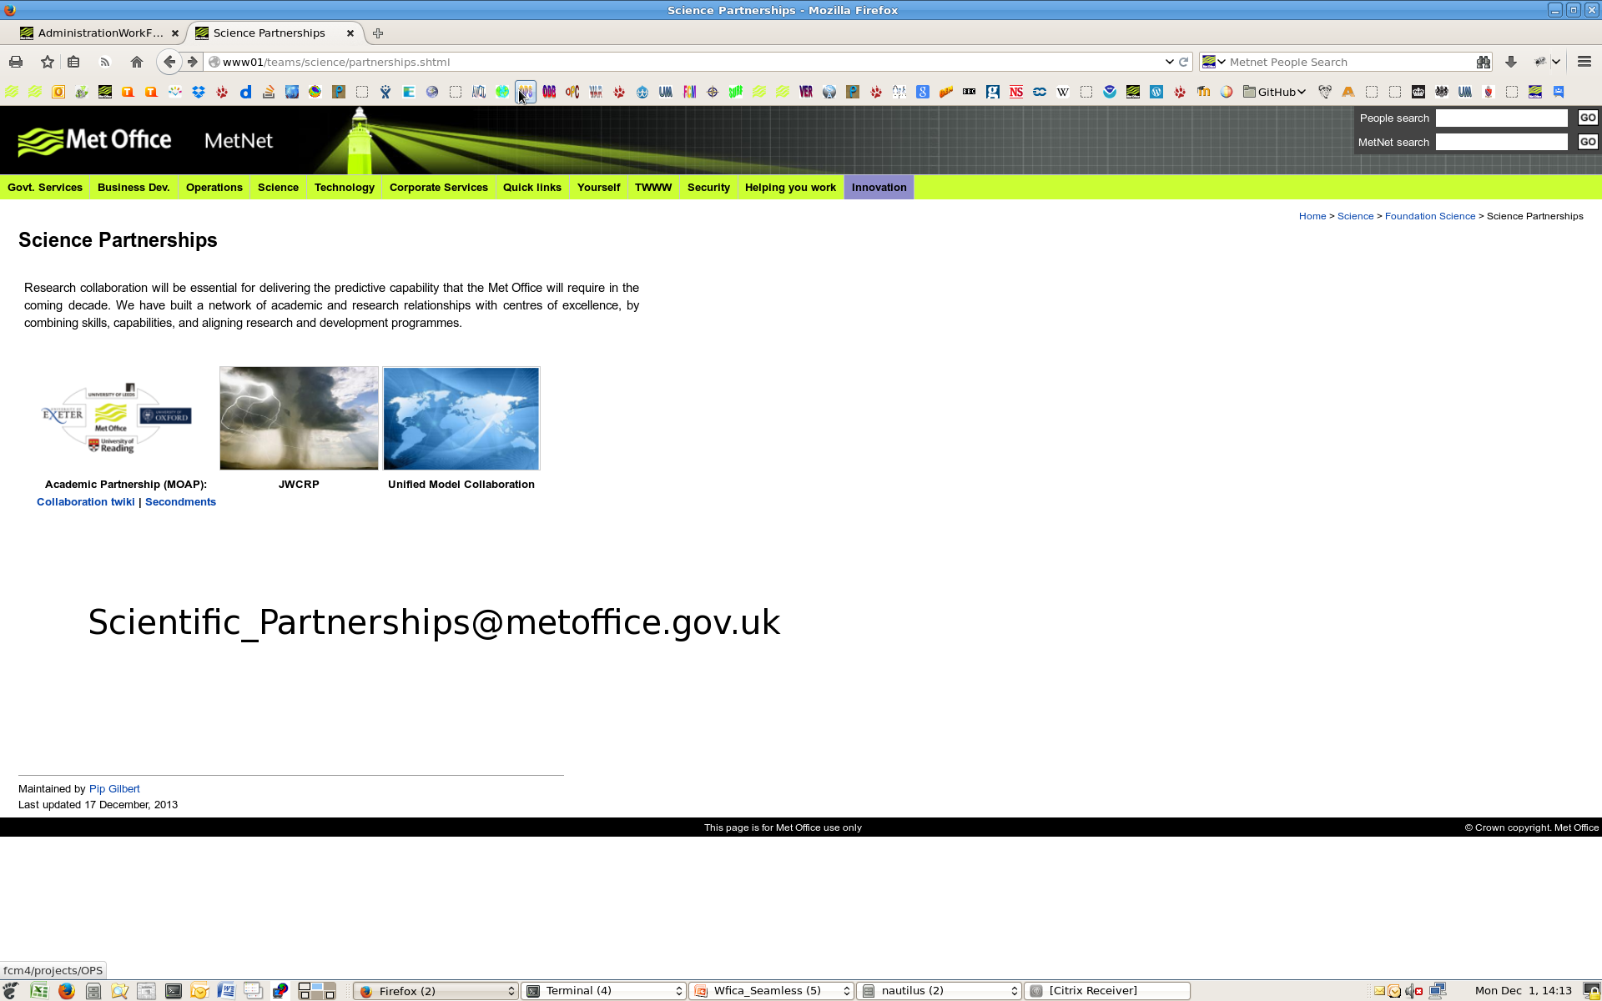
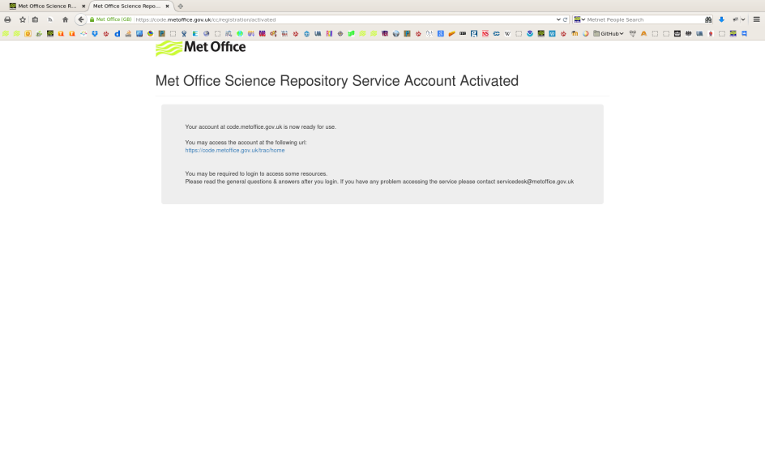
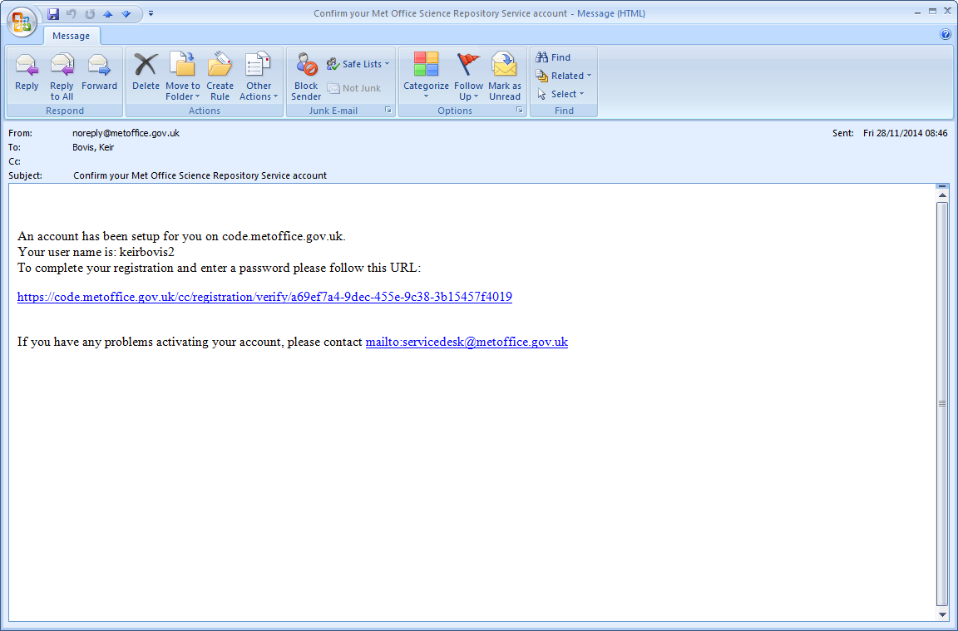
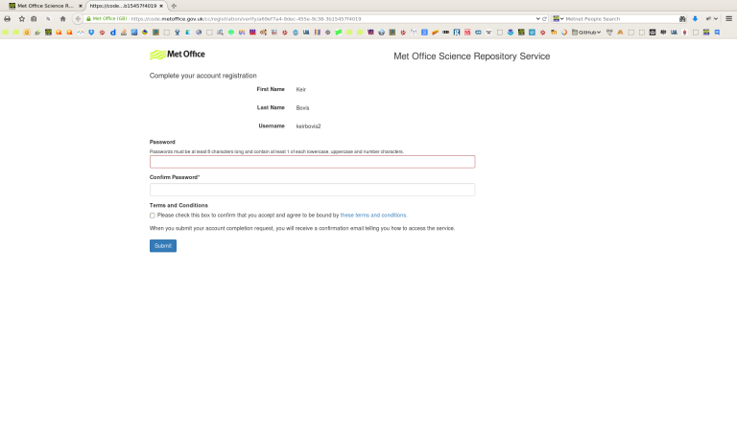
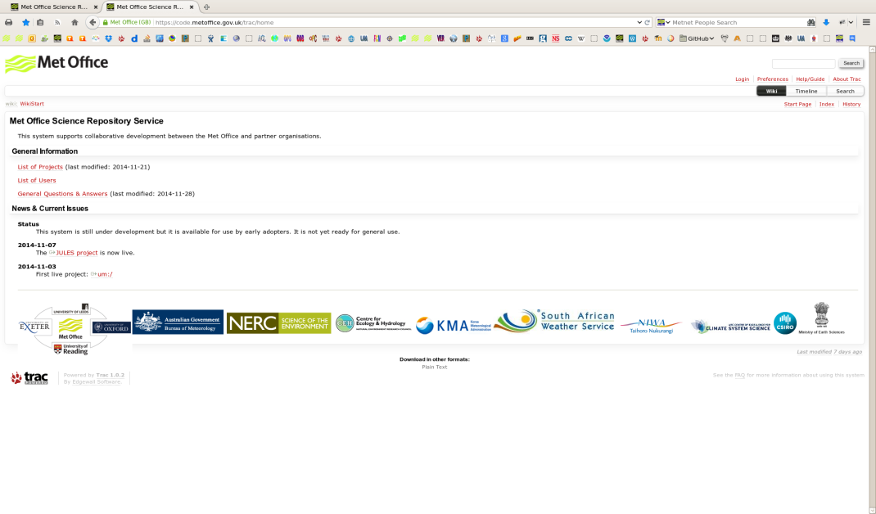
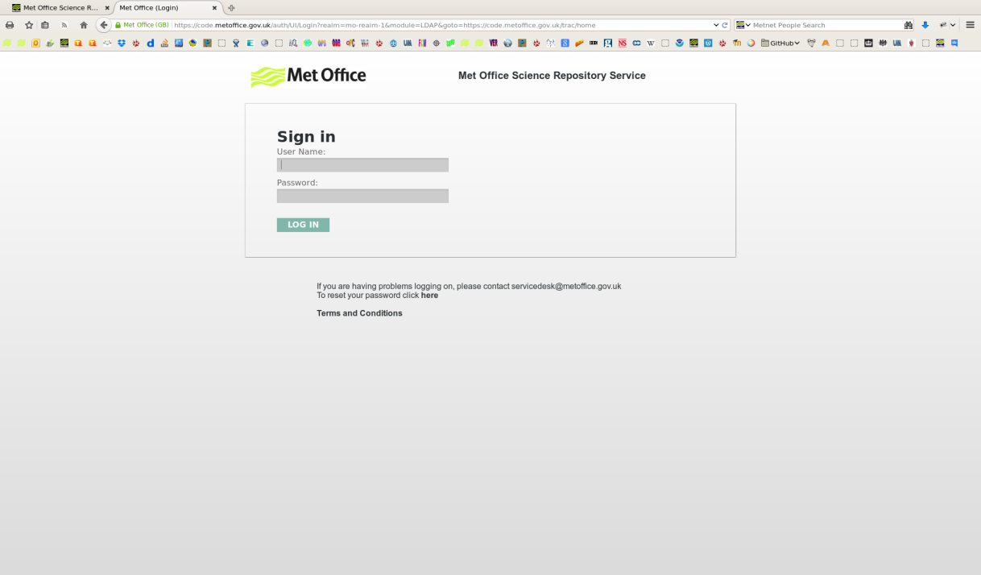
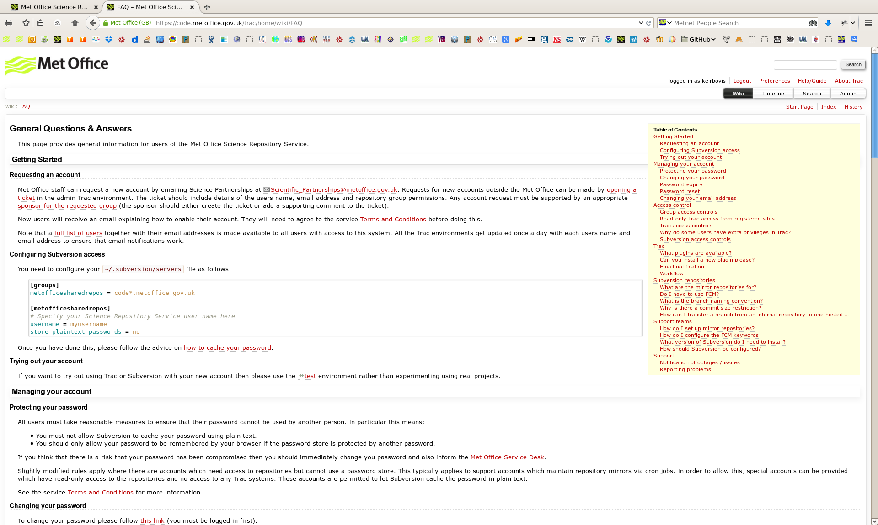
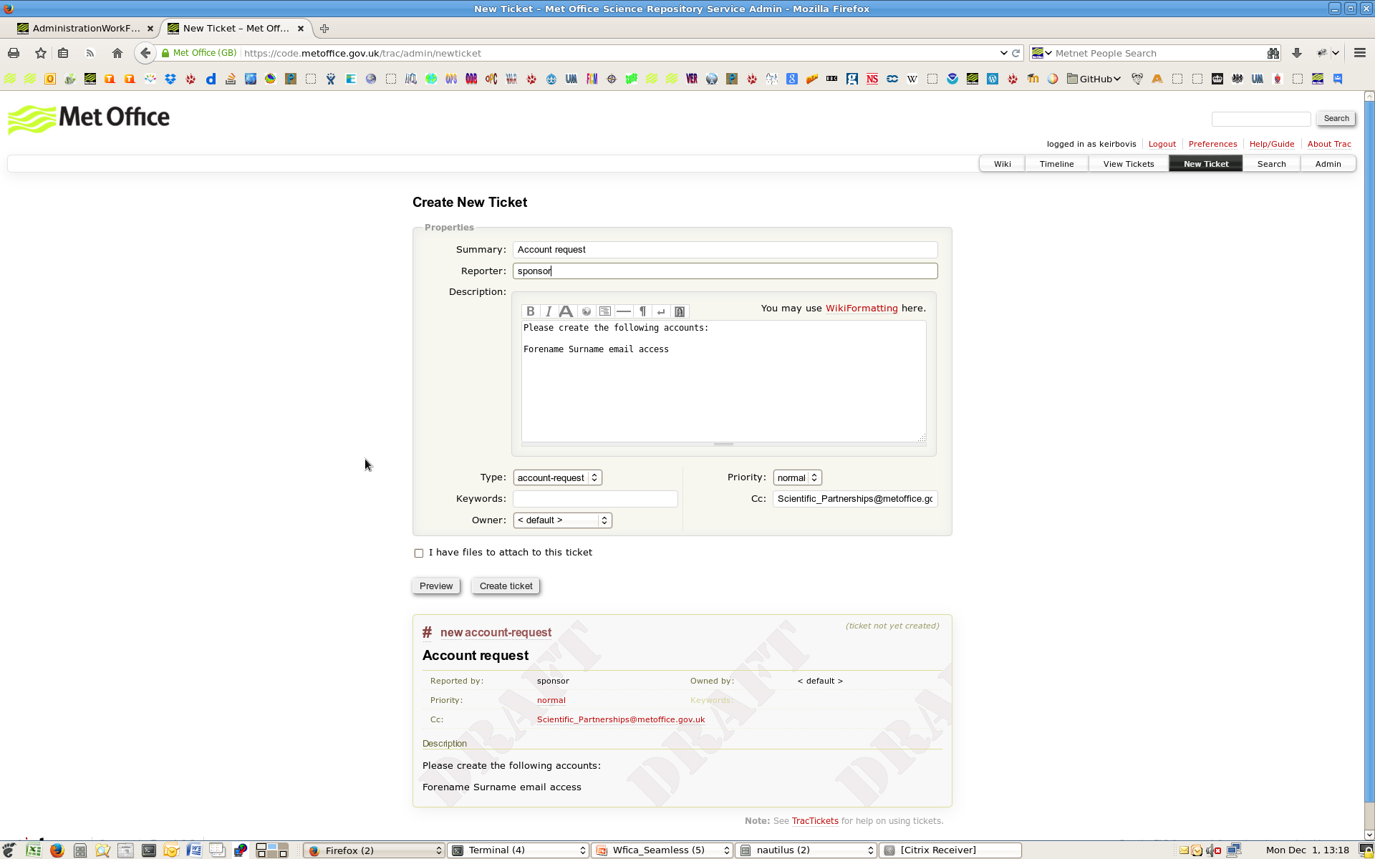
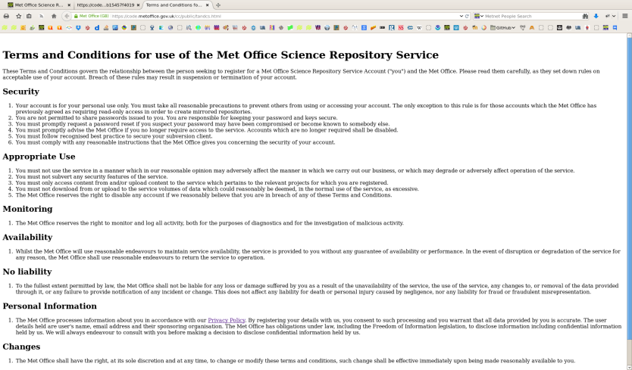
Requesting a user account
Confirm T&Cs
Activated account
Main trac page
Confirm registration
Initial password
Login
Read FAQ
Non Met Office user
Trac ticket request
Account creation
Met Office user
Email Science Partnerships

Slide 24
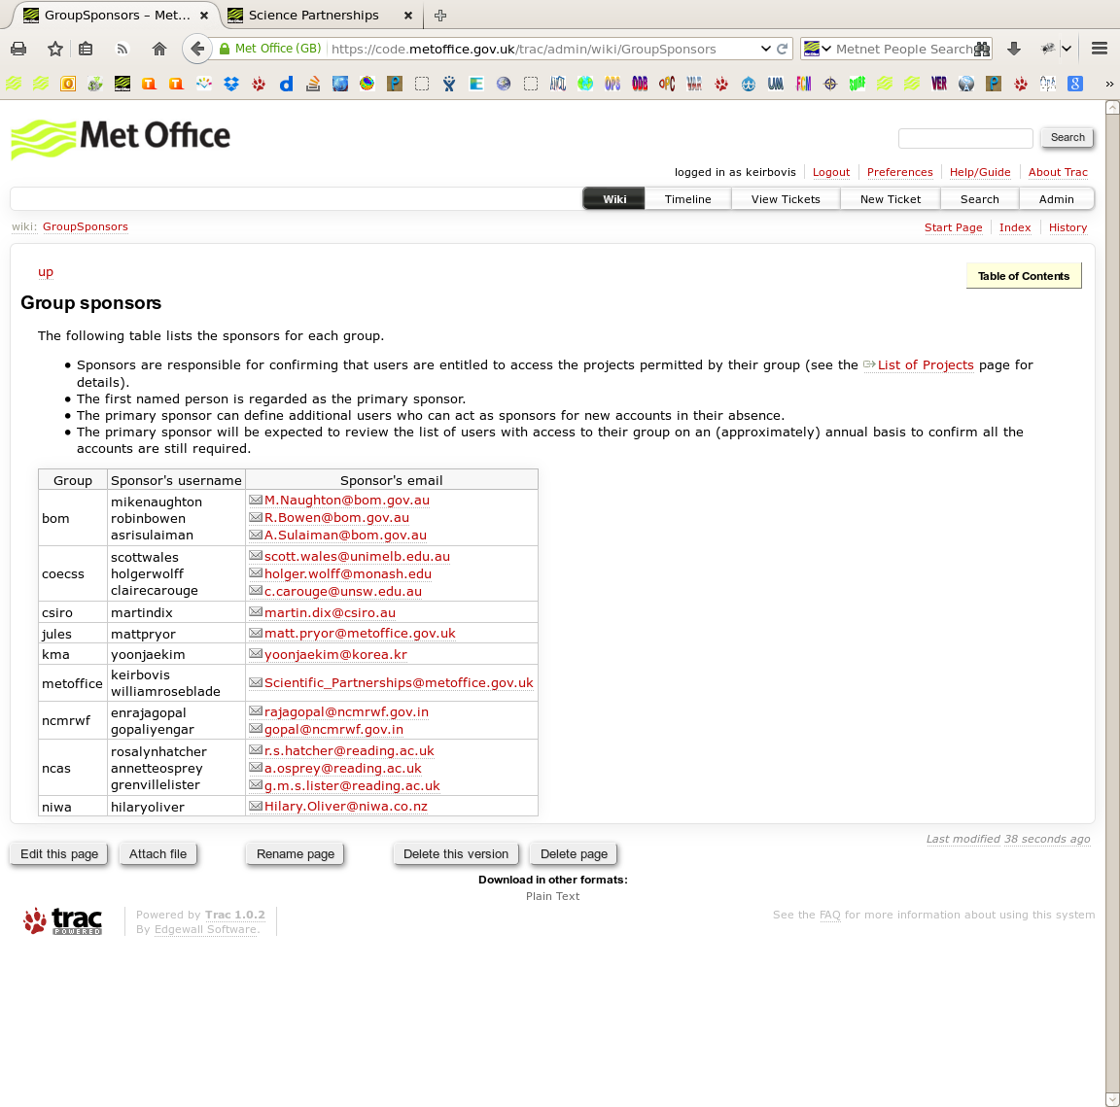
Groups and group sponsors
An access group made up of one or more projects (svn + Trac).
A user may be assigned to one or more group.
Primary and secondary sponsors associated with each group authorise user membership
Notes:
We control access to subversion repositories and trac environments by associating them with an authentication group.

Slide 25
Password rules
Account registration confirmation will expire after 2 weeks if not activated.
Passwords expire every 90 days and will need to be recreated.
Password complexity dictated by Met Office Security Operating Procedures (SyOps) rules:
At least 8 characters
Contain at one of each: one lowercase, one uppercase and one numeric character.
Password reset facility available from login screen where user will receive a one-time password reset link. Will expire after two days.

Slide 26
Support of the service
1st line support is 7days x 24 hours and is provided from the Service desk:
Outside Met Office: email servicedesk@metoffice.gov.uk
Inside Met Office: email Scientific_Partnerships@metoffice.gov.uk
If the service is unavailable, they will route call to Met Office Platforms Team (reasonable endeavours support)
If service is available the incident routed to Scientific Partnerships who will re-assign appropriately, e.g. Modelling Infrastructure Support Systems (working day support only).
As service matures, may be able to pass more support functions to Service desk.

Slide 27





Projects currently available
UM10.0, GCOM and JULES are currently live on the service.
A Rosie suite repository has been created and is available for use. Suites will be prefixed:
U: Universal / UM collaboration
This repository will become the default location in the future.
ANCIL (code for the central ancillary program) has been migrated but not officially live yet.

Slide 28
Plans for future project migration
Remaining projects containing source used in NWP systems, eg: VAR, OPS, VER and SURF are aimed to be migrated by March 2015.
NEMO development is being transferred to IPSL repository although there maybe a need to maintain an internal repository for FOAM
CICE project is planned to move to the new service although timescales unknown at present..

Slide 29






Impact on the collaboration twiki
A variety of Trac environments are available on the collaboration twiki, we plan to migrate these to the new service as soon as possible.
Owners of these systems will be contacted in due course about suitable dates for their migration.
All Trac content, tickets and attachments will be transferred over together with revision history.

Slide 30
Hosting of other projects
If you have a collaborative project you think would benefit from being hosted on the Met Office Science Repository Service, email Scientific_Partnerships@metoffice.gov.uk
Projects that underpin operation systems will be required to address the 5 key working practice principles.

Slide 31
Acknowledgments
This work has been delivered by a cross-Met Office project team including:
Dave Matthews
Glenn Greed
Andrew Munslow
Chris Wood
Andrew Hounslow
Chris Wilkinson
Steve Mudd
Roger Milton
Matt Shin
Modelling Infrastructure Support Systems Team
UM Systems Team
Notes:
Finally should thank,..

Slide 32
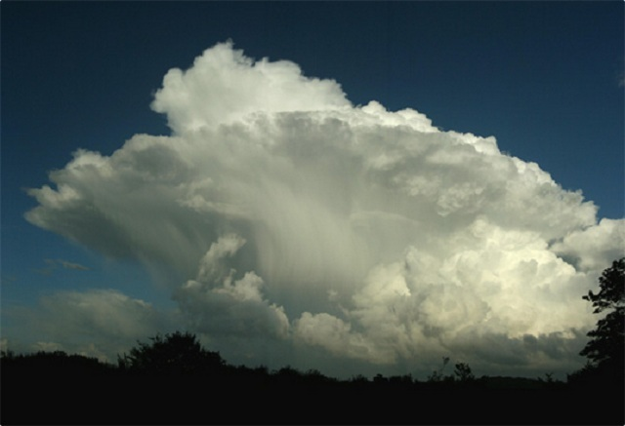

Floating the UM on a cloud
UM sys team
Notes:
The UM sys team have ‘uploaded’ a working UM in the cloud.

Slide 33
Contents
Migration
Working Practices
The future of Testing
How to get an account....

Slide 34

UM10.0 Kinetic Khamsin
Released 28th Nov 2014

Slide 35
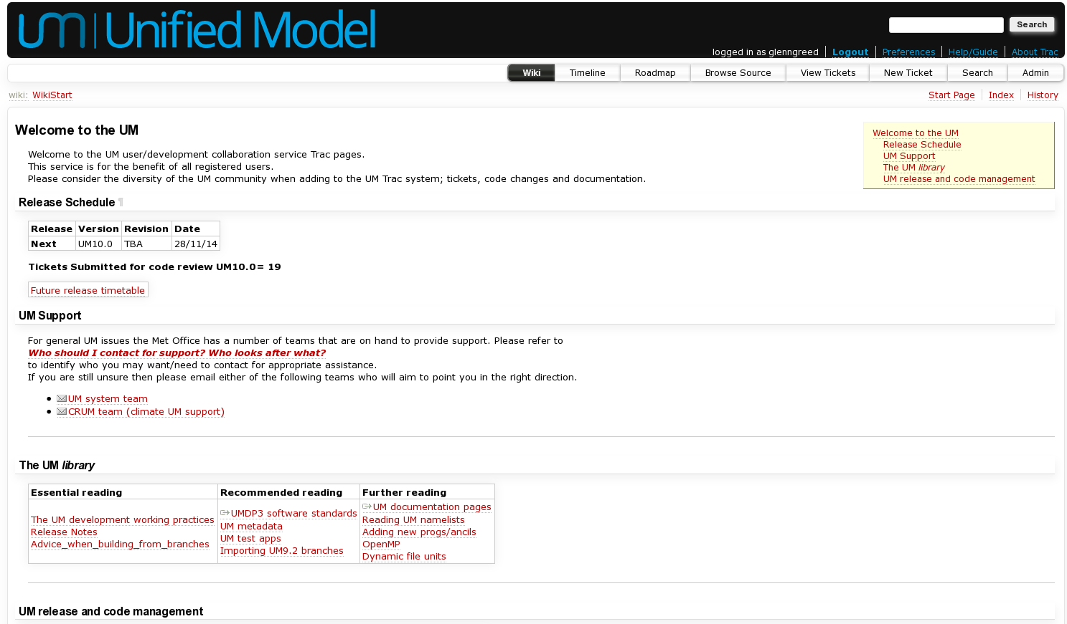
Where can I find it? How can I use it?
https://code.metoffice.gov.uk/trac/um/
Notes:
For Met Office staff, all you need to know may be found on the new UM wiki.
Partners are recommended to browse these pages also and contribute corrections and amendments as these pages become suitable for everyone.

Slide 36

Red sky in the morning,
shepherds warning!
Notes:
Tickets need to be opened on the new system. Please consider closing old issues on the old system.

Slide 37
Red sky in the morning, shepherds warning!
The UM collaboration service is for the benefit of all registered users.
Please consider the diversity of the UM community when adding to the UM Trac system; tickets, code changes and documentation.
NEVER add code to the UM repository (to any branch) that has been developed under a license other than the UM license, without agreement from the UM system team.
Please do not lift code from books either......
Notes:
Please be careful what you put on the UM collaboration service. This is no longer an internal system.

Slide 38

Watch your branches CC attribution 2.0 license SA Hooper, Swansea.
Notes:
Be careful when using branches in a build job.

Slide 39
Watch your branches
If your build job is dependent upon branches then always use known working revision numbers.
You may not be aware when such a branch is altered or removed by the owner, either intentionally or unintentionally.
Suites should aim to include the build apps for the used executables.
Operational/production suites should aim to avoid using branches and push for code to be approved for the UM trunk first. If not possible then use revision numbers!
Branches commits will be locked down to the branch owner
Shared branches to a few owners.
Notes:
Branches, be careful and mitigate against problems.

Slide 40
How to migrate?
No tickets will be migrated from any old repos to the new one.
Why?
At the Met Office we have
989 open tickets....
It is YOUR job to migrate your tickets....
Please please please
only migrate valid tickets and close old invalid tickets.
Notes:
Tickets need to be opened on the new system. Please consider closing old issues on the old system.

Slide 41
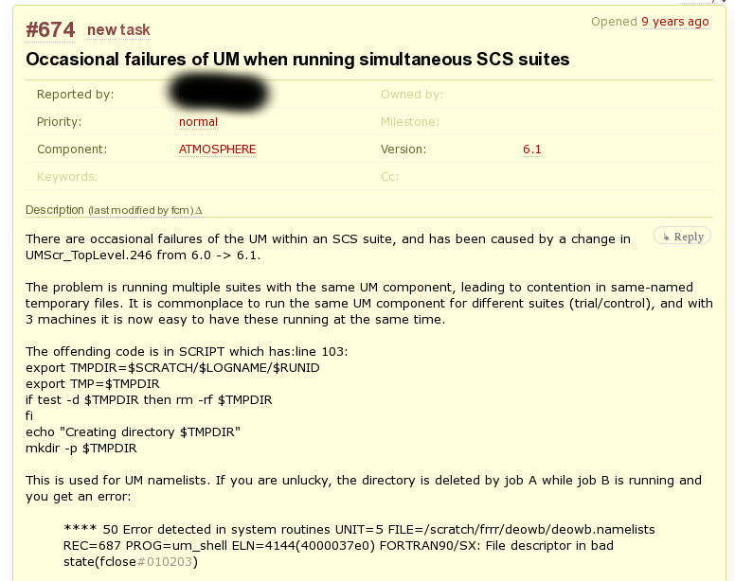
‘Classic’ UM ticket failures….
Notes:
Spot the issues with this ticket...
9 years untouched!
SCS mentioned
No owner
No target milestone
At version 6.1. Is this still a problem at UM10? Of course not!

Slide 42
Migration….
Various changes all documented
UM9.2
Jagged Jetstream
UM internal trunk closed.
Developers continue to branch.
UM9.2.x for UM system work only
Not for code development
Mirrors set up.
Code Styling
UM10.0
Kinetic Khamsin
where developers can work from
UM9.2 forms
rev 1
UM10.0
rev X
Notes:
How we got from UM9.2 to UM10.0.
UM9.2.1 building works using internal JULES.
UM9.2.2 JULES shared platform support added

Slide 43
How to migrate continued..
Before migrating any branch to the new repos
we expect you to have created a suitable ticket to document the branch.
The UM system have a couple of scripts to assist with some of the migration work for you.
For example:
The first will take a UM9.2 branch and create an equivalent branch on the shared repos.
Notes:
Open tickets before creating branches. A ticket is a vital part of code development documentation.

Slide 44
How to migrate continued..
You CANNOT use a UM9.2 branch to build anything
on the shared repository. The build configs do not support it.
Once you have a branch at UM9.2 on the shared repos you must then upgrade your changes to UM10.0 the inaugural release on the shared repository.
A second script is provided to reapply the UM10.0 code styling after merging your changes in.
Please note JULES has also migrated!
https://code.metoffice.gov.uk/trac/jules
Notes:
Active code development for the general user/developer should work from UM10.0
The configs at UM9.2 do not support the new build process (mirrors) and hence one cannot build a UM exec from UM9.2 on the shared repos.
You must use a later revision, a stable 10.x series release.

Slide 45
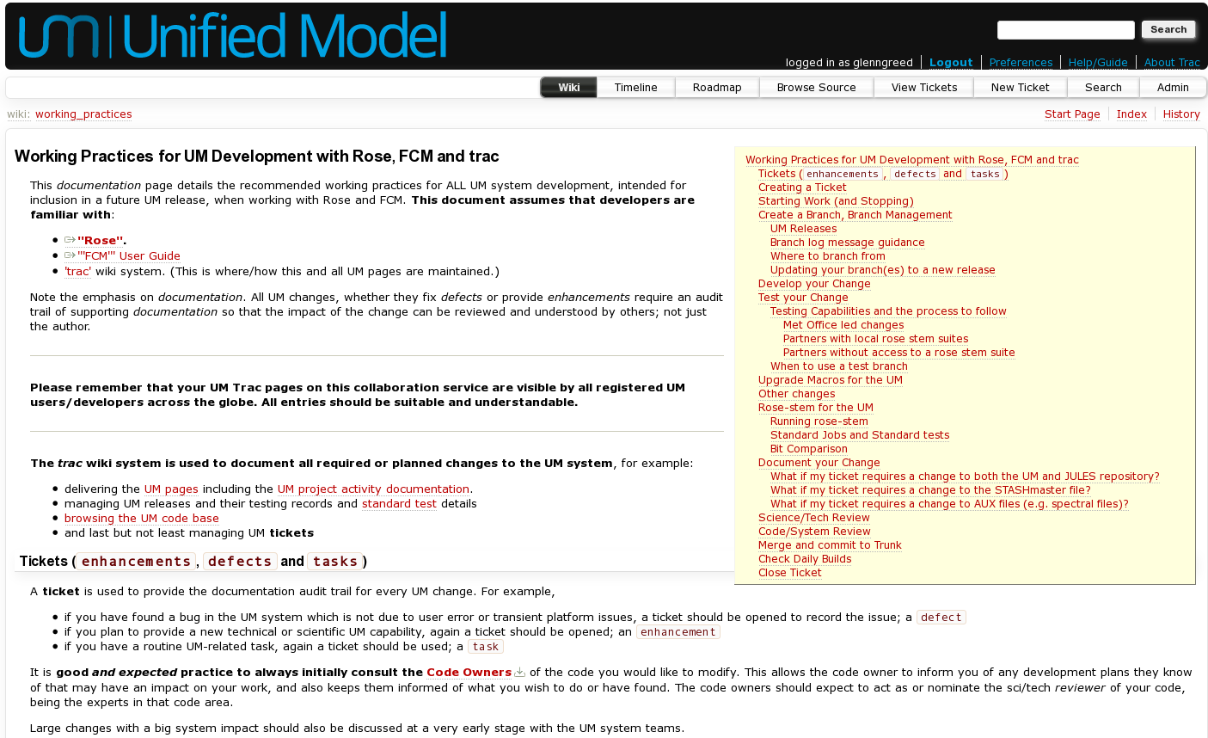
The Working Practices
As part of Quality Assurance the UM working practices must be followed when developing changes on the UM repos.
Notes:
It is expected that all code development will follow the UM working practices.
Please can all developers read this. While they are based upon the previous Met Office UM practices, we have made changes to them to support shared development and to hopefully improve our process.
If you feel that you have a development that does not fit with these working practices then please get in touch as this is a living document that will change in response to feedback. We expect this to change as partners get more involved.

Slide 46
Mirror mirror held locally… What is different for our community?
The build system extracts from an internal UM mirror.
fcm-make app takes config files from the mirror and the configs then extract the source from the mirror too.
You cannot extract anything from the shared repository itself.
The Met Office mirror is updated every 5 mins.
Each site is expected to maintain an internal UM mirror.
Shared repos fcm:um.x Where branches are created/committed
Mirror fcm:um.xm No commits possible here. Read-only
Notes:
The implications of an internal mirror. Extracts are quicker from an internal mirror than from the cloud, speeding up the build process.
Thus one needs to be aware of the presence of the mirror.

Slide 47
The future for UM testing.....

Slide 48
The future of UM testing…
“Automation is the key to unlock robustness.”
Benefit
Cost
Configurations
Platforms
Test space
code base
Notes:
Tests need to encompass as much as possible:
balance between benefit and cost

Slide 49
Partner Testing configurations
Common
small
subset
N48 global
SmallLAM
Met Office
Partner site specific tests
Notes:
Currently the only routine testing of the UM trunk is at the Met Office.
Now that partners can see the UM trunk I encourage our partners to contribute to our routine testing of the trunk to improve multi platform testing of our code.
A common set of tests need to be agreed.

Slide 50
Some issues to overcome…
Partners
With
Work
When will partners contribute to
daily testing?
When partners do routinely test the UM when can we close tickets as being successful?
Communication of results ...... ??
When things are broken how to resolve issues.
How to forewarn known results will change to partners and support the updating of known good output?
Code reviewers outside of the building?
Notes:
We have not yet got all the answers and things need to be worked out between the UM tech teams.

Slide 51



Future releases code submission timelines
UM10.1 (Luminescent Lighting) 13th Feb 2015
UM10.2 (Moist Monsoon) 12th Jun 2015
UM10.3 (Nebulous Nimbostratus) 16th Oct 2015
UM10.4 (Opaque Occlusion) 12th Feb 2016
Currently all planned to be open for science changes.
Notes:
Future release timetable.

Slide 52
Accounts…..
If you are inspired (and not put off) to use the new UM repository....
Met Office staff apply to
​Scientific_Partnerships@metoffice.gov.uk
Partners please consult
https://code.metoffice.gov.uk/trac/home/wiki/FAQ
for details on how to apply for accounts.
We look forward to your UM contributions!

Slide 53
Questions ?

