Slide 1
ACCESS-ESM1.5
Tilo Ziehn

Slide 2
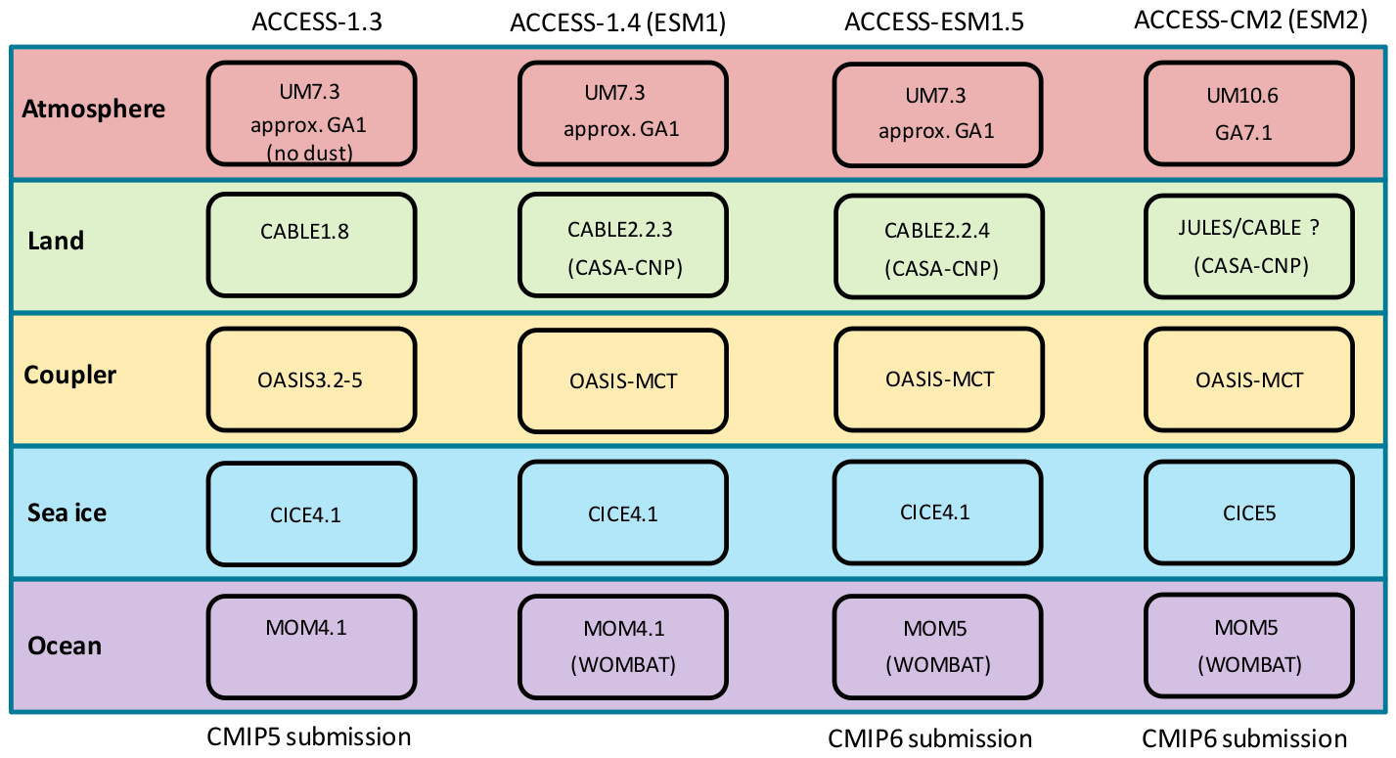
ACCESS configuration/components

Slide 3
ACCESS-ESM1.5
Land – CABLE improvements and bug fixes
Improved land carbon conservation
Improved prognostic LAI (mainly evergreen needle leaf and C4 grass)
Improved arctic sea ice thickness
Land use and land cover change (LULCC) capability
Ocean – model upgrade
MOM5 instead of MOM4.1
New biogeochemical parameter set in WOMBAT

Slide 4
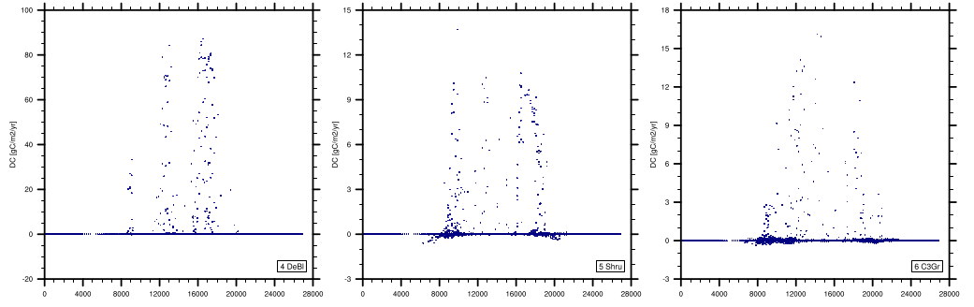
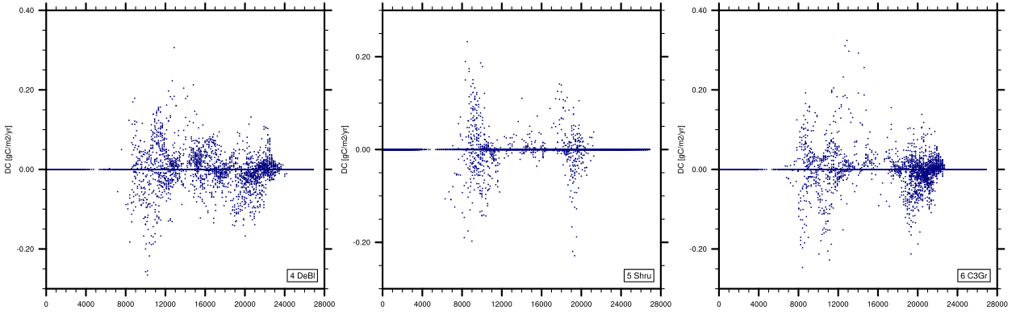
a. Land carbon conservation
Imbalance ACCESS-ESM1
(NEE vs. change in Cpools)
Approx.: 0.07 PgC/yr
Imbalance ACCESS-ESM1.5
(NEE vs. change in Cpools)
Approx.: 0.00015 PgC/yr

Slide 5
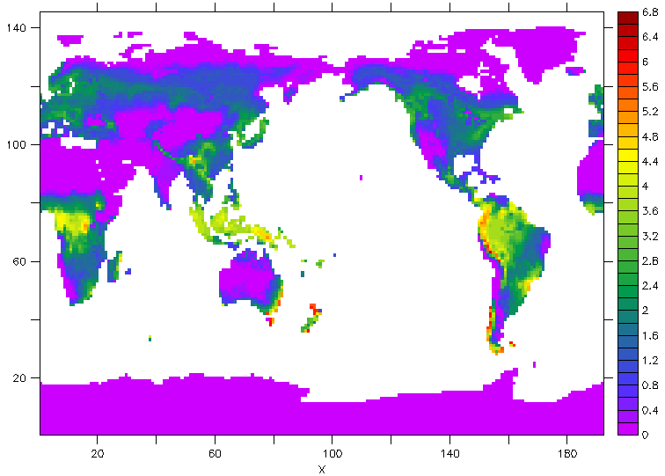
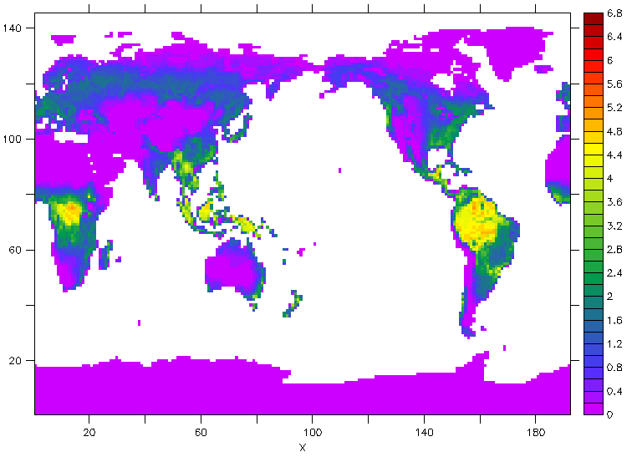
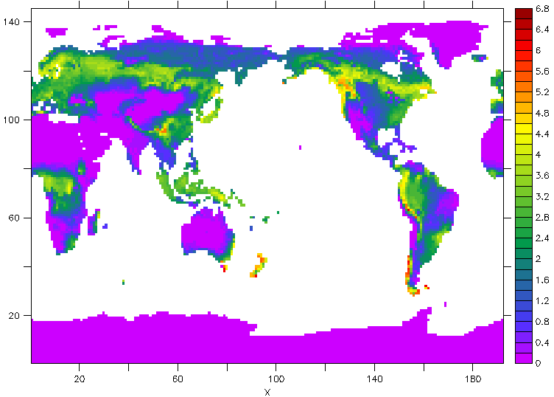
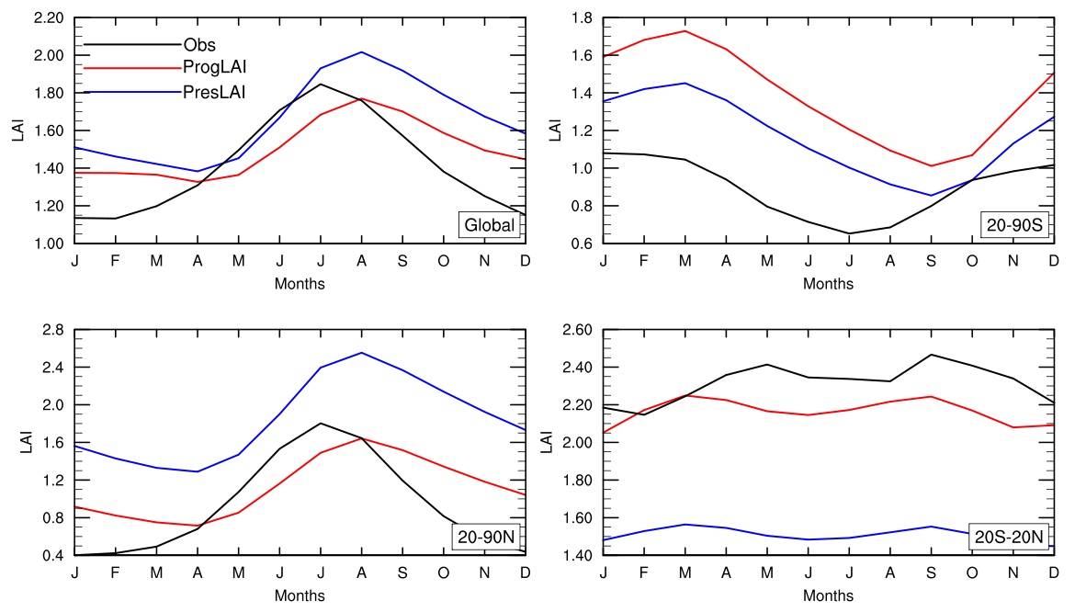
b. Prognostic Leaf Area Index (LAI)
ACCESS-ESM1.5 (pre-industrial)
Observations (present day)
ACCESS-ESM1 (present day)
Observations
ACCESS-ESM1.5
ACCESS-ESM1
Mean LAI in ACCESS-ESM1.5
reduced in NH (evergreen needle leaf)
increased in TR (evergreen broadleaf and C4 grass)
Too high in SH (but only small area)

Slide 6
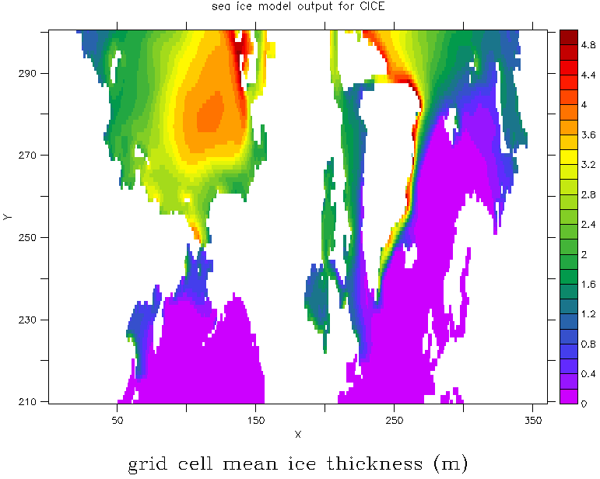
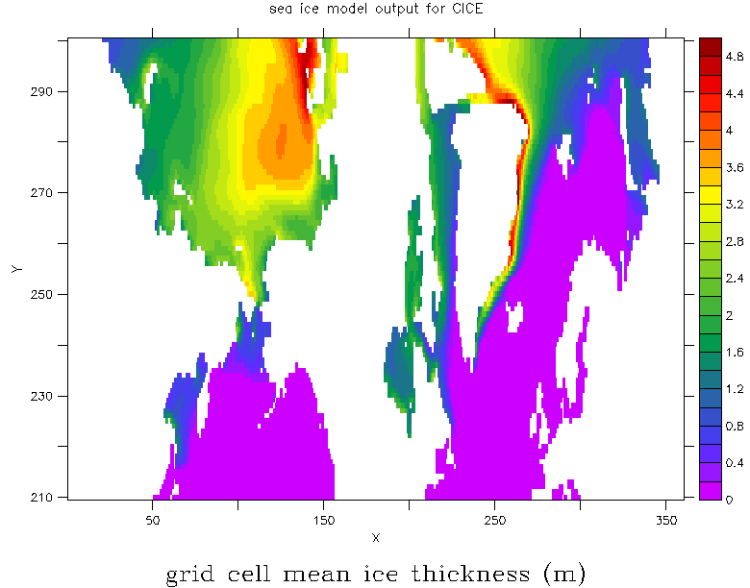
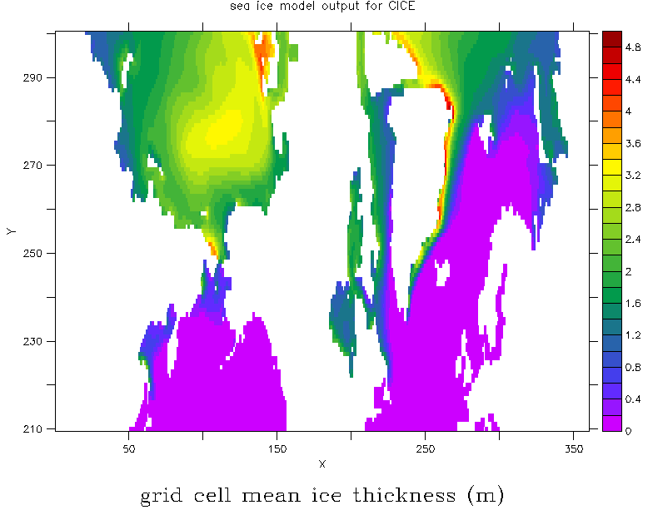
c. Arctic sea ice
10 year mean for April from control run
ACCESS-ESM1.5 (progLAI)
ACCESS-ESM1 (presLAI)
ACCESS-ESM1 (progLAI)

Slide 7
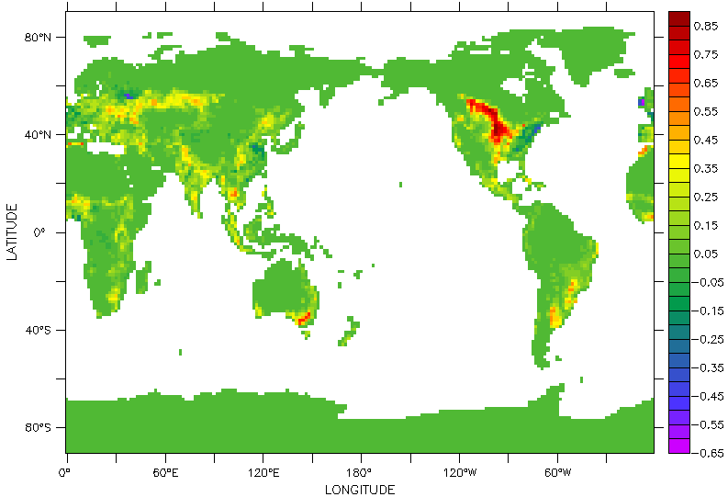
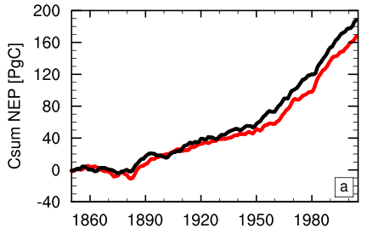
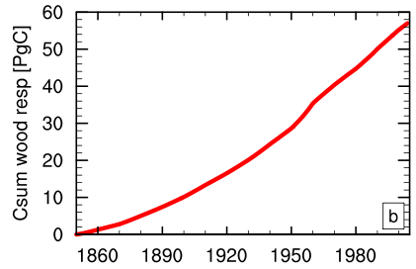
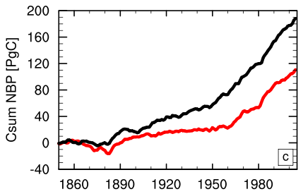
d. Land use change component
LULCC scheme based on previous Mk3L implementation (tested and published*)
No secondary vegetation, no transition matrix
3 wood harvest pools (equally partitioned)
Consumption of wood is accounted for through respiration fluxes (fuel wood (1yr⁻¹), paper and paper products (0.1 yr⁻¹), wood products (0.01 yr⁻¹))
Change in crop fractions (2005-1850)
Preliminary results
Black: no LULCC
Red: with LULCC
*Zhang et al. (2013)

Slide 8
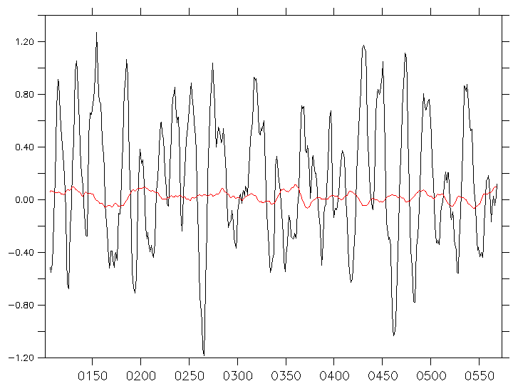
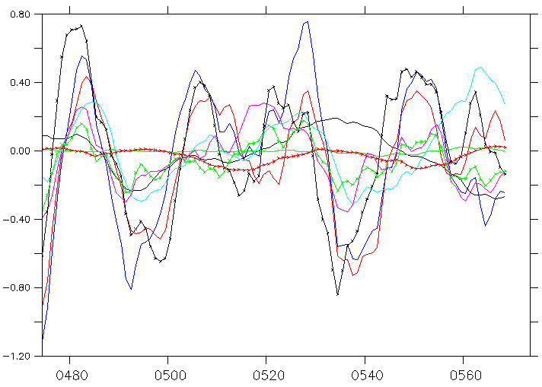
Progress towards CMIP6
Code for ACCESS-ESM1.5 (almost) finalized
Spin-up run commenced (but still using CMIP5 forcing)
Test-run over historical period with and without LULCC (CMIP5 forcing)
Black: net land carbon flux (10yr mean), approx. 0.05 PgC/yr over last 100 years
Red: ocean net carbon flux (10yr mean), approx. 0.02 PgC/yr over last 100 years
(CMIP6 recommendation: carbon fluxes should be close to 0 (< 0.1 PgC/yr))
Colored lines: net land carbon flux for each of the 9 PFTs (10yr mean)

Slide 9
[name] | [email] [phone]

