Slide 1
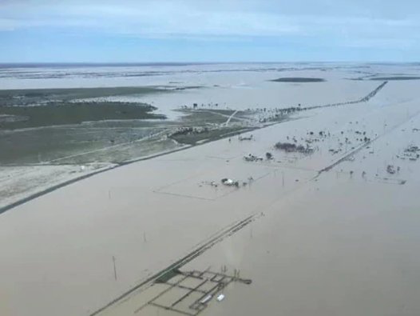
River routing in ACCESS-G: preliminary results and future opportunities
Huqiang (Hugh) Zhang
ESM/Research/BoM
Acknowledgement: Huw Lewis (MO hydro-JULES discussions)
Narendra Tuteja and Urooj Khan (hydro modelling)
ACCESS Science Day 11/06/2021

Slide 2
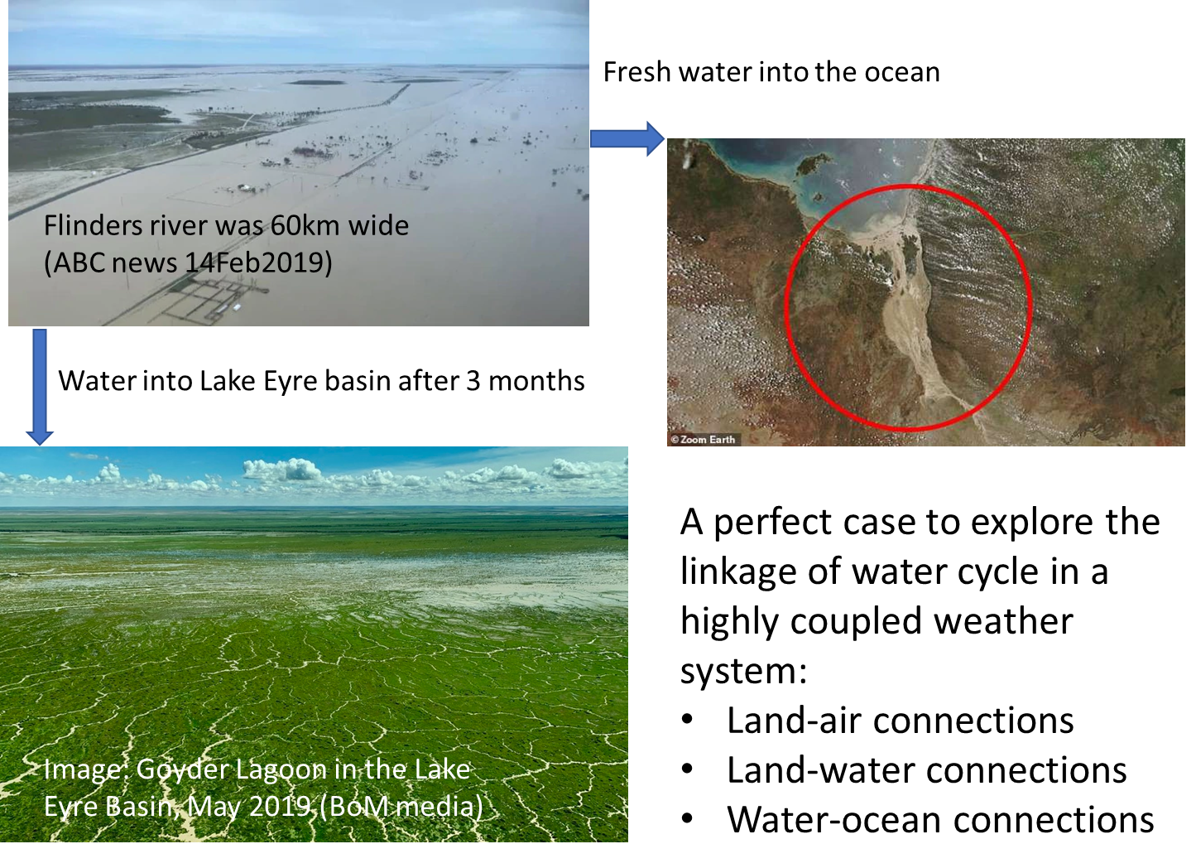
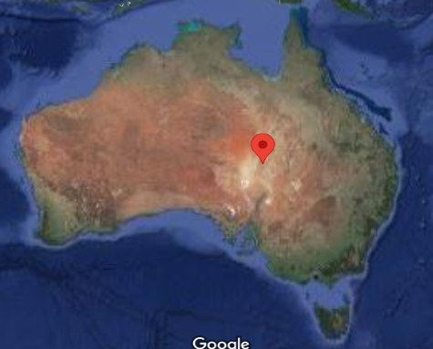
Jan-Feb 2019 Queensland flood:
We need to know where did the water go and by how much
Horizontal water move
Inundation
Vegetation-soil water interaction
Surface water-ground water interactions

Slide 3

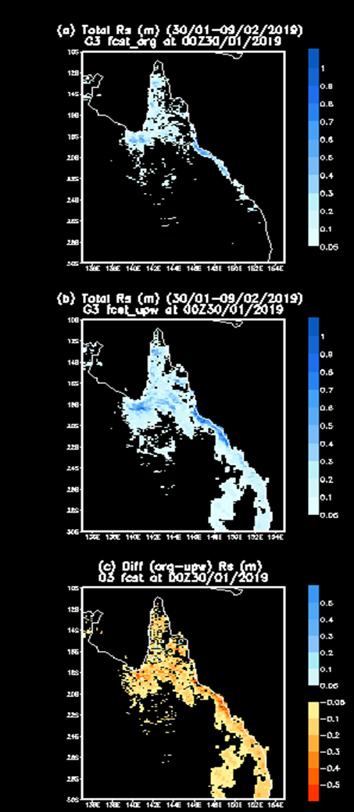

Operational System Evaluation and Assessment: sensitivity to different physics settings in ACCESS-G3
l_soil_sat_down=.false. (default =true)
Increase in surface runoff
(Fast runoff generatio)
Drier sub-surface soil moisture
Affecting predictability
Affecting intraseasonal/seasonal prediction due to soil moisture memory
Org
Total runoff (m)
30/01-09/02/2019
New
Diff
What one is right to use?

Slide 4
Routing (integrating) these model-produced runoff and then comparing them with observational river flow could give us some clue on the UM physics settings in our region
JULES + PDM/TOPOMODEL TRIP

Slide 5
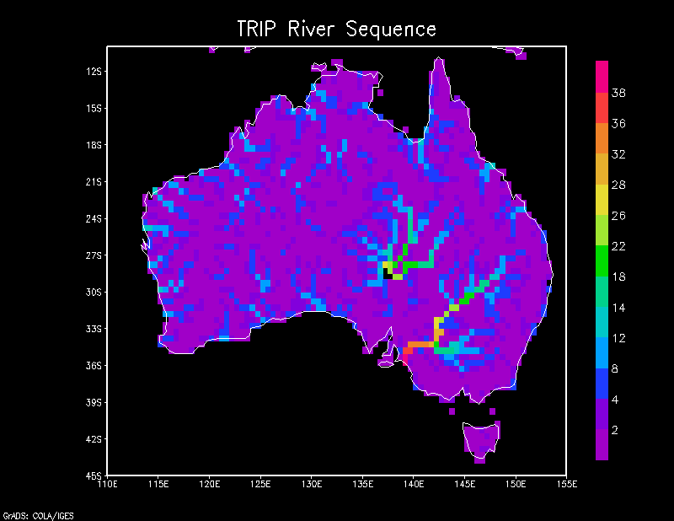
TRIP (Total Runoff Integrating Pathways scheme) at 1ox1o resolution
This river routing can be run as post-processing or within the operational suite

Slide 6
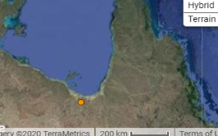
Daily River discharge Comparison (ML/day)
Leichhardt River at Floraville Homestead (913007B: 18.14S 139.52E)

Slide 7
Future: towards seamless and integrated hydrological modelling system
Hydro-JULES development
High resolution river routing over Australia: RFM
Linkage with eReef G2G science and application
JULES~ AWRA-L knowledge and science fusion
(modified from Dadson et al. 2019)

