Slide 1
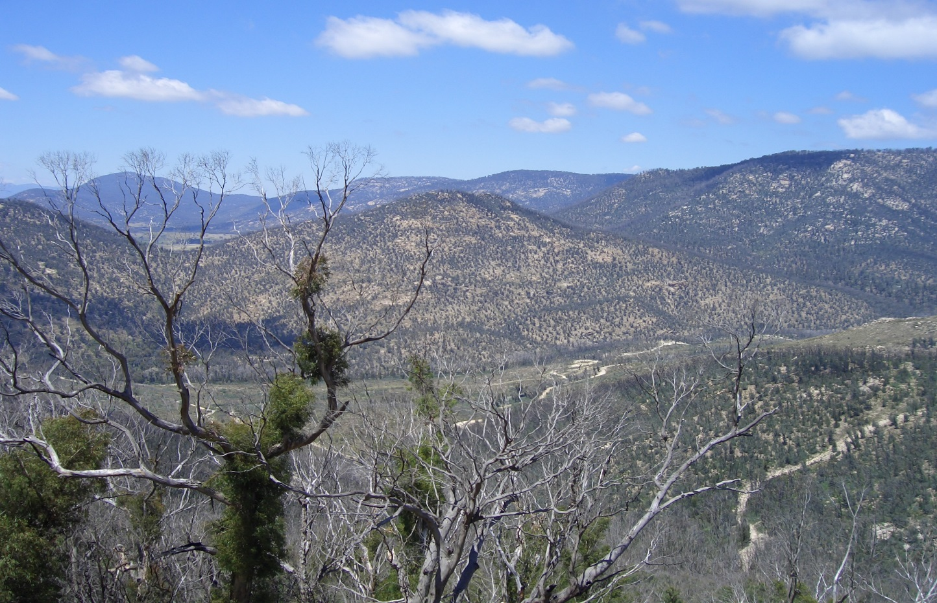
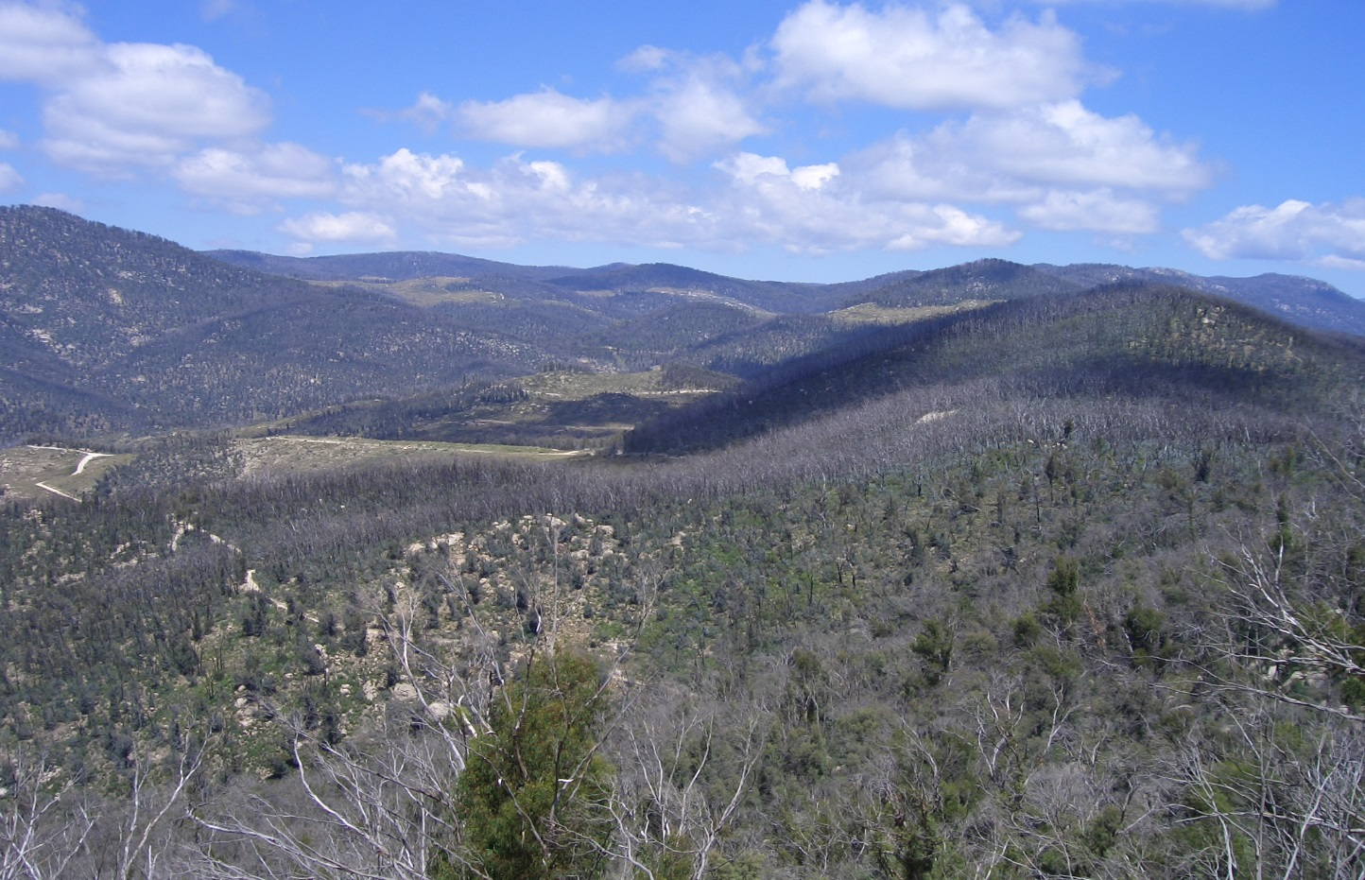
CABLE in ACCESS-CM2: A closer look
Ian Harman
C Mackallah, M Dix, R Law, J Srbinovsky
+ ACCESS team, CLEX and CMS colleagues
CSIRO OCEANS and Atmosphere
Notes:
First like to acknowledge the range of contributors in this work – especially technical support people at CSIRO and CMS without whom this would not have been possible.
Credit goes to collaborators but any errors are due to me.
Going to show early (indicative) results – mainly model-model not model-obs – so differences not better/worse performance.
10 veg types – ENL, DNL, EBL, DBL, shrubs, c3 grass, c4 grass, tundra, C3 crop, wetland: + lake, bare soil, urban, permanent ice.
c4 crop exists but no land area; realistically no difference between c3 grass and c3 crops.

Slide 2
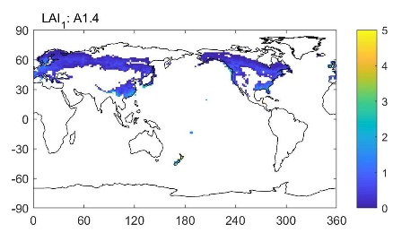
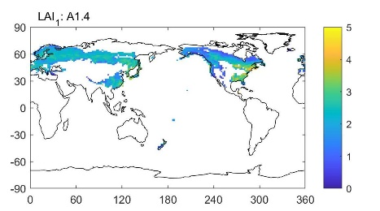
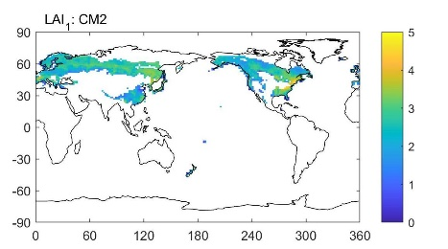
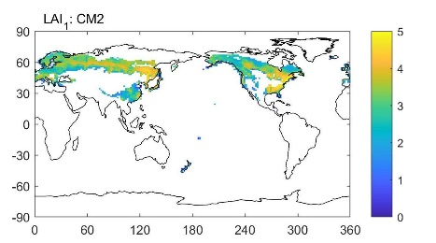
what? why?
CABLE in ACCESS1.3 ≠ ESM1.5 ≠ CM2
Changes in biophysics since ACCESS1.3
technical interface(s) with the UM/JULES
internal bug fixes
new parameter sets
ice roughness and albedo
leaf-area by plant type
rooting depths by plant type
radiative properties by plant type
new science options
Medlyn stomatal function (Kala et al.)
soil moisture-transpiration-photosynthesis (Haverd et al.)
soil thermal conductivity (Decker & Verhoef)
Leaf area for evergreen needleleaf trees
DJF JJA
monthly leaf area is derived from satellite product (MODIS) for the 10 CABLE vegetation types, via an NCAR-developed disaggregation
DECK-AMIP runs (1980-2009) with ACCESS-AM2
A1.4 – with CABLE configuration as in ACCESS1.4*
A1.4+I – with updated parameters for permanent ice
A1.4+I+V – with updated parameters for ice and vegetation
CM2 – with updated parameters and new science configuration
*includes technical interface changes (including embedded science) and bug fixes. ACCESS1.4 = ACCESS1.3 + dust
Notes:
Starting point is that CABLE – as a important novel component of the ACCESS climate and Earth system models – comes in different flavours. This is not just whether or not certain science is active (e.g. carbon cycle) but also in code base, parameters and process representation.
During the development a number of changes made – some imposed (technical interface changes) – some bug fixes and some more discretionary. For example the leaf area inputs was updated allowing different disaggregation of satellite-derived estimate across vegetation types and in time. Leaf area is key input as it impacts the radiative exchange of the surface (albedo) and roughness – so we would be expecting differences from this change alone.
There is a legitimate question as to what (if any impact) did these changes have on performance (independent of changes elsewhere in ACCESS).
To get a handle on this we’ve run 4 experiments using different configurations of CABLE under the same atmospheric model. These are …
CABLE configured to be as close as possible to ACCESS1.3 (actually A1.4)
as 1. but with updates to parameters for permanent ice
as 2. but with additional updates to vegetation parameters (which includes leaf area maps)
as CM2 – so adding in 3 key science changes.

Slide 3
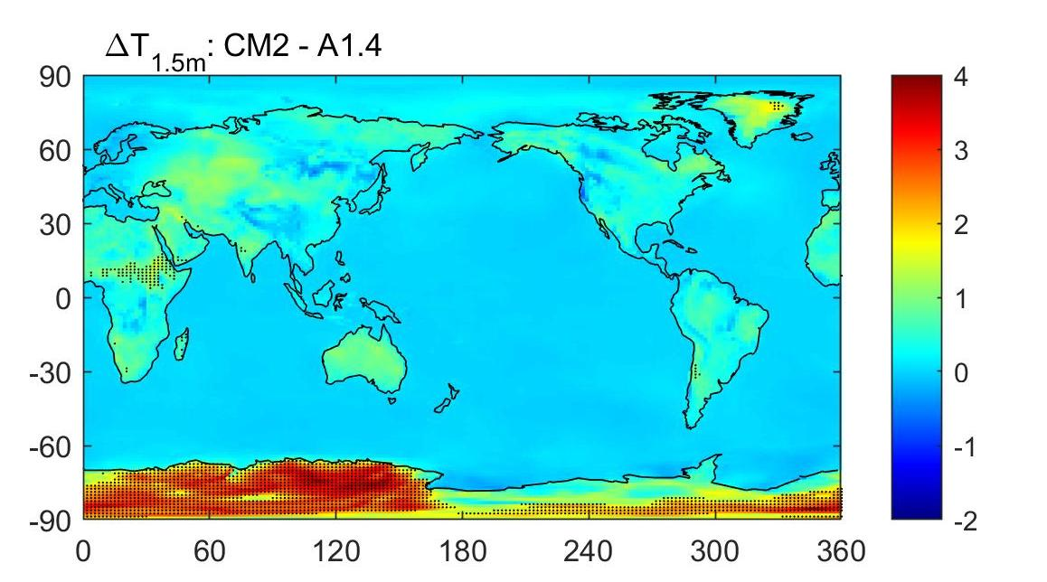
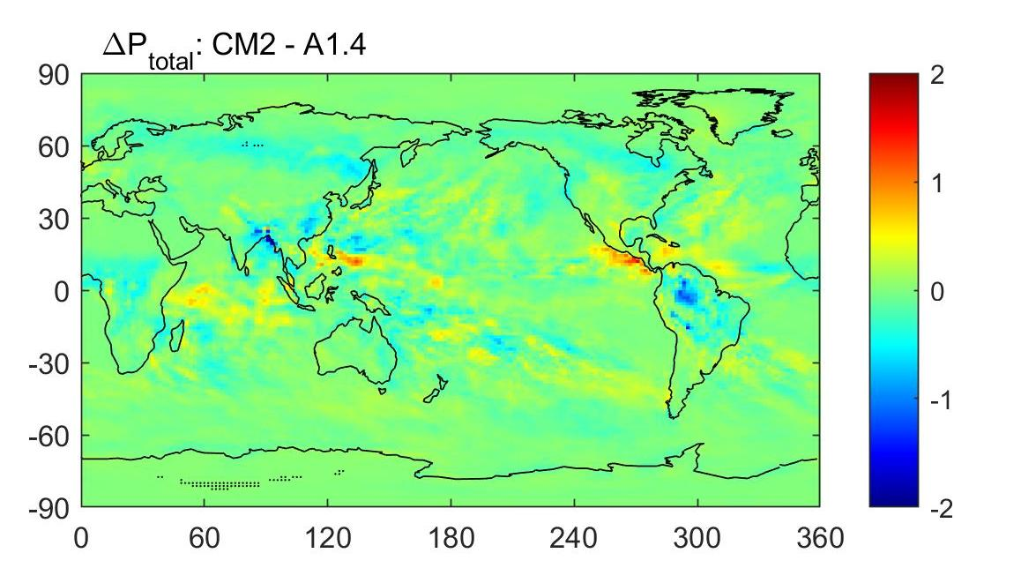
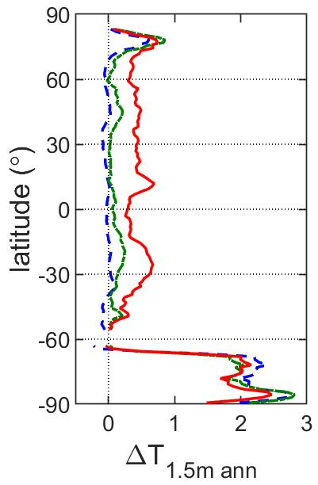
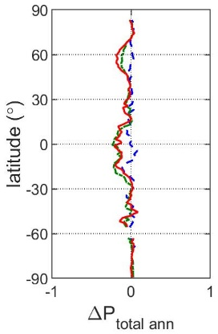
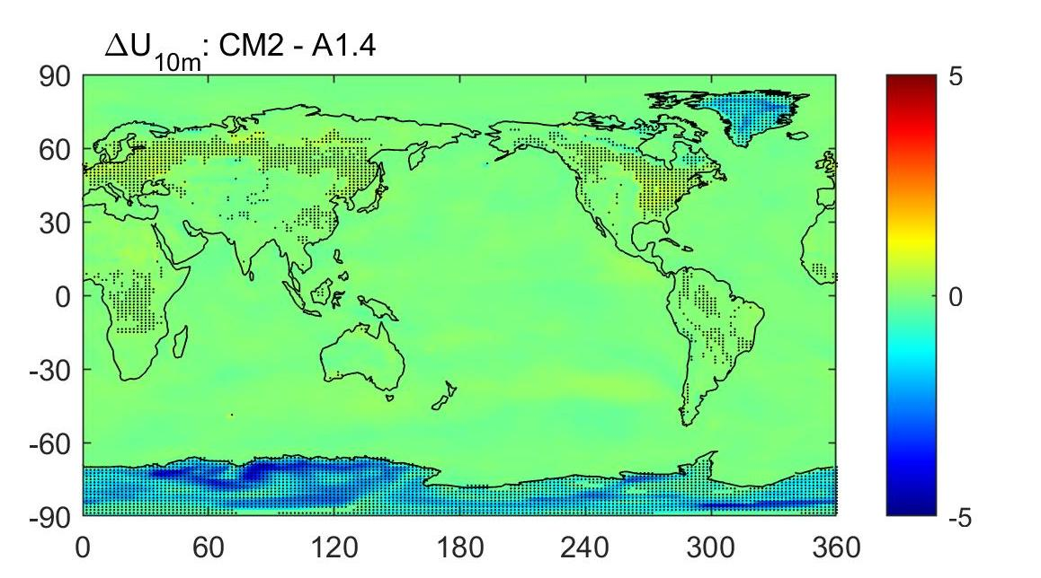
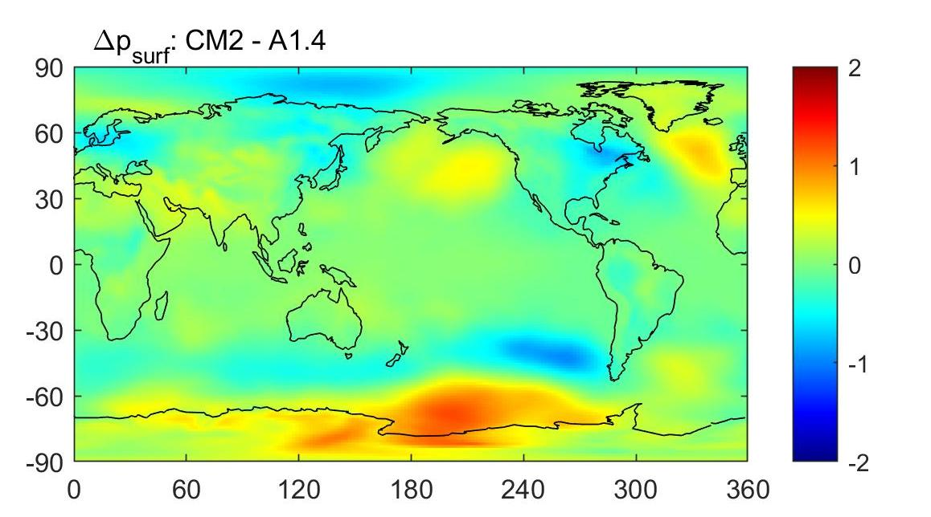
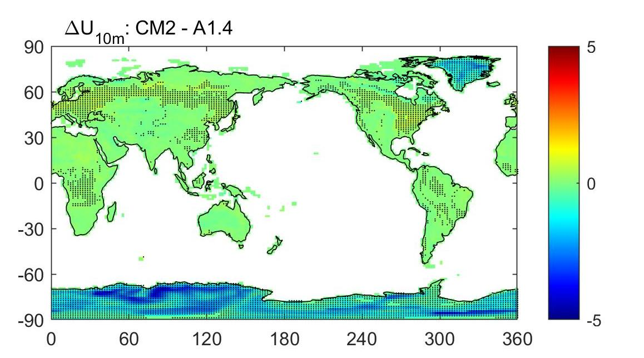
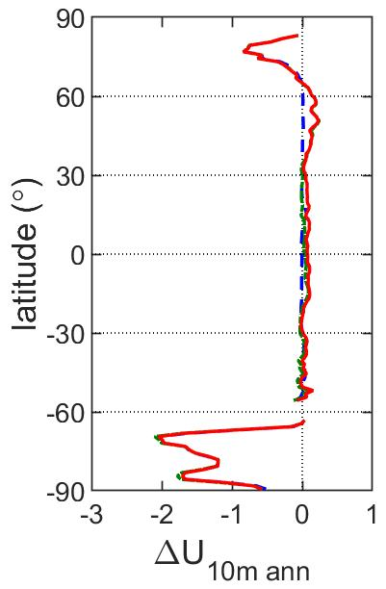
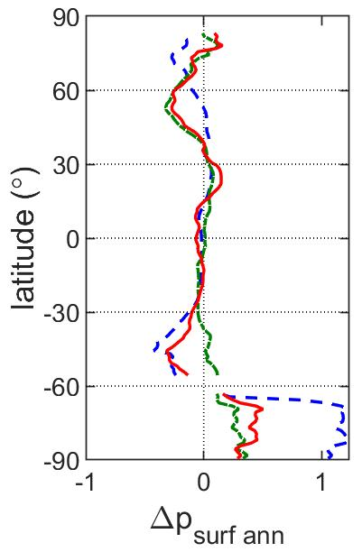
Near-surface climatology (annual average)
temperature (screen level)
precipitation (all forms)
(°C): obs 8.5; A1.0 8.75; A1.3 9.15; A1.4 7.69; CM2 8.29
(mm day⁻¹): obs 2.04; A1.0 2.13; A1.3 2.57; A1.4 2.31; CM2 2.24
wind speed (10m)
surface pressure
no significant differences in global-average AOD, soil moisture, snow mass and cover, runoff
Observational estimates and values from ACCESS1.0 and ACCESS1.3 from Kowalczyk et al. (2013); ACCESS1.3 = ACCESS1.0+CABLE+UM updates
Notes:
Start with the overall climate – four panels showing difference between the full CM2 configuration and A1.4 configuration; stippling a rudimentary indication of significance with respect to year-to-year variability. The side panels show latitudinal averages over land with colours indicating the scenario (show provide some indication as to where any differences emerge).
Two areas of significant differences in near-surface air temperature emerge – Antarctica and Sahel. Though note that (while not necessarily significant) localised differences in annual near-surface air temperature between configurations are comparable/larger than historical change. The annual grid cell averages are also hiding larger magnitude differences by season and by land cover.
In 10m wind – again Antarctica/Greenland but also many other areas are nominally significant even if the change is small. Due to increase in roughness.
Otherwise – hard to discern significant changes in many, broad scale aspect of the mean climate.

Slide 4
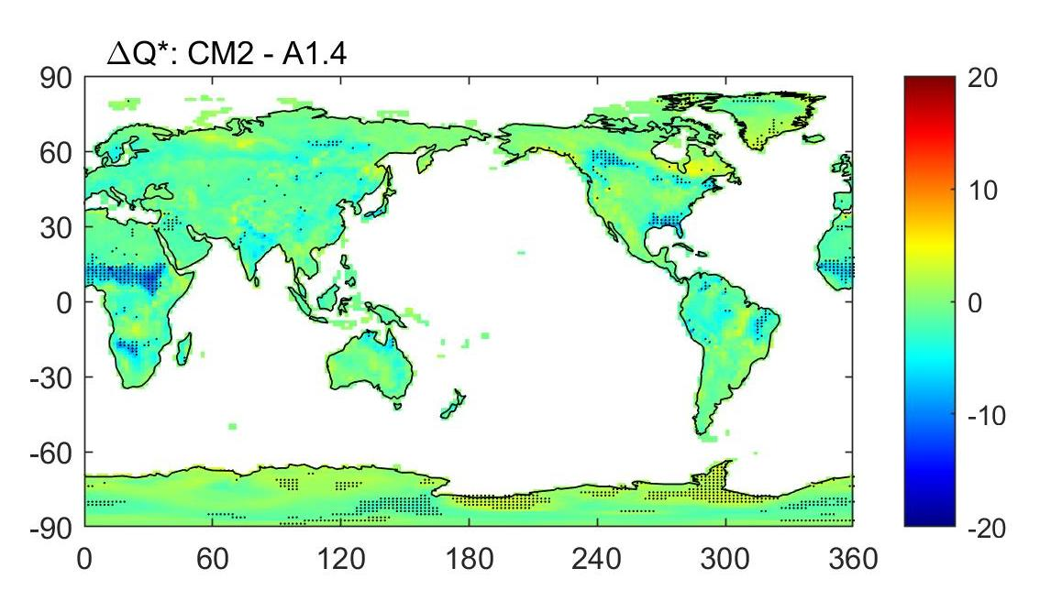
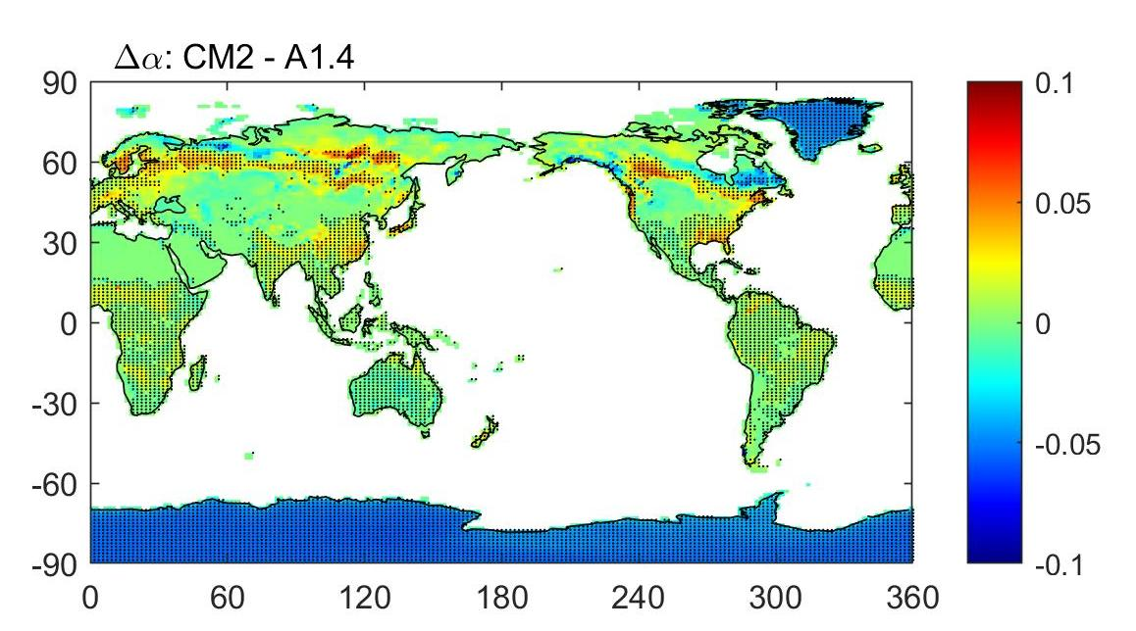
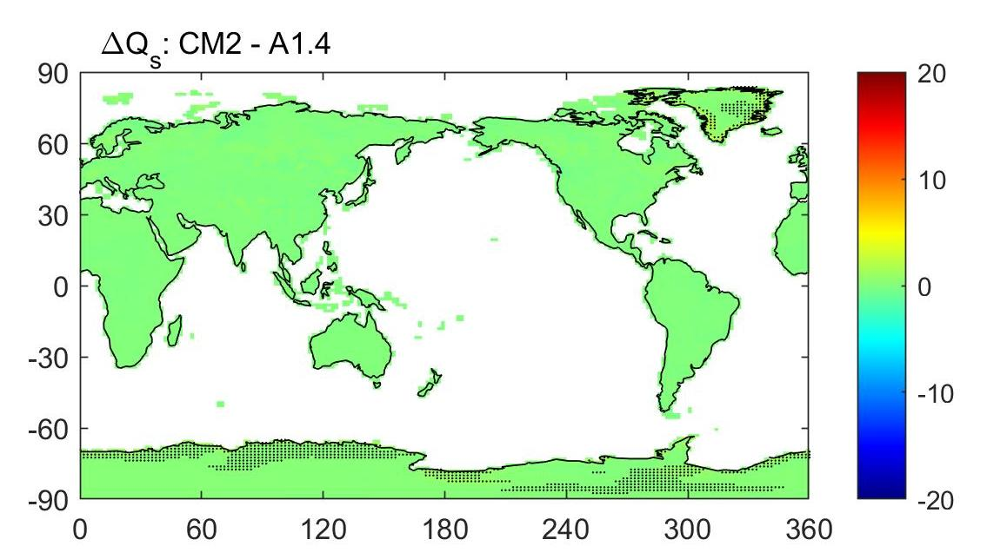
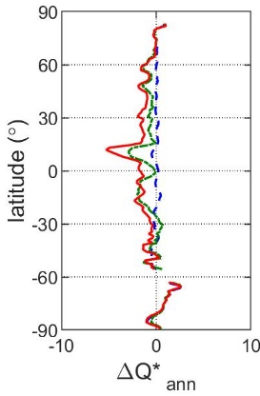
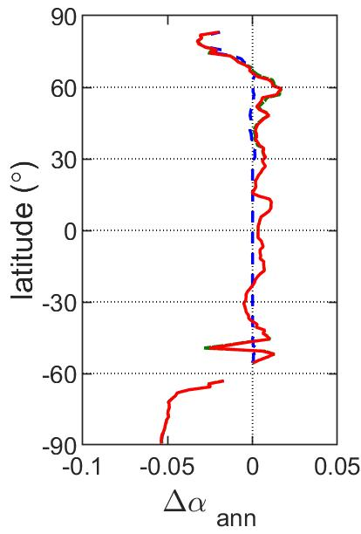
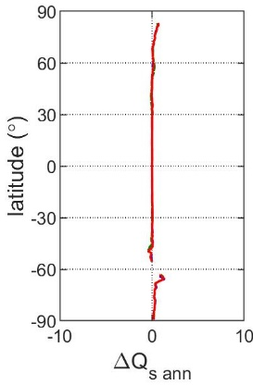
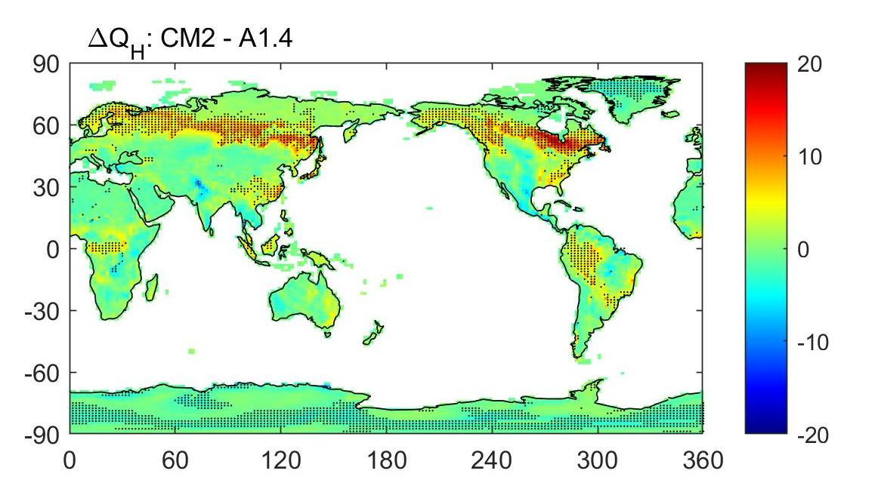
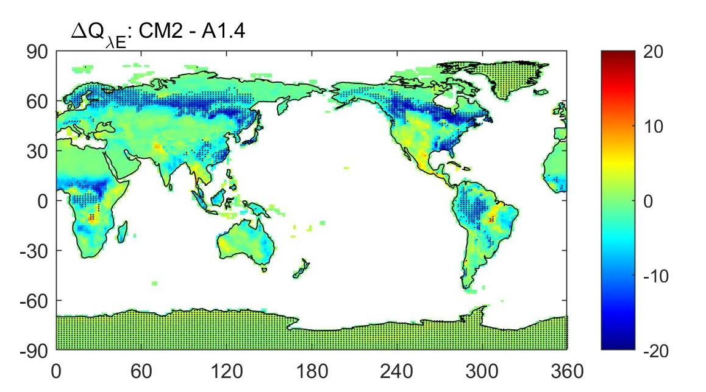
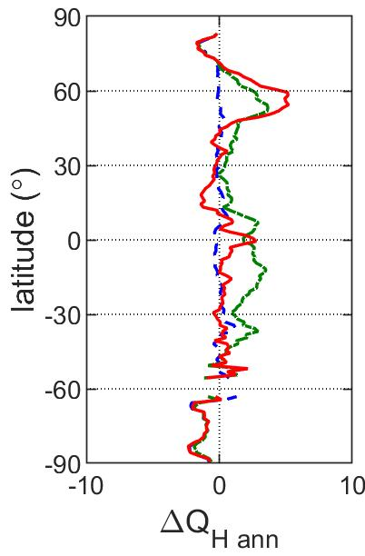
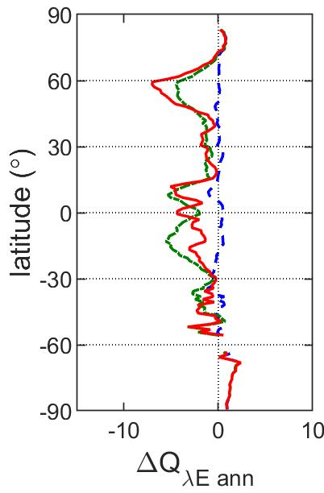
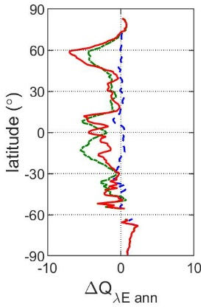
Surface Energy Balance
averaging is masking a lot of variation by season and vegetation type
net radiation
albedo
(Wm⁻²): obs 66.4-72.2; A1.0 77.7; A1.3 74.8; A1.4 73.3; CM2 72.1
sensible heat
latent heat
(Wm⁻²): obs 30.5-37.3; A1.0 31.4; A1.3 24.0; A1.4 27.2; CM2 27.8
(Wm⁻²): obs 34.4-35.9; A1.0 43.4; A1.3 48.8; A1.4 45.1; CM2 43.0
Tall canopies: change in Bowen ratio
Sparse canopies: soil is exposed → changes to soil thermal conductivity involved
Observational estimates and values from ACCESS1.0 and ACCESS1.3 from Kowalczyk et al. (2013); ACCESS1.3 = ACCESS1.0+CABLE+UM updates
Notes:
Nevertheless, its worthwhile investigating deeper if only to understand why those particular differences.
Consider first albedo – net decrease in surface albedo centred on permanent ice (about 0.05). This is primary driver of increase in surface temperature over ice (net Q=0 and a little increase in LE/decrease in H).
Away from Antarctica – combination of vegetation parameters and science over tall canopies leads to shift in Bowen ratio. Stomatal response is prime candidate - but note that the small change in albedo is hiding a lot of variation by season/veg type which could also allow non-trivial changes in the other surface fluxes.
Over sparser canopies (Sahel) the net result is a switch from latent to net radiation with little change in sensible.
This need further exploration though with sparse canopies the soil is exposed – so the soil thermal conductivity changes could be involved (as well as vegetation).
However – if this is the case then why is the Sahel impacted but not other semi-arid regions such as Australia?

Slide 5
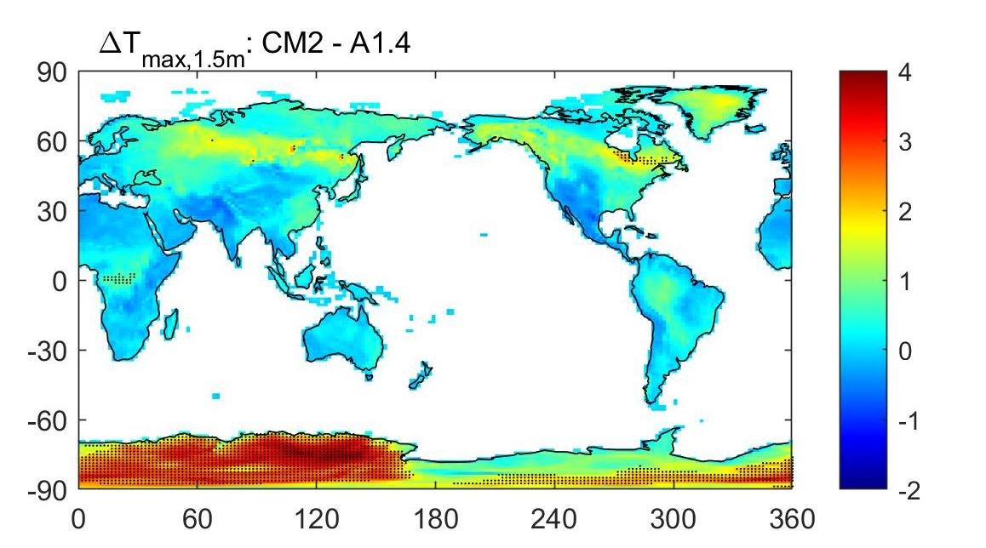
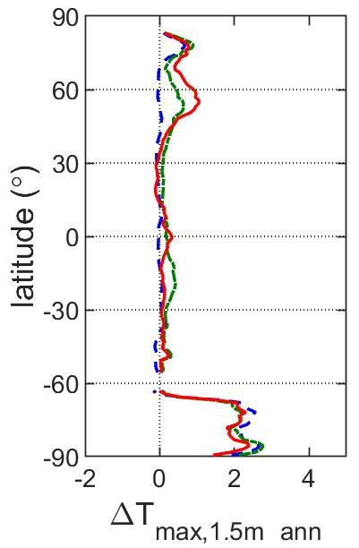
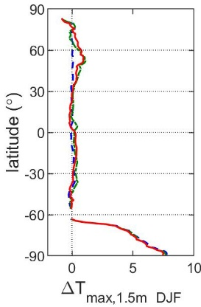
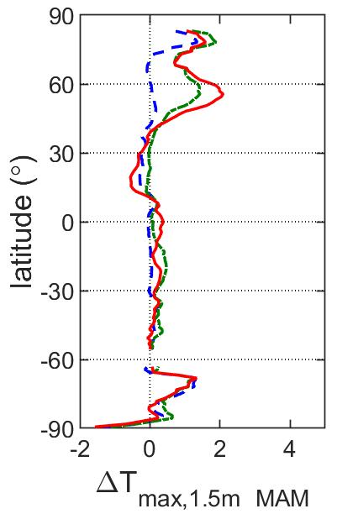
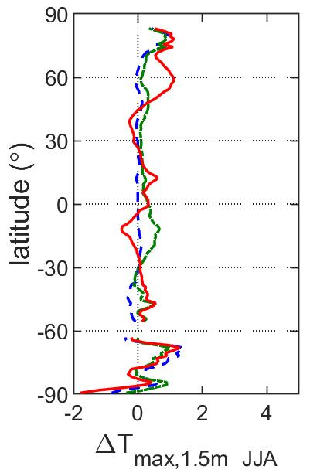
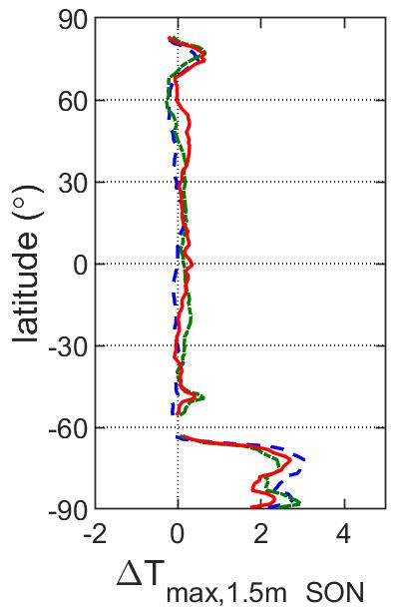
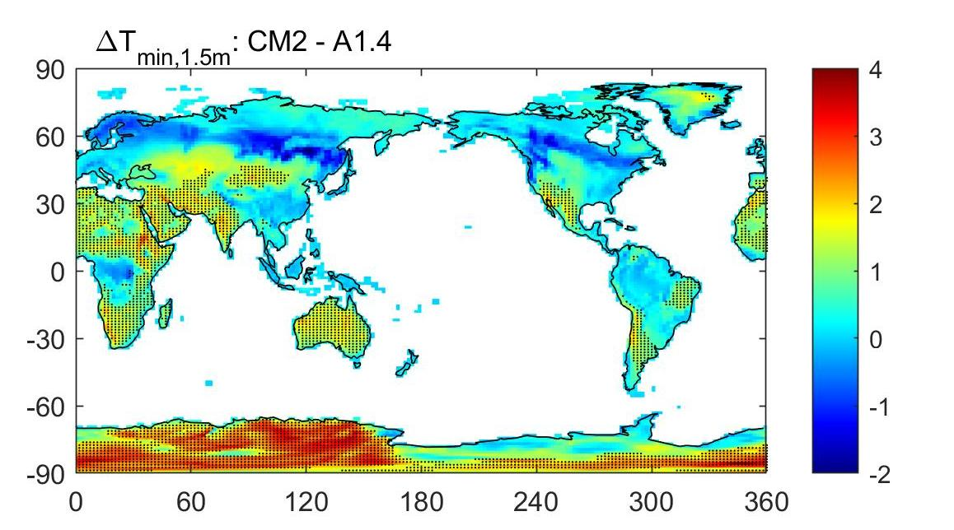
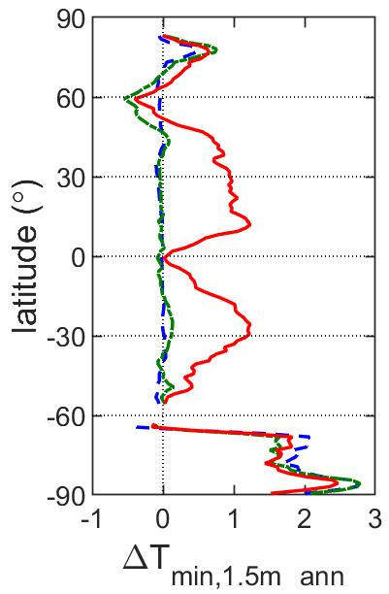
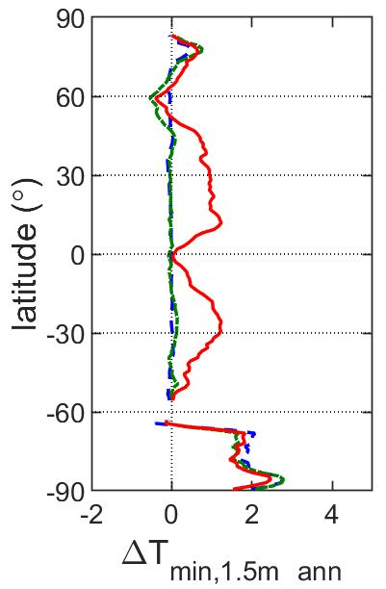
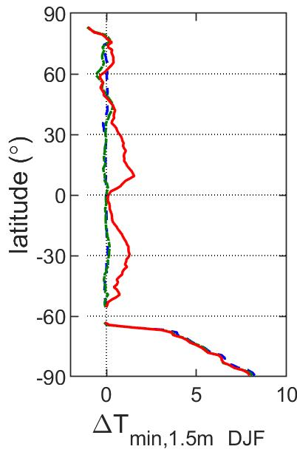
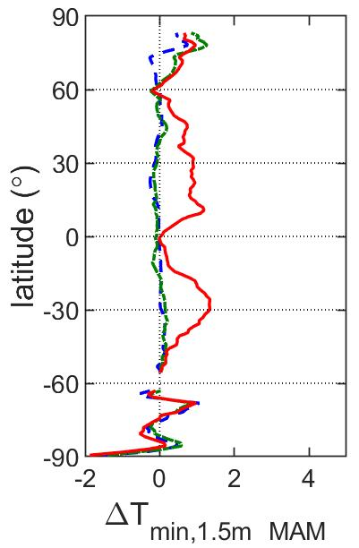
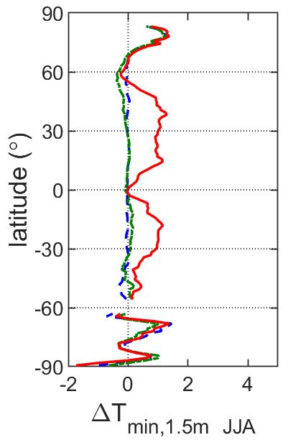
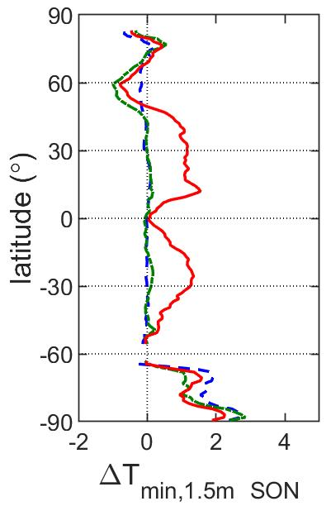
Diurnal temperature range
max T
differences by season
(°C): A1.0 13.3; A1.1 12.4; A1.4 12.4; CM2 12.8
min T
(°C): A1.0 3.8; A1.1 3.9; A1.4 2.9; CM2 3.7
warmer over Antarctica in both maximum and minimum temperatures
general decrease in diurnal temperature range – mainly increase in T_{min}
BUT increase in diurnal temperature range over boreal/tall canopies
Values from ACCESS1.0 and ACCESS1.1 from Kowalczyk et al. (2015); ACCESS1.1 = ACCESS1.0+CABLE
Notes:
Daily extremes in temperature are of key interest in many applications – as well as in verification space given that these are what the met/climate community routinely measures.
Here the panels on the right show the seasonal breakdown of the annual signal.
Broadscale results: Antarctica warmer throughout with little change in DTR.
Elsewhere – decrease in DTR (actually not what we would like with respect to agreement with observations), largely due to widespread increase in min temperature. (has to be thermal conductivity as impacts deserts as well as sparse canopy areas).
and a rather odd increase in DTR over tall canopies/boreal regions. Odd because the changes in LAI (roughness) and increased albedo would indicate smaller DTR.

Slide 6
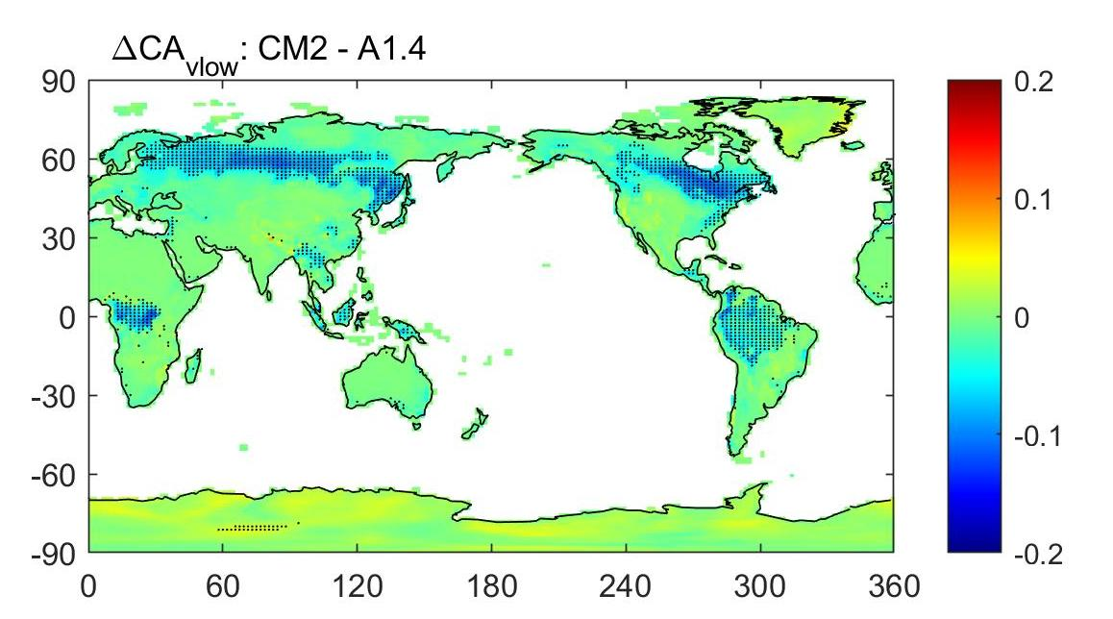
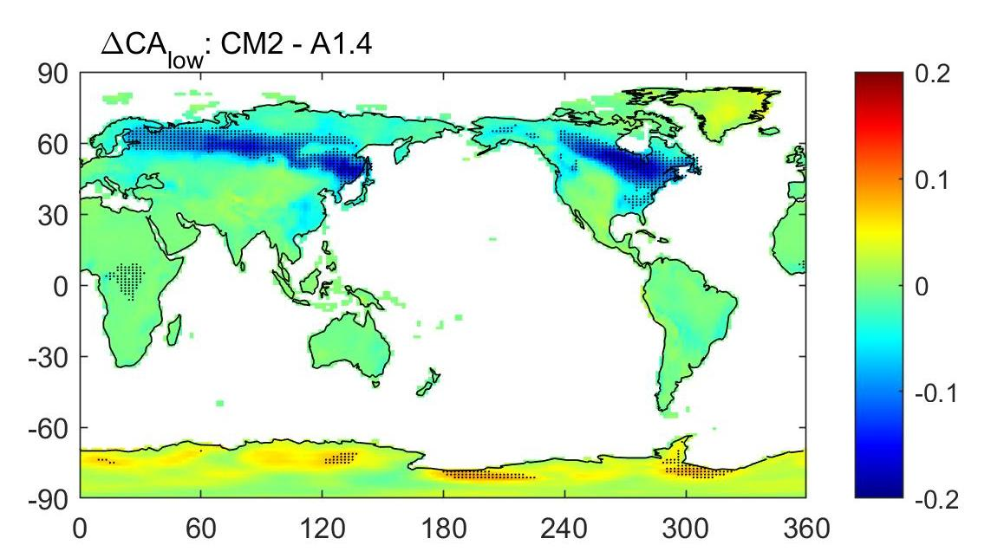
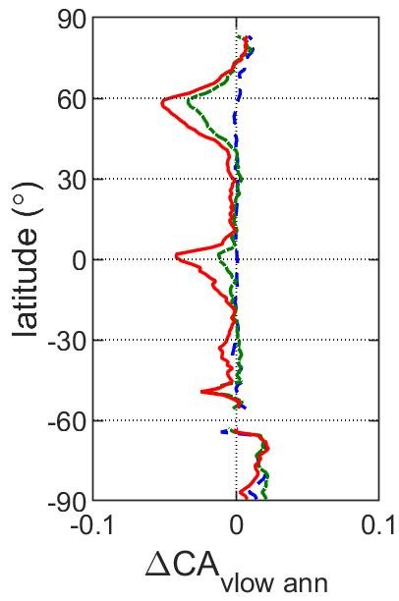
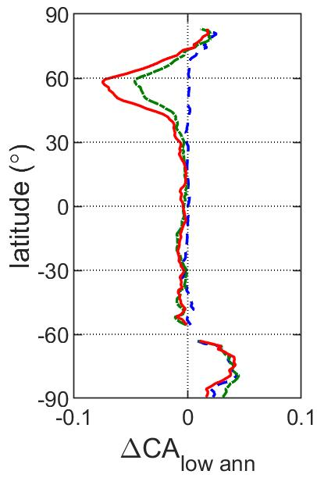
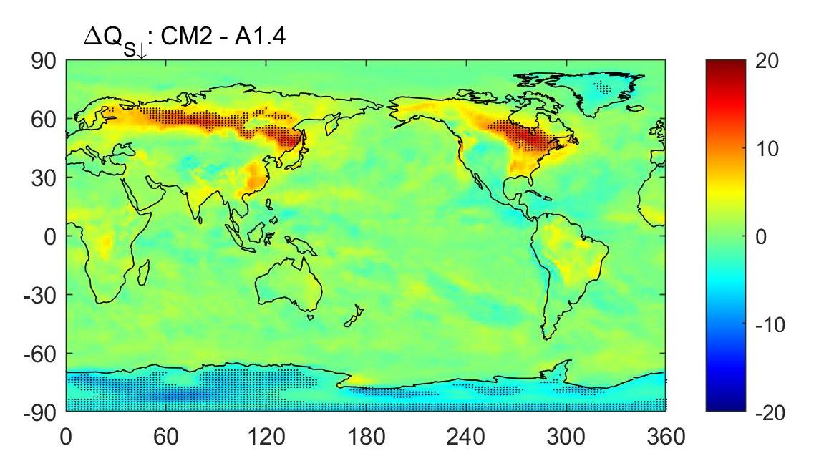
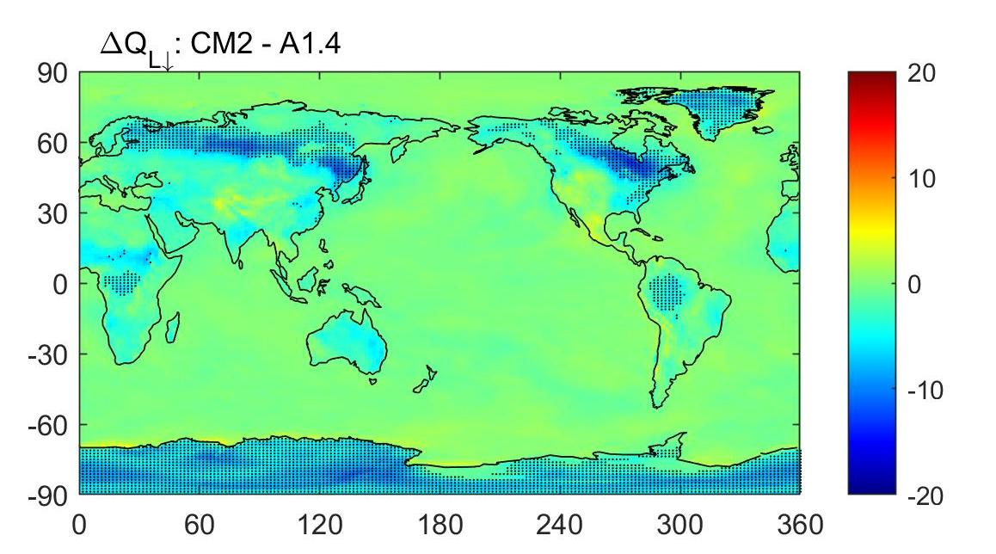
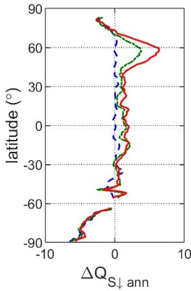
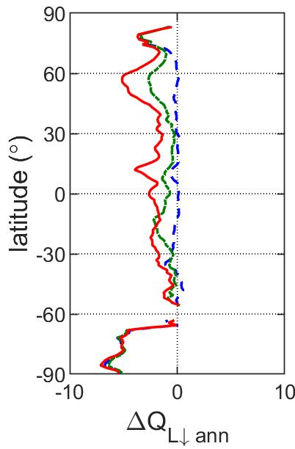
Clouds
cloud amount (v low)
cloud amount (low)
incoming shortwave
downwelling longwave
Reduced evapotranspiration over boreal regions (NH spring)
→ less low level cloud, increased S↓, decreased L↓ & larger diurnal temperature range
Notes:
notes: WMO definition of low cloud is 0-2km above surface, middle & high vary with latitude. Link between definition and form/cloud processes. I’m assuming that v low cloud == lowest model layer (i.e. fog)
The explanation for this is found in the coupling with the atmosphere – the reduction in evapotranspiration appears to be sufficient to trigger larger decreases in v low and low cloud amounts.
More solar radiation gets through to surface resulting in increased maxT, and more longwave rad cooling at night, resulting in cooler minT.
Largest effect in MAM – NH spring - losing almost 30% of vlow and low cloud. (actually when delta albedo is negative as well – so the effect doubles up).
Critical example of coupling – you won’t get that response looking at atmosphere or land on its own. Possible that this is unphysically sensitive property of the UM and/or threshold dynamics are at play (given locations are typically operating at/near freezing point).

Slide 7
Take home messages
Surface climatology is the net result of complex interactions between atmospheric and terrestrial processes
Localised differences in climate between CABLE configurations > historical trends
Plenty of challenges remain – in understanding and model representation
Thank you
CSIRO Oceans and Atmosphere
Ian Harman
ian.harman@csiro.au
CSIRO OCEANS AND ATMOSPHERE www.csiro.au
Notes:
Take home messages:
1) Need to consider the interactions if interested in surface climate
2) Deltas are larger
– good because it means that objective decisions on configuration and parameter values can be made even in face of intrinsic variability
- bad because science of surface climate is inherently nonlinear (smart ideas needed around parameter optimisation etc.)
3) Plenty of challenges remain – please get in contact if interested in partnering
N Parameters:
ice – 2
vegetation – 5*2 in radiation, 10 in roots – 20 without considering LAI maps.
Need at least 5 years spin up (better 10 years) to accommodate any surface related change.
So factorial analysis between two sets of parameters is impossible

