Slide 1
ACCESS-CM2 Performance
Target 4 model years per day
Dr Roger Bodman
School of Earth Sciences
rwbodman@unimelb.edu.au
Sept 2017

Slide 2
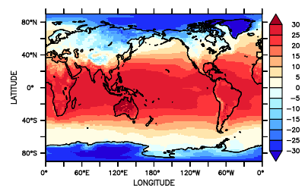
ACCESS-CM2 Performance Target 4 model years per day
CM1.3 & CMIP5:
UM 7.3 GA1.0
Processor layout:
UM – 8 by 12
MOM – 8 by 5
CICE - 6
= 144 processors
On Vayu - 3 to 5 model years per day (anecdotal)
150 year simulation, 38 days
UM 10.6 GA7.1:
On Raijin (Broadwell nodes):
PBS wall time 1.8 hours per month
1.1 model years per day*
150 year simulation, 136 days (4.5 months)
* assuming no queuing delays
Notes:
150 years at 4 model years per day

Slide 3
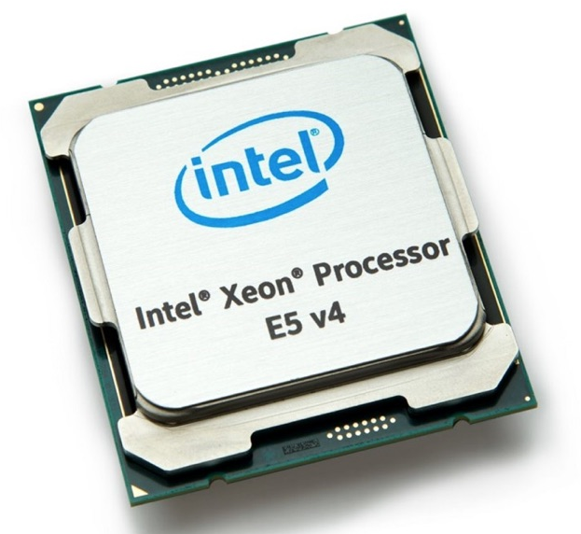
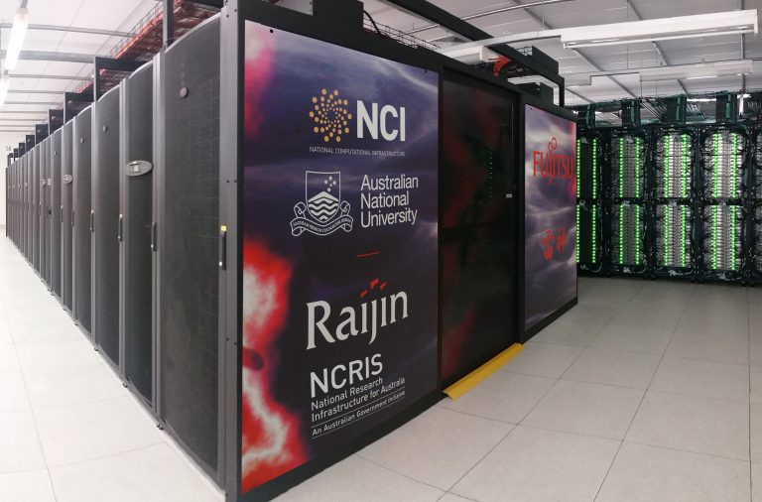
ACCESS-CM2 for CMIP6 UM 10.6 GA7.1
Processor layout:
UM – 24 by 16
MOM – 8 by 12
CICE - 16
= 496 processors
On Raijin (Broadwell nodes)
PBS wall time 37 mins per month
3.2 model years per day*
150 year simulation, 50 days
* assuming no queuing delays
Notes:
3.4 times as many cpus (al623), mainly for UM

Slide 4
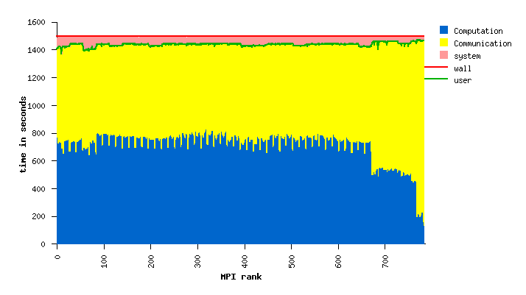
ACCESS-CM2 for CMIP6 4 model years per day
More CPUs:
Processor layout:
UM – 28 by 24
MOM – 8 by 12
CICE - 16
= 784 processors
27 mins per month
4.4 model years/day
IPM wall time 1500 s = 25 mins
Notes:
28x24 = 672

Slide 5
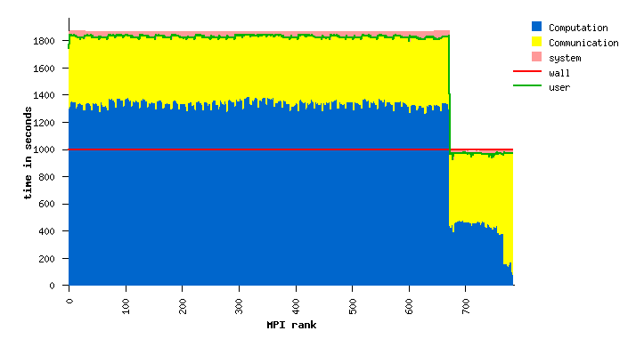
ACCESS-CM2 for CMIP6 4 model years per day
OpenMP 2 Threads
Processor layout:
UM – 28 by 24 x 2
MOM – 8 by 12
CICE - 16
= 1456 processors
20.6 mins per month
5.8 model years/day
IPM wall time 995 s = 16.7 mins
Notes:
But will increase SUs considerably! This is best case scenario > repeated test at 24 mins, 5 per year. UM 672*2 = 1344

Slide 6
ACCESS-CM2 for CMIP6 Scaling results
Acknowledgments:
Peter Dobrohotoff & Martin Dix, CSIRO; Scott Wales, UoM; Marshall Ward, NCI
Notes:
But will increase SUs considerably!

