Slide 1
Seasonal forecast of the stratosphere-troposphere coupling in the SH, using ACCESS-S1 (& POAMA)
Eun-Pa Lim and Harry H. Hendon
Science to Services
Bureau of Meteorology

Slide 2
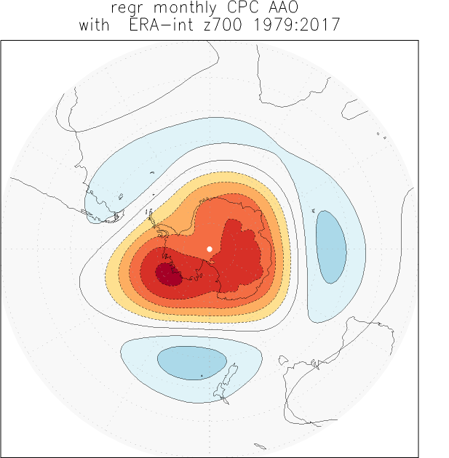
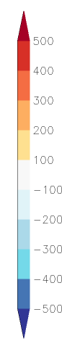
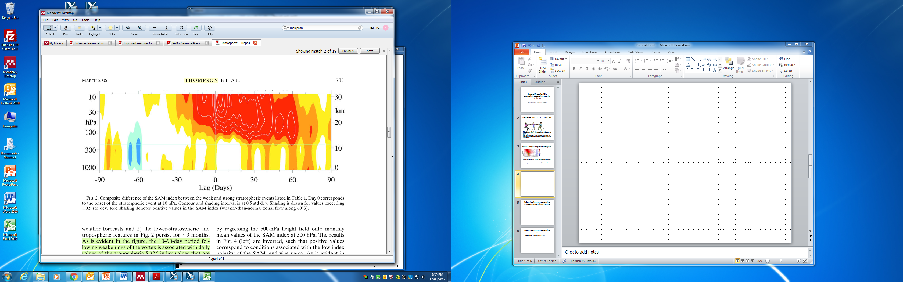
Stratosphere-troposphere coupling in the Antarctic region
Southern Annular Mode (SAM) :
- Most dominant mode of variability of the SH extratropical circulation
- Characterized by an annular pattern of pressure/geopotential height anomalies with the opposite signs between the mid and high latitudes
- One of the major drivers of Australian climate variability in various timescales
Stratosphere-troposphere coupling in the SH:
Stratospheric SAM signal in late winter to early spring propagating down to the surface with time lags
-ve SAM with higher GPH anomalies over Antarctica
← we have a method to capture this process

Slide 3
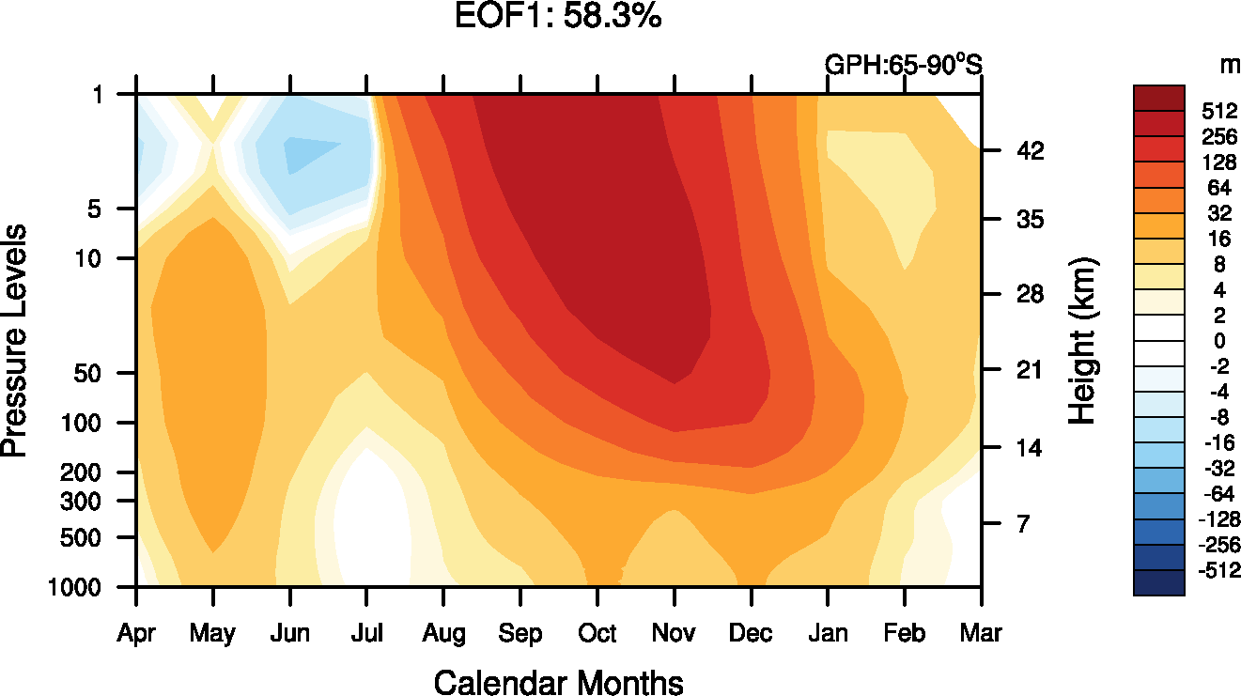
A novel method to capture the stratosphere-troposphere coupling
Using ERA-Interim data over 1979 Jan -2017 March
Prepare 3-D data of de-trended monthly GPH anomalies averaged over the Antarctic region (65-90S) as a function of vertical levels, 12 calendar months and years
Apply EOF analysis to the data to capture the vertical and temporal co-variability of the Antarctic polar cap GPH anomalies
The 1st EOF mode well captures the maximum loading in the stratosphere in spring and the downward propagation of the signal with time lags
Taken from Thompson et al. (2005) J. Atm. Sci. Fig. 2

Slide 4
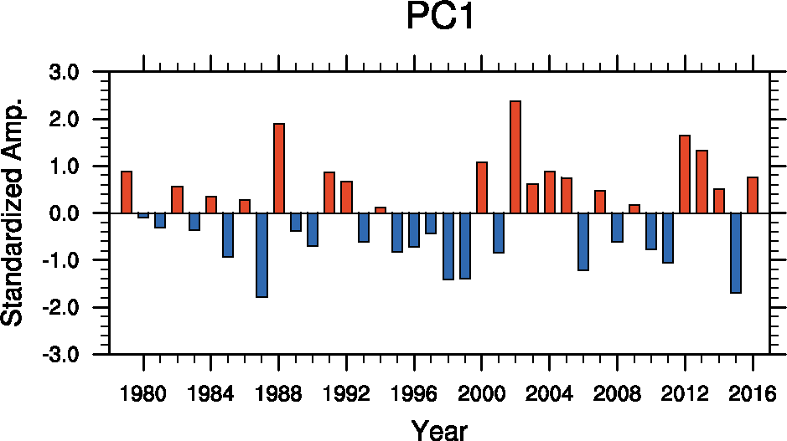
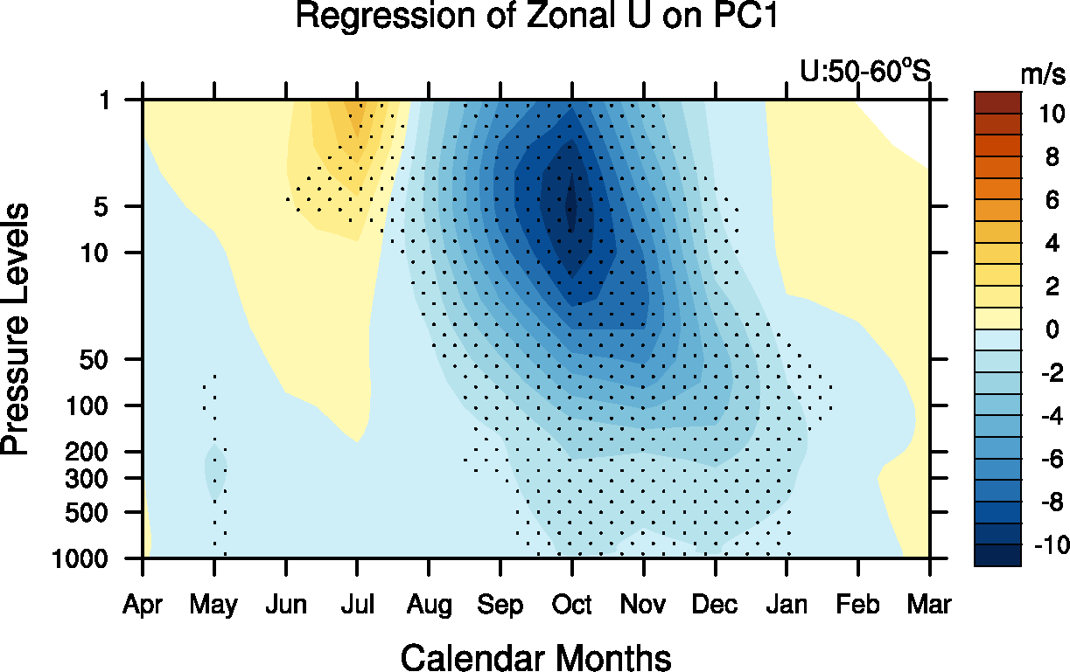
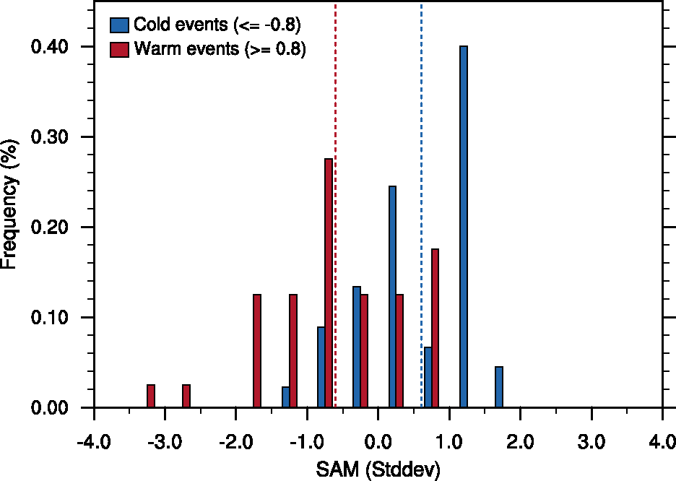
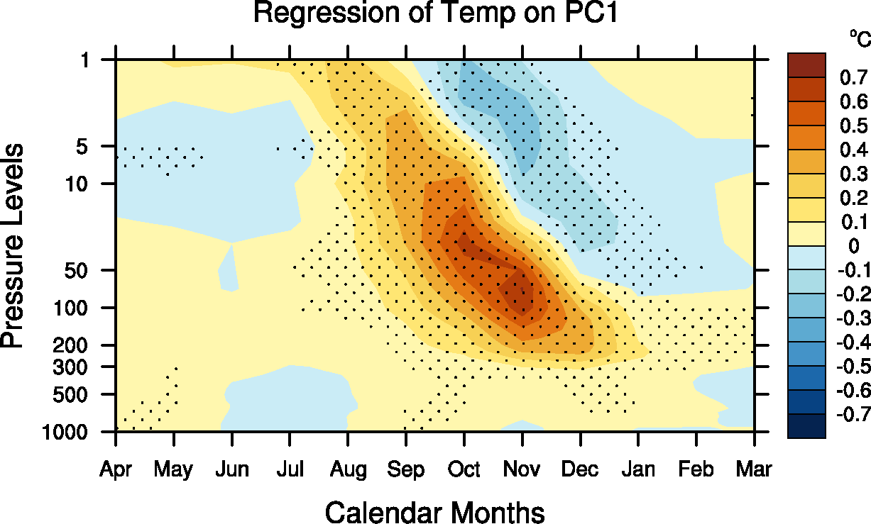
A novel method to capture the S-T coupling
Conditional PDFs of SAM in Sep-Jan
~60% of the total vertical-temporal co-variability of the Antarctic GPH anomalies
Higher GPH – Weaker polar vortex – Warmer polar cap ← defined as +ve S-T coupling
Lower GPH – Stronger polar vortex – Colder polar cap
PC1 well picks the 2002 extreme stratospheric warming event → record strong –ve SAM → severe drought over AUS in spring 2002 (e.g. Lim and Hendon 2015)
Prediction of the S-T coupling from winter can be useful for the long-lead outlook of the SAM and associated AUS climate – CAN WE PREDICT IT ?

Slide 5
Forecast skill assessment
22 member ensemble hindcasts from ACCESS-S1 and POAMA for 1990-2012: ACCESS-S1 (L85; high top) vs POAMA (L17; low top)
Model configurations, initialisation → Bureau Res. Reps, No. 13, 16, 19, 20
Predict the peak of S-T coupling in September to January
Project de-trended ACCESS-S1 and POAMA ensemble mean forecasts onto the sub-domain of the EOF pattern from September to January
Big S-T coupling events are well picked up by forecasts at LT1

Slide 6
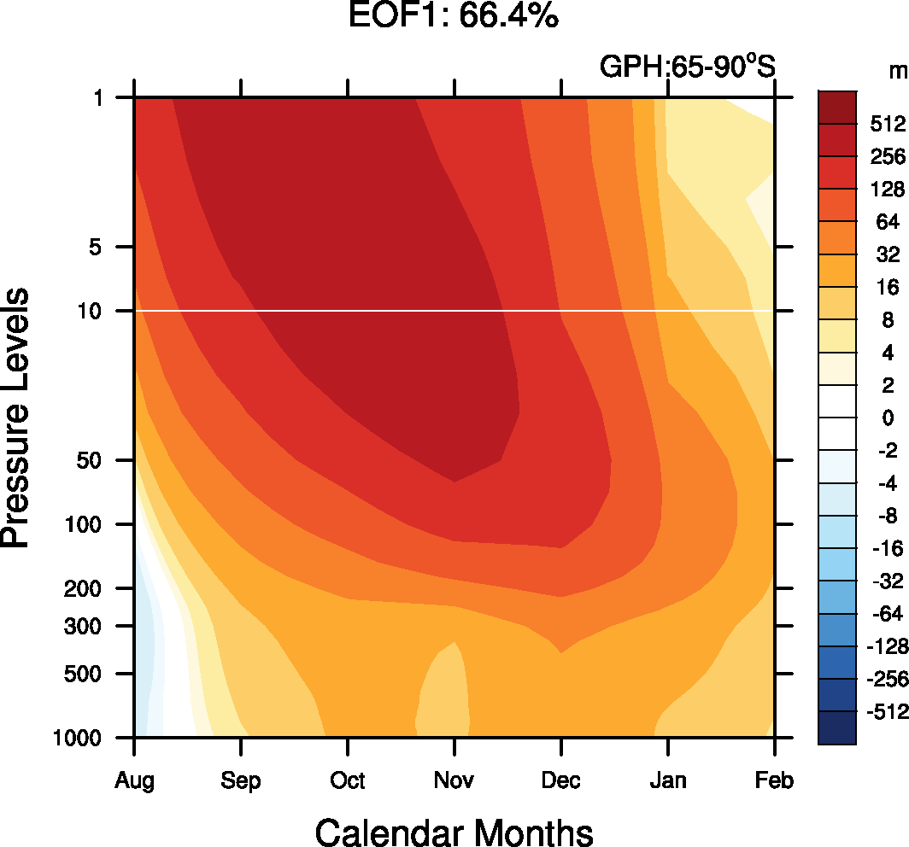
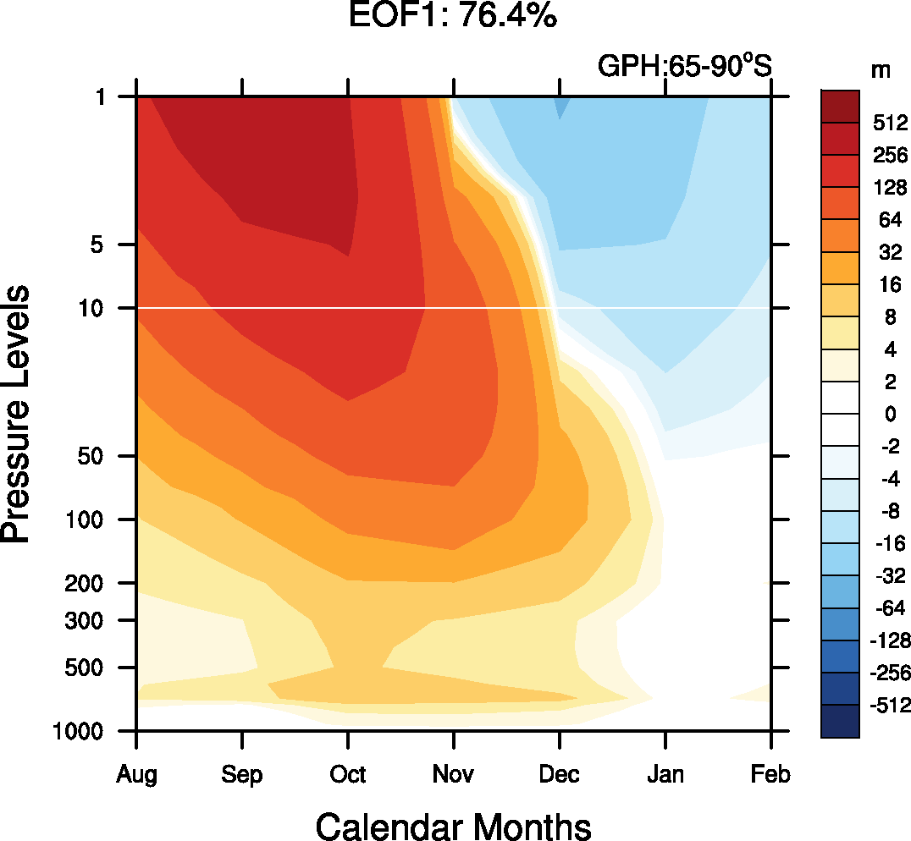
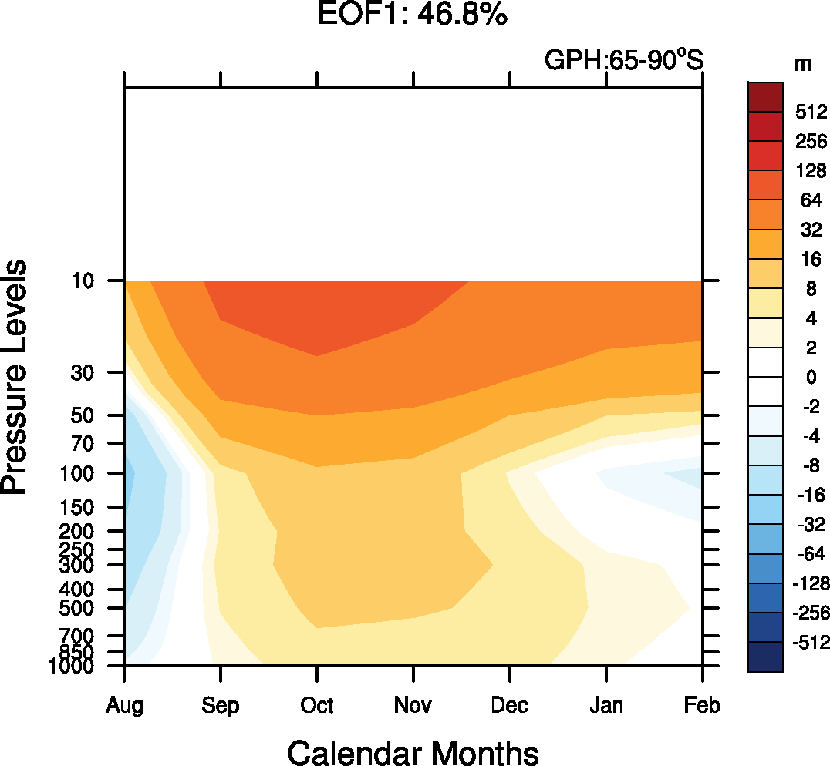
Forecast skill to predict the S-T coupling in Sep-Jan
BoM's two seasonal forecast systems can predict the S-T coupling in Sep-Jan with good skill at LT 0-1 month
POAMA can predict the S-T coupling with high skill at up to 3 month lead time (corr > 0.5 and rmse < 1)
ACCESS-S1 forecast at LT 1 is skilful but not as good as POAMA forecast
ACCESS-S1 forecast at LT 0 is better than POAMA
S-T coupling mode (i.e. 1st EOF) of ACCESS-S1 and POAMA forecasts for August to February, initialised on the 1st of August
ERAI ACCESS-S1 POAMA

Slide 7
Summary
A simple method has been devised to capture the stratosphere and troposphere coupling, which is an important driver of SAM in spring and summer
ACCESS-S1 and POAMA both demonstrate good skill to predict the S-T coupling at 1 month lead time
ACCESS-S1 skill seems limited by a bias of short persistence in the stratosphere, which needs further investigation.

