Slide 1
ACCESS-C2 fog and visibility investigations
5 Sep 2017
Belinda Roux

Slide 2
Visibility and fog fraction
Visibility: P, Tscrn, q (spec.hum), qcl (water mixing ratio), dry aerosol mass mixing ratio (MURK)
It operates by hydrating the aerosol field so that it is in equilibrium with the atmospheric humidity, and then computing visibility based on the fog droplet size and the number density.
APS2 ACCESS-C (and R) dry aerosol mass mixing ratio is calculated using a prognostic aerosol variable (MURK).
In Australia, MURK is not constrained through DA, which can lead to an unrealistically large build-up of aerosol, leading to low visibilities even if the humidity is low
Fog fraction: frac of gridbox with vis < 1km
Water content in a grid box compared to water content that would result in vis <= 1km
Basically the inverse of visibility, but in a dry atmosphere the real water content will be very small compared to that required to give a 1 km visibility, essentially neglecting the contribution of dry aerosol to the visibility.

Slide 3
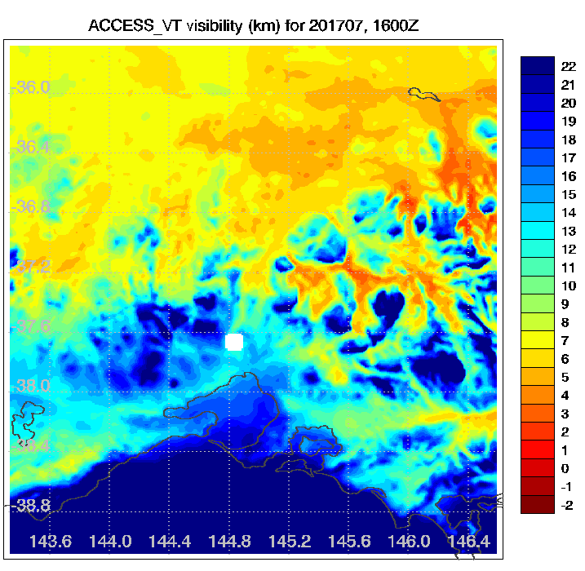
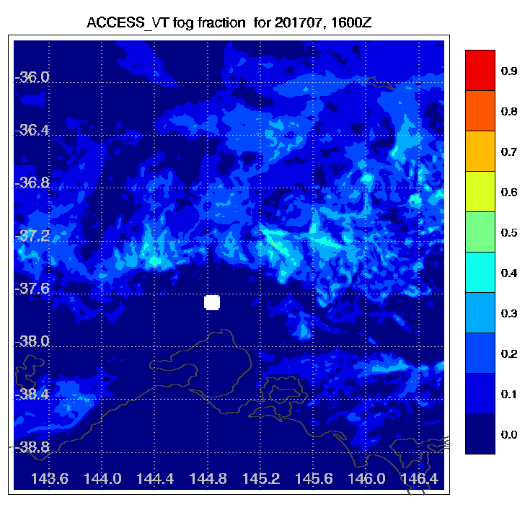
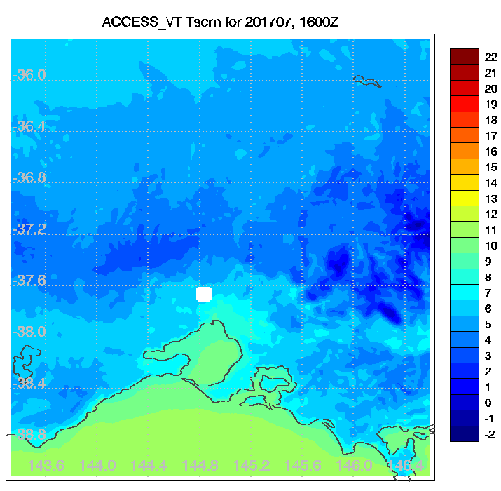
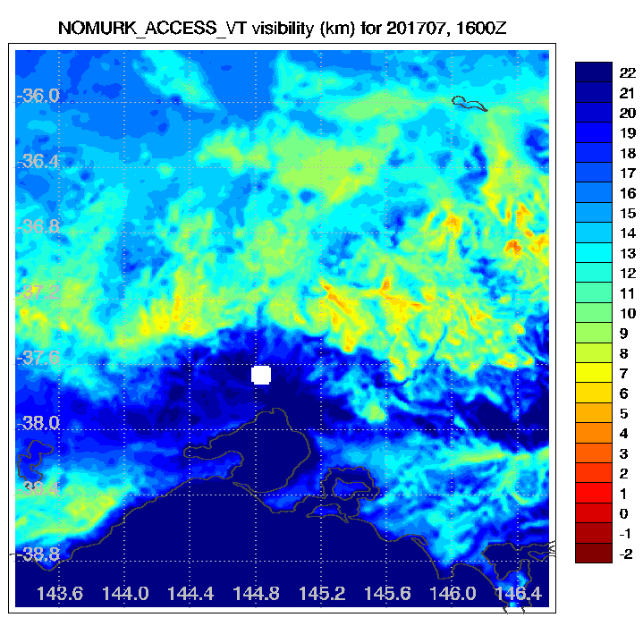
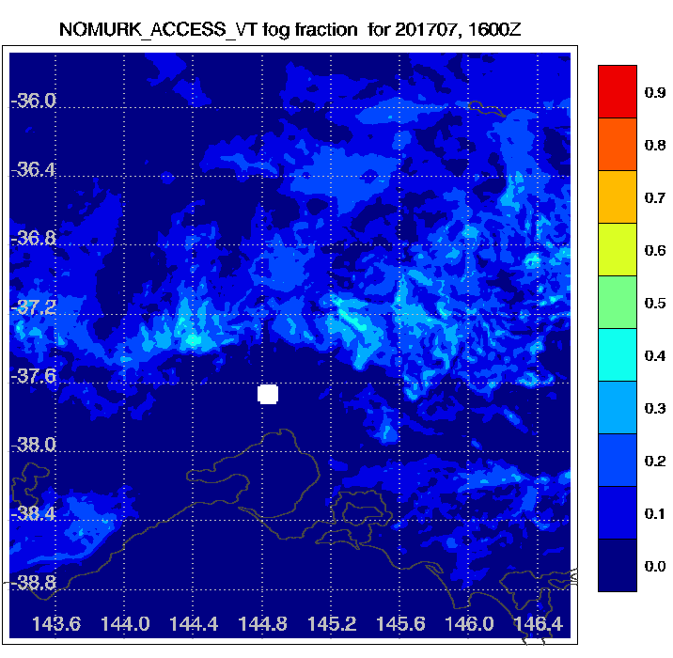
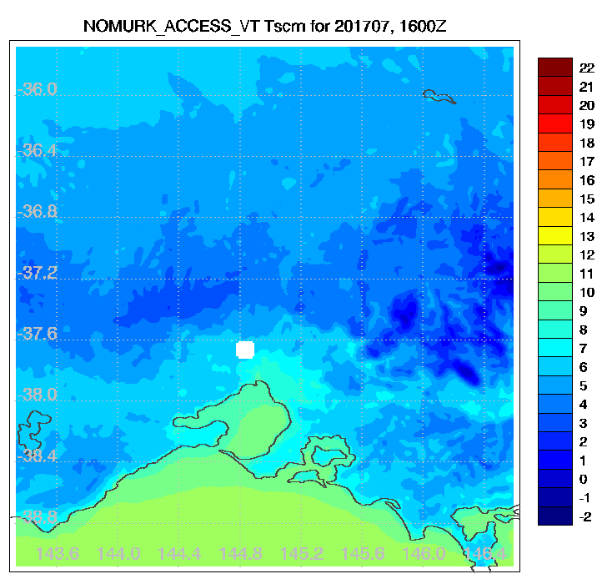
Average hourly comparison for July 2017
Notes:
Images show mean of visibility, fog fraction and screen temp at 1600Z for the month of July.
Upper images are with forecast murk field included in visibility calculation.
Lower images do not include forecast murk field in visibility calculation but use a 'standard' murk value that represents a nominal constant climatological value.

Slide 4
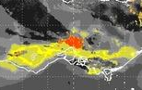
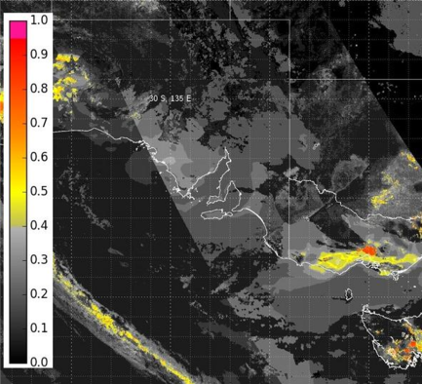
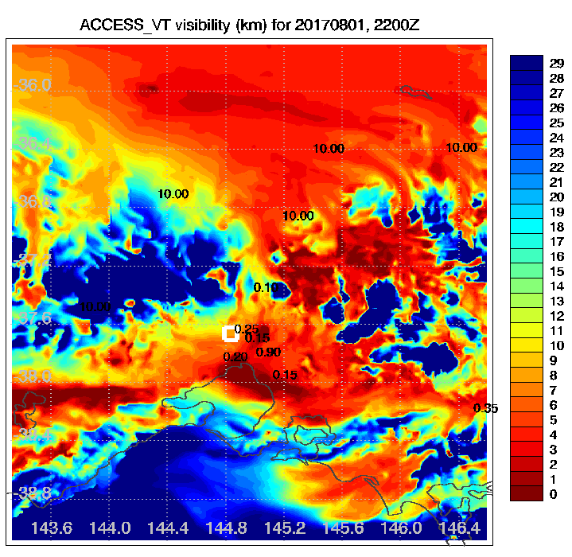
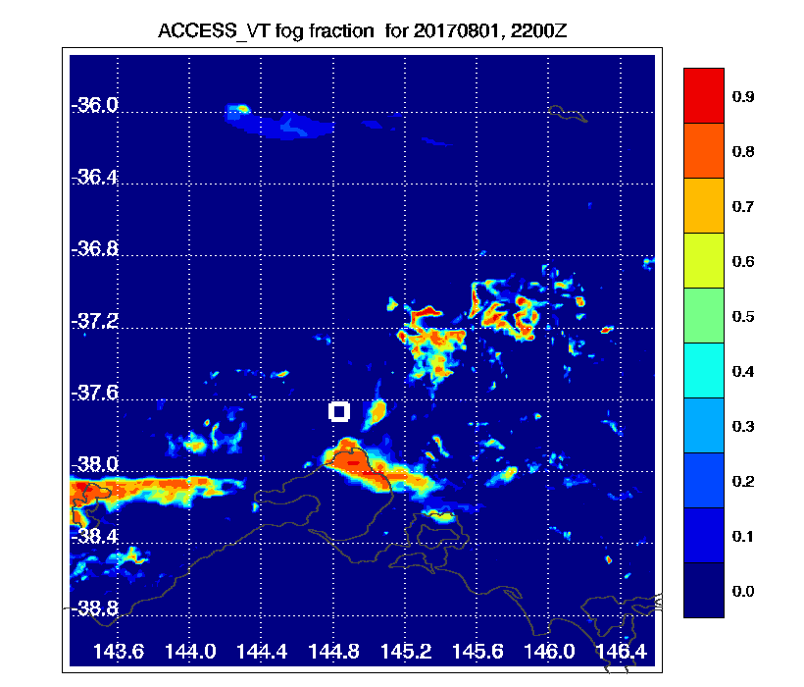
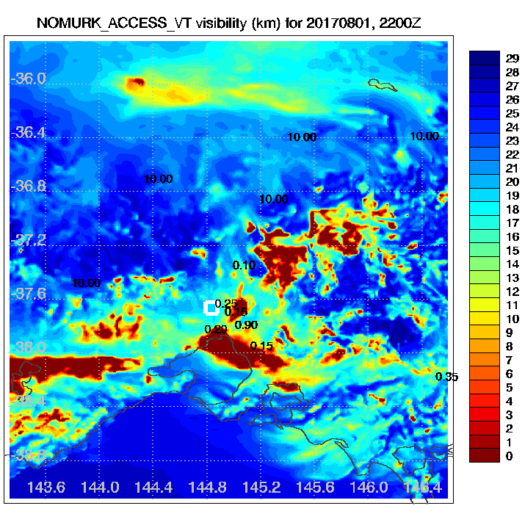
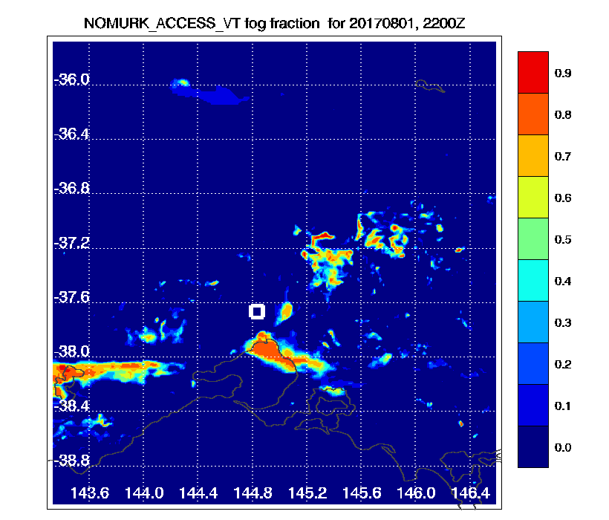
Case study: 1 Aug 2017
Fog and Vis (km) for 2200 UTC
(obs in black, 10km obs represent any vis >= 10km)
C2
C2 (no murk)

Slide 5
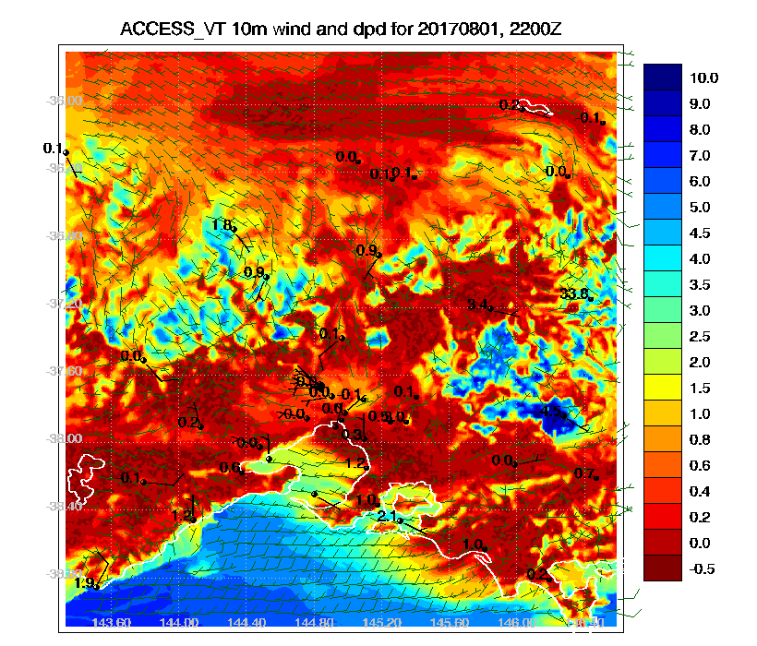

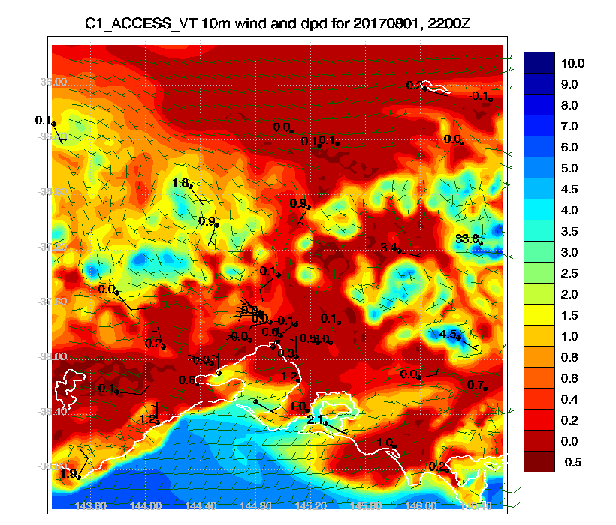
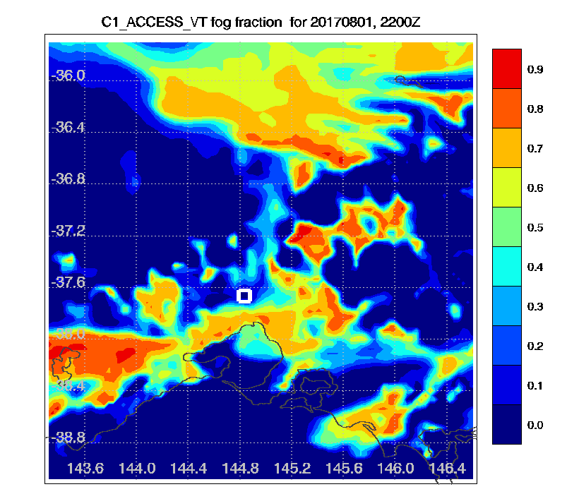
Comparison between model versions

Slide 6
Conclusions
Vis and fog fraction calculations in ACCESS sensitive to small differences in moisture
model upgrades might lead to bigger changes than expected
Not all Met Office settings appropriate for Aus
Visibility calculations can be sensitive to aerosols

