Slide 1
Efforts of reconfiguring MOM5 to reduce Southern Ocean warm bias in ACCESS-CM2
Dave Bi, Siobhan O’Farrell, Arnold Sullivan, Peter Dobrohotoff, and Simon Marsland
Climate Science Centre, CSIRO Ocean and Atmosphere

Slide 2
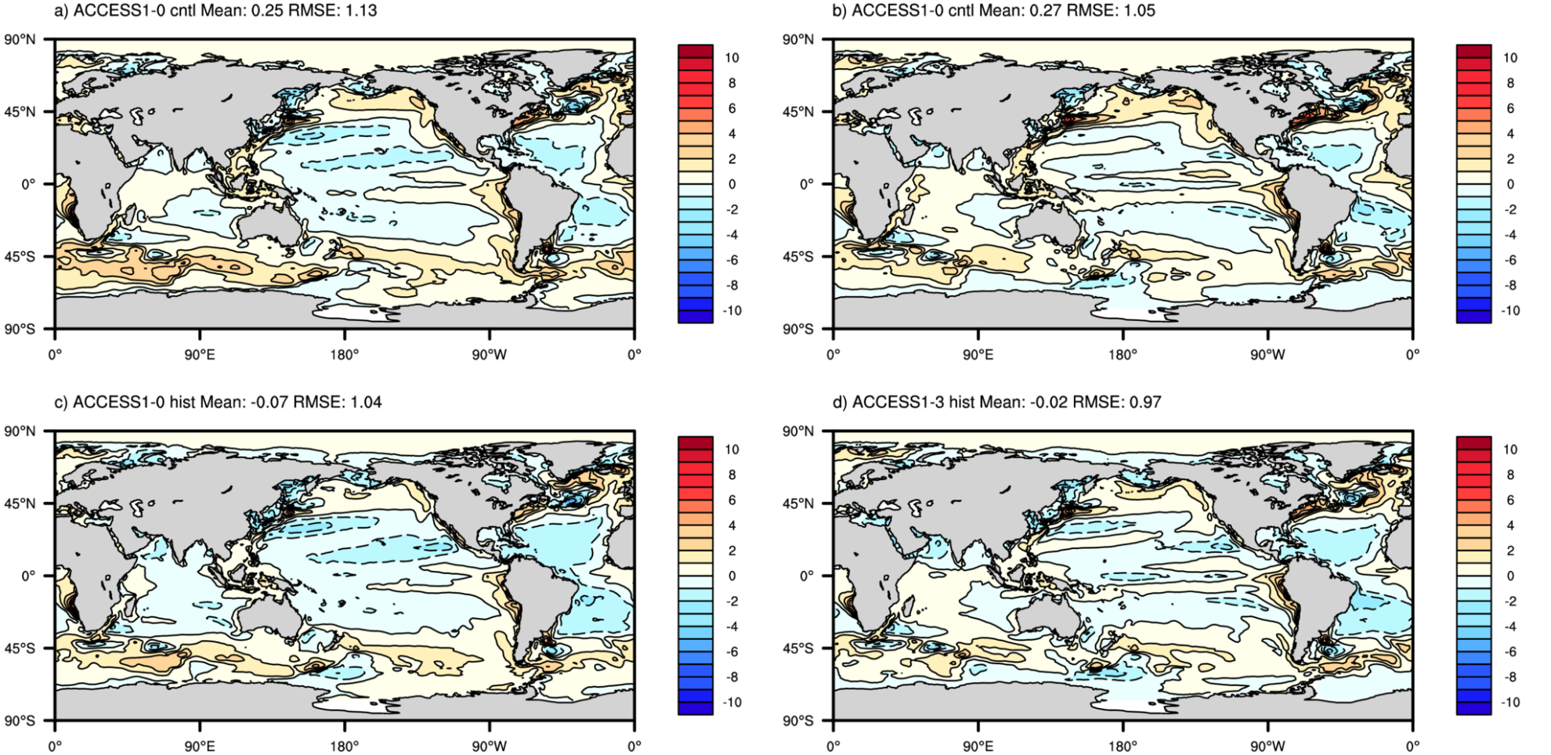
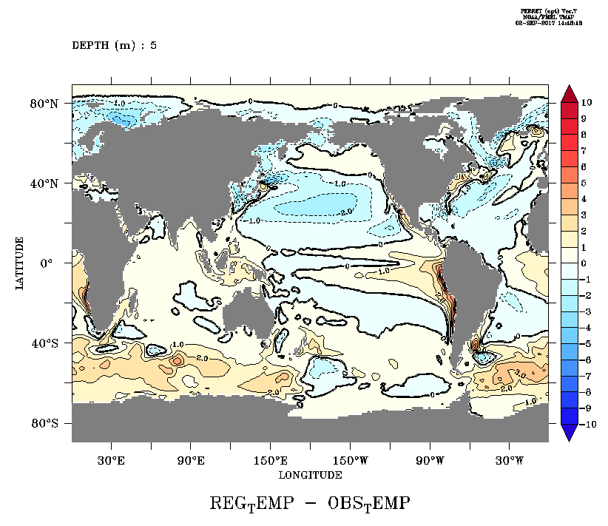
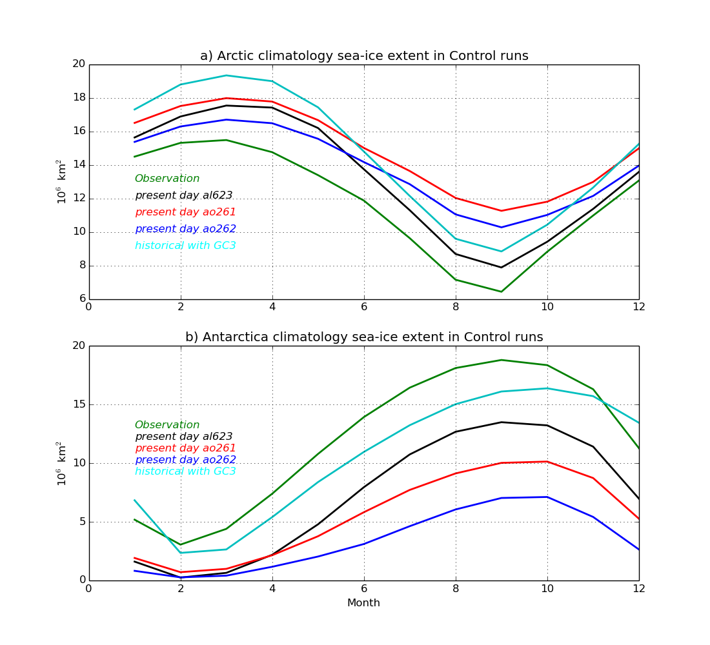
What’s the issue: The SO Warm Biases & poor AA sea ice in ACCESS-CM2 (vs. HadGEM GC3.1)
ACCESS1.0 N96O1 ACCESS1.3 N96O1
ACCESS-CM2 N96O1
(PD yrs 171-200)
GC3.1-N96O1 GC3.1-N216O0.25

Slide 3
Doing something to reduce the SO warm bias ACCESS-CM2 ?
Can we deepen SO mixed layer depth and cool the surface water, especially in summer ➔ better AA sea ice simulation ?
Approaches:
Tuning the ocean model MOM5 neutral-physics and GM diffusion parameters to enhance vertical mixing
Neutral diffusivity aredi = 600 ➔ 1200 m^2/sec
GM-skew diffusivity agm_closure = .true.
(agm_closure_min, agm_closure_max) = (50, 600) ➔ (600, 2000)
Implementing a “statistical model of global Langmuir mixing” to enhance KPP mixing
(Li et al., 2017. Ocean Modelling, 113 (2017), 95-114)
Effects of Langmuir mixing on the surface ocean mixing is parameterised by applying an enhancement factor (which depends on wave, wind, and ocean state) to the turbulent velocity scale in the K-Profile Parameterization
langmuirfactor = cvmix_kpp_efactor_model(u10, ustar, hbl)
Turbulent velocity scales are thus enhanced as:
ws = ws * langmuirfactor
wm = wm * langmuirfactor
Applying different mixing schemes
GOTM (setup and bug fix courtesy Russ Fiedler)
Chen (also with bug fix)

Slide 4
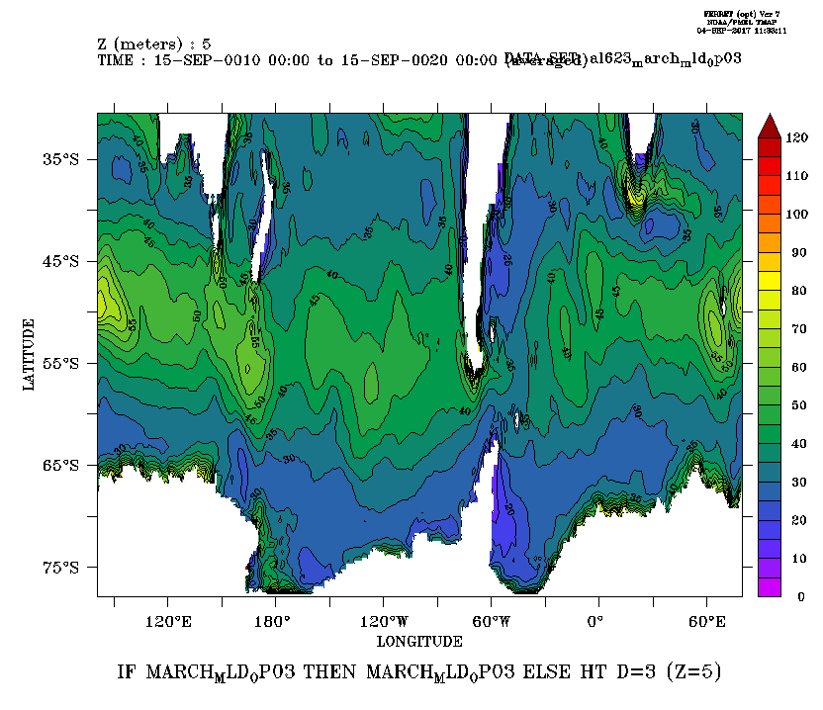
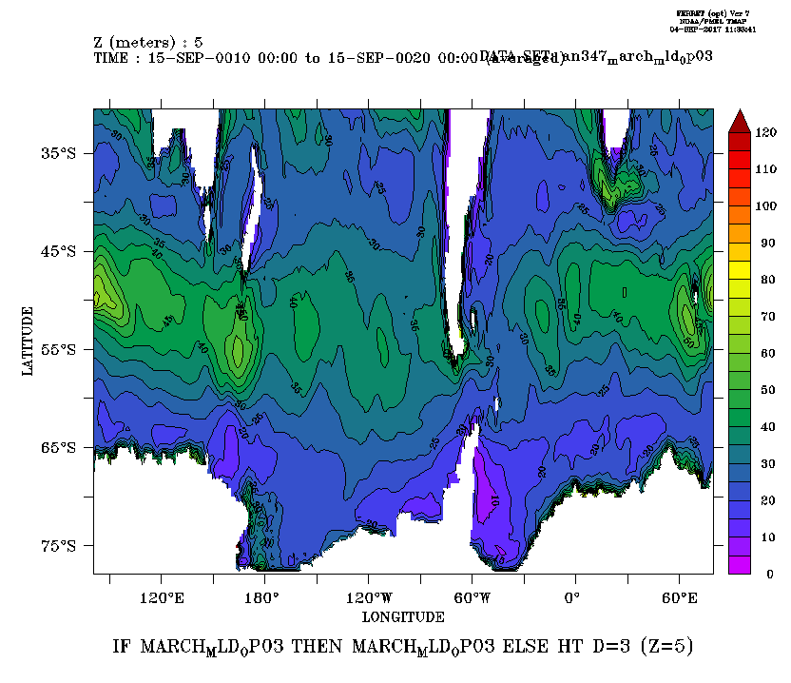
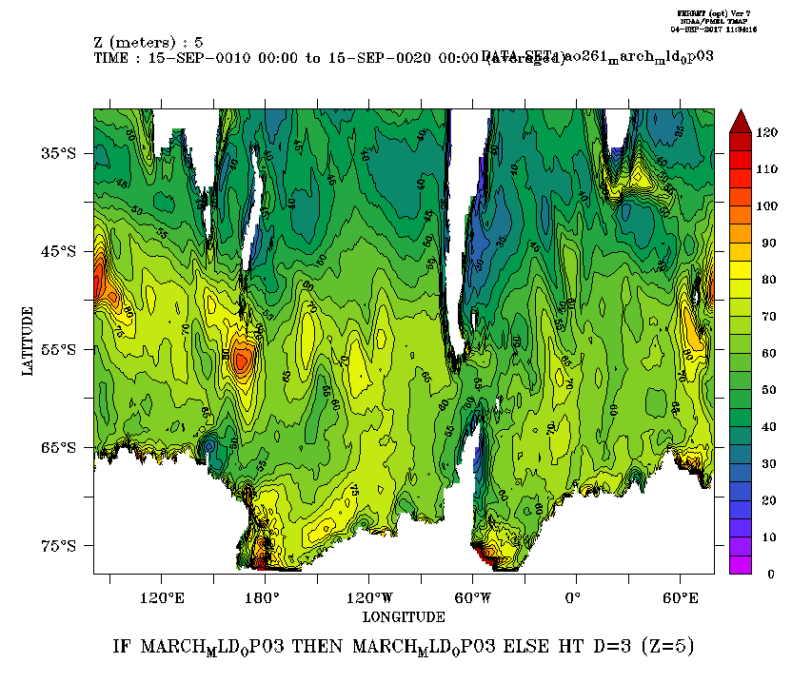
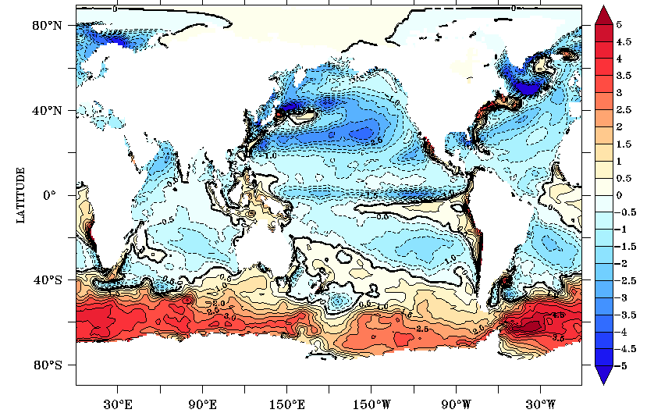
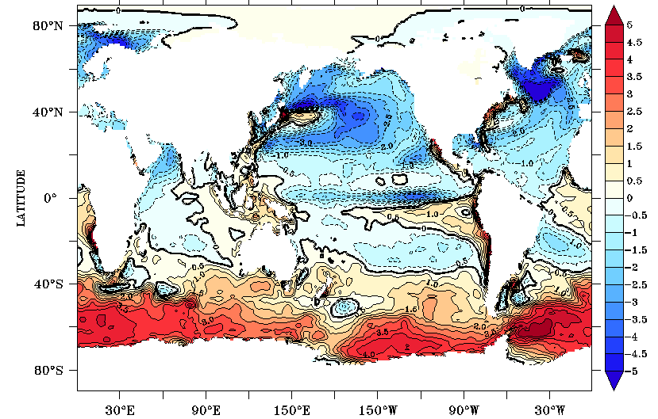
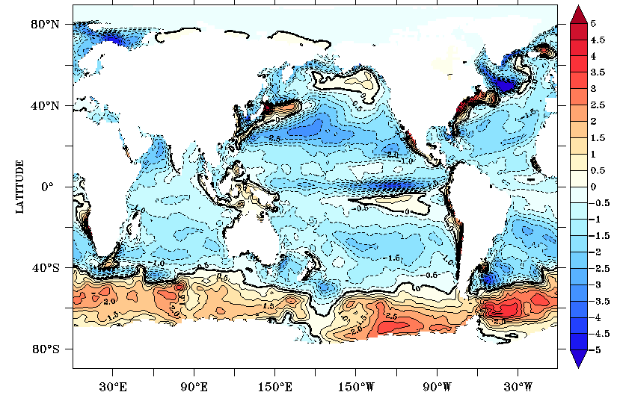
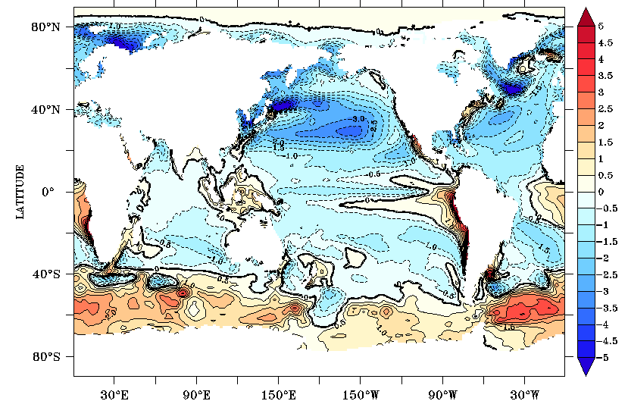
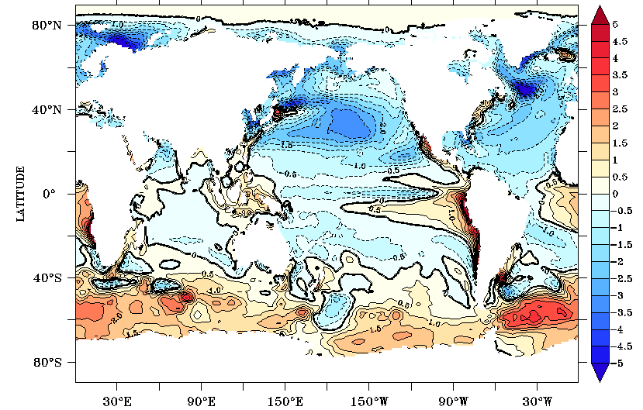
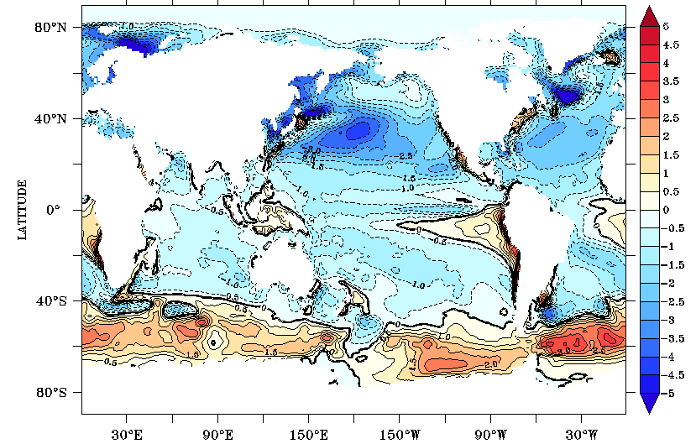
Different vertical mixing schemes: March and/or annual mean mixed-layer depth, SST bias (yrs11-20, Present Day simulations)
KPP
GOTM
Chen
March
MLD
March
SST Biases
Annual
SST Biases

Slide 5
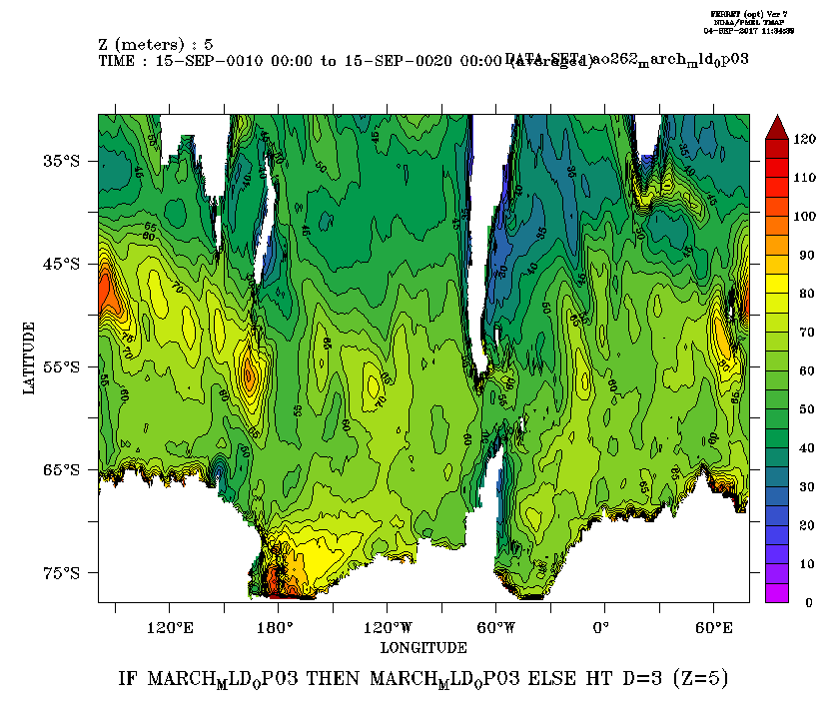
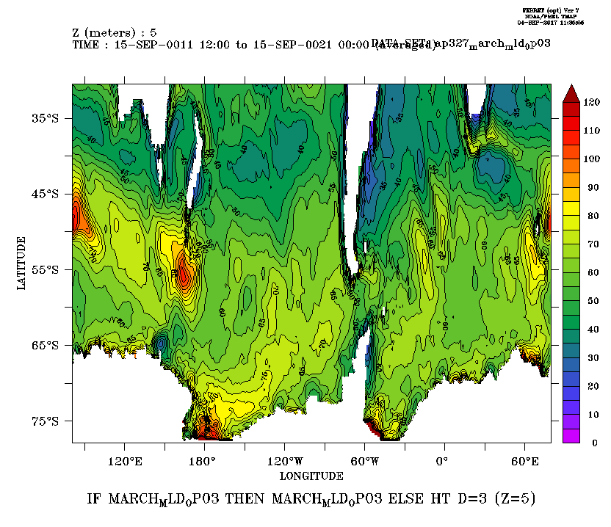
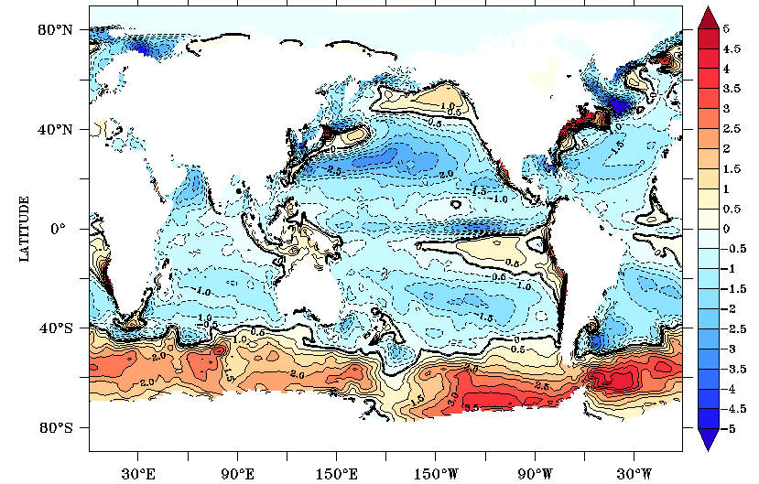
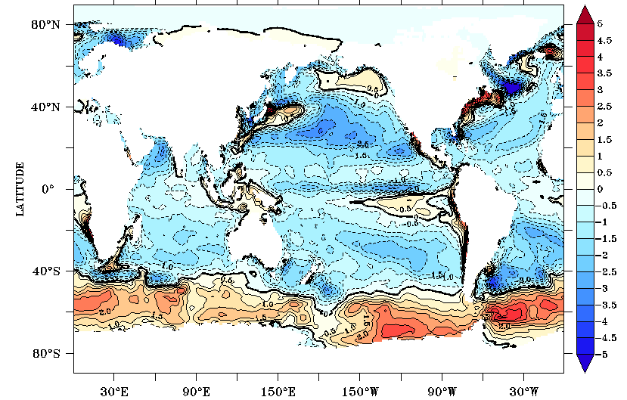
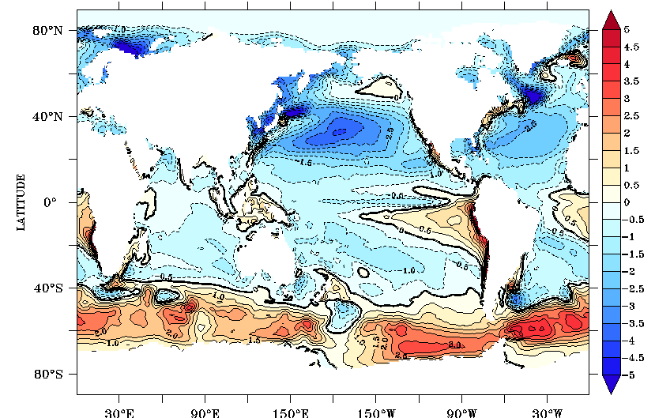

Neutral Physics tuning (and a bug fix) with Chen mixing: March and/or annual mean mixed-layer depth, SST bias (yrs11-20)
aredi = 600
aredi = 1200
aredi=600 with i2o saltflux sign change
March
MLD
March
SST Biases
Annual
SST Biases

Slide 6
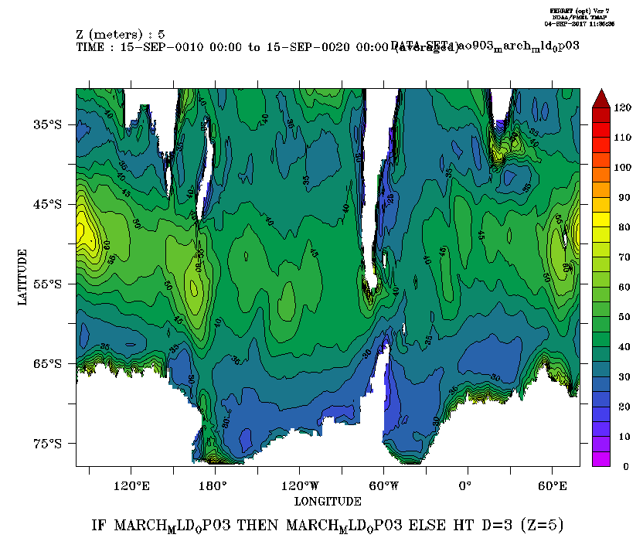
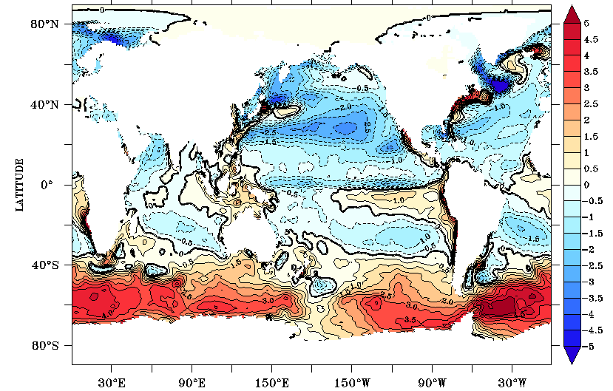
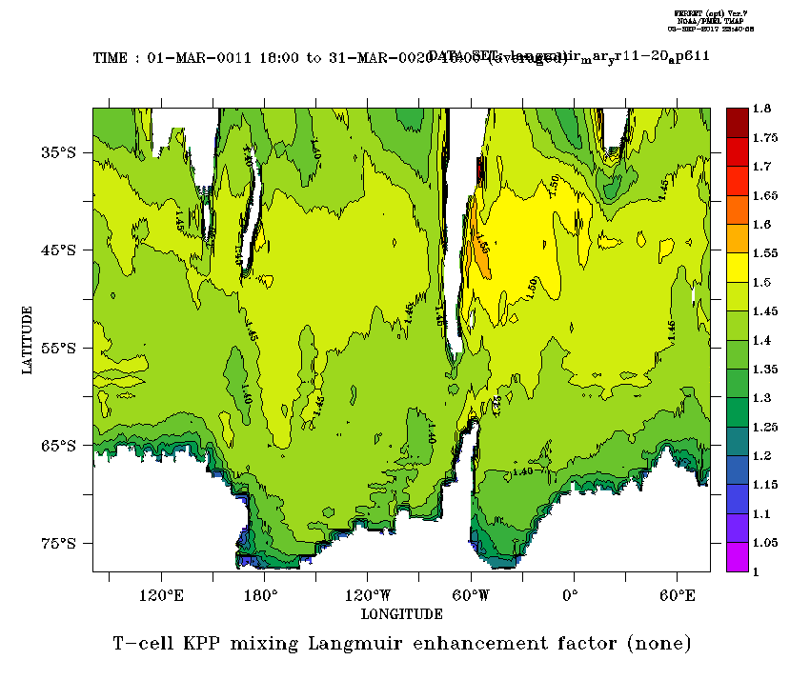

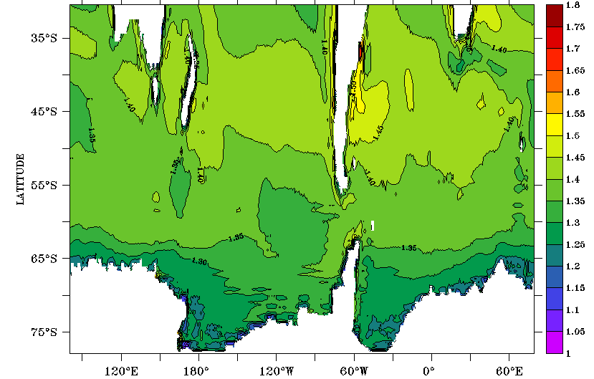
KPP mixing enhancement: March and/or annual mean mixed-layer depth, SST bias (yrs11-20)
Base Run
Longmuir enhancement run
March
MLD
Enhancement factor for Turbulent velocity scales
Top: March
Bottom: Annual
March
SST Biases
Annual
SST Biases

Slide 7
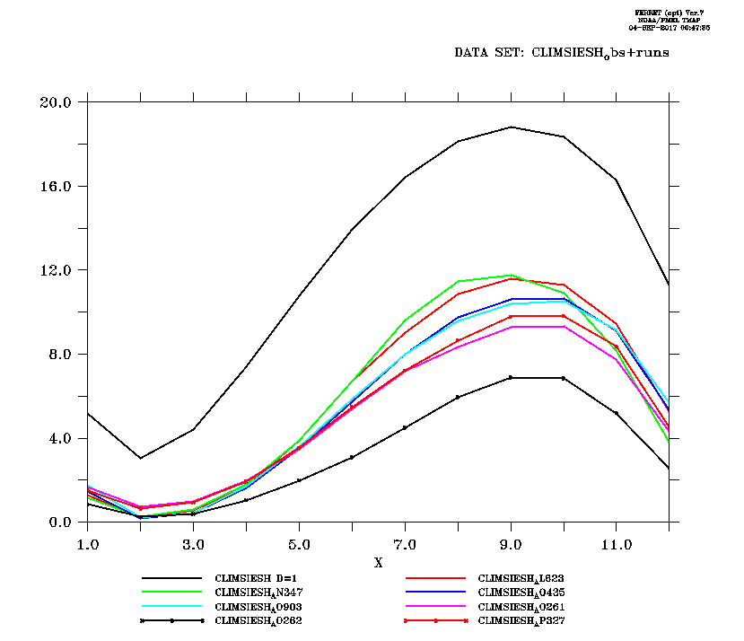
Summary and future work
The above ocean reconfiguring/tuning efforts have not achieved the goal, i.e., SO warm bias is still big and AA sea ice is poorly simulated
Future work
Configure the ocean model with finer vertical resolution for the surface layers (e.g., 10m➔5m, 2m, 1m) ?
Adopt an “enhanced” TKE mixing scheme (as in NEMO) ?

Slide 8
Thank you!

Slide 9
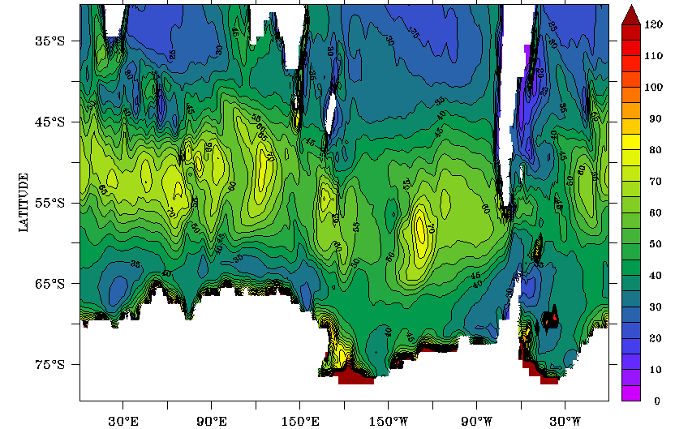
GC3.1 sea ice and obs. Mixed layer depth

Slide 10
Theory Wave implementation
Li et al., 2017. Statistical models of global Langmuir mixing. Ocean Modelling, 113 (2017), 95-114
The effects of Langmuir mixing on the surface ocean mixing is parameterised by applying an enhancement factor which depends on wave, wind, and ocean state to the turbulent velocity scale in the K-Profile Parameterization.
In our MOM5 practice, the enhancement factor is calculated as a function
langmuirfactor = cvmix_kpp_efactor_model(u10, ustar, hbl)
following the Theory Wave implemented in the Community Ocean Vertical Mixing Project (CVMIX).
Turbulent velocity scales are thus enhanced as:
ws = ws * langmuirfactor
wm = wm * langmuirfactor

