Slide 1

The ACCESS-CM2 rose/cylc suite
You can change this image to be appropriate for your topic by inserting an image in this space or use the alternate title slide with lines. Note: only one image should be used and do not overlap the title text.
Enter your Business Unit in the ribbon above the url.
[delete instructions before use]
Improving robustness and usability
Peter Dobrohotoff & Martin Dix
5 September 2017
Oceans and ATMOSPHERE

Slide 2
Outline
Model components and build
Run time options
Reproducibility
Post-processing
Performance (see Roger’s presentation this afternoon)
Documentation (link to Roger’s notes on wiki)

Slide 3
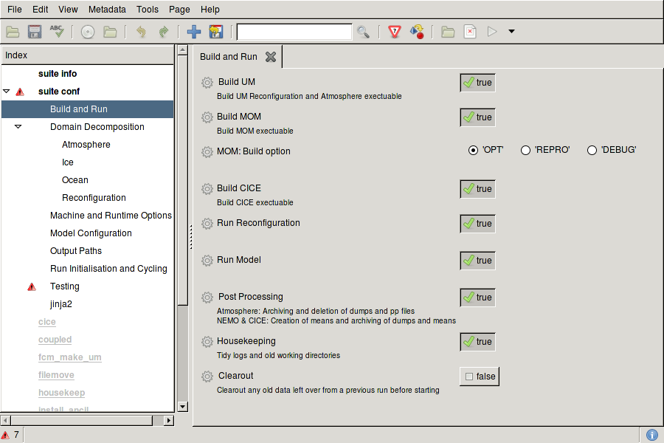
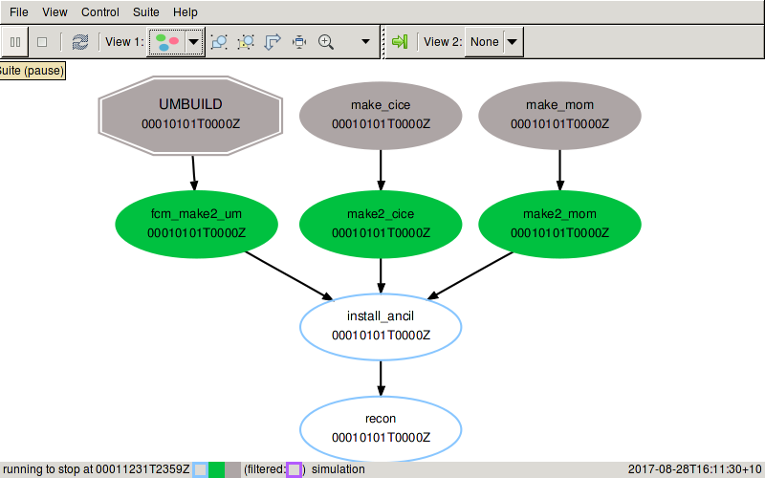
Build
Suite builds UM, MOM and CICE from respective repositories
Uses prebuilt OASIS library (installed in ~access/modules)
MOM compile options (e.g. REPROD) set in rose-suite.conf
CICE decomposition (required at build time) set in rose-suite.conf
Metadata added to make rose-edit usable

Slide 4
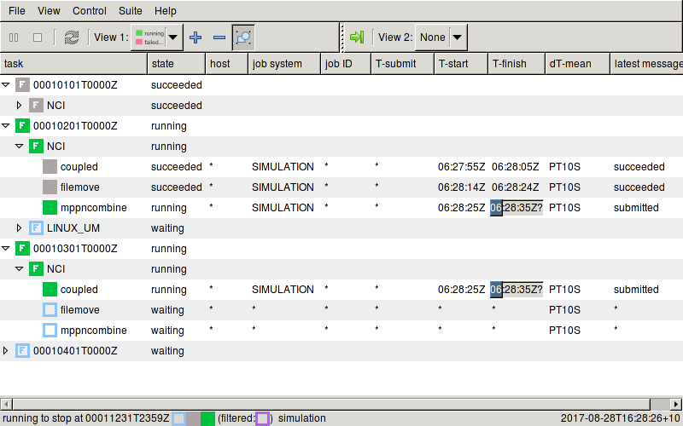
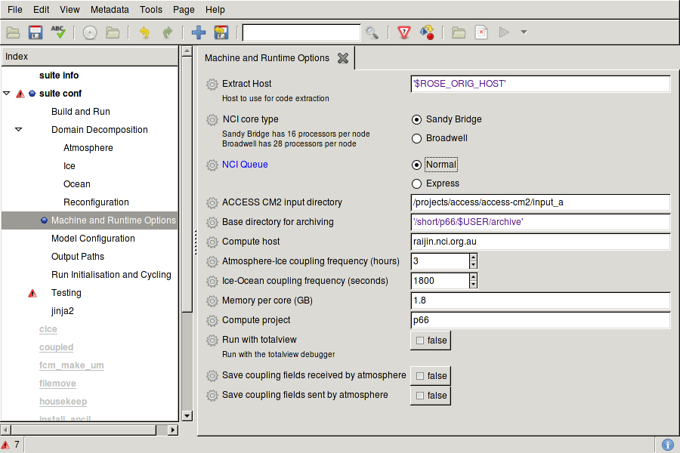
Running
Flexible control of run length, chunk size, processors,

Slide 5
Reproducibility
Suite u-ao219 includes tests for reproducibility across different processor decompositions and different restart frequencies
UM in AMIP mode ok with both
CICE ok with processor layout change
MOM gives different results with processor layout change
Coupled model not reproducible with different restart frequencies

Slide 6
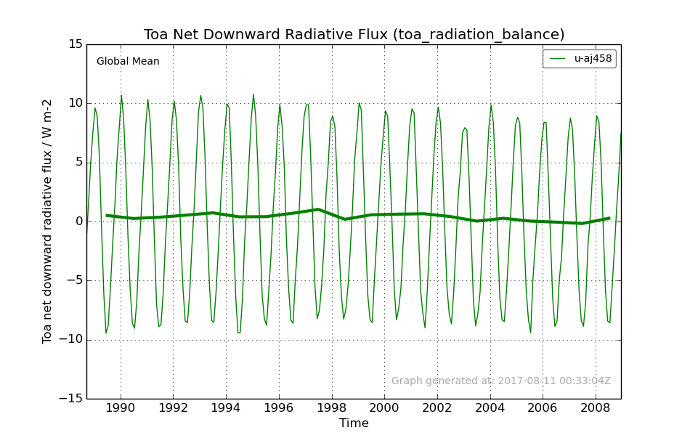
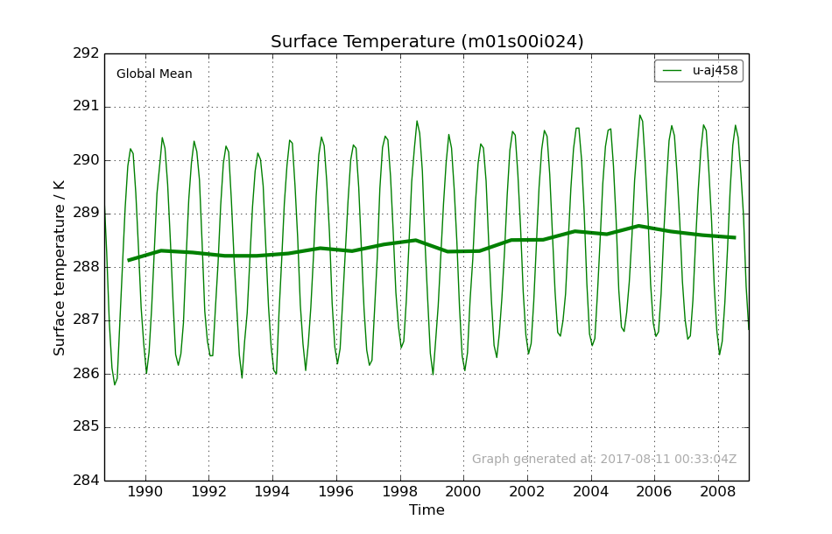
Post-processing
Conversion to NetCDF included as optional app in the suite
Met Office Afterburner tool produces diagnostics from active experiments. Now works with our UM and coupled model NetCDF output

