Slide 1

ARCCSSive Scott Wales & Paola Petrelli
ARCCSS CMS
Aim:
Provide improved access to CMIP5 data replicated at NCI
Uses:
Search downloaded files for files matching constraints
Compare against ESGF catalogue for new files
Bruce Miller, CSIRO http://www.scienceimage.csiro.au/image/8199 (CC-BY)

Slide 2
Filesystem Limits
authoritative `-- IPCC |-- CMIP5 | |-- CSIRO-BOM | |-- CSIRO-QCCCE | `-- UNSW |-- CORDEX | |-- AUS-44 | `-- AUS-44i |-- GeoMIP | `-- UNSW |-- PMIP3_CMIP5 | `-- UNSW `-- PMIP3_PMIP3 `-- UNSW
DRSv2_legacy/CMIP5
|-- ACCESS1-0
| |-- 1pctCO2
| |-- abrupt4xCO2
| |-- amip
| |-- historical
| |-- historicalExt
| |-- piControl
| |-- rcp45
| `-- rcp85
|-- ACCESS1-3
| |-- 1pctCO2
| |-- abrupt4xCO2
| |-- amip
| |-- historical
The climate research community maintains a replica of commonly used CMIP5 files at /g/data/ua6
The area has become disorganised, with several different organisation structures all symlinked to each other
drstree/CMIP5
|-- GCM
| |-- BCC
| | |-- bcc-csm1-1
| | `-- bcc-csm1-1-m
| |-- BNU
| | `-- BNU-ESM
| |-- CAU-GEOMAR
| | `-- KCM1-2-2
| |-- CCCMA
| | |-- CanAM4
| | |-- CanCM4

Slide 3
Basic Use
$ search_replica --experiment historical \
--model ACCESS1-0 --variable tas
$ cat search_result.txt historical,tas,day,ACCESS1-0,r1i1p1,v20131108,\
/g/data/ua6/authoritative/IPCC/CMIP5/CSIRO-BOM/ACCESS1-0/historical/day/atmos/day/r1i1p1/v20131108/tas historical,tas,day,ACCESS1-0,r3i1p1,v20140402,\
/g/data/ua6/authoritative/IPCC/CMIP5/CSIRO-BOM/ACCESS1-0/historical/day/atmos/day/r3i1p1/v20140402/tas
ARCCSSive is a database cataloguing all the CMIP5 files at NCI, with a Python wrapper to allow use in scripting etc.
search_replica - Find files in /g/data1/ua6
compare_ESGF - Find files on ESGF that haven't been downloaded
Scripts output CSV format files with model and location/version information
$ compare_ESGF --experiment historical \
--model ACCESS1-0 --variable tas
$ cat historical.csv
model_ensemble/variable,tas_day,tas_Amon,tas_3hr
ACCESS1-0_r1i1p1, v20120115 | v20130124 | v20130227 | v20130529 | v20131108
ACCESS1-0_r2i1p1, v20141119 | v20141119 latest new | , v20130726 | v20130726 latest new | ,NP
ACCESS1-0_r3i1p1, v20140402 | v20140402 latest new | , v20140402 | v20140402 latest new | ,NP

Slide 4
Advanced Use
sqlite3> SELECT instances.* FROM ( SELECT model,experiment,mip,realm,
count(*) AS count
FROM instances WHERE variable = 'tas'
GROUP BY model,experiment,mip,realm)
AS inst_group
NATURAL JOIN instances
WHERE count > 2 AND variable = 'tas'
Advanced users are able to query the database either in Python using sqlalchemy or directly using SQL
This allows for more complex queries, e.g. what datasets are available that have the variable 'tas' in at least two ensemble members?
We don't expect the majority of researchers to use this feature, but it allows us to create tools for specific use cases
inst_group = cmip.query(Instance, func.count(Instance.ensemble).label('count'))
.filter_by(variable='tas')
.group_by(Instance.experiment, Instance.mip, Instance.model, Instance.realm)
.subquery()
cmip.query(Instance)
.join(inst_group, and_(Instance.experiment == grouped.c.experiment, Instance.mip == grouped.c.mip,
.filter(grouped.c.count > 2, Instance.variable == 'tas')
.order_by(Instance.model, Instance.experiment)[0:5]

Slide 5
hh5 Conda environments
basemap
beautifulsoup4
cartopy
cdat-lite
cf_units
compliance-checker
dask
ecmwf_grib
f90nml
gdal
ipython
iris
jupyter
mule
numpy
pandas
pandoc
ARCCSSive is available as part of the CMS team's `analysis` Anaconda environment, on both Raijin and the VDI desktops
module use /g/data3/hh5/public/modules
module load conda/analysis27
or
module load conda/analysis3
These environments provide a wide range of Python libraries for working with climate and weather datasets
proj4
pytest
pydap
pyferret
pyspharm
readline
scipy
six
sqlalchemy
sqlite
sympy
windspharm
wrf-python
xarray

Slide 6
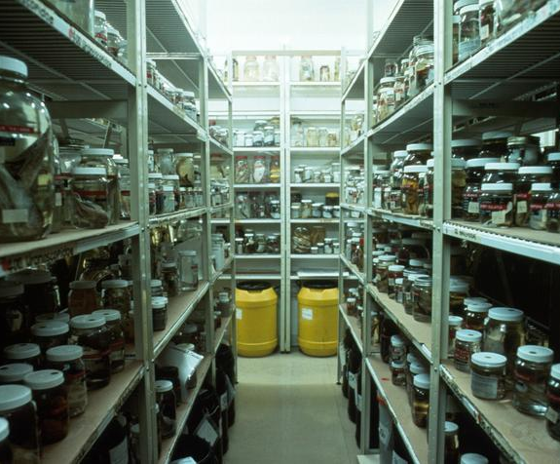
More Info
Training: https://training.nci.org.au (Under Research Data / CMIP)
Documentation: https://arccssive.rtfd.org
Code: https://github.com/coecms/arccssive
DOI: 10.5281/zenodo.844936
Help: climate_help@nci.org.au
CSIRO Marine Research http://www.scienceimage.csiro.au/image/2620 (CC-BY)

