Slide 1
Tropic-extratropical teleconnection in UM/ACCESS: model evaluation
and implication for regional projections
Huqiang (Hugh) Zhang
Bureau of Meteorology, h.zhang@bom.gov.au
Conclusions:
Teleconnection is an essential component in ACCESS model evaluation;
Model errors are connected and think outside of the square when exploring model uncertainty in a region

Slide 2
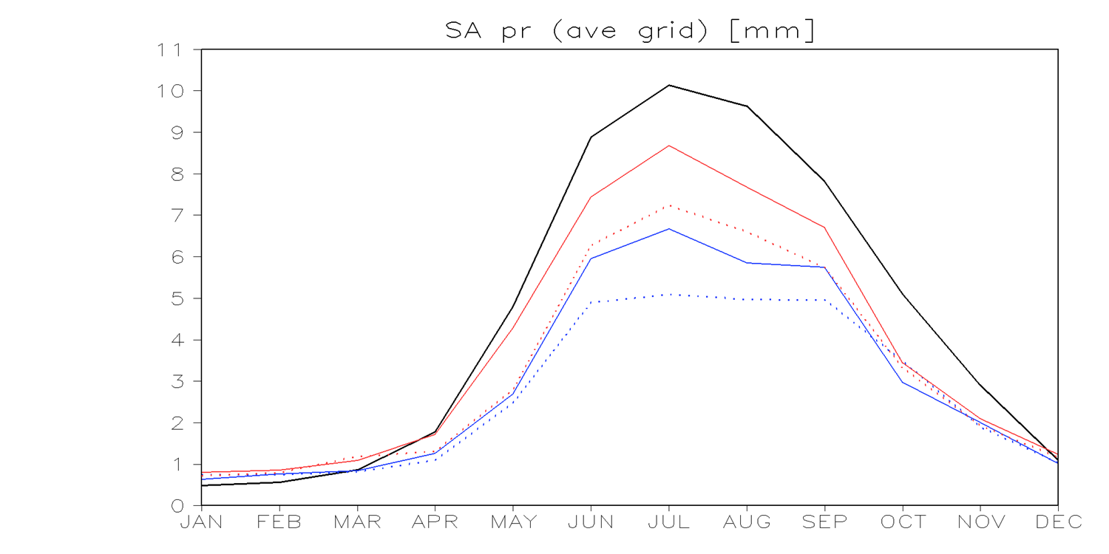
Rainfall averaged over 70-110ºE, 5-25ºN
mm/day
Black = obs
Red = GA7
Blue = GA6
Dashed line =N96
Solid line =N216
UM is well known for its dry bias in Indian monsoon rainfall, but it is improving in GA7. A similar version is being used in UKMO and ACCESS CMIP6 contributions. Question: what are the benefits?

Slide 3
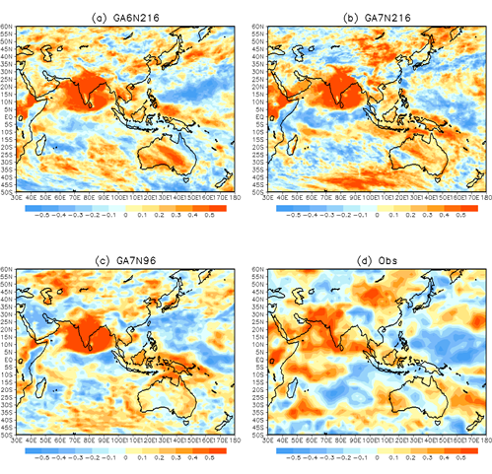
Partial correlations between averaged Indian monsoon rainfall (70-90ºE, 5-25ºN) and rainfall in the region after removing ENSO impacts

Slide 4
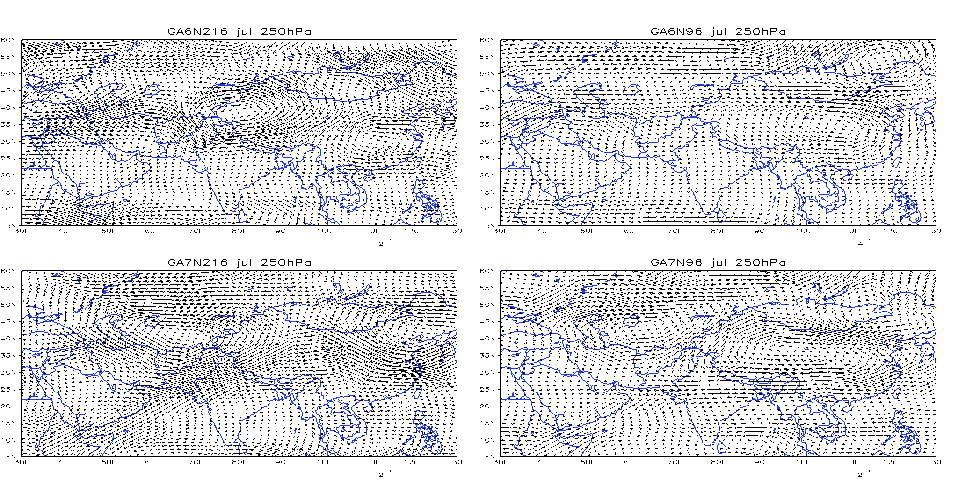
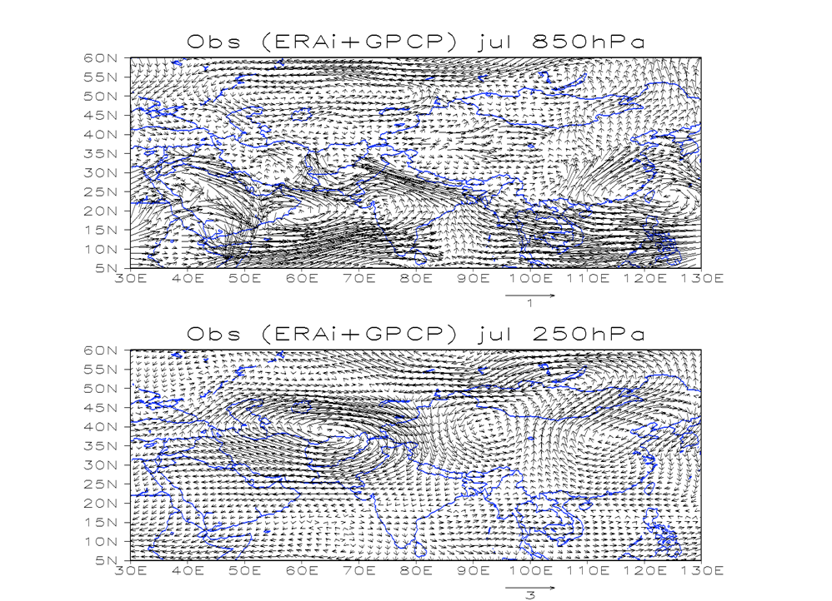
Indian monsoon rainfall correlations with regional circulation

Slide 5
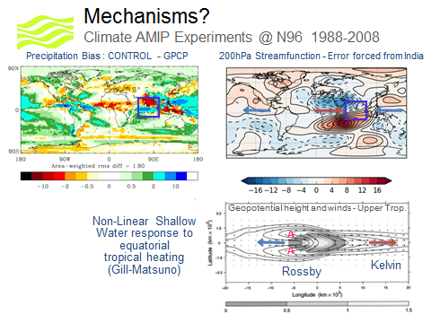
Q1 (apparent diabatic heating)
Diabetic heating intensity is almost doubled over Indian monsoon region in ~GA7 (G. Martin)
Courtesy: Sean Milton

Slide 6
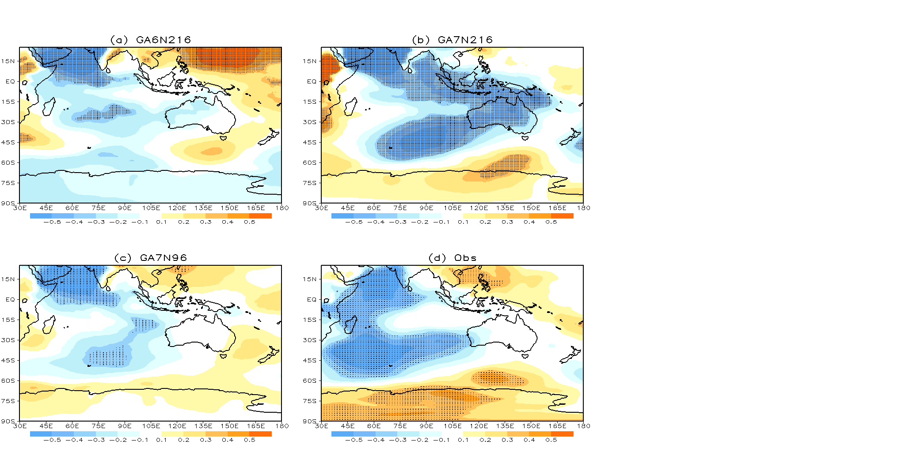
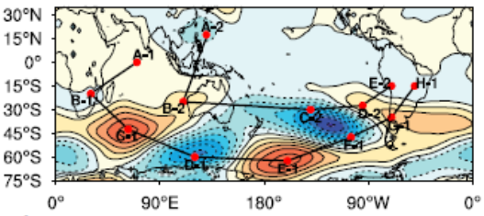
Interhemispheric teleconnections
Zhao et al. (2018) Climate Dynamics

Slide 7
Questions:
If tropical monsoon is poorly simulated in current climate, how confident are we in predicting its potential changes in warmed climate?
As tropical monsoon has far-reaching impacts, how could we consider its induced uncertainty in regional climate projections outside the monsoon domain?
Conclusions:
Teleconnection is an essential component in ACCESS model evaluation;
Model errors are connected and think outside of the square when exploring model uncertainty.

