Slide 1
ACCESS-CM2 - AMIP realisations 24 May 2019
Roger Bodman | University of Melbourne & CSIRO

Slide 2
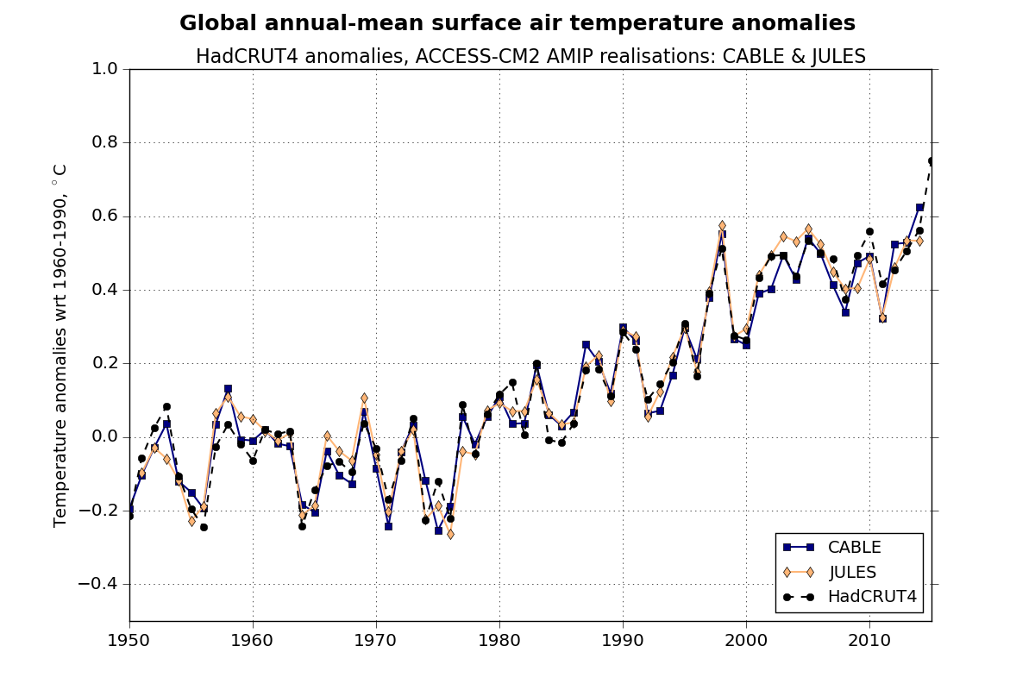
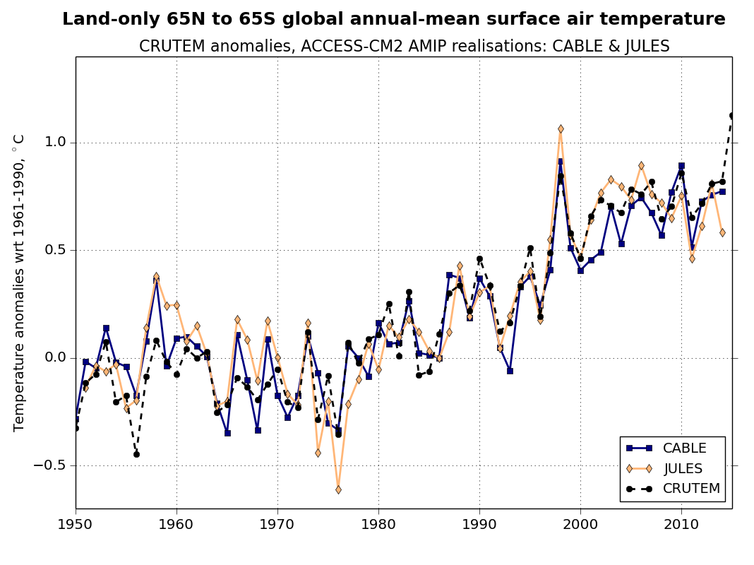
AMIP Surface air temperature
Setup for CMIP6
CABLE and JULES versions

Slide 3
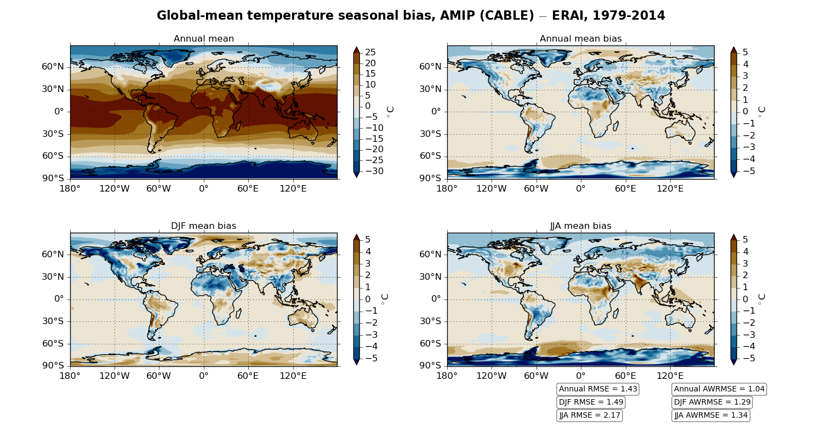
CABLE version (bg209). ERAI = ERA-Interim reanalysis.

Slide 4
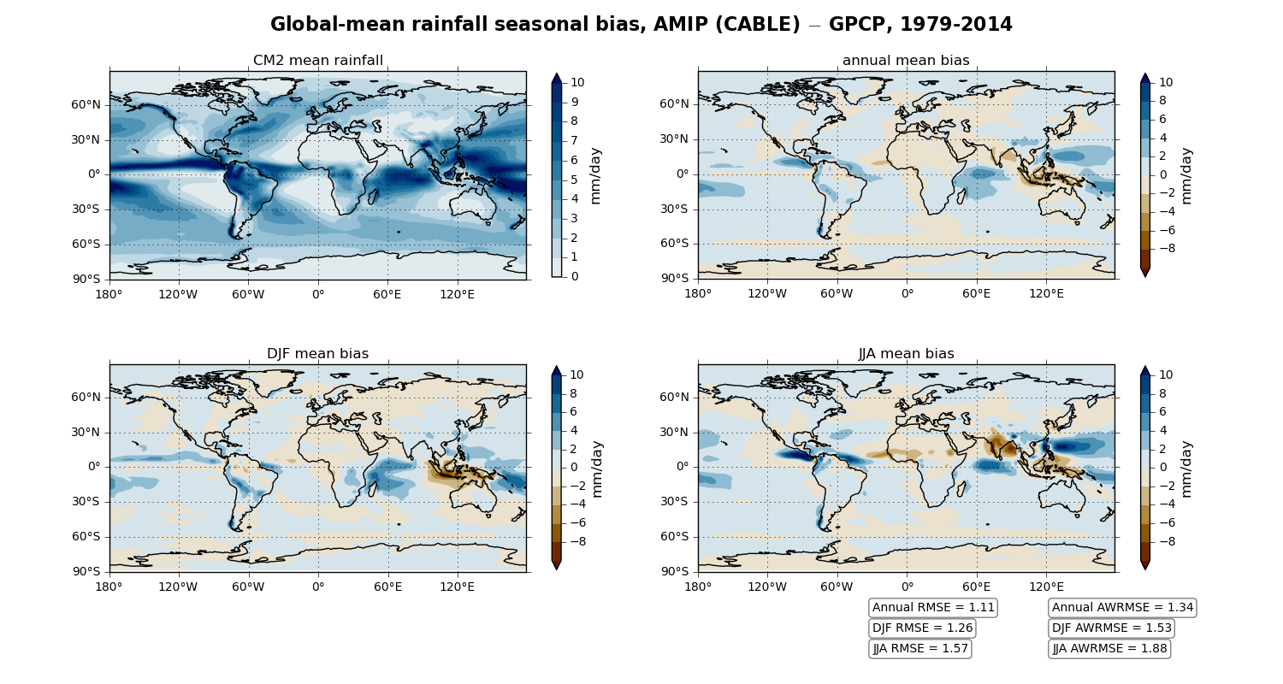
CABLE version (bg209). GPCP observations.

Slide 5
Temp and Precip: global scale biases
AMIP AWRMSE bias
 | A1.3 | CABLE | JULES ensemble*
Temperature (model – ERAI)
annual | 1.21 | 1.04 | 1.06
djf | 1.50 | 1.29 | 1.44
jja | 1.44 | 1.34 | 1.33
Precipitation (model – GPCP)
annual | 1.26 | 1.34 | 1.23
djf | 1.57 | 1.53 | 1.34
jja | 2.02 | 1.88 | 1.72
A1.3, ACCESS1.3 AMIP from CMIP5
* 3 realisations

Slide 6
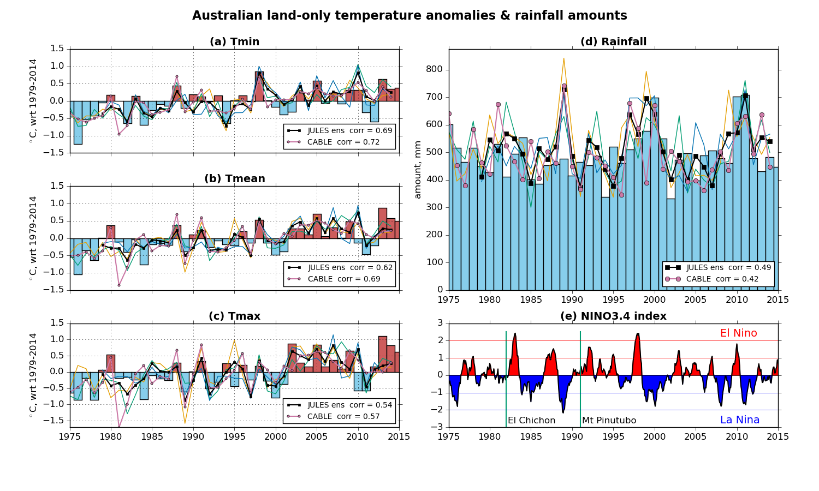
Bars: AWAP observations. Correlations between AWAP and model annual time series
Notes:
Australian Water Availability Project

Slide 7

The End

