Slide 1
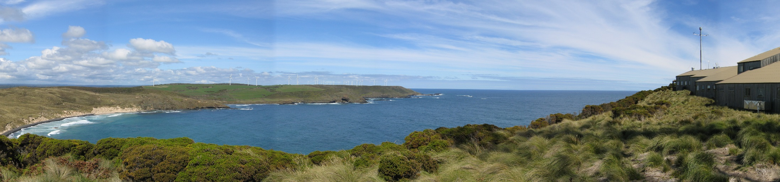
Current state of ACCESS-CM2 CMIP6 simulations
CSIRO Climate Science Centre
Martin Dix| Coupled climate modelling team

Slide 2
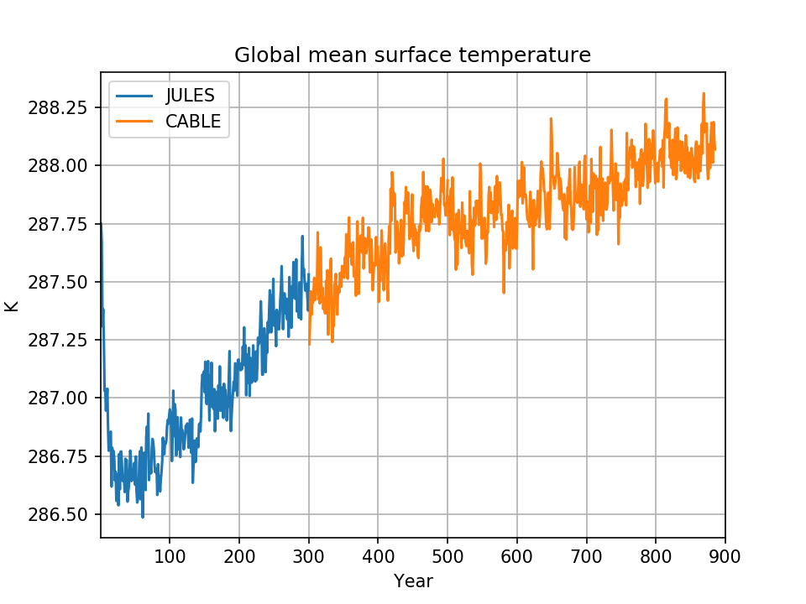
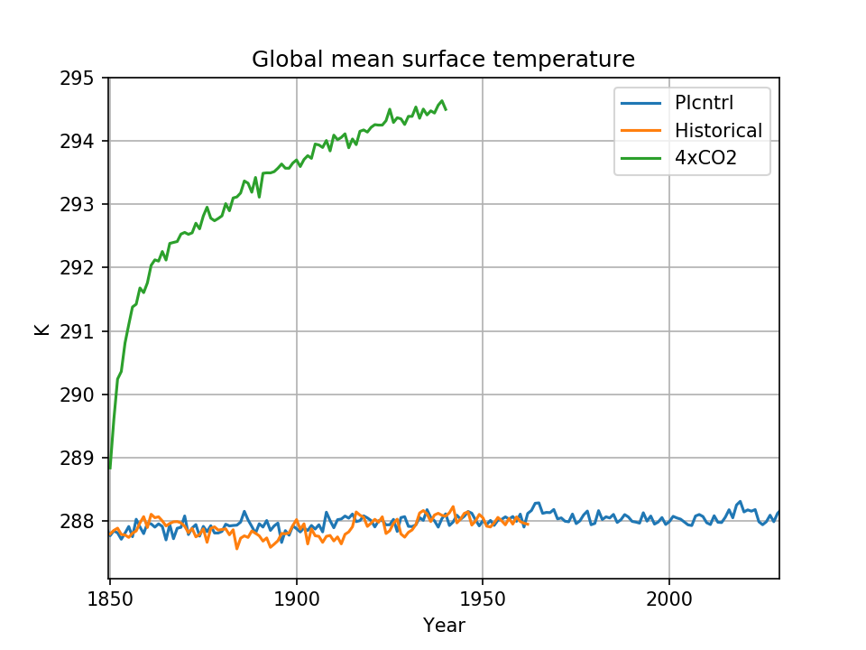
Spinup and DECK runs

Slide 3
Recent problems
Sea salt aerosol showed problems from unphysical spikes in CABLE diagnostic 10m wind speed in calm stable conditions
Surface fluxes unaffected so expect little effect on overall climate
However several important CMIP6 diagnostics show effect
E.g., daily surface net solar radiation
Decided we couldn’t submit the simulations to CMIP6 with this problem
PI control restarted with CABLE problem fixed
Also some other JULES/UKCA sea-salt related bugs fixed

Slide 4
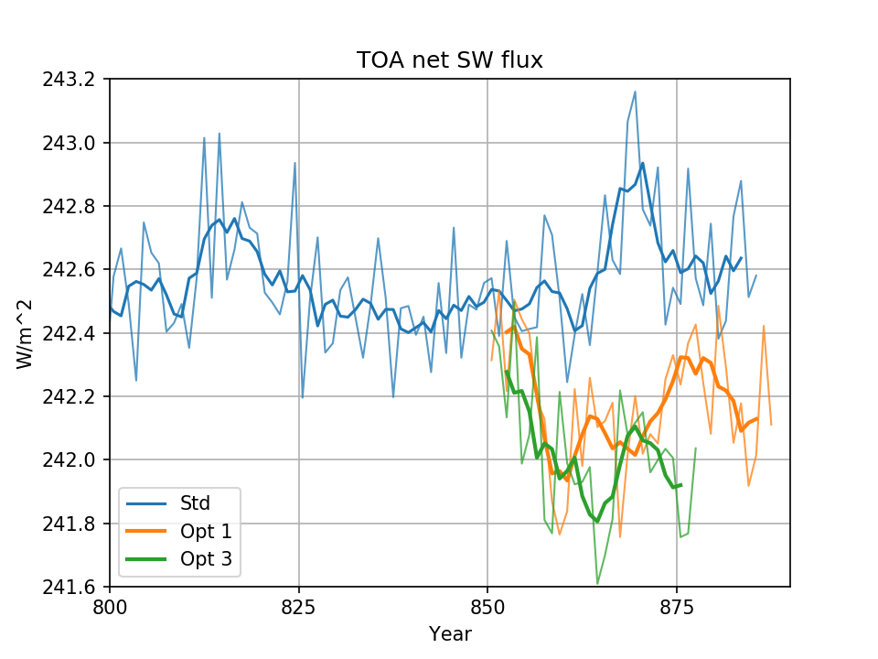
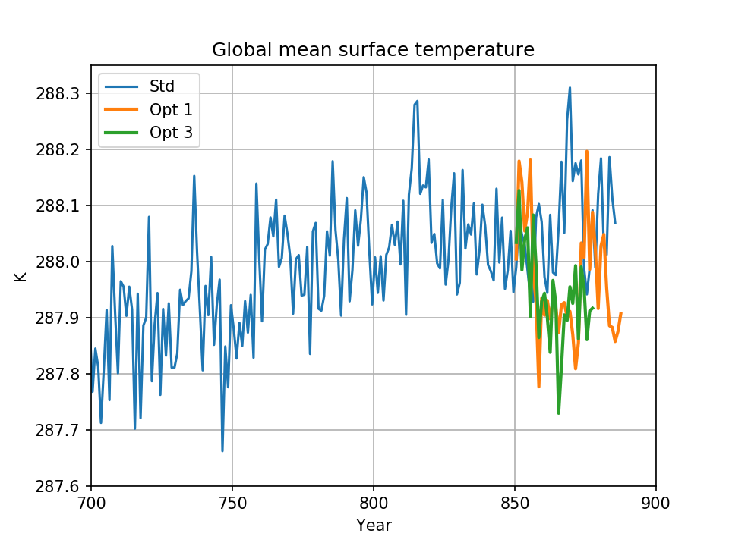
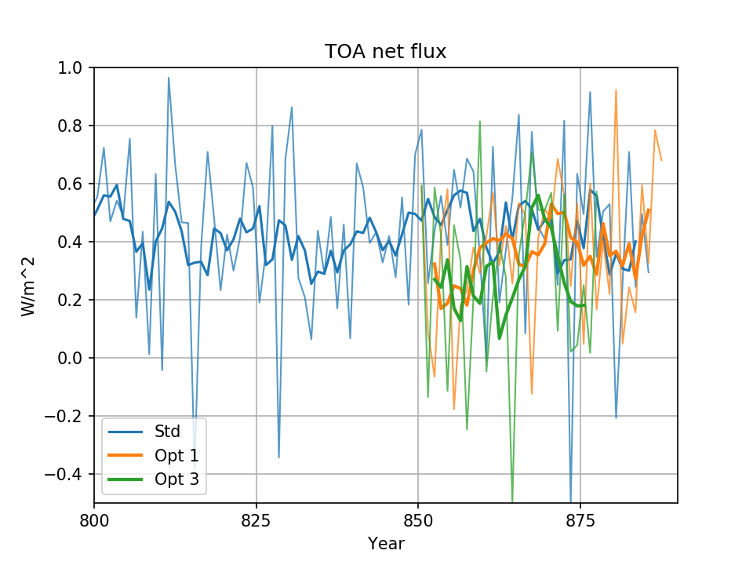
New PI control simulations

Slide 5
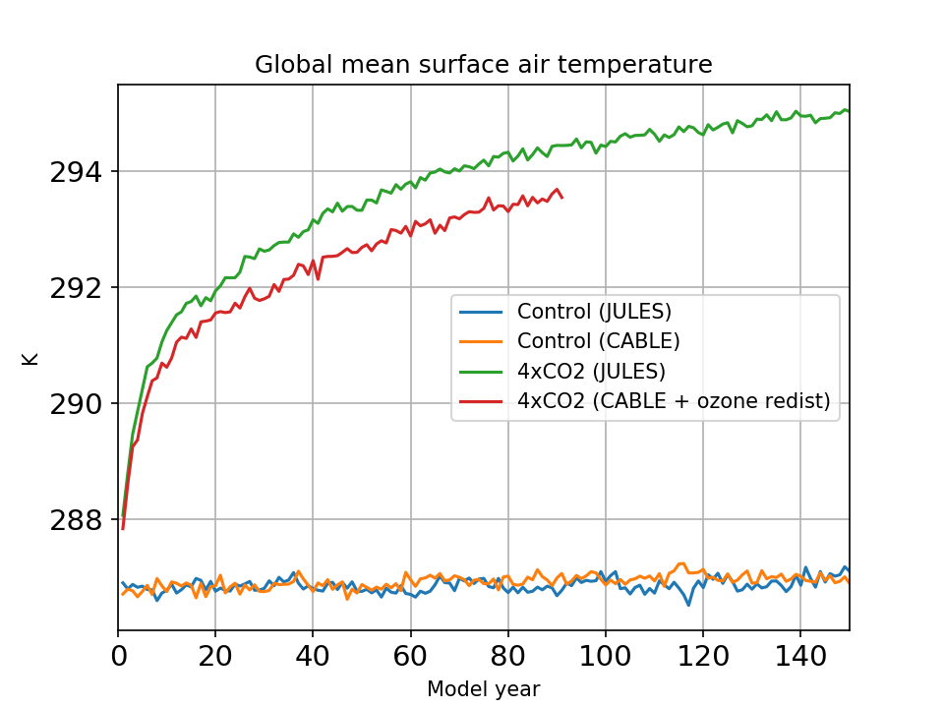
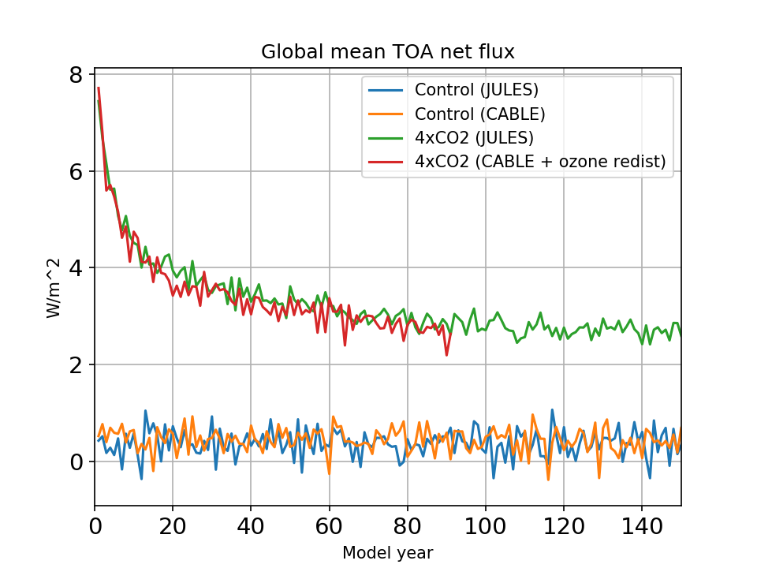
Equilibrium climate sensitivity
Notes:
Acquised

Slide 6
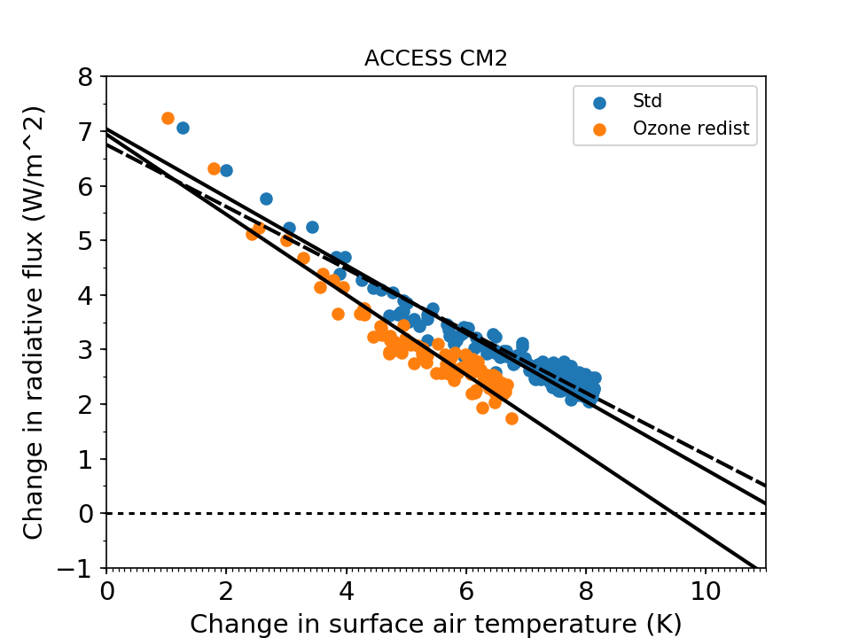
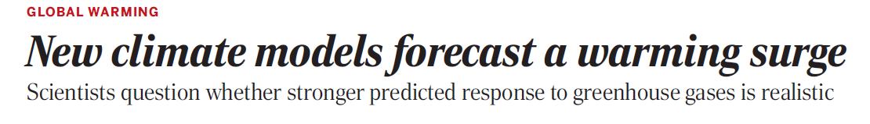
Equilibrium climate sensitivity
Case | 2xCO2 ECS
Std 150 years | 5.9
Std 90 years | 5.6
Ozone fix 90 years | 4.7
Science, 19 April 2019

