Slide 1
Improving tropospheric ozone in ACCESS‐UKCA
Ashok Luhar, Matt Woodhouse and Ian Galbally
Acknowledgements: Luke Abraham (Cambridge), Fiona O’Connor (Met Office), Marcus Thatcher, Bodeker Scientific, NCI, ECMWF, WDCGG and more
ACCESS Science Day, 24 May 2019
Climate Science Centre, Oceans and atmosphere Business Unit

Slide 2
Tropospheric ozone
Ozone is a greenhouse gas, and impacts human health and plant productivity
Ozone represents about 15% of the net anthropogenic radiative forcing - dominated by tropospheric ozone
Ozone is not emitted directly but formed by photochemical reactions involving precursor species (e.g. NO_{x})
Tropospheric ozone budget (IPCC AR5): Chemical production + stratosphere-to-troposphere exchange (STE) = chemical loss + dry deposition loss (4877 ± 853 Tg yr⁻¹) + (477 ± 96 Tg yr⁻¹) = (4260 ± 645 Tg yr⁻¹) + (1094 ± 264 Tg yr⁻¹) Ozone burden = 337 ± 23 Tg
In models, ozone burden and bias is linked to the processes associated with the above budget components, also impact OH⁻, CH₄, CO
We have investigated processes influencing tropospheric ozone in ACCESS-UKCA (UK Chemistry and Aerosol)
UKCA is the climate-chemistry-aerosol component (https://www.ukca.ac.uk) of ACCESS; a component of UKESM
We use the model at UM vn8.4, N96L85, CheST, atmosphere only, monthly-varying emissions
Notes:
Dry deposition is about three times the tropospheric ozone burden

Slide 3
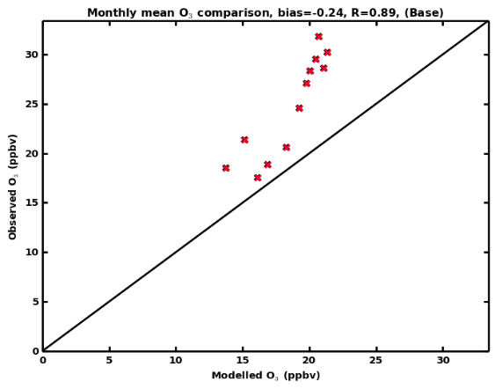
Dry deposition of ozone to the ocean
All current global models (including UKCA) overestimate ozone dry deposition loss to the ocean, which is ~ 30% (~300 Tg yr⁻¹) of the total (IPCC AR5; Young et al., 2013); leads to smaller tropospheric ozone burden
The main reason for the v_{d} overestimation is that is the dominant surface resistance term r_{c} in is assumed to be constant at 2000 – 2200 s/m (Wesely, 1989)
UKCA overestimates measured v_{d} by a factor of 2–4 (Luhar et al., ACP, 2017)
Cape Grim – O₃ (UKCA)
Ozone underestimation in mid to high latitudes, particularly in the Southern Hemisphere (e.g. Cape Grim); some of this can be explained by deposition overestimate

Slide 4
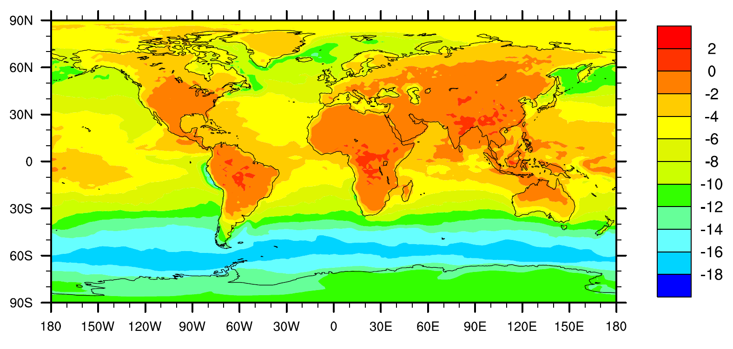
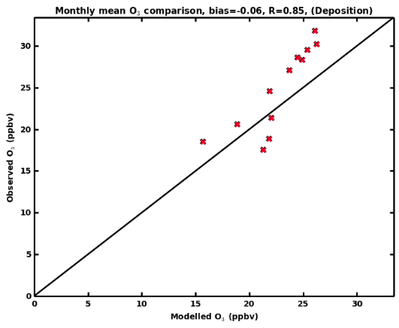
Improving O₃ dry deposition to the ocean
A new analytical scheme for the surface resistance r_{c} for the ocean developed; it includes waterside processes: ozone solubility, its reaction with dissolved iodide, molecular diffusion & turbulent mixing (Luhar et al., 2018)
% Surface O₃ difference ((original – new ) /new)
Cape Grim O₃ (UKCA)
K₀, K₁ modified Bessel functions
Original
ACCESS-UKCA,
r_{c} = 2200 s/m
New scheme for r_{c} in ACCESS-UKCA
With new deposition scheme

Slide 5
Impact of the new deposition scheme
The ozone deposition loss to the ocean is reduced from ~300 to ~100 Tg O₃ yr⁻¹ (by ~65% over the current estimates)
20% reduction in total global deposition of ozone (~1000 to ~800 Tg O₃ yr⁻¹)
Tropospheric O₃ burden increases from 252 Tg to 273 Tg (8% increase, correct trend compared to O₃ data)
Increase in near-surface O₃ by up to 16% in the mid to high latitudes, particularly in the Southern Hemisphere
Will impact tropospheric O₃ radiative forcing
Other impact
The new deposition scheme is being incorporated in other global models by other groups (e.g. in GEOS-Chem by York with improved model performance demonstrated)
The lodgement of the new deposition scheme into the UM Trunk at the current UM vn11.3 is virtually complete. Will be available from vn11.4 from next month.

Slide 6

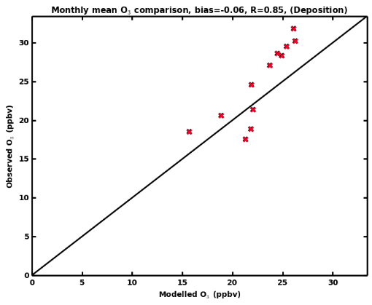
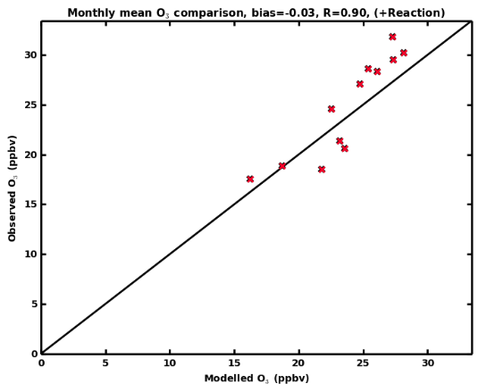
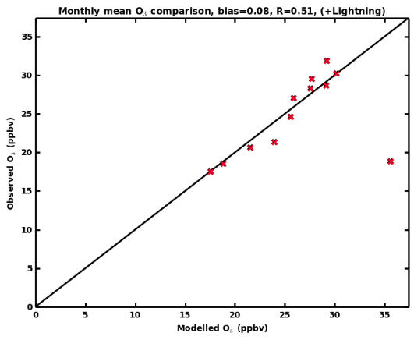
Further improvements
k₂
k
Chemical reactions: HO₂ + NO --> HNO₃ (sink of NO); HO₂ + NO --> NO₂ + HO
Inconsistencies with rate coefficients k₂ and k were resolved
NO_{x} generation due to lightning (LNO_{x})
A major contributor of ozone in the middle to upper troposphere, large uncertainty (2 – 8 Tg N /yr)
Lightning flash rate parameterised in terms of modelled convective cloud-top height
A modified parameterisation (Michalon et al., 1999) that includes cloud microphysics was incorporated
Results: Further improvements in modelled ozone and burden
Table: Observed and modelled lightning flash frequency (count s⁻¹)
 | Global | Land | Sea | Northern Hemisphere | Southern Hemisphere
LIS/OTD data | 46.5 | 35.0 | 12.5 | 26.2 | 20.3
UKCA | 32.1 | 31.7 | 0.4 | 16.1 | 16.0
UKCA with modified marine flash rate | 43.4 | 31.8 | 11.6 | 23.0 | 20.4
1) Original (O₃ burden 252 Tg)
2) With new deposition (O₃ burden 273 Tg)
3) + reaction changes (O₃ burden 286 Tg)
4) + lightning changes (O₃ burden 307 Tg)
Cape Grim O₃
Ozone burden 307 Tg; 9% smaller than the IPCC’s 337 ± 23 Tg
??

