Slide 1
Using ACCESS-S for 'pre-event’ attribution
Pandora Hope, S Abhik and Guomin Wang
Bureau of Meteorology, Melbourne

Slide 2
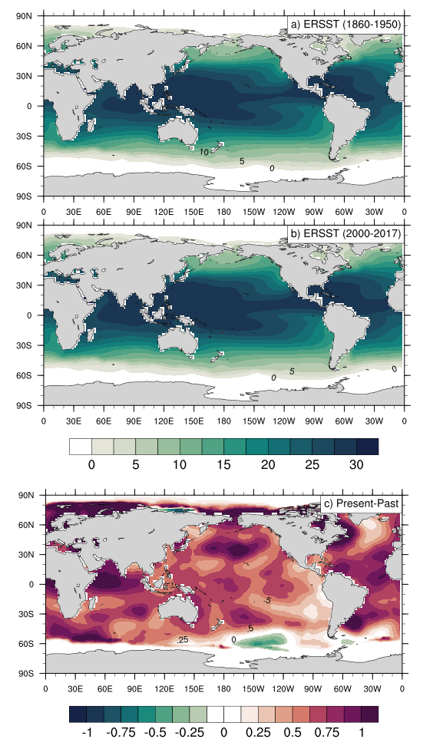
September SST
Observed SST difference shows more warming relative to GC2 over the globe.
Any influence of change in SST measurement technique post-WWII?

Slide 3
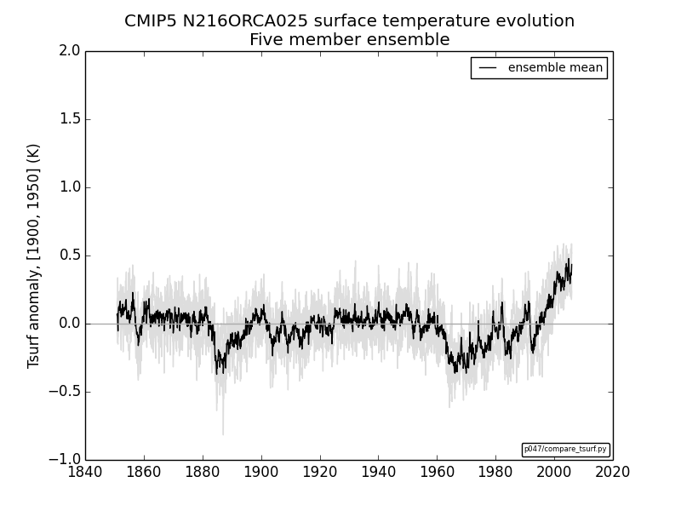

Slide 4
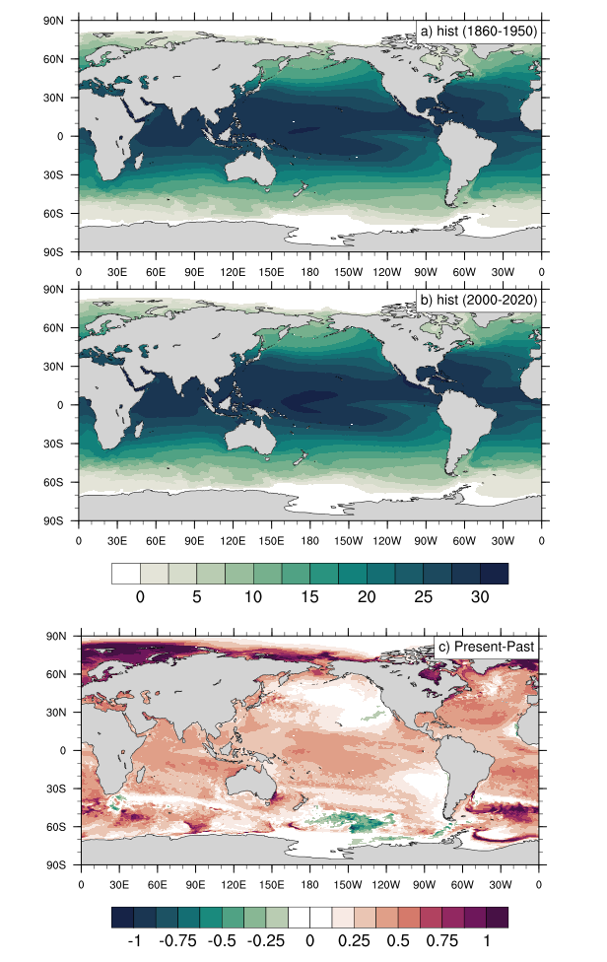
GC2 5-member historical: September SST
(after 2005: RCP 4.5)

Slide 5
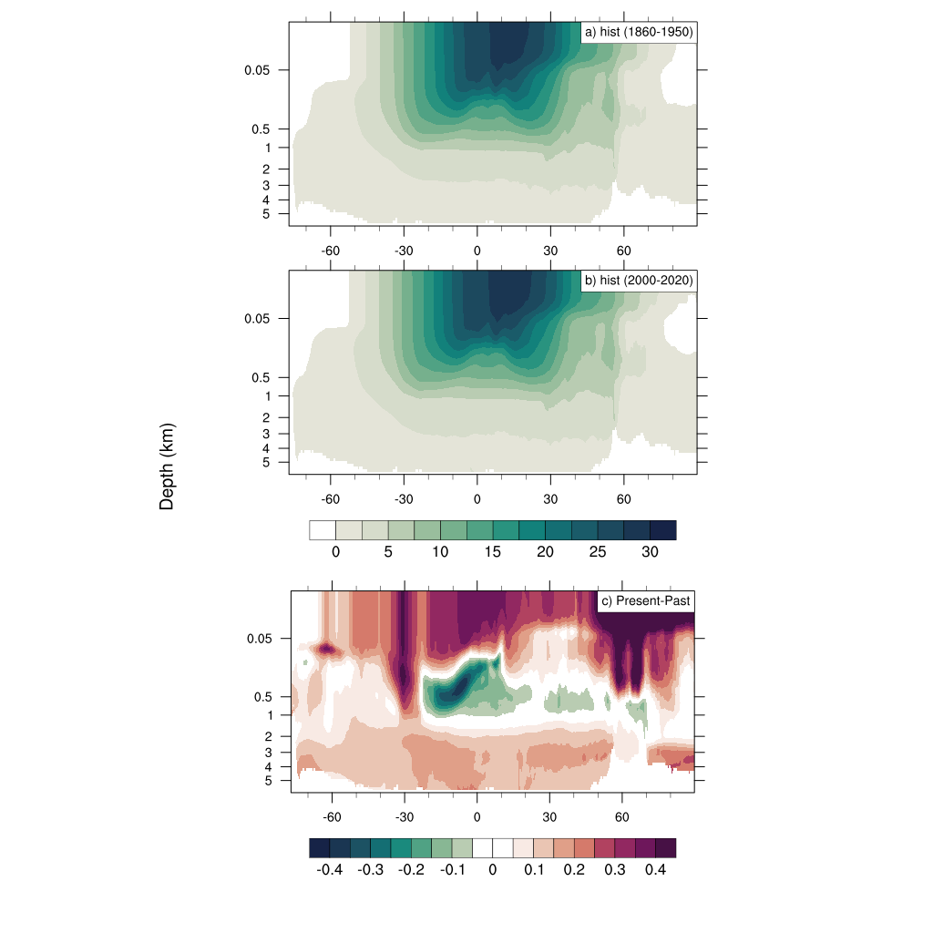
meridional Tocean profile

Slide 6
ACCESS-S1
Test run
IC: 25 September 2009
Single member run for a month, but first 10 days are discarded for spin-up
Only ocean temperature has been changed to pre-industrial period

Slide 7
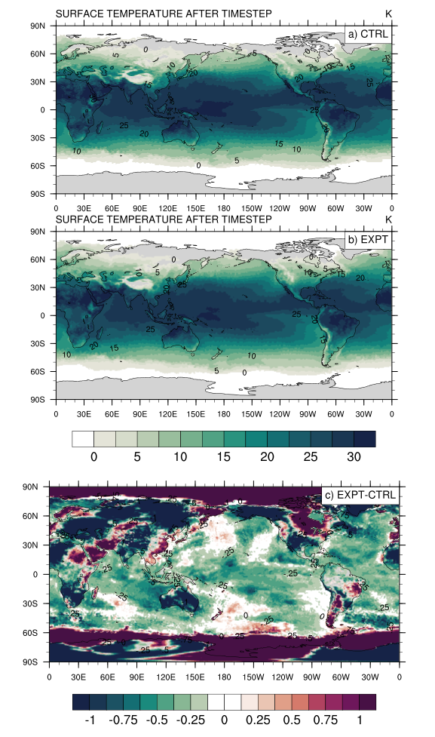
20 day mean surface temperature and difference
Current climate
'cold' ocean
'cold' ocean – current climate

Slide 8
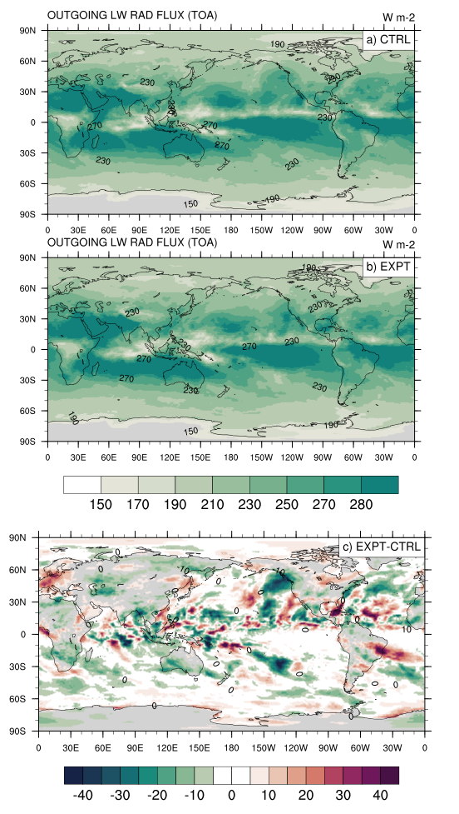
20 day mean OLR at TOA and difference

Slide 9
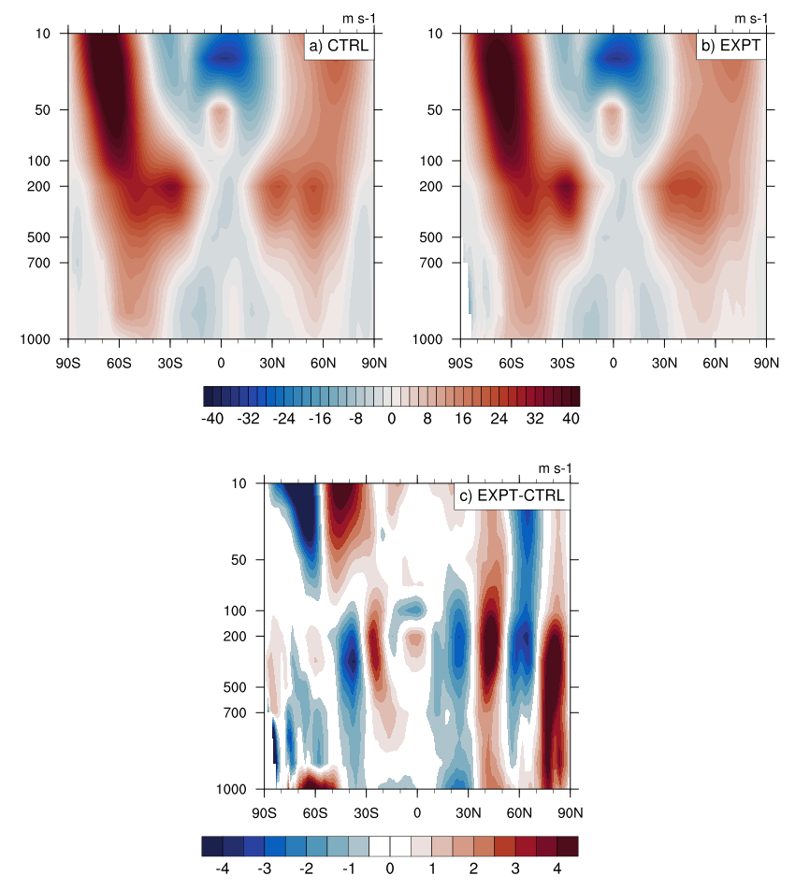
20 day mean zonal mean zonal wind and difference

Slide 10
Next Steps:
Add salinity to dOcean
Develop dAtmos (temperature and humidity)
Test response time of e.g. winds to dAtmos
Develop dSoil – temperature and moisture
Test-run full system
Develop ensembles and test-run. Define compute space/time estimates
Develop understanding of the 'trigger' to run this alongside the operational seasonal/subseasonal forecast. i.e. when is an event 'extreme'?
Develop analysis suite
Develop messaging about results and disseminate the message.
Further work:
Test other estimates of dOcean – e.g. from CMIP6

