Slide 1

Convection scheme development in the latest GA models
Hongyan Zhu
ESM, STS, Bureau of Meteorology

Slide 2
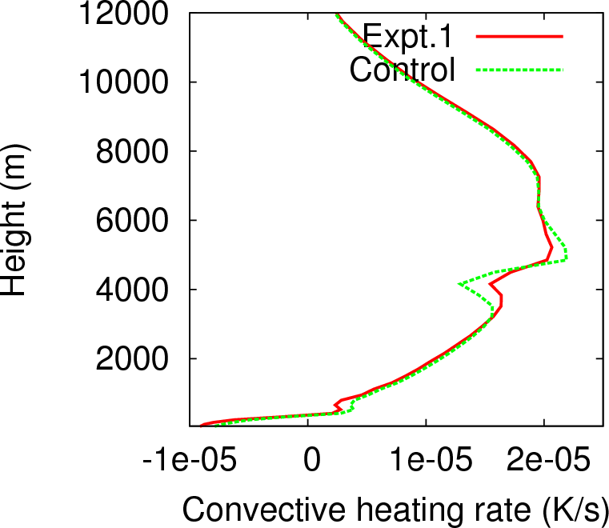
Convection changes in GA8
1. Improved Melting layer physics
Spreading the melting of snow between temperatures from the freezing level to 3K above the freezing level. This change allows a mix of snow and rain between the freezing level and 3K above this with the proportion of rain increasing linearly from zero at the freezing level to one at the freezing level plus 3K.
Zhu, H., E. Maloney, H. Hendon and R. Stratton, 2017: Effects of the changing heating
profile associated with melting layers in a climate model. Quart. J. Roy Met. Soc.
143: 3110–3121

Slide 3
Convection changes in GA8
2. Improved Convective Memory
Linking the deep convective entrainment rate to the amount of convective activity within the last several hours.
Locations that have experienced high levels of recent convective activity will be populated with relatively large convective clouds that have low entrainment rates.
Conversely, locations that have experienced low levels of recent activity will be populated with relatively small convective clouds (if any) that will have high entrainment rates.
Willett M. R. and M. A. Whitall, 2017: A simple prognostic based convective entrainment rate for the
unified model: description and tests, Forecasting Research Technical report No: 617, UK Met
Office.

Slide 4
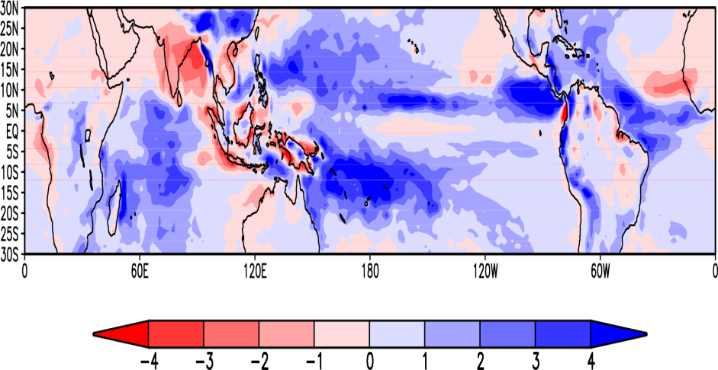
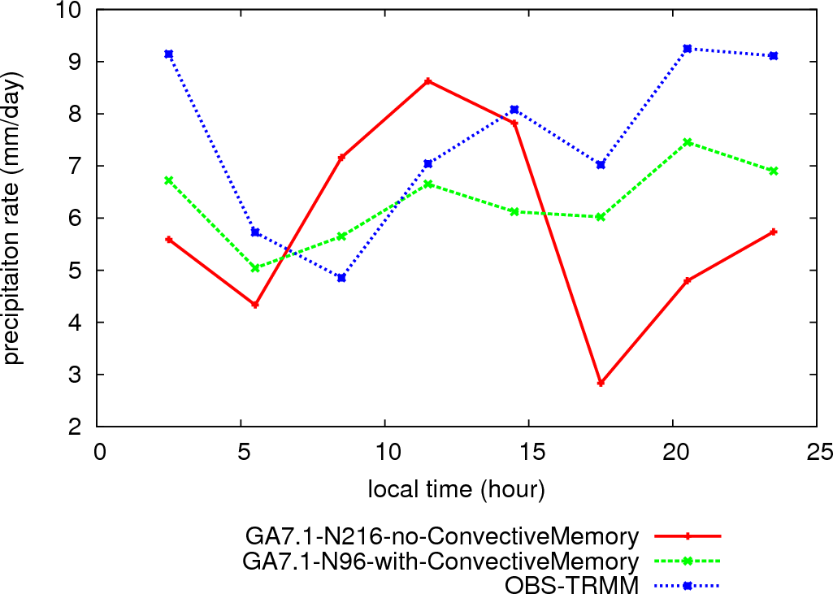
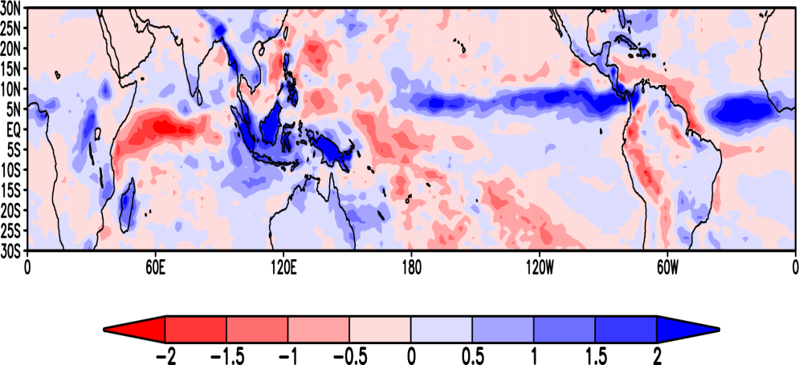
(a)
(b)
Diurnal cycles of the rainfall rate (mm/day) over the Borneo island with N216 resolutions for GA7.1 model at N96 resolution with and without the convective memory change.
(a) The annual mean rainfall rate (mm/day) bias for the experiment in N96 GA7.1 model with the convective memory changes comparing to GPCP rainfall estimate. (b) The difference in annual mean rainfall rate (mm/day) in GA7.1 model between the simulations with and without the convective memory change. (10y, from 1989-1998, unit: mm/day)

Slide 5
Things need to be improved:
Dry precipitation bias over India and Maritime Continent
Intermittent behaviour at grid-point
Lack of propagating MJO
Poor diurnal cycle of convection
Failure to capture summertime MCSs

Slide 6
New convection scheme development
Old scheme:
Convection parameterization split into independent “triggering”, “cloud-model” and “closure”
Intermittency, and hampering efforts at scale-awareness / stochasticity.
Post-hoc CAPE closure rescaling ignores triggering condition, causing intermittency.
CoMorph:
Predicts triggering and mass-fluxes in the unified framework of the updraft dynamics.
Scale-awareness is included in the CIN closure framework by modelling the scale-dependence of the sub-cloud updraft KE available to overcome the CIN.
A CIN closure gives similar mean behavior but without the on-off noise.

