Slide 1

The role of the South Pacific in modulating Tropical Pacific variability
Christine Chung
Scott Power, Arnold Sullivan, Francois Delage
24 May 2019

Slide 2


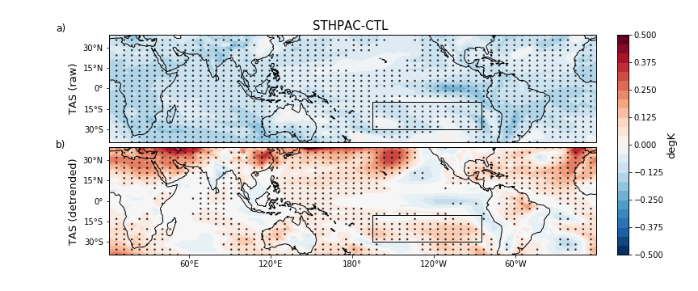
Pacemaker-style runs with prototype ACCESS-CM2
Prototype ACCESS-CM2: GA7.1 with JULES
400-year control run (starting from bb275 run)
400-year SouthPac run:
Switched on sponge layer, restored temperature and salinity at all ocean levels to climatology (year 50-100) from control run

Slide 3
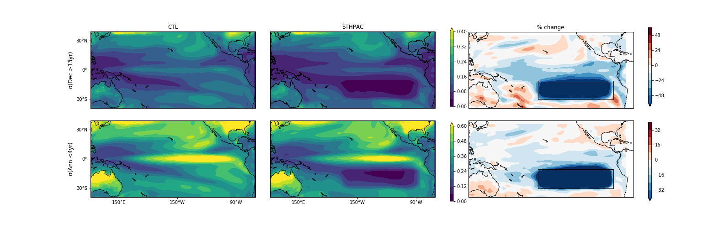
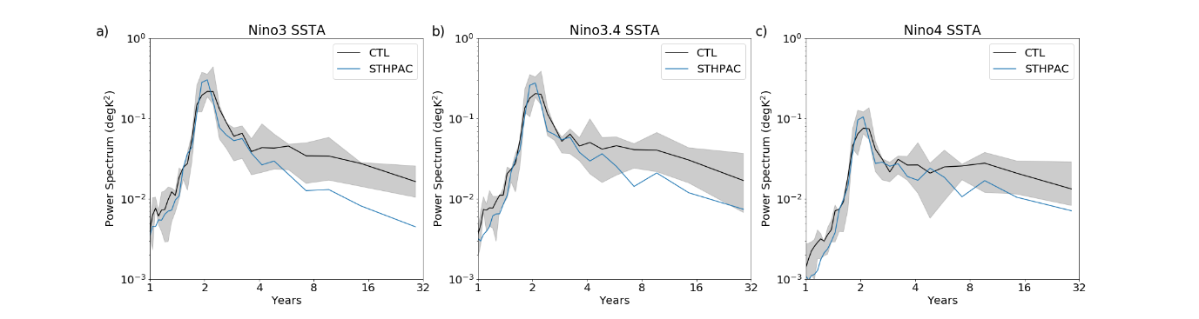
Changes to Tropical Pacific variability
Dec (>13yr)
Interann (<4yr)
Decadal: ~30% reduction
Interannual: ~6% reduction (not significant)

Slide 4
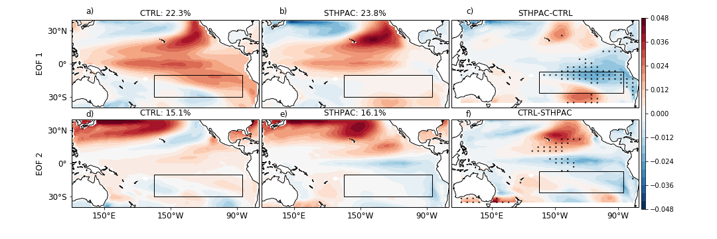
Disruption of the IPO
CTL STHPAC STHPAC-CTL

Slide 5
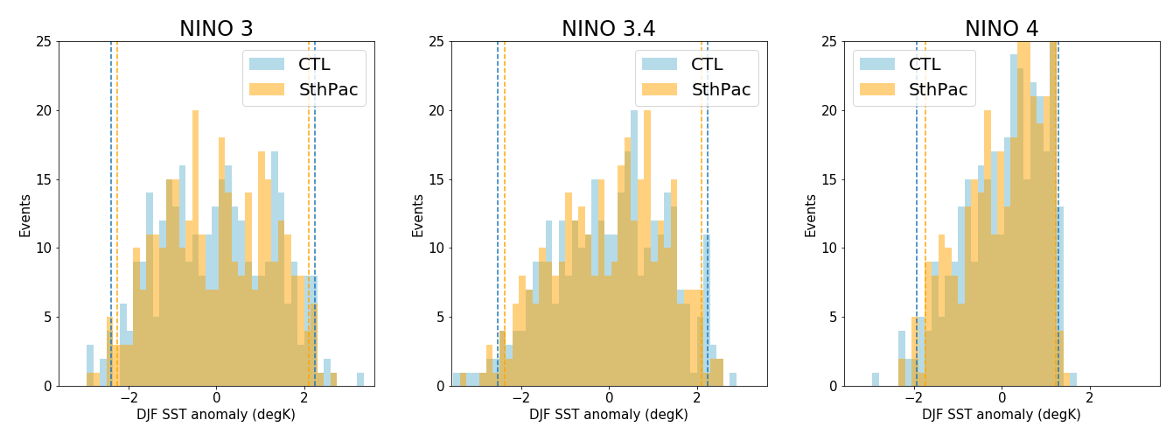
Changes to ENSO
STHPAC run has weaker extreme ENSO SSTAs
Weaker decadal variability
Disruption of coupled feedback processes linking the South Pacific to the equatorial Pacific
Change in mean state

Slide 6
