Slide 1
Evaluation of the latest high resolution model configuration: Regional Atmosphere 2 (RA2)
Charmaine Franklin, Belinda Roux, Hongyan Zhu and Vinod Kumar

Slide 2
RMED = Regional Model Evaluation and Development
RA2
Numerous developments applicable to all km-scale models
Midlatitude physics developments
Tropical physics developments
Differences
RA2-M
cloud scheme
boundary layer settings
RA2-T
midlatitude
tropical
RA2 testing consisted of two RA2-M/T options – a conservative and a stretch package,
the difference being graupel changes included in stretch

Slide 3
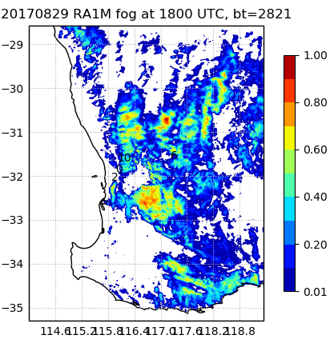
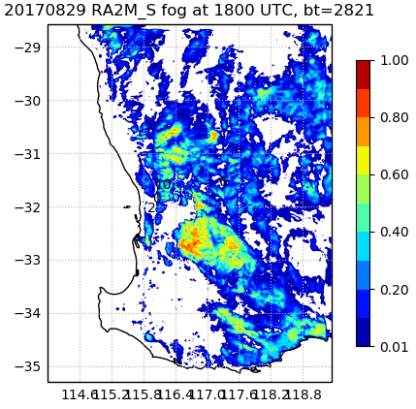
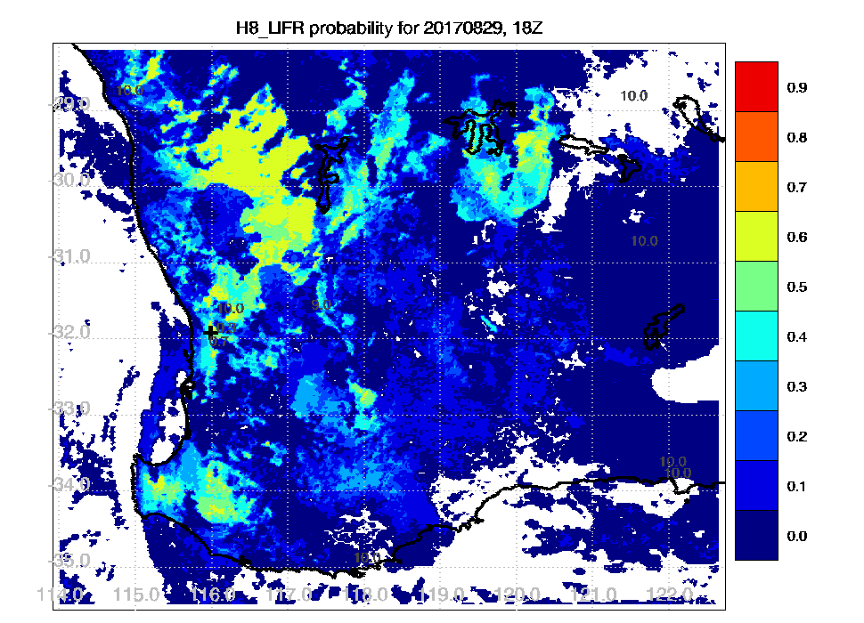
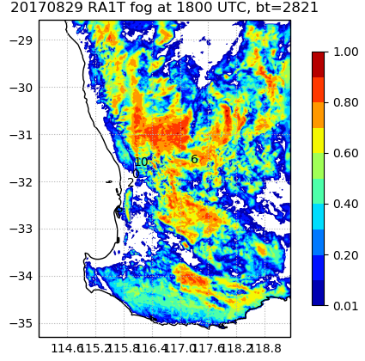
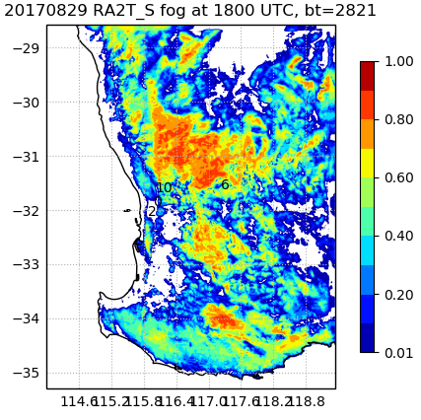
Perth fog – Belinda Roux
Fog fraction
RA1M
RA2M-str
Himawari obs
More fog in tropical configurations due to different cloud schemes and effects on surface cooling
RA2M improves the spatial extent of fog
RA1T
RA2T-str

Slide 4
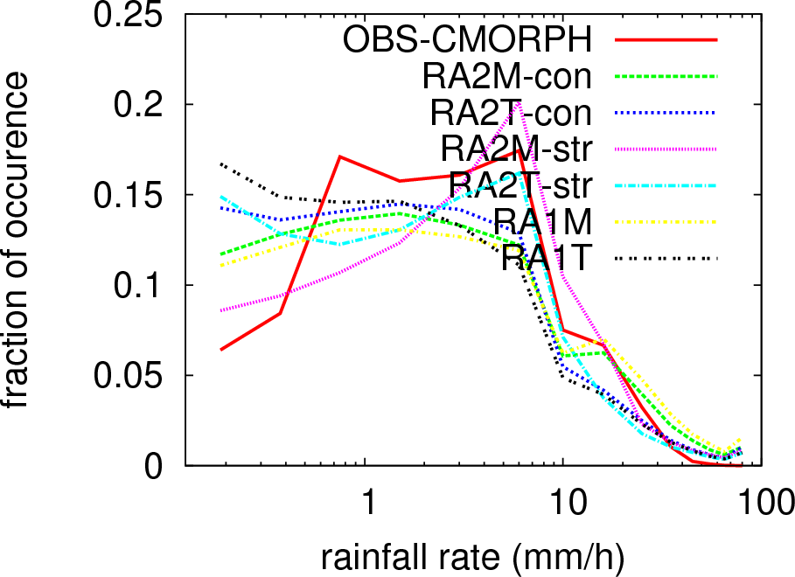
Sydney supercell thunderstorm – Hongyan Zhu
RA2 has better peak in rain rate distribution at 6 mm/h but too little light rain
RA2M reduces the overestimate of very heavy rain

Slide 5
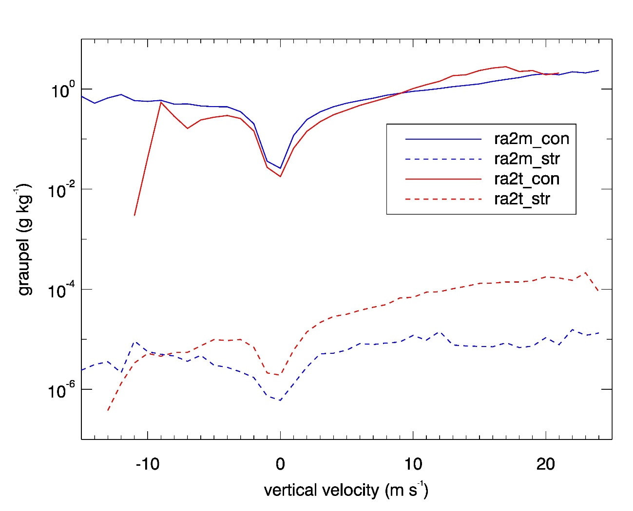
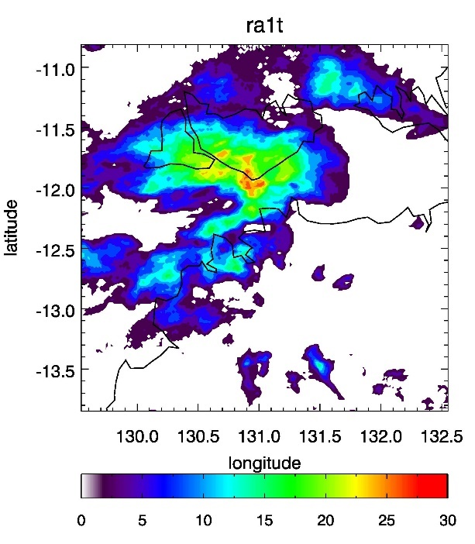
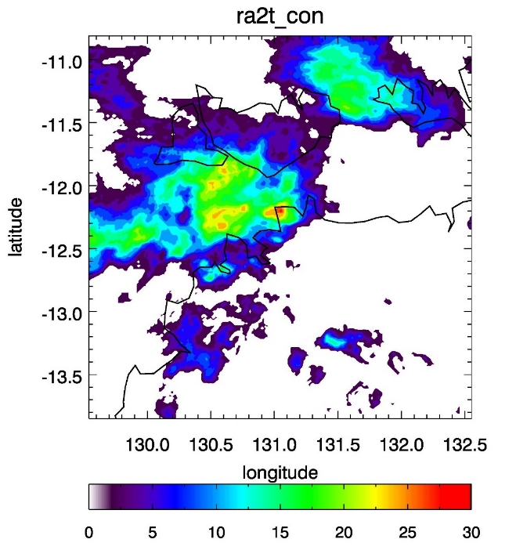
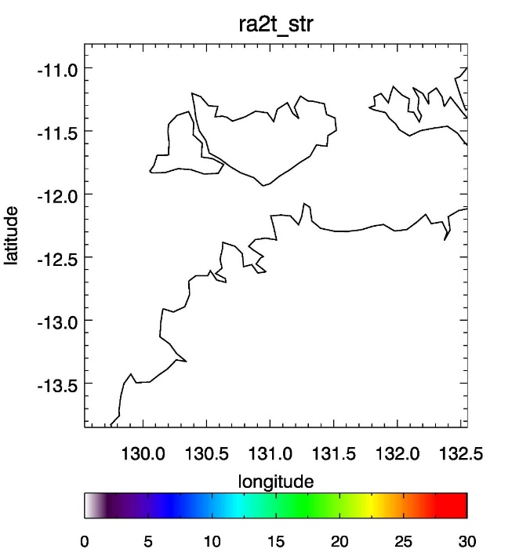
Darwin mesoscale convective system - Charmaine
Simulated lightning flash rate
Graupel amount as fn of vertical velocity
RA1T
RA2T-con
RA2T-stretch
RA2-stretch graupel changes produce no lightning
Graupel significantly reduced in the tropics
These results contributed to the released RA2 configuration being the conservative package

Slide 6
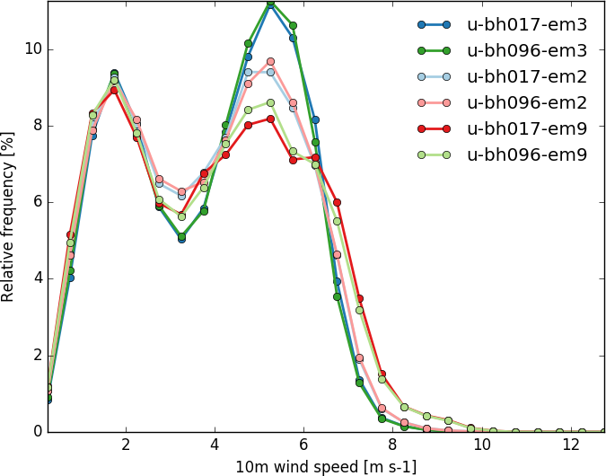
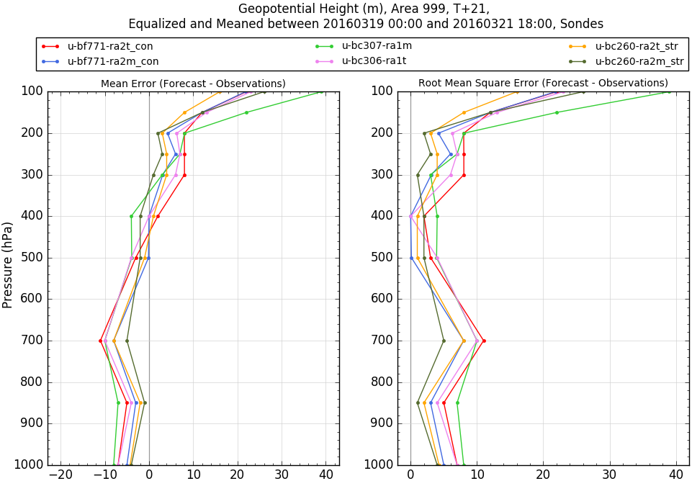
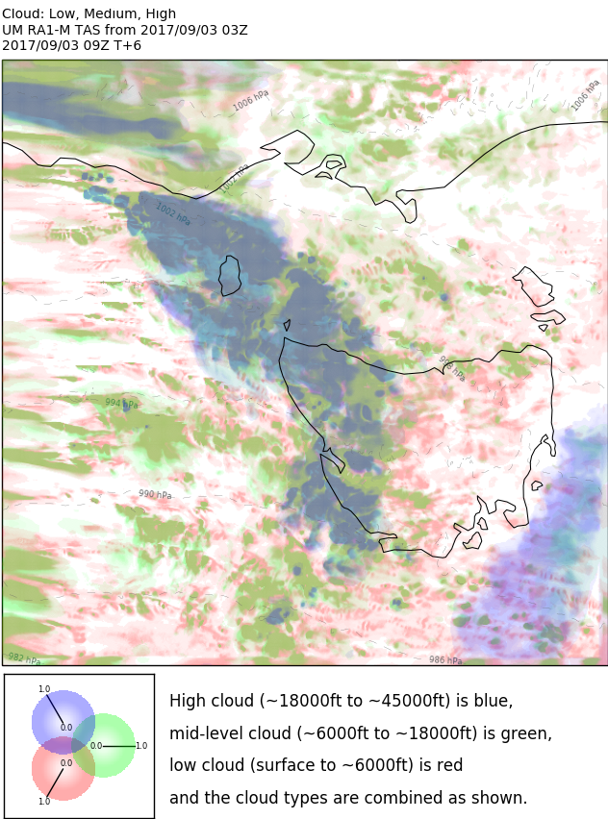
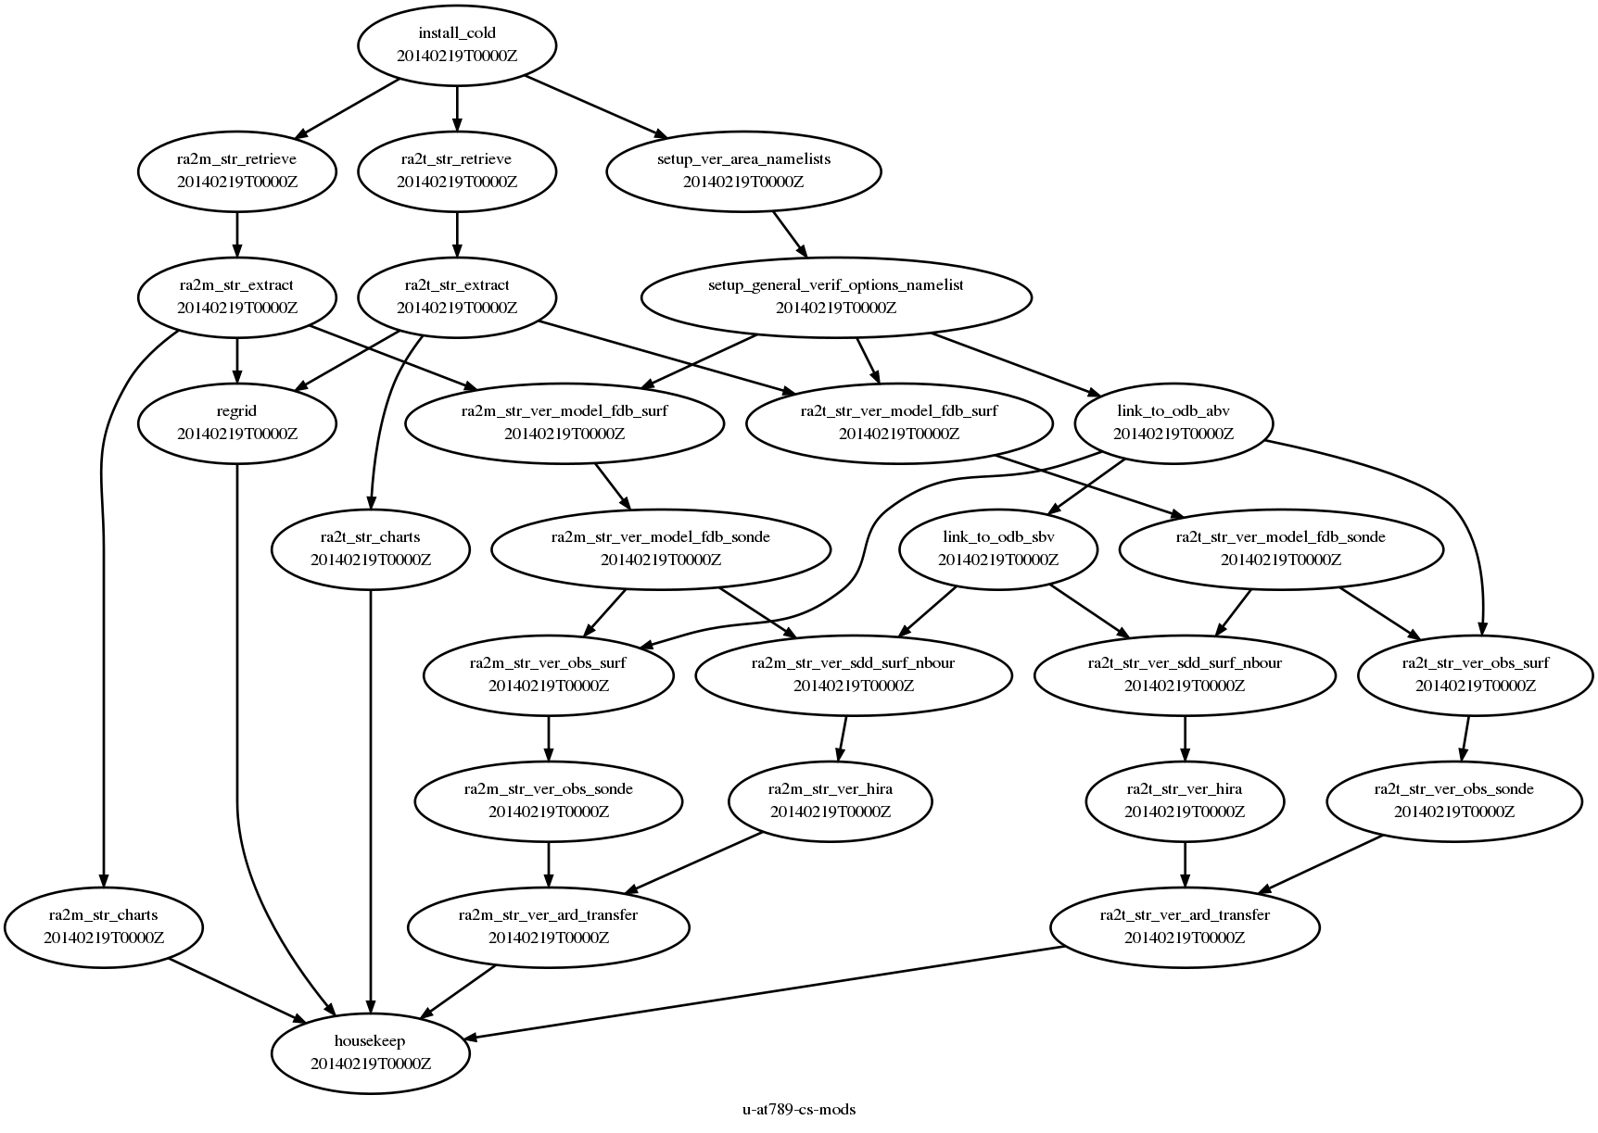
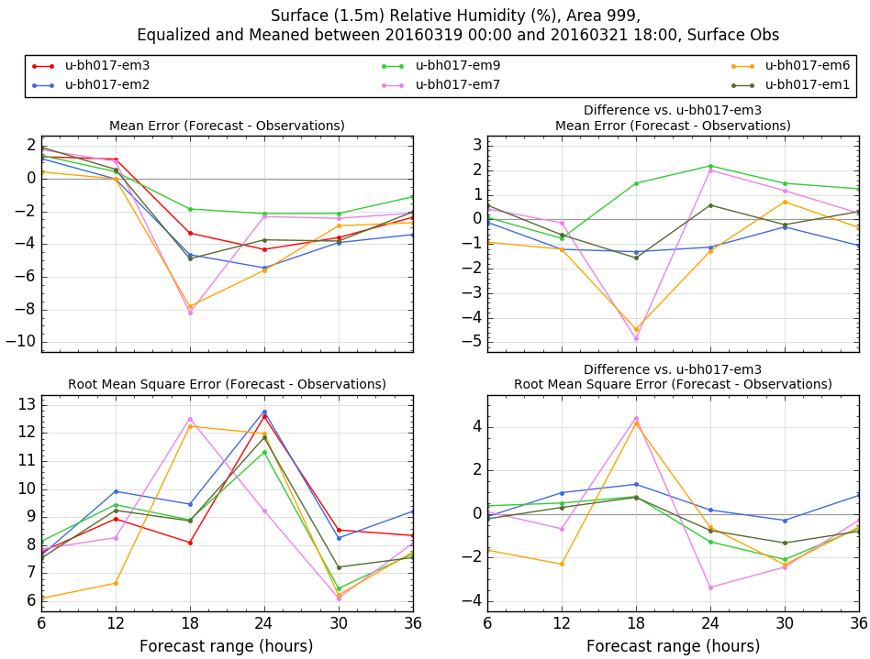
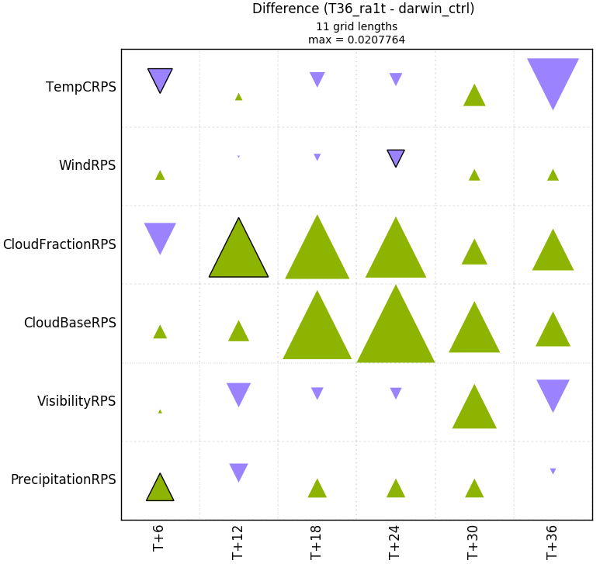
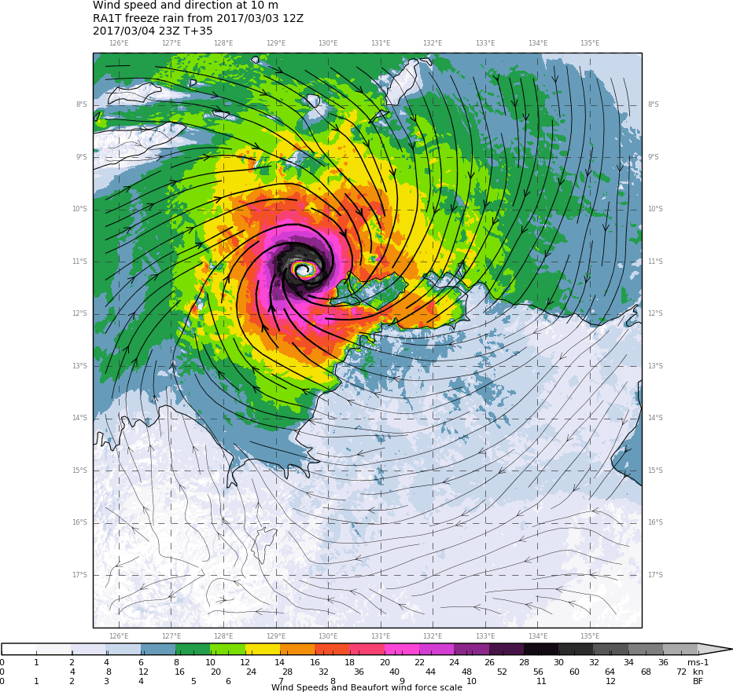

Vinod Kumar
What is Regional Evaluation Suite?
A task management interface for regional, hi-res NWP evaluation
Developed by the Met Office with possibility for partner contribution
Leverages a number of Met Office packages (e.g. RMED-toolbox)
An enabler for BoM's next-gen NWP development (via RMED)
Evaluation of 8 RA2 Australian case studies at https://code.metoffice.gov.uk/trac/rmed/wiki/eva/test_cases

