Slide 1

The impact of the Tropical Atlantic on Tropical Pacific variability in ACCESS-CM2j
Christine Chung
Scott Power, Arnold Sullivan, Francois Delage
13 Sep 2019

Slide 2

Pacemaker-style runs with ACCESS-CM2j
ACCESS-CM2: GA7.1 with JULES
400-year piControl run (starting from bb275 run)
400-year 'clamped' runs:
Switched on sponge layer, restored temperature and salinity at all ocean levels to climatology (year 50-100) from control run
South Pacific (Chung, Power, Sullivan & Delage 2019, Scientific Reports – under review)
Tropical Atlantic – 367 years - preliminary

Slide 3
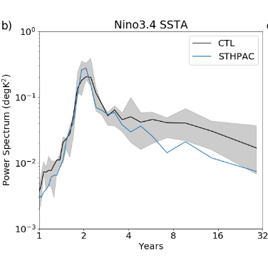
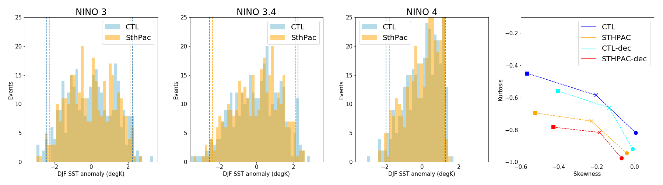
The role of the South Pacific on the Tropical Pacific Chung et al 2019, Scientific Reports
Decadal timescales: ~30% reduction
Interannual timescales: ~6% reduction (not significant)
Reduction in extreme ENSO SST anomalies
Consistent with
Liguori & Di Lorenzo 2019 (CESM1)
Liu et al 2006 (FOAM1.0)

Slide 4
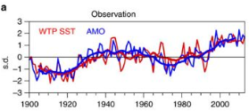
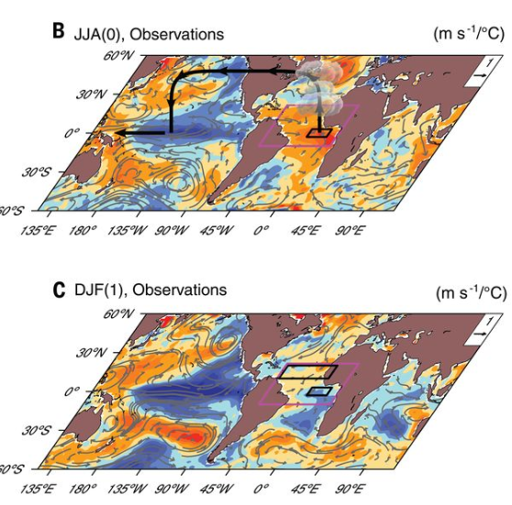
Clamping the Tropical Atlantic
Why the Tropical Atlantic?
Western tropical Pacific multidecadal variability forced by the Atlantic multidecadal oscillation
(Sun et al 2017, Nature Comms)
Atlantic Niño can initiate a Pacific La Niña
(Review by Cai et al 2019, Science)
Observed decadal trends in Pacific SSTs partially forced by Atlantic SSTs
(Chikamoto et al 2016, McGregor et al 2017)

Slide 5
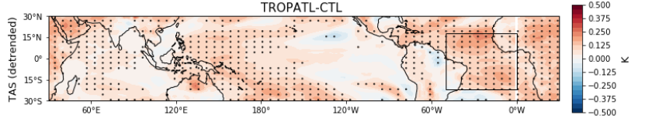
Clamping the Tropical Atlantic
CTL = 400 years
TROPATL = 377 years
Trend in global mean surface temperature:
CTL = 0.1 K/100yr
TROPATL = 0.008 K/100yr

Slide 6
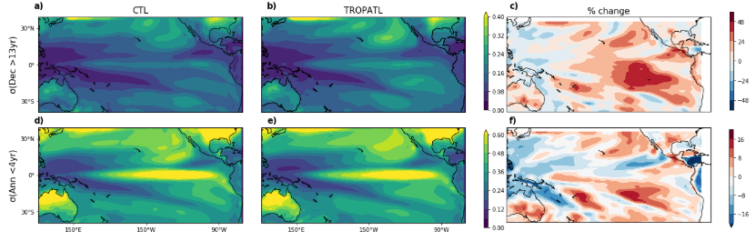
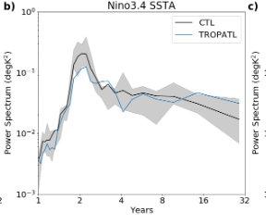
Impact on Tropical Pacific variability
Dec
North Pac Meridional Mode
Ann
South Pac Meridional Mode
North Pac Meridional Mode
SPMM: decadal timescales
NPMM: interannual timescales
Liguori & Di Lorenzo 2019
Liu et al 2006
Min et al 2017
South Pac Meridional Mode

Slide 7
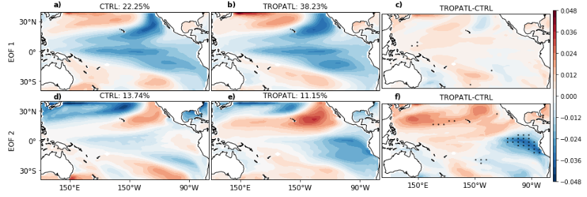
Changes to the IPO
EOF 1 (IPO) becomes more dominant
EOF 2 changes structure in eastern equatorial Pacific

Slide 8
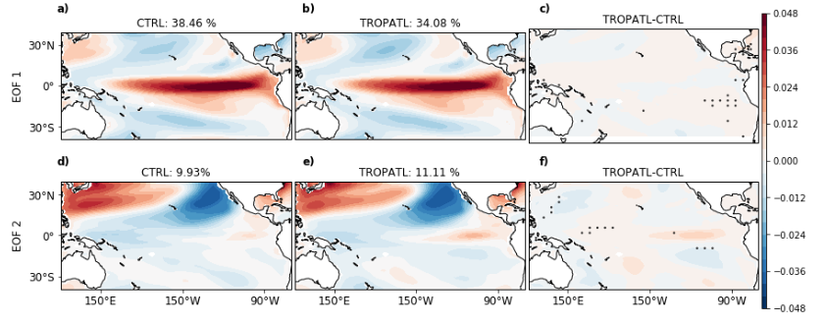
Changes to ENSO
EOF 1 (ENSO) becomes less dominant
Not much change in spatial structure

Slide 9
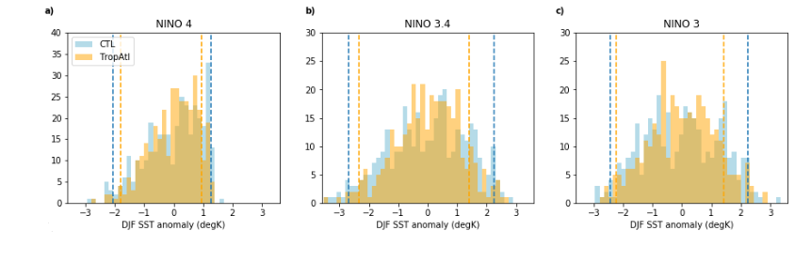
Changes to DJF SSTA distribution
TROPATL – weaker SSTAs
More neutral years, weaker EN/LNs

Slide 10
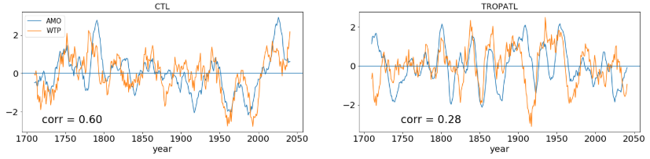
The AMO and the Western Tropical Pacific*
WTP_obs = 0°-25°N, 130°E-170°E
WTP_model = 0°-25°N, 100°E-140°E
Corr = 0.9
* Very preliminary!

Slide 11
Caveats & further analysis
Model has biennial ENSO & skewed towards stronger La Ninas, but results are all consistent with literature
Investigate relationship between Atlantic Nino & ENSO
Investigate physical mechanisms of changes
Investigate impact of mean state change
Second CTL run to improve analysis of statistical significance

Slide 12
Summary
Suppressing variability in the Tropical Atlantic impacts the Tropical Pacific in the following ways:
Decrease in interannual-scale variability linked to NPMM
Increase in decadal-scale variability linked to SPMM
Weaker EN/LNs, more neutral years
Relationship between AMO and Western Tropical Pacific SSTs is weakened*
Thanks to ACCESS development team!

