Slide 1
BoM Plans for Seamless Coupled Modelling
Oscar Alves
Bureau of Meteorology

Slide 2
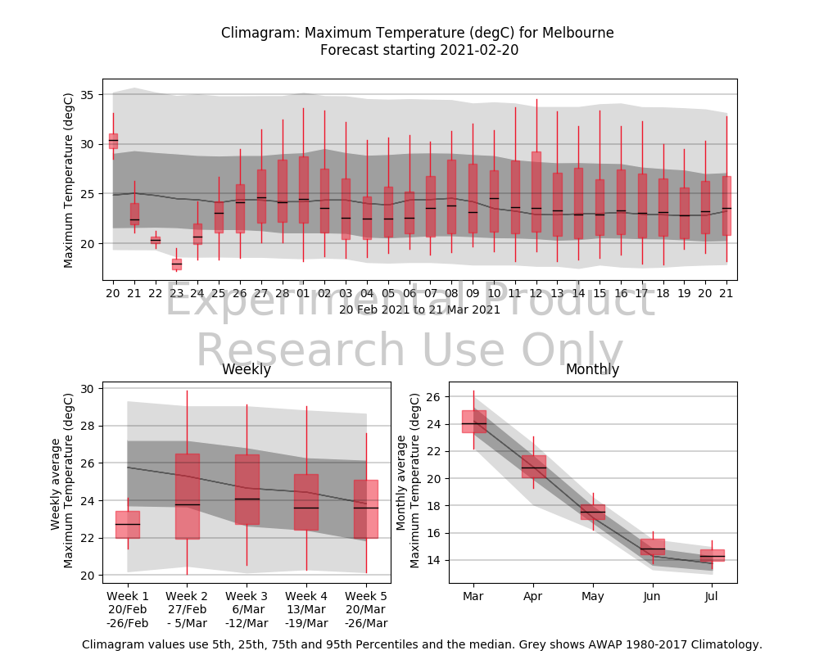
What's Driving Our Global Modelling Plans
Our customers want:
More accurate and regionally specific forecasts
Focus Areas
NWP, Week 2, Multiweek, Seasonal
Seamless Forecasts
Consistency in time (e.g. NWP and Multiweek, seasonal)
Consistency in domains (e.g. Ocean forecast and NWP forecast)
Consolidation of models (maintenance costs)

Slide 3
Next Gen Seamless Global Prediction Capability
Rationale for our approach
Deliver seamless and consistent earth system forecasts across timescales and domains including weather, ocean, multiweek and seasonal (multiyear ?)
Multi-week forecasts is a key are for us (and potentially gap at UKMO)
Maintain forecast skill of its global forecasts in the top 5 in the world by utilising the latest state of the art models
Reduce development costs by using the same coupled model across all global applications and sharing development costs with the UK Met Office (and partners)
UKMO Operational Coupled NWP in 2022
Work much more closely with UKMO (Implement improvements within 6 months?)

Slide 4
Next Gen Seamless Global Prediction Capability
Long-Term Seamless Vision
Deterministic Global Model (7+ day forecasts)
UKMO NWP coupled model (GC5 onwards)
For NWP and Ocean forecasting Longer term add wave coupling and other enhancements
<10km resolution in ocean (NEMO) and atmosphere (UM/NGMS)
But no ensembles (no uncertainty estimates)
Weakly coupled DA (likely ocean based on NEMOVAR)

Slide 5
Next Gen Seamless Global Prediction Capability
Long-Term Seamless Vision
Ensemble Global Model
UKMO Ensemble Global NWP system (GC5+)
Decrease resolution at 14 days (and at say 1 year for multi-year ?)
Eg. 20km resolution first 14 days then 40-60km beyond
Longer term add wave coupling and other enhancements
Add new features important for multi-week/seasonal timescales
Interactive ozone/green house gases
Interactive vegetation (rather than climatological vegetation)
etc
New features will depend on additional investment

Slide 6
Next Gen Seamless Modelling System
Timelines
Years 1-2 Prototyping Phase: Explore how to expand UKMO coupled global NWP as a seamless system
NWP Ensemble /Multiweek/Seasonal Seamless system (medium resolution)
Prototype UK Met Office initialization system (NEMOVAR)
Explore: decrease resolution with lead time, how to do re-analyses, tailored improvements, atmos+ocean perturbations
Improvements: e.g. Indo-Pacific PEG work
Evaluate UKMO GC4 and GC5
Work with UKMO to create GC5.CoMorph
Focus on NWP/Multi-week (cheaper)
Notes:
Project purpose:
R&D Plan Outcome Alignment (which outcome/s?):
Customer sector (who benefits?):
CSG/BSG project partners (names and teams):
Interlinkages/dependencies (any critical timelines?):
In SIG:
Other groups/ research partners:
Resource commitment:
Project length (years):
Estimated FTE (overall, or per year):
Risks to delivery (what is the largest risk being managed now?):

Slide 7
Next Gen Seamless Modelling System
Timelines
Years 1-2 Prototyping Phase: Explore how to expand UKMO coupled global NWP as a seamless system
NWP Ensemble /Multiweek/Seasonal Seamless system (medium resolution)
Prototype UK Met Office initialization system (NEMOVAR)
Explore: decrease resolution with lead time, how to do re-analyses, tailored improvements, atmos+ocean perturbations
Improvements: e.g. Indo-Pacific PEG work
Evaluate UKMO GC4 and GC5
Work with UKMO to create GC5.CoMorph
Focus on NWP/Multi-week (cheaper)
Years 3-4 Operationalisation Phase1 + Prototype 2:
Coupled NWP+Multiweek+OceanForecasting Operational
Prototype Wave coupling, Seasonal (+ Multiyear ?)
Tailored improvements with UKMO partners (where we have need and expertise)
Notes:
Project purpose:
R&D Plan Outcome Alignment (which outcome/s?):
Customer sector (who benefits?):
CSG/BSG project partners (names and teams):
Interlinkages/dependencies (any critical timelines?):
In SIG:
Other groups/ research partners:
Resource commitment:
Project length (years):
Estimated FTE (overall, or per year):
Risks to delivery (what is the largest risk being managed now?):

Slide 8
Next Gen Seamless Modelling System
Timelines
Years 1-2 Prototyping Phase: Explore how to expand UKMO coupled global NWP as a seamless system
NWP Ensemble /Multiweek/Seasonal Seamless system (medium resolution)
Prototype UK Met Office initialization system (NEMOVAR)
Explore: decrease resolution with lead time, how to do re-analyses, tailored improvements, atmos+ocean perturbations
Improvements: e.g. Indo-Pacific PEG work
Evaluate UKMO GC4 and GC5
Work with UKMO to create GC5.CoMorph
Focus on NWP/Multi-week (cheaper)
Years 3-4 Operationalisation Phase1 + Prototype 2:
Coupled NWP+Multiweek+OceanForecasting Operational
Prototype Wave coupling, Seasonal (+ Multiyear ?)
Tailored improvements with UKMO partners (where we have need and expertise)
Years 4-6 Upgrade to latest UKMO model and expand operations to seasonal/multi-year:
including past re-analyses and tailored improvements, seasonal operational, wave coupling
Notes:
Project purpose:
R&D Plan Outcome Alignment (which outcome/s?):
Customer sector (who benefits?):
CSG/BSG project partners (names and teams):
Interlinkages/dependencies (any critical timelines?):
In SIG:
Other groups/ research partners:
Resource commitment:
Project length (years):
Estimated FTE (overall, or per year):
Risks to delivery (what is the largest risk being managed now?):

Slide 9
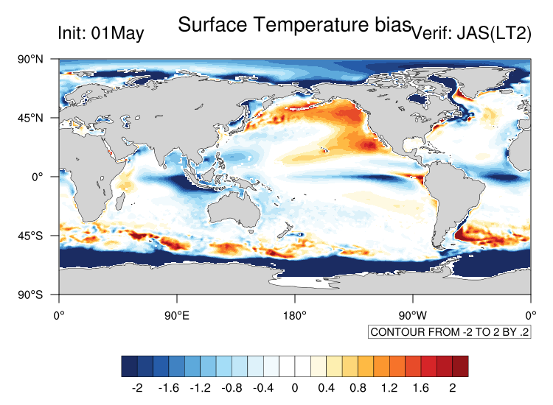
Indo-Pacific PEG
Priority Evaluation Group –
Led by Oscar Alves and Harry Hendon at BoM, Michael Vellinga at UKMO and Magdalena Balmaseda at ECMWF
SST IOD-E Cooling bias
IOD overactive
UKMO and ECMWF models same issue
Atmosphere, Ocean and Initialisation playing a role
Suspects:
Atmospheric convection
Indonesian throughflow in ¼ NEMO
Notes:
Project purpose:
R&D Plan Outcome Alignment (which outcome/s?):
Customer sector (who benefits?):
CSG/BSG project partners (names and teams):
Interlinkages/dependencies (any critical timelines?):
In SIG:
Other groups/ research partners:
Resource commitment:
Project length (years):
Estimated FTE (overall, or per year):
Risks to delivery (what is the largest risk being managed now?):

Slide 10
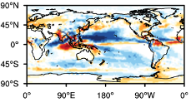
Indo-Pacific PEG
Priority Evaluation Group –
Led by Oscar Alves and Harry Hendon at BoM, Michael Vellinga at UKMO and Magdalena Balmaseda at ECMWF
SST IOD-E Cooling bias
IOD overactive
UKMO and ECMWF models same issue
Atmosphere, Ocean and Initialisation playing a role
Suspects:
Atmospheric convection
Indonesian throughflow in ¼ NEMO
Rainfall Bias
Notes:
Project purpose:
R&D Plan Outcome Alignment (which outcome/s?):
Customer sector (who benefits?):
CSG/BSG project partners (names and teams):
Interlinkages/dependencies (any critical timelines?):
In SIG:
Other groups/ research partners:
Resource commitment:
Project length (years):
Estimated FTE (overall, or per year):
Risks to delivery (what is the largest risk being managed now?):

Slide 11
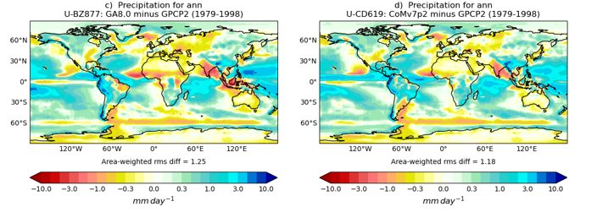
CoMorph
From Sally Lavender
Precipitation Mean State Error
Previous model – GA8
With CoMorph
Notes:
Project purpose:
R&D Plan Outcome Alignment (which outcome/s?):
Customer sector (who benefits?):
CSG/BSG project partners (names and teams):
Interlinkages/dependencies (any critical timelines?):
In SIG:
Other groups/ research partners:
Resource commitment:
Project length (years):
Estimated FTE (overall, or per year):
Risks to delivery (what is the largest risk being managed now?):

Slide 12
Biases
Theme | Activity | Leaders
Indo-Pacific Ocean Tunnel Processes | Rossby Wave propagation through IT | Xiaobing Zhou and Oscar Alves, BoM
 | Throughflow properties and impact on mean bias in NEMO ocean model | Matt Hawcroft, USQ/UKMO
Indian Ocean air-sea interaction | Air-sea interaction properties/biases across timescales | Michael Vellinga and Charline Marzin, UKMO
 | Indian Ocean Teleconnections with Monsoon and monsoon forecasts | Ankur Gupta, NCMRWF, India
 | Ocean/Atmos bridge between Pacific/Indian | Eric Behrens, NIWA, New Zealand
Assessment and Intercomparison of current systems | Ocean reanalyses in Indian Ocean (used for initial conditions) | Robin Wedd and Oscar Alves, BoM
 | Seasonal Forecast skill of IOD | Stephanie Johnson, ECMWF
Assessment of Model Improvements | How Good is GC4/5 in the Indian Ocean + common diagnostic package | Catherine de Burgh-Day and Hongyan Zhu, BoM
 | Impact of CoMorph on Indian Ocean | Hongyan Zhu, Sally Lavender, Catherine de Burgh-Day, BoM/USQ/UKMO

Slide 13
Summary
Seamless single coupled model framework for NWP , ocean prediction, multiweek, seasonal (multi-year?)
Based on UKMO coupled model + Coupled DA (with significant BoM contribution)
Two initial configurations:
Deterministic global model for weather and ocean prediction (ocean ~8km NEMO)
Ensemble system for weather, multi-week, seasonal (potentially decreasing resolution with lead time)
First implementation:
UKMO GC5
Or UKMO GC5.CoMorph (depending on Indo-Pacific PEG)

Slide 14
Thank you
oscar.alves@bom.gov.au

