Slide 1
Separating Southern Ocean responses to the surface heat/freshwater/wind forcing
Kewei Lyu
Centre for Southern Hemisphere Oceans Research
CSHOR

Slide 2
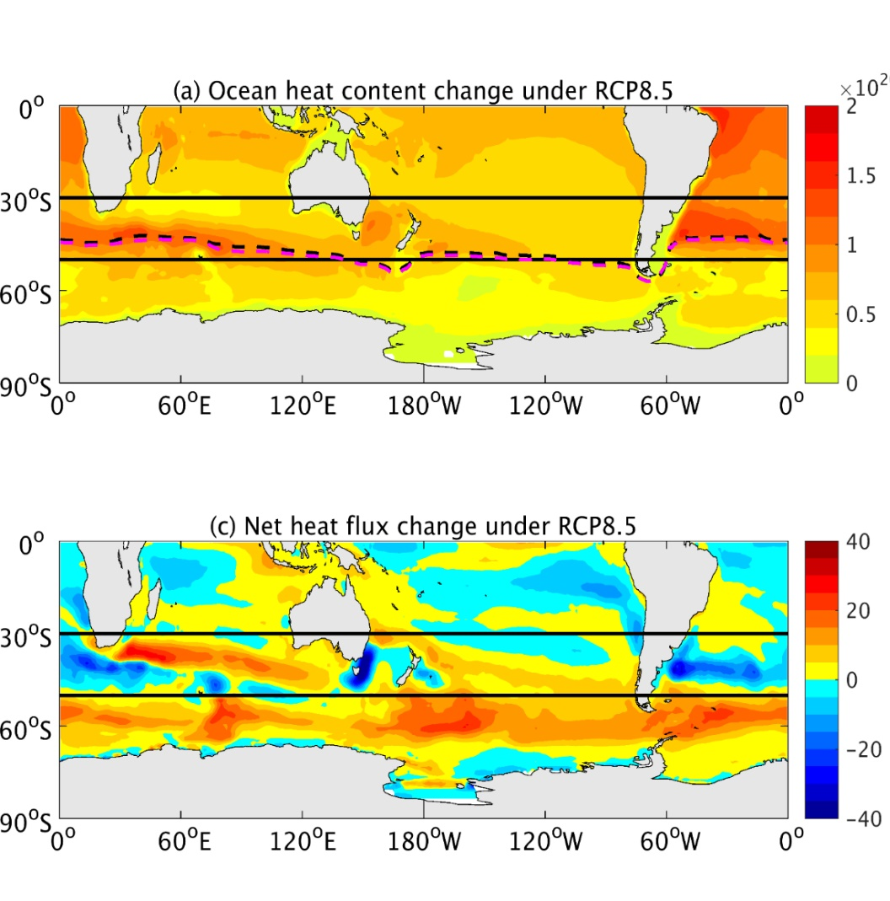
Full-depth OHC
Surface wind stress
50ºS
Surface heat flux
Positive: net freshwater input to ocean
50ºS
Lyu et al. 2020

Slide 3
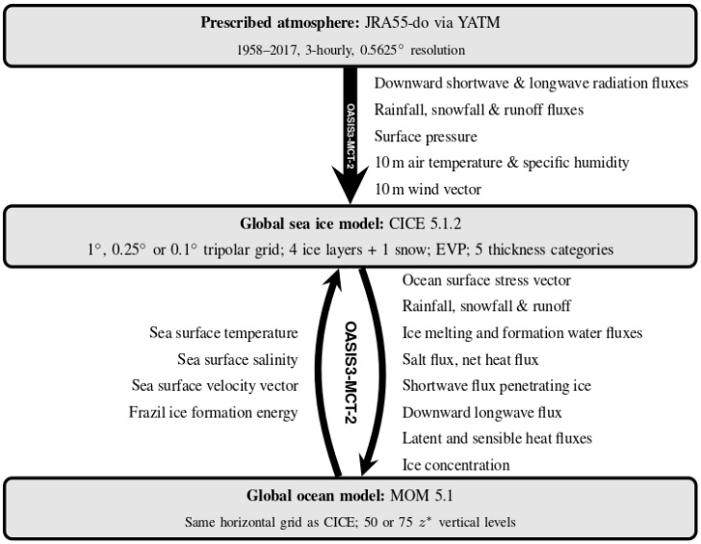
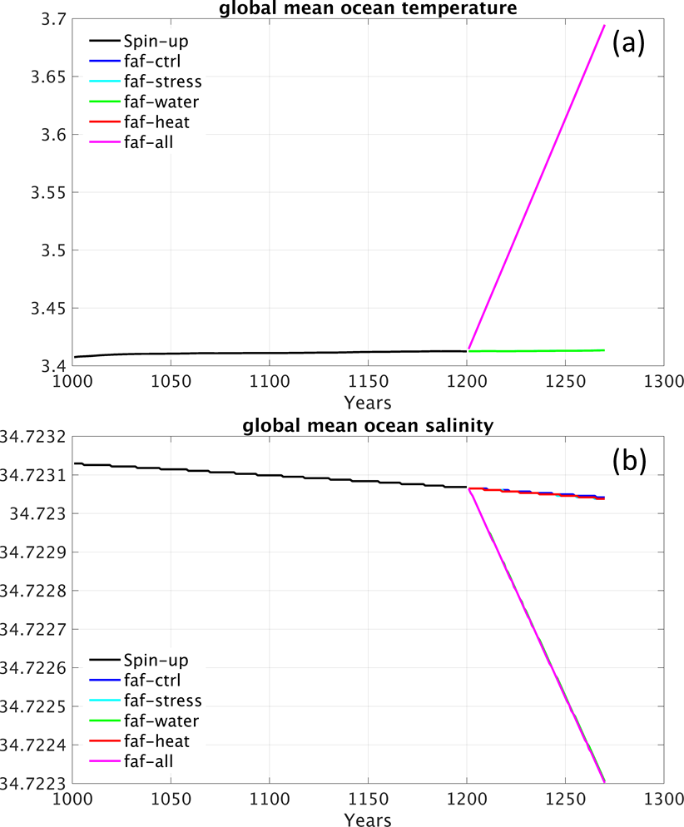
(Kiss et al. GMD 2020)
1-degree ACCESS-OM2
Add flux perturbations from the Flux-Anomaly-Forced Model Intercomparison Project (FAFMIP)
Remove flux feedbacks through ocean-atmosphere and ocean-ice interactions so that ocean only feels the added perturbations

Slide 4



Bindoff and McDougall (1994) proposed a theoretical framework to separate subsurface T&S change into three processes on T&S diagram
Pure warming: no salinity change at depth level
Pure freshening: no temperature change at depth level
All
Heat
$$ρ_{1}$$
$$ρ_{2}$$
$${θ′|}_{z}=\underbrace{{θ′|}_{n}}+\underbrace{−N′\frac{∂θ}{∂z}}$$
?
Heat flux - Pure warming
Water flux – Pure freshening
Wind - Pure heave
spiciness
heave
Wind
Water
(Lyu et al. 2021, to be submitted)
Pure heave (i.e., spiciness=0)
(Todd et al. 2020)
Ocean heat content changes with global mean removed
Bindoff and McDougall 1994; Lyu et al. 2020

Slide 5
Surface heat flux experiment: ocean temperature changes and heave & spiciness components
temperature
heave
spiciness
Pure warming contribution to ocean temperature change – diagnosed from FAF-all
The estimated pure warming contribution from BM theoretical framework share very similar patterns as model reponses to the surface heat flux forcing

Slide 6
Wind forcing experiment: ocean temperature changes and heave & spiciness components
temperature
heave
spiciness
Pure heave contribution to ocean temperature change – diagnosed from FAF-all
The estimated pure heave contribution captures the enhanced warming at middle latitudes – through the local deepening of isopycnals
However, the simulated wind-driven temperature changes are mainly attributed to the spiciness changes, through a spin-up of the MOC and anomalous northward transport of heat and salt.
Pure freshening by definition has no contribution to temperature change – but this is not the case in freshwater forcing experiment

