Slide 1
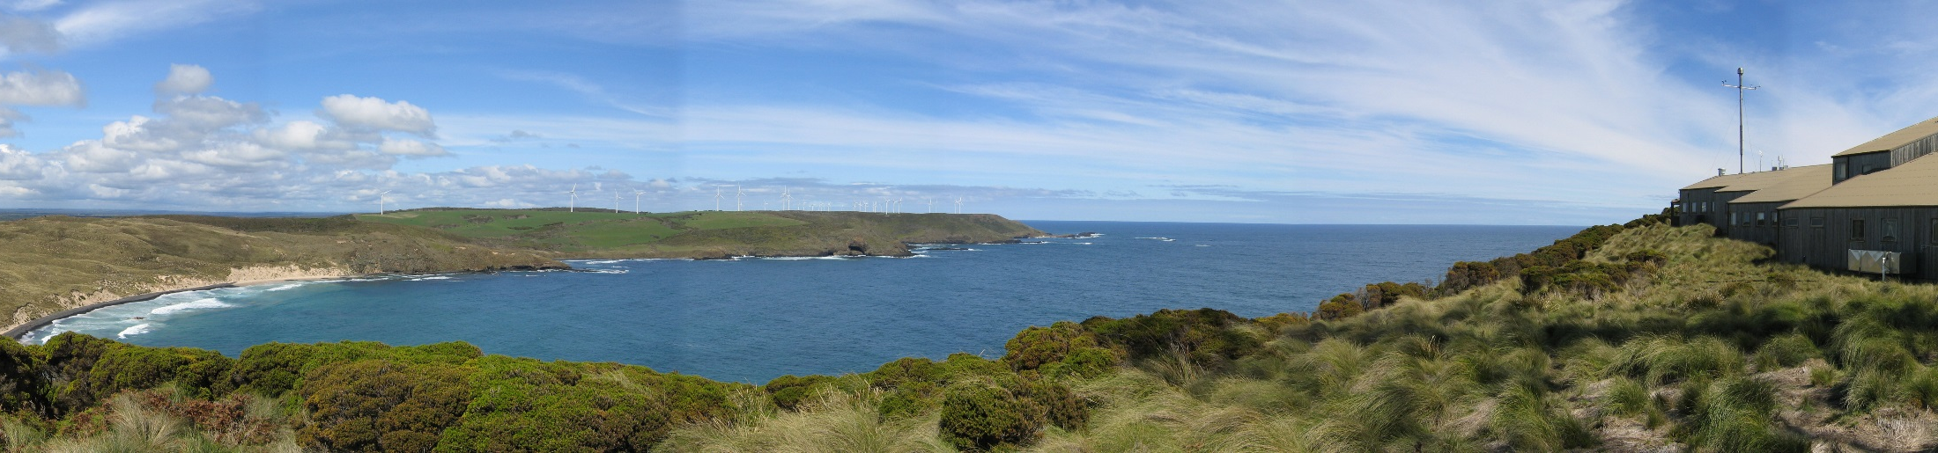
CMIP6 SSP extensions to 2300
CSIRO Climate Science Centre
Martin Dix| ACCESS coupled climate modelling team

Slide 2
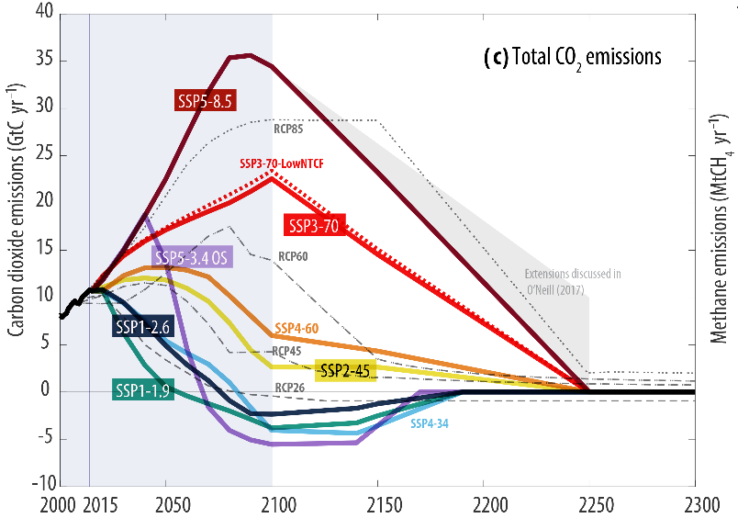
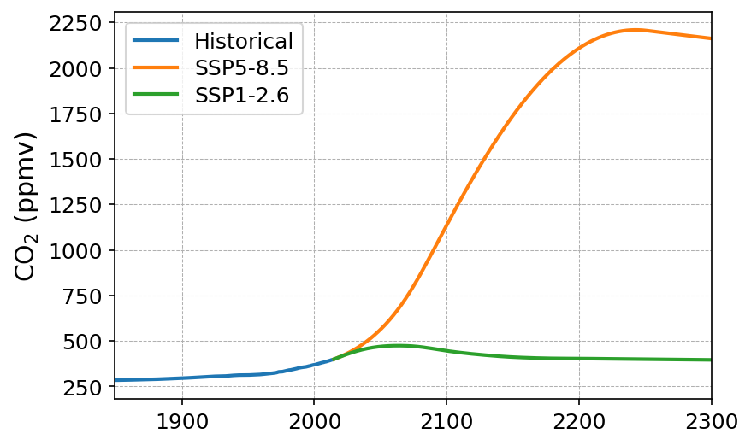
SSP extensions to 2300
~ 8x PI
CO₂ emissions
(Meinshausen et al, 2020)
CO₂ concentrations
Notes:
Perhaps neither is very realistic from a policy viewpoint. Hard to believe FF usage will continue to increase at the rate of 585 and 126 is looking too optimistic at the moment. However such extreme scenarios are interesting from a modelling viewpoint.
585 is socially and economically optimistic, but full on FF growth

Slide 3
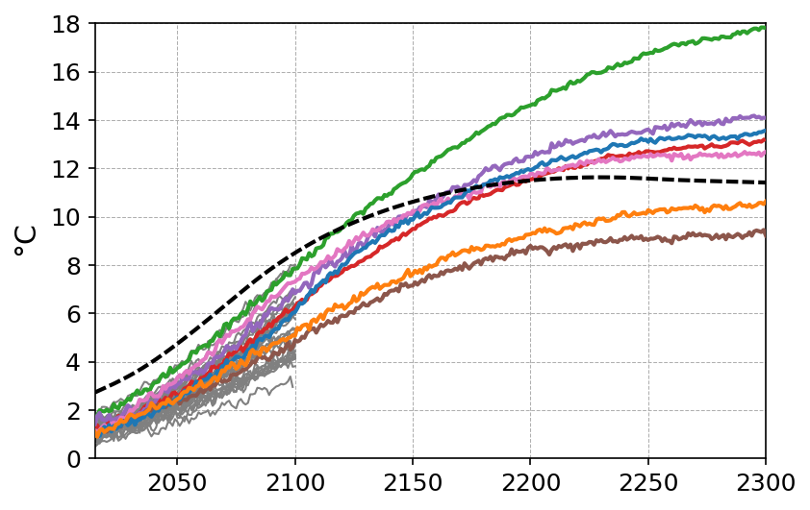
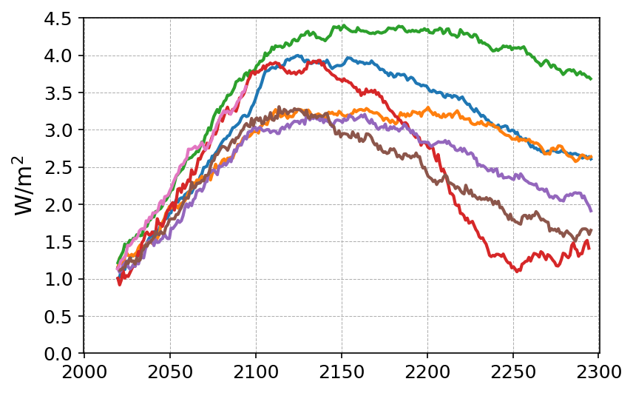
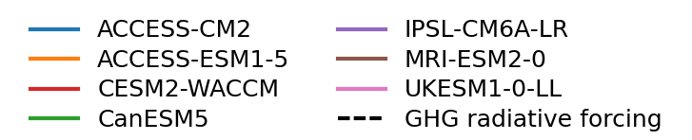
SSP5-8.5: Anomalies relative to piControl
Surface air temperature
TOA net radiation
Notes:
Linear fit to piControl removed

Slide 4
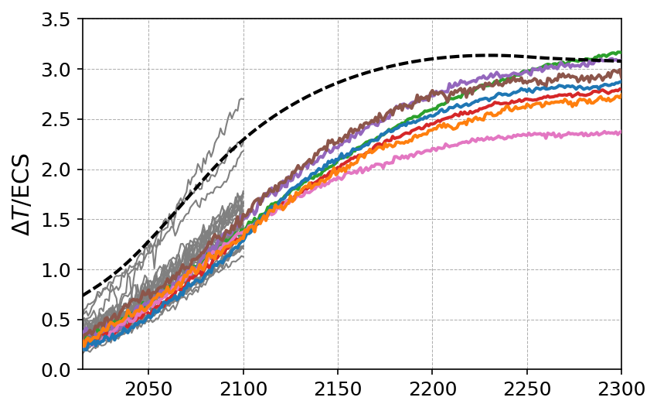
SSP5-8.5: Anomalies relative to piControl
Surface air temperature
Surface air temperature
Scaled by 2xCO₂ equilibrium
climate sensitivity
Notes:
Linear fit to piControl removed

Slide 5
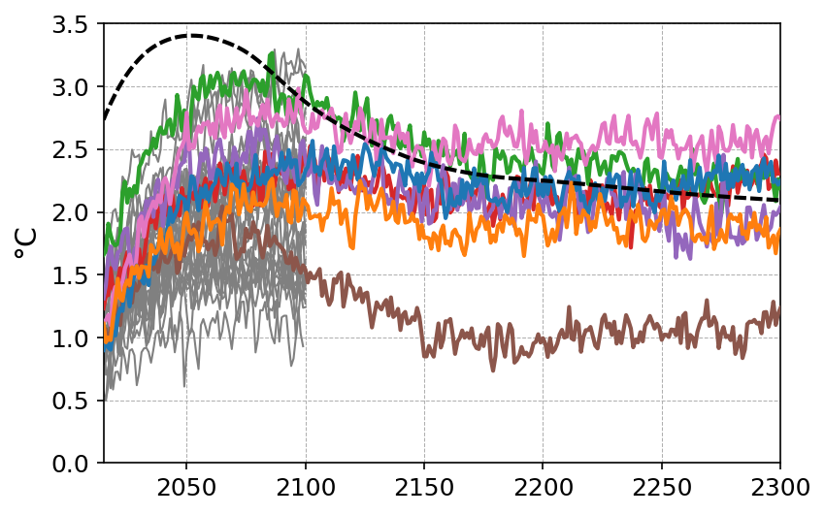
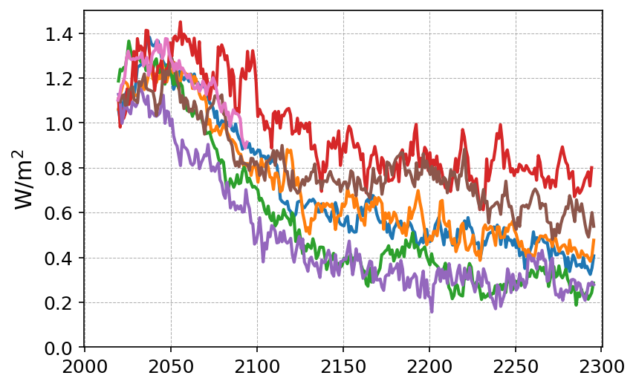
SSP1-2.6: Anomalies relative to piControl
Surface air temperature
TOA net radiation
Notes:
Linear fit to piControl removed

Slide 6
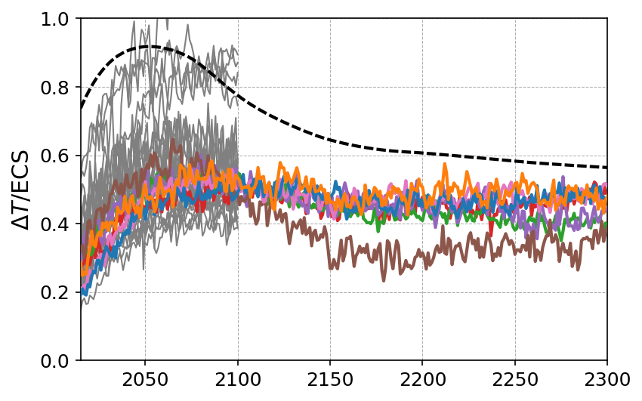
SSP1-2.6: Anomalies relative to piControl
Surface air temperature
Surface air temperature
Scaled by 2xCO₂ equilibrium
climate sensitivity
Notes:
Linear fit to piControl removed

Slide 7
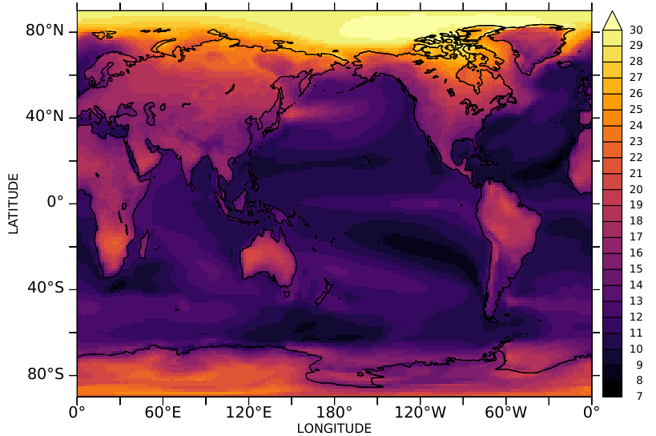
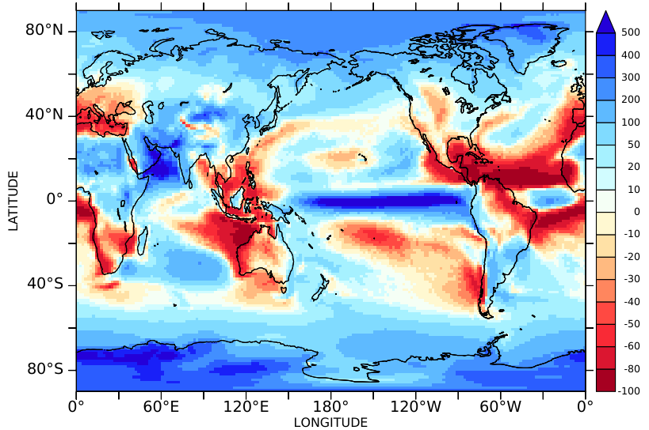
SSP5-8.5 ACCESS-CM2 2250-2300 relative to piControl
Annual mean surface air temperature
Percentage change in annual mean precipitation

