Slide 1
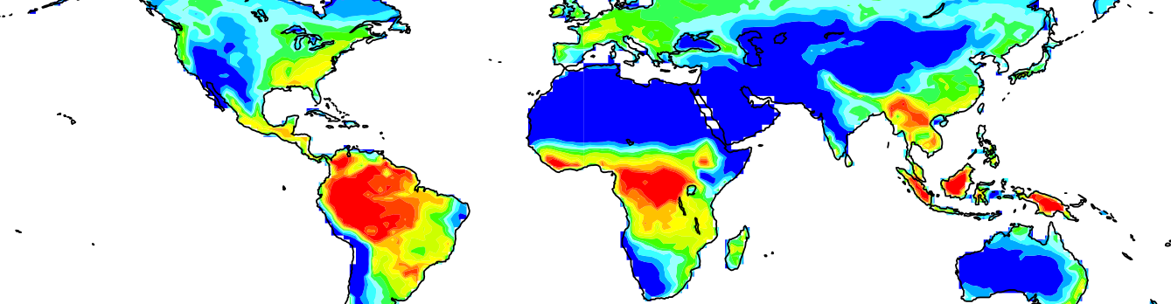

Land carbon-cycle feedbacks in ACCESS-ESM1.5
You can change this image to be appropriate for your topic by inserting an image in this space or use the alternate title slide with lines. Note: only one image should be used and do not overlap the title text.
Enter your Business Unit in the ribbon above the url.
[delete instructions before use]
Tilo Ziehn
10 June 2021
Oceans and Atmosphere

Slide 2
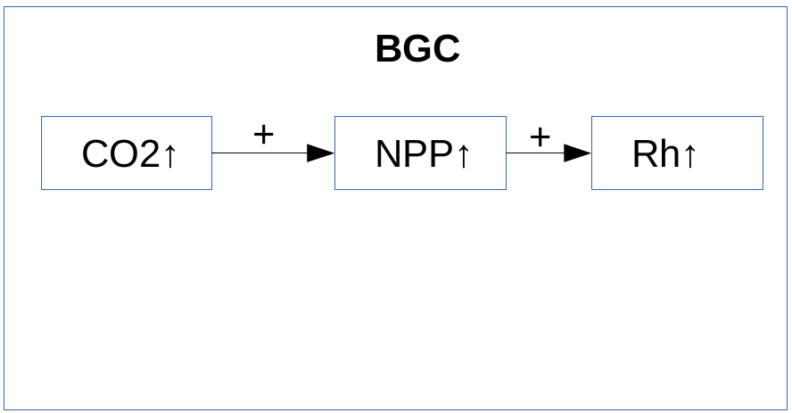
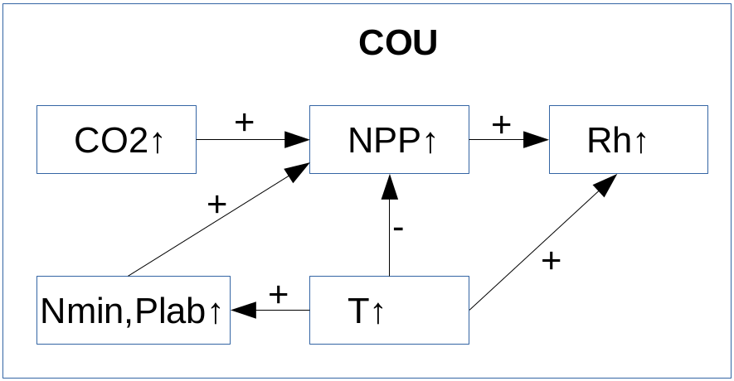
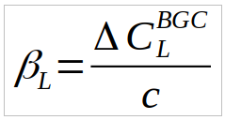
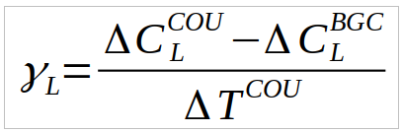

Impact of nutrients on land cc feedbacks
Sensitivity of land carbon uptake to changes in CO₂ (carbon-concentration, β_{L}) and T (carbon-climate, γ_{L})
BGC – biogeochemically coupled ( biogeochemical processes respond to increase in CO₂)
COU – fully coupled (biogeochemical and radiative transfer processes respond to increase in CO₂)
Standardised 1% CO₂ runs to calculate feedbacks (part of CMIP6 DECK + C4MIP)
3 configurations: C, CN, CNP
(Simplified relationship at global scale)

Slide 3
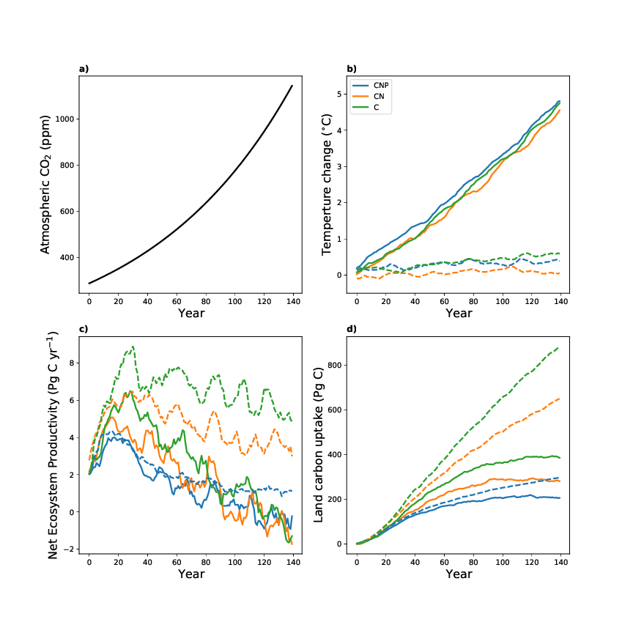
Global results
 | ACCESS-ESM1.5 | CMIP6 mean
β_{L} (C) | 1.1 | 1.2 ± 0.4
γ_{L} (C) | -123 | -64 ± 63
β_{L} (CN) | 0.8 (-30%) | 0.9 ± 0.1 (-30%)
γ_{L} (CN) | -85 (-30%) | -31 ± 22 (-50%)
β_{L} (CNP) | 0.4 (-65%) | -
γ_{L} (CNP) | -22 (-85%) | -
Carbon-concentration (Pg C ppm⁻¹) and carbon-climate feedback (Pg C °C⁻¹). Numbers in brackets indicate reduction with reference to C configuration.

Slide 4
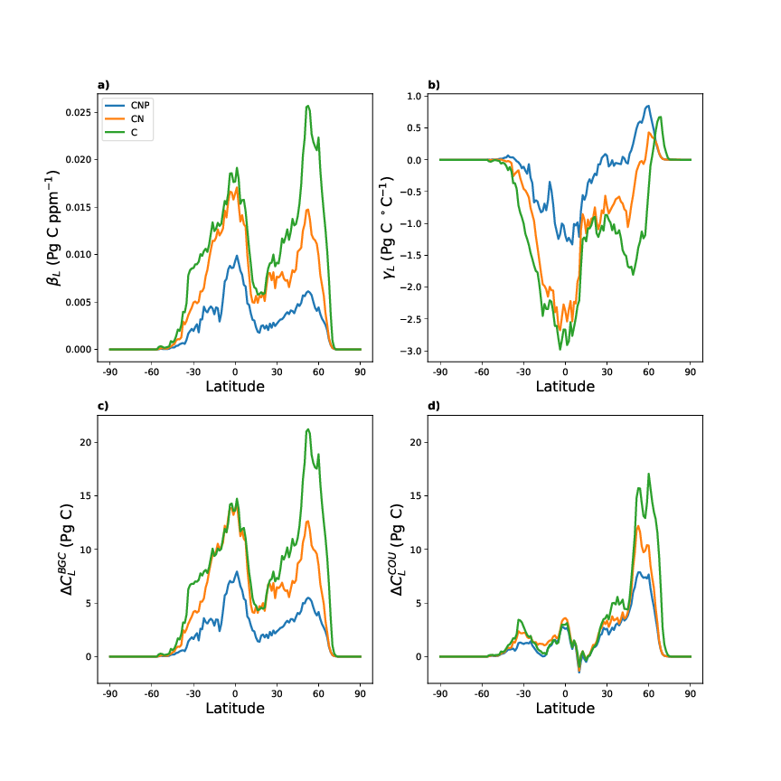
Latitudinal results and Implications
N has largest impact on feedbacks in temperate regions
P (or NP combined) impacts feedbacks across all latitudes
Future land c-uptake might not increase as much as projected by models without N,P
Land-based carbon mitigation might be less effective
Larger emissions reductions required to limit global warming (to below 2°C)

Slide 5
ACCESS future development (co-design)
ACCESS is a community model; needs to be developed for community needs
Future development requires input from next users, end users and stake holders
What do you currently use ACCESS for?
What prevents you from using current ACCESS versions?
What new features/processes/components should ACCESS have? Why?
What new configurations are required?
If you are interested in providing input and would like to be involved in future ACCESS development contact: tilo.ziehn@csiro.au

Slide 6
Thank you
Oceans and Atmosphere
Dr Tilo Ziehn Senior Research Scientist
t +61 3 9239 4560
e tilo.ziehn@csiro.au
Oceans and Atmosphere

