Slide 1


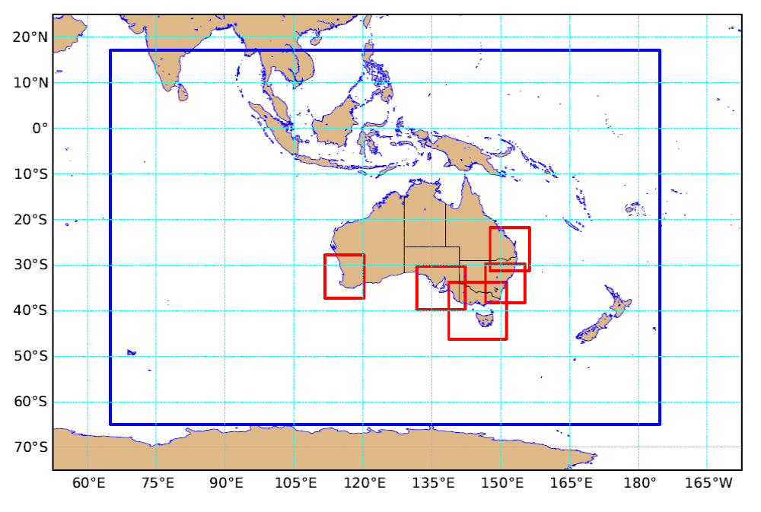
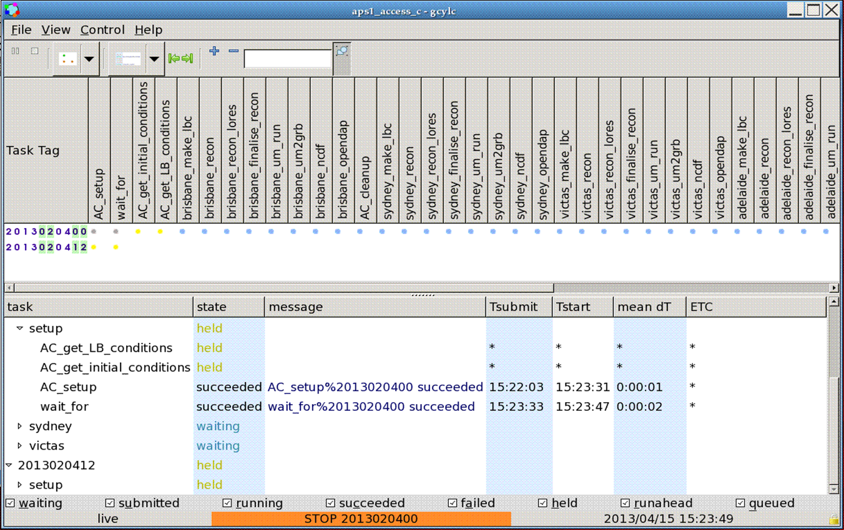
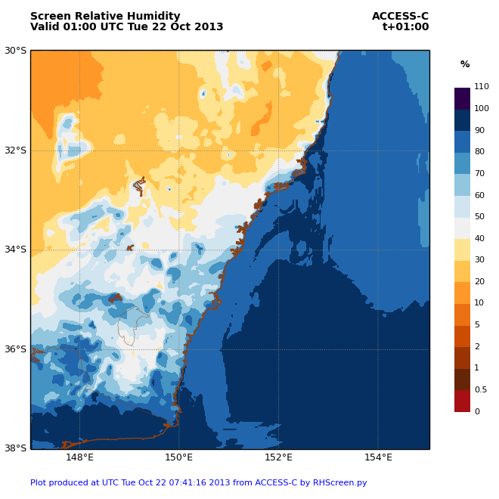
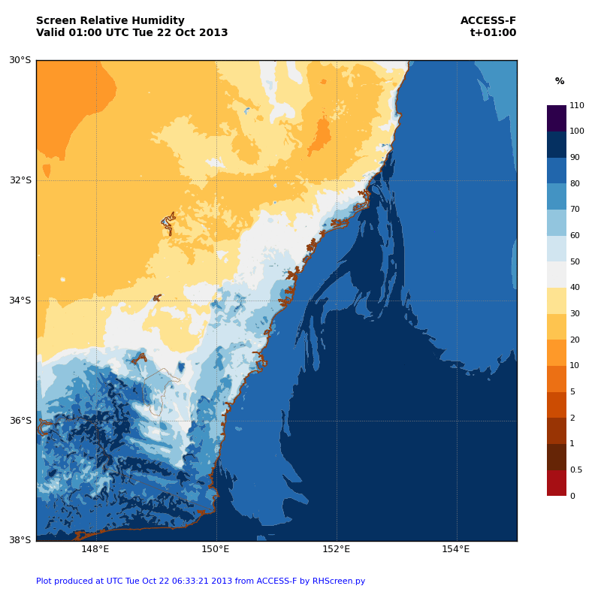
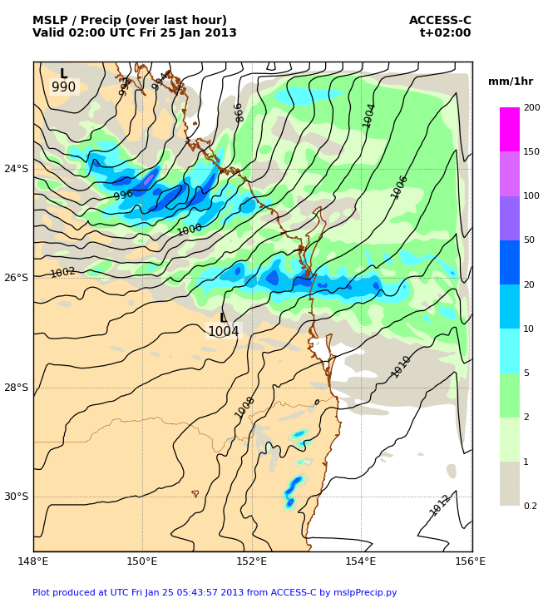
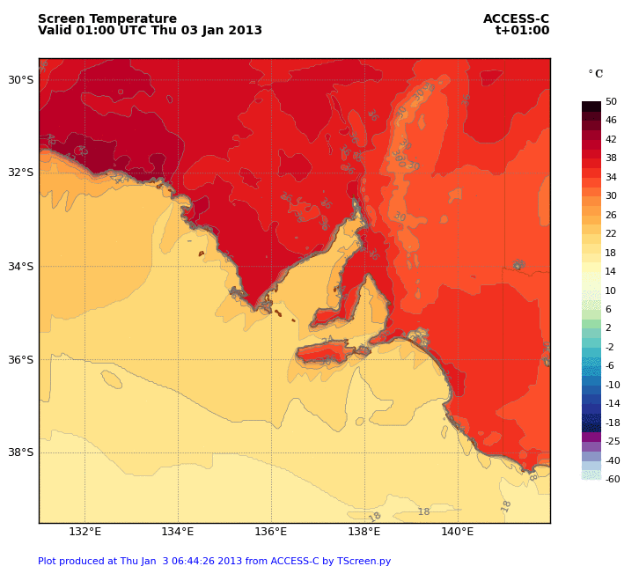
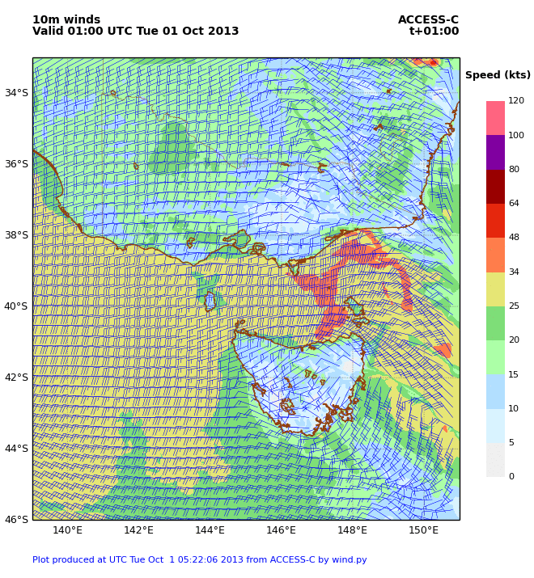
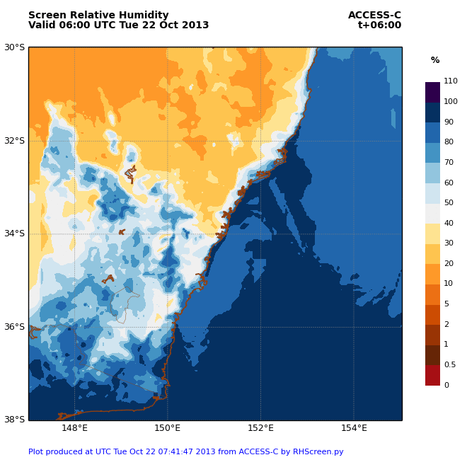
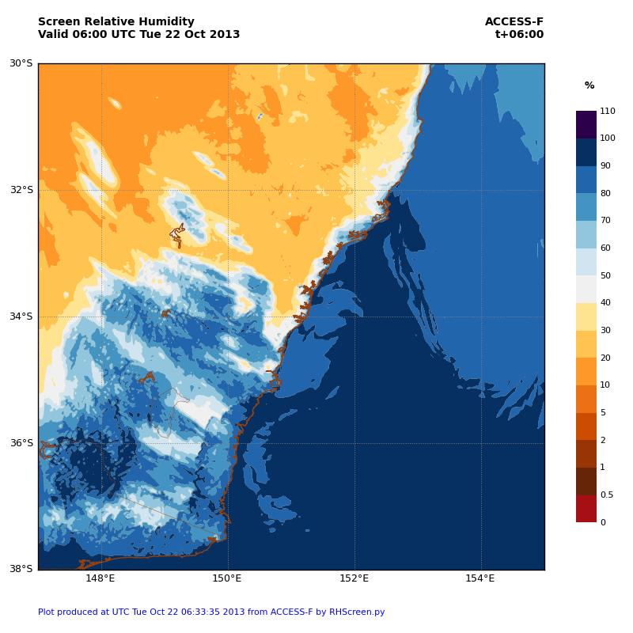
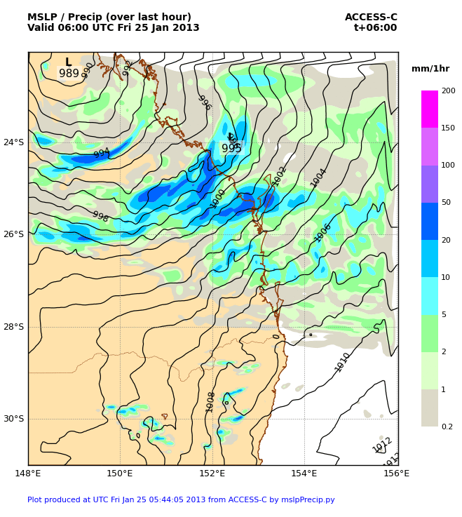
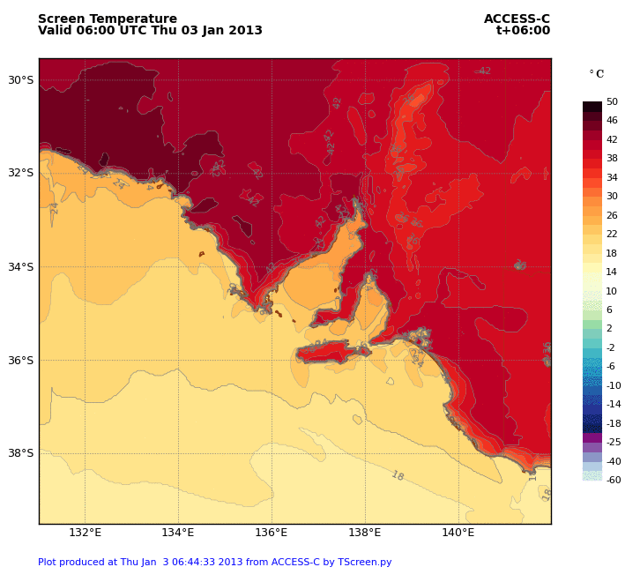
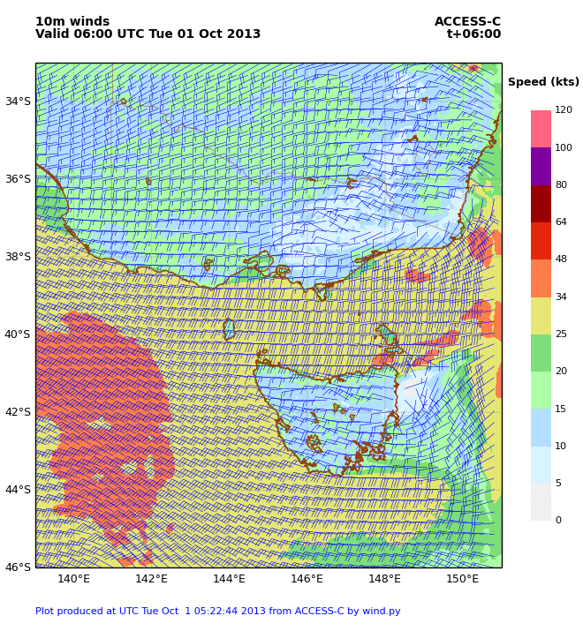
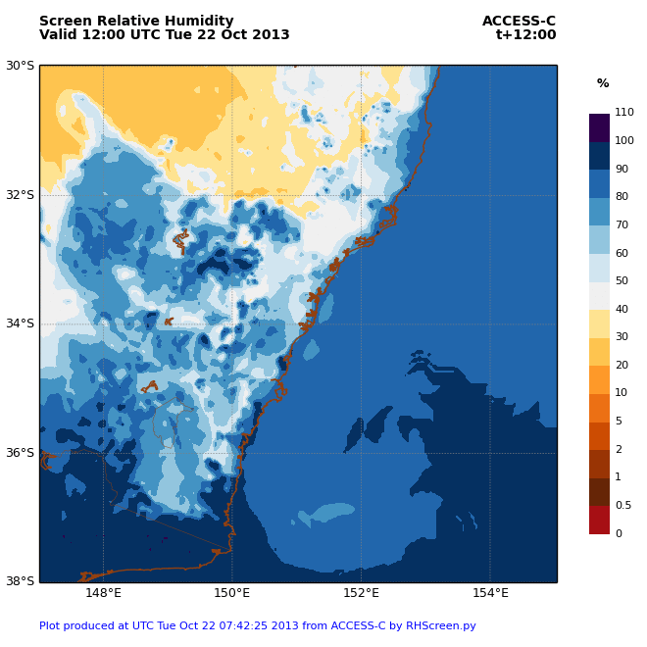
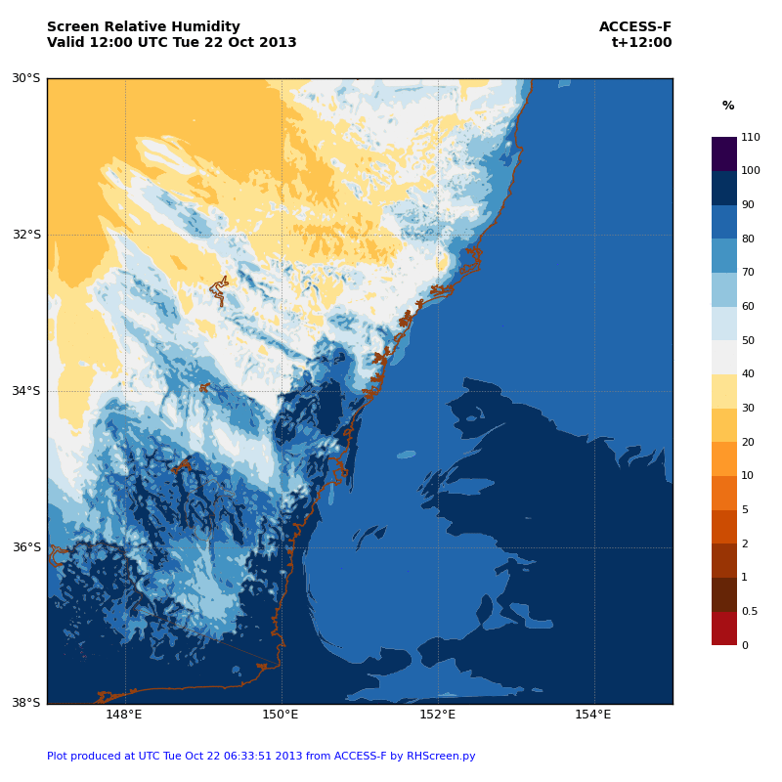
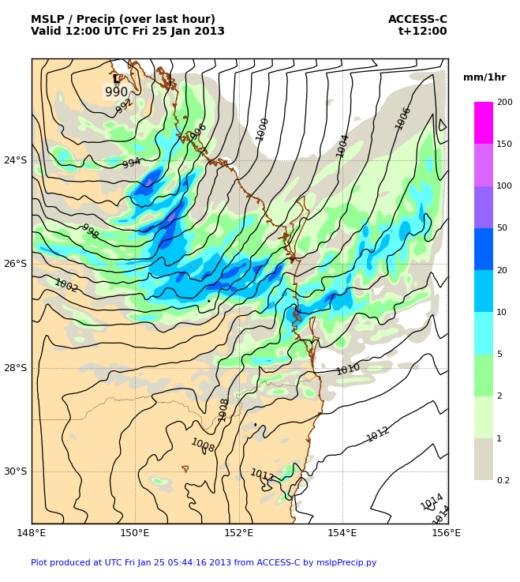
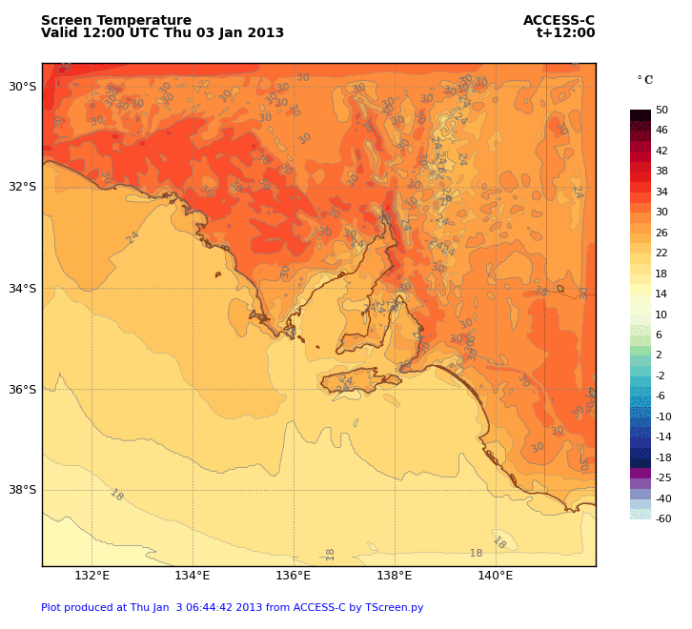
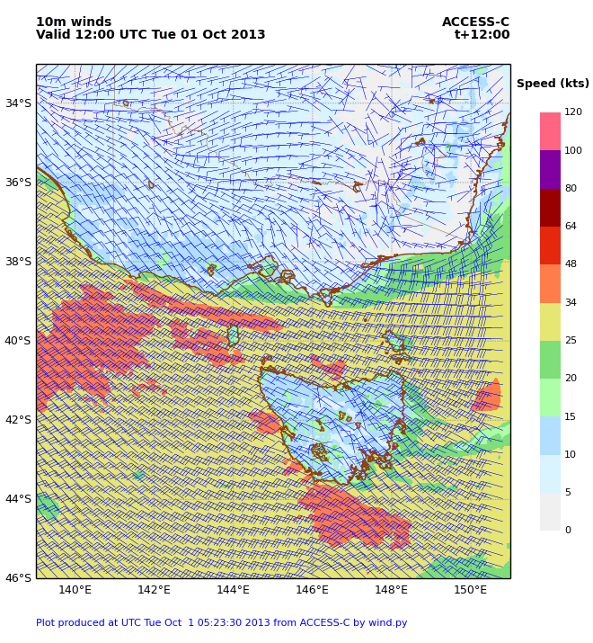
Availability of ACCESS City Forecast System to the National Research Community
Michael Naughton, Wenming Lu
The Centre for Australian Weather and Climate Research – A partnership between the Bureau of Meteorology and CSIRO, Melbourne, Australia
M.Naughton@bom.gov.au, L.Wenming@bom.gov.au
ACCESS City Forecast System
ACCESS City Forecast system, ACCESS-C, is the operational numerical weather prediction system with the highest resolution in the Bureau of Meteorology (BoM).
ACCESS-C has spatial resolution of 4km, vertical resolution of 70 levels.
ACCESS-C covers 6 domains, South-East Queensland (Brisbane), Sydney, Victoria/Tasmania (VicTas), Adelaide, Perth and Darwin.
ACCESS-C runs out to 36 hours and 4 times daily, 00, 06, 12 and 18Z (UTC), nesting within ACCESS Regional (ACCESS-R, 12km): the initial and boundary conditions are interpolated from the larger ACCESS-R analyses and forecasts.
DOMAIN | ABBR. | LAT. RANGE | LON. RANGE | GRID
Brisbane | BN | -31.00S, -22.04S | 148.00E, 156.03E | 250x224
Sydney | SY | -38.00S, -29.98S | 147.00E, 155.03E | 224x224
VicTas | VT | -46.00S, -33.04S | 139.00E, 150.99E | 362x334
Adelaide | AD | -39.50S, -29.53S | 132.00E, 141.98E | 278x306
Perth | PH | -37.00S, -28.04S | 112.00E, 122.98E | 250x306
Darwin | DN | -16.00S, -7.97S | 128.50E, 139.98E | 224x320
NeCTAR Climate and Science Laboratory ACCESS Model Experimental Library: ACCESS-C Standard job
ROSE/CYLC
ACCESS-C Suite
@ accessdev
Remote Jobs
@ raijin
Simple Facts for Reference
Brisbane ( BN domain, other domains scale with number of grid pints):
Using 64 cores
Wall time: around 1500 seconds ~ 25minutes
CPU time: 95000 seconds ~ 26 CPU hours
Input data size:
dump (for initial condition) 5.2Gb
pi files (for lateral boundary condition) 63Gb
Output data size:
initial condition 300Mb
lateral boundary condition 3.9Gb
total forecast data 18 Gb
Easy to run: install the executable, configuration on raijin and suite on accessdev, use the input data available then run it by a single command.
Sample forecast data on raijin: easy to compare the output to make sure things are fine.
Source code on raijin: modify the physics and compile your own executable to improve UM!
BoM Daily initial and boundary conditions available in RDSI supported archive at NCI.
Research configurations can also be run for higher resolution (e.g. 1.5km) and other locations.
Wiki: https://trac.nci.org.au/trac/access/wiki/AccessModelExperimentLibrary
Figure: ACCESS-C running in Cylc
Sample Forecast Plots
SY Fire Weather Oct 2013
SY Fire Weather Oct 2013 1.5km
BN Heavy Rainfall Jan 2013
AD Heatwave Jan 2013
VT Gusty Wind Oct 2013

