Slide 1
Cylc and SMS Interoperable Suite
www.cawcr.gov.au
Wenming LU, Mike NAUGHTON
lwenming@bom.gov.au
mjn@bom.gov.au
ESM, Oct 14 2014

Slide 2
Cylc and SMS
Cylc ("silk") is a suite engine and meta-scheduler that specializes in suites of cycling tasks for weather forecasting, climate modeling, and related processing (it can also be used for one-off workflows of non-cycling tasks, which is a simpler problem).
SMS (Supervisor Monitor Scheduler) is an application that enables users to run a large number of programs which may have dependencies on one another, and in time, in a controlled environment with reasonable tolerance of both hardware and software failures, combined with good restart capabilities.

Slide 3
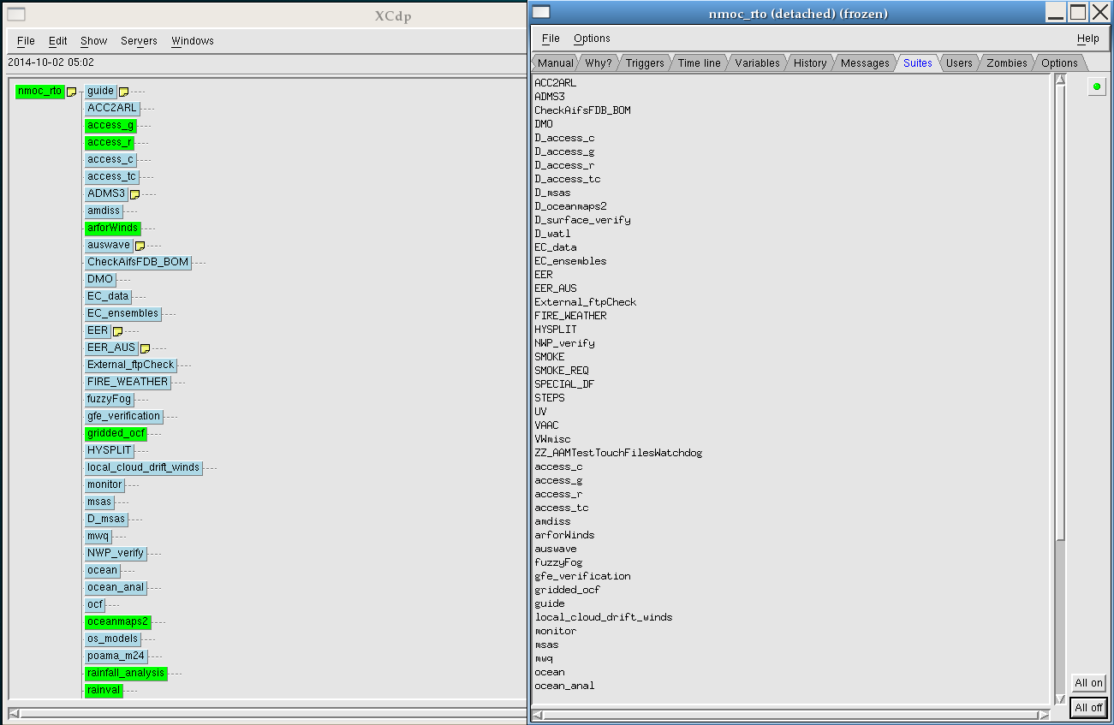
SMS

Slide 4
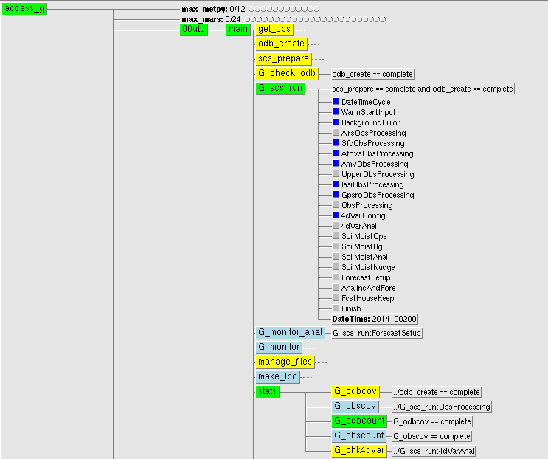
SMS

Slide 5
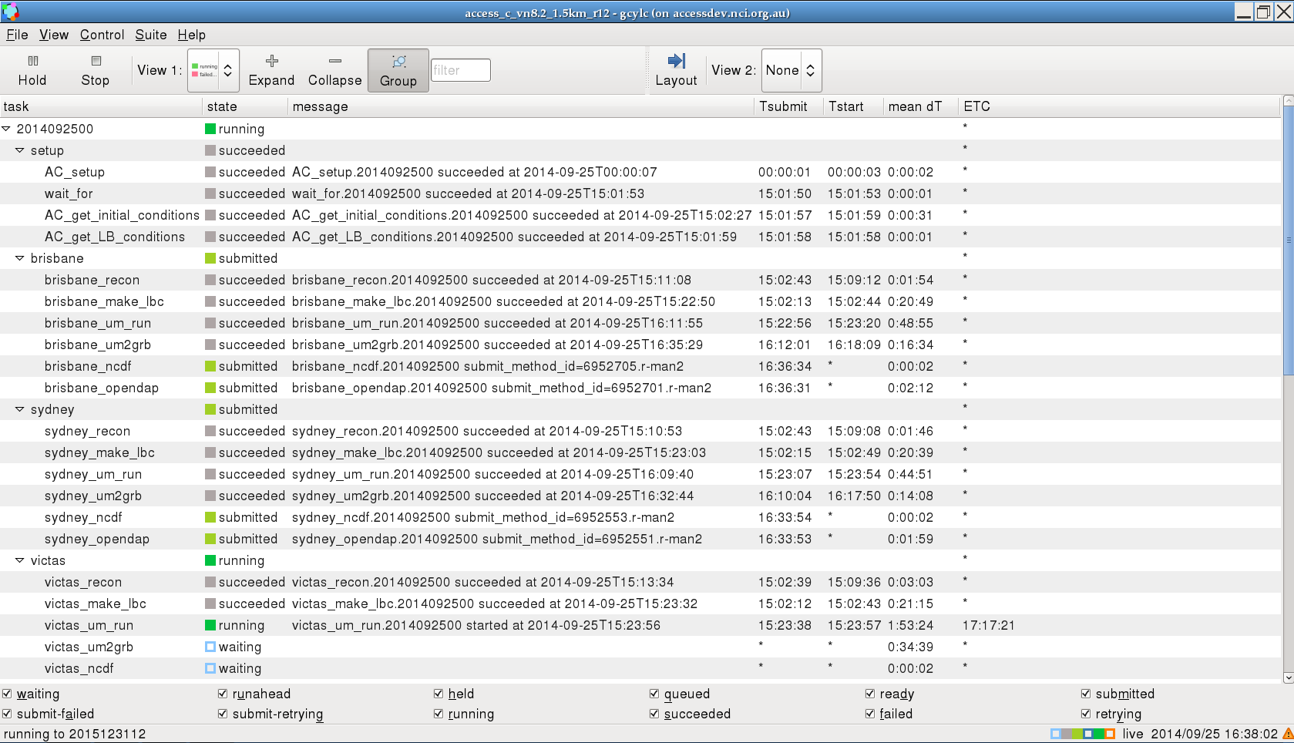
Cylc

Slide 6
Why Cylc and SMS Interoperable Suite?
Cylc is the default scheduler for research ACCESS NWP suites
New versions of ACCESS NWP systems are developed in CAWCR ESM(Earth System Modeling) and the experimental suites are running in Cylc
New ACCESS suites will be handed over to BNOC (Bureau National Operations Centre) for operations when ready
BNOC has been using SMS for more than 20 years for operational suites
BNOC is running about 60 operational suites using SMS
BNOC is looking into a possible upgrade: Cylc, ecFlow or sticking to SMS?

Slide 7
Why Cylc and SMS Interoperable Suite?
Ideally, BNOC chooses Cylc so handover will be straightforward
BNOC chooses ecFlow or SMS, suites must be redone to be operational
Mike Naughton proposed to have a design of dual or interoperable Cylc-SMS suite to reduce potential handover time
After research and experiments, We are finally convinced an interoperable Cylc-SMS suite is practical – HelloWorld suite
This is only a demo to show the design is achievable but we do not recommend the design: we recommend Cylc!

Slide 8
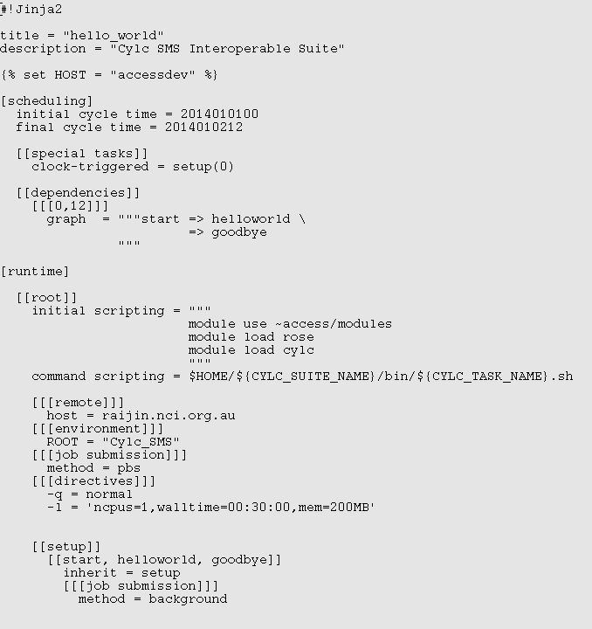
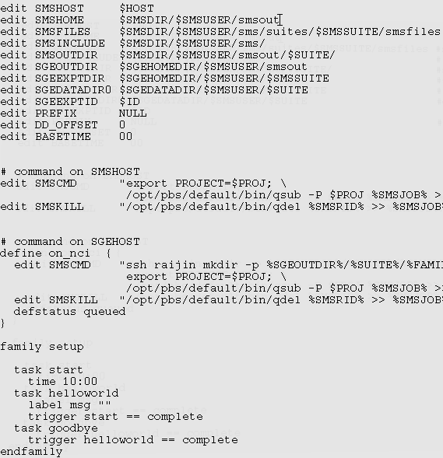
Cylc-SMS Interoperable Suite: Definition File
Cylc
SMS

Slide 9
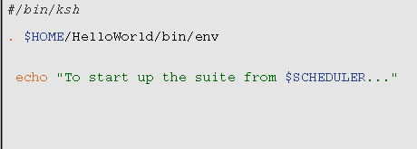
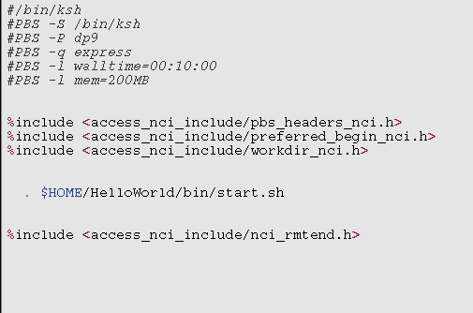
Cylc-SMS Interoperable Suite: Task Script
start.sh
start.sms
PBS headers
SMS include headers

Slide 10
Cylc-SMS: Scheduler Specific Feature
Cylc
SMS

Slide 11
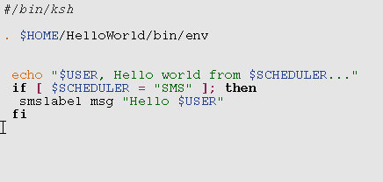
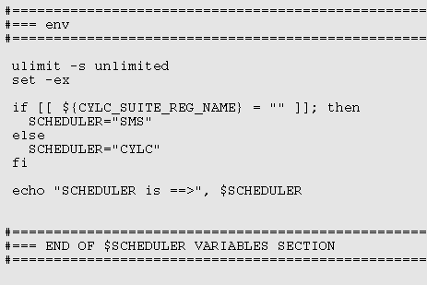
Cylc-SMS Interoperable Suite: Task Script 2
helloworld.sh
env
Ignored in Cylc

Slide 12
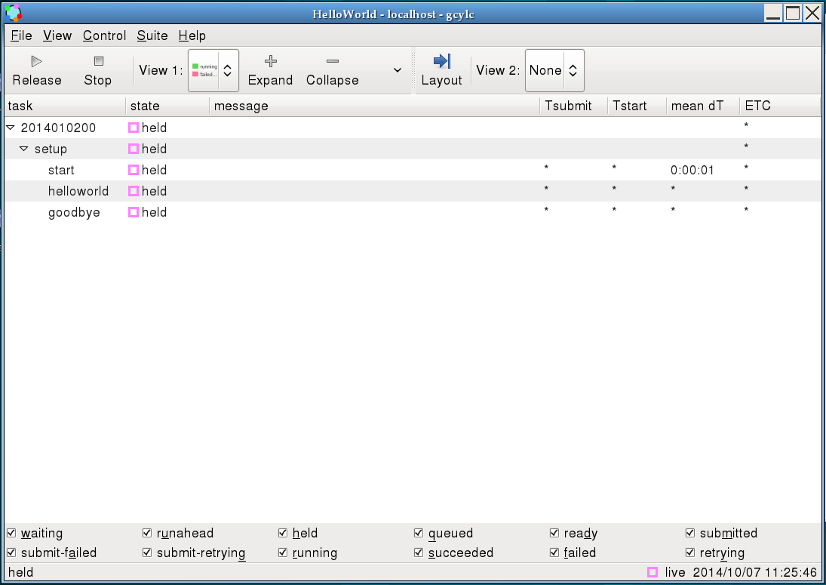
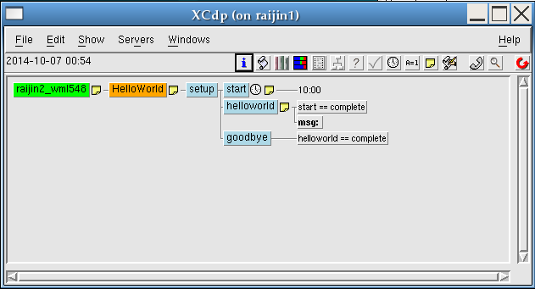
Running Cylc-SMS Interoperable Suite
Cylc
SMS

Slide 13
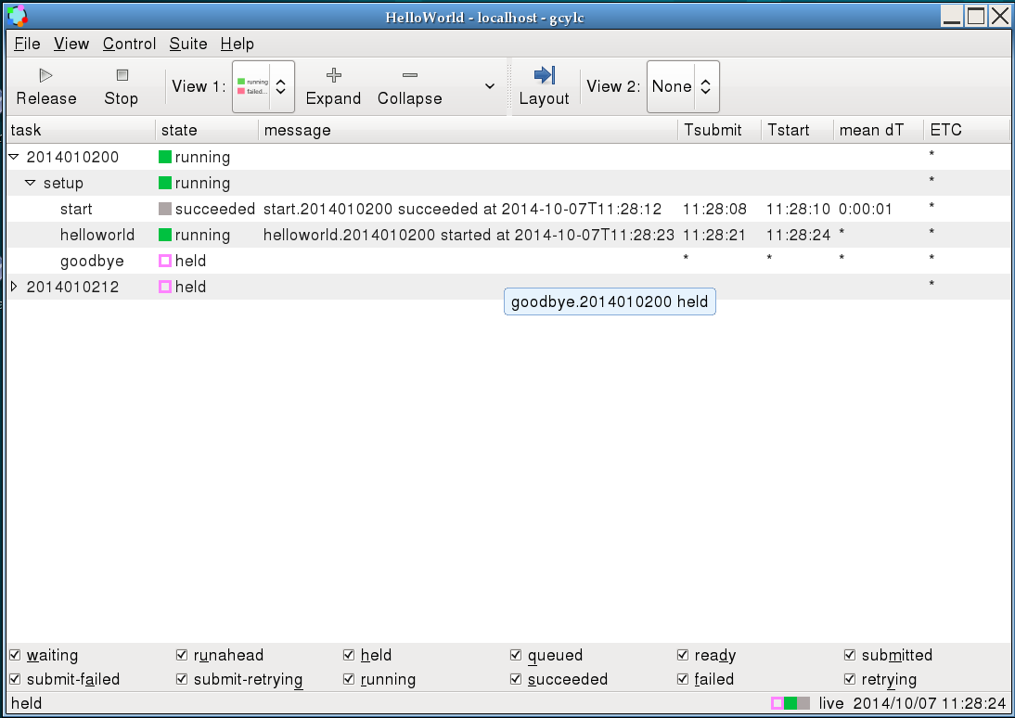
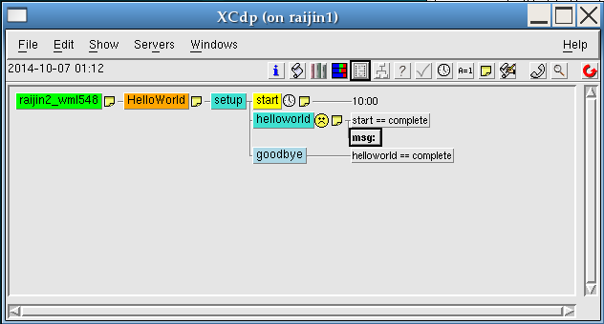
Running Cylc-SMS Interoperable Suite
Cylc
SMS

Slide 14
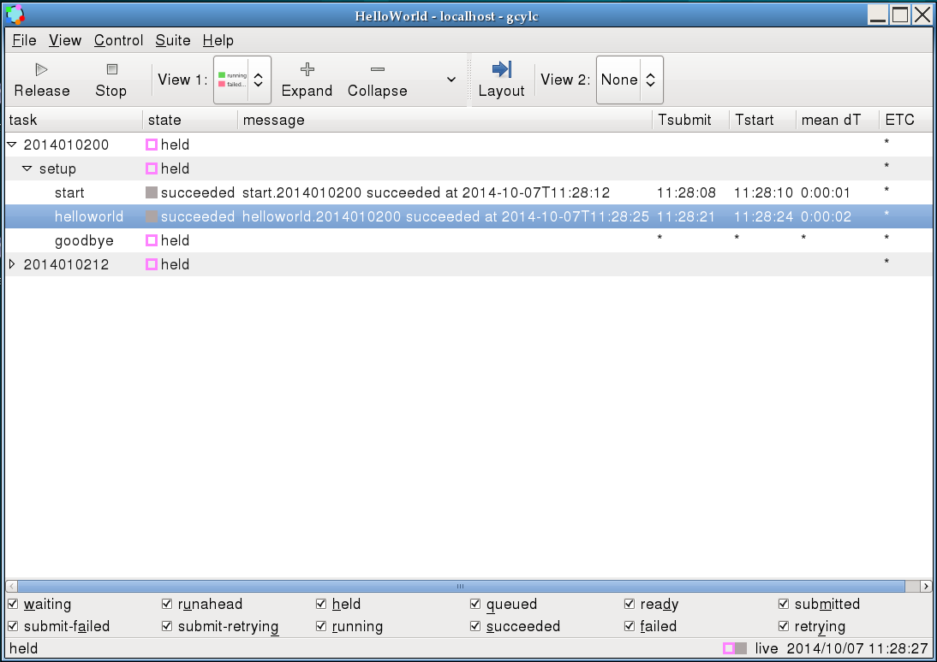
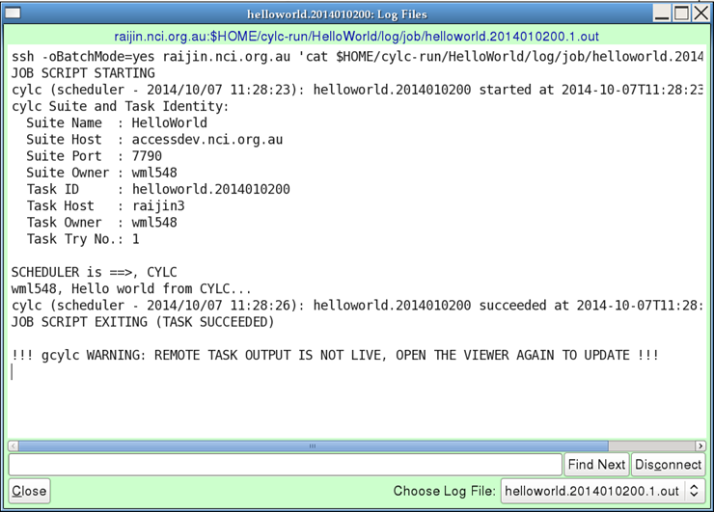
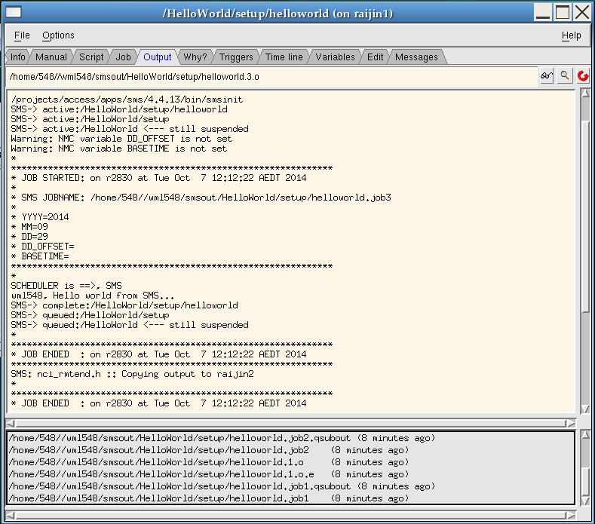
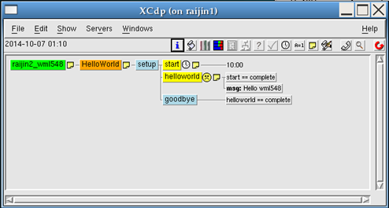

Running Cylc-SMS Interoperable Suite
Cylc
SMS

Slide 15
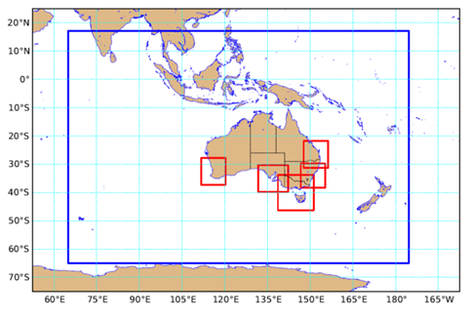
APS1 ACCESS-C(ity) NWP suite
This idea is practical in real-world complex suites
We have developed the APS1 ACCESS-C NWP suite in interoperable Cylc-SMS framework on NCI accessdev-raijin
ACCESS-City

Slide 16
Summary
Design for interoperable Cylc-SMS suite has been explained based on differences in the mode of operations of Cylc and SMS job schedulers.
More complex suites can be done the same way, but this becomes more difficult to manage if advanced features such as inter-cycle dependencies and the complex triggering are used in either scheduler.
We still recommend Cylc!

Slide 17

Thank you
The Centre for Australian Weather and Climate Research
A partnership between CSIRO and the Bureau of Meteorology
Thank you, and Questions??
www.cawcr.gov.au

