Slide 1
ACCESS Rose-cylc
Technical Infrastructure at NCI & BoM
www.cawcr.gov.au
Asri Sulaiman
CAWCR Model System Team
Tuesday 14th October 2014
plus Scott Wales,
Wenming Lu, Mike Naughton, Martin Dix
Ian Campbell, Peter Uhe and other
Model Systems / Technical Infrastructure
Team Members

Slide 2
ACCESS Rose-cylc
Technical Infrastructure at NCI & BoM
BoM
CSIRO
CoE (ARC Centre of Excellence for Climate System Science ARCCSS)
NCI
Universities
.. others
} CAWCR
}
The Centre for Australian Weather and Climate Research
A partnership between CSIRO and the Bureau of Meteorology

Slide 3


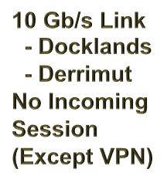

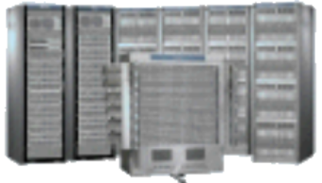


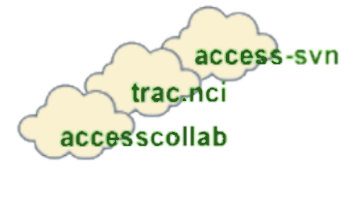



ACCESS Rose-cylc
Technical Infrastructure at NCI & BoM
NCI
+ CoE & Universities
BoM
RAIJIN
-1.2PF
57,472 Sandy
Bridge Cores
ngamai
- 0.1PF
- 576nodes
-- 6912 cores
- legacy umui
on login node
-- can submit
to raijin
- svn, trac,
- sms, web
twister
OpenStack-Puppet
Cloud Machine
Rose/cylc apps
au repository
Rosebush
UMUI Legacy
etc.
- Operational
Development
- sms, Rose/cylc
cherax
SGI UV1000
legacy
umui
CSIRO
- Batch jobs
- File server
The Centre for Australian Weather and Climate Research
A partnership between CSIRO and the Bureau of Meteorology

Slide 4
ACCESS Rose-cylc
Technical Infrastructure at NCI & BoM
Repositories for Source codes and job Suites
  access-svn for source code of UM, JULES, VAR etc.
  accessdev for suites (au repository ) & accessdev.nci.org.au/rose-bush/
  ngamai for mirror repository and BoM specific
Documentation
Main project page - trac.nci.org.au/trac/access
  trac on accessdev - accessdev.nci.org.au/trac/wiki
  trac on ngamai - ngamai04.bom.gov.au:8011
UKMO Collab wiki -- collab.metoffice.gov.uk (also trac projects)
Rose and FCM docs on github -- metomi.github.io/rose/doc and metomi.github.io/fcm/doc
cylc home on github -- cylc.github.io/cylc
CWSlab NeCTAR funded Virtual Laboratory for Climate & Weather simulations -- http://climate-cms.unsw.wikispaces.net/CWSlab
The Centre for Australian Weather and Climate Research
A partnership between CSIRO and the Bureau of Meteorology

Slide 5
ACCESS Model Experiment Library
Standard, supported experiments for ACCESS community use
ACCESS 1.3 coupled model Rose version (Ian Campbell and Martin Dix)
ACCESS-C Rose-Cylc-SMS interoperable versions (Wenming Lu and Michael Naughton)
  6 standard city domains & model-on-demand
  vn7.6_4km
  vn7.8_1.5km
  vn8.2_1.5km
  vn8.5 EG 1.5km
  2.2km
ACCESS APS2 N512 NWP forecast-only run (Yi Xiao and Ian Campbell)
ACCESS APS2 N512 NWP 4DVar & forecast suite (Yi Xiao)
ACCESS SREP High Resolution DA & forecast suite (Yi Xiao)
SCM (Greg Roff & Martin Dix)
The Centre for Australian Weather and Climate Research
A partnership between CSIRO and the Bureau of Meteorology

Slide 6
Documentation, training & communication
ACCESS Rose Training Workshops:
Jan 2014
Mar 2014
Will consider customised training session
The Centre for Australian Weather and Climate Research
A partnership between CSIRO and the Bureau of Meteorology

Slide 7
ACCESS ROSE-CYLC
Technical Infrastructure at NCI & BoM
MISCELLANEOUS
Interoperability
~access/ directory both at BoM and NCI
similar run and programming environment as much as practicable
Shared Repositories
Globally shared suite repository
Shared UM repository
Shared data repository
Expected 2nd Half 2015
New BoM Supercomputer
The Centre for Australian Weather and Climate Research
A partnership between CSIRO and the Bureau of Meteorology

Slide 8
ACCESS Rose-cylc
Technical Infrastructure at NCI & BoM
THANK YOU
Questions?
The Centre for Australian Weather and Climate Research
A partnership between CSIRO and the Bureau of Meteorology

