Slide 1
Building the UM within Rose/Cylc
www.cawcr.gov.au
Ian Campbell
26th March 2014

Slide 2
Background
Current method for building the UM
UMUI interface
FCM 1.5
FCM 2.0 (released in March 2011, current version 2.3.1)
Single command and framework of a configurable chain of steps
New configuration file format
Peformance greatly increased
Rose (first release in Nov 2012, current version 2014-03)
A framework for managing and running meteorological suites
A replacement for UMUI

Slide 3
Simple Build Job for UM 8.5
Suite au-aa054 is a basic suite that builds the UM 8.5 and reconfiguration executable.
To run the suite on Accessdev
rosie checkout au-aa054
rose suite-run -C ~/roses/au-aa054
This suite will build the following executables on Raijin
$HOME/cylc-run/au-aa054/share/fcm_make/build-atmos/bin/um-atmos.exe
$HOME/cylc-run/au-aa054/share/fcm_make/build-recon/bin/um-recon.exe
Share and work directories are in
/short/$PROJECT/$USER/cylc-run/au-aa054/work/
/short/$PROJECT/$USER/cylc-run/au-aa054/share/

Slide 4
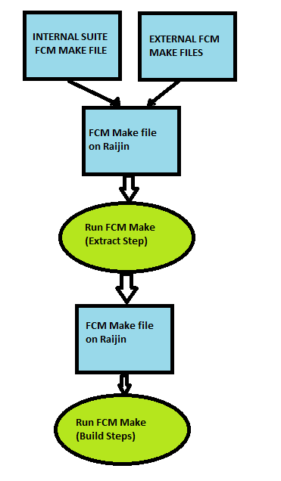
How the UM is built within Rose
Rose has FCM 2 as a built-in application
Any task names starting with "fcm_make" are considered FCM tasks.
FCM tasks use make files defined in your suite.
Eg. au-aa054/app/fcm_make/file/fcm-make.cfg
Combines suite's make file with external make files into single make file.
Eg. $HOME/cylc-run/au-aa054/share/fcm_make/fcm-make.cfg
On Raijin build jobs need to be a two-step process
fcm_make - Extracts the Source code.
fcm_make2 - Compile the Source code

Slide 5
Example FCM tasks in Suite.rc
[runtime]
[[root]]
initial scripting = """
module use ~access/modules
module load rose
module load cylc
. ~access/umdir/vn8.5/environment
module rm fcm
module load fcm/2013-12
"""
command scripting = "rose task-run -vv"
[[[environment]]]
ROSE_TASK_N_JOBS = 4
ROSE_TASK_OPTIONS = --ignore-lock
[[[event hooks]]]
…
[[[remote]]]
host=raijin.nci.org.au
[[fcm_make]]
[[[job submission]]]
method = background
[[fcm_make2]]
[[[job submission]]]
method = pbs
[[[directives]]]
…..
Module Environment
module use ~access/modules
module load rose
module load cylc
~access/umdir/vn8.5/environment
module unload fcm
module load fcm/2013-12
Environment Variables passed to FCM
ROSE_TASK_N_JOBS
ROSE_TASK_OPTIONS

Slide 6
Overview of the fcm-make.cfg (I)
Defining Source Base Version
$um_base = fcm:um-tr #FCM keyword to trunk
$um_rev = vn8.5 #FCM revision number
$jules_base = fcm:um-tr #FCM revision number
$jules_rev = vn8.5 #FCM revision number

Slide 7
Overview of the fcm-make.cfg (II)
Adding Branches/working copies:
extract.location{diff}[um] = \
branches/dev/vn8.5/GlobalAtmos6p0@7678 \ fcm:um_dev/vn8.5/local_changes@HEAD
extract.location{diff}[jules] = \ branches/dev/mrd599/um8.5_GlobalLand6p0@387

Slide 8
Overview of the fcm-make.cfg (III)
Steps for Building the UM
$steplist = extract mirror
$mirror_steplist = preprocess-atmos build-atmos \
preprocess-recon build-recon
$MIRROR_TARGET = \
$HOME/cylc-run/$ROSE_SUITE_NAME/share/fcm_make
include = fcm:um_dev/vn8.5/local_changes/fcm-make/linux-ifort-nci/um-atmos-safe.cfg@HEAD

Slide 9
Overview of the fcm-make.cfg (IV)
Definitions for pre compiler
$keys_atmos_app = A03_9C=a03_9c A13_2A=a13_2a A19_1B=a19_1b C84_1A=c84_1a C95_2A=c95_2a C96_1C=c96_1c C97_3A=c97_3a C98_0A=c98_0a UM_JULES=um_jules L19_1A=l19_1a
$keys_recon_app = RECON=recon GRIB_API=grib_api C95_2A=c95_2a C98_0A=c98_0a UM_JULES=um_jules
Extra compiler options
$fcflags_omp = # Extra options for open mpi at compile time
$ldflags_omp = # Extra options for open mpi at link time

Slide 10
When things go wrong!!
Rose log files
Suite log files on Accessdev
$HOME/cylc-run/au-aa054/log/suite/log
$HOME/cylc-run/au-aa054/log/suite/out
$HOME/cylc-run/au-aa054/log/suite/err
Extract log files on Accessdev
$HOME/cylc-run/au-aa054/log/job/fcm_make.1.N.err
$HOME/cylc-run/au-aa054//log/job/fcm_make.1.N.out
Compile log files on Raijin
$HOME/cylc-run/au-aa054/log/job/fcm_make2.1.N.err
$HOME/cylc-run/au-aa054/log/job/fcm_make2.1.N.out
FCM log files on Raijin and Accessdev
$HOME/cylc-run/au-aa054/share/fcm_make/fcm-make.log
High level
Low level

Slide 11
Stand alone Build Suites
Don't rely on external FCM make files in the access-svn repository
Allow users see the nuts and bolts of make files without searching through the various external make files
UM Build Suite
au-aa059
Reconfiguration Build Suite
au-aa063

Slide 12
Further information
Access Wiki
https://trac.nci.org.au/trac/access/wiki/UMRoseExecs
https://trac.nci.org.au/trac/access/wiki/UMStandAloneExecs
Rose Documentation
http://metomi.github.io/rose/doc/rose.html
http://metomi.github.io/rose/doc/rose-rug-task-run.html#rose-task-run.built-in-app.fcm_make
FCM 2
http://metomi.github.io/fcm/doc/user_guide/

Slide 13

Thank you
The Centre for Australian Weather and Climate Research
A partnership between CSIRO and the Bureau of Meteorology
Ian Campbell
Phone: 03 9616 8412
Email: i.campbell@csiro.au
Web: www.cawcr.gov.au
Thank you
www.cawcr.gov.au

