Slide 1
The ACCESS user environment
www.cawcr.gov.au
Martin Dix
March 21 2016

Slide 2
Overview
NCI environment
  BOM have some of these facilities available on ngamai and perhaps on australis soon
Met Office Science Repository Service (MOSRS)
Training environment
Some other useful links
The Centre for Australian Weather and Climate Research
A partnership between CSIRO and the Bureau of Meteorology

Slide 3

NeCTAR CWSLAB
National eResearch Collaboration Tools and Resources Project
Climate and Weather Science Laboratory
ACCESS Simulation and Modelling Service
Model analysis service
Data library, analytics, and service interfaces
Web content and integrated services
Main development 2013-14 with smaller follow-on projects
The Centre for Australian Weather and Climate Research
A partnership between CSIRO and the Bureau of Meteorology
Notes:
Development 2013-14, maintenance 2015. Small follow-on projects

Slide 4
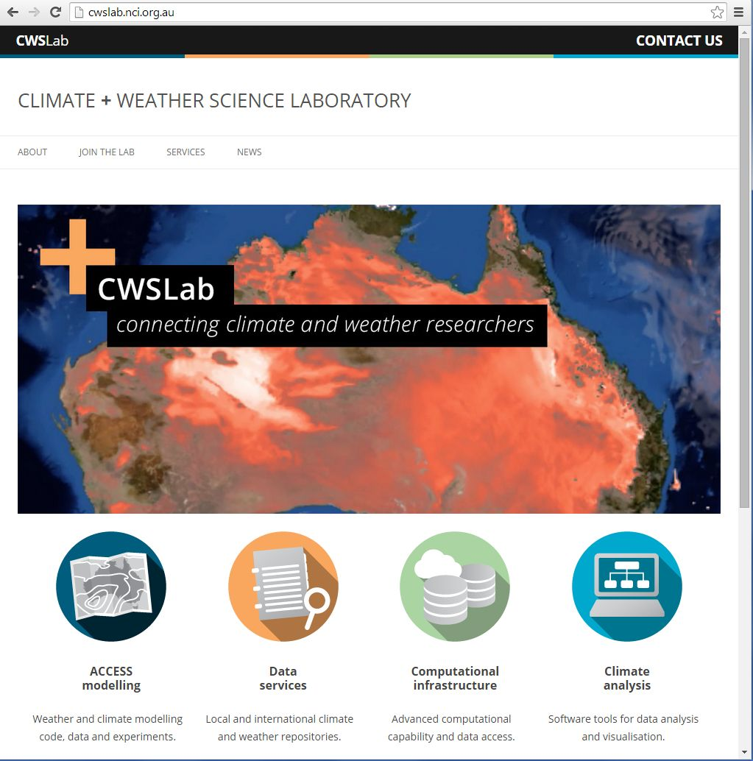
NeCTAR CWSLAB
The Centre for Australian Weather and Climate Research
A partnership between CSIRO and the Bureau of Meteorology

Slide 5
Modelling environment at NCI
Model runs on NCI peak system raijin
  Typical configurations from 10s to 1000s of cores
Shared data in ~access, ~access/apps, /g/data/access and RDSI projects
  E.g. ancillary files, initial conditions, CMIP5 data, BOM analyses
NCI cloud machine accessdev
  Rose/cylc and old UMUI
  Web services (rose bush)
  Trac for access documentation and tickets for system and model development
  Collaboratively managed by CAWCR, ARCCSS and NCI
access-svn
  Older code repositories
The Centre for Australian Weather and Climate Research
A partnership between CSIRO and the Bureau of Meteorology

Slide 6
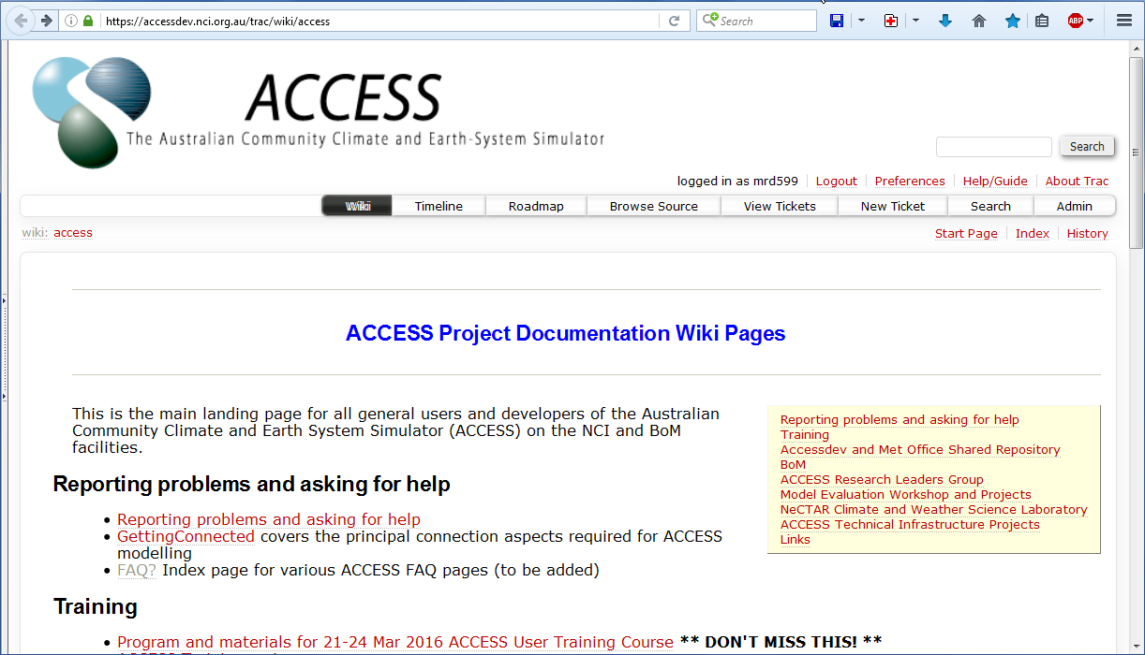
Modelling environment at NCI
The Centre for Australian Weather and Climate Research
A partnership between CSIRO and the Bureau of Meteorology

Slide 7
Modelling environment at NCI (2)
All controlled by membership of the access group at NCI
  File access control lists give the access group read permission
  UM licence conditions
access_help@nf.nci.org.au
  Seen by NCI, CAWCR and ARCCSS staff
access_users email list
The Centre for Australian Weather and Climate Research
A partnership between CSIRO and the Bureau of Meteorology

Slide 8
Other services at NCI
Data post-processing and model analysis
  Raijin or specialized cloud services like CWSLab workflow tool and virtual desktop
Data publication/catalogs
  Earth system grid, other developing NCI services
The Centre for Australian Weather and Climate Research
A partnership between CSIRO and the Bureau of Meteorology

Slide 9
MOSRS
Shared code and suite repositories for UM partners
  From vn10.0 only (earlier versions at NCI)
  Also the main repository for Met Office internal users
  Code repository is mirrored (read-only) at NCI
  Other Met Office internal code repositories are migrating
  Requires a separate account
Trac tickets for code development and testing
Model configuration development
  GA configuration development and evaluation
  NWP configuration development
Model documentation
The Centre for Australian Weather and Climate Research
A partnership between CSIRO and the Bureau of Meteorology
Notes:
One of main outcomes of UM Partnership and Technical Infrastructure Working Group.

Slide 10
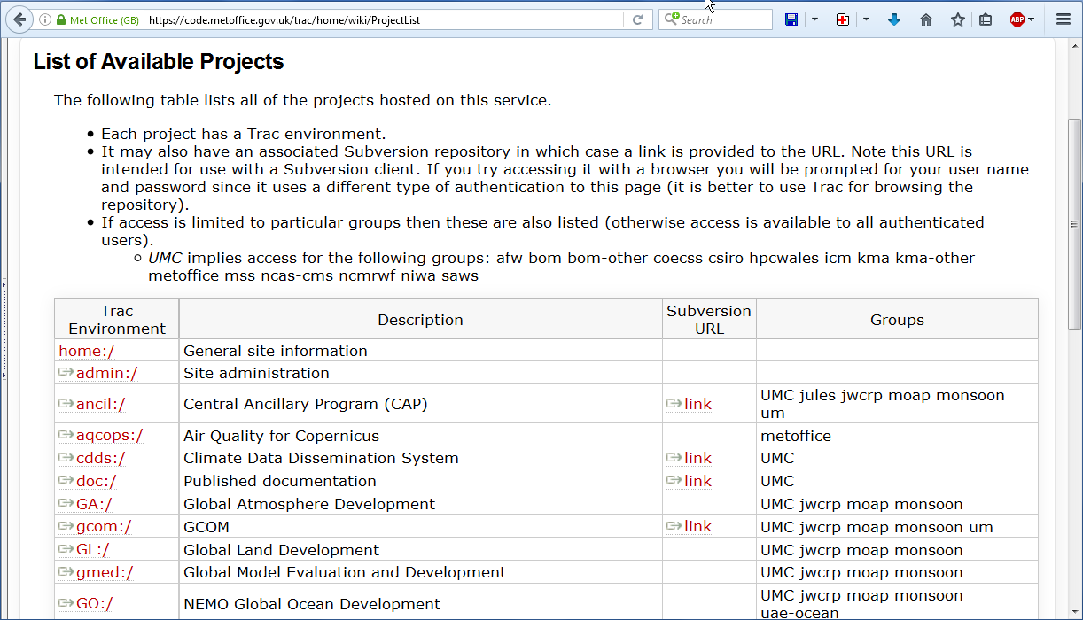
MOSRS projects
The Centre for Australian Weather and Climate Research
A partnership between CSIRO and the Bureau of Meteorology
Notes:
One of main outcomes of UM Partnership and Technical Infrastructure Working Group.

Slide 11
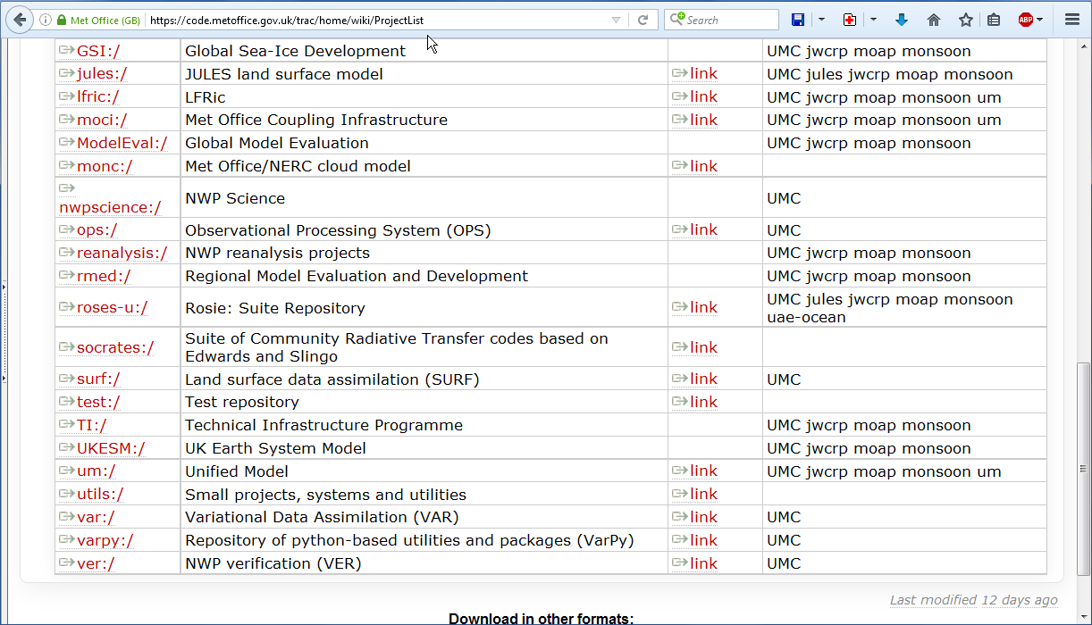
MOSRS projects
The Centre for Australian Weather and Climate Research
A partnership between CSIRO and the Bureau of Meteorology
Notes:
One of main outcomes of UM Partnership and Technical Infrastructure Working Group.

Slide 12
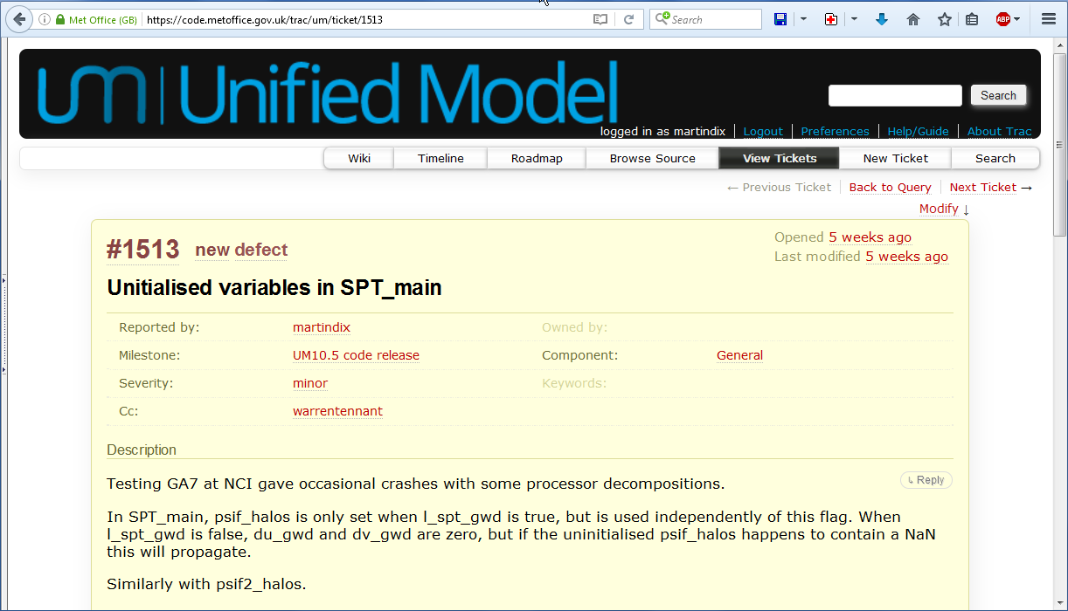
Ticket example
The Centre for Australian Weather and Climate Research
A partnership between CSIRO and the Bureau of Meteorology

Slide 13
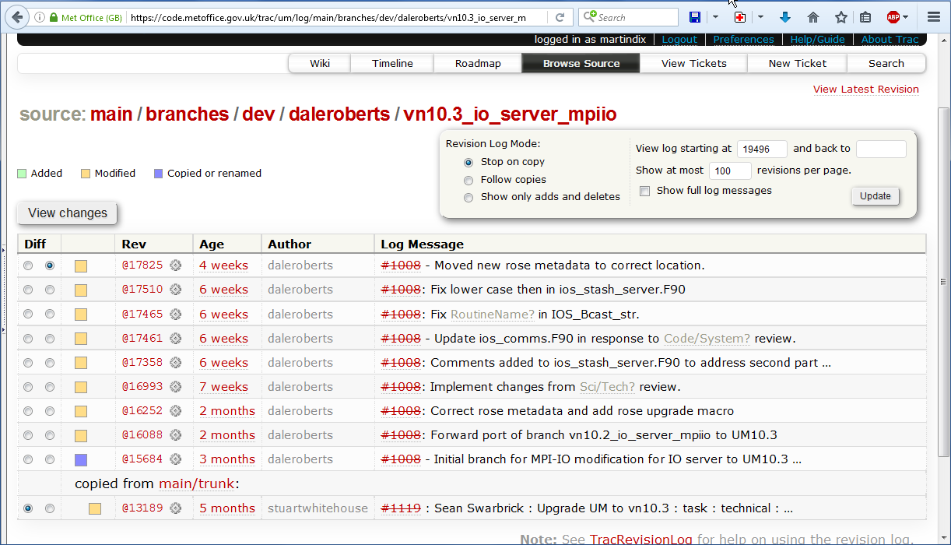
Trac code view
The Centre for Australian Weather and Climate Research
A partnership between CSIRO and the Bureau of Meteorology

Slide 14
Training environment
Aim is for things to work without a MOSRS account
Use the local code mirrors
  Can check out code but can’t create a branch
Use a local test suite repository
  Not a mirror so can modify and commit
The tools are all the same as when using MOSRS
The Centre for Australian Weather and Climate Research
A partnership between CSIRO and the Bureau of Meteorology

Slide 15
Links
Access wiki https://accessdev.nci.org.au/trac/wiki/access
MOSRS https://code.metoffice.gov.uk
Met Office collab wiki http://collab.metoffice.gov.uk
NCI http://nci.org.au/systems-services/national-facility/
  Includes a link to training
ARCCSS Computational Modelling Systems wiki http://climate-cms.unsw.wikispaces.net/
Rose https://github.com/metomi/rose
Cylc https://github.com/cylc/cylc
FCM https://github.com/metomi/fcm
The Centre for Australian Weather and Climate Research
A partnership between CSIRO and the Bureau of Meteorology

Slide 16



Thank you
The Centre for Australian Weather and Climate Research
A partnership between CSIRO and the Bureau of Meteorology
Martin Dix
martin.dix@csiro.au
Thank you
www.cawcr.gov.au

