Slide 1
Introduction to a UM suite
How to control the UM with Rose
09/02/2016 by João Teixeira

Slide 2
Contents
What we will cover…
Overview of UM
What’s the UM
What’s in the UM suite
The fcm_make app
Walk through menus
Develop UM code
The um app
Walk through menus
Editing STASH
Editing namelists

Slide 3
Overview of UM
What does it contain?

Slide 4

What’s the UM ?
What cant it be used for?
The Unified Model is a Numerical Model
Applies a spatial discretization
Continuous equations into discrete counterparts.
Integrates equations forward in time:
Newton’s laws for rotating fluid
Gas laws
Laws of thermodynamics
Parameterizes sub-grid processes:
Convection / Cumulus
Microphysics / Clouds
Boundary Layer
etc..

Slide 5
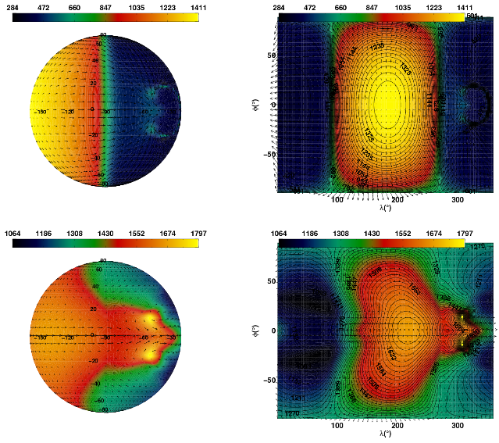
Uses and Application
What can the UM be used for?
The UM may be run in many modes
Global
Limited Area Model
Mesoscale NWP
Idealised tests – Aquaplanet – Flat Earth
Exoplanet research
Climate modelling – atmosphere only or coupled (e.g. Ocean)

Slide 6
What’s the UM made of?
Dark matter? Sorcery? Magic?
Mainly Fortran and some C
Fortran 77 through Fortran 95 and recently the use of some Fortran 2003.
Uses FCM for code management (Trac and subversion)
UM Support Infrastructure
bash Perl and Python rose/cylc – python gtk
DO i = istart, iend, idiff
height_want = height(i)
IF (height_want == height_start) THEN
flux_got = flux_start
flux_deriv_got = eval_flux_deriv(height_want, flux_got, params)
ELSE
CALL range_integrate(comm, eval_flux_deriv, height_want, height_got, &
flux_got, flux_deriv_got, params, err)
...

Slide 7
The UM does not...
and what can you use to do it...
Cannot process observations – OPS/ODB does that
Cannot alone assimilate observations – VAR is required
Cannot objectively verify results – VER & SBV do that
Does not archive/retrieve data – MASS does that
Cannot create ancillaries – CAP does that
Cannot control all the above – Rose/cylc does that
Cannot scientifically interpret results – you do that!

Slide 8
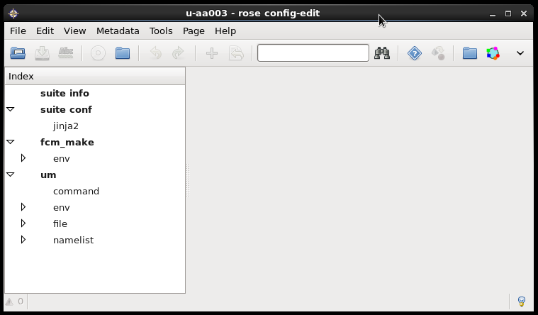
Rose GUI vs File Structure
u-aa003
|---app/
| |---fcm_make/
| | |---file/
| | | |---fcm-make.cfg
| | |
| | |---rose-app.conf
| |
| |----um/
| | |---rose-app.conf
|
|---rose-suite.conf
|---rose-suite.info
|---suite.rc

Slide 9
Rose GUI vs File Structure
u-aa003
|---app/
| |---fcm_make/
| | |---file/
| | | |---fcm-make.cfg
| | |
| | |---rose-app.conf
| |
| |----um/
| | |---rose-app.conf
|
|---rose-suite.conf
|---rose-suite.info
|---suite.rc

Slide 10
Rose GUI vs File Structure
u-aa003
|---app/
| |---fcm_make/
| | |---file/
| | | |---fcm-make.cfg
| | |
| | |---rose-app.conf
| |
| |----um/
| | |---rose-app.conf
|
|---rose-suite.conf
|---rose-suite.info
|---suite.rc

Slide 11
The fcm_make app
What does it contain?

Slide 12
fcm_make app
What does it do? How to configure?
Compiles the UM code and necessary tools
Options include definitions for:
Platform dependent options – can specify the platform
Defining what we want to compile
Where to find/extract the code & at what revision
Compilation options and keys

Slide 13
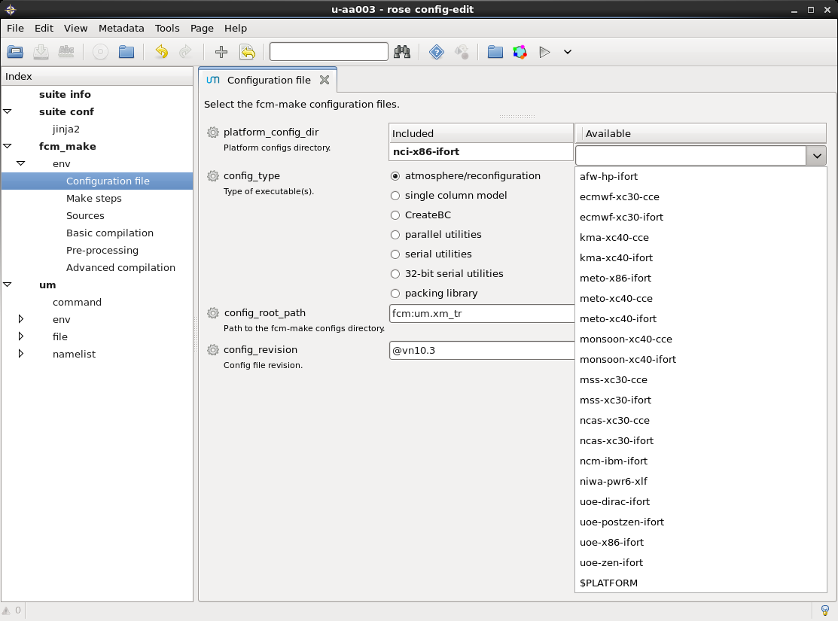
fcm_make app
Configuration files
Several configurations are already available from the UM trunk

Slide 14
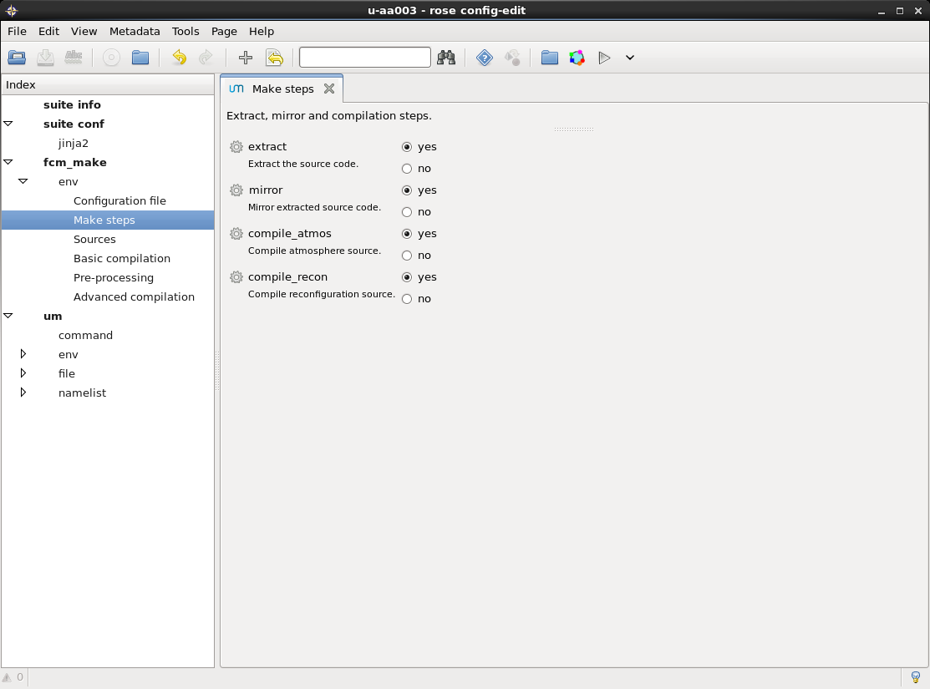
fcm_make app
Compile steps

Slide 15
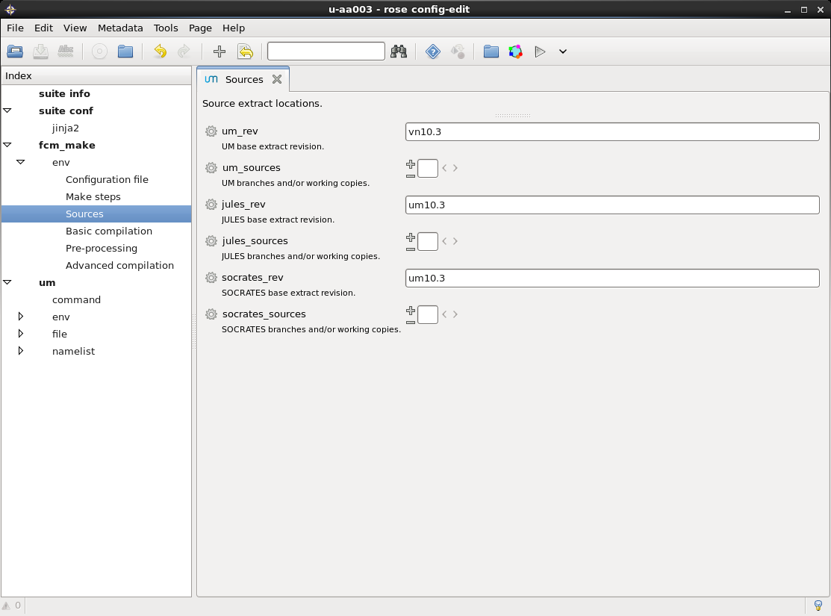
fcm_make app
Revision and branches
Changes to the code can be added through branches
Create branch from trunk
Make changes
Add to Sources

Slide 16
Developing UM code
Working Practices... A practical will follow...
Opening a Ticket
meaningful summary of your change and a detailed description
Creating and Checking Out a Branch
All code changes to the UM must be made in a branch which refers to a ticket
Developing your Change
Comply with the UMDP3 coding standards and make commit messages meaningful
Testing
It is vital that it has undergone an appropriate level of testing before review
Documenting your Change
Most code changes should be documented. Ticket or even edit UMDP
Sci/Tech Review & Code/System Review
Once your change is complete, you should send it to a reviewer
Merging and Committing to the Trunk
Once reviewed, UM Team will attempt to commit your change to the UM trunk

Slide 17
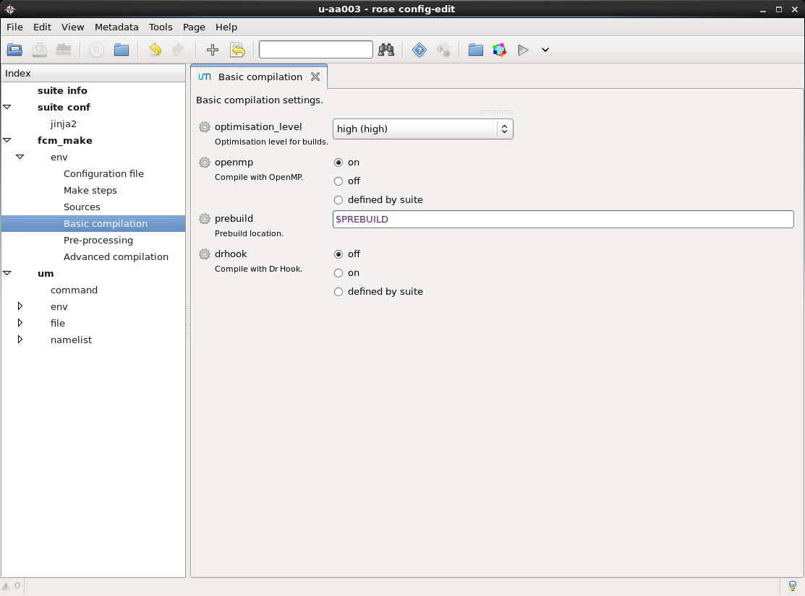
fcm_make app
Compilation
Optimization levels
(e.g. debugging)
Using existent pre-built binaries

Slide 18
fcm_make task
Compilation and standard output
stored on the host upon which the compilation was performed
~/cylc-run/suitename
Output from the tasks
The output from fcm_make is symbolically linked inside the directory containing the build share/ and in log/
Remember that you can use Rose-Bush to see it !!!
Compilation Output
~/cylc-run/u-aa003/share/fcm_make/fcm-make.log
Standard Output
~/cylc-run/u-aa003/log/job/1/fcm_make/NN/job.out
~/cylc-run/u-aa003/log/job/1/fcm_make/NN/job.err

Slide 19
The um app
What does it contain?

Slide 20
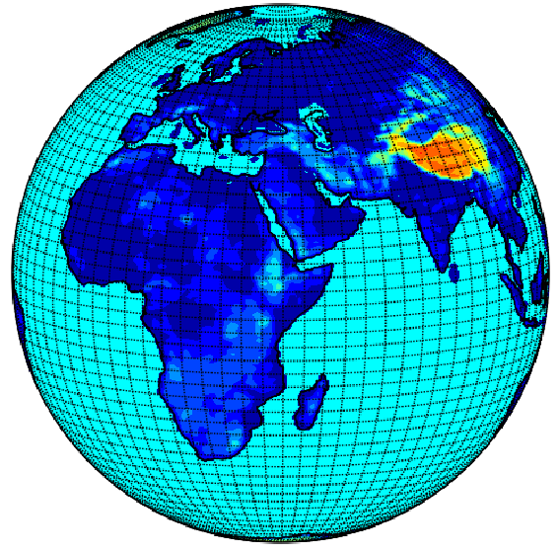
um app
What does it do? How to configure?
UM related options – STASH – Namelist – Model Setup
Options include definitions for:
STASH control
Model setup (e.g. Run time, ancillaries, start dump, etc...)
Namelist options (e.g. Microphisics, radiation, etc...)
Env variables (e.g. Coupling, etc...)

Slide 21
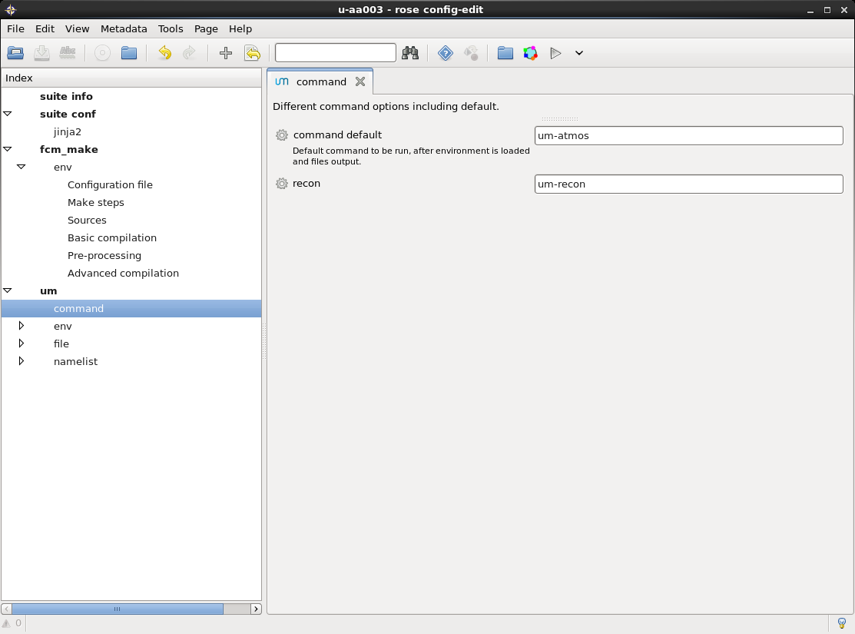
um app
Command
App executables to run

Slide 22
Reconfiguration
recon – Initialising the UM
Standalone program which modifies start dumps
Prepares the input data to be read by the model:
Add/subtract fields from dump
Upgrade a start dump from an earlier release
Create new start dumps for a new (sub)domain and/or resolution
If new ancillary files are not supplied data is interpolated (e.g. land sea mask, ozone, orography, soil/veg, SSTs etc.)
Supply ensemble perturbations (e.g. transplant prognostic fields etc.)

Slide 23
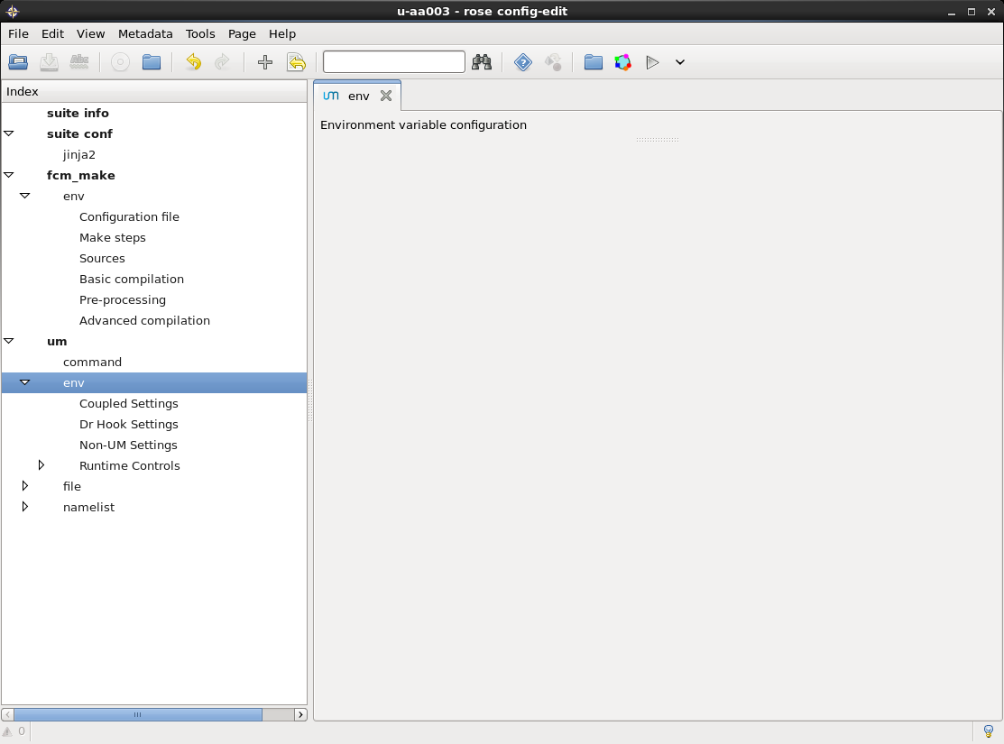
um app
Environment variables
Non-UM settings
(OASIS coupler Dr Hook)
Print Status
Spectral files location
Path to History file
... Many other options ...

Slide 24
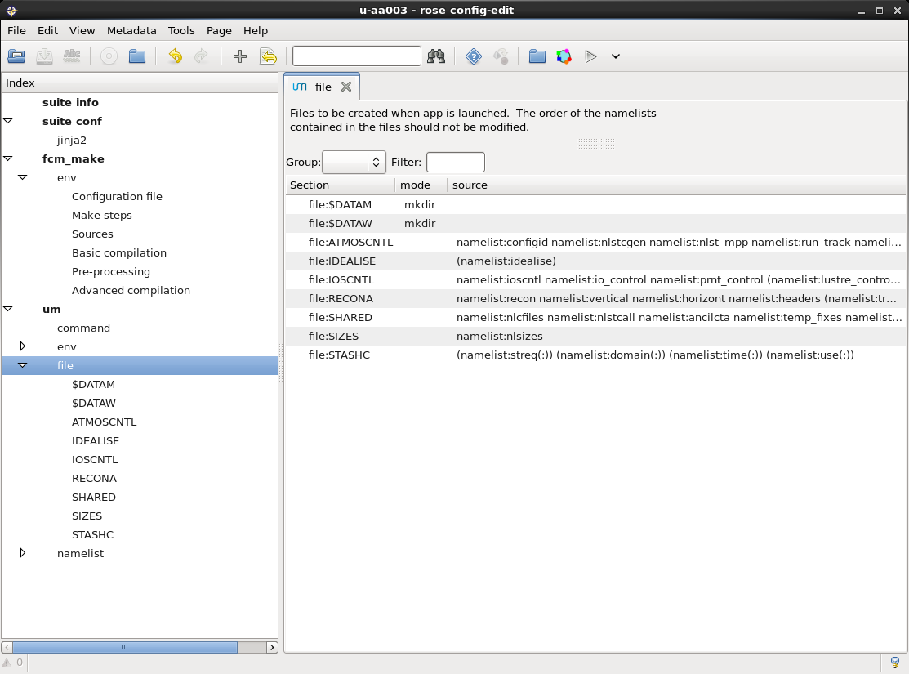
um app
Files
Namelist files and files to be created when the app is launched

Slide 25
Editing STASH
Diagnostics heaven and hell... practical will follow...
Spatial and
Temporal
Averaging and
Storage
Handling
Addressing and internal memory
Handling100’s of diagnostics per section
Each diagnostic request has a profile linked with it:
Time Profile – Output times, temporal min/max/means
Spatial Profile – Horizontal, vertical, spatial meaning
Usage Profile – Where to put the diagnostic
All configured via User Interface

Slide 26
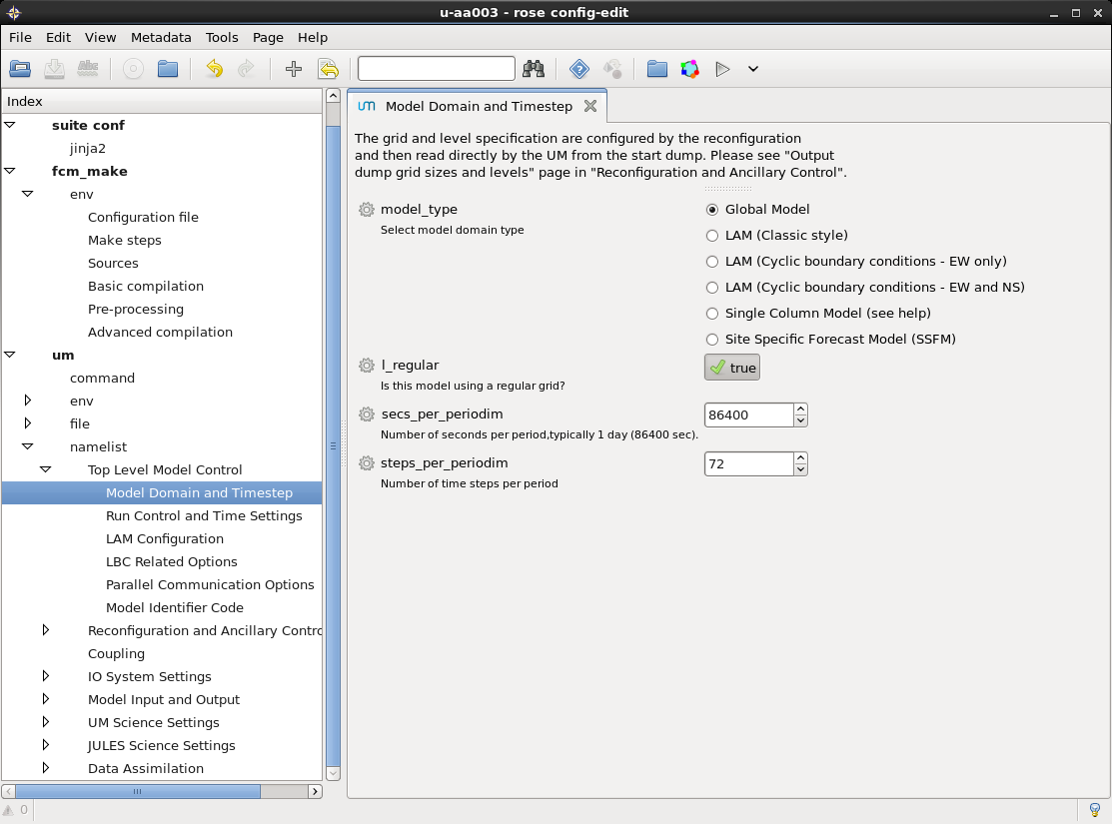
um app
Namelist Options
Namelist options and model setup

Slide 27
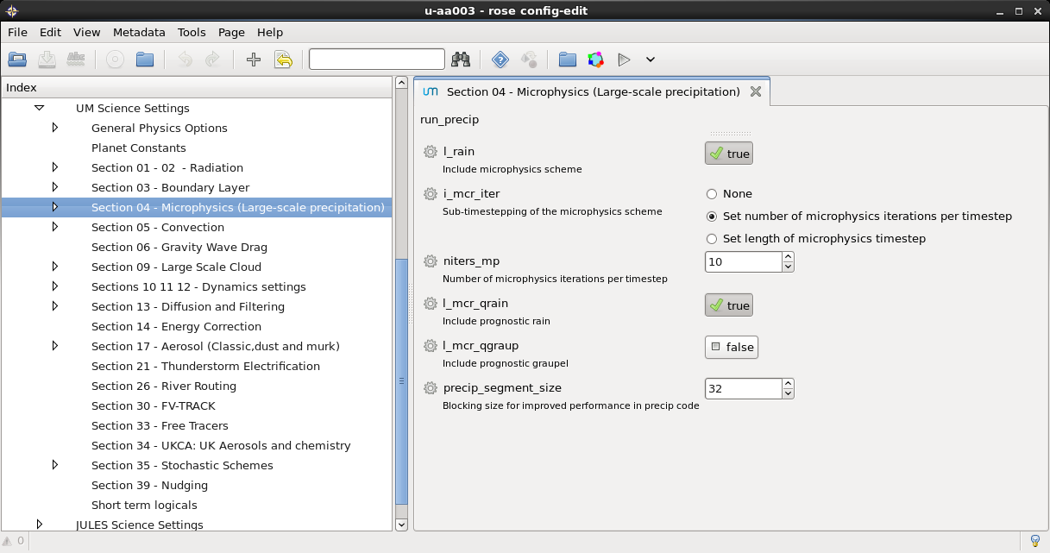
Editing namelists
Quick walk through... Practical will follow...
All app namelists are contained in the namelist section
namelist item names are visible in addition to a familiar descriptions underneath
Notes:
All app namelists contained in the namelist section. First let's take a look at the science namelist for Large Scale Precipitation, run_precip.
One of the first differences you should notice compared to a UMUI panel is that the UM namelist item names are visible in addition to the more familiar descriptions underneath.

Slide 28
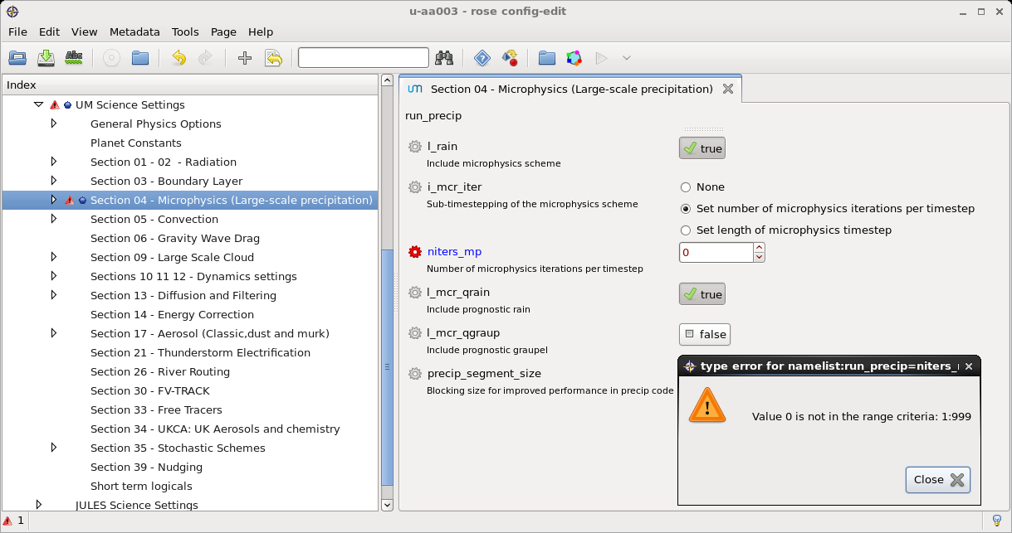
Editing namelists
Range and type checking
Checking of variables is done as soon as the user enters a new value
Try changing the value of niter_bs to 0, this will cause an error flag to appear
Notes:
Range and type checking of variables is done as soon as the user enters a new value. Try changing the value of niter_bs to 0. This will cause an error flag to appear, hover over the error for more information and click the undo button to revert to the original value. If a variable has associated help information this can be accessed by either clicking on the variable name or on the cog next to the variable and selecting Help.

Slide 29
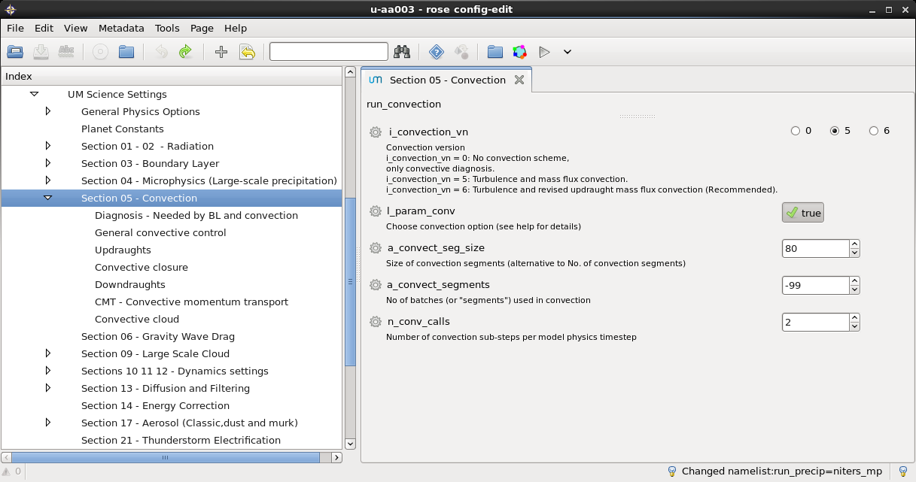
Editing namelists
Large sections
Larger science sections have been divided into subsections
Take a look at Section 05 – Convection, for an example of this.
Notes:
Some larger science sections have been been divided into subsections, take a look at Section 05 - Convection for an example of this. To open a section in a new tab click with the middle mouse button, expand the section by clicking the page triangles.

Slide 30
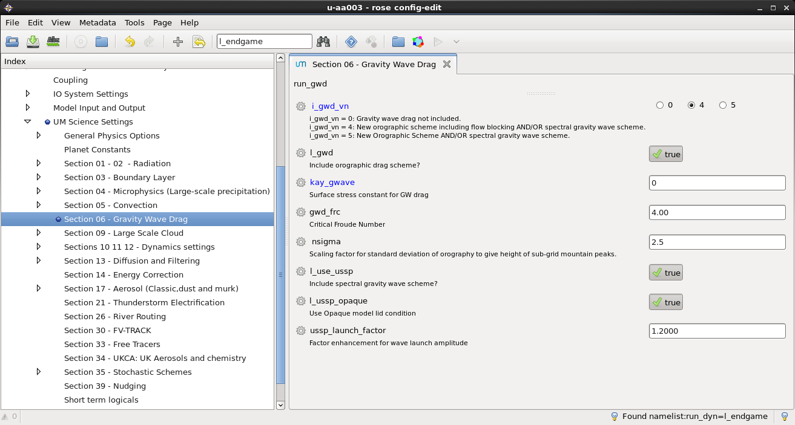
Editing namelists
Trigger ignored settings
Trigger ignored settings are hidden by default
Open the Gravity Wave Drag panel, then try changing i_gwd_vn from 5 to 4...
Notes:
Trigger ignored settings are hidden by default and only appear to the user when the appropriate options are selected. Open the Gravity Wave Drag panel, if you change i_gwd_vn from 5 to 4 the options available change. Click the save button to apply these changes to your app. Let's take a look at what effect this has had to the rose-app.conf file, run fcm diff in the suite directory.

Slide 31
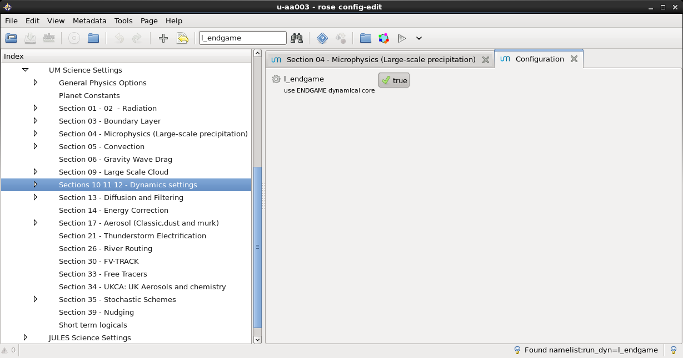
Editing namelists
Search...
Rose edit has a search box which can be used to search item names
Try searching for l_endgame
Notes:
Rose edit has a search box which can be used to search item names. Try searching for l_endgame, you will be taken directly to the dynamics configuration panel.

Slide 32
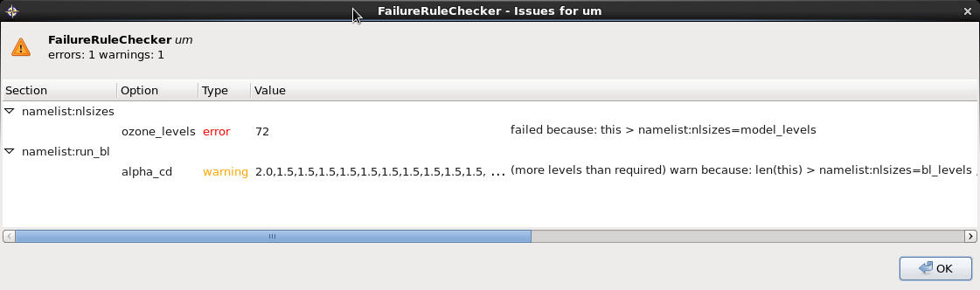
Error checking of UM inputs
Using Rose macros and metadata
Checks using Rose macros and the fail-if/warn-if metadata
Change the boundary layer option "alpha_cd“ adding an array element = 1.5
"Implicit solver options" subsection within the "Section 03 - Boundary Layer“
Click on the plus sign to add an array
Increase the number of ozone levels to 72 in the "Output dump grid sizes and levels“
within "Reconfiguration and Ancillary Control”
Run the fail-if, warn-if checker available in the Metadata menu
This produces an error and a warning, can you tell why?

Slide 33
Error checking of UM inputs
What other checks are available?
Check fail-if/warn-if
Checks metadata fail-if and warn-if staments
STASH validation macro
Rose macro provided to ensure that the STASH output requested is valid given the science configuration of the app
Duplicate namelist indexing macros
Several of the UM namelists have the "duplicate=true" attribute set in the UM metadata. This means that a UM app may contain multiple instances of these namelists.
Profile namelist validation/tidying macros
Checks whether an app's stash request and profile namelist references are set up correctly.

Slide 34
The UM File format
IO files and more…

Slide 35
Input and Output Files
Feeding the UM...
Files In | Files Out
Initial Conditions: Start Dumps Increment files from VAR (Obs) | Initial Conditions: Restart dumps Background files for VAR
Boundary Conditions: LBCs for Limited Area Models Ancillary files (e.g. Surface conditions, spectral files for radiation)
Run time namelists (all defined within a UM Rose app file) | Model Output: STASH (Model diagnostics/prognostics) Runtime text files

Slide 36
UM File Format
FF files
The UM works with a proprietary direct access file format
Field Files
Primary header record with pointers to a series of secondary header records
Records pointing to and describing the data areas as well as the data areas themselves
Adaptable for different applications to which the UM might eventually be put
Full details please read UMDP F3

Slide 37

UM Post Processed Files
PP files
Historically designed for use with data analysis and data archiving
Processed Files
Sequential, rather than direct access
pp file is made up of a number of pp fields
Each pp field contains a pp header and is followed by a data field
Full details please read UMDP F3

Slide 38
UM Post Processed Files
Why one should convert from FF to PP files
Supports faster record-based I/O for Fortran
Quicker to slurp in a header, work out if you need the field or skip it
Can be split up, or concatenated together

Slide 39
Useful links
Online tutorials and documentations ...
UM
https://code.metoffice.gov.uk/doc/um/vn10.3/umdp.html
https://code.metoffice.gov.uk/doc/um/vn10.3/um-training/index.html
MOSRS
https://code.metoffice.gov.uk
roses-u https://code.metoffice.gov.uk/trac/roses-u

Slide 40
Questions … ?

