Slide 1
The ACCESS user environment:
Rose and cylc at NCI
Martin Dix (martin.dix@csiro.au)
Scott Wales: ARCCSS CMS
(scott.wales@unimelb.edu.au)

Slide 2
Modelling environment at NCI
Models run on raijin
Shared data in ~access, ~access/apps, /g/data/access and RDSI projects
  E.g. ancillary files, initial conditions, CMIP5 data, BOM analyses
NCI cloud machine accessdev
  Rose/cylc and old UMUI
  Web services (rose bush)
  Trac for access documentation and tickets for system and model development
  Collaboratively managed by CAWCR, ARCCSS and NCI
  Configured with puppet
access-svn
  Older code repositories
The Centre for Australian Weather and Climate Research
A partnership between CSIRO and the Bureau of Meteorology

Slide 3
Met Office Science Repository Service (MOSRS)
svn code repository for UM and associated systems
  Trac for development tickets
  Documentation
Use gpg-agent for access
  Creating branches, committing changes etc
Use read-only mirror on accessdev for builds
  No authentication required
  Only give accessdev accounts to those with Met Office code licence agreements
roses-u suite repository
The Centre for Australian Weather and Climate Research
A partnership between CSIRO and the Bureau of Meteorology

Slide 4
Rose/cylc
System for configuring and running models
  Both on github (GPL)
  Almost always used together
  Over time some migration of capability from rose to cylc so need to run matching versions
Releases every few months
  We’re now installing most new releases at NCI
  New releases tested on accessdev-test machine before installation
  Default versions are set to latest release
Generally backwards compatible on suite level
  running suites should continue with original versions and be unaffected by upgrades
The Centre for Australian Weather and Climate Research
A partnership between CSIRO and the Bureau of Meteorology

Slide 5
Rose/cylc version history at NCI
Rose | Cylc | Became default | Removed
2014-05 | 5.4.14 | 2014 | 2016-05-16
2015.02.0 | 6.3.0 | - | 2016-05-16
2015.04.1 | 6.4.1 | 2015-06-03
2015.11.0 | 6.7.2 | 2015-11-10
2016.03.0 | 6.9.1 | 2016-03-17
2016.05.0 | 6.10.1 | 2016-05-17
2016.06.1 | 6.10.2 | 2016-06-28
https://accessdev.nci.org.au/trac/wiki/access/RoseCylcVersions
Currently running suites
  Cylc 6.10.2 19, 6.10.1 3, 6.9.1 7
The Centre for Australian Weather and Climate Research
A partnership between CSIRO and the Bureau of Meteorology

Slide 6
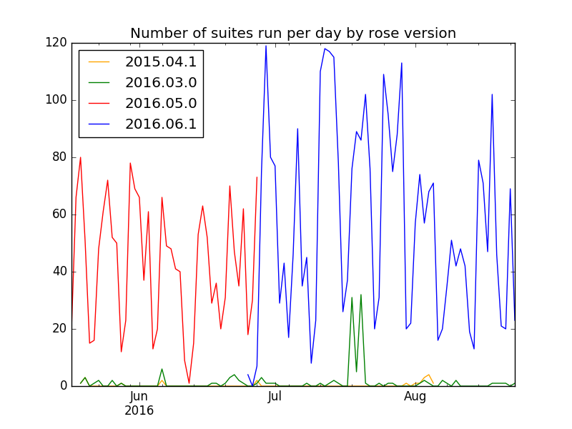
Rose/cylc version history at NCI
The Centre for Australian Weather and Climate Research
A partnership between CSIRO and the Bureau of Meteorology

Slide 7
Workflow
Cylc server runs on accessdev
Submits jobs to raijin, communicating via ssh (passwordless)
  ssh raijin qsub job
Raijin job sends a message back to accessdev (e.g. job started, failed, succeeded)
  ssh accessdev cylc ‘succeeded’ –env=CYLC_SUITE_NAME=test …
Cylc task on accessdev communicates to cylc server on accessdev using pyro (soon to be replaced by HTTPS)
Cylc server submits next job
The Centre for Australian Weather and Climate Research
A partnership between CSIRO and the Bureau of Meteorology

Slide 8
Security
Need passwordless ssh from accessdev to raijin login nodes and from compute nodes to accessdev
NCI remote-job-submission script sets up permissions
Very restricted set of commands that can be run on VM (including cylc)
Communication with cylc server via pyro over specific port, secured by a passphrase
  Can set level of public access to the running suite
  Sharing passphrase gives full control to specific other users
The Centre for Australian Weather and Climate Research
A partnership between CSIRO and the Bureau of Meteorology

Slide 9
Rose/cylc version configuration
Uses environment variables to run the appropriate version and keep working after upgrades
Wrapper means users don’t need to load explicit modules
Site specific configuration
  Use ssh
  Directories on raijin
  Matching versions of software
The Centre for Australian Weather and Climate Research
A partnership between CSIRO and the Bureau of Meteorology

Slide 10
FCM
https://github.com/metomi/fcm
Perl-based wrapper around SVN + custom build tool
Simple to install - download repository and add $FCM_ROOT/bin to $PATH
Requires some non-default Perl libraries, see docs
`fcm test-battery` will run tests

Slide 11
Build Workflow
Download Model Source
Combine Models & Apply Patches
Rsync sources to HPC
Build Model
Run Model
FCM / Flexible Configuration Manager
https://github.com/metomi/fcm

Slide 12
Build Workflow
Download Model Source
Combine Models & Apply Patches
Rsync sources to HPC
Build Model
Run Model
Source code is downloaded from SVN repositories at https://code.metoffice.gov.uk
Recent SVN version preferred for speed - Accessdev obtains 1.8 from http://opensource.wandisco.com
Security requirements: No plaintext cached passwords
http://svnbook.red-bean.com/en/1.8/svn.serverconfig.netmodel.html
Inconvenient for users (svn requires network access for most operations)
Secure caching with gpg-agent / gnome keyring allowed

Slide 13
Build Workflow
Download Model Source
Combine Models & Apply Patches
Rsync sources to HPC
Build Model
Run Model
Cylc will run SVN extract in batch mode to download sources
Accessdev uses a read-only SVN mirror running on the NCI cloud, which syncs every 10 min
Mirrors are set in FCM config file $FCM_ROOT/etc/fcm/keyword.cfg
um.x: Met Office repository
um.xm: Local mirror
SVN setup instructions at https://code.metoffice.gov.uk/trac/home/wiki/FAQ#Supportteams

Slide 14
Build Workflow
Download Model Source
Combine Models & Apply Patches
Rsync sources to HPC
Build Model
Run Model
Different SVN branches are combined by FCM
UM 10's main component repositories:
um
jules - land surface
socrates - radiation
All stored at https://code.metoffice.gov.uk/trac

Slide 15
Build Workflow
Download Model Source
Combine Models & Apply Patches
Rsync sources to HPC
Build Model
Run Model
Source code is copied with rsync in batch mode
Requires passwordless access to HPC, e.g.
Passphraseless SSH key
SSH agent
Certificate-based access
Only required if not checking out source directly on the machine - At NCI source is downloaded on Accessdev due to security requirements of the SVN mirror, Raijin is a public machine

Slide 16
Build Workflow
Download Model Source
Combine Models & Apply Patches
Rsync sources to HPC
Build Model
Run Model
Site-specific build config stored in `fcm-make` directory of UM source

Slide 17
Cylc
https://github.com/cylc/cylc
HPC task scheduling tool
Supports cycling tasks, external dependencies
Runs as a user process, tasks communicate over Pyro or SSH to report success or failure
Tasks can be run using a variety of drivers - shell, at, PBS, loadleveler
Installed on UI server & HPC, instructions at https://github.com/cylc/cylc/blob/master/INSTALL.md
Multiple versions can be installed at the same time, with a wrapper script choosing the correct version according to environment variable CYLC_VERSION.

Slide 18
Cylc
Site configuration guide at https://cylc.github.io/cylc/html/multi/cug-htmlse18.html
Important options:
General
UTC mode: Ignore timezone/daylight savings by default
Per host:
cylc executable: Path to cylc on remote host
use login shell: Source ~/.profile when running remote commands
task communication method: How tasks report success or failure
retrieve job logs: Copy raijin log files back to accessdev (with configurable delays and retries)

Slide 19
Cylc
Tasks on the HPC communicate with the server to report their state - started, succeeded, failed
Pyro
Uses Python library Pyro to communicate
Requires a range of ports open between compute nodes and the suite control server
SSH
Tasks on the compute nodes SSH to the suite control server to report their status
Requires port 22 access from compute nodes to the server, passphraseless keys
Poll
Suite control server contacts the HPC at regular intervals to collect task state
Accessdev uses 'SSH' method

Slide 20
Rose
https://github.com/metomi/rose
Grab-bag of tools for running Met Office models
Namelist/configuration editor
Task runner
Experiment catalogue
Test system
Datetime arithmetic
Installed on UI server & HPC, instructions at http://metomi.github.io/rose/doc/rose-install.html
Web services/experiment catalogue shouldn't be required locally, provided by Met Office at https://code.metoffice.gov.uk/rosie. Might need local version for operations?
Similar install to Cylc - multiple versions can be installed, with a wrapper selecting the version to use

Slide 21
Rose
rosie go
GUI Experiment browser
Connects to https://code.metoffice.gov.uk/rosie web service to search through available configurations
Individual configurations are stored in a Subversion repository https://code.metoffice.gov.uk/trac/roses-u
# $ROSE_ROOT/etc/rose.conf
[rosie-id]
local-copy-root = $HOME/roses
prefix-default = u
prefix-location.u = https://code.metoffice.gov.uk/svn/roses-u
prefix-web.u = https://code.metoffice.gov.uk/trac/roses-u/intertrac/source:
prefix-ws.u = https://code.metoffice.gov.uk/rosie/u

Slide 22
Rose
rose edit
GUI configuration & namelist editor
Builds an interface from model-specific metadata

Slide 23
Rose
rose suite-run
Runs a Rose job
Builds a Cylc configuration using a Jinja2 template, copies the configuration to ~/cylc-run/$JOBID, then runs the Cylc job
Files are also mirrored to the HPC, so they can be accessed by running jobs
Local rose configuation
[rose-suite-run]
root-dir{share}=raijin*=/short/$PROJECT/$USER
root-dir{work}=raijin*=/short/$PROJECT/$USER
[rose-home-at]
raijin.nci.org.au=/projects/access

Slide 24
Rose
rose host-select
Helper script to select a remote computer
Useful for systems with multiple login nodes
Can check if hosts are online
Selects host based on load or randomly

Slide 25
Rose
rose task-run
'Magic' command to run individual tasks
'suite-run' runs Cylc, individual Cylc jobs run 'task-run'
The task to run is selected automatically based on the Cylc task name and environment variables, configuration is then loaded from ~/cylc-run/$JOBID/app/$TASKID
The actual shell command to run is set in the task configuration, as are environment variables, files to create &c.

Slide 26
Rose
rose stem
Integration test runner
Works like 'suite-run', but the suite is stored with the model's source code in a 'rose-stem' directory. Also allows the user to select different test groups
'developer' test group runs short low-resolution tests, expected to be run by developers changing the model to make sure it compiles & runs
ARCCSS runs UM nightly tests on Raijin using Jenkins (https://climate-cms.nci.org.au/jenkins)
STEM_GROUP='nightly'
rose stem --group="${STEM_GROUP}" --name "${JOB_NAME##*/}" -- --debug --no-detach | tee cylc.log
Weekly complete test

Slide 27
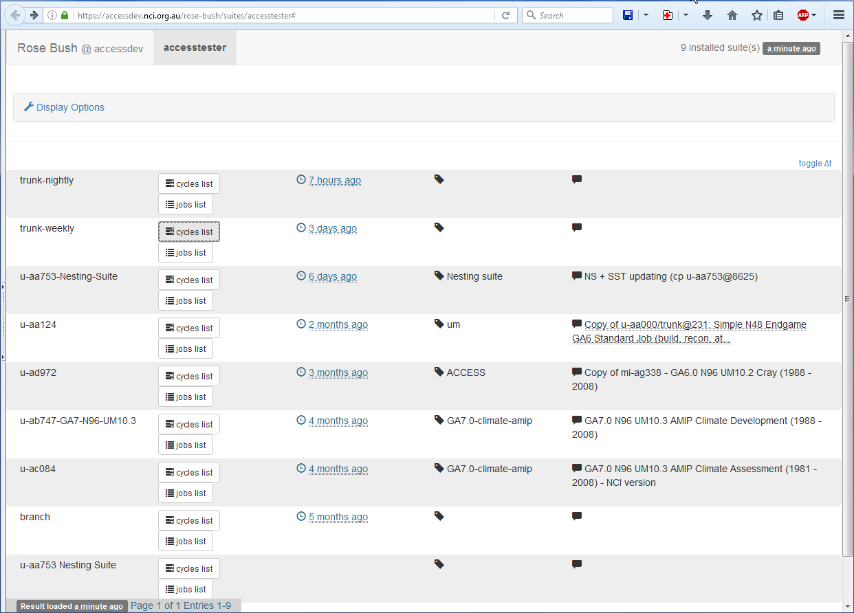
rose-stem testing
The Centre for Australian Weather and Climate Research
A partnership between CSIRO and the Bureau of Meteorology

Slide 28
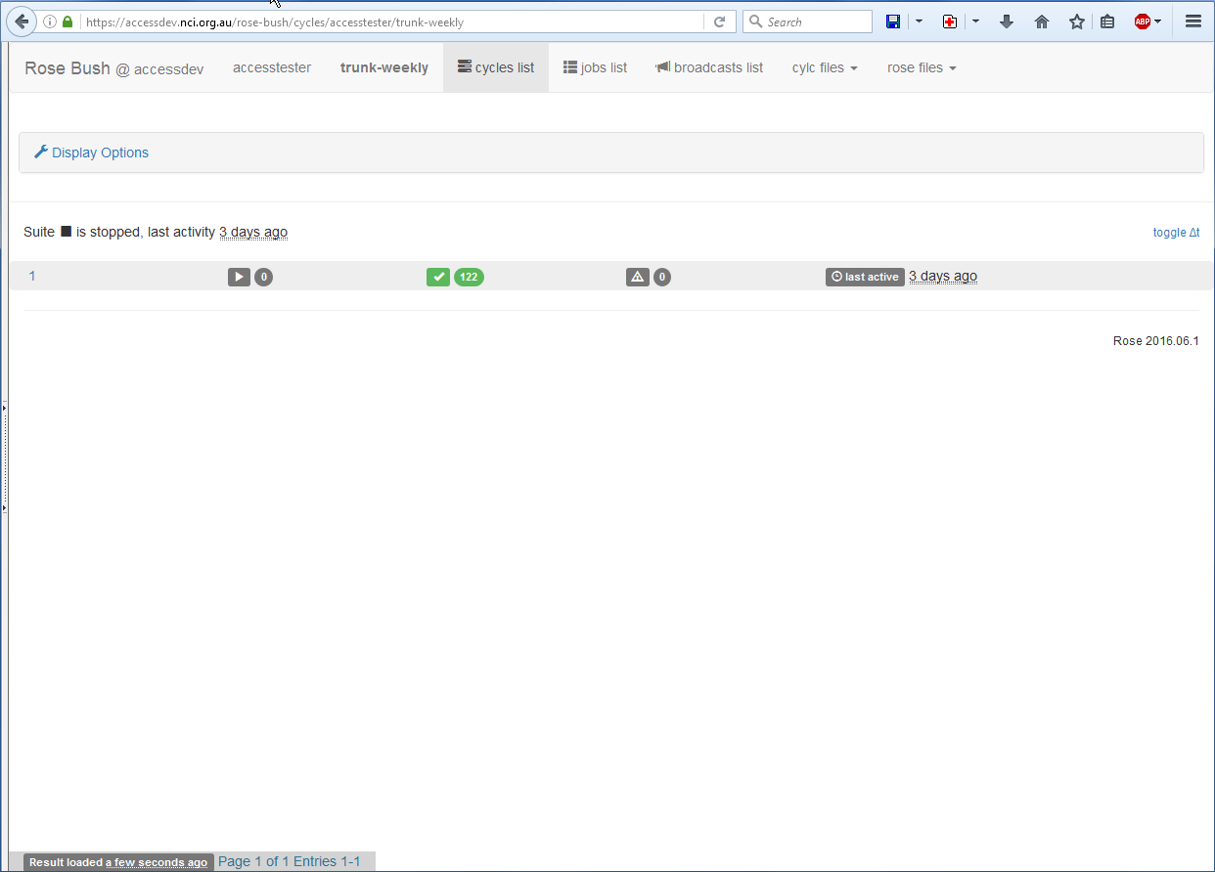
rose-stem testing
The Centre for Australian Weather and Climate Research
A partnership between CSIRO and the Bureau of Meteorology

Slide 29
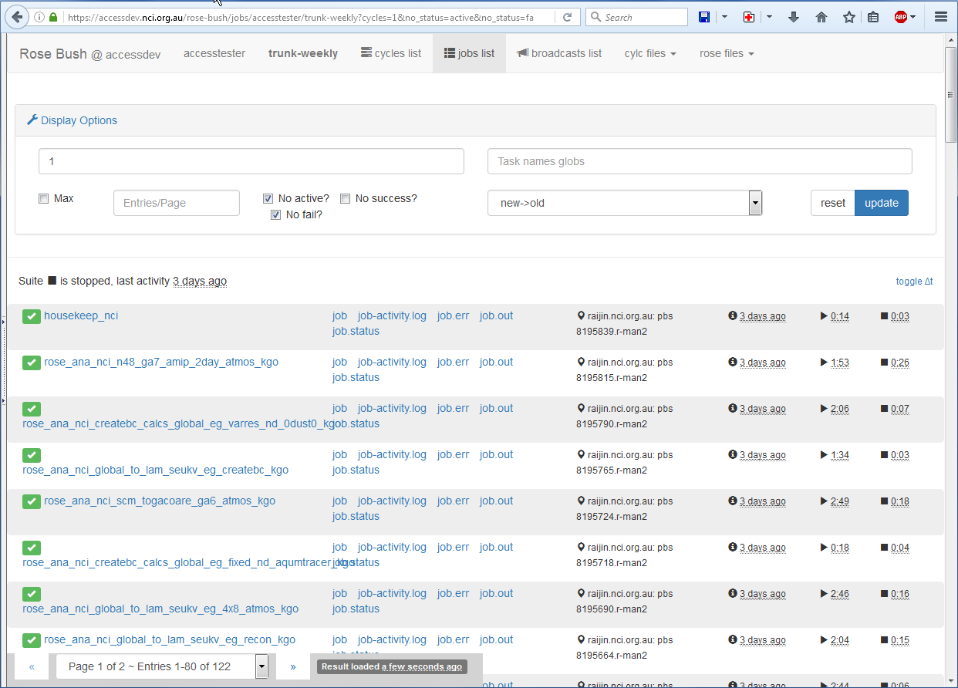
rose-stem testing
The Centre for Australian Weather and Climate Research
A partnership between CSIRO and the Bureau of Meteorology

Slide 30
Puppet on accessdev
Builds on NCI standard VM
When accessdev was set up, VMs didn’t support modules so we installed rose and cylc with puppet too
  Might choose to use modules if we were starting again?
Being able to create an identical test system (accessdev-test) is very useful
The Centre for Australian Weather and Climate Research
A partnership between CSIRO and the Bureau of Meteorology

Slide 31
Software dependencies
Python >= 2.6
sqlite
PyGTK
Graphviz & Pygraphviz
jinja2
pyro (included with cylc)
cherrypy
requests
sqlalchemy
simplejson
The Centre for Australian Weather and Climate Research
A partnership between CSIRO and the Bureau of Meteorology

Slide 32
Resource usage
During training in March accessdev was 4 CPUs, 16 GB
  Memory problems with ~ 50 active users
  Probably mainly from the GUIs
Accessdev now 4 CPUS, 32 GB (m1.large.2.r32 flavor)
top - 12:27:22 up 140 days, 18:32, 55 users, load average: 2.24, 1.64, 1.35
Tasks: 911 total, 1 running, 880 sleeping, 3 stopped, 27 zombie
Cpu(s): 16.3%us, 4.6%sy, 0.0%ni, 78.3%id, 0.3%wa, 0.0%hi, 0.3%si, 0.2%st
Mem: 32878856k total, 19585044k used, 13293812k free, 1291232k buffers
Swap: 0k total, 0k used, 0k free, 7506628k cached
Cylc has become much more memory and CPU efficient in recent versions
The Centre for Australian Weather and Climate Research
A partnership between CSIRO and the Bureau of Meteorology

Slide 33
Issues
Communications are tricky to set up
  Environment check script, but users still manage to find interesting ways to stop it working
Puppet slightly awkward for installing multiple versions when they need different site configuration files
  ok now that we understand it
Python 3 eventually
The Centre for Australian Weather and Climate Research
A partnership between CSIRO and the Bureau of Meteorology

