Slide 1
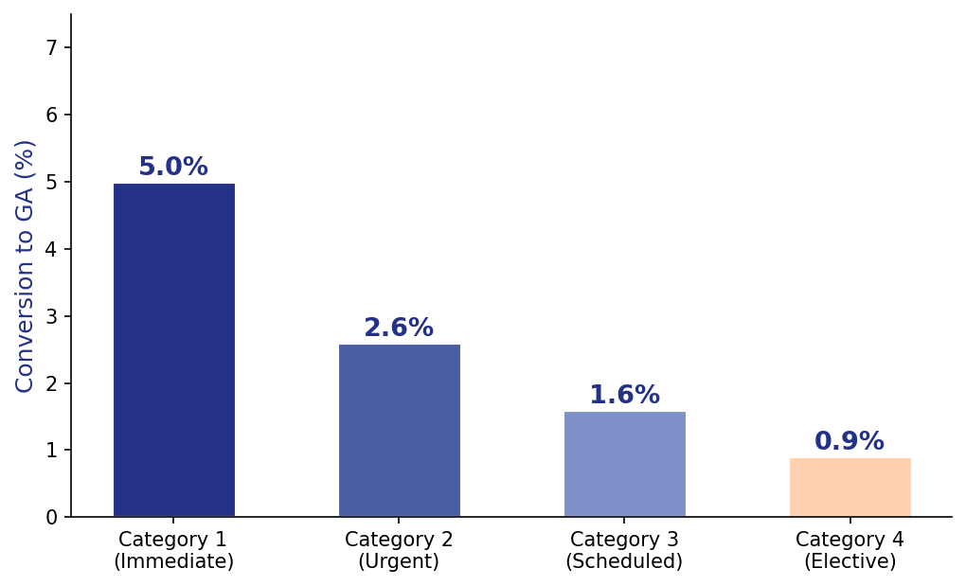
Regional Anaesthesia Failure in 5080 Caesarean Sections
Category 1 CS carries a 5% conversion rate to GA — nearly 6× higher than elective cases.
Kinsella SM, Anaesthesia 2008

Slide 2
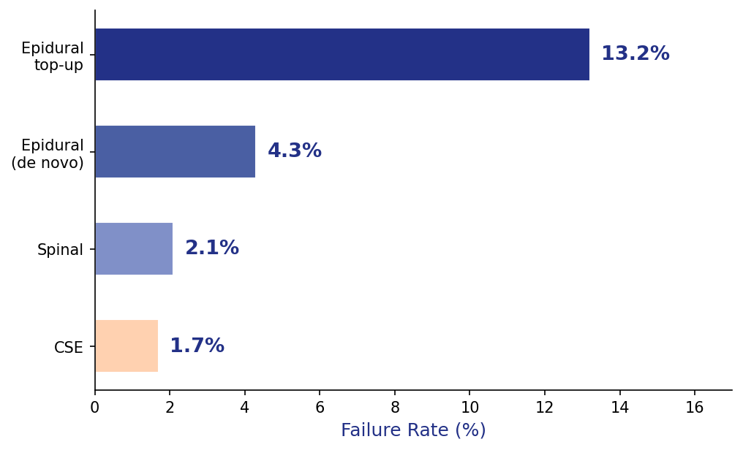
Neuraxial Failure Rate by Anaesthetic Technique
Epidural top-up carries the highest failure rate (13.2%); CSE is the most reliable neuraxial technique.
Kinsella SM, Anaesthesia 2008

Slide 3
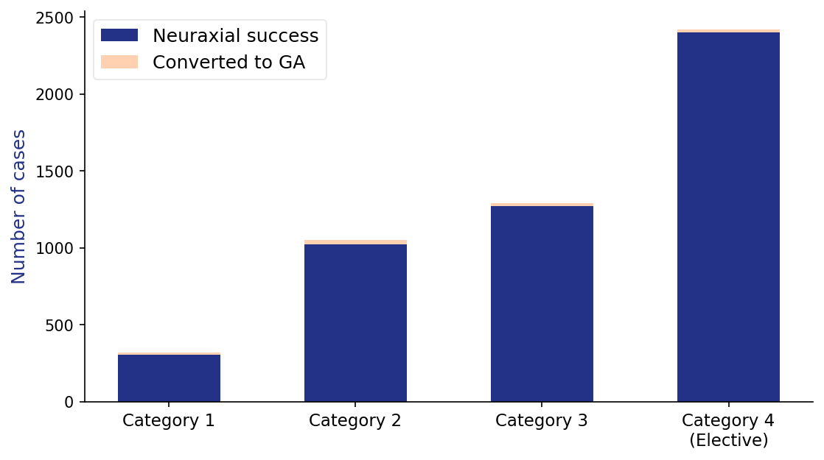
Neuraxial Success vs. GA Conversion: All 5080 Cases
Neuraxial anaesthesia was overwhelmingly successful in elective cases; GA conversions clustered in the most urgent emergencies.
Kinsella SM, Anaesthesia 2008

Slide 4
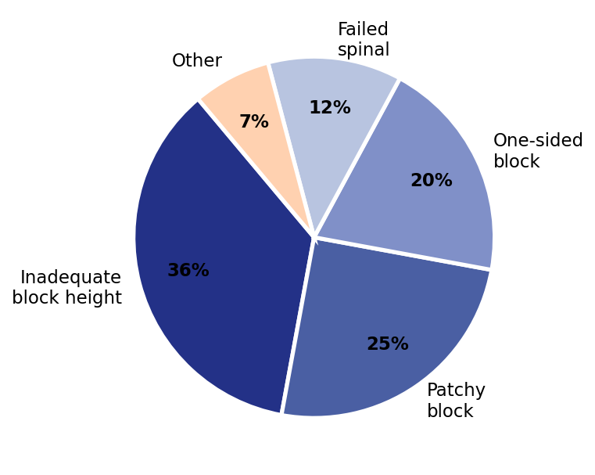
Causes of Regional Anaesthesia Failure
Inadequate block height accounts for over a third of all failures; patchy and unilateral blocks are also common.
Kinsella SM, Anaesthesia 2008

Slide 5
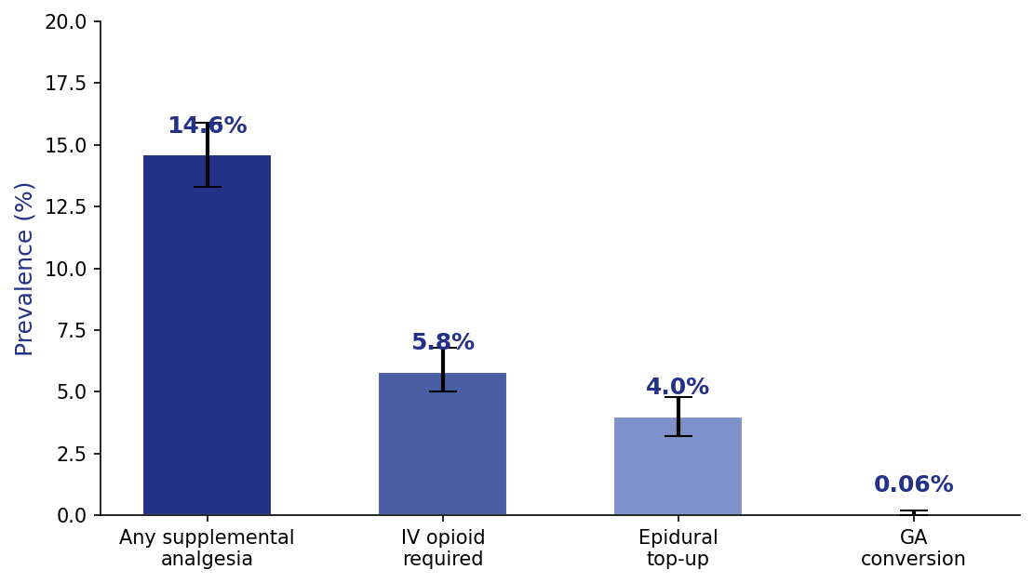
Inadequate Neuraxial Anaesthesia: Prevalence Across 54 RCTs
1 in 7 women required supplemental analgesia during elective CS — even with optimal (≥ED95) neuraxial dosing.
Patel R, Anaesthesia 2022

Slide 6
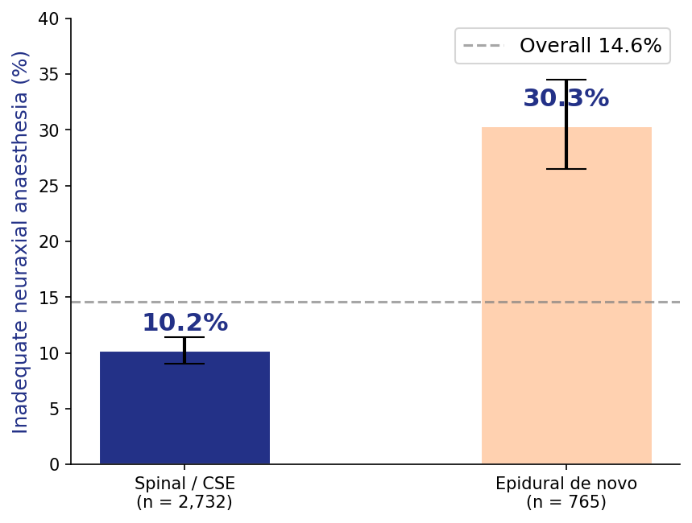
Spinal/CSE vs. Epidural: Rate of Inadequate Anaesthesia
Epidural anaesthesia is 3× more likely to require supplementation than spinal or CSE (30.3% vs. 10.2%).
Patel R, Anaesthesia 2022

Slide 7
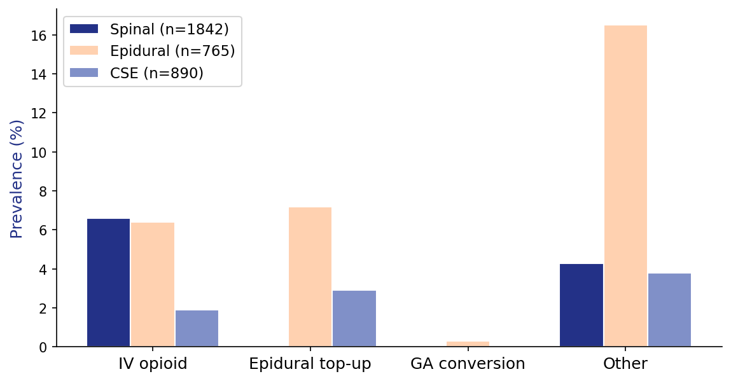
Type of Supplemental Intervention by Neuraxial Technique
Epidural technique shows excess supplementation across all categories, especially 'other' (16.5%) vs. spinal (4.3%).
Patel R, Anaesthesia 2022

Slide 8
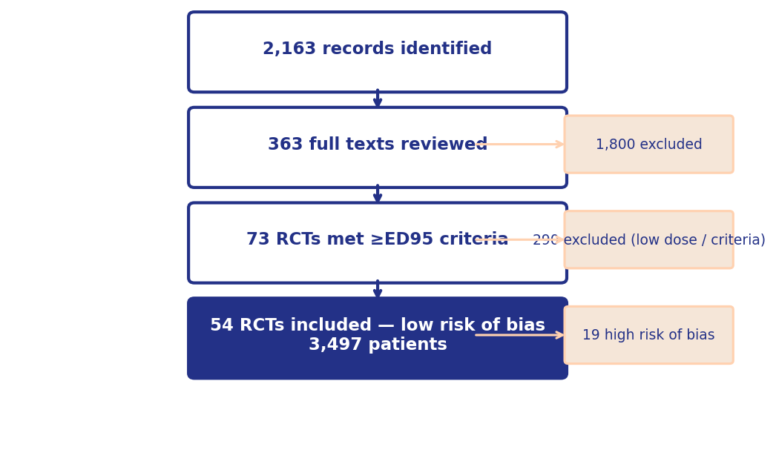
Systematic Review: Literature Search and Selection
Only RCTs using ≥ED95 neuraxial doses were included — ensuring the highest-quality evidence base for prevalence estimates.
Patel R, Anaesthesia 2022

Slide 9
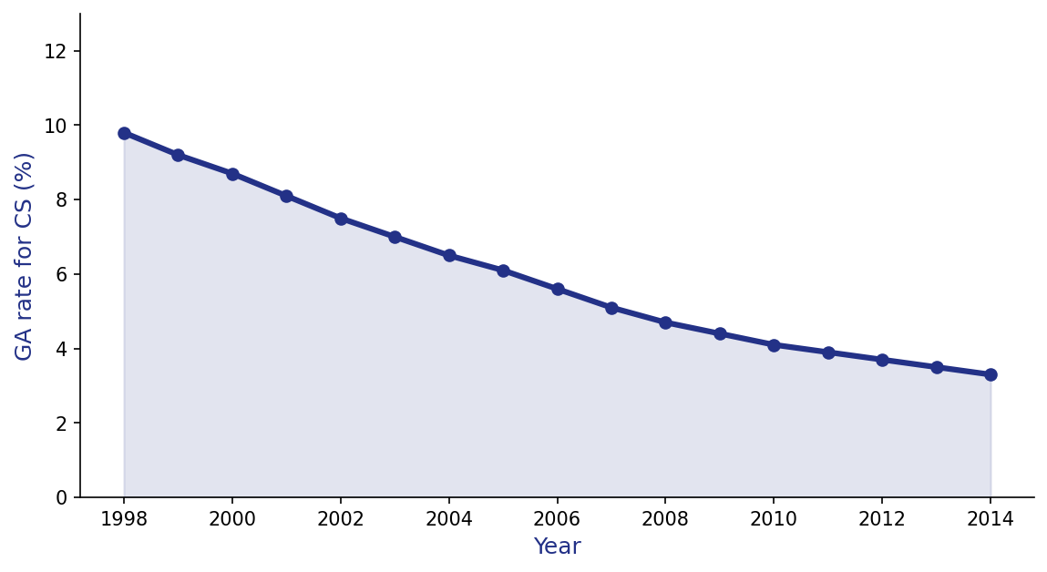
National Trends in General Anaesthesia for Caesarean Delivery: USA
US national GA rates for CS fell by two-thirds over 17 years — driven by anaesthesia training, epidural uptake, and patient safety initiatives.
Juang P, Anesthesiology 2017

Slide 10
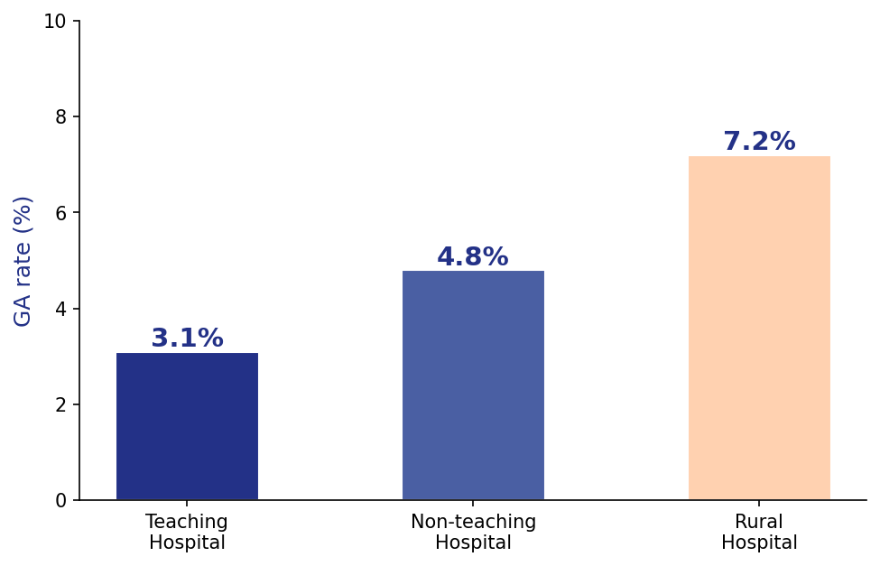
General Anaesthesia Rates by Hospital Type
Rural hospitals have twice the GA rate of academic centres, reflecting workforce and resource disparities across the healthcare system.
Juang P, Anesthesiology 2017

Slide 11
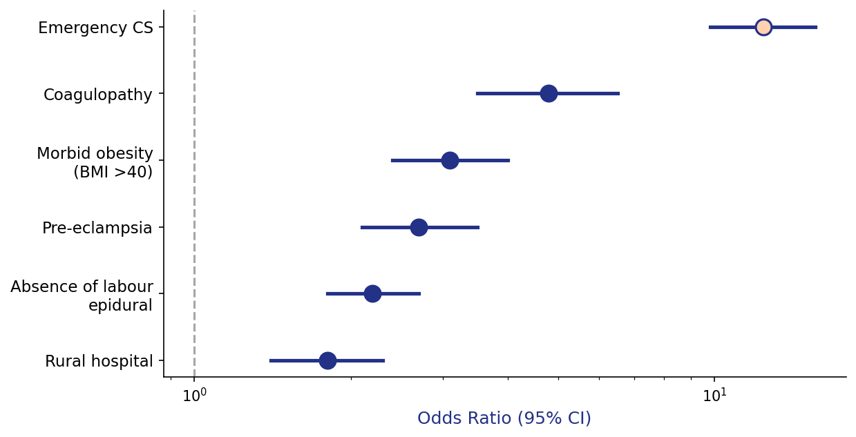
Risk Factors for General Anaesthesia: Adjusted Odds Ratios
Emergency CS is the dominant risk factor; absence of a functioning labour epidural is the largest modifiable risk for GA.
Juang P, Anesthesiology 2017

Slide 12
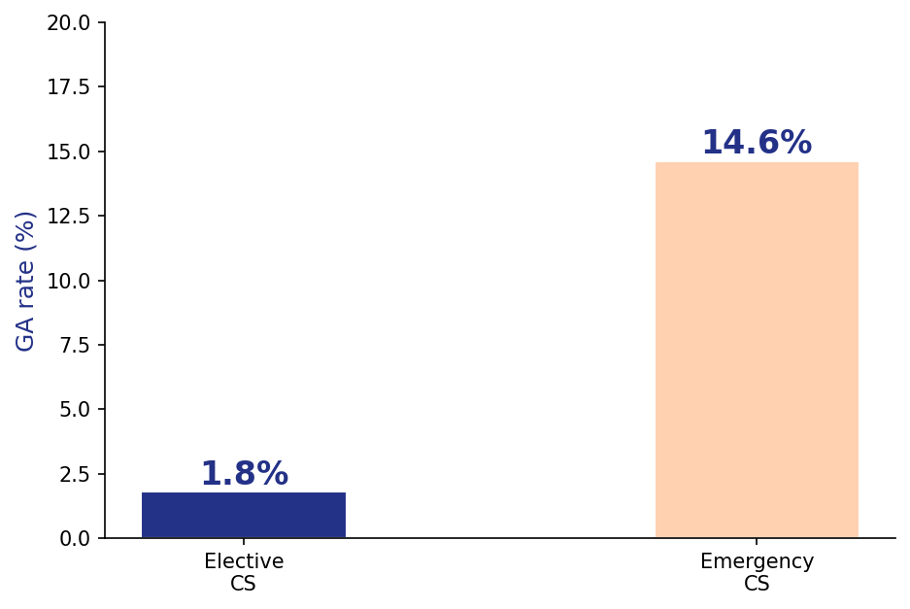
GA Rate: Elective vs. Emergency Caesarean Delivery
Emergency CS carries an 8-fold higher GA rate than elective — underscoring the role of planning, preanesthesia assessment, and labour epidural.
Juang P, Anesthesiology 2017

Slide 13
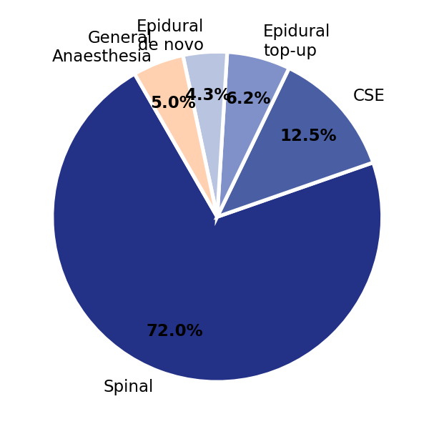
Anaesthetic Techniques for CS: National UK Survey
Spinal anaesthesia dominates UK practice (72%); GA represents 5% — used for contraindications and failed neuraxial techniques.
Shibli K, RCoA National Audit 2019

Slide 14
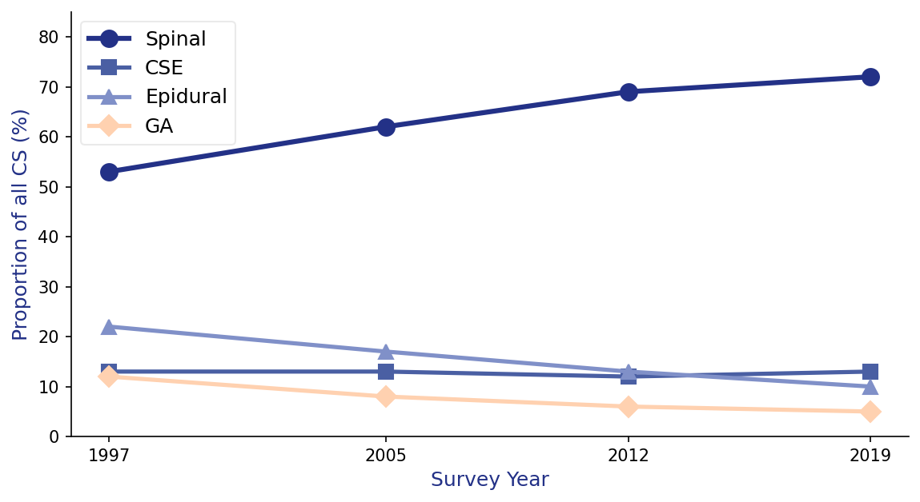
Trends in Anaesthetic Technique: UK Surveys 1997–2019
Spinal use has risen steadily; GA rates have halved from 12% to 5% — representing a major patient safety improvement over two decades.
Shibli K, RCoA National Audit 2019

Slide 15
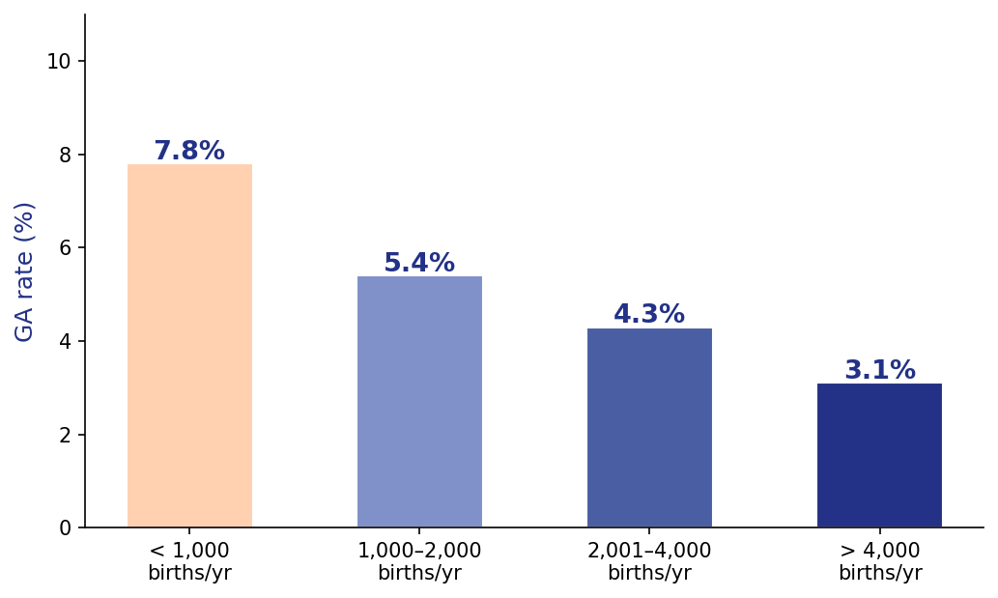
GA Rate by Obstetric Unit Volume
High-volume units consistently achieve lower GA rates — reflecting the protective effect of specialist obstetric anaesthesia expertise.
Shibli K, RCoA National Audit 2019

Slide 16
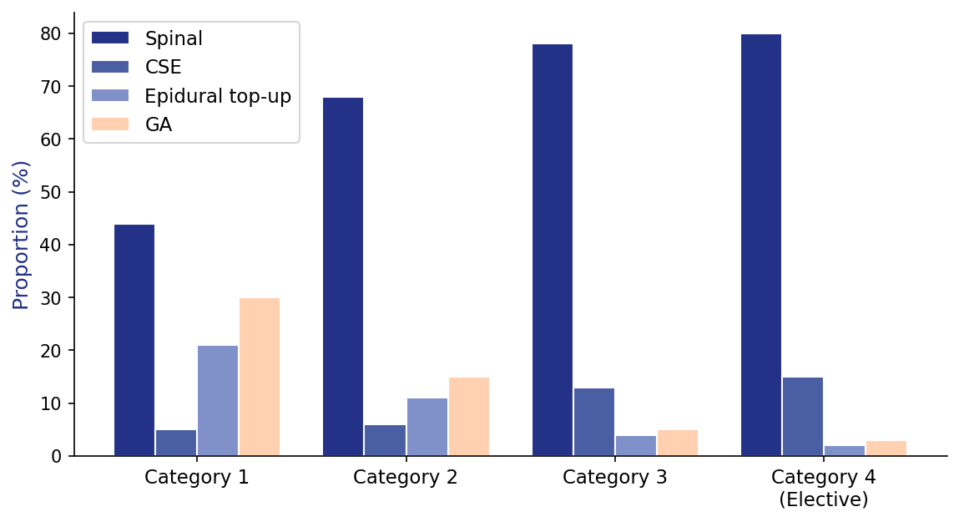
Anaesthetic Technique by Urgency of Caesarean Section
GA is used in ~30% of Category 1 cases; as urgency falls, spinal becomes dominant — highlighting the importance of pre-existing neuraxial access.
Shibli K, RCoA National Audit 2019

Slide 17
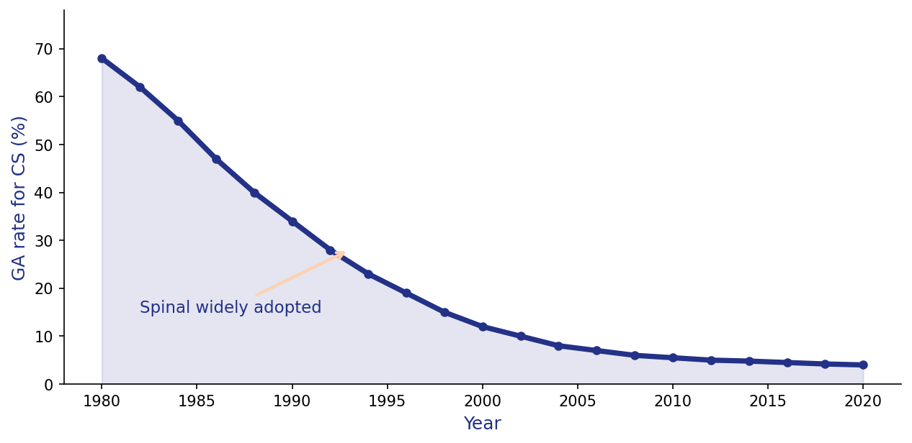
40 Years of Change: GA Rates for Caesarean Delivery in the UK
GA fell from ~70% in the 1980s to <5% by 2020 — one of the most dramatic patient safety transformations in modern anaesthesia.
OAA/AAGBI Workforce Survey, 2021

Slide 18
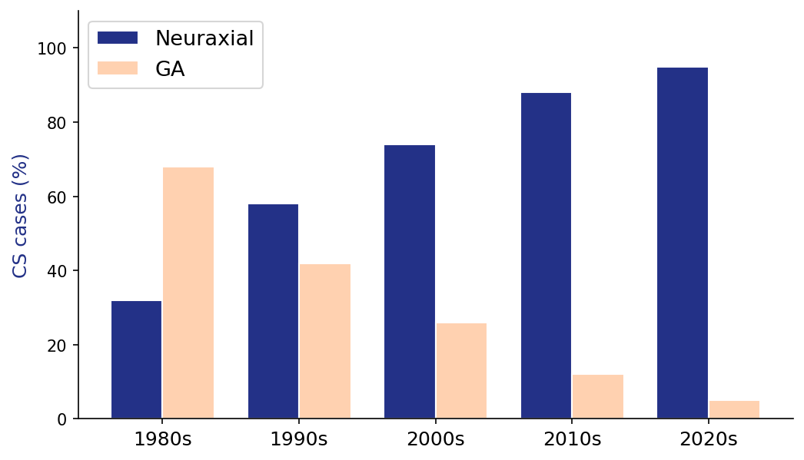
Neuraxial Anaesthesia: From Minority to Standard of Care
By the 2020s, neuraxial anaesthesia is standard of care for CS, with GA reserved for absolute contraindications.
OAA/AAGBI Workforce Survey, 2021

Slide 19
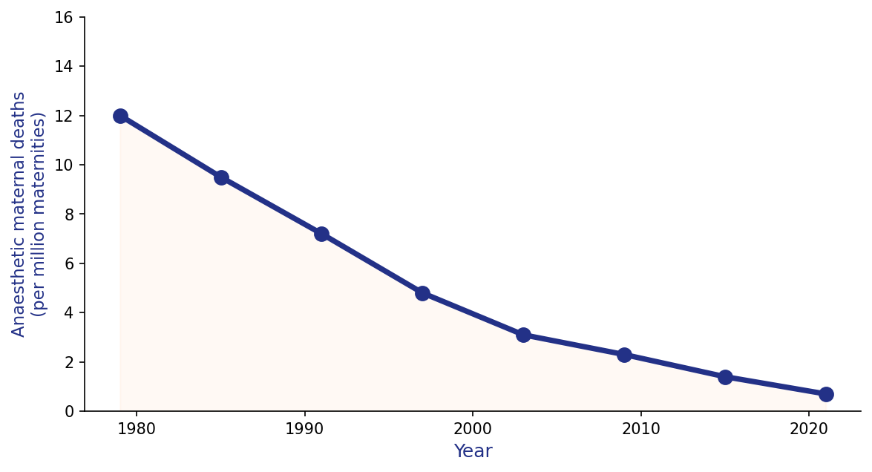
Decline in Anaesthesia-Related Maternal Mortality
Anaesthesia-related maternal mortality has fallen 17-fold over 40 years, tracking the rise of neuraxial techniques.
OAA/AAGBI Workforce Survey, 2021

Slide 20
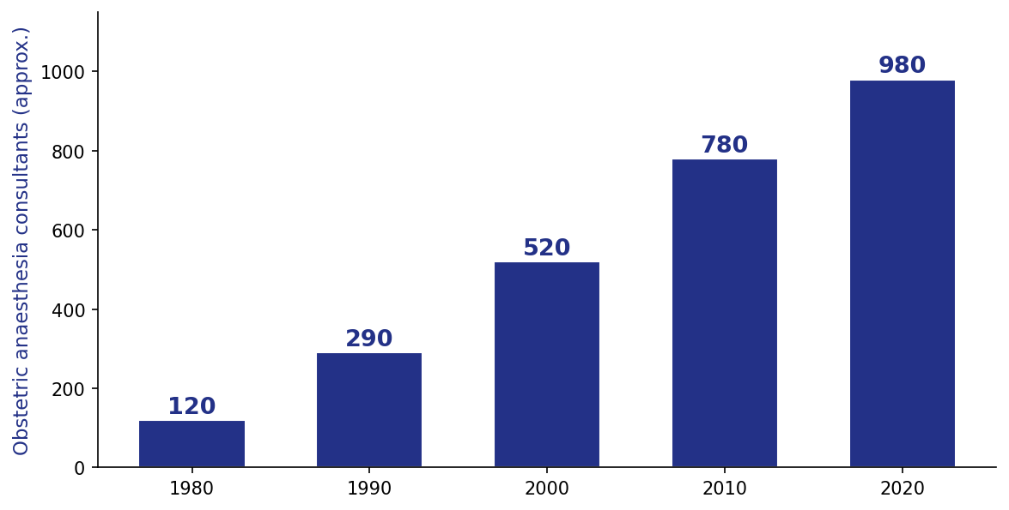
Obstetric Anaesthesia Workforce Growth Over 40 Years
The specialist obstetric anaesthesia workforce has grown 8-fold over 40 years — the structural foundation of the shift away from GA.
OAA/AAGBI Workforce Survey, 2021

Slide 21
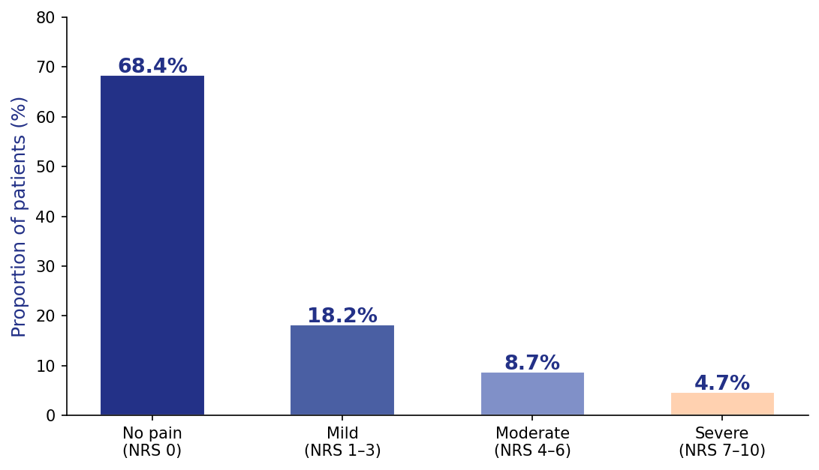
Patient-Reported Intraoperative Pain During Caesarean Delivery
31.6% of women report pain during CS; 4.7% experience severe pain (NRS ≥7) despite neuraxial anaesthesia.
Charles LF, Anesthesiology 2024

Slide 22
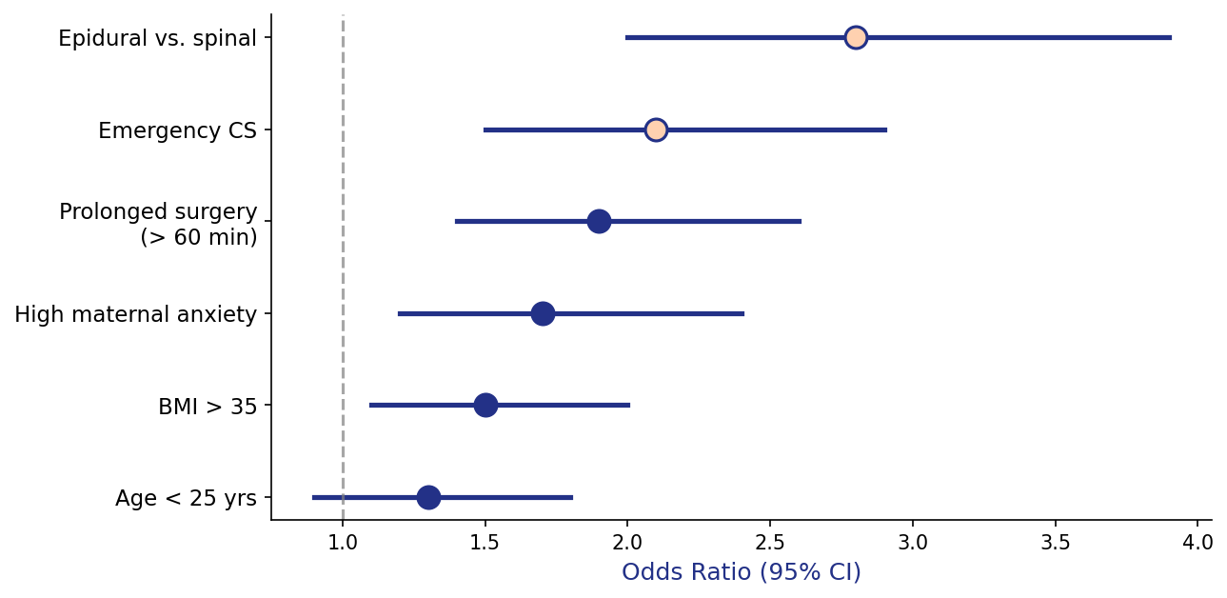
Risk Factors for Intraoperative Pain During CS
Epidural anaesthesia and emergency surgery are the strongest independent risk factors for patient-reported intraoperative pain.
Charles LF, Anesthesiology 2024

Slide 23
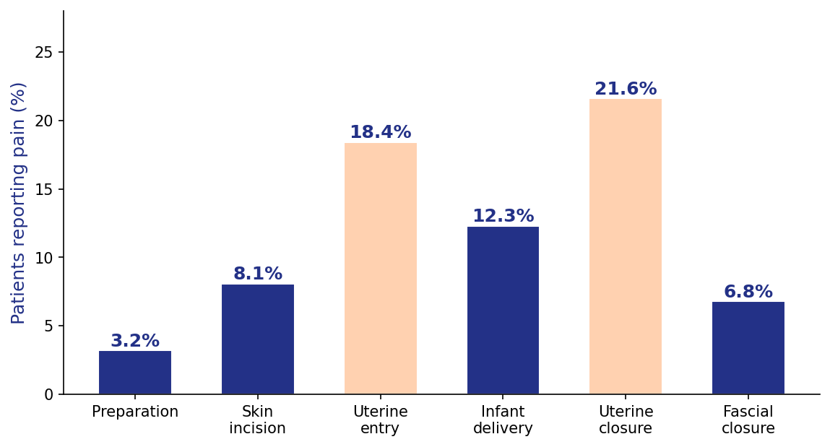
Intraoperative Pain: Timing by Surgical Phase
Pain peaks during uterine closure — the most under-recognised phase of surgery for patient discomfort.
Charles LF, Anesthesiology 2024

Slide 24
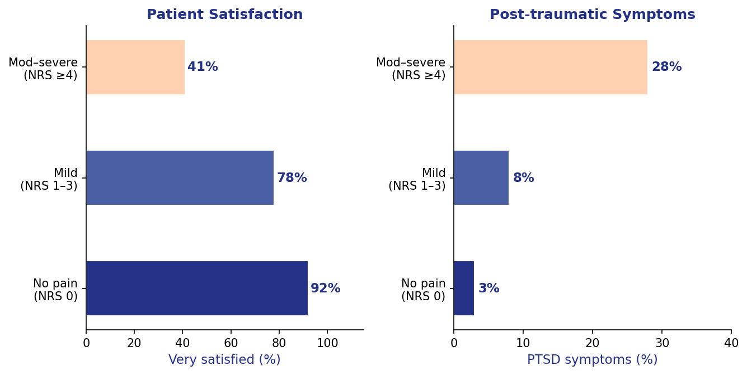
Intraoperative Pain and Maternal Outcomes
Moderate-to-severe pain halves patient satisfaction and is associated with a 9-fold increase in post-traumatic symptoms.
Charles LF, Anesthesiology 2024

Slide 25
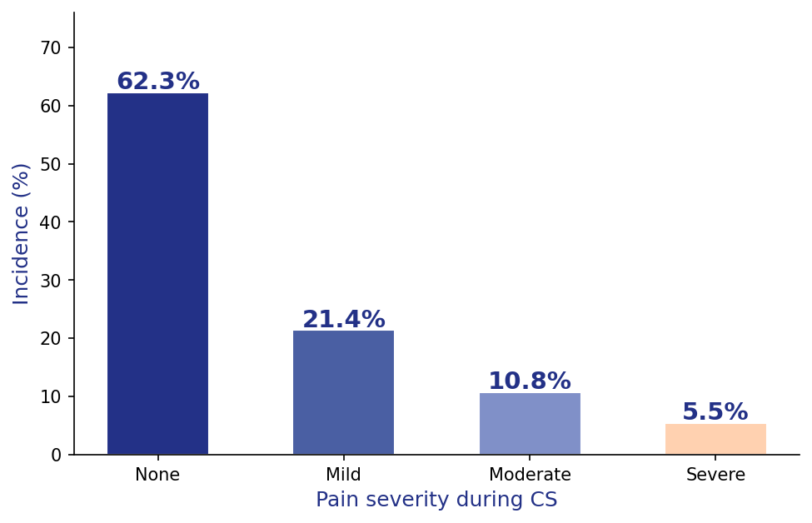
Incidence of Intraoperative Pain During CS: National Study
37.7% of women experience intraoperative CS pain; >1 in 20 report severe pain — representing hundreds of thousands globally each year.
O'Carroll JE, Anesthesiology 2025

Slide 26
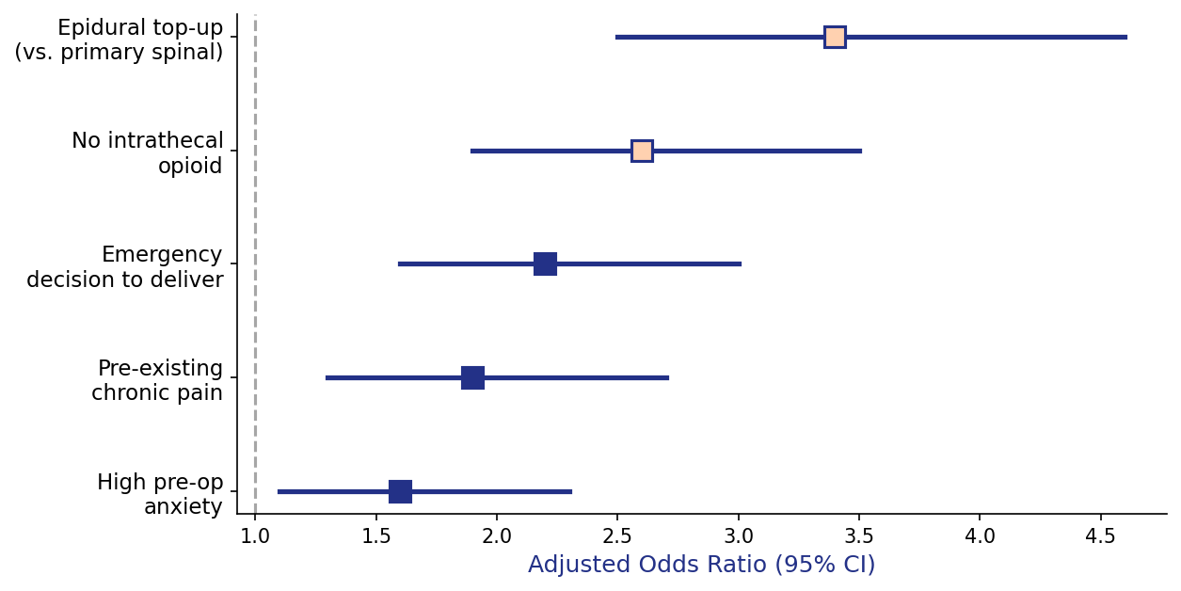
Predictors of Severe Intraoperative Pain: Adjusted Odds Ratios
Epidural top-up is the strongest predictor of severe pain — reinforcing the benefit of a primary spinal or well-functioning epidural.
O'Carroll JE, Anesthesiology 2025

Slide 27
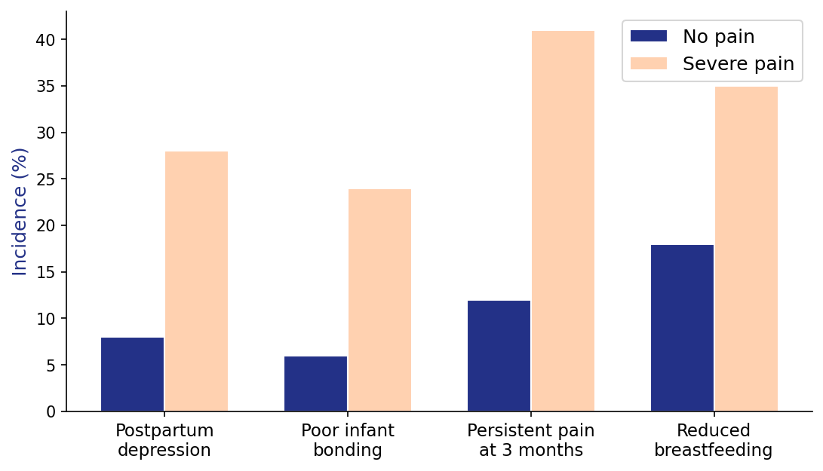
Intraoperative CS Pain and Postnatal Outcomes
Severe intraoperative pain is associated with a 3.5-fold increase in postpartum depression and 4-fold increase in poor infant bonding.
O'Carroll JE, Anesthesiology 2025

Slide 28
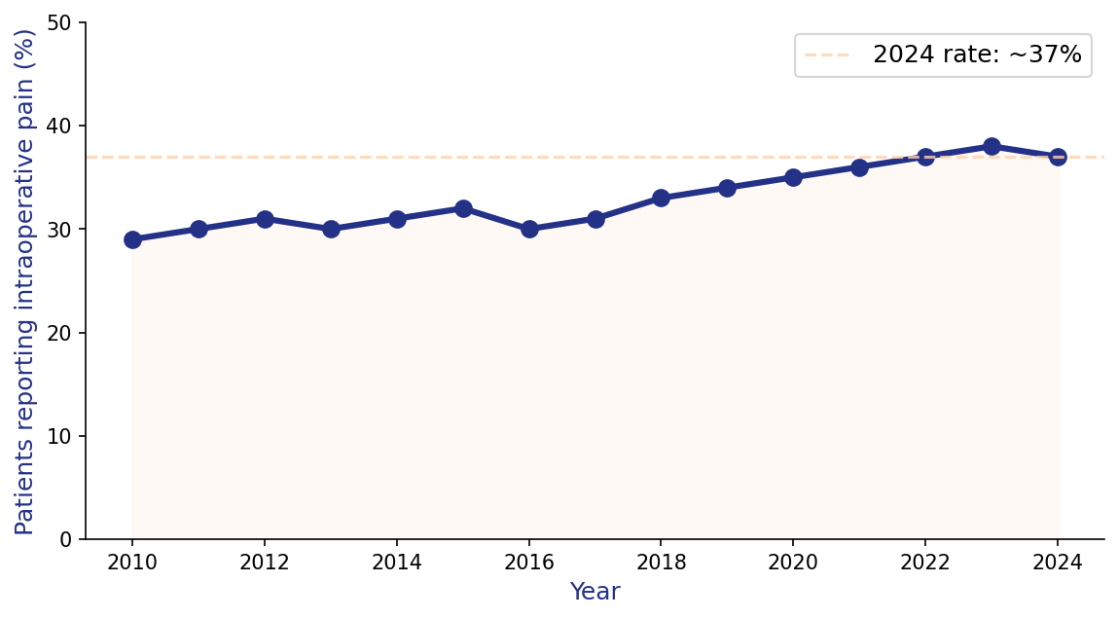
Reported Intraoperative Pain Has NOT Declined: 2010–2024
Unlike GA rates, the incidence of intraoperative CS pain has not fallen over 15 years — an unresolved quality gap in obstetric care.
O'Carroll JE, Anesthesiology 2025

Slide 29
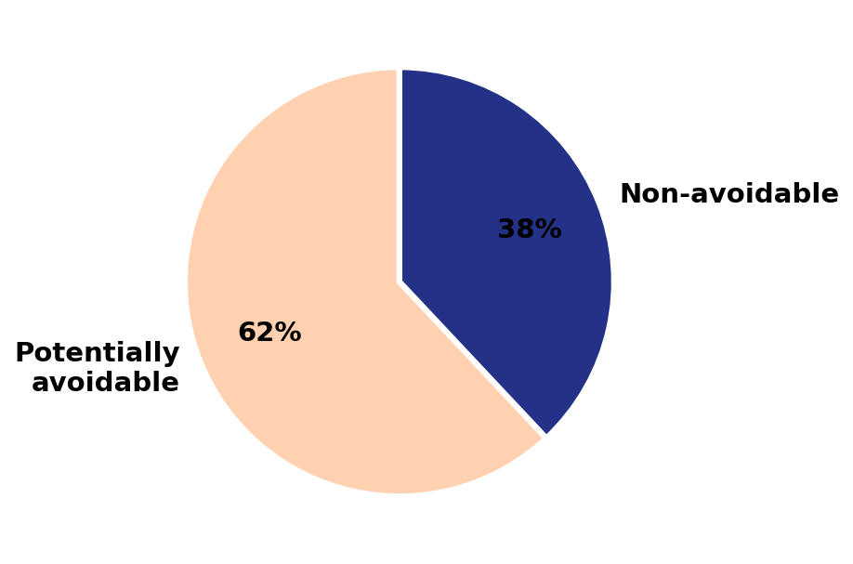
What Proportion of General Anaesthetics for CS are Avoidable?
An estimated 62% of GAs for CS are potentially avoidable with better preparation, adequate epidural access in labour, and specialist staffing.
Guglielminotti J, Anesthesiology 2019

Slide 30
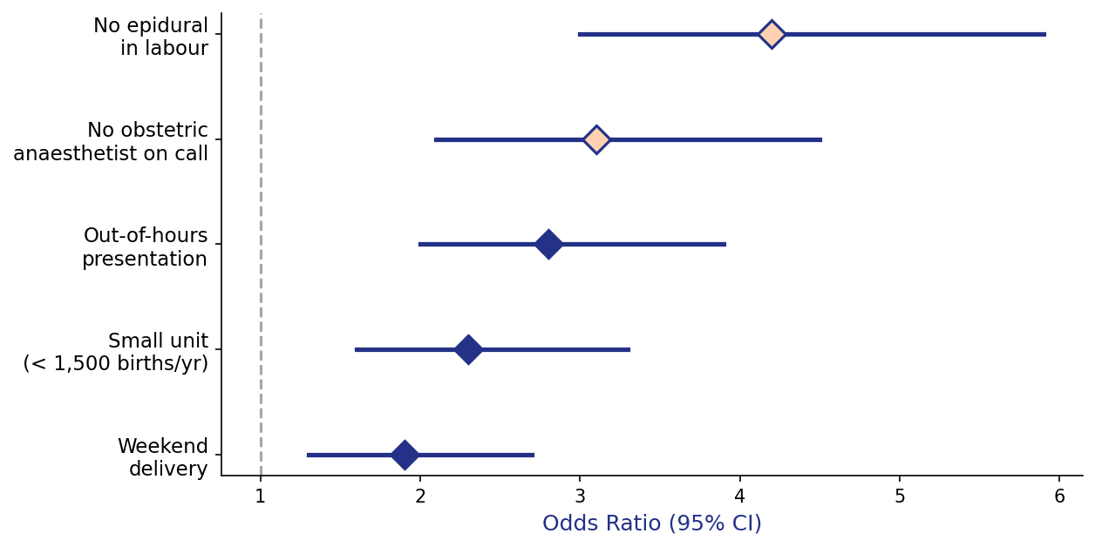
Risk Factors for Avoidable GA: Adjusted Odds Ratios
Absence of a functioning labour epidural is the most powerful avoidable risk factor — reinforcing the value of early epidural analgesia.
Guglielminotti J, Anesthesiology 2019

Slide 31
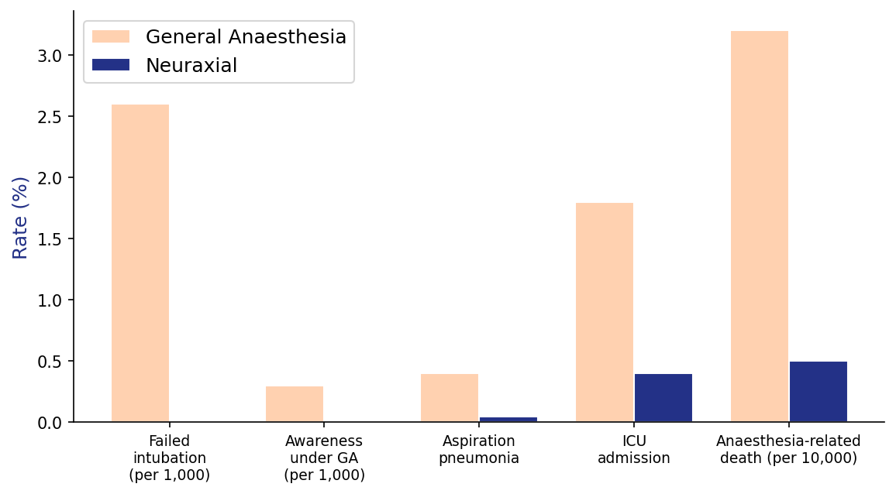
Maternal Complication Rates: GA vs. Neuraxial Anaesthesia for CS
GA for CS carries substantially higher complication rates — every avoidable GA prevented reduces maternal risk.
Guglielminotti J, Anesthesiology 2019

Slide 32
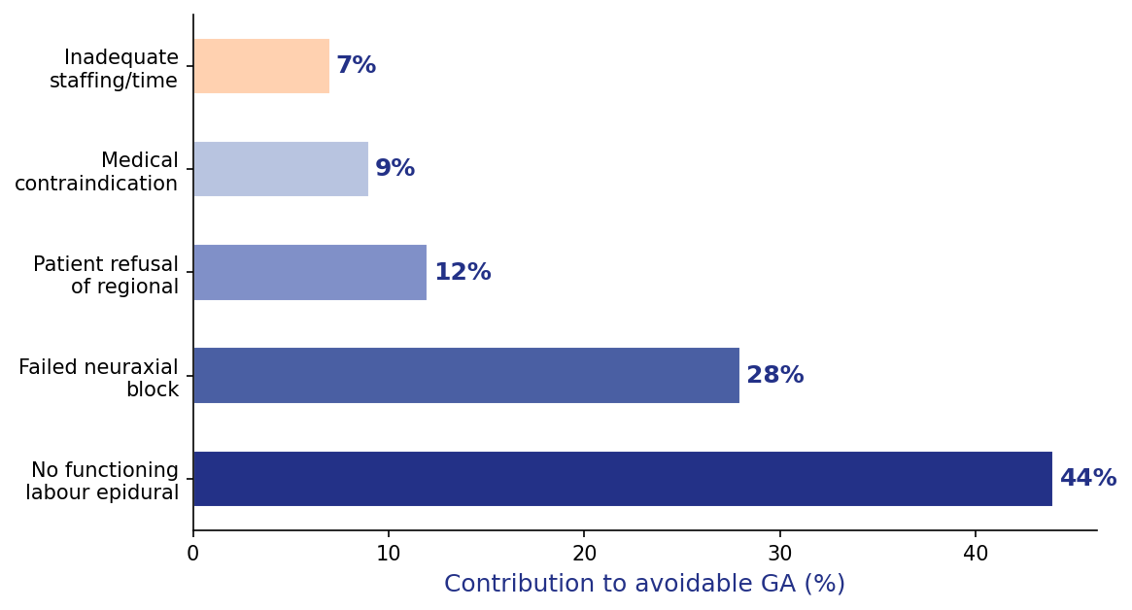
System-Level Factors Contributing to Avoidable GA
44% of avoidable GAs stem from no functioning epidural — making epidural maintenance a core patient safety priority in labour.
Guglielminotti J, Anesthesiology 2019

Slide 33
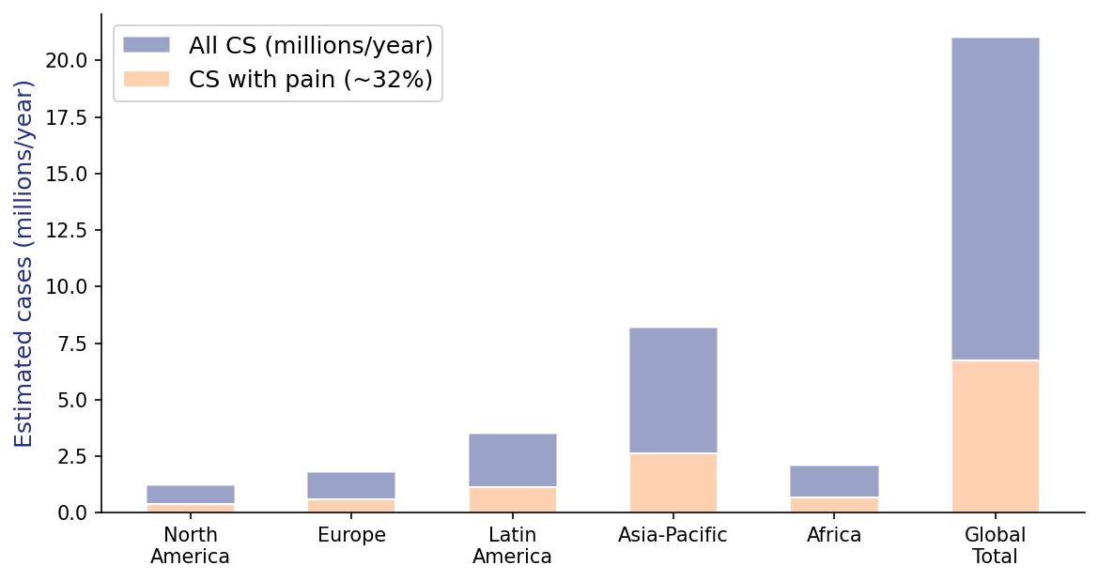
Intraoperative CS Pain: A Global Patient Safety Problem
Over 6 million women may experience pain during CS each year globally — one of the most common preventable surgical harms in medicine.
Sultan P & Landau R, Int J Obstet Anesth 2025

Slide 34
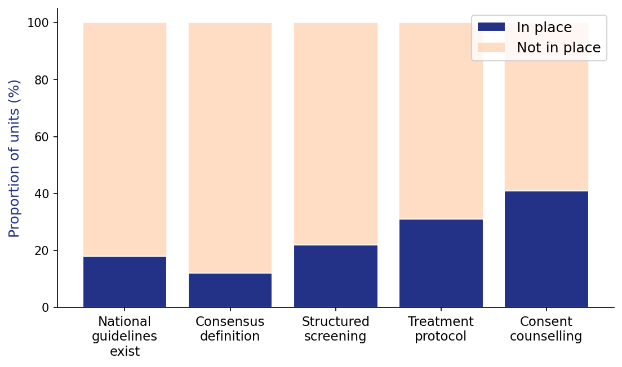
The Clinical Management Gap: Pain During CS
Most obstetric units lack guidelines, standardised definitions, and treatment protocols for pain during CS — a critical unmet need.
Sultan P & Landau R, Int J Obstet Anesth 2025

Slide 35
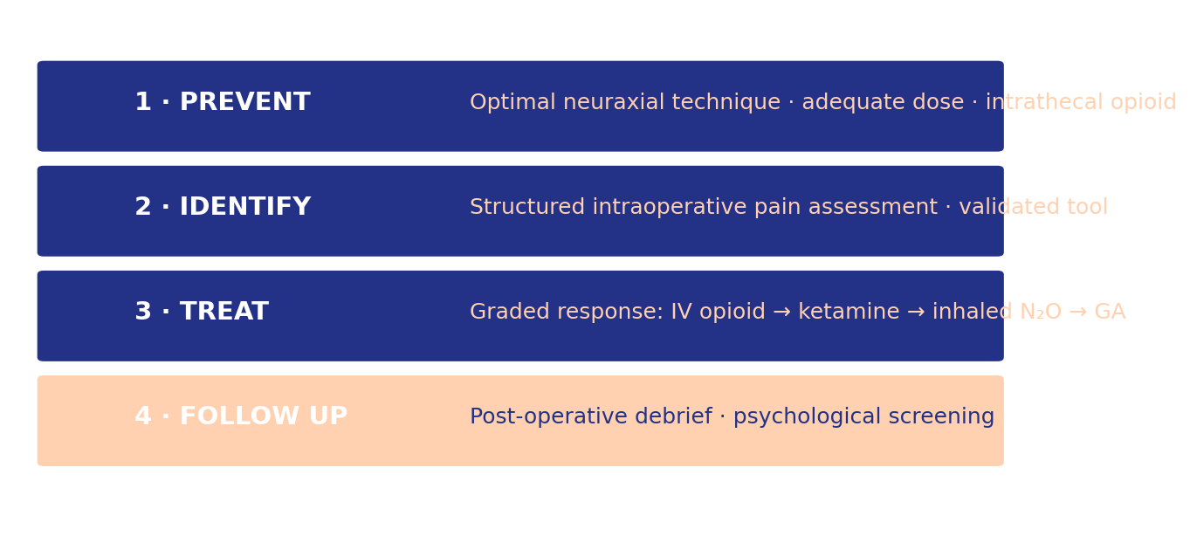
A Framework for Preventing and Managing Intraoperative CS Pain
Sultan P & Landau R, Int J Obstet Anesth 2025

Slide 36
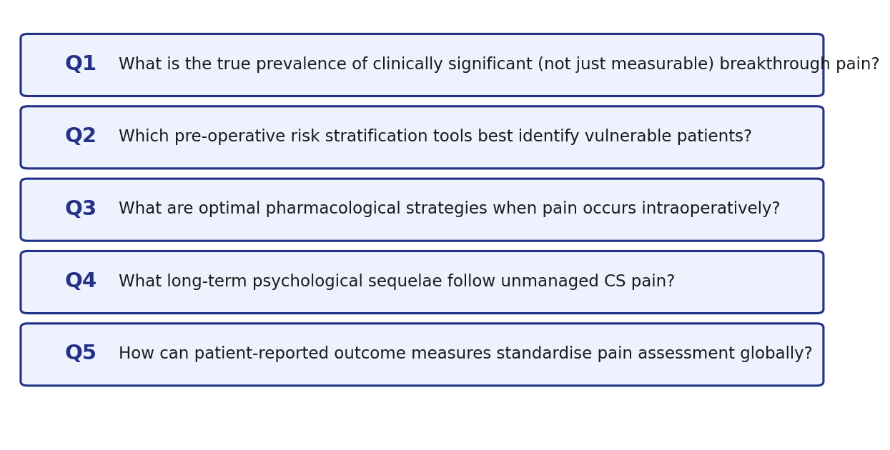
Priority Research Agenda: Intraoperative CS Pain
Sultan P & Landau R, Int J Obstet Anesth 2025

Slide 37
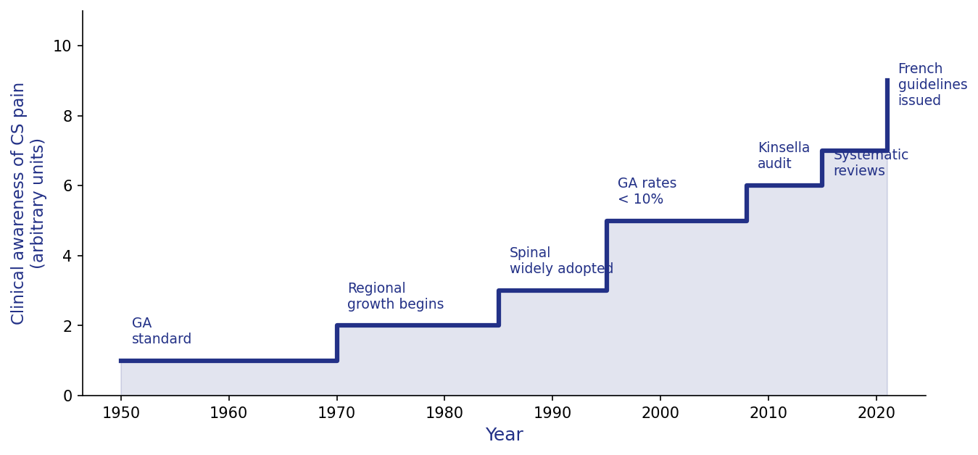
Are We Finally Tackling CS Pain? — Historical Context
Despite 40 years of growing awareness, standardised management of intraoperative CS pain was absent from most guidelines until 2021.
Landau R & Janvier AS, Anaesth Crit Care Pain Med 2021

Slide 38
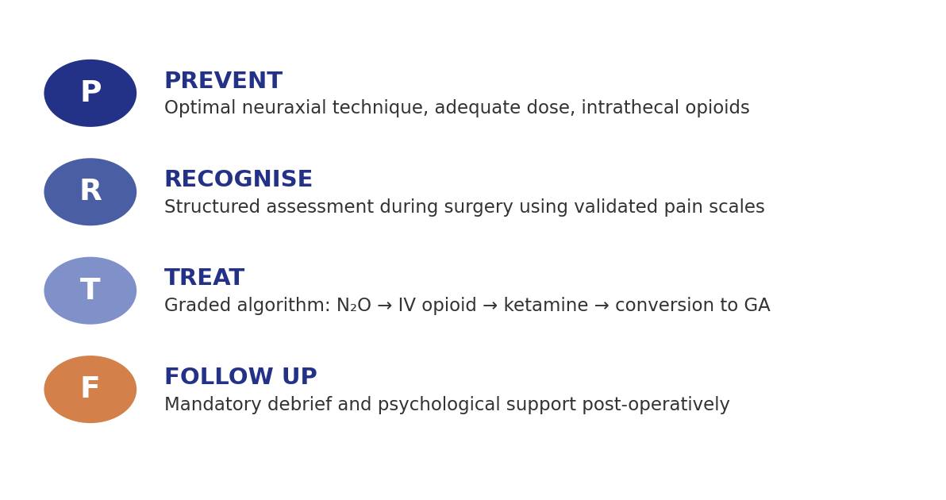
French Practice Bulletin: A Model for Global Adoption
Landau R & Janvier AS, Anaesth Crit Care Pain Med 2021

Slide 39
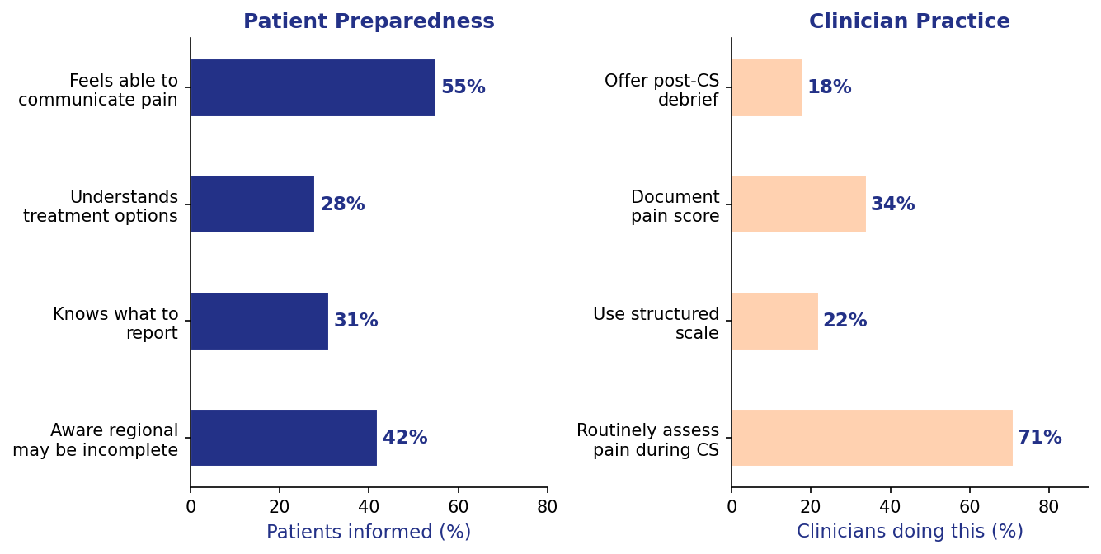
Informing Patients: The Consent Challenge
Most women are unprepared for intraoperative CS pain, and structured intraoperative pain assessment is absent from most clinical units.
Landau R & Janvier AS, Anaesth Crit Care Pain Med 2021

Slide 40
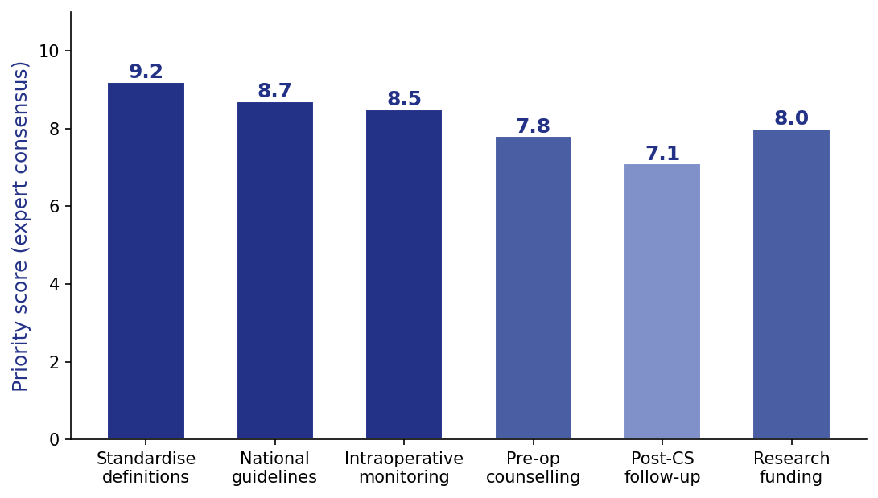
Priorities for Improving CS Anaesthesia Quality
Expert consensus identifies national guidelines and standardised intraoperative monitoring as the highest-priority actions to improve CS pain management.
Landau R & Janvier AS, Anaesth Crit Care Pain Med 2021

