Slide 1




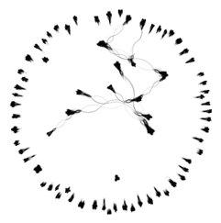
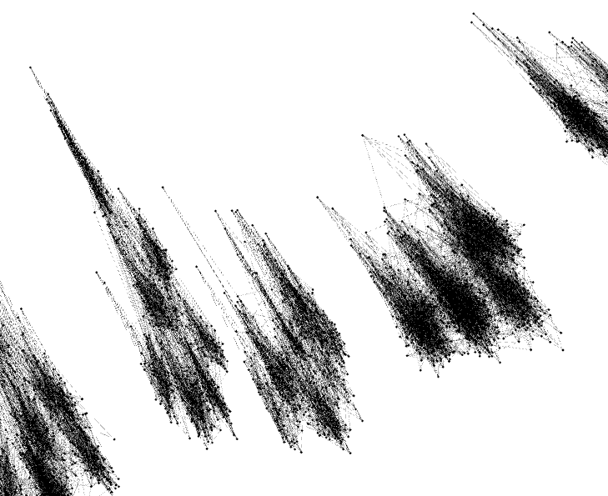
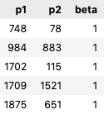
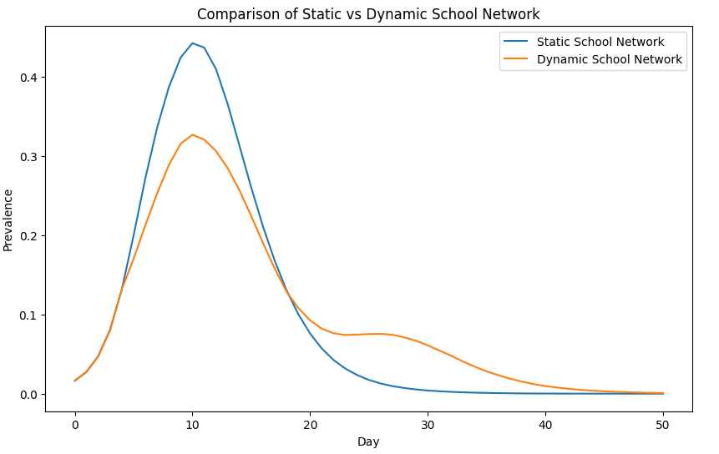
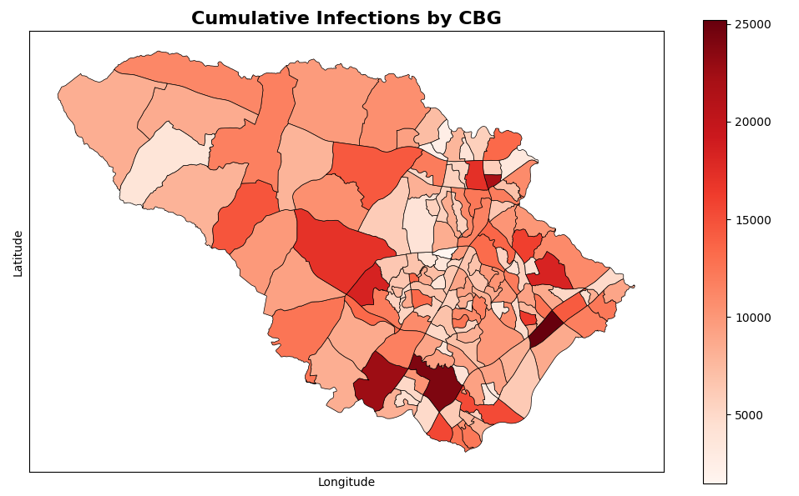
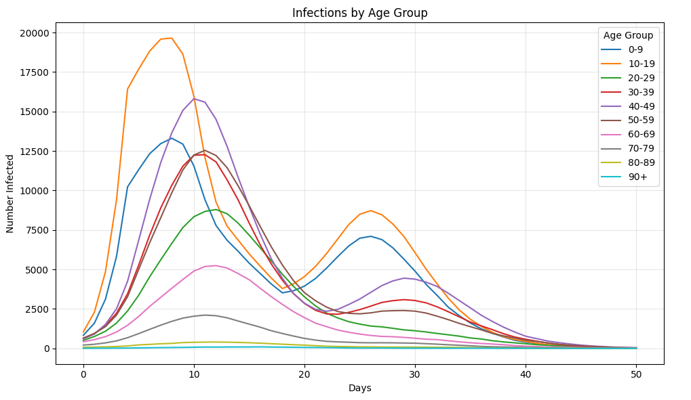
GeoPops demonstration: An open-source, adaptable framework for agent-based modeling on synthetic populations
Alisa Hamilton¹, Alexander Tulchinsky², Cliff Kerr³, Eili Klein^{1,2}, Lauren Gardner¹
¹Johns Hopkins University, ²One Health Trust, ³Institute for Disease Modeling
ahamil33@jh.edu
Definition
github.com/ACCIDDA/GeoPops
GeoPops¹ is an open-source tool for generating geographically and demographically realistic synthetic populations for any US Census area from publicly available data with associated home, school, workplace, and group quarters (GQ) networks. GeoPops has the same underlying methodology as GREASYPOP-CO² with the following changes:
Wrapped in convenient Python package
Can be pip installed
Compatibility with Census data beyond 2019 (still developing)
Automated data downloading
Users can adjust all config parameters from the front-end
Compatibility with the agent-based modeling software Starsim³
pypi.org/project/geopops
Methodology
Usage
Step 1: Generate individuals within households
Code
Attributes | Combinatorial Optimization (CO)
Age Gender Race/ethnicity Worker status Student status School grade Commuter status Income category Workplace category Home CBG School CBG Workplace CBG
Example for Howard County, MD
import geopops pars = {'path’: ‘YOUR_OUTPUT_DIR’, # Where you want outputs 'census_api_key’: “YOUR_KEY", # Census API key 'main_year': 2019, # main year 'geos': [24027], # state or county fips of main geo 'commute_states': [24], # states where people commute 'use_pums': [24]} # pums state to download geopops.WriteConfig(**pars) # Set parameters geopops.DownloadData() # Downloads raw data files geopops.ProcessData() # Preprocessing for next steps geopops.RunJulia() # CO, network generation, export to csv geopops.ForStarsim() # Format for Starsim
Public Use Microdata
Samples (PUMS)
CO samples households from PUMS until a set is found that reasonably matches ACS targets
American Community Survey (ACS)
Step 2: School and Workplace Assignment
Outputs
 | Methods | Data | Data Sources
Schools | Students assigned to closest school that offered required grade Teachers assigned to school by selecting teachers from nearby CBGs | Student and staff counts for each grade level in public schools | National Center for Education Statistics (NCES)
Workplaces | Iterative proportional fitting (IPF) to make origin-destination commute matrix IPF to make industry by destination commute matrix for each origin CBG Includes outside workers | Origin-destination and workplace category matrices | Longitudinal Employer-Household Dynamics (LEHD)
Original files from each data source
csv of agents and attributes
csv of homes with locations (CBG level)
csv of schools with locations and students and teachers by grade
csv of workplaces with locations and workers by category
csv of GQ facilities with locations and residents and workers by type (e.g., dormitory vs LTCF)
csv of outside workers (people who commute into area for work)
Files in matrix and csv format for each network
Starsim compatible files for agents and networks
Step 3: Network Generation
A
B
Network | Algorithm | Parameters
Household | All agents within a household are fully connected | N/A
School | Stochastic Block Model within each school | Assortativity: ⍺=0.9 Mean degree: K=12 Blocks are grade levels (Pre-k – 12)
Workplace | Stochastic Block Model within each workplace | Assortativity: ⍺=0.9 Mean degree: K=8 Blocks are income levels (<40k or ≥ 40k)
Group quarters | Watts-Strogatz Model within each GQ facility | Mean degree: K=12 Rewiring probability: β=0.25
Visualization and table snippet of school network. (A) Nodes are students or teachers clustered in grades within schools. (B) Same graph in Starsim tabular format where beta is the weight of the connection between person one and person two.
Demonstration (NOT REALISTIC APPLICATION!)
Pass these components into Starsim
simulation
SIR model
Respiratory disease
Infection duration ~7 days
Transmission coefficient ~0.1
50-day simulation
GeoPops agents
Feedback module
Removes edges of school network when prevalence > 0.1
GeoPops networks
Subgroup Tracking
Infections by age and CBG
References
Hamilton, Alisa, Sasha Tulchinsky, Gary Lin, Cliff Kerr, Eili Klein, and Lauren Gardner. 2025. GeoPops: Geographically Realistic Synthetic Population Generator. Johns Hopkins University and One Health Trust. https://github.com/ACCIDDA/GeoPops.
Tulchinsky, Alexander, Fardad Haghpanah, Alisa Hamilton, Nodar Kipshidze, and Eili Klein. 2024. “Generating Geographically and Economically Realistic Large-Scale Synthetic Contact Networks: A General Method Using Publicly Available Data.” arXiv, ahead of print, June 20. https://doi.org/10.48550/arXiv.2406.14698.
Kerr, Cliff, Robyn Stuart, Romesh Abeysuriya, et al. 2024. “Starsim: A Fast, Flexible Toolbox for Agent-Based Modeling of Health and Disease.” https://starsim.org/.
github.com/ACCIDDA/GeoPops/tutorials/MIDAS
Contact
Alisa Hamilton, PhD(c)
Dept. of Civil and Systems Engineering
Center for Systems Science and Engineering
Johns Hopkins University
ahamil33@jh.edu

