Slide 1

GeoPops demonstration: An open-source, adaptable framework for agent-based modeling on synthetic populations
Alisa Hamilton, PhD(c)
Systems Engineering
Johns Hopkins University
ahamil33@jh.edu
Alisa Hamilton¹, Alexander Tulchinsky², Cliff Kerr³, Eili Klein^{1,2}, Lauren Gardner¹
¹Johns Hopkins University, ²One Health Trust, ³Institute for Disease Modeling

Slide 2
GeoPops
Open-source package for generating geographically and demographically realistic synthetic populations for any US Census location using publicly available data
Same methodology as GREASYPOP-CO (One Health Trust) but wrapped in convenient Python package that can be pip installed
Automatic data downloading
Compatibility with Census data beyond 2019 (in development)
Compatibility with agent-based modeling software Starsim (IDM)
github.com/ACCIDDA/GeoPops
pypi.org/project/geopops

Slide 3
MIDAS Notebook Tutorial
Demonstration of framework. Not a realistic application!
1. Make a population of Howard County, MD
2. Run a COVID-like SIR Starsim model on the population
3. Incorporate prevalence-dependent "school closures"
4. Track outcomes by age and Census Block Group (CBG)
github.com/ACCIDDA/GeoPops/tutorials/MIDAS

Slide 4




Output: Agents and networks
Agents
Age
Gender
Race/ethnicity
Worker status
Student status
School grade
Commuter status
Income category
Workplace category
Home CBG
School CBG if applicable
Work CBG if applicable
GQ CBG if applicable
School
List of students for each
Size of grade levels
Number of teachers
CBG location
Workplace
Number of workers
CBG if inside population area
Household
List of agents for each
CBG location
Group quarters (GQ)
Number of residents
Number of staff
CBG location

Slide 5

Methods: Generating agents and households
Public Use Microdata Samples (PUMS)
American Community Survey (ACS)
Combinatorial optimization (CO)
Subset of census survey responses
Compositional details, e.g., the number of 5-member households in a CBG with school-aged children
Demographic data at fine geographic scale
Limited to marginal counts, e.g., the number of households in a CBG with 5 members and the number of households in a CBG with school-aged children
Alexander Y. Tulchinsky, Fardad Haghpanah, Alisa Hamilton, Nodar Kipshidze, and Eili Y. Klein. (2024). Generating geographically and economically realistic large-scale synthetic contact networks: A general method using publicly available data. https://arxiv.org/abs/2406.14698

Slide 6
Methods: Assigning agents to schools and workplaces
 | Data source | Data | Methods
Schools | National Center for Education Statistics (NCES) | Student and staff counts for each grade level in public schools | Students assigned to closest school that offered required grade Teachers assigned to school by selecting teachers from nearby CBGs
Workplaces | Longitudinal Employer-Household Dynamics (LEHD) | Origin-destination and workplace characteristics | Iterative proportional fitting (IPF) to make origin-destination commute matrix IPF to make industry by destination commute matrix for each origin CBG Includes outside workers
Alexander Y. Tulchinsky, Fardad Haghpanah, Alisa Hamilton, Nodar Kipshidze, and Eili Y. Klein. (2024). Generating geographically and economically realistic large-scale synthetic contact networks: A general method using publicly available data. https://arxiv.org/abs/2406.14698

Slide 7
Methods: Generating Contacts
Layer | Algorithm | Parameters
Household | All agents within a household are fully connected | N/A
School | Stochastic Block Model within each school | Assortativity: ⍺=0.9 Mean degree: K=12 Blocks are grade levels (Pre-k – 12)
Workplace | Stochastic Block Model within each workplace | Assortativity: ⍺=0.9 Mean degree: K=8 Blocks are income levels (<40k or ≥ 40k)
Group quarters | Watts-Strogatz Model within each GQ facility | Mean degree: K=12 Rewiring probability: β=0.25
Alexander Y. Tulchinsky, Fardad Haghpanah, Alisa Hamilton, Nodar Kipshidze, and Eili Y. Klein. (2024). Generating geographically and economically realistic large-scale synthetic contact networks: A general method using publicly available data. https://arxiv.org/abs/2406.14698

Slide 8
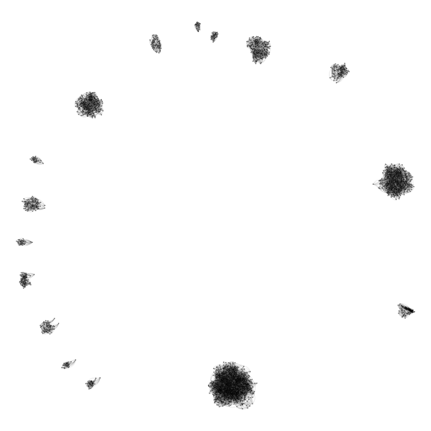
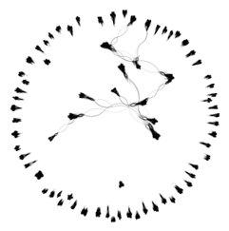
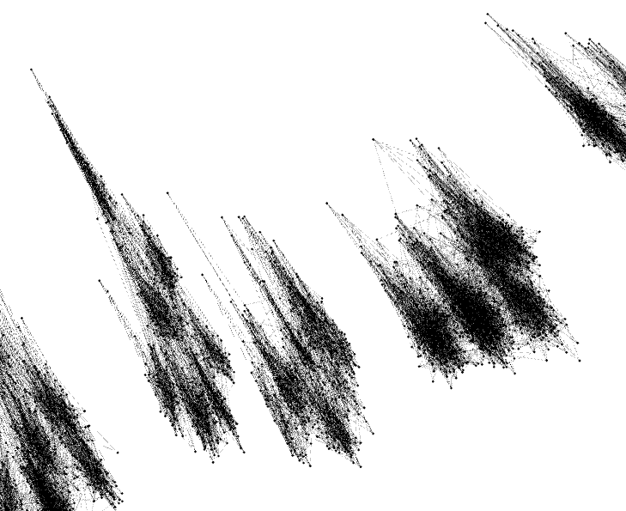
Network visualizations for Howard County, MD
School
Group Quarters

Slide 9
GeoPops with Starsim
SIR model
Respiratory disease
Infection duration ~7 days
Transmission coefficient ~0.1
50-day simulation
Starsim
Simulation
GeoPops agents
Feedback module
Removes edges of school network when prevalence > 0.1
GeoPops networks
Subgroup Tracking
Infections by age and CBG

Slide 10
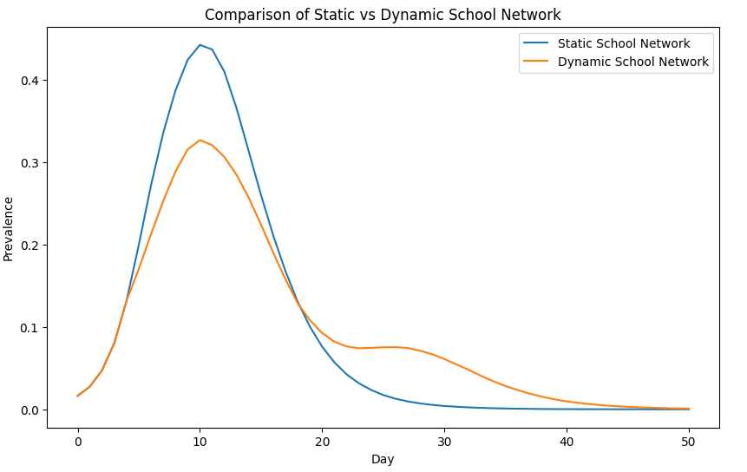
Feedback vs No Feedback

Slide 11
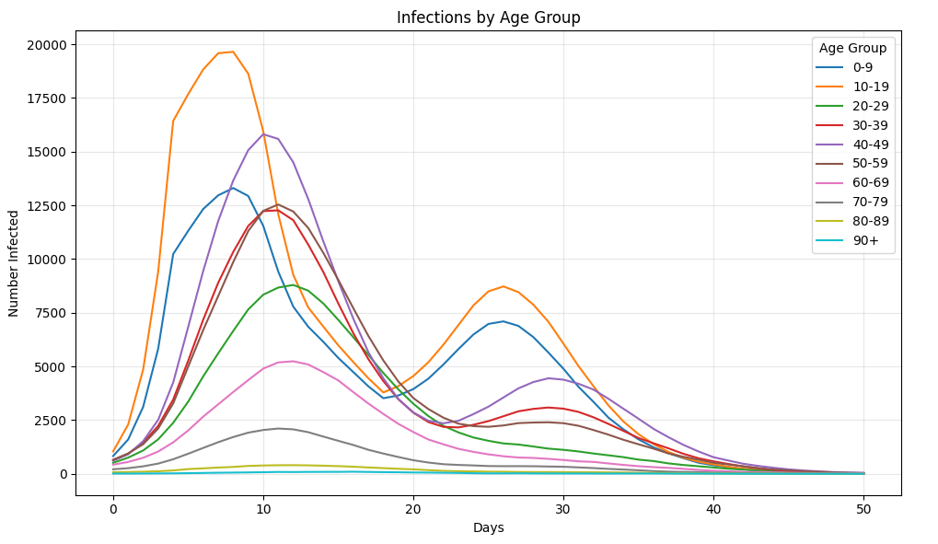
Outcome tracking by demographic subgroup

Slide 12
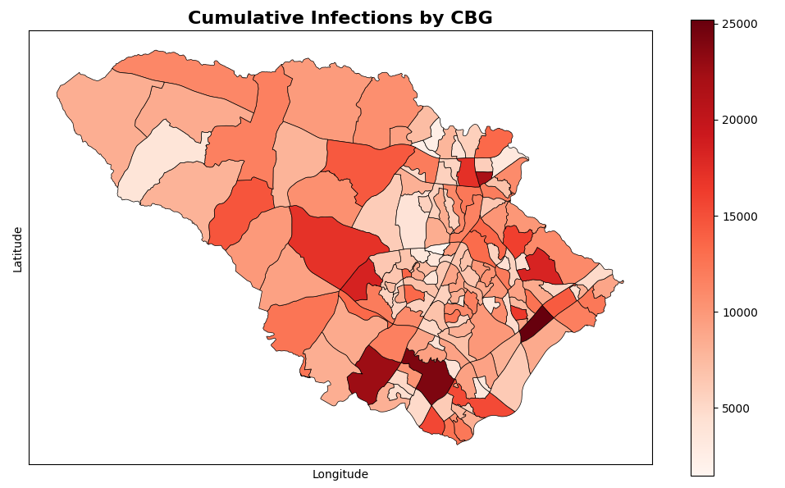
Outcome tracking by geographic subgroup

Slide 13
Why is this cool?!
Reasonably realistic geographic and demographic granularity for night and day-time activities
Don't have to build a model from scratch
Can be used by state and county health departments for context-specific scenario modeling
Seed infections to a specific geography
Target interventions to specific demographic or geographic groups
There are several research groups already using Starsim to model respiratory diseases that can now use GeoPops as well

Slide 14
Conferences
Alisa Hamilton, PhD(c)
Systems Engineering
Johns Hopkins University
ahamil33@jh.edu
Winter Simulation Conference 2025
GeoPops: An open-source package for generating geographically realistic synthetic populations
More detailed methodology and usage
Compare GeoPops to two other open-source synthetic population generators (UrbanPop and Geo-Synthetic-Pop)
Make three MD pops (one with each generator)
Compare individuals and homes to real Census data
Compare network stats of each home, school, and workplace network
Run Starsim COVID-19 model on each population
Compare simulation results to each other and observed data for first wave of pandemic
Discuss usability of each generator
Epidemics 2025
Modeling the impact of dynamic decision making on infectious disease outcomes by demographic and geographic subgroups: An open-source agent-based modeling framework
Run Starsim COVID-19 model with utility framework on GeoPops population of MD
Individuals weigh health-wealth trade-offs of staying home from work as a function of their income and age
Test different policy scenarios (e.g., paid sick leave, cash transfer) and compare to observed data from first wave of pandemic
Demographic and geographic subgroup outcome tracking

Slide 15
Questions
Alisa Hamilton, PhD(c)
Systems Engineering
Johns Hopkins University
ahamil33@jh.edu
Find me at the poster session
Pip install geopops and try going through the tutorial
Log issues! Please be patient ☺
github.com/ACCIDDA/GeoPops/tutorials/MIDAS
Slides
Poster
Tutorial

