Slide 1
Where am I?

Slide 2
Full Stack Web Development
Introductions and Course Overview

Slide 3
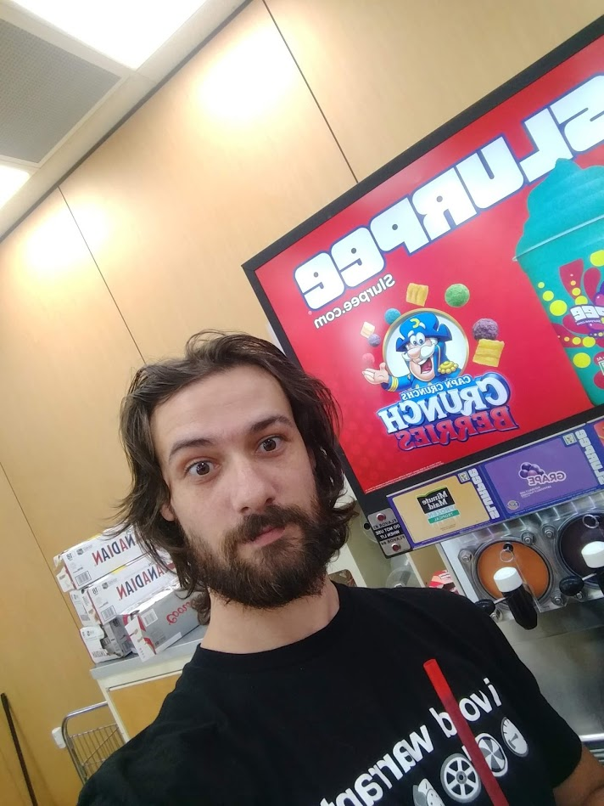
Who am I?
Bill Caffery
Currently working as a web developer for a major media CMS based in the midwest
Former Sr. Developer at The Buffalo News
More than 15 years experience developing websites in a variety of languages (PHP, GoLang, JS, etc)

Slide 4
Who are you?
What is your name?
In three sentences, tell us your story and why you choose this course.
Past web development, programming, or computer experience?
What do you think make good qualities for a web developer?
OR
What qualities do you possess that you think will make you a good developer?

Slide 5
What is this anyway?
In this course, you will be building a real website, in groups. The design and layout of that site will be decided within your own group.
Every Class:
Part 1 - Learn a front end concept
Part 2 - Do a lab to reinforce that lesson
Part 3 - Learn a back end concept related to the front end lesson
Part 4 - Finish up with a lab incorporating both concepts into the group site
Each week, the lecture slides will be posted online after class.

Slide 6
Expectations
...No, this isn’t some relationship kind of deal, I don’t need a text every time you get home safely…..

Slide 7
But I will expect you to:
Be present in class, physically and mentally.
Stay Up To Date. If you miss a class, you will be lost next class, so reach out to me to catch up before the next class.
Participate and complete all assignments and all tasks.
Ask Questions! There are no stupid questions, only stupid assumptions.
Use lab time wisely and if you finish a task early use that time to expand on a project or try to figure out something new. Seriously!!
I also have a have full-time job, don’t wait until the last minute to ask questions, do it early enough to give me time to respond.
You get out what you put in. Full stop.

Slide 8
What to Expect From This Class
What will we build?
Personal “about me” page
Basic database driven CRUD api
Small 5-page team website
What are we going to learn?
HTML
CSS
JavaScript
PHP
SEO / SMO
Working with and Building APIs
Web Hosting
Security
MySQL Databases
Git / Debugging Tools

Slide 9
The Fine Print
No letter grading, this course is Pass/Fail. All work must be completed to receive your certificate of completion.
The goals of this class are to build a portfolio for you to show potential employers, and to give you the skills necessary for an entry level position.
Attendance will be taken during each class. If you cannot attend class, please let your instructor know.
Expectation of a minimum of 10 hours of additional studying each week, outside of lecture/lab time.
Bring computers to every class. We will be writing live code.
Ask as many questions as you need, and ask for clarification whenever necessary.
Again, please be present, put phones away, and give your instructor your attention.

Slide 10
OK! That’s over…
Phew...
Time to learn...

Slide 11

Computer Basics
Hold on tight, this is going to go quick!

Slide 12

Computers & Networking
Monitor
Computer
CPU
Memory (RAM)
Graphics
Storage (Hard Drive)
Mouse
Keyboard

Slide 13
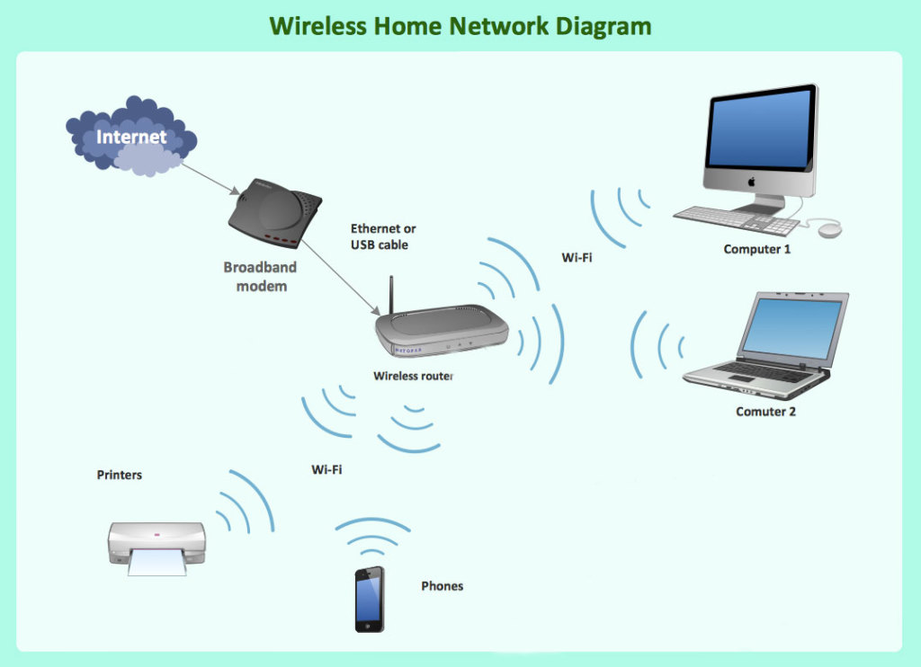
How does a computer connect to the Internet?
Your computer connects to a modem, either through a wired connection or a wireless connection.
That modem connects to an Internet Service Provider (ISP), like Spectrum or Verizon.
The ISP connects your computer to the Internet.
Source: http://beonservices.com

Slide 14
But How Does that work?
IP Addressing
IPv4 (255.255.255.255)
Decimal (0-9)
IPv6 (ffff:ffff:ffff:ffff:ffff:ffff:ffff:ffff)
Hexidecimal (0-f)
Localhost (127.0.0.1)
Domain Names (DNS)
TLD (.com, .net, .org, etc)
Subdomains (dev.example.com)

Slide 15
Protocols
So, we have domains and IP addresses, but what are protocols?
HTTP(S) – secure and non-secure web traffic
FTP(S) – secure and non-secure file transfer
SSH – secure shell access to servers

Slide 16
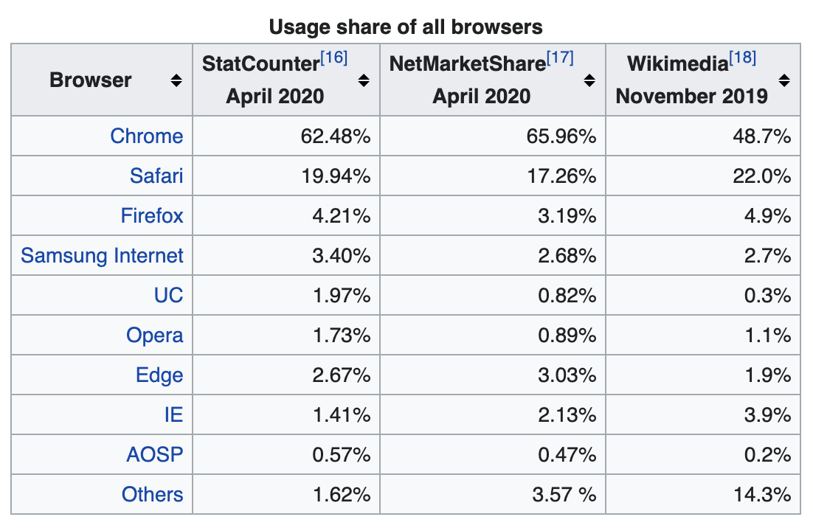
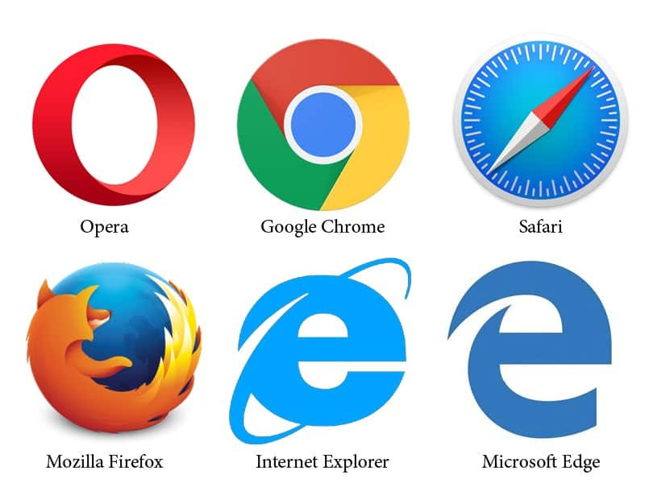
Web Browsers
Source: Wikipedia.com

Slide 17
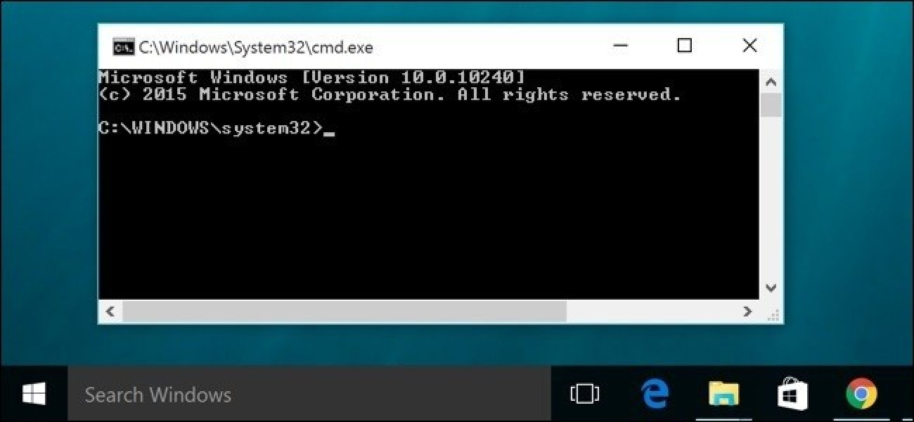
Command Line Tools
In Windows, click the Start button, then in the search box type cmd and hit enter.
You should see the window at the right.

Slide 18
Command Line Tools
Common Commands:
cd – change directory
dir / ls - list
copy / cp – copy
move / mv – move
del / rm – delete
More Information: https://www.thomas-krenn.com/en/wiki/Cmd_commands_under_Windows

Slide 19
Command Line Tools
Tutorial:
https://www.youtube.com/playlist?list=PL6gx4Cwl9DGDV6SnbINlVUd0o2xT4JbMu
9 Videos that show the basics of how the command line in Windows works. It’s about an hour and worth it!

Slide 20

What is Web Development anyway?

Slide 21
What is Front-End development?

Slide 22
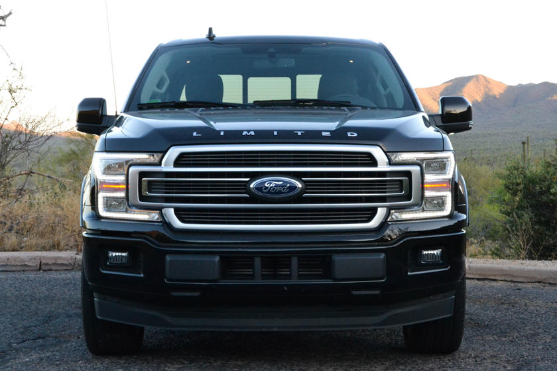
No, not that front end...

Slide 23
Actually,
Building web applications that perform logic on a user’s device directly (computer, phone, etc.)
Communicate with the back-end systems that handle secure data and do complex analysis
Focuses on design and user-interaction, not on algorithmic logic and databases.
Works heavily with APIs and third-party services
Requires hyper-focus on user experience and less on behind-the-scenes databases and structure.
Accept user input and display data in a visually pleasing manner

Slide 24
What is Back-End Development?

Slide 25
…...No, not that back end…...

Slide 26
Instead,
Working with databases and processing/storing data
Big focus on algorithms, how to make code fast and efficient
build for use cases that may not be clearly seen at the beginning of a project
Builds APIs for front-end developers to interact with
Requires a strong focus on security, structure, data aggregation
These are the devs that “make it work”
The part of the iceberg you don’t see

Slide 27
So, Full Stack is?

Slide 28

Pancakes!

Slide 29
No, but it’s really:
The ability to switch between front and back-end development easily.
The ability to “walk a mile in their shoes” and understand what the other developer needs to be successful.
A “jack-of-all-trades” that can easily be team lead or can be a one person army for a small company.

Slide 30
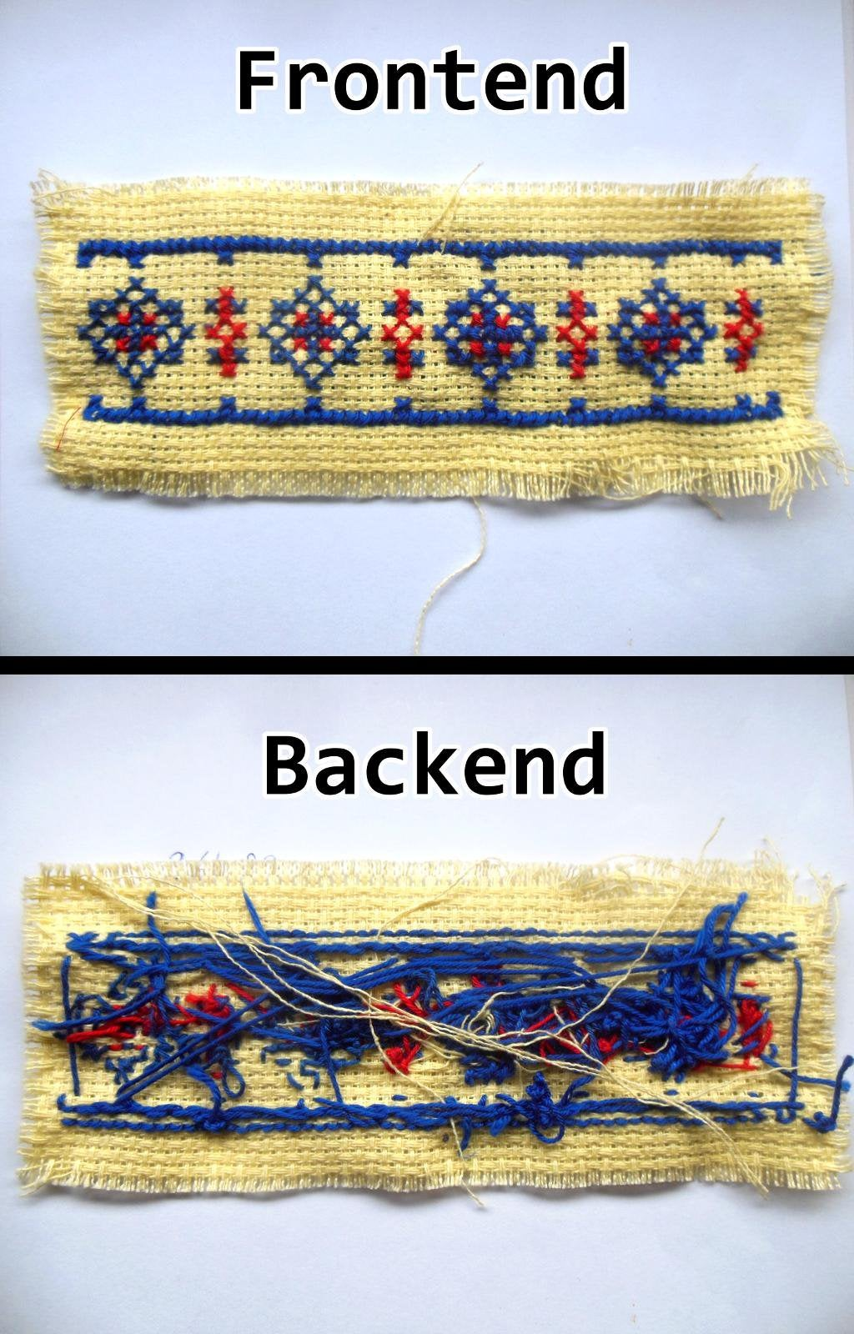
Which looks like

Slide 31
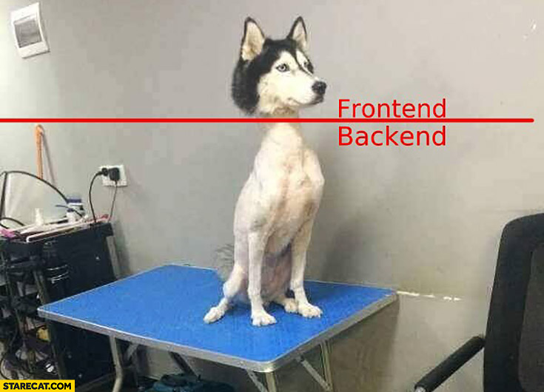
But also sometimes this

Slide 32
Development VS Design
Back End
Makes it work
Focus
Security
Data management
Stability
A good backend dev is one you don’t know exists
Front End
Makes it pretty (still has to work tho)
Focus
Aesthetics
UI/UX
Presentation
A good front end dev is a digital artist

Slide 33
In Case You’re Interested…
https://www.webdesignmuseum.org/web-design-history

Slide 34
Full Stack Web development
Lecture 1: HTML

Slide 35
HTML Introduction
What is HTML?
Hyper Text Markup Language
Defines the base structure for a webpage.
Fundamental building block for every other web programming language.
Set of nested tags that define where elements display.

Slide 36
Basic HTML Tag
<html> - an HTML element
<input type=“text” value=“test”> - an HTML element with two attributes
<a href=“test.htm”>Link</a> - an HTML element with one attribute and inner content
<span>This is <em>important</em>.</span> - two nested HTML elements
<ELEMENT ATTKEY=ATTVALUE>

Slide 37
Basic HTML Page
<!doctype html>
<html>
<head>
<title>Full Stack Developer</title>
</head>
<body>
I am going to be a developer!
</body>
</html>

Slide 38
BODY Section
Tangible parts of the page (the layout) go into the BODY section.
Headings
<h1>, <h2>, <h3>, <h4>, <h5>, <h6>
Paragraphs
<pre>, <br>, <p>
Text (formatting)
<strong>, <em>, <b>, <i>, <font>, <center>
Hyperlinks
<a> (Internal, External, Anchors)
Images
<img src=“” alt=“”>
Lists
<ul>, <ol>, nesting
Forms
<button>, <input>, <select>, <textarea>
Layout
<div>, <span>, <table>, <th>, <tr>, <td>

Slide 39
BODY Section
Attributes:
Regular Attributes: href, type, width, height
Global Attributes: draggable, style, tabindex
Event Attributes: onload, onclick, onblur, onfocus
For a complete list of HTML tags and attributes: https://www.w3schools.com/tags/ https://www.w3schools.com/tags/ref_attributes.asp
HTML 5 Specification https://dev.w3.org/html5/html-author/

Slide 40
HEAD Section
Intangible parts of the page (the metadata) go into the HEAD section.
Meta Tags
<meta>
Keywords
Description
Social Media tagging
Viewport
Cache Control
In Page CSS Styles
<style>
External Files
<link>
Prefetching
External CSS Files
<script>
External Javscript Files
Embedded Javascript Functions

Slide 41
Let’s Build a Page
Open a blank text editor
Notepad
Wordpad
Even Word (though this has major issues later lol)
Save the file as <firstname_lastname>.htm
Reopen using File → Open and get ready to code

Slide 42
Lab
Build an “about me” page that includes at least one image and multiple headings.
Be as creative as possible
Describe yourself
Use ul or li tags
Look at other pages on the web and try to mimic them
BE ORIGINAL

Slide 43
Full Stack Web Development
Lecture 2: Setting up your environment

Slide 44
Setting up your dev environment
What do we need to do?
What OS are you using?
Create your “workspace”
Get git
Get IDE
Set up a local server

Slide 45

What are you running on?
Windows VS Mac & *nix
Windows/PC
Easy to use
More difficult to develop on
WTF is *nix?
Linux/Unix
Mac is the pretty cousin
CLI (command line interface)

Slide 46
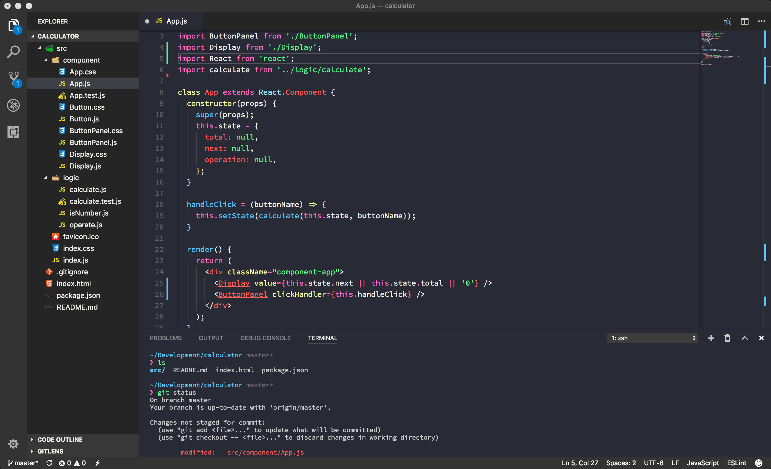
Integrated Development Environments
An IDE is a tool used for writing code. It offers lots of extensions that make writing web pages easier.
In this class we will use a variety of online tools and most in-class demos will be done with VSCode (https://code.visualstudio.com)

Slide 47
Where does the code live?
Set up your “workspace”
PC users:
My Documents or Desktop is a good place to start
Right click → create new folder
Mac/*nix
Start in your home directory
type: cd ~ (unless you did something strange, then it’s on you...)
Now create a directory named “workspace”
Store all coding related files in this directory

Slide 48
Time to download
Git!!
not girls in tanktops... hr will disapprove
Version Control System
Download →https://git-scm.com/downloads
Install →https://git-scm.com/book/en/v2/Getting-Started-Installing-Git
Interesting fact: Linus Torvalds (the guy who invented linux) sarcastically quipped about the name git (which means "unpleasant person" in British English slang): "I'm an egotistical bastard, and I name all my projects after myself. First 'Linux', now 'git'." The man page describes Git as "the stupid content tracker".

Slide 49
More downloading
IDE
Integrated development environment
We will use VS Code
Other options exist
Eclipse
PHPStorm
Notepad++
VIM (if your a masochist)

Slide 50
Almost Done!
VS Code!!
Download → https://code.visualstudio.com/download
Install
this is super straight forward
if you have issues let me know
Open IDE
Most IDEs will now ask you to set your, workspace some handle this on save (like vscode)
Download and install any extensions or plugins as you see fit
these are completely subjective you will need to find out what works for you...

Slide 51
Last Thing… Maybe…
Lastly you MIGHT need a development server esp if using windows
If *nix use apache
Google will be your friend here
if mac use mamp
http://ampps.com/mamp
if windows use wamp
https://www.wampserver.com/en/

Slide 52

Congrats!!!

