Slide 1
A Revolutionary Programming Pattern that Will Clean up your Code : Coroutines in C++
David Sackstein davids@codeprecise.com
ACCU 2015

Slide 2
Agenda
What’s in it for me?
Three Problems
Solutions in C#
Threads, Fibers and Coroutines
Boost Coroutines
Simplifying Asynchronous code with Boost.Asio Coroutines
Summing Up
Agenda

Slide 3
What’s in it for me?
You will be able to write asynchronous code without state machines.
Therefore
Your code will be efficient and scalable
Your business logic will be readable and maintainable.
What’s in it for me?

Slide 4
Two Problems
Parsers and Generators
Asynchronous Methods
Three Problems

Slide 5
The Parser Problem
A parser reads information from a document or stream
It processes the information and produces tokens.
It is convenient to pull from the source and push tokens to a consumer
But this doesn’t work when:
If the document is received from the network
If the document is itself the result of another parsing.
Solution:
Rewrite so that each call produces one token
Maintains state between calls.
Three Problems

Slide 6
The Generator Problem
A generator produces a sequence of elements
Possible implementation:
Calculate all elements and place in a collection, return the collection
But this doesn’t work when
The number of elements is large or unknown ahead of time
Due to memory constraints and latency
Solution
Rewrite so that on each call it produces one element
Maintain state between calls.
Three Problems

Slide 7
The Asynchronous Method Problem
How is it done?
Call a void method with arguments and completion callback
Callbacks are synchronized with the initiator’s context.
Subsequent operations are performed in the callback.
Problems that arise
Business logic is broken up and dispersed among callbacks
Throwing an exception unwinds all methods on the stack
Three Problems

Slide 8
Solutions in C#
A generator with yield return
An asynchronous function call with Async-Await
Solutions in C#

Slide 9
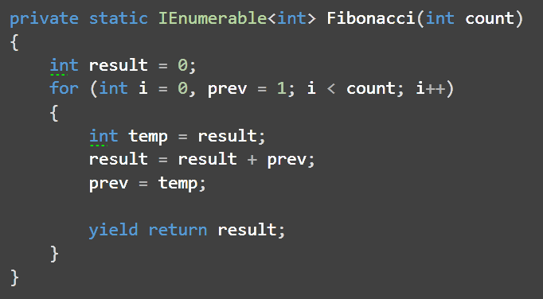
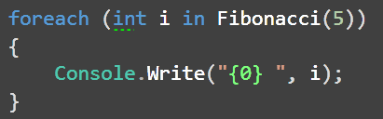
A generator with yield return
See Sample 1.A
Solutions in C#

Slide 10
How does this work?
Caller:
The compiler translates foreach into calls to the IEnumerable interface returned by Fibonacci()
Callee:
The compiler generates a class that implements IEnumerable based on the implementation of Fibonacci()
The implementation of Fibonacci() instantiates an instance of the class and returns it.
Solutions in C#

Slide 11
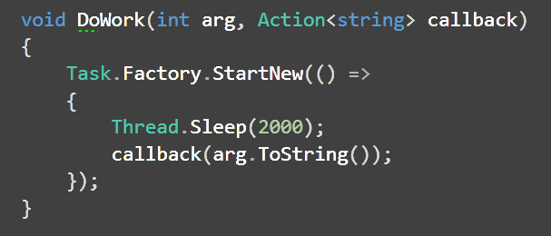
An asynchronous call with async-await
Consider this asynchronous call with a callback
Solutions in C#

Slide 12
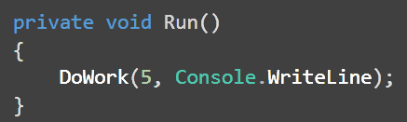
An asynchronous call with async-await
Which is called like so
Solutions in C#

Slide 13
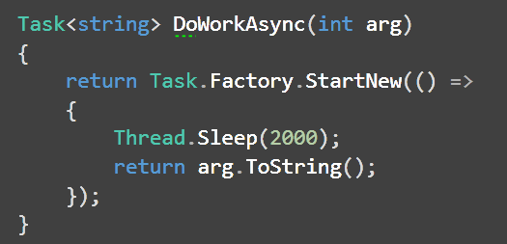
An asynchronous call with async-await
Should be rewritten like so
See Sample 1.B
Solutions in C#

Slide 14
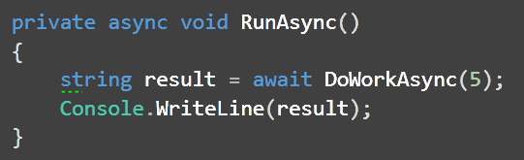
An asynchronous call with async-await
Which can be called like so
Solutions in C#

Slide 15
How does this work?
The compiler creates a class which implements a state machine.
The code before the await and the code after await are compiled as the work to be done in different states
When the awaited task completes, the state machine’s MoveNext is invoked and it executes the code for the next state.
The compiler starts the state machine and returns.
Solutions in C#

Slide 16
Threads, Fibers and Coroutines
Threads, fibers and coroutines use the stack to store state
But there are important differences between them
Threads, Fibers and Coroutines

Slide 17
How Threads Can Help
Each thread has its own stack which stores context
Cons
Synchronization is required to switch context
Threads are expensive
Request Data 1
Supply Data 1
Request Data 2
Supply Data 2
Threads, Fibers and Coroutines

Slide 18
Fibers Might Be Better
Fibers are like threads with cooperative multitasking
Execution continues until a fiber yields explicitly
Execution is serial - no protection of shared data is required
No kernel mode overhead
Context switching is immediate. No idle wait.
Supported on Windows and Linux
Threads, Fibers and Coroutines

Slide 19
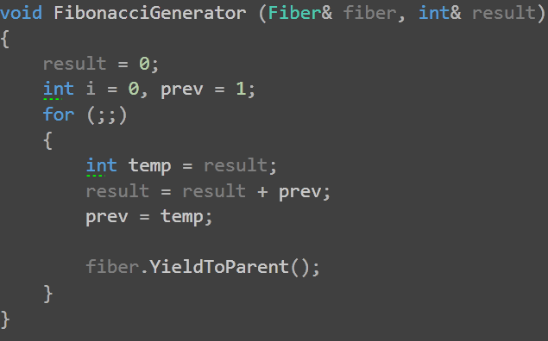
A Generator with Fibers
The generator:
See Sample 2
Threads, Fibers and Coroutines

Slide 20
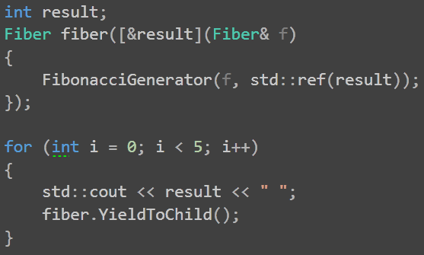
A Generator with Fibers
The caller
Threads, Fibers and Coroutines

Slide 21
The Fiber class
The Fiber class wraps the following Windows APIs:
API Function | Description
ConvertThreadToFiber | Enables the thread to create fibers
CreateFiber | Creates a child fiber
SwitchToFiber | Switches to a fiber by its handle
DeleteFiber | Deletes the child fiber from CreateFiber
Threads, Fibers and Coroutines

Slide 22
Coroutines
Coroutines are similar to fibers, though
Fibers are described in terms of threads
Coroutines are described in terms of functions (subroutines)
A coroutine is a routine that can be entered more than once:
Suspends execution preemptively by invoking a yield call
Execution is resumed when another coroutine yields
The stack is preserved between entries
Threads, Fibers and Coroutines

Slide 23
An Important Difference
Both coroutines and fibers unwind themselves when an exception is thrown, but behave differently when an exception is not caught in the coroutine/fiber:
Fibers behave like threads:
Uncaught exceptions terminates the process
Coroutines behave like nested functions:
Uncaught exceptions may be caught by the caller
Threads, Fibers and Coroutines

Slide 24
Boost Context (Oliver Kowalke)
Managing stacks is a difficult problem that has been attempted in C using setjmp() and longjmp()
But these do not handle stack unwinding for objects that have non-trivial destructors.
Boost.Context provides context management in a portable way.
Boost.Coroutine uses Boost.Context and provides a higher level of abstraction for multitasking in one thread.
Boost Coroutines

Slide 25
Boost Fiber (Oliver Kowalke)
Boost Fiber is currently under review.
It will provide a framework for micro-threads scheduled cooperatively (fibers).
The API contains classes and functions to manage and synchronize fibers similarly to Boost.Thread
Boost.Fiber uses Boost.Context to manage a stack per fiber.
Boost Coroutines

Slide 26
Boost Coroutines (Oliver Kowalke)
Boost.Coroutine uses Boost.Context to provide:
Asymmetric coroutines
An asymmetric coroutine knows its invoker, using a special operation to implicitly yield control specifically to its invoker
Symmetric coroutines
All symmetric coroutines are equivalent; one symmetric coroutine may pass control to any other symmetric coroutine
Both types may or may not pass a result (in one direction)
Boost Coroutines

Slide 27
Boost.Coroutine and Boost.Fiber
Boost.Coroutine
Boost.Fiber
Stackful Coroutines
asymmetric coroutine
symmetric coroutine
fiber
Boost.Context
Boost Coroutines

Slide 28
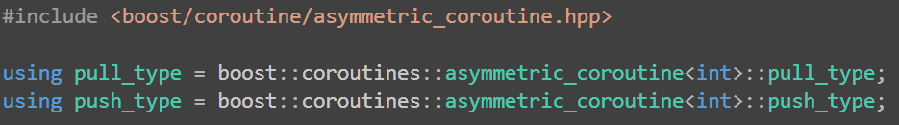
A Generator using Asymmetric Coroutines
Use these definitions:
See Sample 3.A
Boost Coroutines

Slide 29
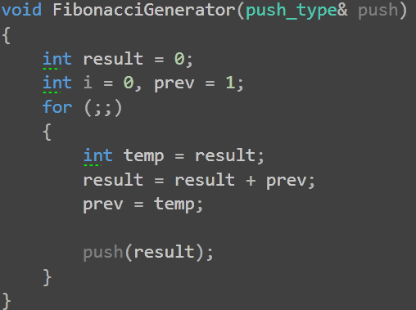
A Generator using Asymmetric Coroutines
The generator
Boost Coroutines

Slide 30
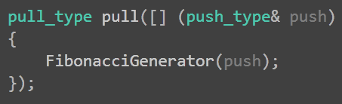
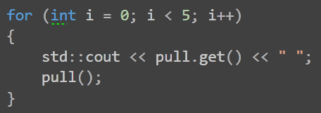
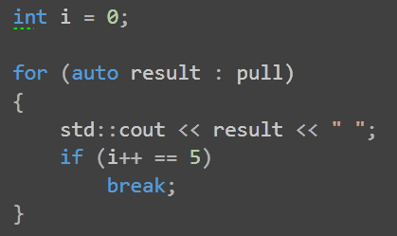
A Generator using Asymmetric Coroutines
The consumer
Boost Coroutines

Slide 31
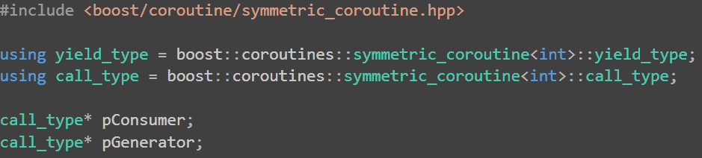
A Generator using Symmetric Coroutines
Use these definitions:
See Sample 3.B
Boost Coroutines

Slide 32
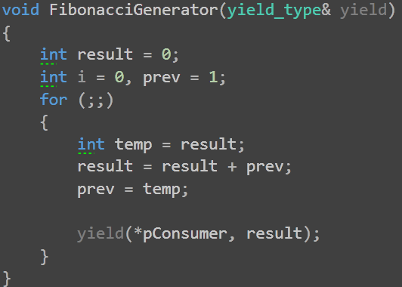
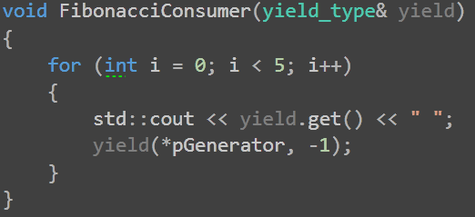
A Generator using Symmetric Coroutines
Generator and Consumer
Boost Coroutines

Slide 33
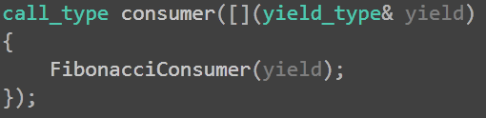
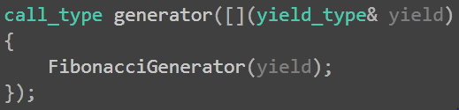
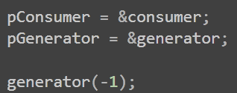
A Generator using Symmetric Coroutines
Usage of the generator and consumer
Boost Coroutines

Slide 34
Back to Asynchronous Methods
Introduction to Boost Asio
Boost Asio and Coroutines
Using boost::asio::yield_context with asynchronous I/O
Extending yield_context for any asynchronous call.
Boost Asio and Coroutines

Slide 35
Boost.Asio (Christopher Kohlhoff)
A library that provides tools to manage long running operations, without requiring threads and explicit locking.
The central object exposed is the io_service
io_service encapsulates an event loop
To service the event loop call run() in one or more threads
You can post any callable object to the io_service
Provides synchronous and asynchronous networking services
Boost Asio and Coroutines

Slide 36
Asynchronous functions in Boost.Asio
An “invoker” initiates an asynchronous function passing in a callback handler which returns immediately.
The invoker can now call io_service.run() which blocks for as long as there is work in the queue.
As soon as the asynchronous function completes, the callback handler is posted to the io_service queue.
The invoker encounters the callback “work” and the callback is then invoked in the thread of the invoker.
If you call io_service.run() from two threads. What happens?
Boost Asio and Coroutines

Slide 37
Applying coroutines (1)
The “invoker” creates a pull_type, passing in the “work” as a lambda
The work lambda receives a push_type and the pull_type by reference.
It initiates an asynchronous function, passing in a special callback handler which captures a reference to the push_type object.
The work lambda then yields to the pull_type yielding to the invoker.
The work lambda should then yield to the invoker.
The invoker now calls io_service.run() which services other clients.
Boost Asio and Coroutines

Slide 38
Applying coroutines (2)
When the asynchronous operation completes, the special callback handler is posted to the io_service queue.
Eventually run() picks it up and executes the handler.
The handler yields to the invoked push_type coroutine.
The initiating coroutine magically wakes up after the asynchronous call completed.
Boost Asio and Coroutines

Slide 39
Applying coroutines (3)
This is more or less how Boost Asio wraps coroutines
It defines boost::asio::yield_context which encapsulates pointers to a pull_type and push_type asymmetrical coroutines.
The invoker calls spawn function to create the coroutines and pass control to the work delegate.
The work delegate receives the yield_context as an argument.
yield_context is a type that will enable us to write asynchronous functions as if they were synchronous calls.
Boost Asio and Coroutines

Slide 40
Applying coroutines (4)
yield_context is passed as a callback handler to asynchronous functions.
It is invocation of the yield_context that switches context back to the work coroutine to continue work as if the call to the asynchronouls function had completed synchronously.
Therefore, yield_context a type enables us to write asynchronous functions as if they were synchronous calls.
Boost Asio and Coroutines

Slide 41
Building the solution
Presenting an asynchronous function
Initiating an asynchronous chain of calls
Calling the function repetitively (recursively)
How we would prefer to call the function
Revising initiation of the chain of calls
How do we get it to work using coroutines?
Boost Asio and Coroutines

Slide 42
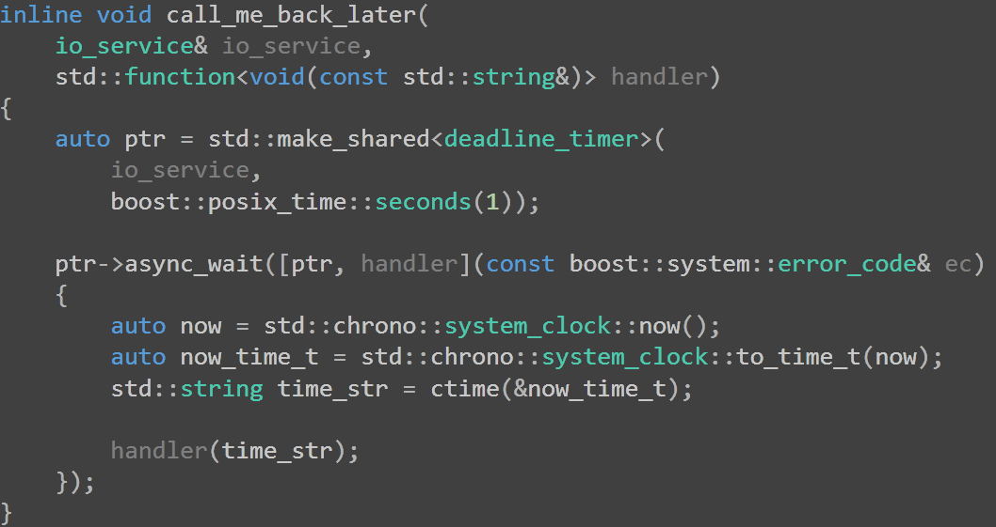
The asynchronous function
The callback handler
Boost will post this delegate to the io_service when the timer expires
The handler will be called after 1 second
Boost Asio and Coroutines

Slide 43
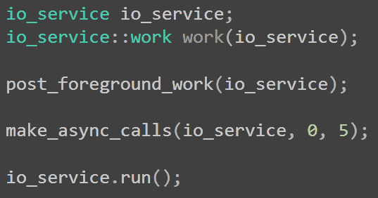
Initiating an asynchronous chain of calls
Post some work to the io_service
Post our chain of calls
Service all work on this thread

Slide 44
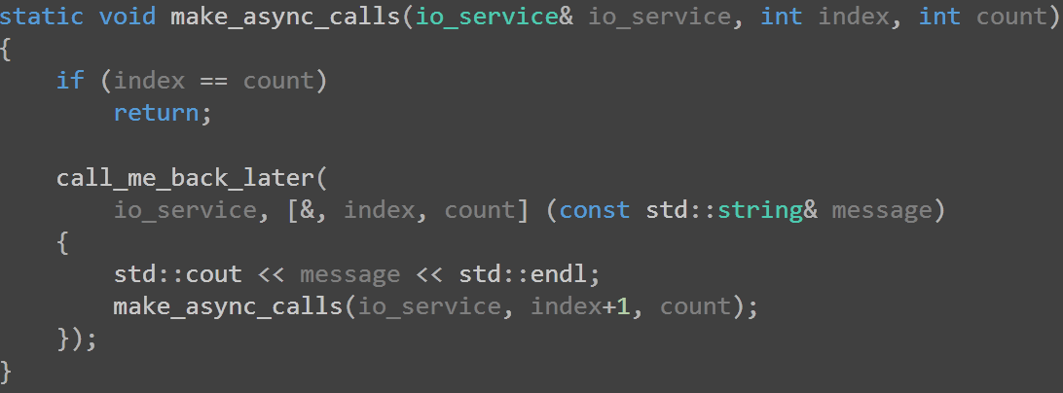
Calling repetitively (recursively)
Provide a callback
Call recursively from the callback
Boost Asio and Coroutines

Slide 45
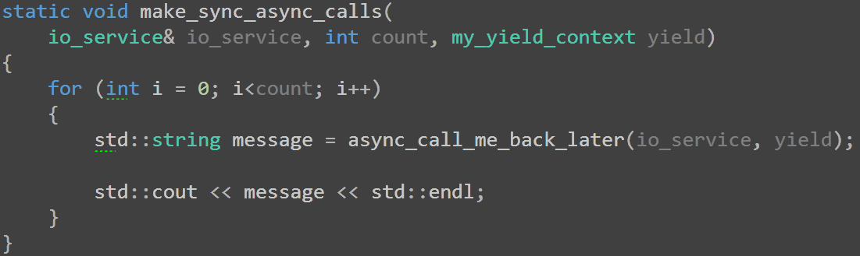
How we would prefer to call the function
A new type by value
Iteration, not recursion
Pass the yield context to the asynchronous function
Boost Asio and Coroutines

Slide 46
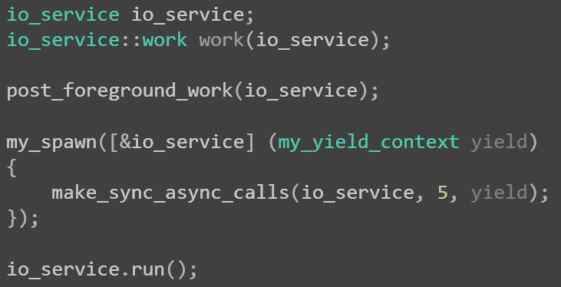
Revising initiation of the chain of calls
Post some work to the io_service
My_spawn sets up the yield_context and passes it to the delegate
Boost Asio and Coroutines

Slide 47
How do we get it to work using coroutines?
Boost Asio and Coroutines

Slide 48
Boost.Asio In Action
Sample 4.A
Demonstrates the use of synchronous I/O for TCP communication
Sample 4.B
Demonstrates the use of asynchronous in the same application
Sample 4.C
Demonstrates the use of yield_context in the same application
Boost Asio and Coroutines

Slide 49
Background: The Echo Application
Server and one or more clients
Each client connects to the server using TCP/IP
Client sends a message the server
The server sends it back
The client sends back what it received ad infinitum.
Each message comprises a 4 byte size followed by the data
Boost Asio and Coroutines

Slide 50
Architecture
Server
Connection
Client
{ Spawns }
Echoer
Application Layer: Echo Logic
{ Uses }
Messenger
Message Layer: Message Format
Samples Differ Here
Boost.Asio
Transport Layer : TCP/IP
Boost Asio and Coroutines

Slide 51
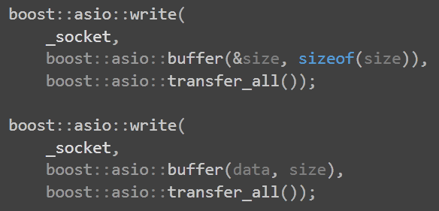
Synchronous I/O : Message Write
See Sample 4.A
Boost Asio and Coroutines

Slide 52
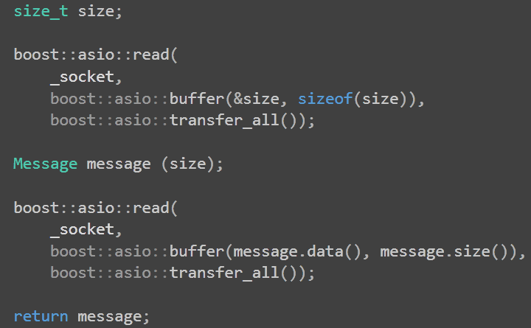
Synchronous I/O : Message Read
Boost Asio and Coroutines

Slide 53
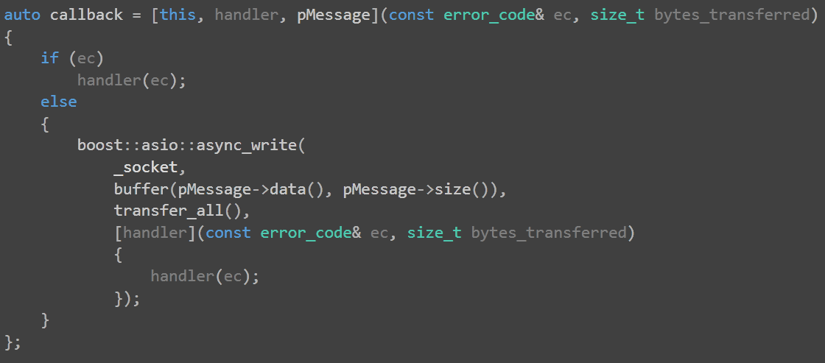
Asynchronous I/O : Message Write (1)
See Sample 4.B
Boost Asio and Coroutines

Slide 54
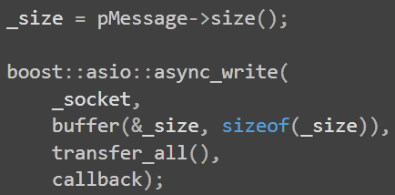
Asynchronous I/O : Message Write (2)
Boost Asio and Coroutines

Slide 55
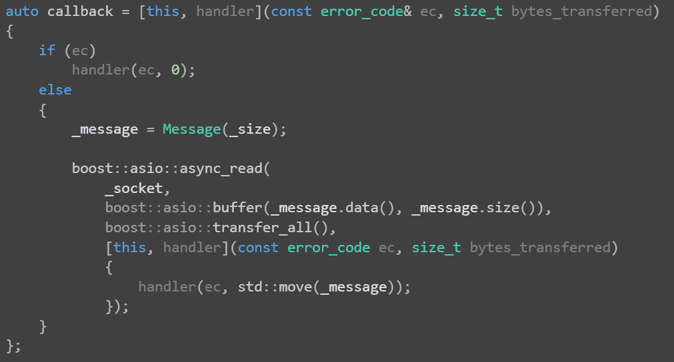
Asynchronous I/O : Message Read (1)
Boost Asio and Coroutines

Slide 56
Asynchronous I/O : Message Read (2)
Boost Asio and Coroutines

Slide 57
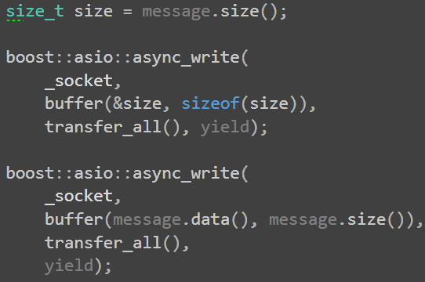
yield_context: Message Write
See Sample 4.C
Boost Asio and Coroutines

Slide 58
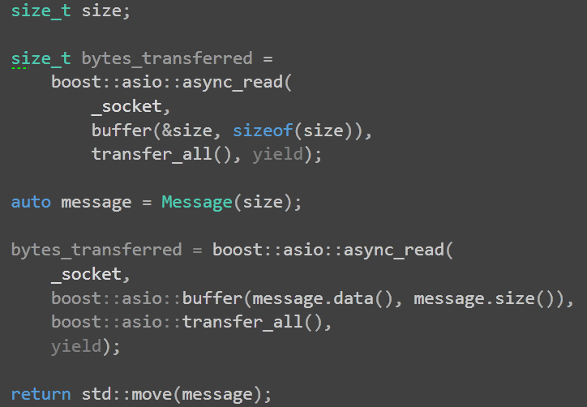
yield_context: Message Read
Boost Asio and Coroutines

Slide 59
Boost Coroutines
Boost.Coroutine
Boost.Fiber
Stackful Coroutines
asymmetric coroutine
symmetric coroutine
symmetric coroutine
Boost.Context
Boost Asio and Coroutines

Slide 60
Boost Asio and Coroutines
Boost.Asio
yield_context
stackless coroutine
Boost.Coroutine
Boost.Fiber
Stackful Coroutines
sockets
asymmetric coroutine
symmetric coroutine
symmetric coroutine
Boost.Context
io_service
Boost Asio and Coroutines

Slide 61
Summing Up
Coroutines allow a function to
yield control preemptively to another coroutine and
resume when control is returned, preserving the state of the stack.
Coroutines can be used to keep parsers and generators flow driven rather than state driven.
spawn and yield_context from Boost.Asio encapsulate coroutines and allow you to write scalable, asynchronous code without callbacks.

Slide 62
What’s in it for me?
You will be able to write asynchronous code without state machines.
Therefore
Your code will be efficient and scalable
Your business logic will be readable and maintainable.
A revolutionary pattern to clean up your code: Coroutines!
What’s in it for me?

