Slide 1
Windows Native API
Roger Orr
OR/2 Limited
How do applications communicate with the O/S kernel?
– ACCU 2019 –

Slide 2
Applications and the Kernel
In common with many operating systems, Windows has two modes
  A mode for user programs ('user')
  A mode for the O/S ('kernel')
A user mode application program
  cannot directly access hardware
  can only access memory locations it 'owns'
Kernel mode allows
  direct access to hardware
  access to the whole of physical memory

Slide 3
Applications and the Kernel
Applications request services from the O/S by making a system call
  the mode changes to kernel mode
  the request and its parameters are verified
  the operation is performed
  the kernel returns a status code (to indicate whether the request succeeded)
However, it is rare to make these requests directly: Windows provides a higher level API known as the Win32* API
* (even when it's 64-bit)

Slide 4
Applications and the Kernel
Programming languages in turn often further wrap the Win32 API to provide their library runtime functions
Application program
Language runtime
Win32 API
Windows Native API
O/S kernel

Slide 5
A simple example
Consider this C++ program
#include <cstdlib>
int main() { exit(42); }
This calls the C++ library function exit()
This (eventually) invokes the Win32 function ExitProcess()
This in turn invokes the Windows Native function NtTerminateProcess()

Slide 6
A simple example
Consider this C++ program
#include <cstdlib>
int main() { return 42; }
This implicitly calls the C++ library function exit()
So it behaves like the previous example
However, I highlight this as there's more to the language runtime than just your calls

Slide 7
A simple example
Let's go one layer down...
#include <windows.h>
int main()
{
ExitProcess(42);
}
Note that this does not let the C++ runtime terminate as gracefully, but it does allow some Win32 teardown (eg DLL unload)

Slide 8
A simple example
Or we can terminate 'with prejudice':
#include <windows.h>
int main()
{
auto self = GetCurrentProcess();
TerminateProcess(self, 42);
}
This does less Win32 tear-down

Slide 9
A simple example
Another layer down... NtTerminateProcess
Firstly, we need to provide a prototype for the function, since only a few Windows Native calls are provided in the Windows Kits
extern "C" NTSTATUS NTAPI
NtTerminateProcess(
IN HANDLE ProcessHandle,
IN NTSTATUS ExitStatus);

Slide 10
A simple example
Then we call the function
int main()
{
auto self = GetCurrentProcess();
NtTerminateProcess(self, 42);
}
Note that this may not let the Win32 runtime terminate gracefully: for example it skips Silent Process Exit monitoring

Slide 11
Inside a native call
The function body is something* like this:
NtTerminateProcess:
mov r10,rcx
mov eax,2Ch
syscall
ret
The syscall instruction transitions to kernel mode. Register eax is the code for the function to invoke.
* dependent on the version of Windows (see next slide)

Slide 12
Inside a native call
The precise details of the function body differ as the mechanisms used to enter kernel mode have changed subtly with different versions of Windows and changes in hardware support:
int 2E - initially windows used an interrupt
sysenter - a special instruction simply added for speed
syscall - a 'new improved' instruction (AMD/Intel split)
The principle is unchanged: inside the kernel there is basically a jump table driven by the function code argument and targetting the desired function

Slide 13
Inside a native call
The target function in the kernel has the same name as the original NtXxx function
However, this implementation function runs in the kernel with the O/S privileges and can therefore perform actions that the user mode program is not able to do

Slide 14
Note on kernel development
The target NtXxx functions are also callable from within the kernel too. However, in this case since the caller is trusted code there is an additional choice of an 'internal' function, with a prefix of 'Zw' rather than of 'Nt'
The Zw version of the function can skip some of the validation of the arguments supplied in the function call
If you're trying to find information about a native call, try to search for both the names

Slide 15
Inside the kernel
I'm not going to cover much about the Windows kernel itself.
  It'd take too long
  I'm not a driver level guy
There is information about the Windows kernel available from many sources, such as:
  Windows Driver Kit (WDK)
  Books, such as “Windows Internals”
  “NT Insider” at www.osr.com/nt-insider/

Slide 16
Argument validation
The native API is where applications transition from the 'protected' environment into the kernel. It's important to verify the arguments passed to the service call to ensure that the program cannot accidentally - or maliciously -
  Crash or corrupt the O/S
  Use resources it does not own
  Perform actions requiring higher privilege

Slide 17
Return codes
The native API normally returns an NTSTATUS value (a 32-bit unsigned value), with the top two bits set on error
Some of the possible error values are documented in WinNt.h, or in NtStatus.h, such as:
STATUS_OBJECT_NAME_NOT_FOUND (0xC0000034)
STATUS_NO_TOKEN (0xC000007C)

Slide 18
Return codes
The function RtlNtStatusToDosError in NtDll converts the NTSTATUS native error value into a user-mode error value
For example, the native error code 0xC0000034 is translated to 2 which is ERROR_FILE_NOT_FOUND

Slide 19
Types of arguments
There arguments used by the native API can be broken down into the following rough categories:
  Simple values
  Handles
  Pointers to memory
  Strings
  Object Attributes

Slide 20
Simple value arguments
Many of the simple values are integers – the commonest example being ULONG (a 32-bit unsigned value). There are also a number of arguments that are enumeration values
For example, NtQueryInformationProcess takes an argument of type PROCESS_INFORMATION_CLASS which has values like ProcessMemoryPriority
Other types include LARGE_INTEGER (64-bit) and BOOL
In quite a few cases the simple values are the same ones as that of a corresponding higher-level Win32 API, as we saw earlier with NtTerminateProcess

Slide 21
Enumeration values
Some of the enumerations used in the Native API are the same as those used in the Win32 API and some of the others are documented by Microsoft
Most of the others can be found in the PDB file for WinTypes.dll; for example:
> dt ALPC_MESSAGE_INFORMATION_CLASS
wintypes!ALPC_MESSAGE_INFORMATION_CLASS
AlpcMessageSidInformation = 0n0
AlpcMessageTokenModifiedIdInformation = 0n1
AlpcMessageDirectStatusInformation = 0n2
AlpcMessageHandleInformation = 0n3

Slide 22
Handle arguments
While on 64-bit Windows handles are 64-bit values in practice they currently seem to be (possibly sign-extended) 32-bit values
This provides obvious benefits for interoperability with 32-bit programs running on the WOW subsystem

Slide 23
Handle arguments
Many kernel resources expose themselves via an opaque handle type
Typically the initial Open or Create call takes a pointer to handle as the first argument, and subsequent operations take the handle value as the first argument
The handle value is usually the same value as that exposed by equivalent Win32 calls, so a mix of native and Win32 calls can be used (with some restrictions)

Slide 24
Pointer to memory arguments
Pointers to memory are usually presented as a pair: an address and a length
Many of the APIs have a clear separation between input and output buffers
In a few cases buffers are modified in-place

Slide 25
String arguments
Most of the native API takes strings as:
struct UNICODE_STRING {
USHORT Length; // Length of string in bytes
USHORT MaximumLength; // Maximum length
PWSTR Buffer; // Pointer to Unicode string
};
A small number of APIs take a PWSTR argument (together with a length)
In both cases note the string is of 16-bit Unicode (UTF-16) characters

Slide 26
String arguments
The UNICODE_STRING structure uses unsigned 16-bit integers for the length, even on a 64-bit platform, which means that strings are limited to 32,767 characters
This is rarely a significant issue in practice!

Slide 27
Object attributes arguments
Many of the APIs take an OBJECT_ATTRIBUTES argument which specifies the name and some additional attributes of the object being accessed. Here's the structure:
typedef struct _OBJECT_ATTRIBUTES {
ULONG Length;
HANDLE RootDirectory;
PUNICODE_STRING ObjectName;
ULONG Attributes;
PVOID SecurityDescriptor;
PVOID SecurityQualityOfService;
} OBJECT_ATTRIBUTES;

Slide 28
Object attributes arguments
The root directory is a handle to use for relative names. The name is a little misleading as it applies to more than files – for example it is used for registry keys
Unlike the Win32 API there is no implicit 'current directory' for calls
The full names for files and directories in the native API may be unfamiliar:
\??\C:\projects\accu\conference\2019 or
\Device\HarddiskVolume5\projects\accu\conference\2019
We'll come back to that shortly!

Slide 29
Some security considerations
The Native API is the gateway from user mode to privileged mode and so there are a number of implications for both security and process separation
The degree of caution taken over argument handling has increased since the early days of Windows NT
I'm not going to cover the recent hardware level vulnerabilities (Meltdown and Spectre) although they have affected the O/S API

Slide 30
Simple value arguments
The security implications of simple values are similar to those in any API; the only difference is that if something is out of range it might produce exploitable behaviour in the kernel which is at a higher privilege level
NTSTATUS ZwCreateEvent(
_Out_ PHANDLE EventHandle,
_In_ ACCESS_MASK DesiredAccess,
_In_opt_ POBJECT_ATTRIBUTES ObjectAttributes,
_In_ EVENT_TYPE EventType,
_In_ BOOLEAN InitialState);
What could happen if I were to provide an invalid value?

Slide 31
Handle arguments
It is important to check that the handle value being passed in is right for the API being used, that it belongs to the calling process, and that is has the right permissions
Earlier checks were done with the handle value as it arrived; but malicious programs found they could close and reopen the handle in other threads so that the same handle value referred to a different entity later on in the call, allowing access above the privilege level of the caller

Slide 32
Pointer to memory arguments
Memory buffers present a few challenges:
  Does the calling process have access to it?
  With the right permissions?
  All of it?
  How does the kernel ensure that it maps the right page(s) from the user program?
  What if the memory is swapped out?
  What if the user changes the contents?

Slide 33
Access to memory arguments
The kernel needs to check that the calling program has provided a valid pointers to memory for which it holds the required access (for example, write access if the API will write into the buffer).
This check needs to be made for the full range of addresses in the buffer

Slide 34
Lifetime of memory arguments
If the kernel will be retaining the buffer (for example, for I/O) then the memory may need locking so that the physical addresses of pages can be passed to hardware
Remember that while this thread is no longer active in the user's application, other threads can be modifying the memory being addressed

Slide 35
String arguments
The buffers used to hold string arguments have the same set of restrictions as other pointers to memory
However, there are additional wrinkles with strings as they may contain various 'odd' characters or invalid character sequences
UTF-16 processing is notoriously hard to get right
Embedded NUL characters (among others) can cause 'interesting' interaction with the Win32 API which often uses LPCSTR

Slide 36
Object namespace
As I briefly mentioned when looking at 'object attributes' the names of entities may be different when using the Native API rather than the Win32 API
The kernel has a hierarchical namespace containing objects of various classes, such as: Device, Event, Key, Mutant*, Section, Semaphore, and SymbolicLink
The Sysinternals “WinObj” tool lets you view the object hierarchy
* A Mutex, with an odd name for historical reasons

Slide 37
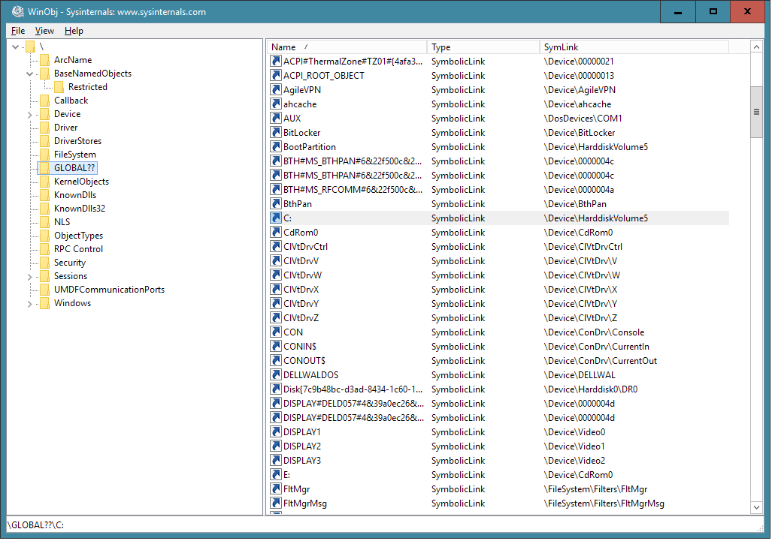
Object namespace - WinObj

Slide 38
Object namespace
We saw earlier:
\??\C:\projects\accu\conference\2019 or
\Device\HarddiskVolume5\projects\accu\conference\2019
The top level “??” is the global namespace, which has a symbolic link to the actual device
\Device\HarddiskVolume5 is the device name for the C: drive on my desktop PC
The rest of the path is not in the object namespace, but is understood by the device driver itself

Slide 39
Object namespace
There are quite a few symbolic links in the object namespace – here are some of the other aliases for the same hard disk:
\Device\BootDevice
\??\BootPartition
\??\Volume{661a4c3d-06b0-45e2-98aa-3e6b647c1f37}
These are typically set up when the system starts up and devices are initialised
Few application programmers need to be concerned about the set of names

Slide 40
Object namespace
Some of the Win32 API calls support access via the global namespace – but, just to make it more confusing, using the prefix of \\? rather than \??
For example: dir \\?\c:\temp
This actually opens \??\c:\temp
However, this syntax allows filenames longer than MAX_PATH and disables some the Win32 mappings - for instance you can create a filename called “...”

Slide 41
More than just the filesystem
As is probably already obvious from the list of classes the object namespace is used for much more that just the filesystem
Most of the Win32 calls that take names start by finding a root name in the object namespace
For example, the registry API accesses paths like \Registry\Machine\Software
Creating a named Semaphore adds an item to the object namespace – for example
CreateSemapore(0,0,1,"example.sema4")

Slide 42
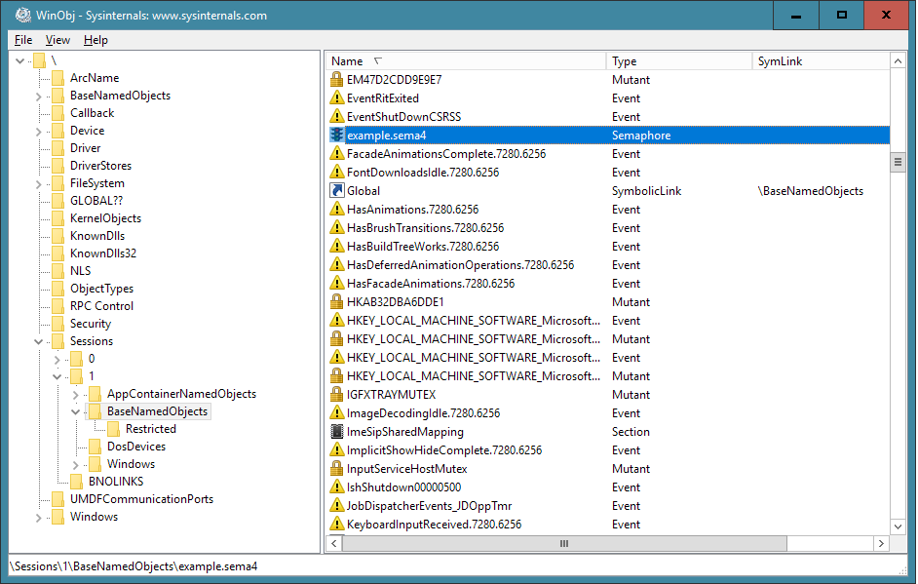
Object namespace - WinObj

Slide 43
Categorising the Native API
There are various ways to categorise the 500 or so functions in the Native API. For example:
And a few that are hard to categorize (28)
Atom (5)
Device (31)
File (48)
LPC (47)
Object (20)
Registry (42)
Synchronization (35)
Transaction (49)
Debug (17)
Environment (17)
Job (8)
Memory (35)
Process (44)
Security (38)
Time (17)
WOW64 (20)

Slide 44
Categorising the Native API
But wait – there's more!
So far I have only mentioned the functions located in NtDll.dll
There are (at least) three other mechanisms that give user mode programs access to functionality in the Windows kernel
  NtUserXxx functions for UI functionality
  NtGdiXxx functions for graphics
  WSL system calls (lxss.sys and lxcore.sys)

Slide 45
Categorising the Native API
Most of the work for the windowing subsystem takes place in kernel (for various reasons, such as performances). The API is loosely split into “user” (winuser.h) and “gdi” (wingdi.h) functions
NtUserXxx functions such as NtUserCreateWindowEx provide the core functionality for the Win32 CreateWindowEx
NtGdiXxx functions such as NtGdiSaveDC implement SaveDC
(The mapping is not always quite this direct)

Slide 46
Categorising the Native API
While the graphic subsystem uses some new data structures the basic mechanism is essentially the same
  The function codes are above 0x1000
  The implementation entry point is in win32k.sys
The return codes are messier – functions return a variety of types (such as BOOL and various handle types) so there's not such a consistent way to detect failures
I won't cover any more ground about this set of functions

Slide 47
Windows Subsystem for Linux
Windows 10 supplied a whole new way to execute user-mode programs – WSL
This allows running native Linux binaries on Windows
The interface to the O/S is via the standard Linux syscall mechanism
Inside the kernel there is a device driver lxss.sys that provides the functionality of the Linux system call interface
The implementation provides a cached shim over direct calls to ZwXxx functions

Slide 48
Windows Subsystem for Linux
The Linux syscall mechanism uses the same underlying syscall mechanism as NtDLL - but with different register conventions
The set of codes used is stable (unlike on Windows) but does overlap
When the O/S detects that the calling process is running as a “pico process” it passes the system call on to lxss.sys
Again, this talk is not primarily about WSL so that's all I intend to say about it

Slide 49
WOW64
The 64-bit version of Windows (“x64”) can also run 32-bit programs (“x86”). How is this achieved?
The 32-bit EXE and its required DLLs are loaded into the low 4GB of linear address space for the process and the selectors (CS, DS, etc):
  Have a 32-bit address range
  Use 32-bit mode (this defines the interpretation of the instructions and the register set available)

Slide 50
WOW64
The running program makes calls exactly as usual to other functions in the 32-bit address space
It also makes calls to the 32-bit Native API to access O/S resources
On a genuine 32-bit O/S these calls would go into the kernel in a corresponding way to the 64-bit cases discussed above
On a 64-bit O/S the calls are intercepted by the wow64 subsystem and eventually call the 64-bit Native API

Slide 51
WOW64
32-bit 'bubble'
64-bit address range
NTDLL (64-bit)
Wow64.dll
Wow64win.dll
32-bit address range
NTDLL (32-bit)
Kernel32.dll
Wow64cpu.dll
Wow64 subsystem
Program.exe

Slide 52
WOW64
The 32-bit Native API makes an indirect call to invoke the system call, for example:
NtTerminateProcess:
mov eax,0x7002c
mov edx,Wow64SystemServiceCall
call edx
ret 0x4
Register eax is the code for the function to invoke (low word) and some mapping information (encoded into the high word)
Wow64SystemServiceCall contains a jump into 64-bit land

Slide 53
WOW64
Wow64SystemServiceCall makes a “far jump” to a 48-bit target address consisting of a 16-bit selector (segment register) and a 32-bit offset. The new CS is a 64-bit one and so the process can access 64-bit instructions and registers.
A load of a different DS gives access to the full 64-bit address range
On return from 64-bit land another far jump returns to the 32-bit world
Sometime the jump to 64-bit land is referred to as “Heaven's Gate”

Slide 54
WOW64
Once in 64-bit land the arguments to the system call need to be translated
32-bit values are zero-extended and 32-bit addresses are also zero-extended (as the first 4GB of the 64-bit world maps to the same linear address range as the 32-bit world)
Data structures may need converting
For example, in 32-bit programs UNICODE_STRING is 8 bytes and OBJECT_ATTRIBUTES is 24 bytes
In the 64-bit API they are 16 and 48 bytes respectively, so new structures need creating

Slide 55
WOW64
Next some additional data transformations are applied (see next slide) to help provide a familiar environment to 32-bit programs
Then the 64-bit Native API call is made
On return reverse translations are performed:
  64 bit values are narrowed
  Returned data structures are converted into the 32-bit format
This is normally transparent to the user; there are occasionally places where the join shows

Slide 56
WOW64
The translation layer changes filenames and registry keys to provide a (nearly) seamless 32-bit environment on the 64-bit O/S. For example:
The directory System32 in C:\Windows is mapped to SysWow64
The registry key Software in HKEY_LOCAL_MACHINE is mapped to Software\Wow6432Node
The mappings are relatively complex, change a little between versions of Windows, and have exceptions

Slide 57
WOW64
The 32-bit Windows API adds some extra functions to allow 32-bit programs to opt out of the mappings and access the underlying 64-bit filesystem and registry
For the file system a call to Wow64DisableWow64FsRedirection will affect subsequent calls by the calling thread
For the registry access the function RegDisableReflectionKey can be called for a specified registry key

Slide 58
WOW64
The Windows Native API also adds some extra functions to allow 32-bit programs to access a limited amount of 64-bit functionality.
For example:
NtWow64GetNativeSystemInformation can be used to obtain information about the hosting 64-bit system (NtQuerySystemInformation returns information about the 32-bit 'virtual' system)
NtWow64[Read/Write]VirtualMemory64 allows a 32-bit process to access memory above the 4Gb limit

Slide 59
WOW64
WOW64 even supports debugging of 32-bit programs (with a very small number of restrictions)
You can also debug a 32-bit program with a 64-bit debugger (since it 'is' a 64-bit program)
There is no support for debugging a 64-bit program with a 32-bit debugger...

Slide 60
Documentation
The WDK (Windows Driver Kit) does now document a proportion of the Native API
  I believe some of this was in response to pressure from customers and OEMs
Many functions have been re-engineered by the open source ReactOS project
undocumented.ntinternals.net has some useful information
Other web sites, especially ones on software security (!)

Slide 61
Tools
There are some free tools that let you debug calls to the Native API including:
Strace for NT from BindView (archive.org)
drstrace from Dr Memory www.drmemory.org
StraceNT from intellectualheaven.com
NtTrace from github.com/rogerorr/NtTrace
There are also some commercial tools

Slide 62
Conclusion
I need one of these, too.

