Slide 1
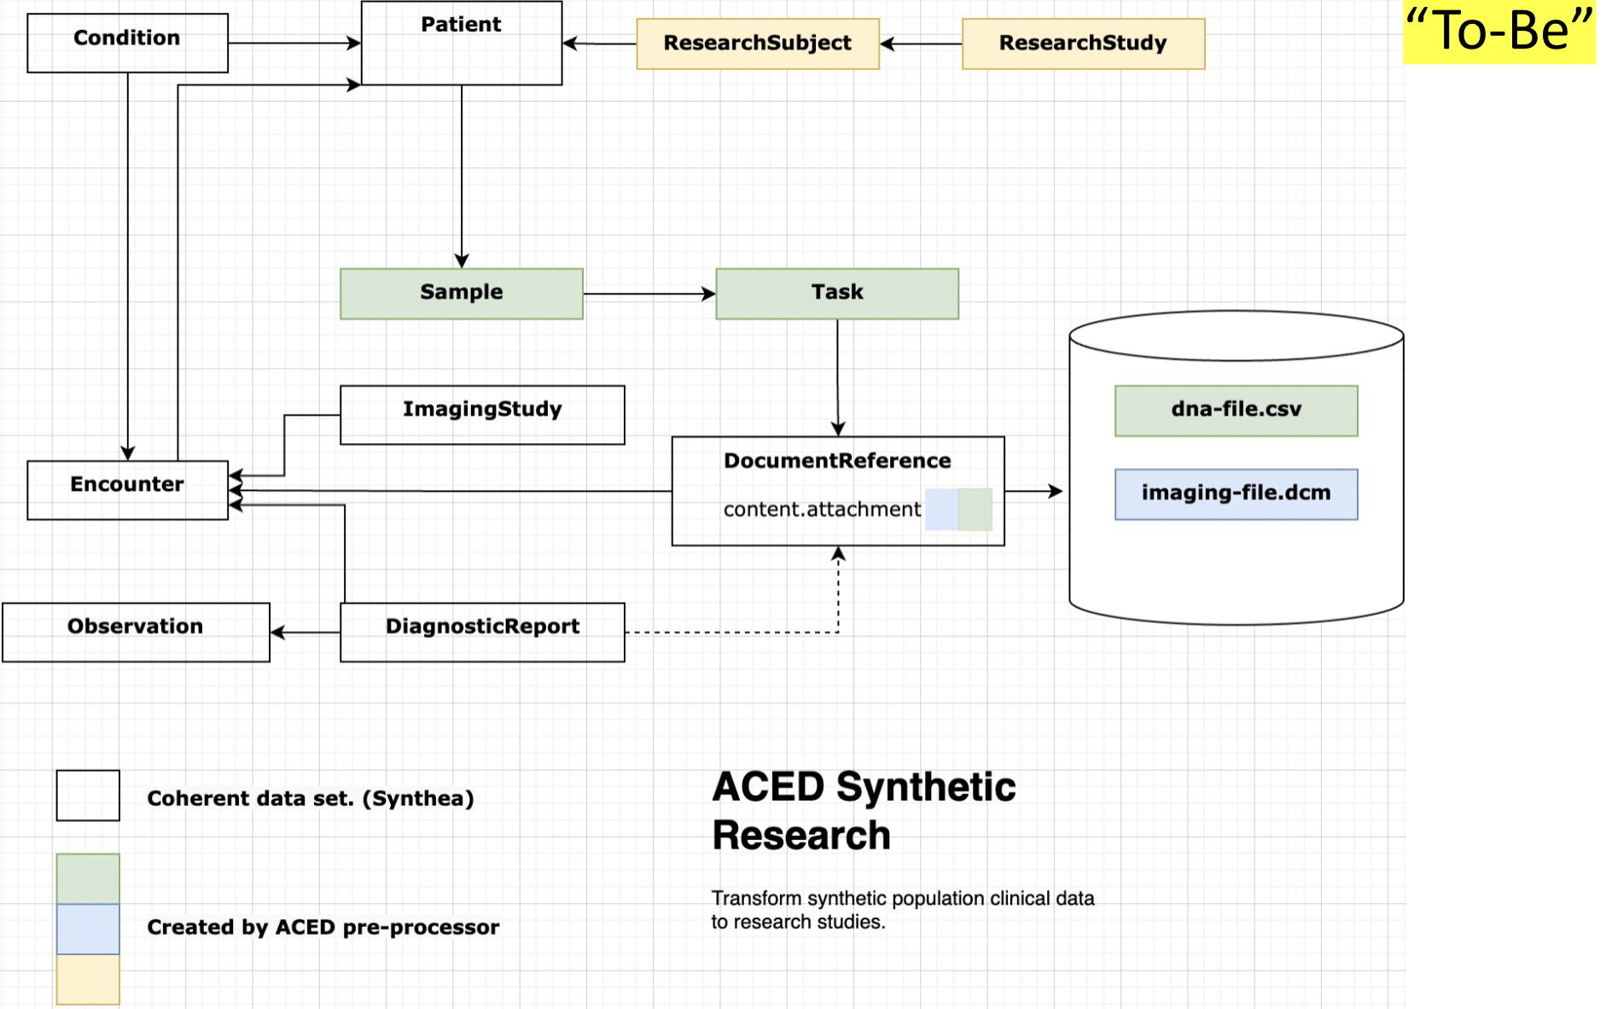
For dna files, create FHIR e Sample and Task (sequencing)

Slide 2
TODO
https://github.com/ACED-IDP/data_model/blob/main/scripts/transform.py#L120

